Slide 1
Module-3
Software Testing

Slide 2
Agenda
Strategic Approach to Software Testing
Strategic Issues
Test Strategies for Conventional Software
Fundamentals
Black box Testing
White box testing

Slide 3
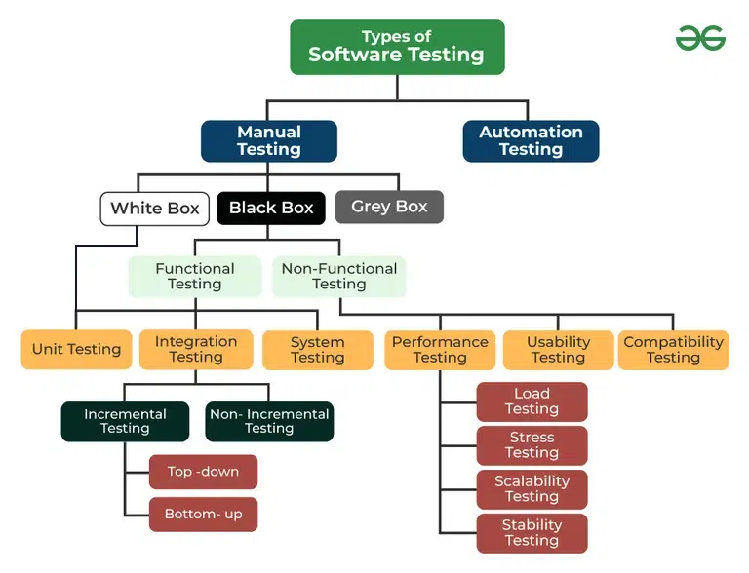
Software testing is the process of checking the quality of software before launching to ensure that all requirements are fulfilled.
SE

Slide 4
Strategic Approach to Software Testing
Testing is a set of activities that can be planned in advance and conducted systematically. A number of software testing strategies have been proposed. All provide you with a template for testing and all have the following generic characteristics:
• To perform effective testing, you should conduct effective technical reviews. By
doing this, many errors will be eliminated before testing commences.
• Testing begins at the component level and works “outward” toward the integration
of the entire computer-based system.
• Different testing techniques are appropriate for different software engineering
approaches and at different points in time.
• Testing is conducted by the developer of the software and an independent test
group.
• Testing and debugging are different activities, but debugging must be accommodated in
any testing strategy.

Slide 5
Verification and Validation: Software testing is one element that is often referred to as verification and validation (V&V). Verification refers to the set of tasks that ensure that software correctly implements a specific function. Validation refers to a different set of tasks that ensure that the software that has been built is traceable to customer requirements.
Boehm states this another way:
Verification: “Are we building the product right?”
Validation: “Are we building the right product?”
Organizing for Software Testing: The people who have built the software are now asked to test the software. This seems harmless in itself; after all, who knows the program better than its developers?

Slide 6
Software Testing Strategy—The Big Picture: The software process may be viewed as the spiral illustrated in the following figure.

Slide 7
Strategic Issues
Some times the best strategy will fail if a series of overriding issues are not addressed.
Tom Gilb argues that a software testing strategy will succeed when software testers: Specify product requirements in a quantifiable manner long before testing commences.
Although the overriding objective of testing is to find errors, a good testing strategy also assesses other quality characteristics such as portability, maintainability, and usability.
The specific objectives of testing should be stated in measurable terms. For example, test effectiveness, test coverage, meantime-to-failure, the cost to find and fix defects, and test work-hours should be stated in the test plan.

Slide 8
Develop a testing plan that emphasizes “rapid cycle testing: learn to test in rapid cycles of customer-useful, The feedback generated from these rapid cycle tests can be used to control quality levels and the corresponding test strategies
Build “robust” software that is designed to test itself: Software should be capable of diagnosing certain classes of errors.
Use effective technical reviews as a filter prior to testing: Technical reviews can be as effective as testing in uncovering errors. For this reason, reviews can reduce the amount of testing effort that is required to produce high quality software.
Conduct technical reviews to assess the test strategy and test cases themselves: Technical reviews can uncover inconsistencies, omissions, and outright errors in the testing approach. This saves time and also improves product quality.
Develop a continuous improvement approach for the testing process: The test strategy should be measured. The metrics collected during testing should be used as part of a statistical process control approach for software testing.

Slide 9
Test Strategies for Conventional Software
A testing strategy that is chosen by most software teams falls between the two extremes.
beginning with the testing of individual program units
moving to tests designed to facilitate the integration of the units
Each of these classes of tests is described in the sections that follow.
Unit Testing: Unit testing focuses verification effort on the smallest unit of software design—the software component or module. The unit test focuses on the internal processing logic and data structures within the boundaries of a component. This type of testing can be conducted in parallel for multiple components.

Slide 10
Integration Testing: Integration testing is a systematic technique for constructing the software architecture while at the same time conducting tests to uncover errors associated with interfacing. The objective is to take unit-tested components and build a program structure that has been dictated by design.
Top-down integration: Top-down integration testing is an incremental approach to construction of the software architecture. Modules are integrated by moving downward through the control hierarchy, beginning with the main control module (main program).
Bottom-up integration: A bottom-up integration strategy may be implemented with the following steps:
Low-level components are combined into clusters (sometimes called builds) that perform a specific software subfunction.
A driver (a control program for testing) is written to coordinate test case input and output.
The cluster is tested.
Drivers are removed and clusters are combined moving upward in the program structure.

