Slide 1

Notes:
Cover Slide

Slide 2

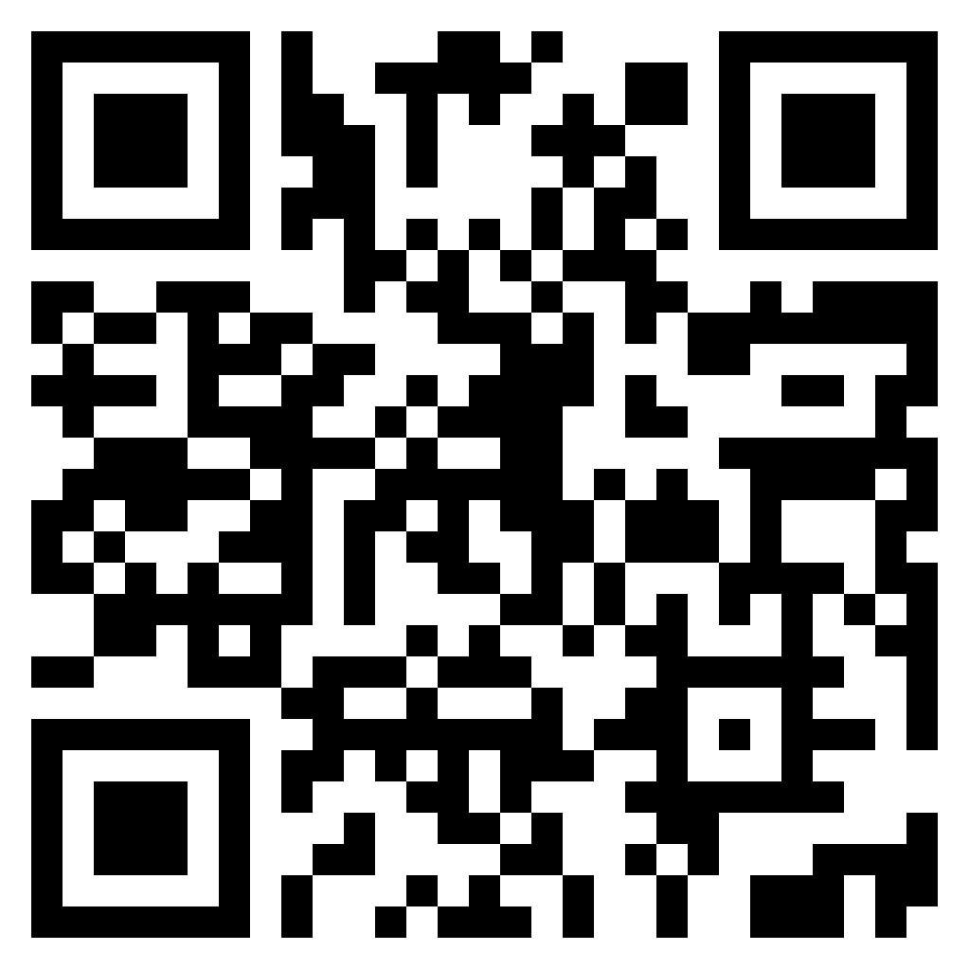

TEST TIME ON NOUNS AND PRONOUNS :
URL: https://forms.gle/gbCFtYXVfVRnHNPx5
QR CODE:

Slide 3
VERBS:
A verb is a doing word that shows an action, an event or a state. A sentence may either have a main verb, a helping verb or both. In other words, a verb is a word that informs about an action, an existence of something or an occurrence. The verb is the main word in a sentence. No sentence can be completed without a verb.
Notes:
Content can be added in this slide and can duplicate the same slide if there is a need of slide.

Slide 4
TYPES OF VERBS:
1. Main Verbs (or Action Verbs)
2. Helping Verbs
3. Linking Verbs
4. Understanding verbs
Notes:
Content can be added in this slide and can duplicate the same slide if there is a need of slide.

Slide 5
MAIN VERBS:
Main verbs or action verbs are used to express action; something that an animal, a person or a thing does. In each of the following sentences, we only have a main verb.
The sun shines.
The horse neighs.
The monkey jumps.
Notes:
Content can be added in this slide and can duplicate the same slide if there is a need of slide.

Slide 6
HELPING VERBS:
As the name suggests, helping verbs help or support the main verb.
We are learning about helping verbs. (are: helping verb; learning: main verb)
We are in the Green House Club. (are: helping verb)
You should complete the work by tomorrow. (should: helping verb; complete: main verb)
Notes:
Content can be added in this slide and can duplicate the same slide if there is a need of slide.

Slide 7
LINKING VERBS:
State of Being verbs state that something 'is'. State of being verbs also known as linking verbs. Linking verbs explain a link between the subject of the sentence and a noun or adjective being linked to it.
List of Example Sentences
The flowers are bright.
Diamond is the hardest substance.
I feel scared.
Notes:
Content can be added in this slide and can duplicate the same slide if there is a need of slide.

Slide 8
UNDERSTANDING VERBS:
The words: am, is, are, was, and were, belong to the verb "to be". We use 'am' or 'was' with the pronoun 'I'. We use 'is' or 'was' when the subject of the sentence is singular. We use 'are' or 'were' when the subject of the sentence is plural.
List of Example Sentences
1. I was late for school yesterday.
2. I am twelve years old.
3. She is a wonderful singer.
4. These questions are difficult.
5. He was planning to meet the doctor.
Notes:
Content can be added in this slide and can duplicate the same slide if there is a need of slide.

Slide 9
Question: 01
Fill in the blanks with suitable verbs:
We ___________ him the money.
has paid
have paid
Has been paid
Have been paid
Answer: B

Slide 10
Question: 02
Fill in the blanks with suitable verbs:
I _________ my sister a watch.
Have bought
Has bought
Have been bought
Has been bought
Answer: A

Slide 11
Question: 03
Fill in the blanks with suitable verbs:
_________ (Show/Shows) me your hands.
Show
Shows
Showed
shown
Answer: A

Slide 12
Question: 04
Fill in the blanks with suitable verbs:
You _________ (has made/have made) your shirt dirty.
Has made
Have made
Had made
Have been made
Answer: B

Slide 13
Question: 05
Fill in the blanks with suitable verbs:
We _________ (are waiting/is waiting) for Rohan.
Are waiting
Is waiting
Was waiting
Were waiting
Answer: A

Slide 14
Question: 06
Fill in the blanks with suitable verbs:
These books _________ to me.
Belong
Belongs
Is belong
Was belong
Answer: A

Slide 15
Question: 07
Fill in the blanks with suitable verbs:
She _________ to go.
Want
Wants
Wanted
Is want
Answer: B

Slide 16
Question: 08
Fill in the blanks with suitable verbs:
We _________to visit the museum.
Will like
Would like
Will like
Was like
Answer: B

Slide 17
Question: 09
Fill in the blanks with suitable verbs:
He _________ (has finished/have finished) talking.
Has finished
Have finished
Has been finished
Have been finished
Answer: A

Slide 18
Question: 10
Fill in the blanks with suitable verbs:
My brother _________ playing cricket.
Enjoy
Enjoys
Enjoyed
Enjoying
Answer: B

Slide 19
Question: 11
Fill in the blanks with suitable verbs:
We _________ the house deserted.
Find
Found
Was found
Finding
Answer: B

Slide 20
Question: 12
Fill in the blanks with suitable verbs:
We _________ (hope/hoped) that you would succeed.
Hope
Hoped
Hoping
Hopeful
Answer: B

Slide 21
Question: 13
Fill in the blanks with suitable verbs:
She _________ (has assured/have assured) me that she is ready to help.
Has assured
Have assured
Has been assurd
Have been assured
Answer: A

Slide 22
Question: 14
Fill in the blanks with suitable verbs:
Nobody _________ (know/knows) when he will arrive.
Know
Knows
Known
knowing
Answer: B

Slide 23
Question: 15
Fill in the blanks with suitable verbs:
We _________ (must find out/find) where to put it.
Must find out
Find
Found
Finding
Answer: A

