Slide 1

Notes:
Cover Slide

Slide 2

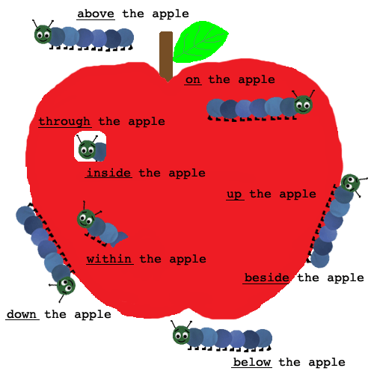

Topic Name
Preposition

Slide 3
Preposition
Preposition Tells Us The Position Of Something In a Relation To Another.
A Preposition Is A Word Which Is Placed Before A Noun Or A Pronoun To Show Its Relation With Something Else In The Sentence.
Here is a list of commonly used prepositions: above, across, against, along, among, around, at, before, behind, below, beneath, beside, between, by, down, from, in, into, near, of, off, on, to, toward, under, upon, with and within.
The golden preposition rule:
A preposition is followed by a "noun". It is NEVER followed by a verb.

Slide 4
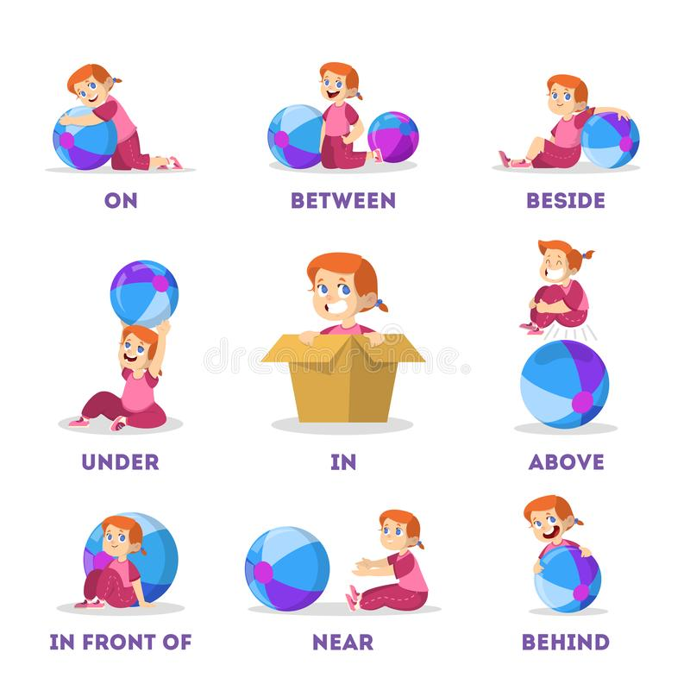
Some examples

Slide 5
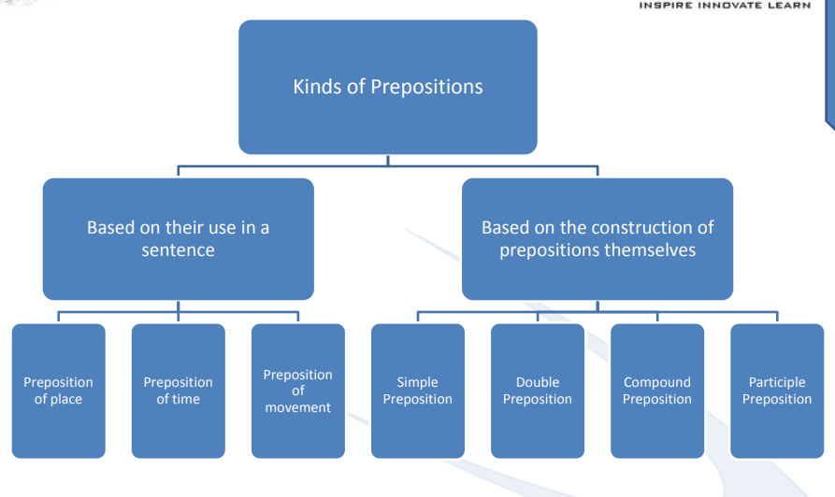
Types of preposition

Slide 6
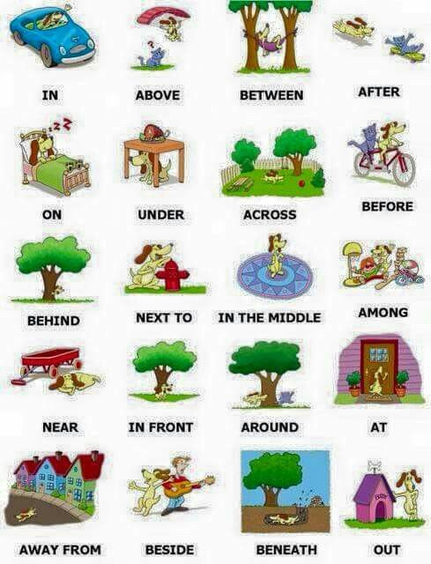
Categories of preposition

Slide 7
Preposition of Place
Preposition of place refer to those preposition which can be used to show where something is located.
Here are some examples for preposition of place: “Above, up, after, on, before, against, by, behind, below, along, near, down, in, at, across, inside, between, over”
EXAMPLE:
The aeroplane is flying above the clouds.
The dog buried the bone under the ground.
Our house is at the end of the street.
The cat ran across the road.

Slide 8
Preposition of Time
A preposition of time helps to link the noun or pronoun with a time value. If functions as an indicator as to what point of time did an event occur.
Here are some examples for preposition of time: “ About, before, for, by, around, in, ago, at, past,
since, to, on, after, until, between, during “
EXAMPLE:
The train is about an hour late.
The classes begins at 8 o’ clock. My birthday falls on Wednesday
India has been independent since 1947.

Slide 9
Preposition of Movement
A preposition of movement is used to show movement to or from a place.
Here are some examples for preposition of movement: “Down, past, into, behind, up, onto, through, off, over, on, across, at, by, for, after, towards”
Example:
The cat has climbed up a tree.
The children got off the bus.
She ran along the pavement.
The bus goes towards the market

Slide 10

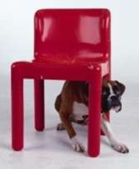


EXAMPLE
The dog is under the chair.
The apple is on the book.

Slide 11
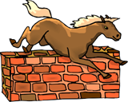
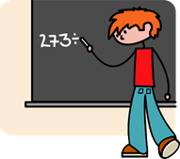
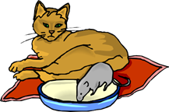
EXAMPLE
The horse is jumping over the wall.
The boy is writing board on the black
The rat is near the cat.

Slide 12
Preposition
Based on the construction of prepositions themselves, the prepositions are of four different kinds:
•Simple Prepositions
•Double Prepositions
•Compound Prepositions
•Participle Prepositions

Slide 13
Simple Preposition
Prepositions that consist of one word and are very simple to understand. These are the most basic prepositions and are used frequently.
Here are some examples for simple prepositions: Above, under, around, through, after, on,
before, about, among, behind, along, near, down, in, at, across, between, over
Example:
The paper is on my desk.
The man was standing under the tree.
I will meet you near your house at 5 p.m. .

Slide 14
Double preposition
Double prepositions are two prepositions, but are joined to make a whole new one.
Here are some examples for double prepositions: Inside, outside, into, onto, upon,
up to, within, without, amid
Example:
Outside the house lies a beautiful garden. It is up to us to find a way out.
The dog jumped onto the bed.
Once upon a time, there lived a king.

Slide 15
Compound Preposition
Compound prepositions are two word prepositions. Unlike double prepositions, compound prepositions are not joined and turned into one word. They remain as two different words.
Here are some examples for compound prepositions: According to, apart from, close to, because of, far from, next to, rather than, instead of, out of, due to, relating to, in front of
Example:
My car is parked in front of the house.
Rita was never close to her parents. She cannot stay here as of now.
His behaviour is far from normal.

Slide 16
Participle Preposition
Participle prepositions are basically participles used as prepositions. A participle is actually a verb that ends with ‘-en’ or ‘-ing’.
Here are some examples for participle prepositions: Concerning, during, excluding, given, following, failing, respected, provided, pending, considering, notwithstanding, including
Example:
Everywhere my father went, his dog was following him.
Ram is always curious about anything concerning Shyam.
Everybody was invited to the function barring small
children.

Slide 17
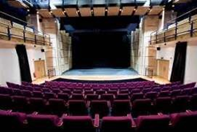
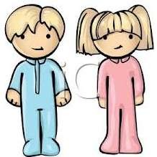
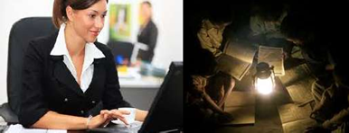
EXAMPLES
The inside of the auditorium is beautiful.
Robin is standing next to Julie.
She works during the day and studies at night

Slide 18

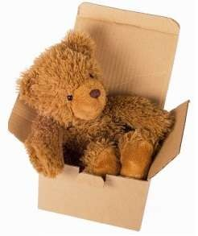
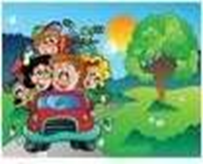
EXAMPLES
The entire class went to picnic including
the teacher.
The toy bear is in the box.
My family is going to vacation this summer.

Slide 19
Question: 01
He felt very much grateful ____his boss for the kindness he had shown in granting him leave.
to
for
with
on
Answer: A

Slide 20
Explanation:
Grateful takes to after it

Slide 21
Question: 02
The consequences of his haughtiness were that his services were dispensed ______by his master.
with
about
from
up
Answer: A

Slide 22
Explanation:
The services were “dispensed with” and it means 'forgo'. Dispense is followed by with

Slide 23
Question: 03
These days everybody complains __high prices of commodities.
away
of
through
over
Answer: B

Slide 24
Explanation:
To complain of or about something

Slide 25
Question: 04
The young boy is ____ the phone right now.
On
In
For
with
Answer: A

Slide 26
Explanation:
The young boy is on the phone because its simple preposition

Slide 27
Question: 05
This book ______________ five sections.
comprises of
comprises
consists
comprises to
Answer: B

Slide 28
Explanation:
The use of preposition 'of' after "comprise" is incorrect

Slide 29
Question: 06
His fever has taken a turn for the better ______yesterday.
Since
On
From
At
Answer: A

Slide 30
Explanation:
Preposition based in time so since it will come

Slide 31
Question: 07
______rice they had curry.
Besides
Before
During
Over
Answer: A

Slide 32
Explanation: 07
Besides for preposition of time

Slide 33
Question: 08
It is surprising indeed that he has an access ____ all the important leaders of the country.
about
by
to
of
Answer: C

Slide 34
Explanation: 08
Access to have authority or permission

Slide 35
Question: 09
The trouble originated ___a petty quarrel.
in
about
to
beside
Answer:

Slide 36
Explanation:
Originated in is the correct usage

Slide 37
Question: 10
My uncle apprised me ____ the incident
about
on
in
of
Answer: D

Slide 38
Explanation:
Apprise is used with of. It denotes being informed

Slide 39
Question: 11
Their country has no mineral resources to speak __________.
of
in
on
with
Answer: A

Slide 40
Explanation: 11
To speak ‘of’ mineral means to speak about(Not speech), Speak on means giving speech.

Slide 41
Question: 12
We judge ourselves by our thought, ____________ others judge us by our actions.
when
because
whereas
lest
Answer: C

Slide 42
Explanation:
There are two ways in which we are judged; one is ‘our thoughts’ whereas other is when our actions are judged.

Slide 43
Question: 13
We must not carp _____ the errors of our ancestors.
From
With
About
In
Answer: C

Slide 44
Explanation:
If we find fault with something and complain continuously and unnecessarily about it, we ‘carp’ about/at it

Slide 45
Question: 14
Autotomy is the ability of an animal to ________ a part of its body at will to save itself from predators and attackers.
Cast off
Cast away
Cut of
Cut down
Answer: A

Slide 46
Explanation:
Cast off , means to remove , and hence this is the answer

Slide 47
Question: 15
A preface ...... a book introduces the book.
by
to
of
over
Answer: C

Slide 48
Explanation:
A ‘preface’ is an introduction to something and the correct preposition is ‘to’

Slide 49
THANK YOU

