Slide 1
Market Place for Movies
Team Name: DMQL_6
Team Members:
I. Karthik Vasireddy, UBID: kvasired
II. Sai Srinivas Chetti, UBID: chettisa

Slide 2
Problem Statement
Designed a marketplace for users to Buy or Rent a Movie.
Motivation:
We wanted to design a marketplace for movies, where any person can visit the marketplace to sell or rent a movie. To watch a movie, people spends a lot of time browsing online to decide on a movie which is a waste of time. Our proposed database design tries to solve this problem by recommending movies to a user based on the user’s inputs.
Target Users: All the movie buffs are potential target users for this application.
Real Life Scenario: When a user wants a list of horror movies directed by James Wan, they can query the database by selecting genre=Horror and director = James Wan using a user interface.

Slide 3
Database Design - Relations
We have used 8 relations to design out database. Below are those relations(E/R diagram in the next slide).
Movies – details of a movie.
Actors - details of an actor.
Directors - details of a director.
Roles – details of role of an actor for a particular movie.
Movies_genres – genre of a movie.
Director_genres – genres of movies for a director.
Movies_directors – table linking movies and director’s relation.
Purchase_History – shows how many times a movie has been rented.
We used “.sql” files to create tables, triggers and Insert the data.
create.sql – creates all the tables with constaints and triggers.
load.sql – Inserts records into the tables, each table contains around 50000 rows

Slide 4
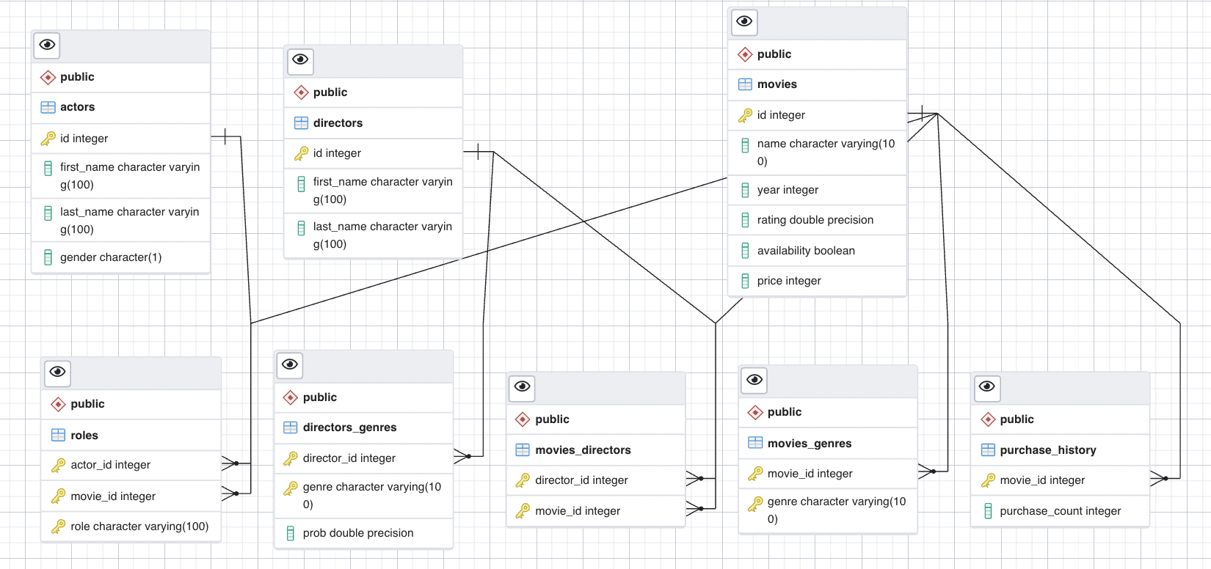
Database Design – E/R Diagram

Slide 5
Database Design - Constraints
Primary Keys:
movies – id
Actors – id
Directors – id
Movies-directors – (director_id, movie_id)
Movies_genres – (movie_id, genre)
Directors_genres – (director_id, genre)
Roles – (actor_id, movie_id, role)
Purchase_history – movie_id
Foreign Keys:
Movies-directors – (director_id, movie_id)
Movies_genres – movie_id
Directors_genres – director_id
Roles – (actor_id, movie_id)
Triggers:
Log_purchase_history – automatically keeps track of the number of times a movie is rented.
Actor_Gender – Only allows (M, F and NB) in gender attribute.
Check Conditions:
Movies price cannot be negative
Movie rating should be between 1 to 10
Sequences:
actors_id_seq
directors_id_seq
movies_id_seq

Slide 6
Database Design – BCNF
actors (id, first_name, last_name, gender)
Functional dependencies:
Id-> first_name
Id-> last_name
Id-> gender
directors (Id, first_name, last_name)
Functional dependencies:
Id-> first_name
Id-> last_name
directors_genres (director_id, genre, prob)
Functional dependencies:
director_id, genre -> prob
movies (Id, name, year, rating, availability, price)
Functional dependencies:
Id-> name
Id-> year
Id-> rating
Id-> availability
Id-> price
movies_directors (director_id, movie_id)
Functional dependencies:
There are no nontrivial functional dependencies as all the columns combined form a candidate key.
movies_genres (movie_id, genre)
Functional dependencies:
There are no nontrivial functional dependencies as all the columns combined form a candidate key.
Roles (actor_id, movie_id, role)
Functional dependencies:
There are no nontrivial functional dependencies as all the columns combined form a candidate key.
Purchase_history (movie_id, purchase_count)
Functional dependencies:
movie_id -> purchase_count

Slide 7
Database Testing – 11 Queries
We have designed several SQL queries to test our database. We will show the execution of each of these queries during our Demo.
5 Select Queries:
Get 5 Top Rated Movies of a Director that are available for rent: Joined 3 tables and used order by, group by and having.
Get 5 Top Rated Movies based on Genre that are available for rent: Joined 2 tables and used order by and Limit.
Recommend movies based on actor, director, year and genre: Joined 6 tables and used order by and Limit. This contains other sub-queries based on all possible combinations.
1 Insert Query: this query will insert a new movie tuple to the movies table.
2 Update Queries:
Updating Director name from director's table.
Updating movie name, rating and availability from movies table.
3 Delete Queries: Deletes a row from a table based on user selection.

Slide 8
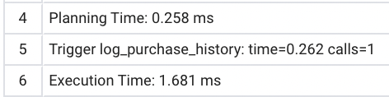



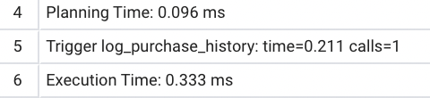

Query execution analysis
SELECT DISTINCT C.first_name,A.year, count(A.id) from movies A, movies_directors B, directors C where A.id = B.movie_id and B.director_id = C.id and A.year > 1930 group by C.first_name, A.year having count(B.movie_id) > 5;
Before Indexing:
Creating Indexes:
CREATE INDEX test ON movies(id, year);
CREATE INDEX test1 ON directors(id,first_name);
After Indexing:
UPDATE movies SET availability = 'False', rating = 2.5 WHERE id = 13334;
Before Indexing:
Creating Indexes:
CREATE INDEX test2 ON movies(id, availability);
CREATE INDEX test3 ON movies(id, rating);
After Indexing:
select B.movie_id, c.name, c.rating, c.availability,c.year, A.last_name, A.gender from actors A inner join roles B on A.id = B.actor_id inner join movies c on B.movie_id = c.id where B.movie_id in (select movie_id from movies_genres where genre = 'Crime’) and A.id in (select id from actors where gender = 'M’);
Before Indexing:
Creating Indexes:
CREATE INDEX test4 ON movies(id, name);
CREATE INDEX test5 ON movies(id, rating);
CREATE INDEX test6 ON movies(id, availability);
CREATE INDEX test7 ON movies(id, year);
CREATE INDEX test8 ON actors(id, gender);
CREATE INDEX test9 ON actors(id, last_name);
After Indexing:

Slide 9
On to the Web Application !!

