Slide 1
Market Place for Movies
Team Name: DMQL_6
Team Members:
I. Karthik Vasireddy, UBID: kvasired
II. Sai Srinivas Chetti, UBID: chettisa

Slide 2
Problem Statement
Designed a marketplace for users to Buy or Rent a Movie.
Motivation:
We wanted to design a marketplace for movies, where any person can visit the marketplace to sell or rent a movie. To watch a movie, people spends a lot of time browsing online to decide on a movie which is a waste of time. Our proposed database design tries to solve this problem by recommending movies to a user based on the user’s inputs.
Target Users: All the movie buffs are potential target users for this application.
Real Life Scenario: When a user wants a list of horror movies directed by James Wan, they can query the database by selecting genre=Horror and director = James Wan using a user interface.

Slide 3
Database Design - Relations
We have used 8 relations to design out database. Below are those relations(E/R diagram in the next slide).
Movies – details of a movie.
Actors - details of an actor.
Directors - details of a director.
Roles – details of role of an actor for a particular movie.
Movies_genres – genre of a movie.(why not include genre in movie table).
Director_genres – genres of movies for a director.
Movies_directors – table linking movies and director’s relation.
Purchase_History – shows how many times a movie has been rented.
We used “.sql” files to create tables, triggers and Insert the data.
create.sql – creates all the tables with constaints and triggers.
load.sql – Inserts records into the tables, each table contains atleast 50000 rows
readme.txt -

Slide 4
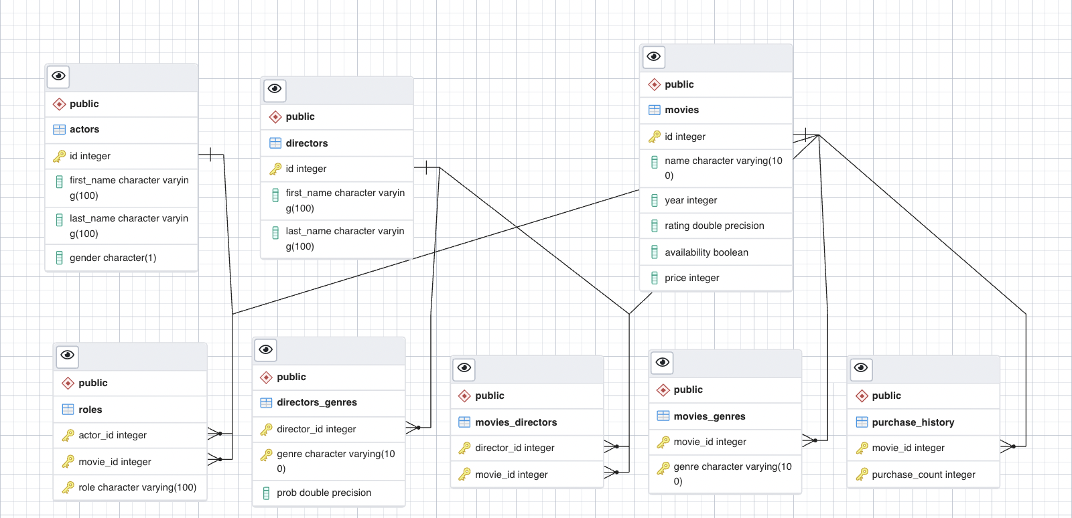
Database Design – E/R Diagram

Slide 5
Database Design - Constraints
Primary and foreign keys
Check conditions
Sequencing
Indexing
triggers

Slide 6
Database Design – BCNF

Slide 7
Database Testing – 11 Queries
We have designed several SQL queries to test our database. We will show the execution of each of these queries during our Demo.
7 Select Queries:
Get 5 Top Rated Movies of a Director that are available for rent: Joined 3 tables and used order by, group by and having.
Get 5 Top Rated Movies based on Genre that are available for rent: Joined 2 tables and used order by and Limit.
Recommend movies based on actor, director, year and genre: Joined 6 tables and used order by and Limit. This contains other sub-queries based on all possible combinations.
1 Insert Query: this query will insert a new movie tuple to the movies table.
2 Update Queries:
Updating Director name from director's table.
Updating movie name and availability from movies table.
3 Delete Queries: Deletes a row from a table based on user selection.

Slide 8
Query execution analysis

Slide 9
On to the Web Application !!

