Slide 1
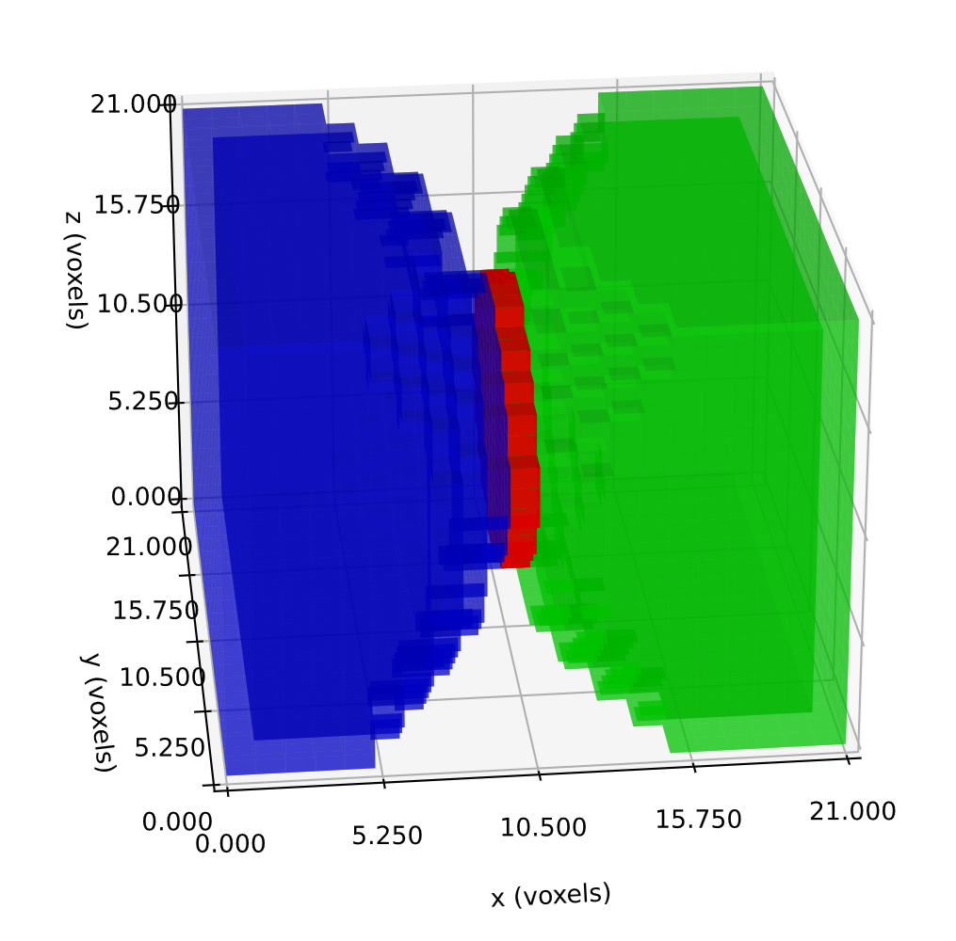
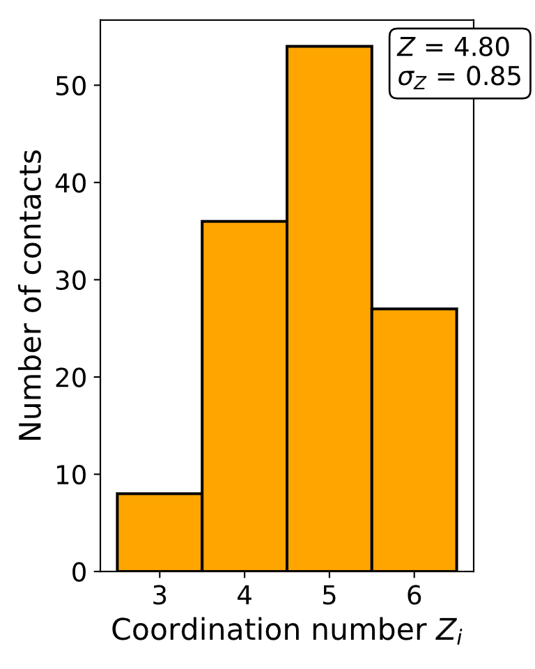
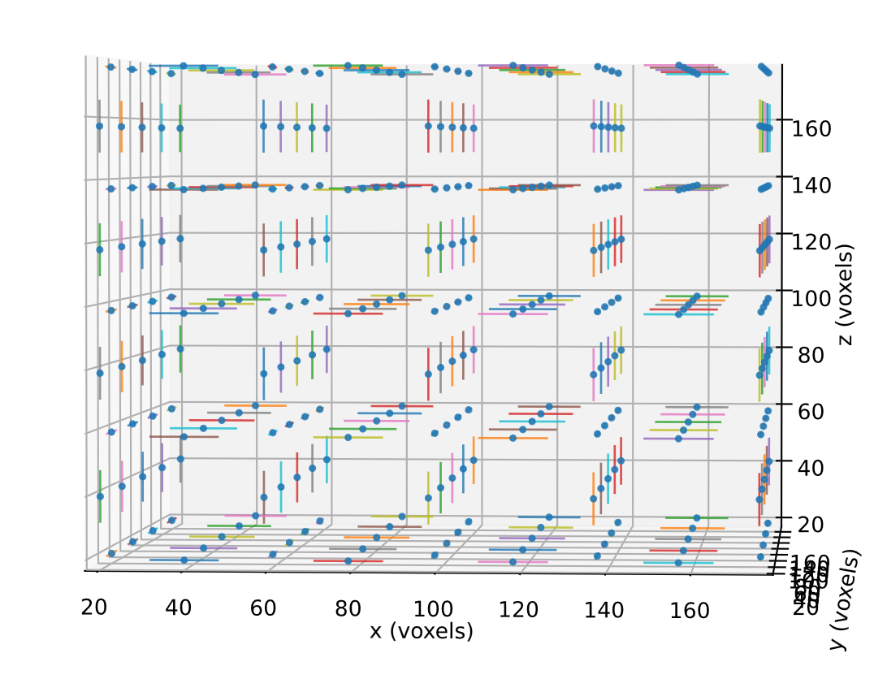
Contact area detected 121 voxels
Contact centroids and normals direction
(a)
(b)
(c)

