Slide 1
Investigation into the application of Model Transformation to Data Transformation Plan B, Research Project
Presented in partial fulfilment for the requirements
for the degree Master of Science in Computer and Information Science
SRINIVAS BALASUBRAMANIAN
Option: INFORMATION ANALYTICS
Advisor: Dr. Joshua C Nwokeji
April 2017

Slide 2
OUTLINE
Introduction
Problem Definition
Proposed Solution
Comparisons
Methodology
Experiment
Conclusion

Slide 3
INTRODUCTION
What is Unstructured data
Implications of unstructured data
What is Structured data
Examples of Structured and Unstructured data

Slide 4
PROBLEM DEFINITION
The techniques for converting unstructured data to structured data have some limitations, which can lead to data errors, inconsistency.
Example
Techniques | Limitations
Data Mining | Missing or Corrupted Data
Text Analytics | Managing the data is complicated

Slide 5
PROPOSED SOLUTION
Model transformation
Benefits of M2M

Slide 6
Comparisons of existing techniques with Benefits of proposed technique
Techniques | Limitations | Limitations addressed by M2M
Data Mining | Missing or Corrupted Data | In M2M the data in the source is mapped exactly to the metamodel which will convert them to the desired target without missing any data.
Text Analytics | Managing & Extracting Data | In MDA, a model to text transformation (M2T) is a transformation definition (set of transformation rules) that transforms an expressed Specific Model to target source code or documentation
Probabilistic Model | Hard to Build & Program | Helps in achieving the goals very easy like transforming the source model to the desired target model

Slide 7
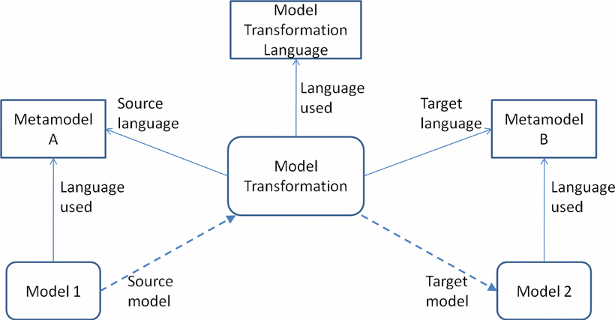
METHODOLOGY
Eclipse Modeling Framework – IDE for Model Driven Development

Slide 8
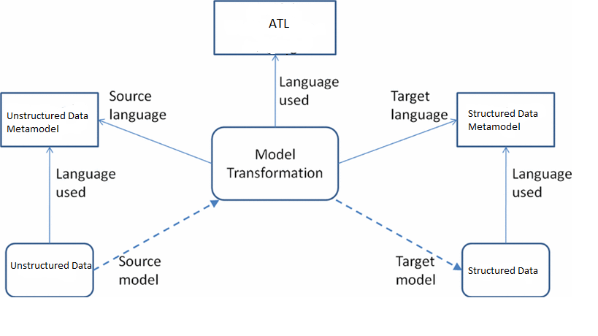
METHODOLOGY

Slide 9
EXPERIMENT
Example 1 shows the process of converting an Unstructured list of Author & Book Name to a structured one.
The list has ISBN Number, Book Name, Author name & Year of Publication which is not in an order so tried to transform the Book Name and their Corresponding Details.

Slide 10
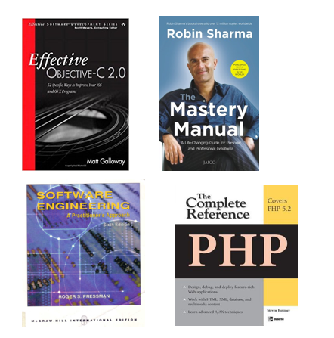
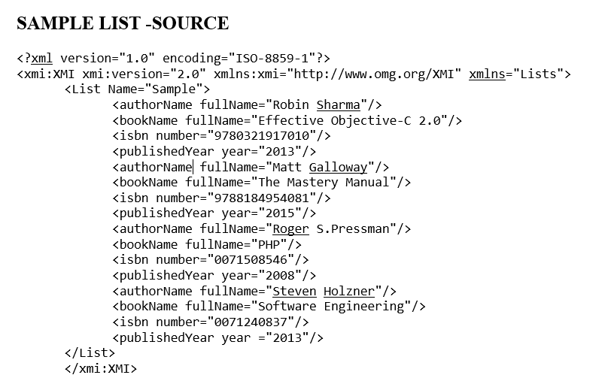
EXPERIMENT

Slide 11
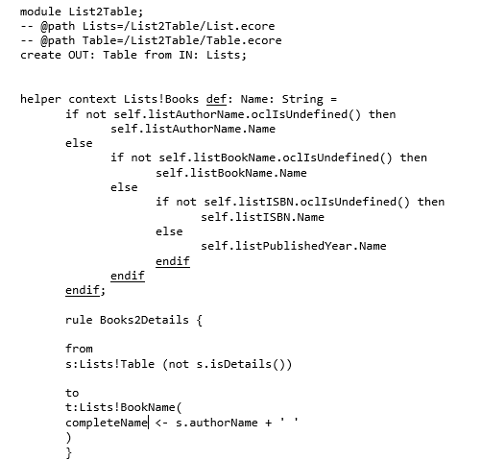
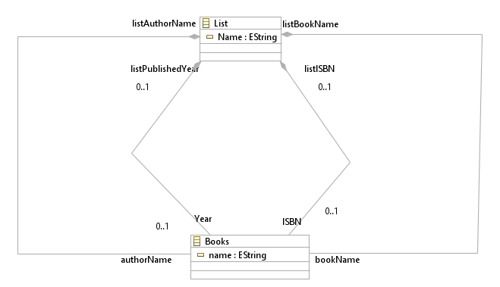
EXPERIMENT

Slide 12
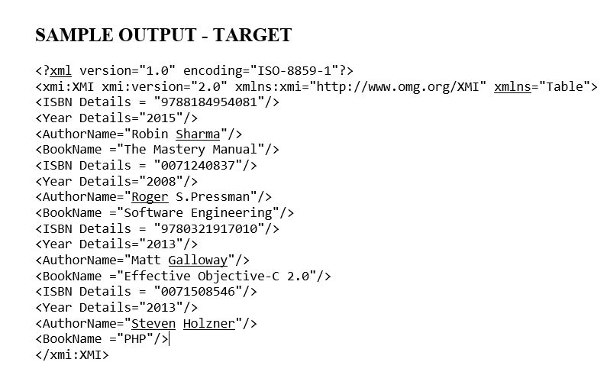
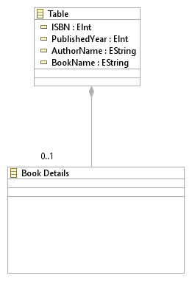
EXPERIMENT

Slide 13
EXPERIMENT
Example 2: Shows a simple transformation of List to MS Office Excel Sheet.
The table in the Web page is not in an editable format so transforming that to the Excel Sheet.

Slide 14
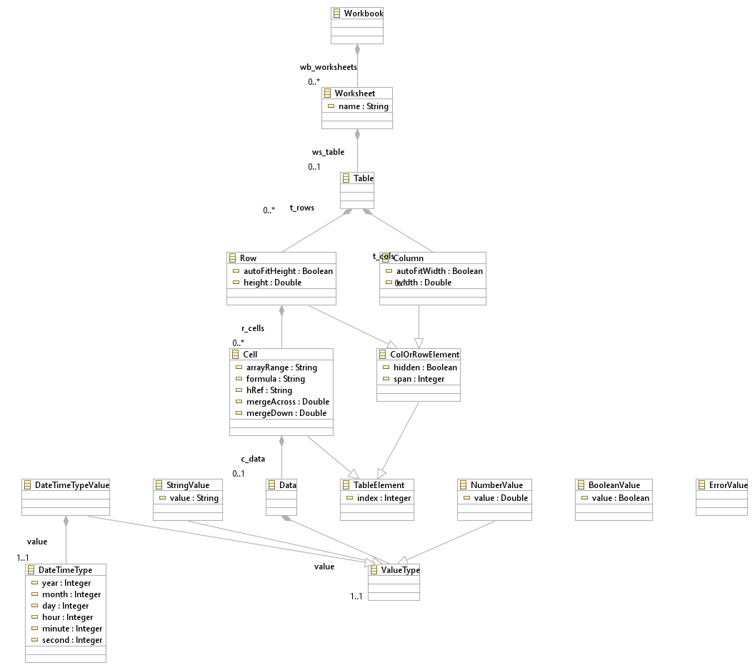
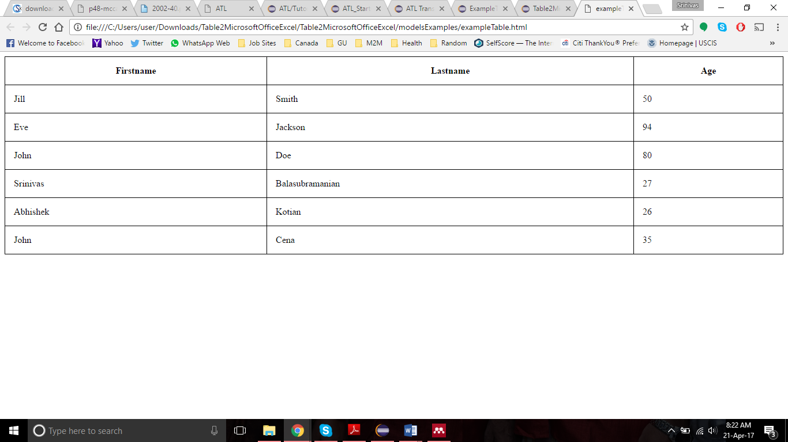
Source

Slide 15
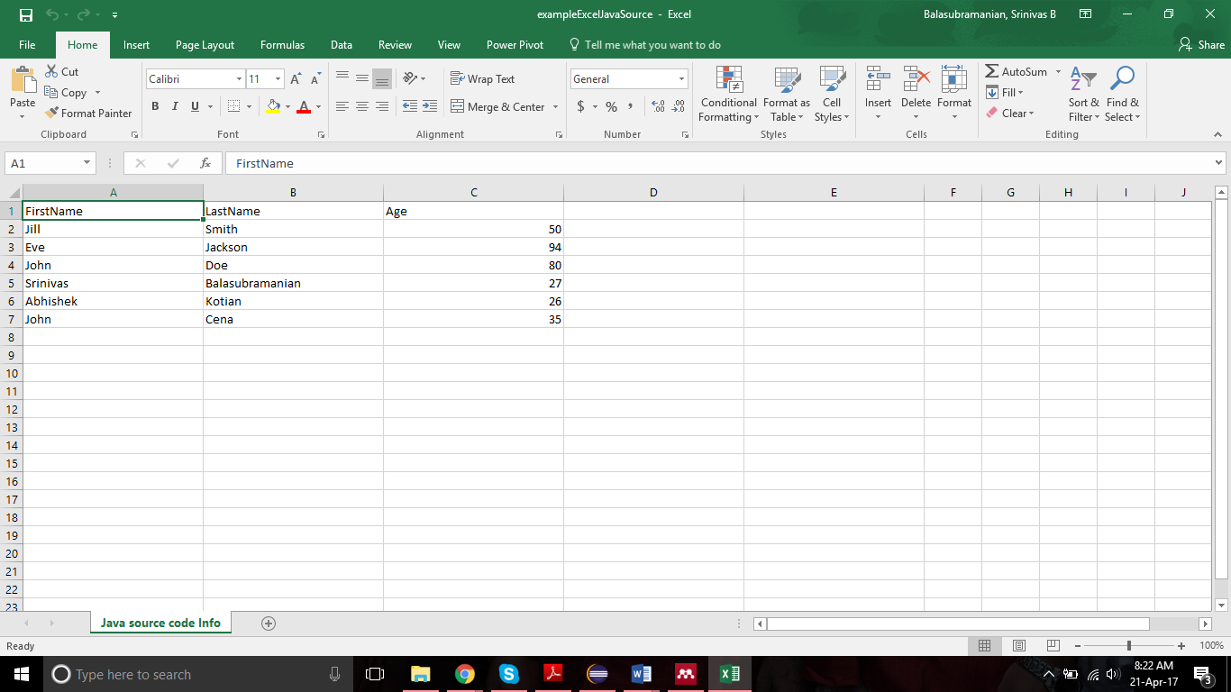
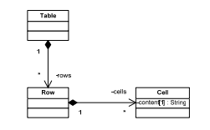
Target

Slide 16
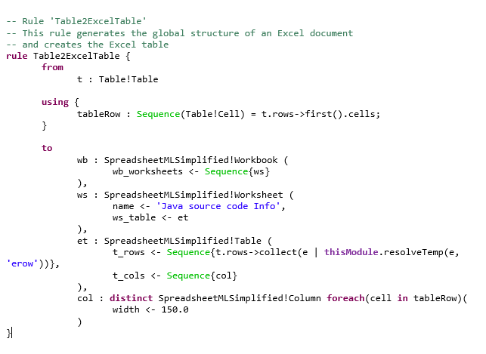
EXPERIMENT

Slide 17
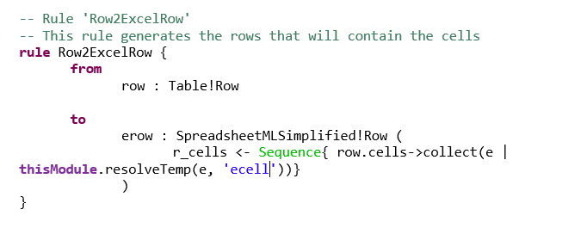
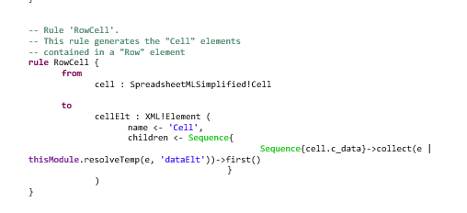
EXPERIMENT

Slide 18
LIMITATIONS,CONCLUSION & FUTURE WORK
Less Investment & Time Consuming
Well Expertise in Model Transformation Languages
Research dealt only with the sample of minimum five values

