Slide 1
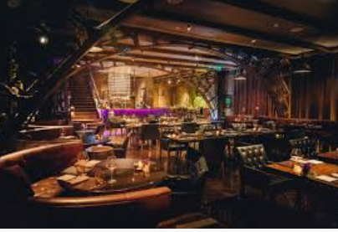
Leverage Analytics to select the Next Best Location(s) for Italian Restaurant

Slide 2
Problem Definition
In this scenario, Person A wants to open an Italian Restaurant in Toronto. The objective is to solve the problem by using location data from Foursquare and by doing a study of restaurants on all neighborhoods on interest through a combination of location profiling and machine learning.
We are going to explore the neighborhoods of Toronto and their venues in order to gain a better understanding on existing places and to narrow down our neighborhood choices to make the best decision.

Slide 3
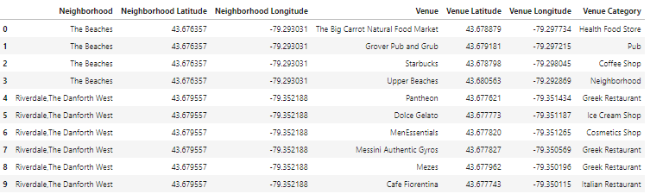
Data Understanding
For this purpose, we were able to explore a total of 38 unique neighborhoods with a total of 674 venues spanning across 187 different venue categories from Foursquare API
Use geo location data to understand to visualize and explore the neighborhoods

Slide 4
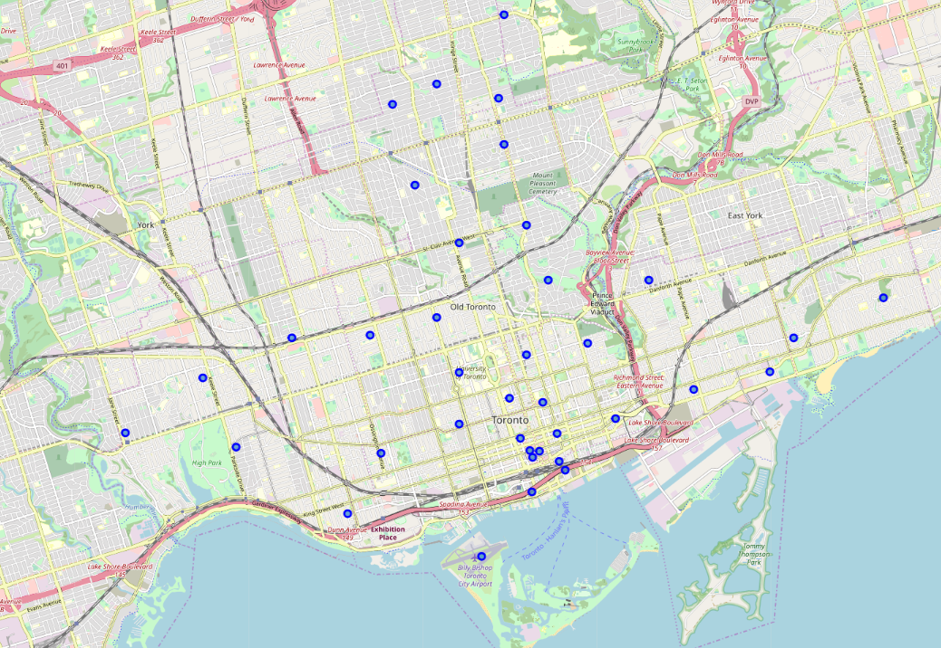
Methodology
Leveraging the API, we can study the top venues in each neighborhoods and can hence fine tune the optimal location for the new Italian Restaurant in Toronto. We then
Use Machine Learning algorithms like Clustering to find hidden behaviors in the data and then use the results of the clustering to drive the Segmentation Analysis which can help us to narrow down the location
Visualize the Data
Explore the Data

Slide 5
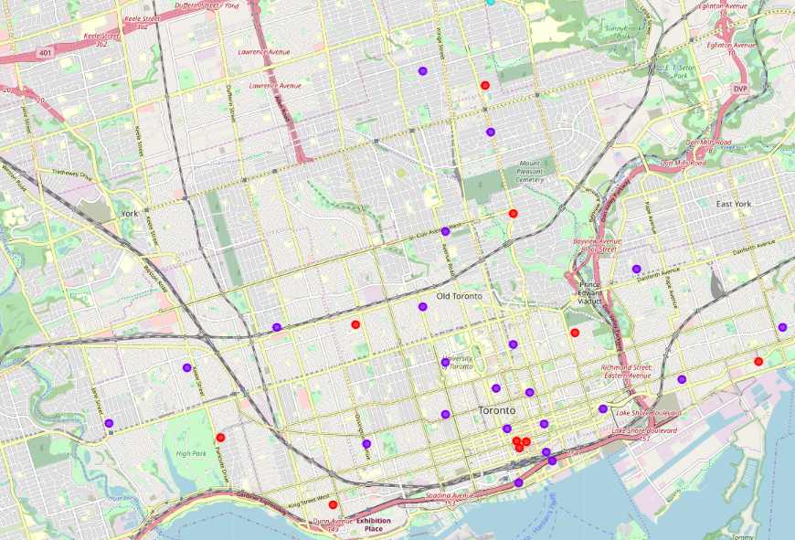
Results
We use a four step process to achieve the results
Filter only be Restaurant Venue Categories
Use Frequency Distribution to Find the Popular Restaurant Category
Cluster the Neighbors based on Frequency
Cluster Inference and Drill Down

Slide 6
Conclusion
Cluster 1 has around 4 Italian Restaurants in the top 3 venues. So, the Italian Favorability Factor (IFF) is 4/10 = 40%.
Cluster 2 has 13 Italian Restaurants in the top 3 venues. So, the Italian Favorability Factor is 13/22 = 59%. Hence, Cluster 2 is the obvious choice as it has strong propensity for Italian Cuisine
Narrow down to 22-13 = 9 locations as the optimal choice for Italian Restaurants
Bring in external demographics data to understand the potential customer behavior, population details and also how many have Italian ethnicities to shortlist from 9 locations

