Slide 1
Exploring Business opportunity in Frisco city, Texas, USA
Srinivas Kondraganti
06/19/2019

Slide 2
Introduction
Frisco is a city in Collin and Denton counties in Texas, USA. It is part of the Dallas -Fort Worth metroplex and is approximately 25 miles away from major airports. As per the data this city is one of the fastest growing and serves as living community for many professionals who works in Dallas metro area and home to variety of sporting venues. The Dallas cowboys a major American Football league moved their headquarters to Frisco in 2016. Frisco also home for hockey, soccer, baseball franchises with world class stadiums like Dr.Pepper ball park, Toyota stadium. This city named as ‘No 1 place to live in America’ by Money magazine in 2018. Since this city is growing rapidly and near to one of major metro cities, this project will help to stake holders to explore this city for new business opportunities.
Business Problem
Explore the city for new business opportunity, evaluate an ideal neighborhood location and feasibility to open business in Frisco, Texas by analyzing the data from available sources

Slide 3
Data Sources
Data sources available for city and community data
http://money.com/money/5387468/best-places-to-live-2018-methodology/
http://money.com/money/collection/2018-best-places-to-live/
https://en.wikipedia.org/wiki/Frisco%2C_Texas
https://datausa.io/profile/geo/frisco-tx/#about
https://friscotexas.gov/
https://friscotexas.gov/176/GIS-Data-Download
https://www.friscotexas.gov/DocumentCenter/View/1446/HOA-Directory-PDF?bidId=
https://www.friscotexas.gov/1454/Population
http://www.friscohomesforsale.com/subdivisions-map.php
http://www.city-data.com/city/Frisco-Texas.html
https://www.usgs.gov/core-science-systems/ngp/board-on-geographic-names
Four square
Four square Api for location data.

Slide 4
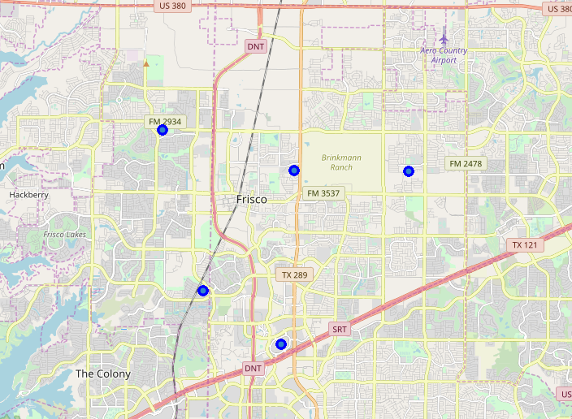
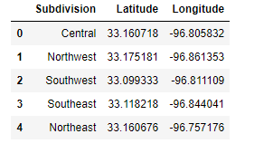
Frisco data –Sub divisions
Frisco Sub divisions
Frisco Sub division map

Slide 5
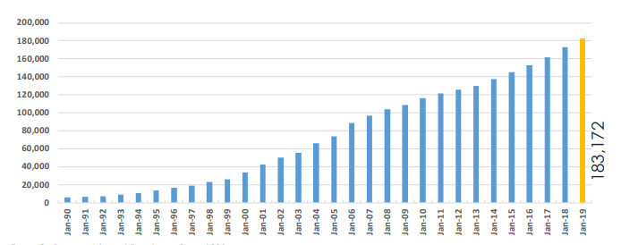
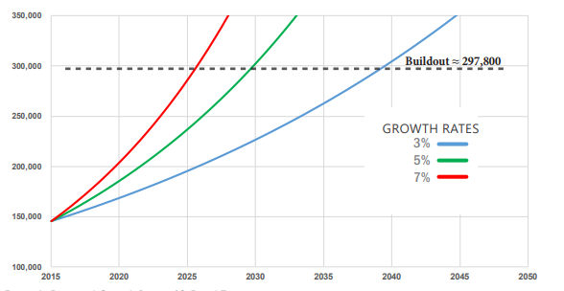
Frisco data -Population
Frisco Population
Projected Growth

Slide 6
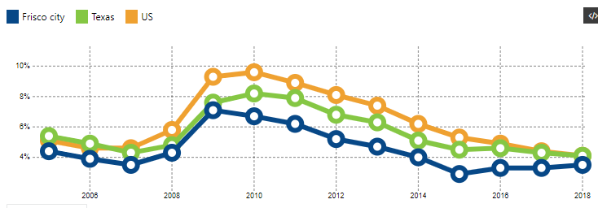
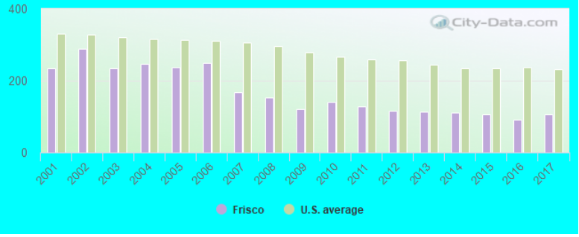
Frisco Data – Unemployment/Crime rate
Frisco Unemployment rate
Frisco Crime Rate

Slide 7
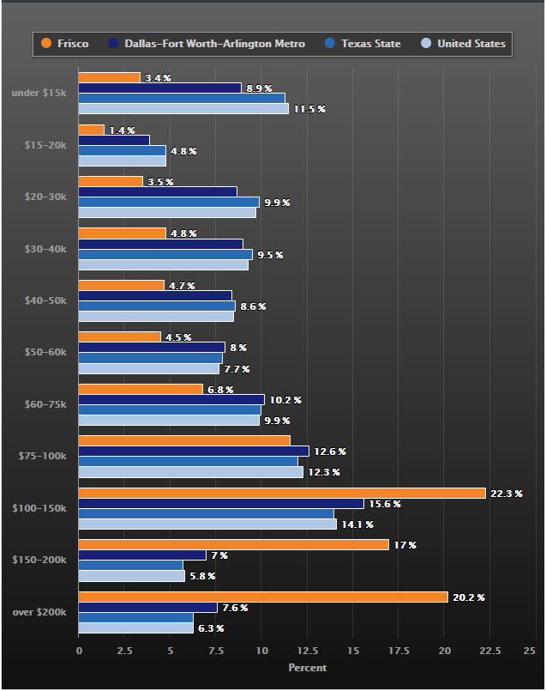
Frisco data – individual Income
Income

Slide 8
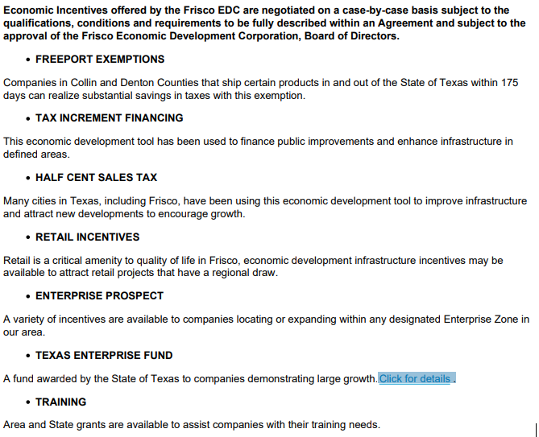
Frisco data – Incentives for new business

Slide 9
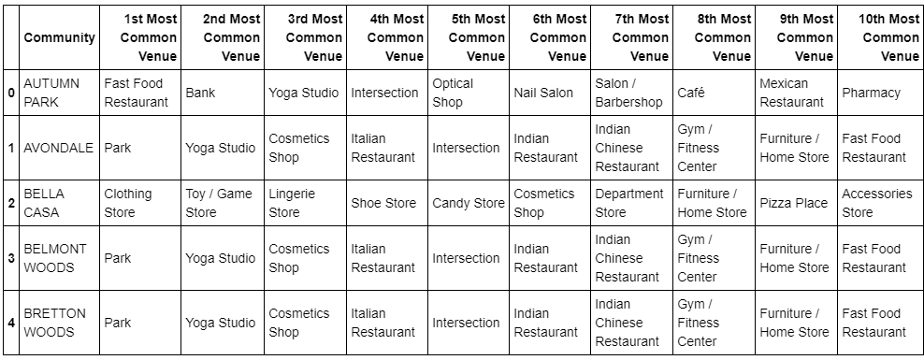
Data Analysis
Methodology : K means algorithm with clustering approach used for data Analysis
Four square utilized to get Frisco business data

Slide 10
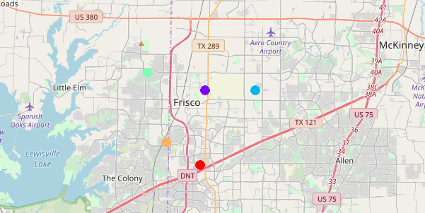
Data Analysis
Data sliced for each sub division cluster

Slide 11
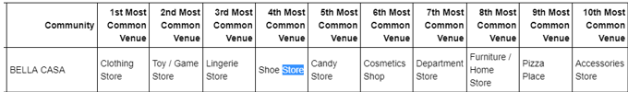

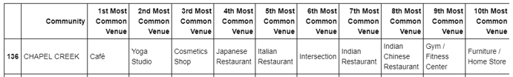
Results – Popular Business data
South West subdivision
South East sub division
Central sub division

Slide 12
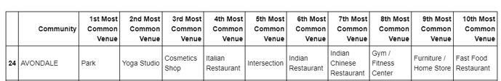

Results - Cont’d
North East sub division
North West sub division
Results Evaluation
Each sub division exists with more than 20 neighborhood communities, Most are existing with stores, parks, cafes and restaurants businesses. One sub division exists with entertainment business. Not found any sub division exists with any sports entertainment venues as per the available data.

Slide 13
Conclusion
Frisco exists with business like cafe, shopping, Restaurants, Banks in each sub divisions but not exists with any sports entrainment business. As per the data Frisco holding low unemployment rate and median individual income is higher than national average, opportunity exists for opening sports bar/sports entertainment business between southeast, central, southwest sub-divisions since these subdivisions surrounded with sports facilities like Toyota stadium, Dallas cowboys training facility, Ice skating arena.

