Slide 1
#1 SmartNow/Main App with Micro-Apps as Packages
Best suited for new Flutter apps where modularity and independent updates are required
Micro-apps are developed as packages and included in the Main App
Main App :
Orchestrates and coordinates the micro apps, ensuring that they load when needed and have access to shared services or global state
Micro Apps :
The micro apps (each representing an independent feature) are self-contained and independently deployable units
Each micro app focuses on its feature and operates independently, with only minimal interaction with the main app for shared resources

Slide 2
Smart Now (package)
Account Services (package)
Liabilities (package)
Ac Statement Request
(package)
TDS Certificate Request
(package)
Online Nomination
(package)
(package)
(package)
Savings Account (package)
NRE/NRO Account (package)
FD/RD
(package)
one_ui
one_ui
one_ui
one_ui
one_ui
one_ui
one_ui (package)
Pan validation
Pan validation
Pan validation
Aadhar validation
Aadhar validation
Aadhar validation
Insurance (package)
Cards (package)
Life Insurance
(package)
PMJJBY/SBY
(package)
one_ui (package)
Other Online Services (package)
one_ui
one_ui
one_ui (package)
one_ui (package)
one_ui (package)
Cross Sell (package)
Loans (package)
one_ui (package)
one_ui (package)
one_ui (package)
textbox
otp_screen
image_card

Slide 3
#2 Integration of Micro-Apps into Existing Native Apps (Android, iOS, Web)
Ideal for integrating Flutter micro-apps into existing native Android, iOS, or web apps
Micro-apps are developed as Flutter modules and integrated into native apps
Android :: AAR
iOS :: CocoaPods
Web :: iframes
Existing Native Apps
(Android)
(iOS)
(Web)
Liabilities (Module)
(package)
(package)
Savings Account (package)
NRE/NRO Account (package)
FD/RD
(package)
one_ui
one_ui
one_ui
Pan validation
Pan validation
Pan validation
Aadhar validation
Aadhar validation
Aadhar validation

Slide 4
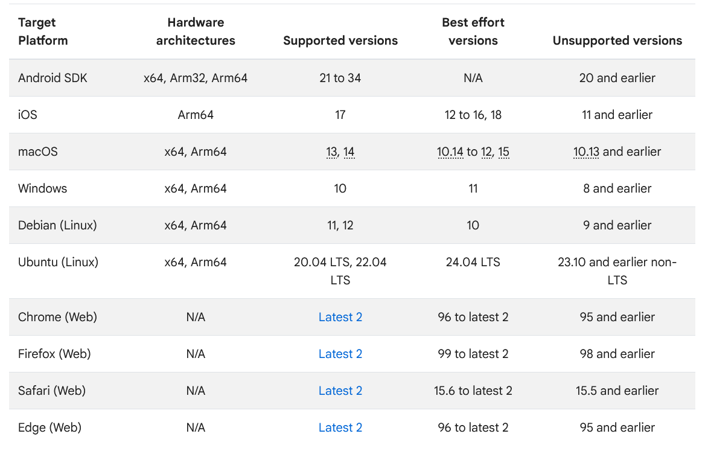
Supported Platforms

Slide 5
Further Scope for Optimization
Deferred (or ) Lazy Loading
They allow apps to download additional Dart code and assets at runtime, helping reduce APK size and storage usage by loading features only when needed
This feature is currently an experimental/preview feature that is available for few platforms

