Slide 1
TerraPraxis: Configuring Backend Azure Services
Cory Lorenz
20 Oct 2021

Slide 2
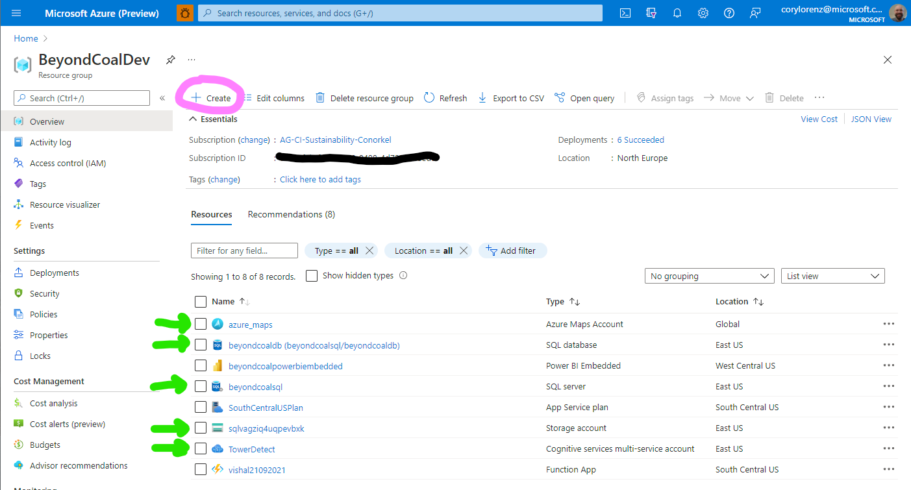
Configure Services
go to portal.azure.com
Create a resource group if you don’t have one.
Backend scripts require the 5 services in green
Create them if needed (pink circle)

Slide 3
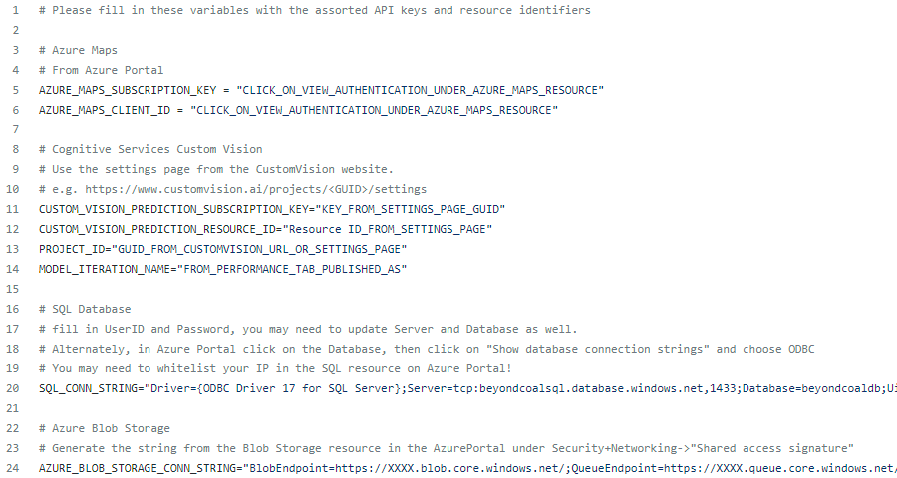
Fill in .env file
Copy repository file example.env to .env and fill in the variables
  More information is found in the README.md of the repo.

Slide 4
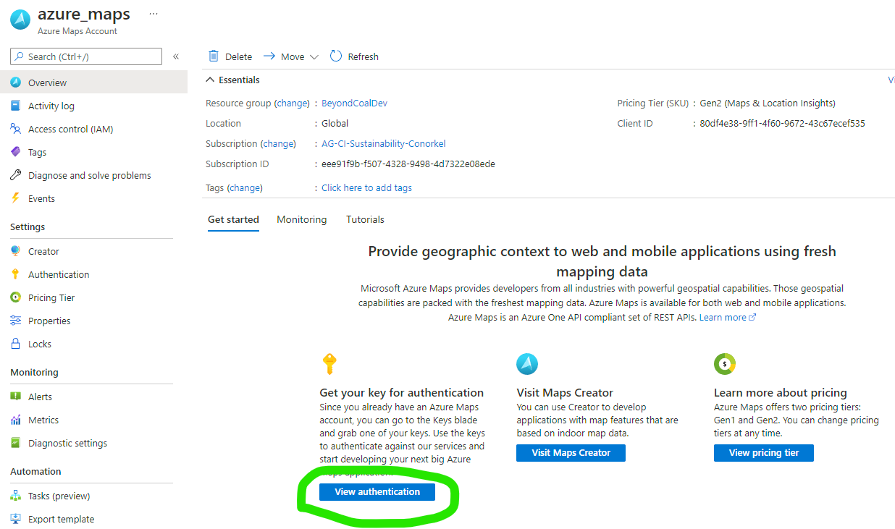
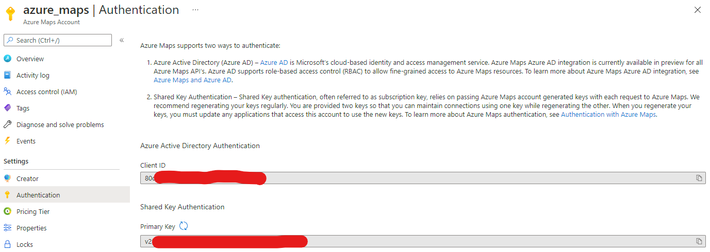
Azure Maps
Click on the resource
Click on view authentication
Copy ClientID and PrimaryKey to .env file. (red blobs)

Slide 5
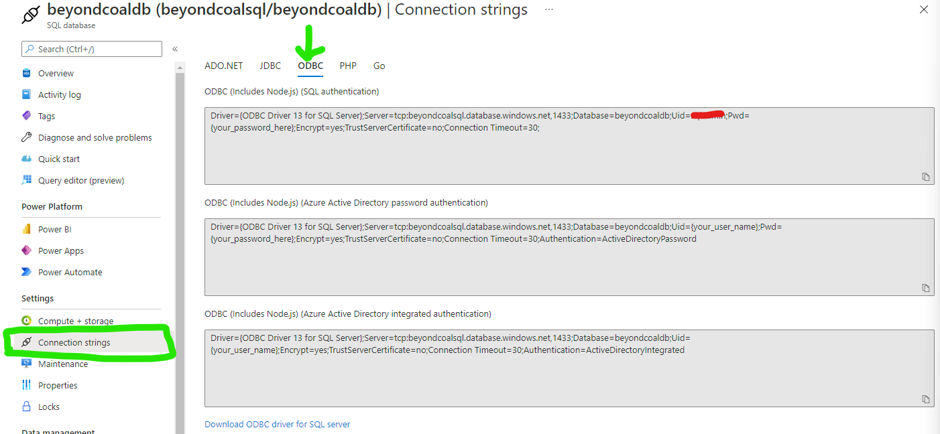
SQL Database
Don’t forget the password from when you set up the DB!
You’ll need to insert the password in the connection string.
You can obtain connection strings

Slide 6
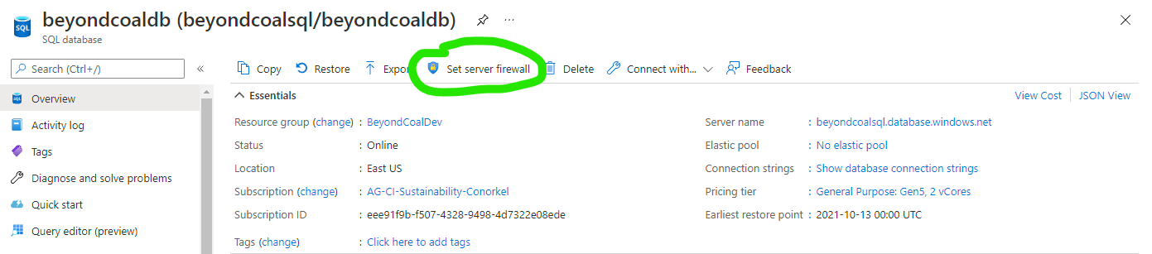
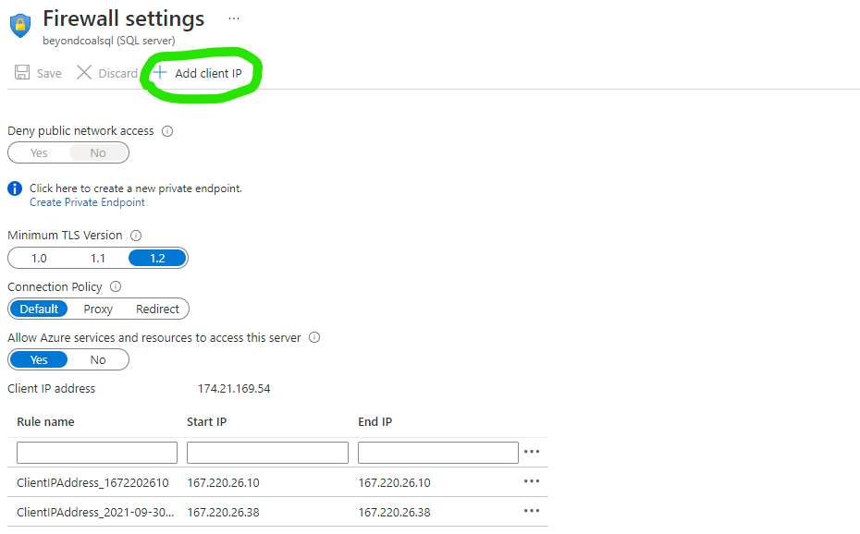
SQL Firewall
Click on set server firewall
Click the “Add client IP” button to have your current IP added to the white list
Make sure you save!

Slide 7
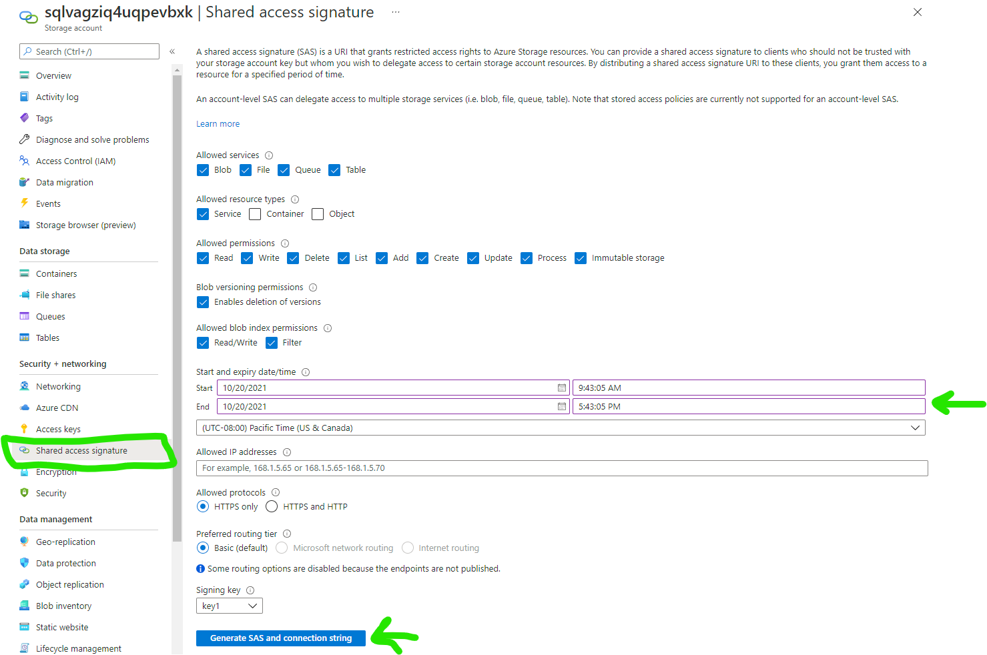
Blob Storage
Generate a Shared Access Signature
Make sure to give a long life to the signature.
Alternately, you can probably use the access keys tab above

Slide 8
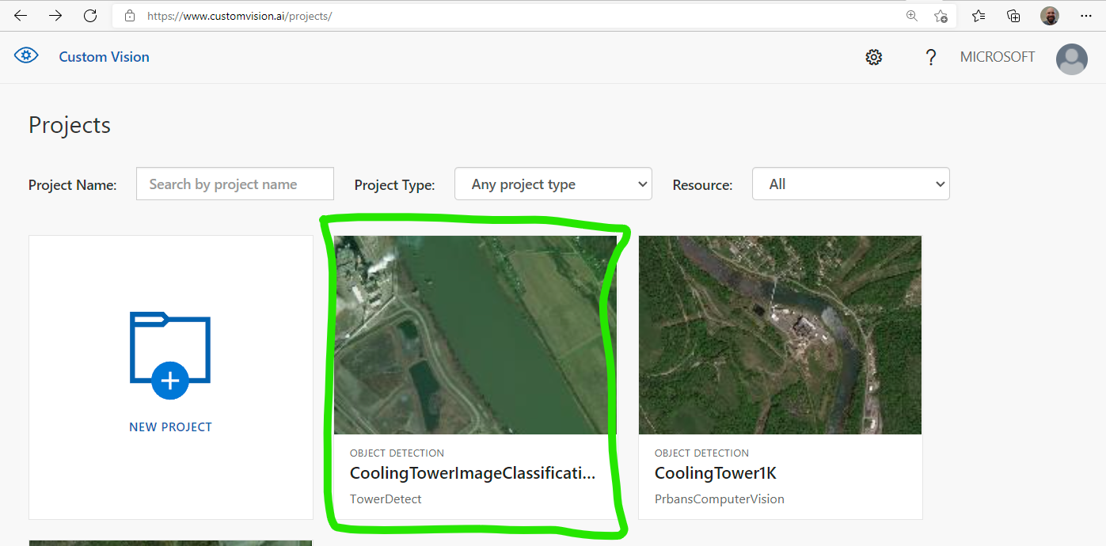
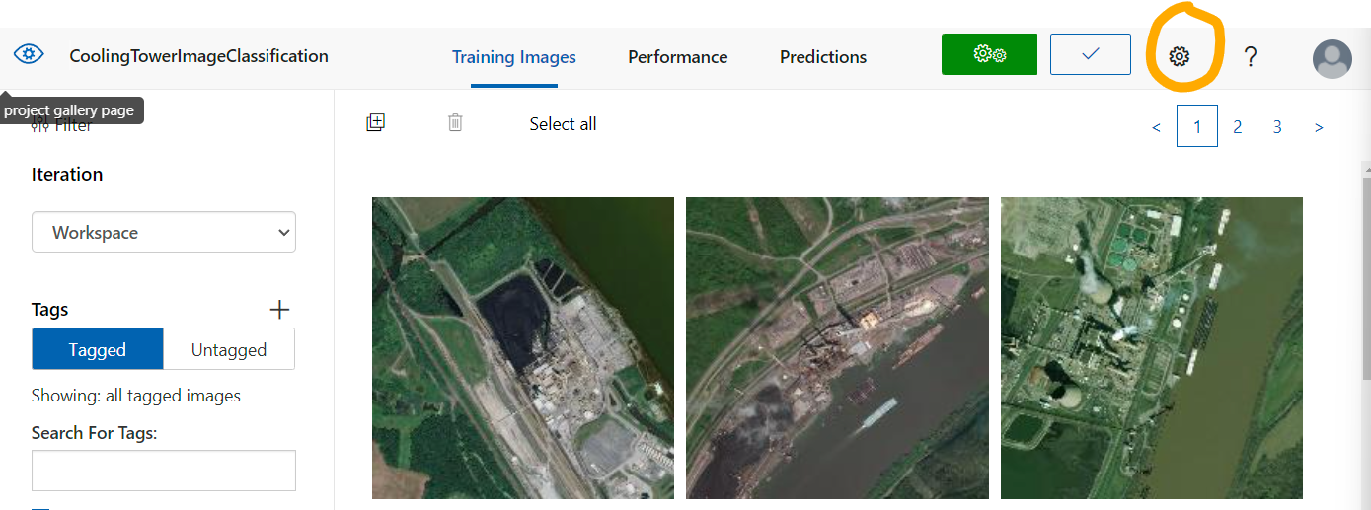
Cognitive Services
Make sure to setup a Custom Vision resource (it might be easier if we copy the already trained project)
Go to https://www.customvision.ai/projects/ and click on the project
Then click on the project settings (orange)

Slide 9
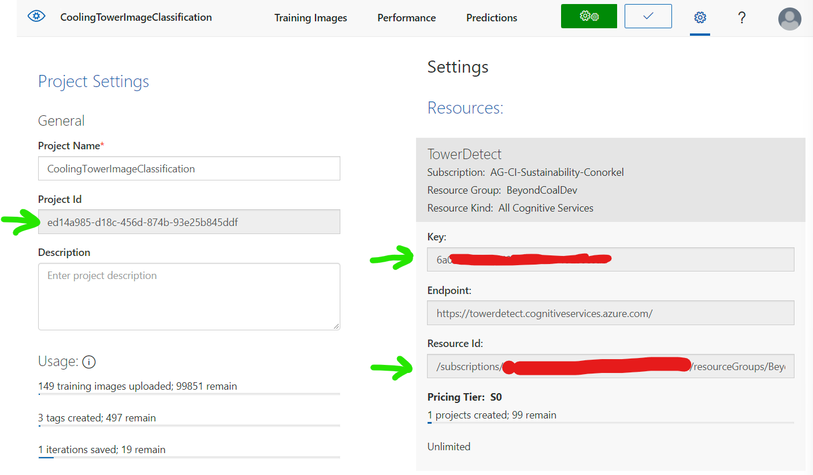
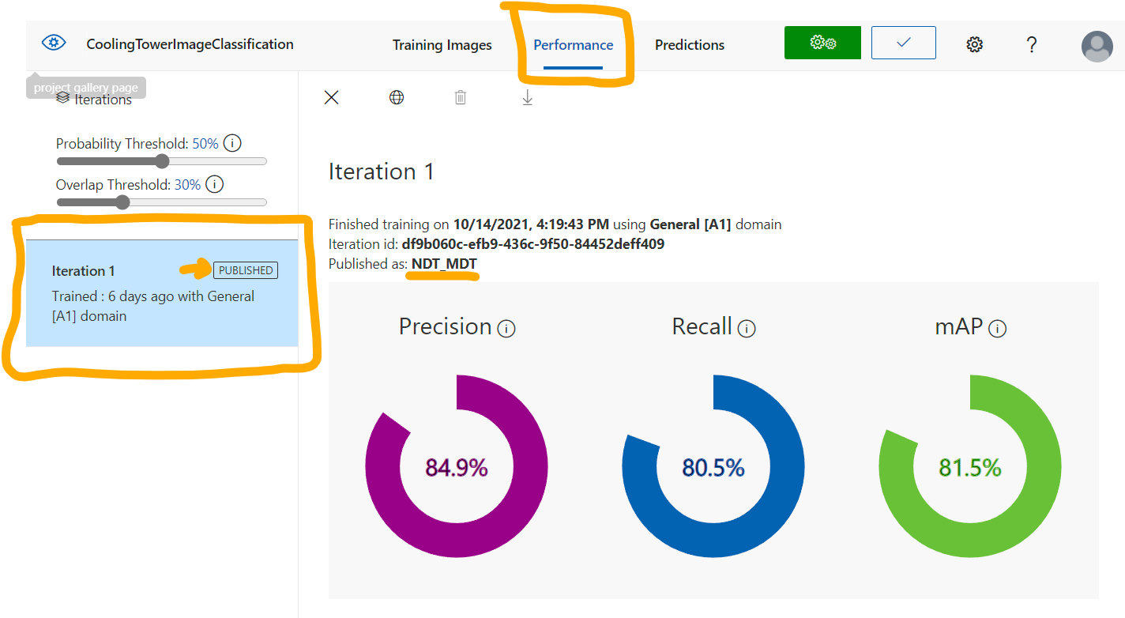
Cognitive Services
Project
Copy the information from the project settings page
Then click on Performance tab to get the Published Iteration Name to use

