Slide 1

StartUp Engineering !
Presented By <N.S.srinivasan> Date:07-06-2015

Slide 2


AGENDA
5
Startup
enginnering
x

Slide 3

AGENDA……
Linux Command Line
Version Control System
Developing WebApps
Introduction to HTML5/CSS3/JavaScript
What is Bootstrap?

Slide 4
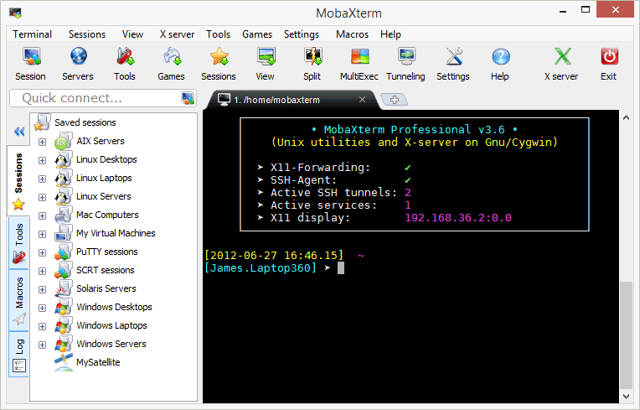
Linux command line
Minilinux : MOBOXTREAM => The primary difference between Linux and many other popular contemporary operating systems is that the Linux kernel and other components are free and open-source software. Linux is not the only such operating system, although it is by far the most widely used.

Slide 5
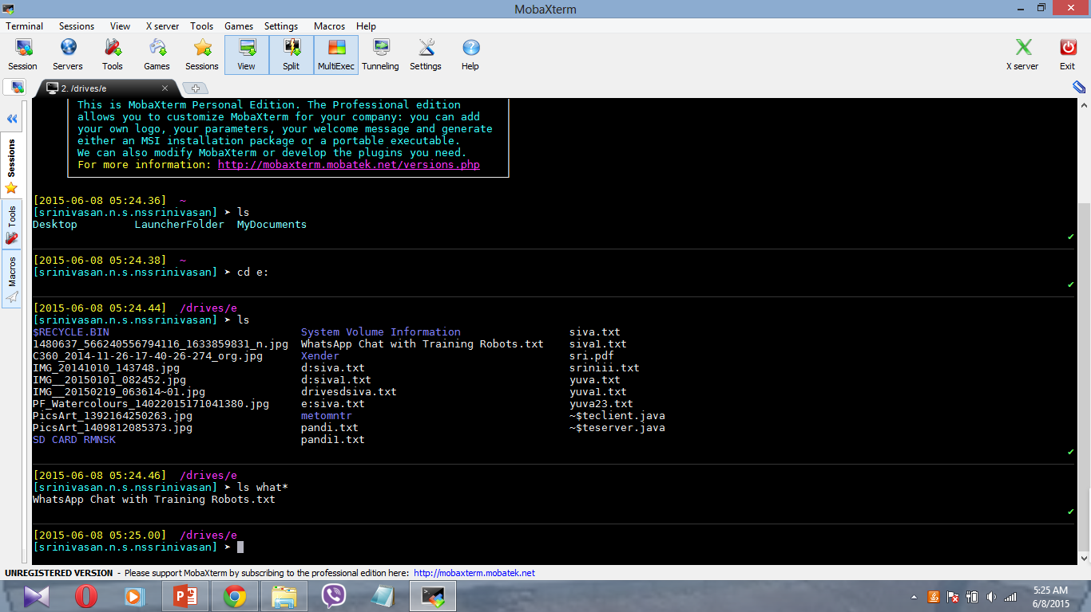

Linux …
Commands :

Slide 6
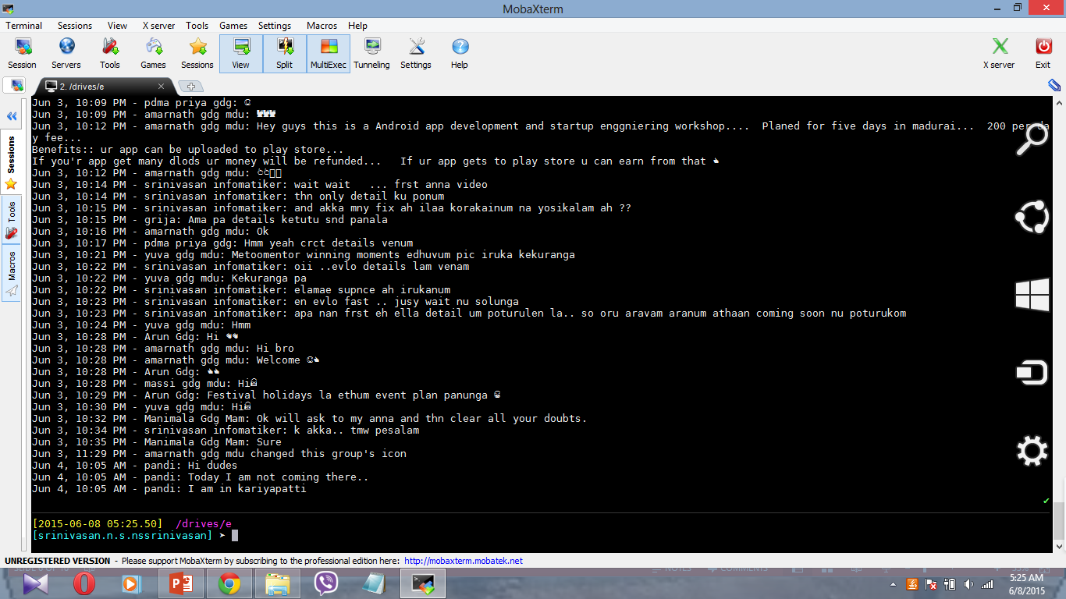
Linux …
Commands :

Slide 7
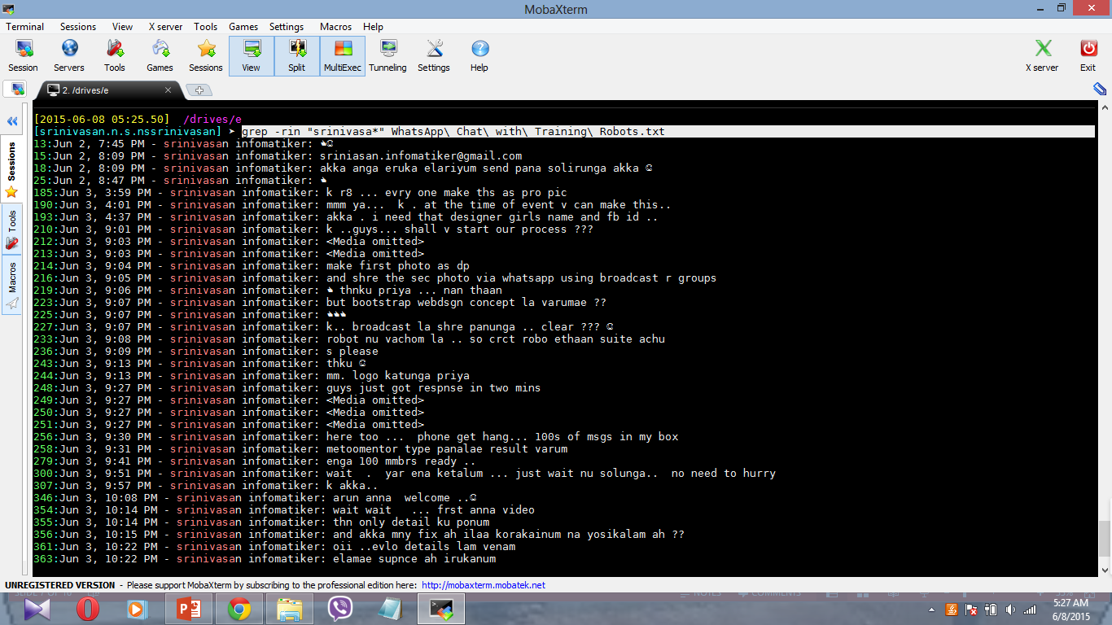
Linux …
Commands :

Slide 8
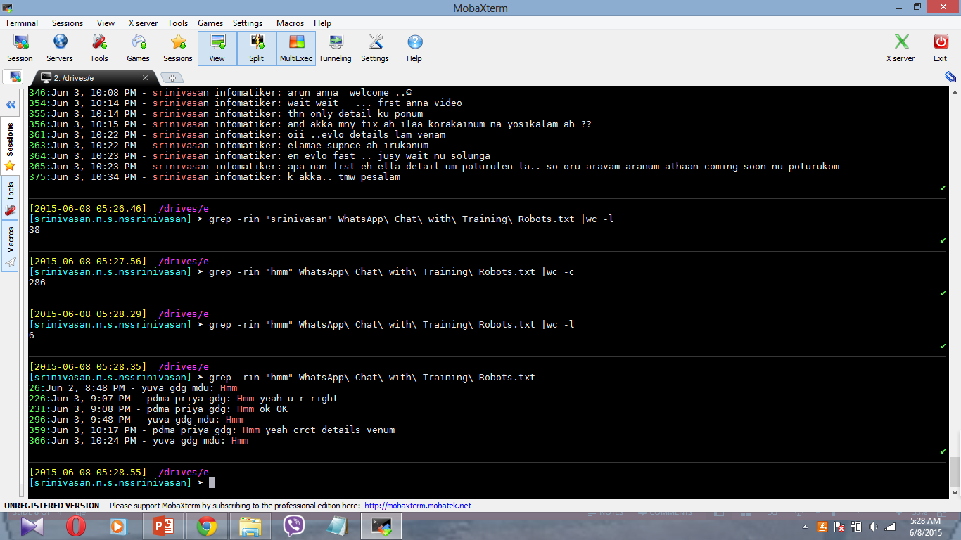
Linux …
Commands :

Slide 9
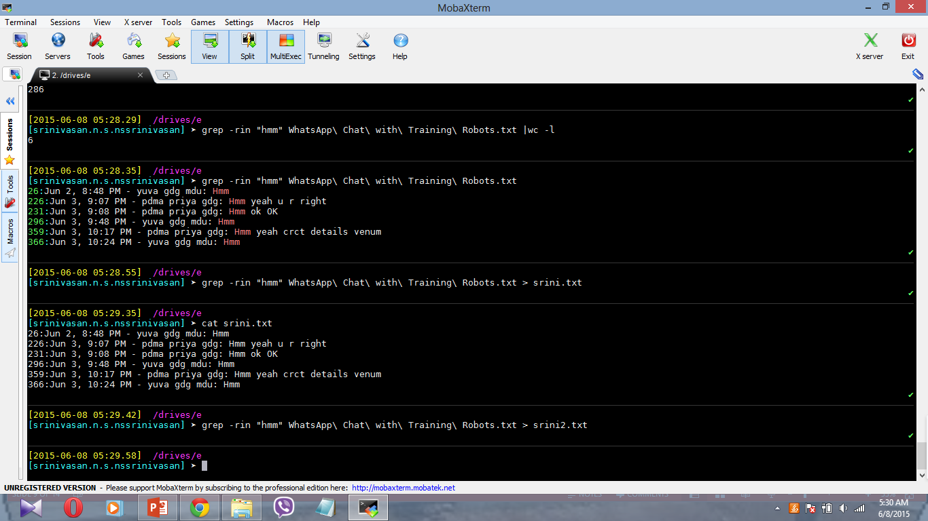
Linux …
Commands :

Slide 10
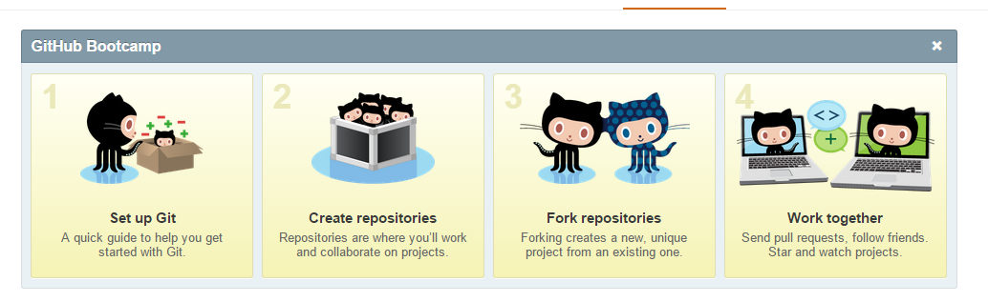
Version control system
Github:

Slide 11
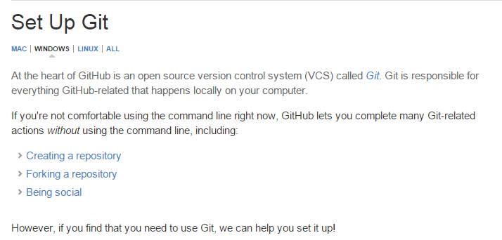
Version control system
Github:

Slide 12
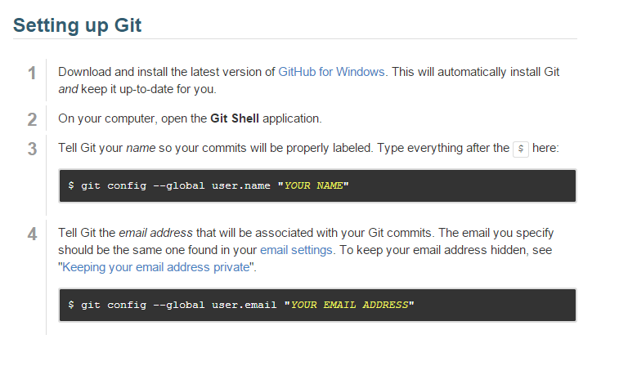
Version control system
Github:

Slide 13
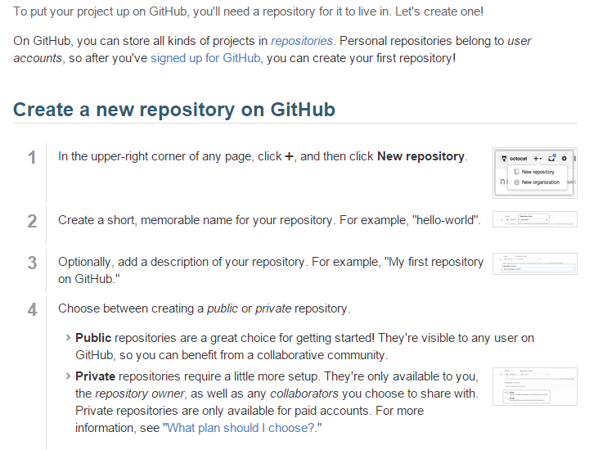
Version control system
Github:

Slide 14
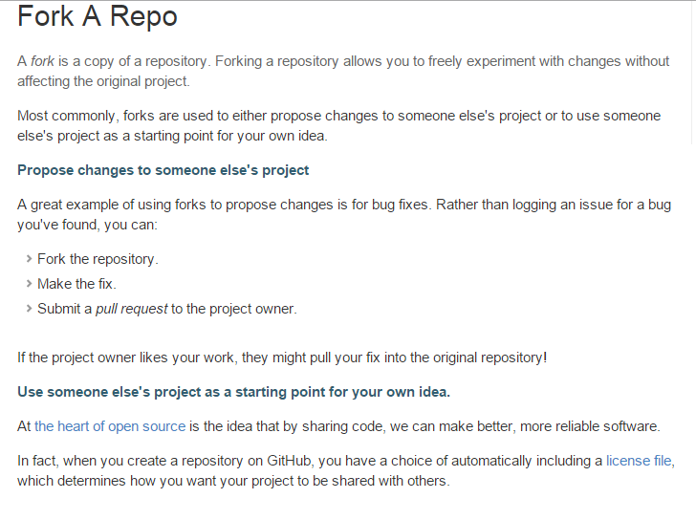
Version control system
Github:

Slide 15
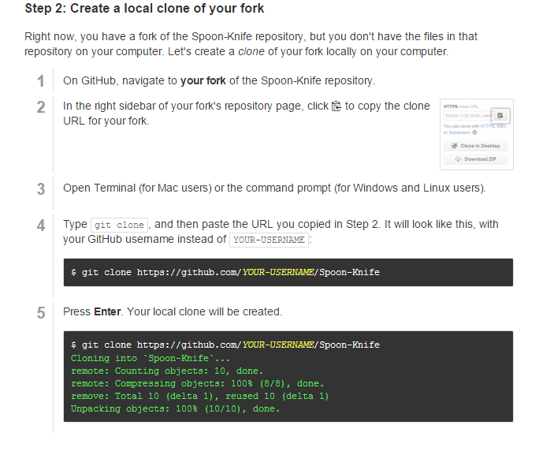
Version control system:
Commands :

Slide 16
Web apps
A web application or web app is any program that runs in a web browser. It is created in a browser-supported programming language(such as the combination of JavaScript, HTML and CSS) and relies on a web browser to render the application.[
Web applications are popular due to the ubiquity of web browsers, and the convenience of using a web browser as a client, sometimes called a thin client. The ability to update and maintain web applications without distributing and installing software on potentially thousands of client computers is a key reason for their popularity, as is the inherent support for cross-platform compatibility. Common web applications include webmail, online retail sales, online auctions, wikis and many other functions.

Slide 17
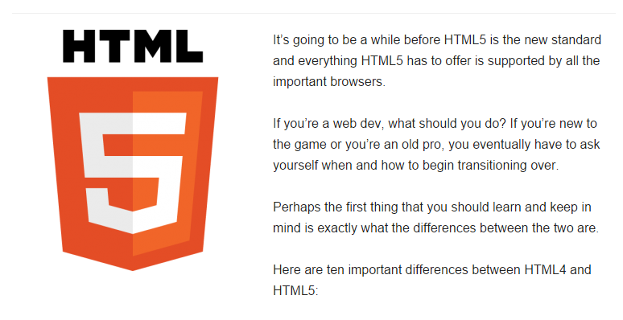
html5
Differences Between HTML4 & HTML5

Slide 18
Html5…
1. HTML5 Is a Work in Progress
:As cool as it is to see what HTML5 can do for you, it hasn’t been standardized like HTML4. You don’t have to worry about updating pages built using HTML4. It’s more than ten years old and it’s a set standard.
2. Simplified Syntax
The simpler doctype declaration is just one of the many novelties in HTML5. Now you need to write only: <!doctype html> and this is it. The syntax of HTML5 is compatible with HTML4 and XHTML1, but not with SGML.

Slide 19
Html…
3. The New <canvas> Element
This is what killed Flash.
Although it isn’t as … uh … flashy … most assume that it will eventually make Flash obsolete.
Only time will tell.
4. The <header> and <footer> Elements
For good or bad, HTML5 has acknowledged the new web anatomy. With HTML5, <header> and <footer> are specifically marked for such. Because of this, it is unnecessary to identify these two elements with a <div> tag.
5. New <section> and <article> Elements
Again, HTML5 has adopted the popular web standard. <section> and <article> allows you to mark specific areas of your layout as such, and should have a positive effect on on your SEO in the end.

Slide 20
Linux …
6. New <menu> and <figure> Elements
<menu> can be used for your main menu, but it can also be used for toolbars and context menus. The <figure> element is another way to arrange text and images.
8. New <audio> and <video> Elements
Embedind audio and video has never been easier.

Slide 21
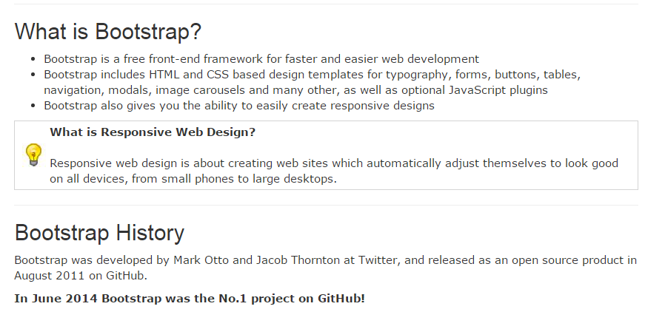
Bootstrap…

Slide 22
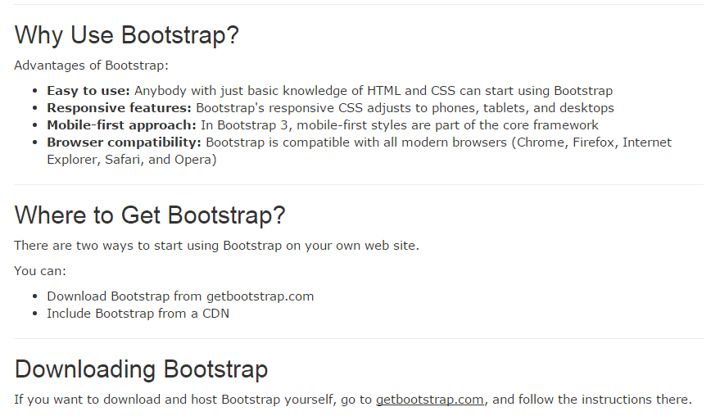
Bootstrap…

Slide 23
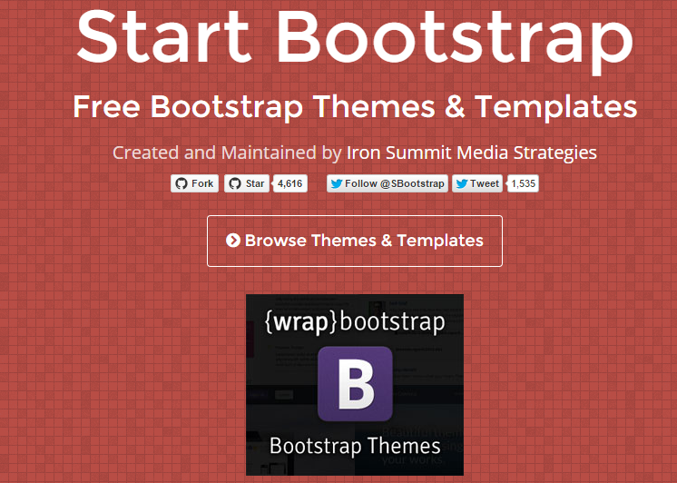
bootstrap …
Commands :

Slide 24
Q & A
Presented Email ID
Website if any

Slide 25
Thank you!
Srinivasan.infomatier@gmail.com
Website if any

