Slide 1

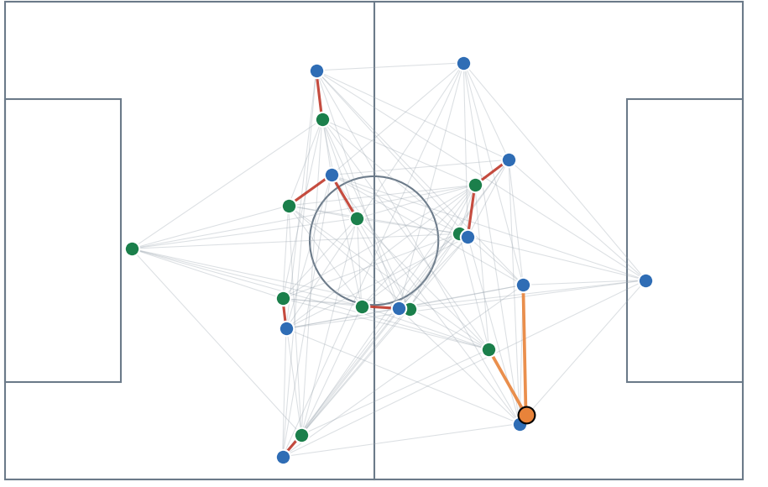
RESEARCH PITCH · OCTOBER 2026
Dynamic
Tactical AI
Key States and player graphs: from the radius graph to the ball-owner graph
Key States · Graph types · Ball-owner graph · Integration · New datasets
REAL + SIMULATED TRACKING
Srinivasan Dhakshanamoorthy
MSc Data Engineering & AI | DVRC / ESILV | Supervisor: Prof. Ahmed Azough
Notes:
Opening. Today: how a football match is turned into Key States, which graph structures we tested, the new ball-owner (BO) graph from the whiteboard specification, how it joins the radius graph, what is running now, and the datasets we want to add.

Slide 2
01 · KEY STATES
A Key State is a frame where play has moved by 3 m or more
KEY STATE RULE
Keep a frame when 0.4 × player movement + 0.4 × shape change + 0.2 × ball movement ≥ 3 m
PLAYER MOVEMENT · WEIGHT 0.4
SHAPE CHANGE · WEIGHT 0.4
BALL MOVEMENT · WEIGHT 0.2
D_abs
D_rel
D_ball
How far every player has moved since the last Key State, matched by player id.
How much the arrangement of the team changed, seen relative to its own centre.
How far the ball travelled since the last Key State.
≈ 3,400
2 types
31% vs 0.4%
Key States per real match
open play and stoppage
stoppage scenes
about 6% of all frames; the simulator keeps 12%
stable across matches: agreement 0.91, and 0.99 when a match is left out
in real matches versus the simulator: the biggest structural gap we found
Everything is measured in metres on a 105 × 68 m pitch at 10 frames per second. Boundaries between sequences come from geometry only; football events describe them afterwards.
DYNAMIC TACTICAL AI · DVRC / ESILV
2 / 8
Notes:
Key State rule: D_KS = 0.4 D_abs + 0.4 D_rel + 0.2 D_ball, threshold 3 m. About 3,400 Key States per real match (23,852 in total). Sequences have boundaries from geometry only (5 s window); football events (shot, foul, ball out) are used only to describe them. Only two types are stable: open play and stoppage. Stoppage scenes are 31% in real matches and 0.4% in the simulator.

Slide 3
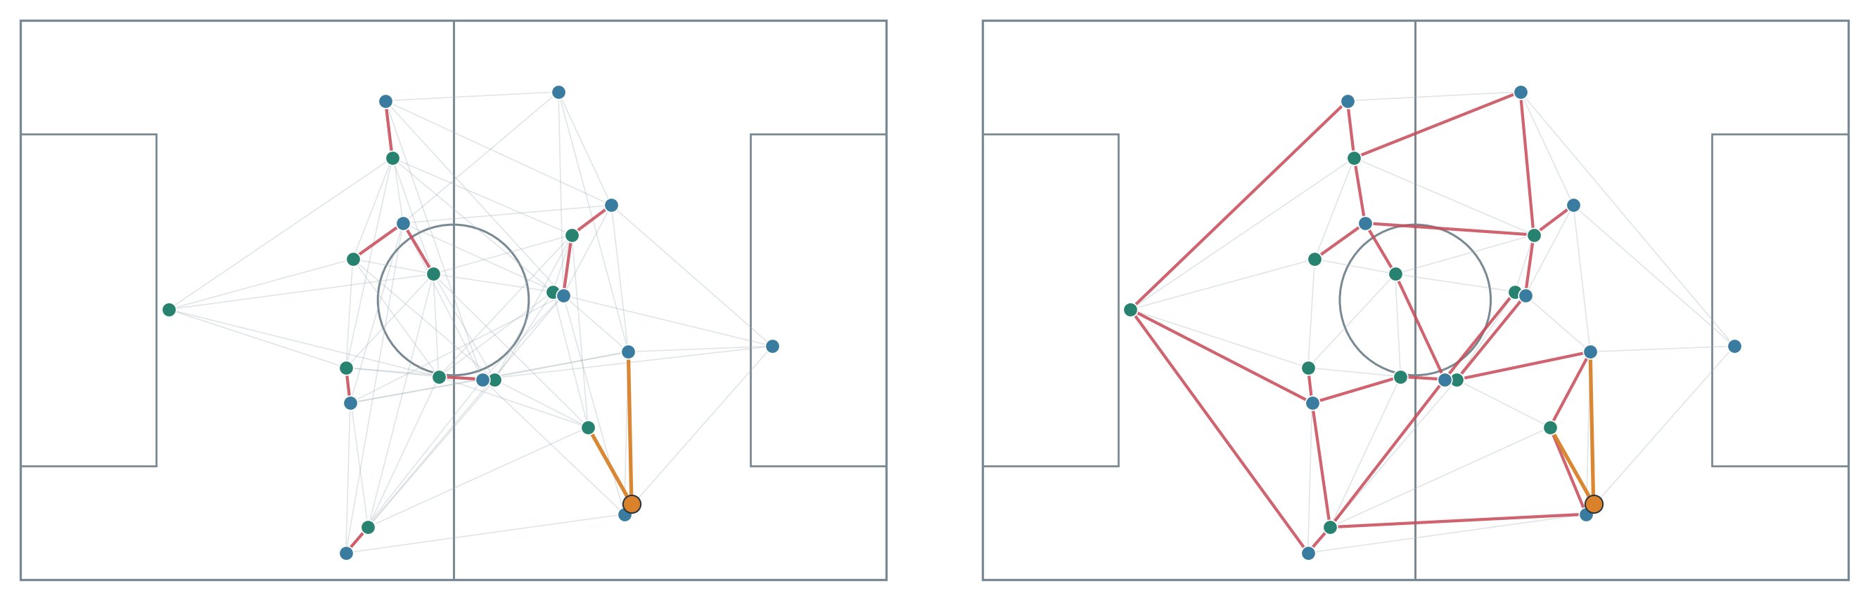
02 · GRAPH TYPES
The graph helps a lot; the exact graph type matters little
RADIUS GRAPH
DELAUNAY GRAPH
team: 5 nearest mates · opponents within 8 m · ball: 3 nearest
geometric neighbours · no radius cutoff
DELAUNAY
1.17 m
against 1.13 m for the radius graph on the same held-out match: no gain, so the radius graph is kept.
Early test, 3 training matches
PLAYER ERROR ON HELD-OUT REAL MATCHES · 3 SHARED MATCHES · KEEP-VELOCITY BASELINE 1.52 m
1.21 m
1.11 m
1.11 m
1.11 m
No graph (control)
Radius graph (ours)
GCN
GAT
20% better than keep-velocity
27% better
27% better
27% better
DYNAMIC TACTICAL AI · DVRC / ESILV
3 / 8
Notes:
We tested four graph types on the same held-out real matches. Without any graph the error is 1.21 m; with the radius graph 1.11 m, a 27% improvement over keep-velocity. GCN and GAT are equal to our edge-type-aware layer, and the Delaunay mesh gave no gain. Conclusion: the graph matters, the exact type matters little. The matches shared by all four runs are 3.

Slide 4
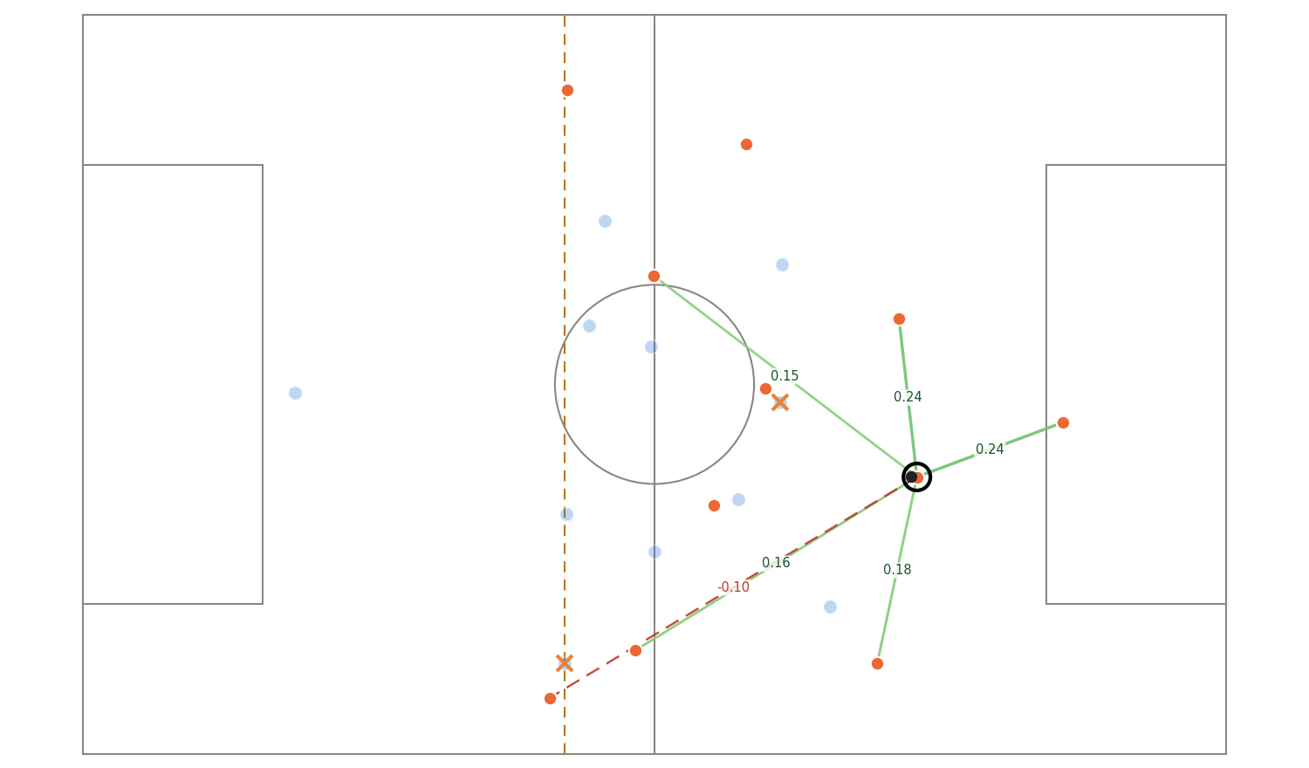
03 · BALL-OWNER (BO) GRAPH
The BO graph turns a pass into a weighted, explainable choice
EDGE WEIGHT: FOUR INGREDIENTS
1
Free space
distance to his nearest opponent
2
Pass length
shorter is easier
3
Goal closeness
to the centre of the goal
4
Open lane
a blocker on the line counts less when far from the ball (lofted pass)
OFFSIDE KEEPS ITS INFORMATION
The weight is multiplied by −1, not by 0: the size stays, so we can ask what the pass would have been worth.
Real match, one Key State. Ring = ball owner. Green = the best five pass options, with their weight. Orange × = a blocking opponent. Red dashed with a minus = offside, size kept. Dashed vertical line = offside line.
DYNAMIC TACTICAL AI · DVRC / ESILV
4 / 8
Notes:
This is the whiteboard specification: the ball owner is connected to every teammate, and to opponents within a threshold. The weight combines free space around the teammate, pass length, closeness to the centre of the goal and an open passing lane (a far blocker blocks less, for lofted passes). Offside teammates keep their weight but with a minus sign. The numbers in the picture use the distances learned from real passes.

Slide 5
03 · BALL-OWNER (BO) GRAPH
On 3,987 real passes the BO graph beats chance 4.5 times over
REAL RECEIVER RANKED FIRST (%) · MATCHES NOT USED FOR LEARNING
SHOT WITHIN 10 s OF THE PASS (%) · BY QUARTER OF THE PASS GAIN
0.84
99%
0.87 vs 0.83
AUC: will the pass arrive?
ball owner from the events
AUC: pass leads to a shot
pass length alone: 0.62
the old nearest-player guess was the real passer
location plus gain against location alone
DYNAMIC TACTICAL AI · DVRC / ESILV
5 / 8
Notes:
Evidence that the BO graph carries real information. Left: with the real passer taken from the match events, the weight ranks the real receiver first in 45% of passes, against 10% for chance and 27% for the nearest teammate; the learned numbers add 6 points over the hand-set ones. Right: passes with a high expected gain are followed by a shot within 10 seconds in 16% of cases, against 0.3% for the lowest quarter. All values are measured on matches that the model never saw (leave-one-match-out). The 'gain' is the chance the pass arrives times the danger of the place it reaches.

Slide 6
04 · INTEGRATION
The BO graph joins the radius graph as a fourth edge type
Key State: 23 slots (22 players + ball), position and velocity
PLAYER ERROR ON HELD-OUT REAL MATCHES
No graph (3 matches)
1.21 m
Team edges
Opponent edges
Ball edges
Pass edges · new
Radius graph
1.115 m
5 nearest mates
within 8 m
3 nearest players
owner to teammates
+ pass edges, real numbers
1.083 m
Edge-aware message passing · one rule per edge type
+ pass edges, shuffled control
1.099 m
Interim, run still going: pass edges against the radius graph −0.032 m (interval −0.043 to −0.019), better in 7/7 matches. Against the shuffled control −0.016 m (−0.033 to −0.002), 5/7 matches: the interval only just excludes zero.
GRU over the last 3 Key States, with the time gaps
Movement
Embeddings
Pass analysis
where players and ball go next
tactical states, novelty
gain, offside cost
7 held-out matches, 37 of 63 runs finished. For the ball the gain is shared with the control.
WHY IT IS USEFUL
Explains each pass option · keeps offside information · compares real and simulated passing
DYNAMIC TACTICAL AI · DVRC / ESILV
6 / 8
Notes:
Integration: the radius network already treats each edge type separately, so the BO graph is added as a fourth edge type between the ball owner and each teammate, in both directions, with the pass numbers on the edge. Control: the same edges with shuffled numbers tell us whether the gain comes from pass information or only from a bigger network. Interim result with 7 matches and 2 of 3 seeds: for players, pass edges beat both the radius graph and the shuffled control, with an interval that excludes zero but only just; for the ball the shuffled control gets most of the gain, so that part is mostly extra capacity. We will report the final numbers when the run ends.

Slide 7
05 · NEXT STEPS · DATA
Next: add real datasets to go from 7 matches to about 70
PFF FC · WORLD CUP 2022
SKILLCORNER OPEN DATA
STATSBOMB OPEN DATA
64
10
events
matches
A-League matches
+ 360 freeze frames
Tracking and events, one file per match; described as free. Licence and access still to confirm.
Broadcast tracking: not every frame shows all 22 players, so we use it as a robustness test.
Positions around events only, no continuous tracking: useful for pass analysis, not for movement.
FIRST CHOICE
SECOND
OPTIONAL
WHAT IT TAKES
Converter to the common format → add to settings.json → run the pipeline → train on the 7 DFL matches, test on a new league
7 to about 71 matches: roughly 3 times narrower confidence intervals, and a cross-league test of generalisation. Nothing is downloaded yet.
DYNAMIC TACTICAL AI · DVRC / ESILV
7 / 8
Notes:
Why more data: all results so far come from 7 real matches of one league, so the confidence intervals are wide. PFF's World Cup 2022 release has 64 matches with tracking and events and is described as free, but licence and access still need checking. SkillCorner has 10 A-League matches of broadcast tracking, which is a good robustness test but not always 22 players. StatsBomb has events plus 360 freeze frames, useful for passes only. Plan: write a converter to our common format, register the matches in settings.json, rerun the pipeline, train on DFL and test on the new league.

Slide 8
06 · RUNNING NOW
Running now: a firmer test that the pass edges really help
FIRMER PASS-EDGE TEST
CURRENT STATUS
37 / 63
training runs finished
7 matches × 3 networks × 3 seeds
Key States and sequences
Implemented
Radius-graph network
Implemented
A
Radius graph
BO graph on real passes
Validated
B
+ pass edges, real numbers
BO edges inside the network
Testing
C
+ pass edges, shuffled numbers (control)
Tactical states
Weak signal
Interim result: for players the pass edges beat both A and the control C; for the ball the control gets most of the gain, so it is mostly extra capacity.
New datasets
Planned
NEXT RESEARCH STEPS
Finish the runs and report the verdict · richer tactical context (possession, pressure, shape) · add PFF World Cup data
DYNAMIC TACTICAL AI · DVRC / ESILV
8 / 8
Notes:
Status as of 2026-10-23: 37 of 63 runs finished. The three networks are compared on the same 7 held-out matches with several random starts; the shuffled control separates pass information from extra capacity. The first version of the tactics layer shows that the four tactical states add nothing to the ball position when predicting shots, so the next step is a richer, interpretable context. New datasets come after the run.

