Slide 1

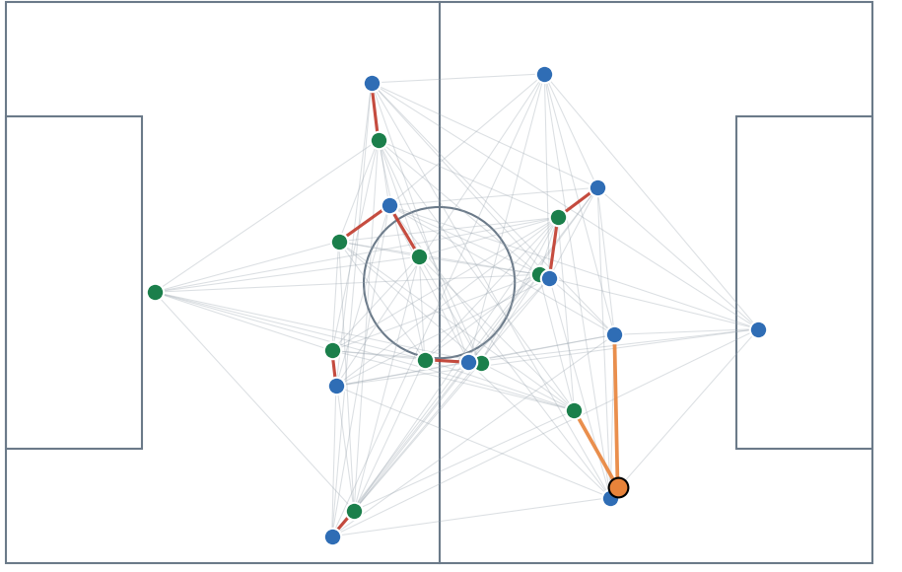
PROJECT DOCUMENTATION · OCTOBER 2026
Dynamic
Tactical AI
Project map: every important file, what it does and where its output is saved
Folders · Scripts · Outputs · Quantified results · GitHub
46 SCRIPTS · 7 REAL MATCHES · 36 SIMULATED GAMES
Srinivasan Dhakshanamoorthy
MSc Data Engineering & AI | DVRC / ESILV | Supervisor: Prof. Ahmed Azough
Notes:
This deck is the map of the repository: for every stage, the scripts, what each one did, the files it wrote and the numbers it produced. The last slide shows how the code is published to GitHub.

Slide 2
01 · PROJECT LAYOUT
The project in one picture: settings, scripts, data, outputs
PATH | WHAT IS INSIDE | SIZE
settings.json | the one place for every number and every match list; scripts read it | 2 KB
scripts/ | all code, 46 Python files, run from the project root | 0.4 MB
data/real/raw/ | downloaded DFL files per match: tracking, events, players, meta | 198 MB · 28 files
data/real/raw_xml/ | the original XML files (resumable download) | 1.09 GB · 9 files
data/real/processed/ | common-format CSV and every file derived from it, per match | 189 MB · 145 files
data/simulated/ | 36 Google Football games in four settings, same format | 208 MB · 475 files
outputs/ | pictures, tables, model weights, the run log (80 experiments) | 7.7 MB · 75 files
docs/ · grf-setup/ | presentations · setup notes for the simulator | small
7
real DFL matches
401,060 frames · 668 minutes at 10 frames/s
36
simulated games
stochastic 12 · easy 8 · hard 8 · competition 8
1.7 GB
data stays off GitHub
the scripts rebuild it: run_pipeline.py
Per match, the processed folder holds about 20 files named <match>_<what>.npz or .csv (for example J03WMX_graphs.npz); outputs/ holds 24 pictures, 22 tables, 18 text logs, 8 model checkpoints, 2 json files and 1 html overview.
DYNAMIC TACTICAL AI · DVRC / ESILV
2 / 10
Notes:
Everything is driven by settings.json. Real data lives under data/real, simulated games under data/simulated. All derived files are named after the match id. Outputs holds everything we show in slides.

Slide 3
02 · DATA AND PIPELINE
Stage 1: raw tracking becomes one common format
FILE (scripts/) | WHAT IT DID | OUTPUT SAVED IN
download_real.py save_meta.py | download one DFL match (tracking and events) in a resumable way; save teams, players, pitch size, direction, score | data/real/raw/<match>_tracking.csv.gz, _events.csv.gz, _players.csv, _meta.json
convert_real.py | 25 to 10 frames/s, metres, home always attacks to x = 105, one row per player per frame, red cards allowed | data/real/processed/<match>.csv.gz
register_matches.py | one row per real match, keyed by the DFL match id | data/real/matches.csv
export_tracking.py | run one Google Football game and export it in the same layout (in grf-setup/) | data/simulated/<setting>/<game>.csv
run_pipeline.py | runs download, convert, Key States, sequences, descriptions, types and graphs; skips what exists | all files of stages 1 to 3
settings.py · runlog.py | read settings.json; append every experiment to the run log | outputs/run_log.csv (80 rows)
401,060
36 × 3,000
105 × 68 m
real frames
simulated frames
one common format
7 matches, 668 minutes, 10 frames/s
5 minutes per game, four settings
metres, 23 slots: 22 players + ball
DYNAMIC TACTICAL AI · DVRC / ESILV
3 / 10
Notes:
The pipeline script runs every data step and skips what already exists, so adding a match to settings.json is enough to bring it through all stages.

Slide 4
03 · KEY STATES AND SEQUENCES
Stage 2: Key States and sequences, with their output files
FILE (scripts/) | WHAT IT DID | OUTPUT SAVED IN
extract_keystates.py keystates.py | keep a frame when 0.4 × player + 0.4 × shape + 0.2 × ball movement reaches 3 m (keystates.py: first tiny test) | data/real/processed/<match>_adaptive_ks.csv
find_sequences.py | boundaries between sequences from geometry only (5 s window, one scale for all matches) | <match>_sequences.csv, <match>_ks_features.csv
describe_sequences.py | describe each boundary with real events (shot, foul, ball out) and compare with random boundaries | <match>_boundary_events.csv, <match>_sequence_desc.csv
cluster_sequences.py | sequence types by k-means; keep only the k that is stable | <match>_sequence_types.csv, outputs/sequence_types_8matches.png
plot_timeline.py plot_state_share.py | Key State timeline and share per state, real against simulated | outputs/key_state_timeline.png, key_state_share.png
23,852
2 types
31% vs 0.4%
Key States in 7 real matches
open play and stoppage
stoppage scenes
about 3,400 per match, 5.9% of frames (simulator: 358 per game)
stable across matches: agreement 0.91, and 0.99 with a match left out
real matches against the simulator, the largest structural gap
DYNAMIC TACTICAL AI · DVRC / ESILV
4 / 10
Notes:
Key States are defined by geometry only; events describe them afterwards. 23,852 Key States in total over the 7 real matches.

Slide 5
04 · GRAPHS AND NETWORK
Stage 3: one graph per Key State, one network over time
FILE (scripts/) | WHAT IT DID | OUTPUT SAVED IN
build_graphs.py | one graph per Key State: 23 nodes; team (5 nearest), opponent (within 8 m), ball (3 nearest) edges; time features | <match>_graphs.npz, <match>_graphs_delaunay.npz
train_gnn.py | edge-type-aware message passing + GRU over 3 Key States; predicts the next movement; archs ours, gcn, gat, mlp, pass_* | outputs/gnn_model.pt, <match>_embeddings.npz, run_log.csv
run_folds.py | hold each real match out in turn and train on the other six | outputs/gnn_model_fold_<match>.pt (7), embeddings per fold
compare_archs.py summarise_gnn.py | one table comparing graph layers on the same held-out matches | outputs/compare_archs.csv
plot_graph.py | draw a graph on the pitch and four consecutive Key States | outputs/graph_snapshot.png, graph_time.png
1.11 m
1.21 m
1.11 m
player error, unseen match
no graph (control)
GCN and GAT
keep-velocity 1.51 m: 26% lower. Ball 3.29 m against 6.19 m
7 points less gain than with the graph (20% against 27%)
equal to our layer: the exact graph type matters little
DYNAMIC TACTICAL AI · DVRC / ESILV
5 / 10
Notes:
Results are leave-one-match-out: the error is measured on a real match the network never saw. The no-graph and GCN/GAT numbers use the 3 matches shared by all runs.

Slide 6
05 · BALL-OWNER GRAPH
Stage 4: the ball-owner graph and its real-pass validation
FILE (scripts/) | WHAT IT DID | OUTPUT SAVED IN
bo_graph.py | the BO graph: weight from free space, pass length, goal closeness and open lane; offside weight × −1 | library used by the scripts below
extract_passes.py | real passer and receiver from the events; a snapshot of the pitch at the moment of each pass | data/real/processed/<match>_passes.npz
receiver_check.py | does the weight rank the real receiver first? hand-set against learned numbers | outputs/receiver_check.csv, receiver_check.png
fit_bo_weights.py | learn the five distances and the importance of each ingredient from real passes | outputs/bo_params_learned.json, bo_fit.csv, bo_fit.png
plot_bo_graph.py | draw BO graphs on the pitch, real and simulated, with blockers and offside | outputs/bo_graph*.png, bo_graph_edges.csv
6,062 → 3,987
99%
35% → 41.5%
pass events to usable passes
ball owner from events
real receiver ranked first
4,838 matched to tracking; 3,987 in open play with a receiver (3,546 completed)
the old nearest-player guess was the real passer in 99% of passes
hand-set against learned numbers; chance 10%, nearest teammate 27%
DYNAMIC TACTICAL AI · DVRC / ESILV
6 / 10
Notes:
The whiteboard specification is implemented in bo_graph.py. The real passer and receiver come from the match events, so the receiver check is a real test: the weight is only credited when the actual receiver is the top-ranked teammate.

Slide 7
06 · PASS MODELS
Stage 5: pass models, expected gain and simulator comparison
FILE (scripts/) | WHAT IT DID | OUTPUT SAVED IN
pass_features.py | movement and timing numbers for every pass option: arrival point, lane time margin, running speed | <match>_passfeat.npz (real and simulated)
fit_pass_model.py | three models: who is picked, will the pass arrive, how dangerous is the place (leave-one-match-out) | outputs/pass_model.json, pass_model.csv, pass_model_completion.csv
build_pass_edges.py | pass edges for every Key State, as network input | <match>_passedges.npz
decision_quality.py speed_check.py | real against simulated passing decisions; is the gap only the simulator's speed? | outputs/decision_quality.csv, speed_check.csv
validate_gain.py | does the expected gain predict a shot in the next 10 s? | outputs/validate_gain.csv, validate_gain_matches.csv
45%
0.3% → 16.3%
17.7 vs 12 m
real receiver ranked first
shot within 10 s
pass length, real vs simulated
still picture 42%, with movement 45%; AUC for 'will it arrive' 0.84
lowest to highest quarter of the pass gain
not a speed effect: slowing the simulator changed the gap from 16.7% to 15.5%
DYNAMIC TACTICAL AI · DVRC / ESILV
7 / 10
Notes:
Three small models, all judged on matches they never saw. The simulator passes shorter and more forward than real players, and that does not disappear when the simulated players are slowed to real speed.

Slide 8
07 · EVIDENCE AND TACTICS
Evidence and tactics: scoreboard, realism and the proof run
FILE (scripts/) | WHAT IT DID | OUTPUT SAVED IN
scoreboard.py | every quantifier in one table with 95% intervals over held-out matches | outputs/scoreboard.csv, scoreboard.png
realism_scorecard.py | gap of each simulator setting to real football on nine measures | outputs/realism_scorecard.csv, realism_scorecard.png
run_pass_proof.py prove_pass_edges.py | three networks × 7 matches × seeds, paired statistics: do the pass edges help? | outputs/prove_pass_edges.csv, prove_pass_edges.png
tactical_states.py tactics_profile.py | four tactical states; playbook, team style, unused best option, validity | <match>_tactical_state.csv, outputs/tactics_*.csv, tactics_profile.png
novelty_holdout.py learned_distance.py | how unusual a match is; learned against hand-made Key State distance | outputs/novelty_holdout.csv, learned_distance.csv, combined_distance.csv
64–68%
−0.032 m
−0.003
simulator gap to real
pass edges, interim
tactical state, AUC
passing gaps 13–50%, structural gaps 90–100% (nine measures)
against the radius network, better in 7/7 matches (37 of 63 runs done)
adds nothing beyond the ball's place for 'shot within 10 s'
DYNAMIC TACTICAL AI · DVRC / ESILV
8 / 10
Notes:
The scoreboard is the one-page answer to 'how do we know we are doing well'. The proof run is still finishing; the tactics layer is a first version and its states carry little information beyond the ball position.

Slide 9
08 · RUN ORDER AND OUTPUTS
Run order: six steps from raw data to the scoreboard
1 · DATA
2 · NETWORK
3 · PASSES
4 · MODELS
5 · CHECKS
6 · EVIDENCE
run_pipeline.py
run_folds.py
extract_passes.py
pass_features.py
fit_pass_model.py
build_pass_edges.py
decision_quality.py
validate_gain.py
tactics_profile.py
scoreboard.py
prove_pass_edges.py
writes data/real/processed and graphs
writes gnn_model_fold_*.pt and embeddings
write _passes.npz, _passfeat.npz
write pass_model.json, _passedges.npz
write the CSV tables
write scoreboard and proof tables
EVERY RUN IS LOGGED
outputs/run_log.csv: 80 experiment rows with parameters, errors and minutes
outputs/ holds 75 files: 24 pictures, 22 tables, 18 text logs, 8 model checkpoints, 2 json files and 1 html overview. Each script prints its table and names the files it saved; commands are in the README.
DYNAMIC TACTICAL AI · DVRC / ESILV
9 / 10
Notes:
The order matters: the pass scripts need the Key States and passes first, and the scoreboard reads the tables written by the earlier steps. Each script skips nothing silently: it prints what it saved.

Slide 10
09 · GITHUB
Publishing: code and results go to GitHub, raw data stays out
REPOSITORY NAME
RUN ONCE
dynamic-tactical-ai-football
gh auth login
private by default; public with -Visibility public
THEN
GOES IN · ABOUT 140 FILES, 8 MB
STAYS OUT
powershell -ExecutionPolicy Bypass -File .\push_to_github.ps1
scripts/ · 46 files
outputs/ · 75 files
settings.json, README
requirements files
docs/ · presentations
grf-setup/
data/ · 1.7 GB, rebuilt by run_pipeline.py
.venv folders
old decks, PDFs, logo
PUBLIC REPOSITORY INSTEAD
... -File .\push_to_github.ps1 -Visibility public
Run it again any time: it commits only what changed and pushes to the same repository.
The script checks that no file is larger than 50 MB before it commits, copies the presentations into docs/, and stops with a clear message if you are not logged in.
DYNAMIC TACTICAL AI · DVRC / ESILV
10 / 10
Notes:
The push script is push_to_github.ps1 in the project root. It creates the repository with the GitHub CLI after you log in once. The data folder is excluded by .gitignore because it is large and fully rebuilt by the pipeline.

