Slide 1
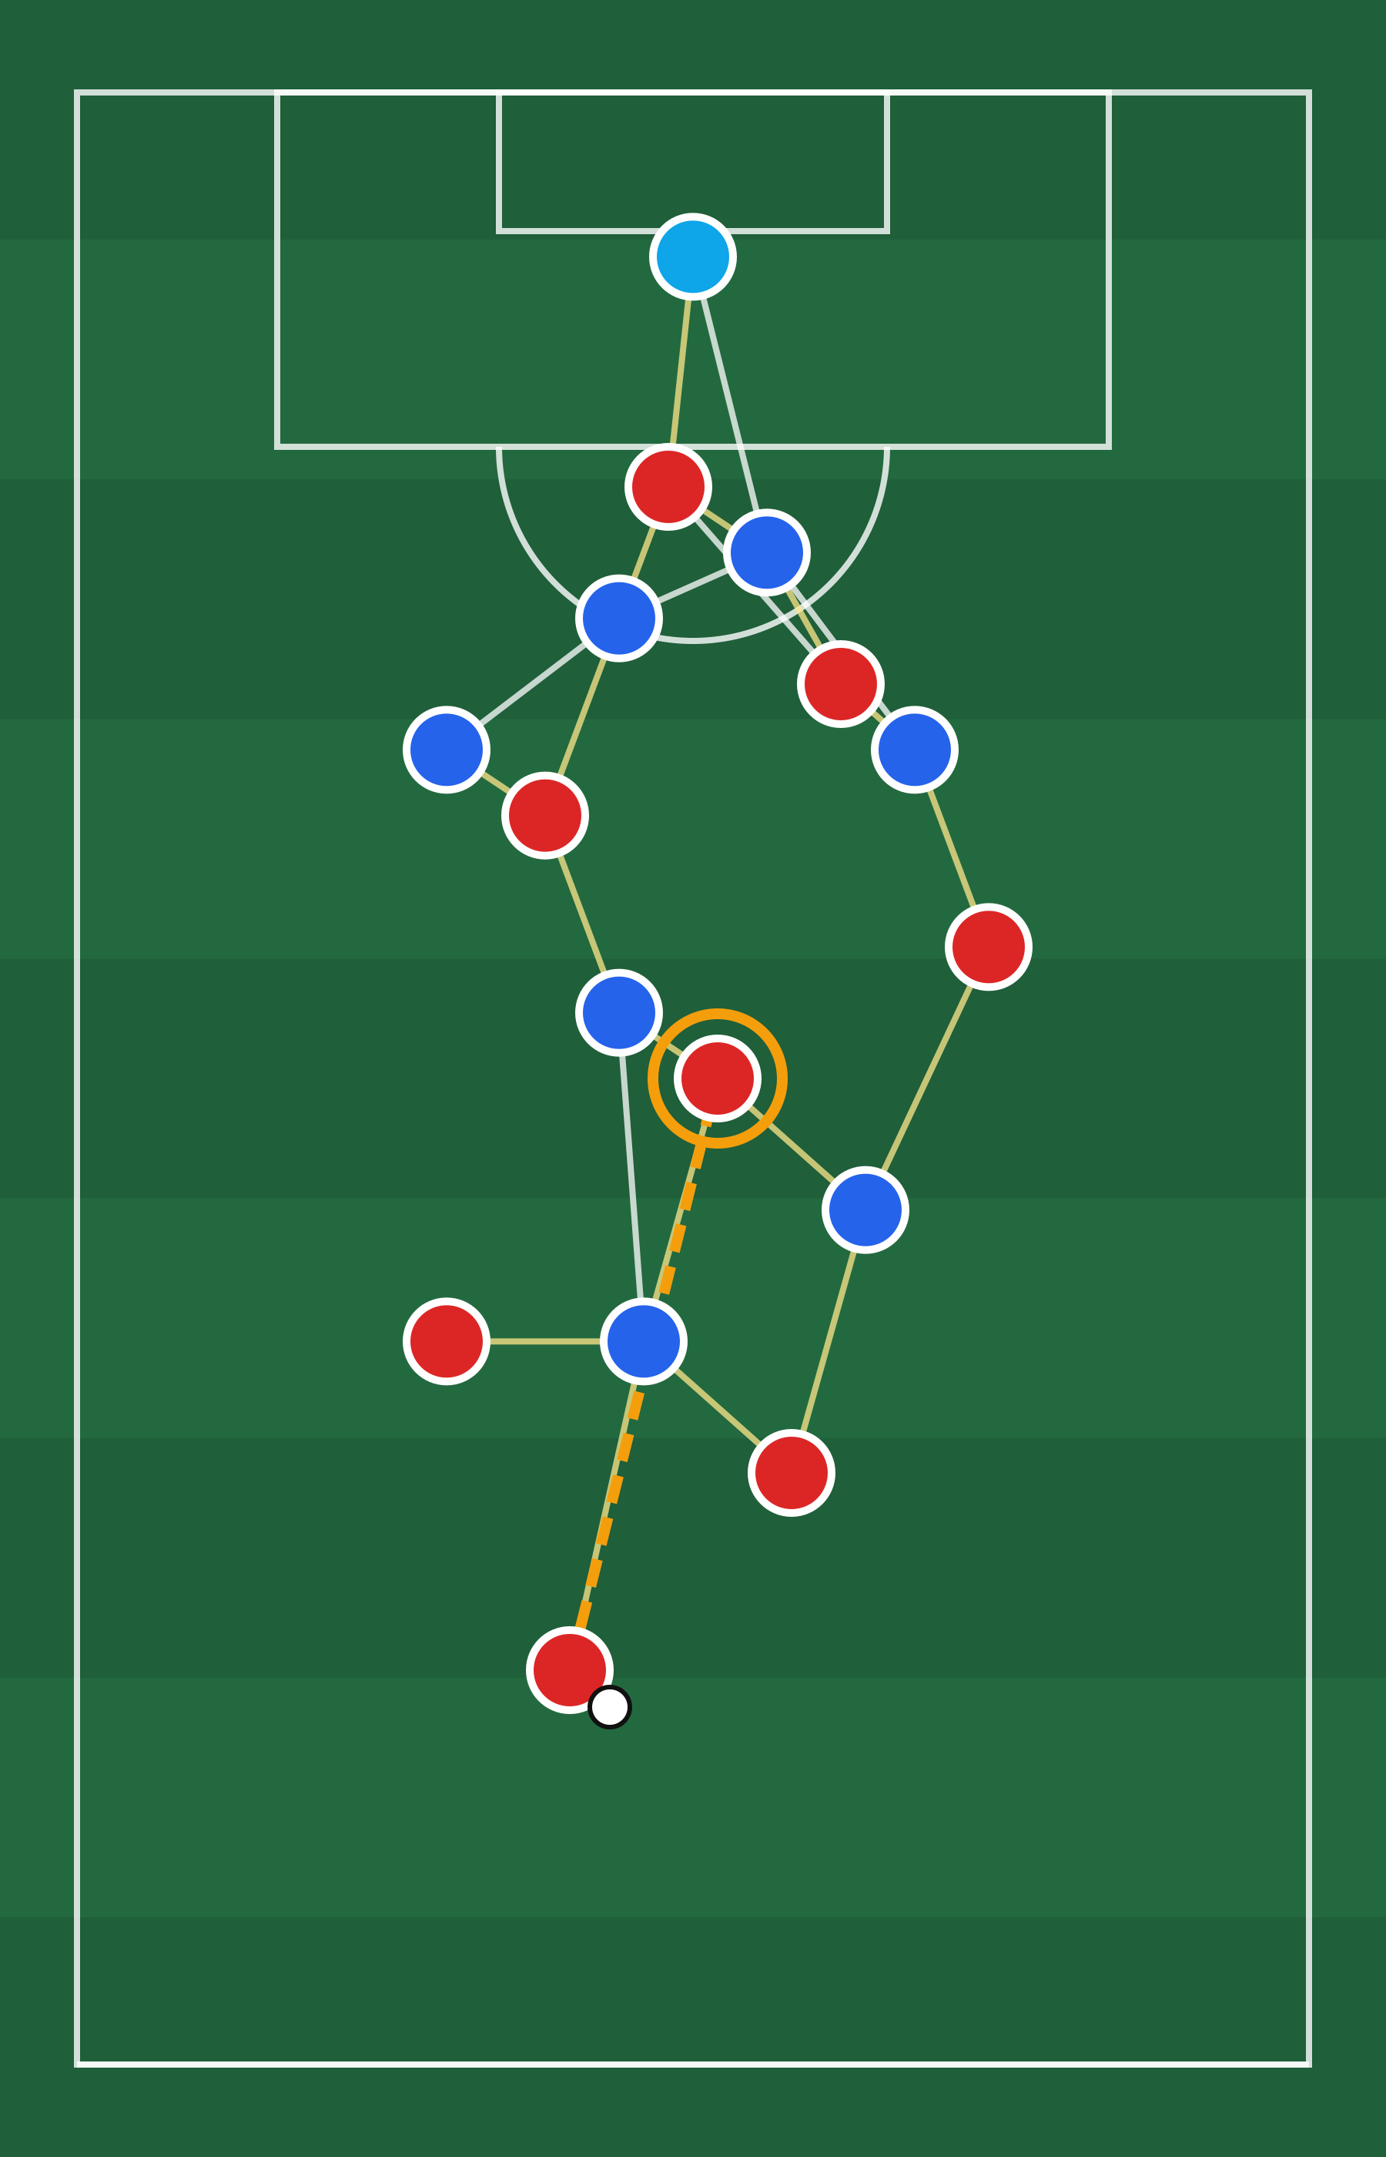



Dynamic Tactical AI
Reading football as a graph:
key tactical states, player interactions and What-If scenarios
Graph Neural Networks
Spatio-temporal AI
What-If simulation
AI Coach Assistant: decision support for football analysts
Research internship proposal · De Vinci Research Center
Researcher
Supervised by
Srinivasan Dhakshanamoorthy
Prof. Ahmed Azough
Confidential — October 2026 · Internship 29 June – 28 December 2026

Slide 2





Why this research
The problem
Tactics are relational
Open play is unsolved
Data is fragmented
Trust is required
Individual statistics miss the structure
Most tactical AI stops at set pieces
Sources disagree on format and quality
Predictions are not recommendations
A press or a passing option is created by several players moving together, not by one player's numbers.
Corner kicks are short and well-defined. Open play changes every few frames and is far harder to model.
Event data, optical tracking, broadcast tracking and simulation differ in coordinates, timing, accuracy and licence.
Outputs must be evaluated against baselines and shown with their uncertainty before analysts can rely on them.
Evidence of the opportunity: TacticAI (DeepMind with Liverpool FC, Nature Communications 2024) showed that graph models can analyse corner kicks and suggest alternatives that expert analysts found useful. The same approach has not yet been established for open play.
Dynamic Tactical AI · DVRC / ESILV
2 / 15

Slide 3
Research foundations
What the literature gives us
TacticAI
Spatio-temporal action detection
Shape graphs
Wang et al. · Nature Communications 2024
Ochin et al. · arXiv 2025
Brandes et al. · npj Complexity 2025
Graph models for corner kicks with predictive and generative heads, judged by expert analysts.
Players as nodes, temporal edges for the same player, proximity edges between players.
Graph description of team shape to infer tactical positions from one instant.
Limited to set pieces
Template for temporal graphs
Basis for team-shape states
Ball–player interaction GCN
GCN · GAT
ST-GCN · T-GCN
Scientific Reports 2025
Kipf & Welling 2017 · Veličković et al. 2018
Yan et al. 2018 · Zhao et al. 2020
Video detection and tracking combined with a GCN over ball–player interaction graphs.
Neighbour aggregation and learned attention over graph edges.
Graph convolution combined with temporal convolution or GRU over sequences.
Optional video-to-graph track
Graph baselines
Temporal extension
Research gap No reproducible open-play pipeline yet defines key tactical states explicitly, tests graph and temporal models against strong baselines, measures robustness to noisy tracking and reports What-If scenarios with uncertainty.
Dynamic Tactical AI · DVRC / ESILV
3 / 15

Slide 4
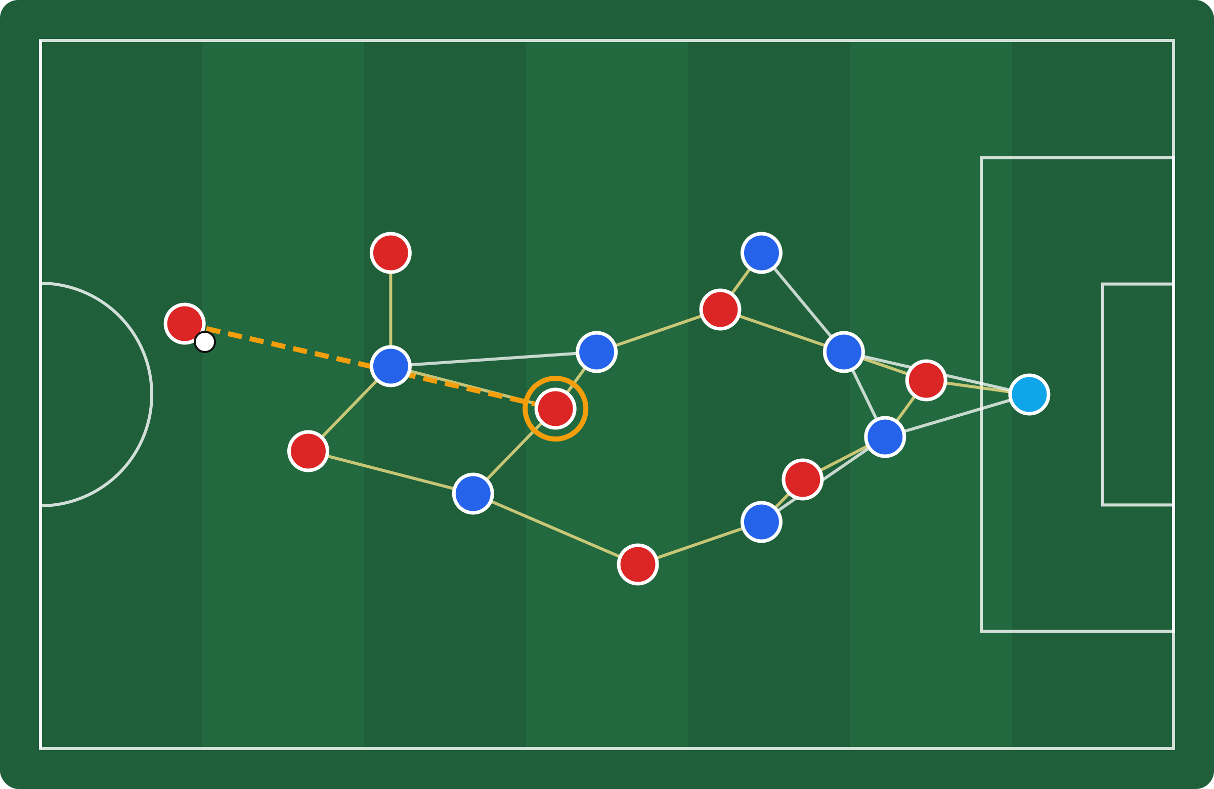
The proposal
AI Coach Assistant
A research pipeline that reads tactical structure from match data
Key Tactical State detection
Possession, pressure, shape, space, transitions
Player-interaction graphs
Players as nodes, relationships as typed edges
Spatio-temporal learning
GCN, GAT and temporal graph models over sequences
Illustrative player graph: attackers (red), defenders (blue), passing lane to a candidate receiver (ring)
What-If scenarios
Controlled positional edits, compared with uncertainty
PRIMARY OBJECTIVE
Robustness by design
Test whether graph structure and temporal context add measurable value for tactical analysis, and present results honestly to analysts.
Noise, missing players and cross-source tests
Analyst-facing output
Pitch visualisations and explainable comparisons
Dynamic Tactical AI
4 / 15

Slide 5
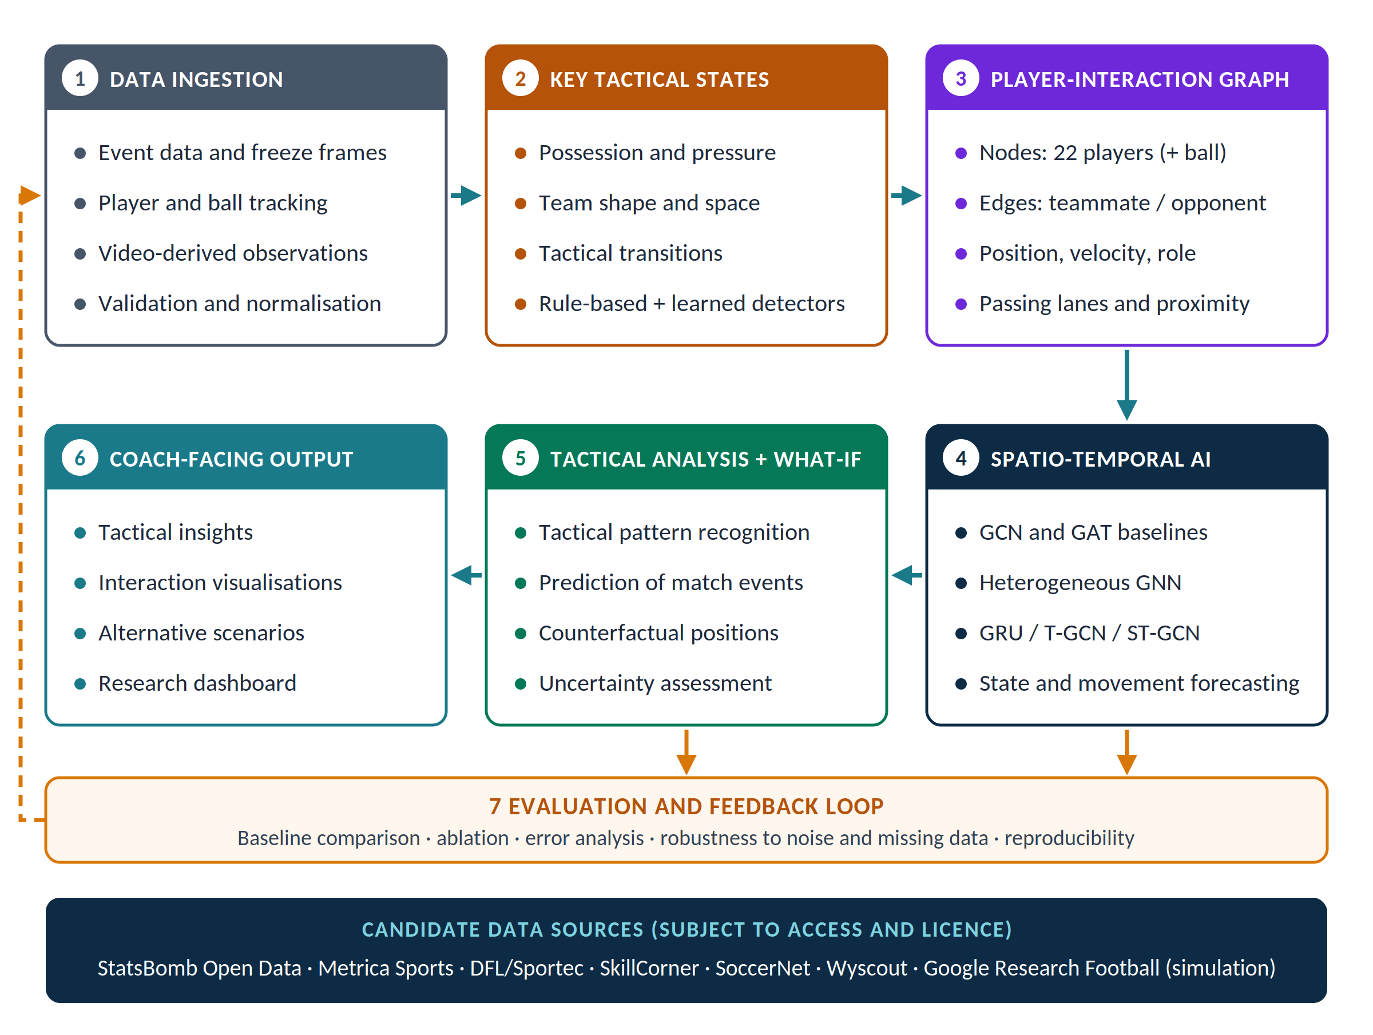
Technical architecture
From match data to tactical insight
Modular
Traceable
Each module has a defined input and output, so a data source or model can be replaced alone.
Observed data, predictions and simulated counterfactuals are always labelled separately.
Dynamic Tactical AI · DVRC / ESILV
5 / 15

Slide 6
Research process
Baseline first, complexity only when it pays
PHASE A · DATA AND STATES
PHASE B · MODELS AND SCENARIOS
Ingest
›
Detect
›
Build
›
Baseline
›
Graph
›
Temporal
›
What-If
match data
key states
graph
non-graph
GCN / GAT
GRU / ST-GCN
scenarios
Load, align and validate one accessible source
Rules first, learned detectors where labels allow
Nodes, typed edges and features per frame window
Rule or feature model sets the reference score
Same split, same metric as the baseline
Adds movement history to the graph model
Edit positions, compare outputs with uncertainty
Is the frame a key tactical state?
Does the model beat the baseline on held-out matches?
Is the What-If result within the data the model has seen?
No: excluded from training, logged for the error review
No: error analysis finds the cause (data, labels, graph or temporal model) and one element is revised
No: reported as out-of-distribution and not interpreted
Every experiment records data version, split, seed, configuration and metrics, so any result can be reproduced and reviewed.
Dynamic Tactical AI · DVRC / ESILV
6 / 15

Slide 7





Layer 2
Key Tactical States: the moments that matter
Possession
Pressure
Team shape
Space
Transitions
Which team controls the ball, for how long, and how many passing options exist.
How closely and from which angle defenders close the ball carrier.
Compactness, width, depth and line spacing of each team.
Open zones between and behind defensive lines.
Switches between attack, defence and counter-attack.
Example features
Example features
Example features
Example features
Example features
carrier, options, sequence length
distance, angle, pressers
centroid, stretch index, lines
pitch control, free area
trigger event, duration
Why key states: most frames in a match carry little tactical change. Selecting the meaningful moments gives the model a focused, labelled dataset and makes errors easier to interpret.
Dynamic Tactical AI · DVRC / ESILV
7 / 15

Slide 8

Layer 3
Every key state becomes a player graph
Nodes
One node per player (optionally the ball): position, velocity, team, role, distance to goal and to the ball.
Edges
Teammate and opponent proximity, plus candidate passing lanes from the ball carrier. A heterogeneous graph keeps the types apart.
Time
A sequence of graphs, one per frame window, feeds the temporal model.
Illustration only: red attackers, blue defenders, yellow cross-team edges, dashed passing lane to the ringed receiver.
Dynamic Tactical AI · DVRC / ESILV
8 / 15

Slide 9
Layer 1
Candidate data sources
7
candidate sources
2
kinds: real matches and simulation
1
accessible source to start
Source | Type | Content | Use in the project | Access
StatsBomb Open Data | Events | Labelled events with freeze frames | First prototype and KTS labels | Open
Metrica Sports | Tracking + events | Synchronised sample matches | Alignment and pipeline tests | Open sample
Google Research Football | Simulation | Physics-based matches, controllable | Synthetic and What-If experiments | Open (not real data)
DFL / Sportec | Optical tracking | High-frequency positions | Precise movement features | To confirm
SkillCorner | Broadcast tracking | Positions from TV footage | Cross-league robustness | Licence needed
SoccerNet / Roboflow | Video + labels | Detection and action annotations | Optional video-to-graph track | Terms vary
Wyscout | Events | Rich event taxonomy | Label enrichment | Subscription
Not every source is weighted equally: real match data and simulated data are never mixed in evaluation, and access and licence are confirmed before any source is used.
Dynamic Tactical AI · DVRC / ESILV
9 / 15

Slide 10
Layer 4
Model ladder: each step must earn its place
Temporal
Hetero-GNN
GRU · T-GCN · ST-GCN
GAT
Typed nodes and edges
Adds how the graph evolves across frames
GCN
Graph attention
Teammate, opponent and passing-lane edges kept apart
Baseline
Graph convolution
Learns which neighbours matter most
Rules or aggregated features
Neighbours share information equally
Reference score without any graph
A model is kept only if it beats the previous rung on held-out matches, with the same target, split and metric.
Dynamic Tactical AI · DVRC / ESILV
10 / 15

Slide 11
Feasibility prototype
TacticAI-Lite: first evidence on corner kicks
~500
corner kicks from StatsBomb FIFA World Cup 2018 open data
22
player nodes per graph, proximity edges
+7.8 pts
receiver probability after moving one attacker 5 m toward goal (What-If)
Set-piece task built before the internship to test feasibility. It is context, not a result of this project.
Code: github.com/srinivasand04/tacticai-lite
Dynamic Tactical AI · DVRC / ESILV
11 / 15

Slide 12


Experimental design
How the claims will be tested
RQ1 · Detection
Can key tactical states be detected reliably?
Precision, recall, macro-F1, error review
RQ2 · Graphs
Do graphs beat feature-based baselines?
Same match-level split and metric
RQ3 · Time
Does temporal context help?
Snapshot vs temporal ablation
RQ4 · Robustness
What happens with noisy or missing data?
Controlled noise, missing players, other sources
RQ5 · What-If
Are scenarios interpretable for analysts?
Scenario deltas, uncertainty, analyst review
Hypotheses H1–H3 (graphs capture relations, time helps movement-dependent tasks, noise degrades performance measurably) are tested, not assumed.
Dynamic Tactical AI · DVRC / ESILV
12 / 15

Slide 13
Roadmap
Six months, one question at a time
Starting point: TacticAI-Lite feasibility prototype (complete) and a Google Research Football environment already running locally.
Months 1–2
Month 3
Month 4
Month 5
Month 6
Literature and data
Architecture
Data and key states
Graph and temporal
What-If and report
Paper matrix
Source assessment
Task selected
›
5-layer design
Experiment protocol
GRF environment
›
StatsBomb into pipeline
KTS detector
First baseline
›
GCN / GAT
Temporal extension
Ablations
›
Scenario experiments
Robustness tests
Report, draft paper
Complete
Complete
In progress
Planned
Planned
After the internship: submission to a suitable venue if the results warrant it.
Dynamic Tactical AI · DVRC / ESILV
13 / 15

Slide 14
Why this project
Six commitments for trustworthy tactical AI
1 reference
Match-level splits
Noise · missing data
Baseline first
No leakage
Measured robustness
Every model is compared with a simple rule or feature baseline.
Training, validation and test sets never share a match.
Degradation under imperfect tracking is quantified, not assumed.
Model scenarios
Decision support
Seeds · configs · versions
Honest What-If
Analyst in the loop
Reproducible
Counterfactuals are labelled as model outputs, with uncertainty.
The system informs analysts; it never directs players.
Every result can be rerun; negative results are kept.
Dynamic Tactical AI · DVRC / ESILV
14 / 15

Slide 15



Team
Project team
Prof. Ahmed Azough
Srinivasan Dhakshanamoorthy
Data or club partner
Principal Investigator
Research intern
To be confirmed
De Vinci Research Center (DVRC), ESILV
MSc Data Engineering & AI, ESILV
Tracking data access and analyst review
ESILV — Parc Campus, Nanterre-Préfecture · Research internship, 29 June – 28 December 2026
Dynamic Tactical AI · DVRC / ESILV
15 / 15

