Slide 1


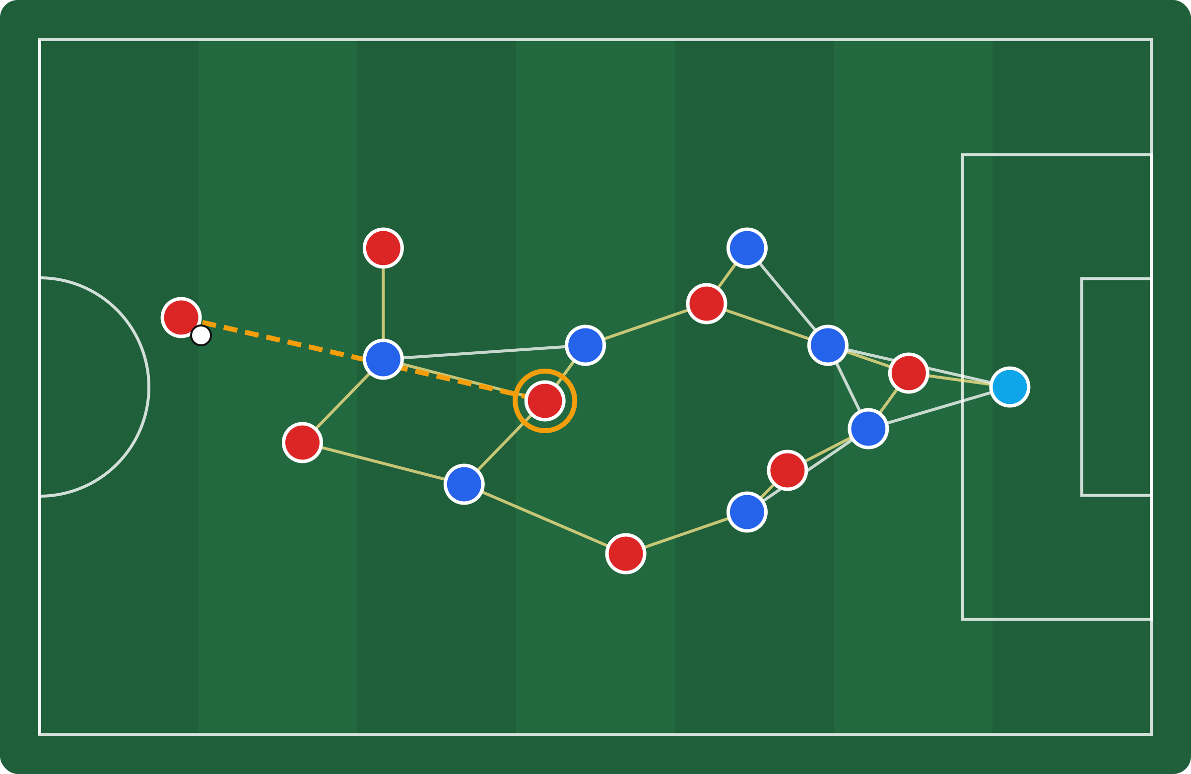
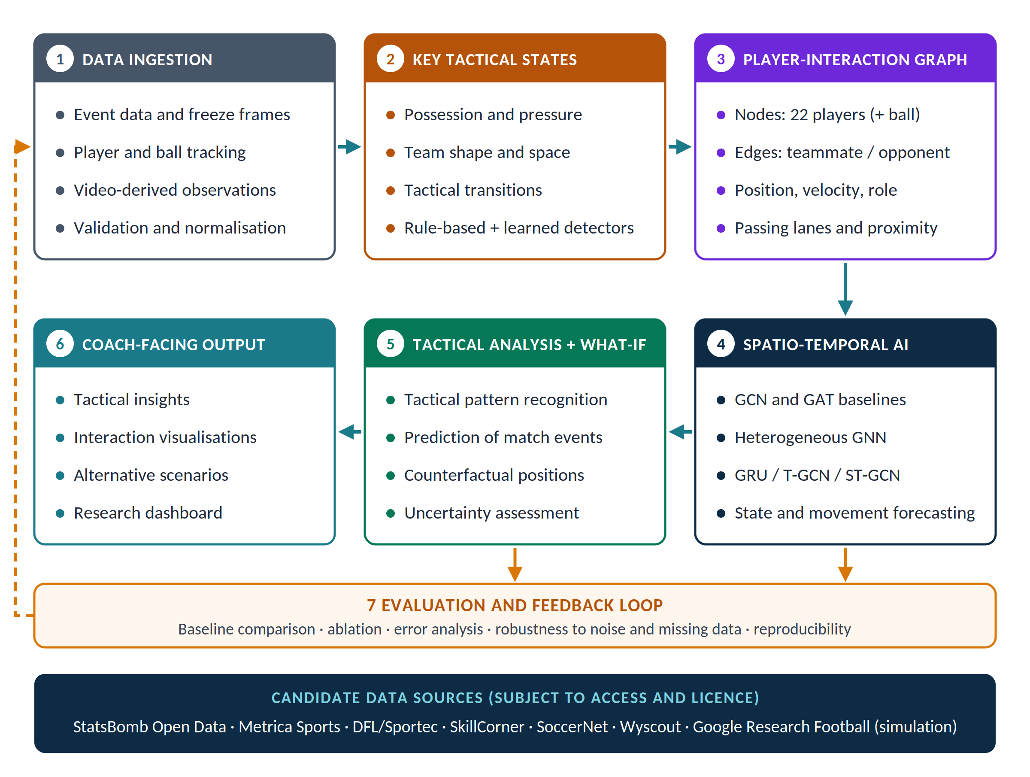
Dynamic Tactical AI in Football: Graph-Based Analysis of Key Tactical States and What-If Scenarios
Reading football as a graph to support analysts with interpretable, evidence-led tactical insights.
Srinivasan Dhakshanamoorthy and Ahmed Azough
De Vinci Research Center (DVRC), ESILV — Parc Campus, Nanterre-Préfecture, France
Context & Challenges
Objectives
Expected Contributions
Research Questions
Tactics emerge from relationships between players, the ball and space
Most tactical AI addresses set pieces; open play remains open
Event, tracking and simulated data differ in format and quality
Predictions need baselines and uncertainty before analysts can trust them
Detect Key Tactical States from match data
Represent each state as a player-interaction graph
Model tactical evolution with spatio-temporal AI
Compare controlled What-If scenarios with uncertainty
Reproducible open-play data pipeline
Operational Key Tactical State taxonomy
Baseline vs graph vs temporal comparison
What-If prototype with stated limits
Can Key Tactical States be detected reliably?
Do graphs beat feature-based baselines?
Does temporal context improve prediction?
How robust is the pipeline to noisy tracking?
Are What-If outputs interpretable?
Global Architecture and Player-Interaction Graph
Illustrative key-state graph
Nodes players (+ ball): position, velocity, team, role
Edges teammate, opponent and passing-lane relations
Time one graph per frame window, fed to the temporal model
Key Tactical States
Possession
Pressure
Team shape
Space
Transitions
Methodology
Feasibility Prototype
Data: StatsBomb open data first; coordinates, timestamps and identities aligned; match-level splits
TacticAI-Lite: ~500 StatsBomb World Cup 2018 corner kicks
Top-1 receiver accuracy vs 9.1% random
What-If: +7.8 pts after a 5 m move
Set-piece feasibility test, not a result of this project
Key states: rule-based detectors for the five state families; learned detectors where labels allow
Graph: heterogeneous player graph with typed edges; features restricted to information available at prediction time
Models: rule/feature baseline, then GCN and GAT, then GRU, T-GCN or ST-GCN for temporal context
Evaluation: precision, recall, macro-F1 or task metrics; ablations; robustness to noise and missing players
What-If: controlled positional edits; output deltas reported as model scenarios with uncertainty
Research Roadmap and Perspectives
Data Sources
Phase 1 · Foundations
Phase 2 · Data and Key States
Phase 3 · Models and What-If
Real matches: StatsBomb, Metrica, DFL/Sportec, SkillCorner, SoccerNet, Wyscout
Simulation: Google Research Football (never used as real-match evidence)
Completed
In progress
Planned
Literature, architecture, GRF environment, TacticAI-Lite
StatsBomb pipeline, key-state detector, first baseline
Graph and temporal models, robustness, What-If, report
Research internship · 29 June – 28 December 2026 · Contact: Prof. Ahmed Azough, DVRC · Prototype code: github.com/srinivasand04/tacticai-lite

