Slide 1




Pushing the Limits of Energy Efficiency for Non-Binary LDPC Decoders on GPUs and FPGAs
Srinivasan Subramaniyan, Oscar Ferraz, Ashuthosh M R‡, Santosh Krishna‡, Guohui Wang†, Joseph R. Cavallaro†, Vitor Silva*, Gabriel Falcao* and Madhura Purnaprajna
Amrita Vishwa Vidyapeetham
*University of Coimbra
‡PES University
†Rice University

Slide 2
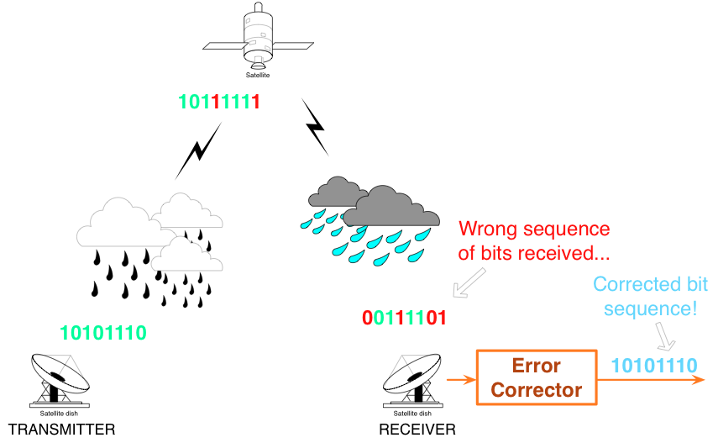
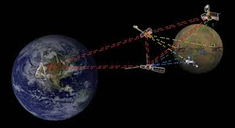
Introduction
Data transmissions are prone to errors
Error Correcting codes helps us to retrieve information
Error correcting codes increase robustness in data transmission

Slide 3
LDPC Codes
These codes were invented by Robert Gallager in his Ph.D. dissertation at M.I.T. in 1960
Operate close to the Shannon limit
Higher BER performance
Galois field arithmetic
Their performance is similar to turbo codes, but they may have some implementation advantages.
More parallelisable compared to Polar codes

Slide 4


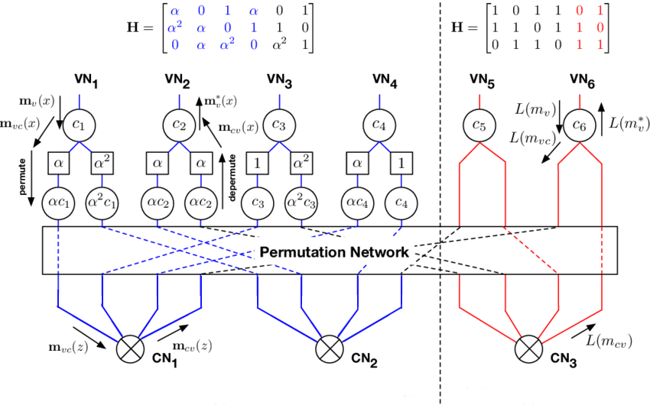
Binary vs Non-Binary

Slide 5
Contribution of the Paper
High throughput GPU NB-LDPC decoder implementation
HLS based design space exploration
Custom RTL implementation
Roofline model-based comparison
Energy efficiency analysis

Slide 6
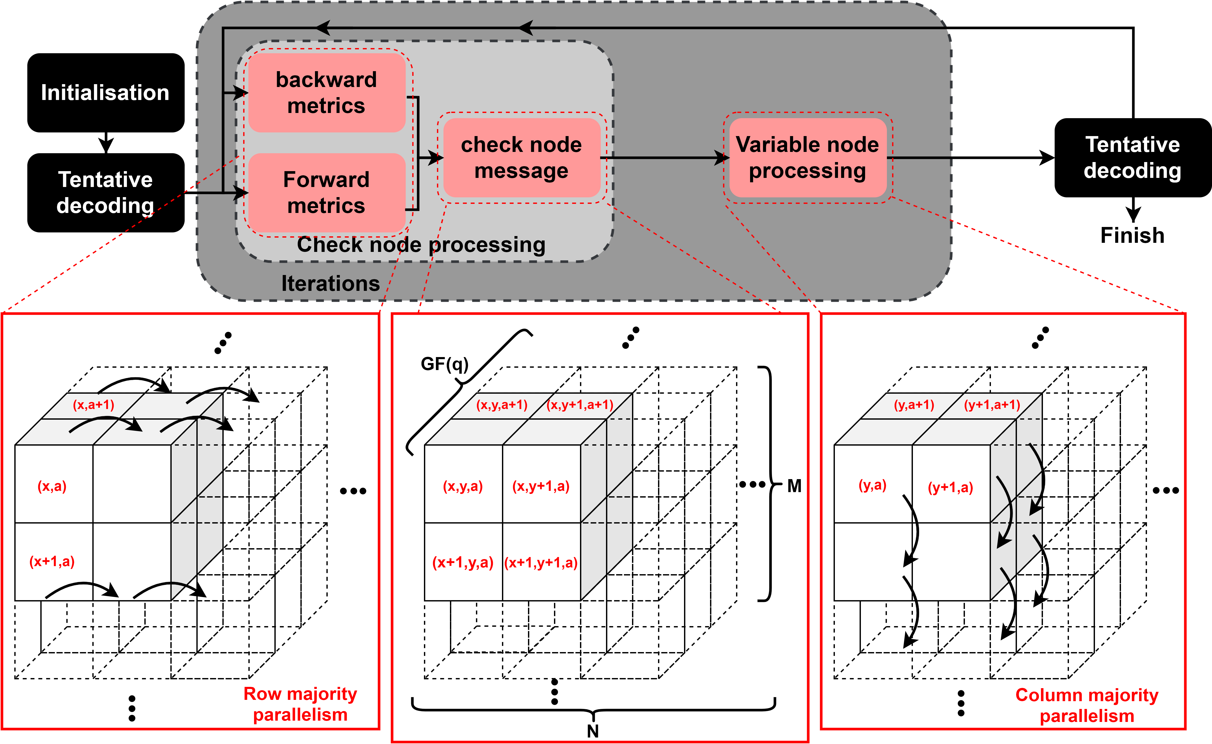

Min-Max Algorithm

Slide 7
Mapping Parallelism On Embedded Devices

Slide 8
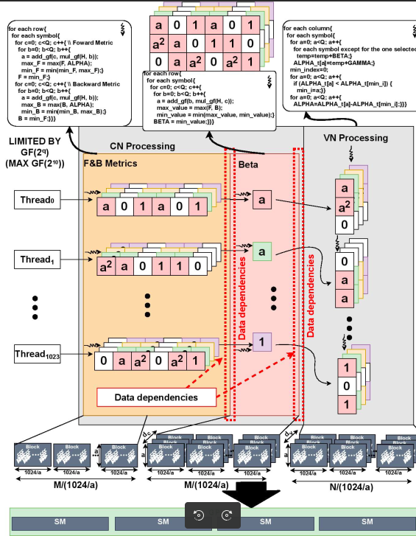
GPU: Multi-threading and fast local memory access
3 Kernels (F&B, CNP, VNP)
Dependencies b/w F & B metrics CNP and VNP Beta kernels
1024 threads
Shared memory implementation
Challenge in scalability

Slide 9
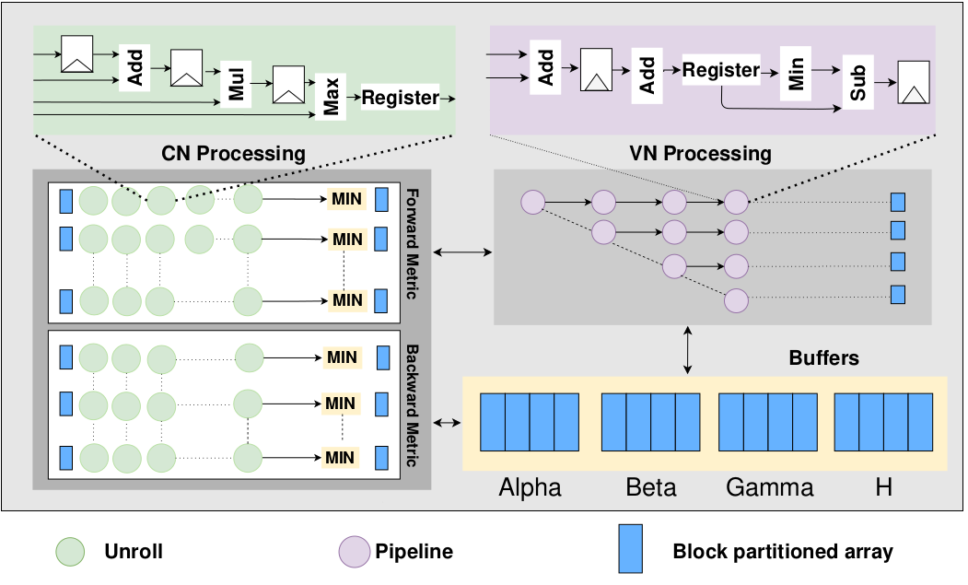
FPGA: HLS Implementation
HLS implementation focused on Low latency and high throughput
Custom bit allocation
Optimising the Galois field operators
Combination of loop unrolling and array partitioning

Slide 10
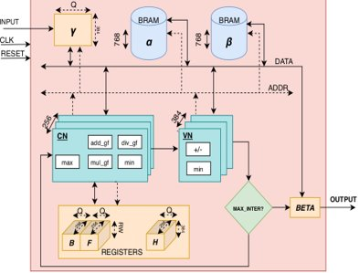
FPGA : RTL Implementation
2 x (a + 1) cycles to assign F&B Metrics
Other columns :(d c −1)×(4+a)
Total no of cycles : 19 + (7 × a)
VNP block is : (a × 3) + (a + 1)
No of cycles for entire design =10 × ((11 × a) + 20)
Arrays are stored in BRAM

Slide 11
Experimental Setup

Slide 12
Design Constraints
10 iterations
H matrix dimmension (256,384)
Regular NB-LDPC code
dc=3
dv=2
SNR= 2db

Slide 13
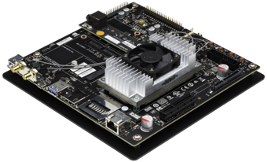
GPU
Jetson TX2 a) ARM Cortex –A57 CPU (4 cores) b) Nvidia Denver 2 CPU (2 cores) c) Nvidia GP10B (256 CUDA cores) d) Power consumption less than 15 W
Implemented in CUDA

Slide 14
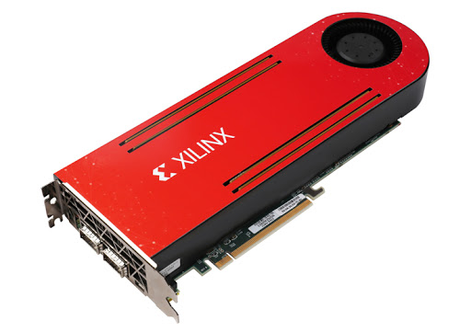
FPGA
Virtex UltraScale+ XCVU13p-FSGA2577-1-i.
Implemented using Xilinx SDSoc 2019.1
Nimbix online platform 192 GB RAM (20 CPU cores)
Overall power consumption less than 15W

Slide 15
Experiments And Results

Slide 16
GPU- Results
Multi-threading , running 1024 in multiple blocks
Shared memory (48KB for each block)
Full shared memory occupancy except for first kernel in GF (4)
Table below shows the variation of throughput vs frequency
Galois Field | Throughput (Mbps) | Frequency(Mhz)
4 | 1.856 | 1300
8 | 2.335 | 1300

Slide 17
FPGA- Description of Optimisations Implemented
m_axi interface is used
8 optimisation strategies were used I) II) III) IV) V) VI)VII) Pipelining the VN & CN with complete array partitioning VIII) I
Index | Description
I | C sequential version
II | Array block partitioning + loop unrolling of inner loops
III | II + pipelining the VN alone
IV | Pipelining the CN alone with complete array partitioning
V | Pipelining the CN + II
VI | Pipelining the CN with complete array partitioning +unrolling inner loops in VN
VII | Implementation using custom bit allocation + using instances + VII

Slide 18
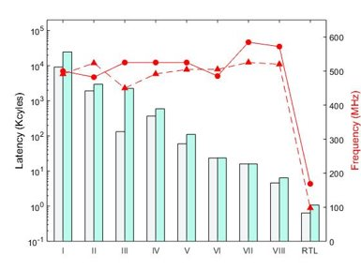
FPGA- Frequency/Latency vs Galois Field

Slide 19
FPGA- Frequency/Latency vs Galois Field
Optimization VIII is the best one for the HLS implementaion • Best Latency is 4.6 K cycles for GF(4) • Best Frequency is 572 MHz for GF(4)
For the RTL implementation • Best Latency is 640 cycles for GF (4) • Best Frequency is 100 MHz for GF (4)

Slide 20
FPGA :Throughput/Power vs Galois Field's

Slide 21
FPGA :Throughput/Power vs Galois Field's
Optimization VIII is the best one for the HLS implementaion • Best throughput was obtained for GF (4) at 95 Mbps • Least power consumption was for GF (4) at 3.4W
For the RTL implementation • Best throughput was obtained for GF(4) at 202 Mbps • Best power was obtained for GF(4) at 9.6 W

Slide 22
Area Utilisation for HLS and RTL implementation
The table list the resource utilisation for FPGAs
Index | GF (4) |  |  | GF(8)
 | BRAM | FF | LUT | BRAM | FF | LUT
I | 18 (0.6) | 3440 (0.1) | 5900 (0.3) | 30 (1.1) | 5721 (0.1) | 8939 (0.5)
II | 23 (0.9) | 8371 (0.2) | 10200(0.6) | 35(1.3) | 11403 (0.3) | 15105 (0.8)
III | 24(0.9) | 9804(0.3) | 11527(0.7) | 36(1.3) | 13856(0.4) | 18895(1.1)
IV | 24(0.8) | 11584(0.4) | 13319(0.7) | 40(1.4) | 22479(0.6) | 32286(1.8)
V | 18(0.8) | 24431(0.7) | 23500(1.3) | 36(1.3) | 34233(0.9) | 44775(2.5)
VI | 24(0.9) | 11458(0.3) | 13034(0.7) | 40(1.4) | 22828(0.6) | 32315(1.8)
VII | 24(0.1) | 11489(0.3) | 13073(0.8) | 40(1.4) | 22999(0.6) | 32649(1.8)
VIII | 48(1.78) | 137508(4) | 637639(38) | 96(3.56) | 275016(8) | 1275278(76)
RTL | 768 (28.6) | 83932(2.7) | 333587(19) | 768(28.6) | 188586(5.46) | 1380989(80)

Slide 23
Roofline model analysis
HLS falls between GPU and RTL

Slide 24
Energy consumption and Efficiency
FPGA has the highest efficiency among CPU&GPU
Among the FPGA implementations • RTL has the best Energy consumption for GF (4) • RTL has the best Efficiency for GF (4)
 | Energy consumption (uJ) |  |  |  | Efficiency (Mbps/W)
Galois Field | CPU | GPU | HLS | RTL | CPU | GPU | HLS | RTL
GF (4) | 5180 | 2068 | 73 | 34 | 0.15 | 0.37 | 10.22 | 22.16
GF(8) | 16390 | 2465 | 136 | 126 | 0.07 | 0.47 | 8.42 | 9.14

Slide 25
Conclusion and future work
Multiple decoders were instantiated in parallel to exploit parallelism
For GF(4) we were able to replicate 4 cores resulting in a throughput of 800 Mbps
Future work addresses more efficient architectures for higher Galois Fields

Slide 26
Acknowledgement
ECHO is a joint work supported under the Indo-Portugal Bilateral Scientific and Technological Cooperation funded by Instituto de Telecomunicações and Fundação para a Ciência e a Tecnologia in Portugal (UIDB/EEA/50008/2020 and PTDC/ EEI-HAC/30485/2017) and the Department of Science and Technology (INT/PORTUGAL/P-12/2017), Government of India. This work was also supported under “Just-in-time Customisation: Research Platform for Accelerating Algorithms-to-Systems” funded within the Early Career Research Award by Science and Engineering Research Board,India (ECR/2016/001765).

Slide 27
Thank you

