Slide 1



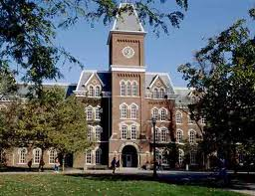
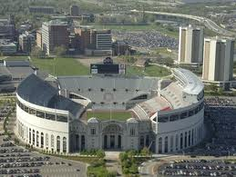
CATS: Correlation-aware Task Scheduling for GPU Power Optimization in AI Data Centers
Srinivasan Subramaniyan and Xiaorui Wang
Dept. of Electrical and Computer Engineering
The Ohio State University

Slide 2



AI Boom Creates a GPU Power Challenge
Explosion of LLMs.
AI services are increasingly delivered through cloud GPU data centers.
Demand for GPUs is growing at an unprecedented rate.
Why is this a concern?
Modern GPUs are extremely power-hungry.
NVIDIA H100 consumes up to 700 W.
Modern AI data centers deploy hundreds of thousands of GPUs.
Notes:
As a result, AI services are increasingly deployed in cloud GPU data centers, driving an unprecedented demand for GPUs

Slide 3
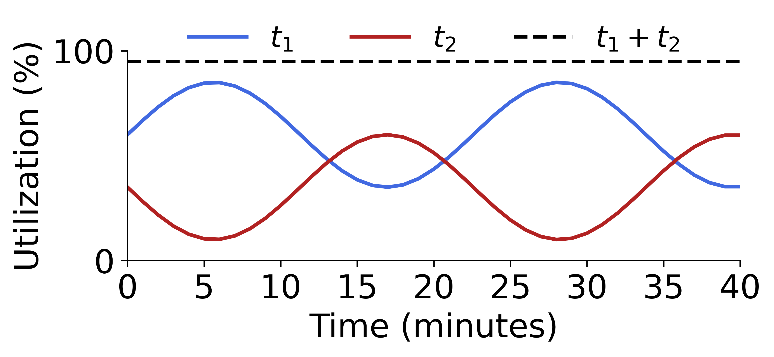
Baselines and Motivation
How can we use fewer GPUs and reduce power consumption?
No Consolidation [OSDI’20]
Distributes tasks to individual GPUs.
Each GPU runs only one job, and at peak frequency.
Example: two GPUs and two tasks.
No Consolidation
t1
t2
Task type | Training
Memory consumption (GB) | 12 | 10
Average GPU utilization (%) | 52.23 | 42.27
t1
t2
GPU 1
GPU 2
Notes:
Existing schedulers typically assign one training job to each GPU using conservative utilization estimates, such as peak or average utilization. Let’s first consider the baseline approach shown here.
Without task consolidation, each training job is assigned to its own GPU. As shown on the right, task t₁ runs on GPU 1, while task t₂ runs on GPU 2. However, if we look at the utilization traces at the bottom, we notice that neither workload fully utilizes its GPU. Their utilization varies over time, with periods when one workload is busy while the other is relatively idle.
As a result, both GPUs remain powered on even though a significant portion of their capacity is unused. This leads to unnecessary energy consumption.

Slide 4
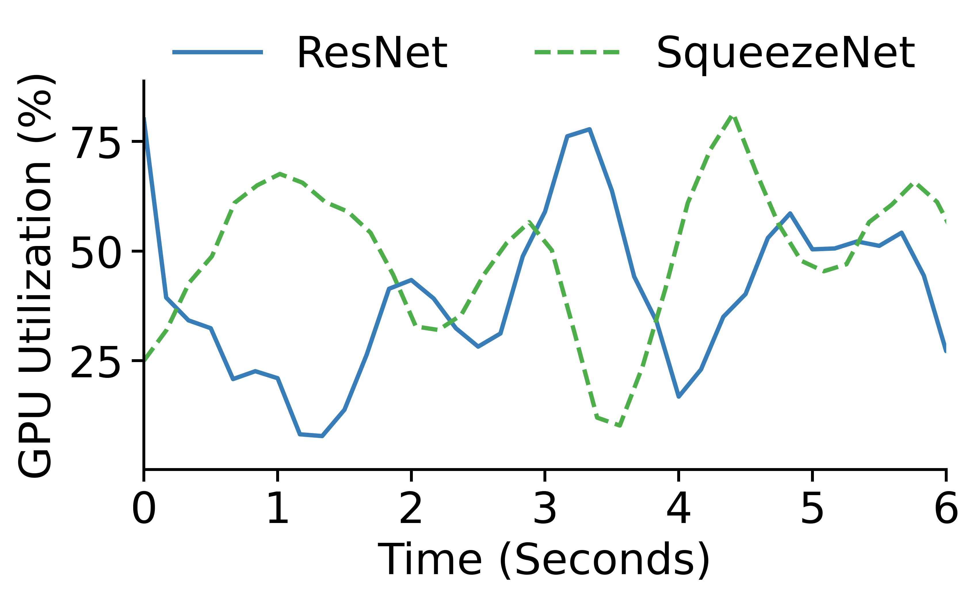
Can we use fewer GPUs and save power?
Task Consolidation
ML workloads have time-varying GPU utilization [IPCCC’25].
Consolidate tasks with complementary GPU utilization.
Example: Consolidate a memory-bound kernel with a compute-bound kernel [EuroSys’24]
Power Savings:
Active GPUs → Dynamic Frequency Scaling (DFS)
Frequency scaling can affect latency [ICPP’25].
Training tasks also have SLAs [SoCC’21].
How do we determine whether the tasks are good candidates for consolidation?
Correlation Analysis
How to apply DFS without SLA violations?
Can we save power from idle GPUs?
Power State Manager
Notes:
Our goal is to reduce GPU power consumption during distributed deep learning training. A common approach is task consolidation, where we pack multiple training jobs onto fewer GPUs so that the remaining GPUs can be turned off.
The key observation that makes this possible is that GPU utilization is highly dynamic over time. As shown in the figure, we plot the GPU utilization of two representative models over a six-second interval. Notice that when one workload is busy, the other is often relatively idle. Because their resource demands complement each other, they can safely share the same GPU with minimal interference. However, this raises an important question. Given two arbitrary training jobs, how do we determine whether they are good candidates for consolidation? Simply looking at average utilization is not enough. Instead, we analyze their utilization traces and use correlation analysis to identify complementary peaks and valleys, allowing us to pair workloads that interfere the least.
So far, we’ve discussed how to consolidate tasks and reduce the number of active GPUs. But what about the GPUs that remain active?
For those GPUs, we apply Dynamic Frequency Scaling (DFS) to further reduce power consumption. However, we cannot simply lower the GPU frequency aggressively because that increases training latency and may violate the service-level agreements required by many training jobs.
This leads to our next challenge: how can we apply DFS to save power while still meeting performance guarantees?
Finally, once consolidation leaves some GPUs completely idle, we place them into low-power sleep states using our Power State Manager, which I’ll describe in the following slides.

Slide 5
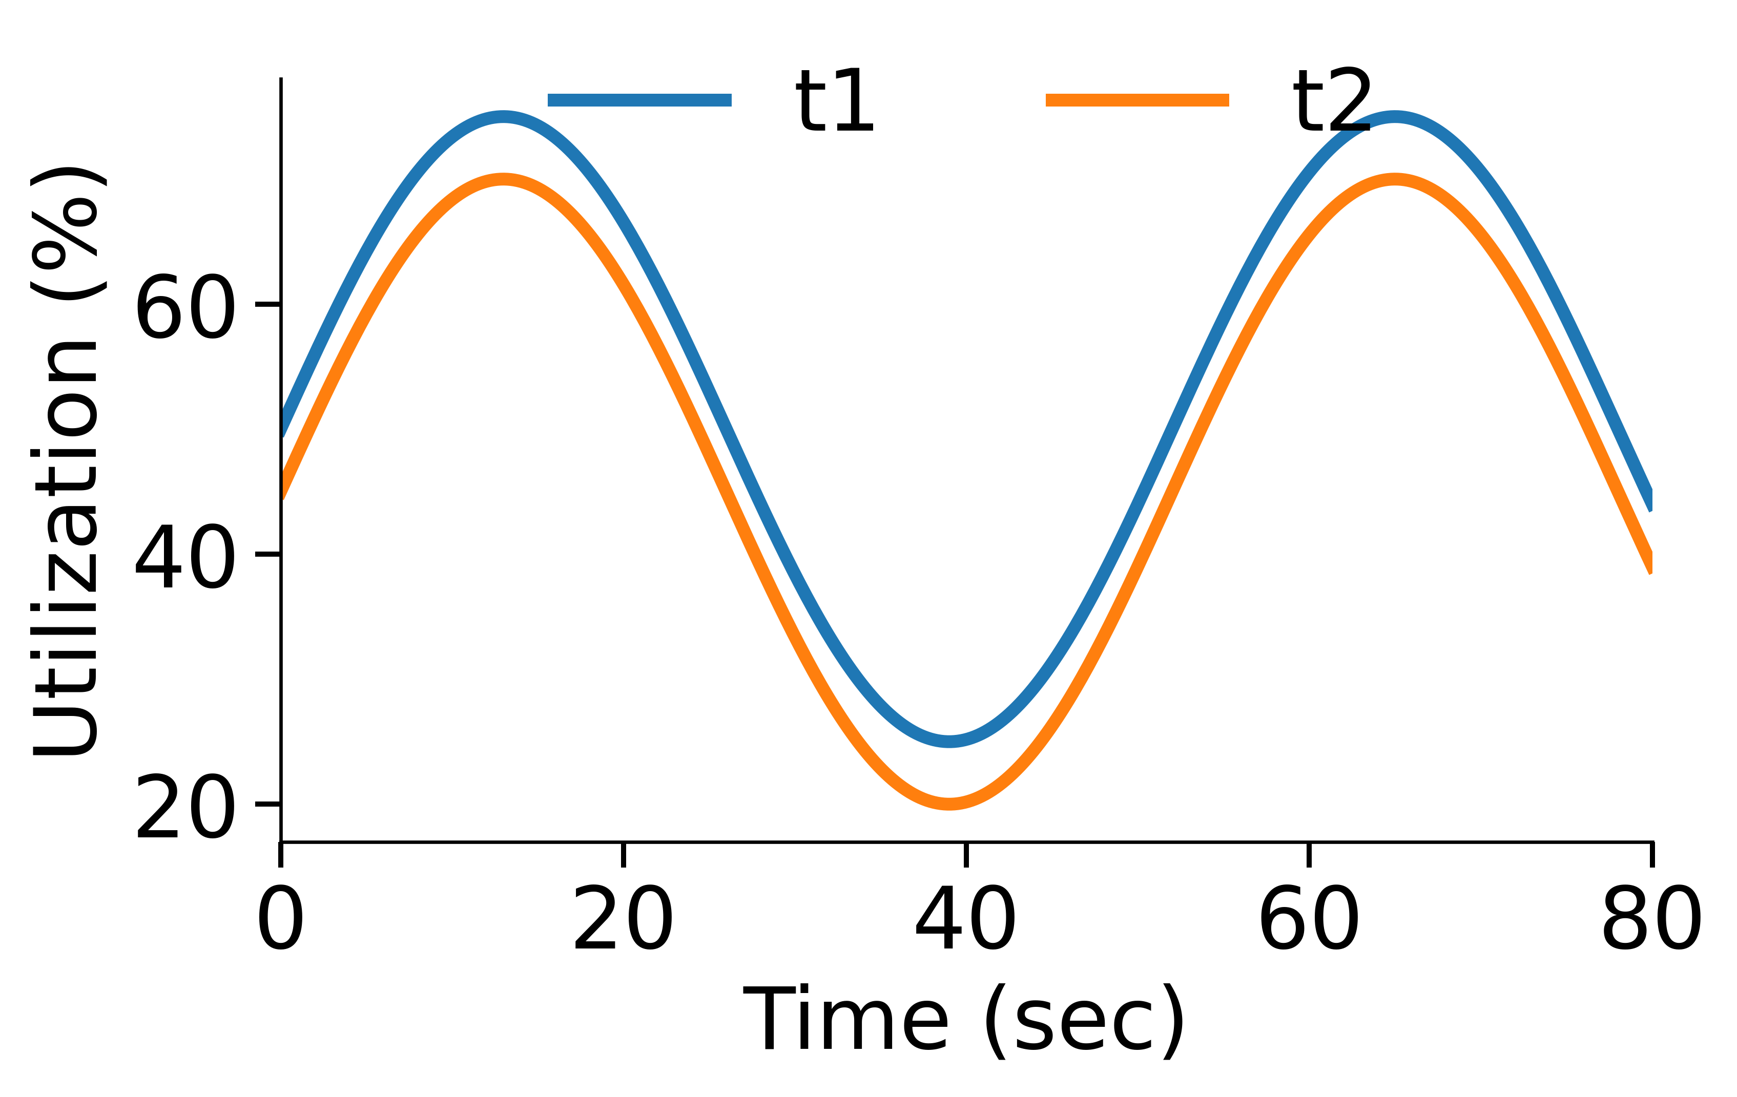
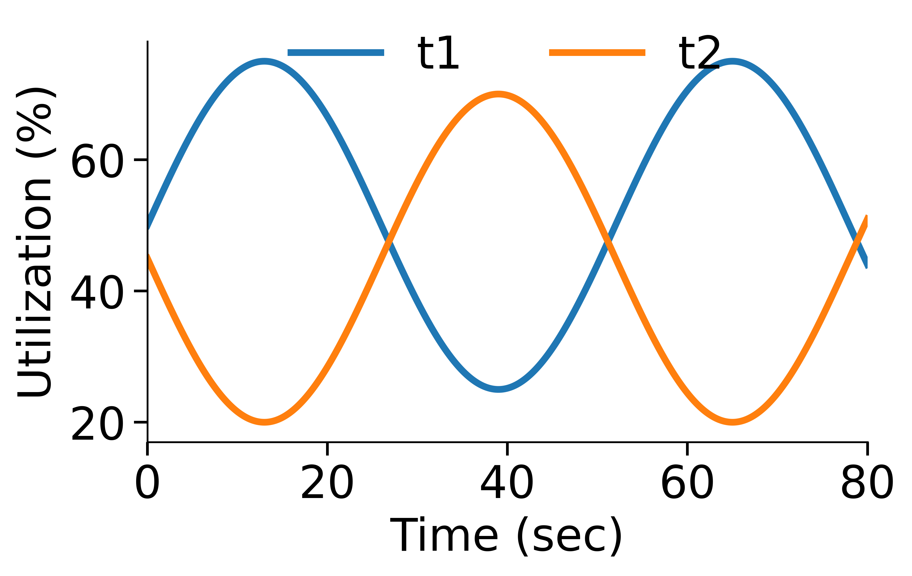
Correlation Analysis
Correlation measures how two variables move together.
For the formal definition, see Equation (15) in the paper.
Positive correlation
Negative correlation
Notes:
“Now let’s look at the first component of our framework: correlation analysis. Correlation simply measures how two workloads change over time. Rather than focusing on the mathematical definition, which is provided in the paper, we use it to understand whether two workloads are good candidates for consolidation.
On the left, we have positively correlated workloads. Notice that both workloads become busy and idle at roughly the same time. If we consolidate these onto the same GPU, they’ll compete for the same resources simultaneously, leading to contention and performance degradation.
On the right, we have negatively correlated workloads. Here, when one workload is busy, the other is relatively idle. Their resource demands naturally complement each other, so they can share the same GPU with much less interference. Therefore, our objective is straightforward: we identify pairs of workloads with negative correlation and consolidate them onto the same GPU. This improves GPU utilization while minimizing performance impact.

Slide 6
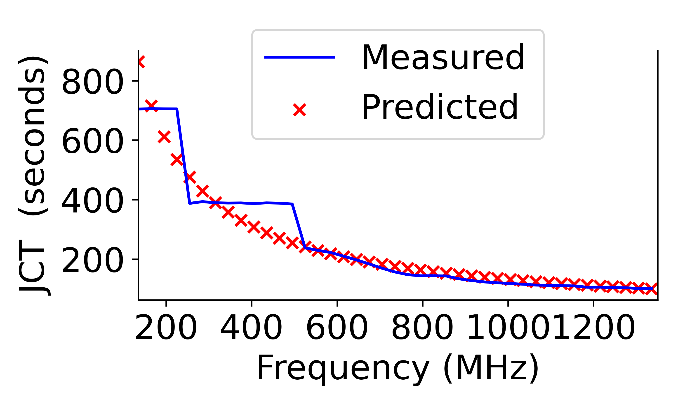
Power State Manager
Active GPUs → DFS
Inactive GPUs → put to a low-power state [AMD arxiv’25].
Frequency
Frequency
GPU
Linear model
SLA
Notes:
“The Power State Manager addresses this problem by reducing the power consumption of both active and idle GPUs.
For active GPUs, we use Dynamic Frequency Scaling (DFS). Instead of always running the GPU at its maximum frequency, we first monitor its current operating frequency and pass this information to a lightweight linear prediction model.
The model also takes the application’s Service Level Agreement (SLA) as input and predicts the application’s execution time at different GPU frequencies.
Based on these predictions, we select the lowest GPU frequency that still satisfies the SLA. This allows us to reduce power consumption while ensuring that the application’s performance requirements are not violated.
For idle GPUs, the solution is straightforward. Once task consolidation frees up a GPU, we transition it into a low-power sleep state, eliminating the idle power that would otherwise be wasted.
Together, these two techniques allow us to save power on both active and inactive GPUs.”

Slide 7
CATS
Correlation Aware Task Scheduling
Consolidate different training jobs on the same GPU
Consolidate tasks with varying GPU utilization using correlation analysis [IPCCC’25].
Correlation = -1
Use DFS with SLA constraints [ICPP’25].
Unused GPUs can be put to sleep.
CATS
t1
t2
Put to sleep
t1
t2
GPU 1
GPU 2
Notes:
“Now that we’ve discussed the individual components, let’s put everything together.
CATS consolidates multiple training jobs onto the same GPU to reduce the number of active GPUs. The first step is identifying workloads with complementary GPU utilization. We do this using correlation analysis, where we look for workload pairs with a correlation close to −1, meaning that when one workload is busy, the other is relatively idle.
In addition, we also consider the characteristics of the workloads. For example, compute-bound and memory-bound kernels tend to complement each other because they utilize different GPU resources and therefore experience minimal interference.
The figure on the left illustrates this idea. Although each workload has varying GPU utilization over time, their combined utilization remains below the GPU capacity, allowing them to safely share the same GPU while satisfying the application’s performance constraints.
As shown on the right, instead of using two GPUs, CATS consolidates both training jobs onto a single GPU and transitions the remaining GPU into a low-power sleep state. This improves GPU utilization while reducing overall power consumption.”

Slide 8



Framework Design
Tasks
Correlation Analysis
Scheduler
GPU Utilization %
GPU number
Power State Manager
Sleep
Periodic Sleep
Data Center
DFS
Frequency Adaptation
Developers
Node 0
Node N
GPU
GPU
GPU
GPU
Notes:
Now let me give you an overview of our framework.
The workflow begins with users submitting deep learning training jobs to the cloud data center. These jobs are then forwarded to our framework for scheduling.
The first component is Correlation Analysis, which analyzes the GPU utilization patterns of the incoming workloads and identifies jobs with complementary resource usage that can safely be consolidated.
These recommendations are then passed to the Scheduler, which determines the placement of training jobs across the available GPUs in the data center. By consolidating compatible workloads onto fewer GPUs, the scheduler reduces the number of active GPUs. Finally, the Power State Manager further improves energy efficiency in two ways. For GPUs that remain active, it applies Dynamic Frequency Scaling to reduce their power consumption while satisfying application SLAs. For GPUs that become completely idle after consolidation, it transitions them into a low-power sleep state.
Together, these three components enable CATS to improve GPU utilization while significantly reducing the overall power consumption of the GPU cluster.

Slide 9
Testbed and Simulation
Testbed: Six Nvidia V-100 GPUs in two servers.
Workloads: DenseNet, GoogleNet, ConvNeXt, ViT, Swin Transformer, ResNet, MobileNet, SqueezeNet.
Metrics: Job Completion Time (JCT), and Power Consumption.
Baselines:
HotCloud: Uses Average Utilization for consolidation [HotCloud’20]
First: Uses first-second utilization for consolidation.
Simulation
Real-world ML trace from Alibaba 6500 GPU cluster [NSDI’22] and Microsoft Philly Trace [ATC’19].

Slide 10
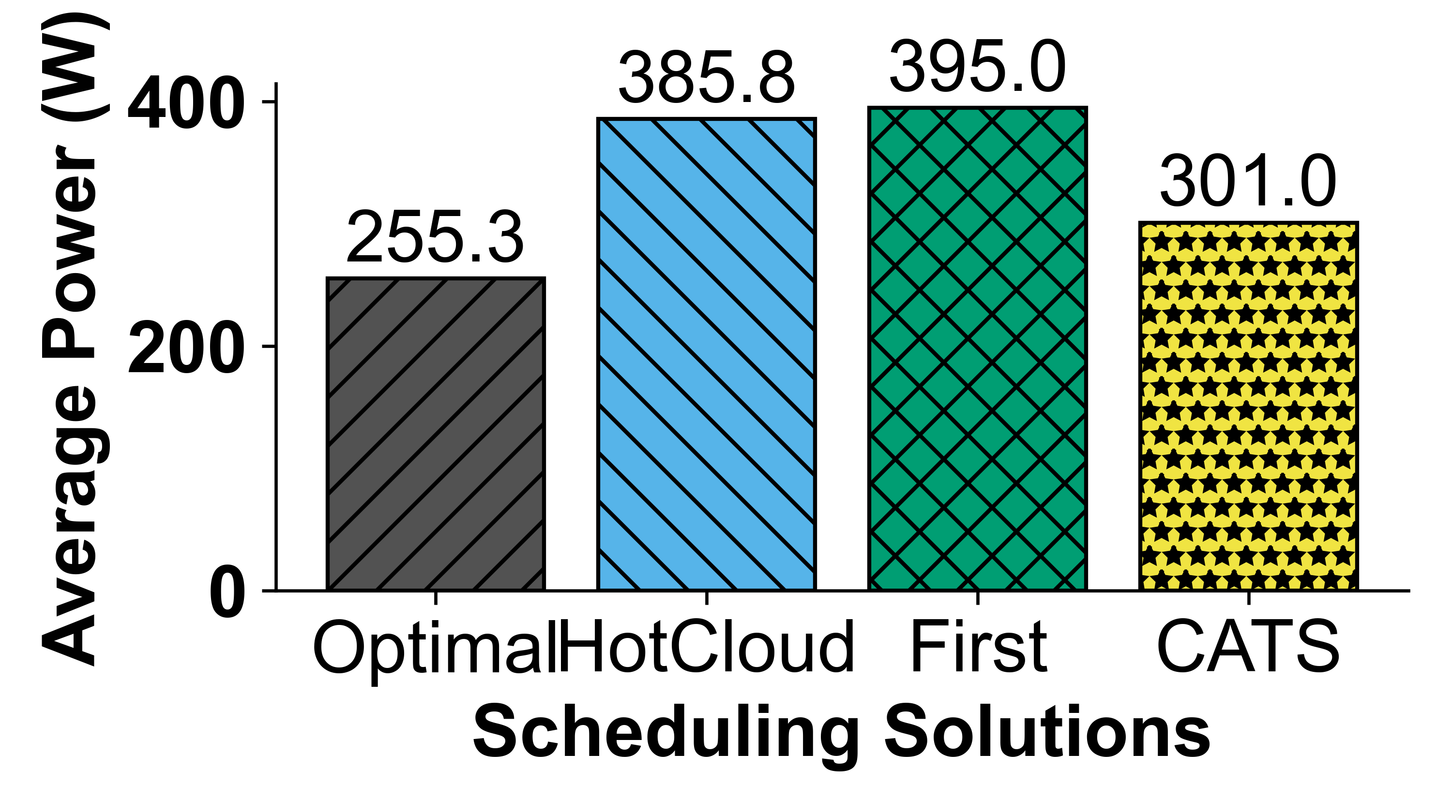
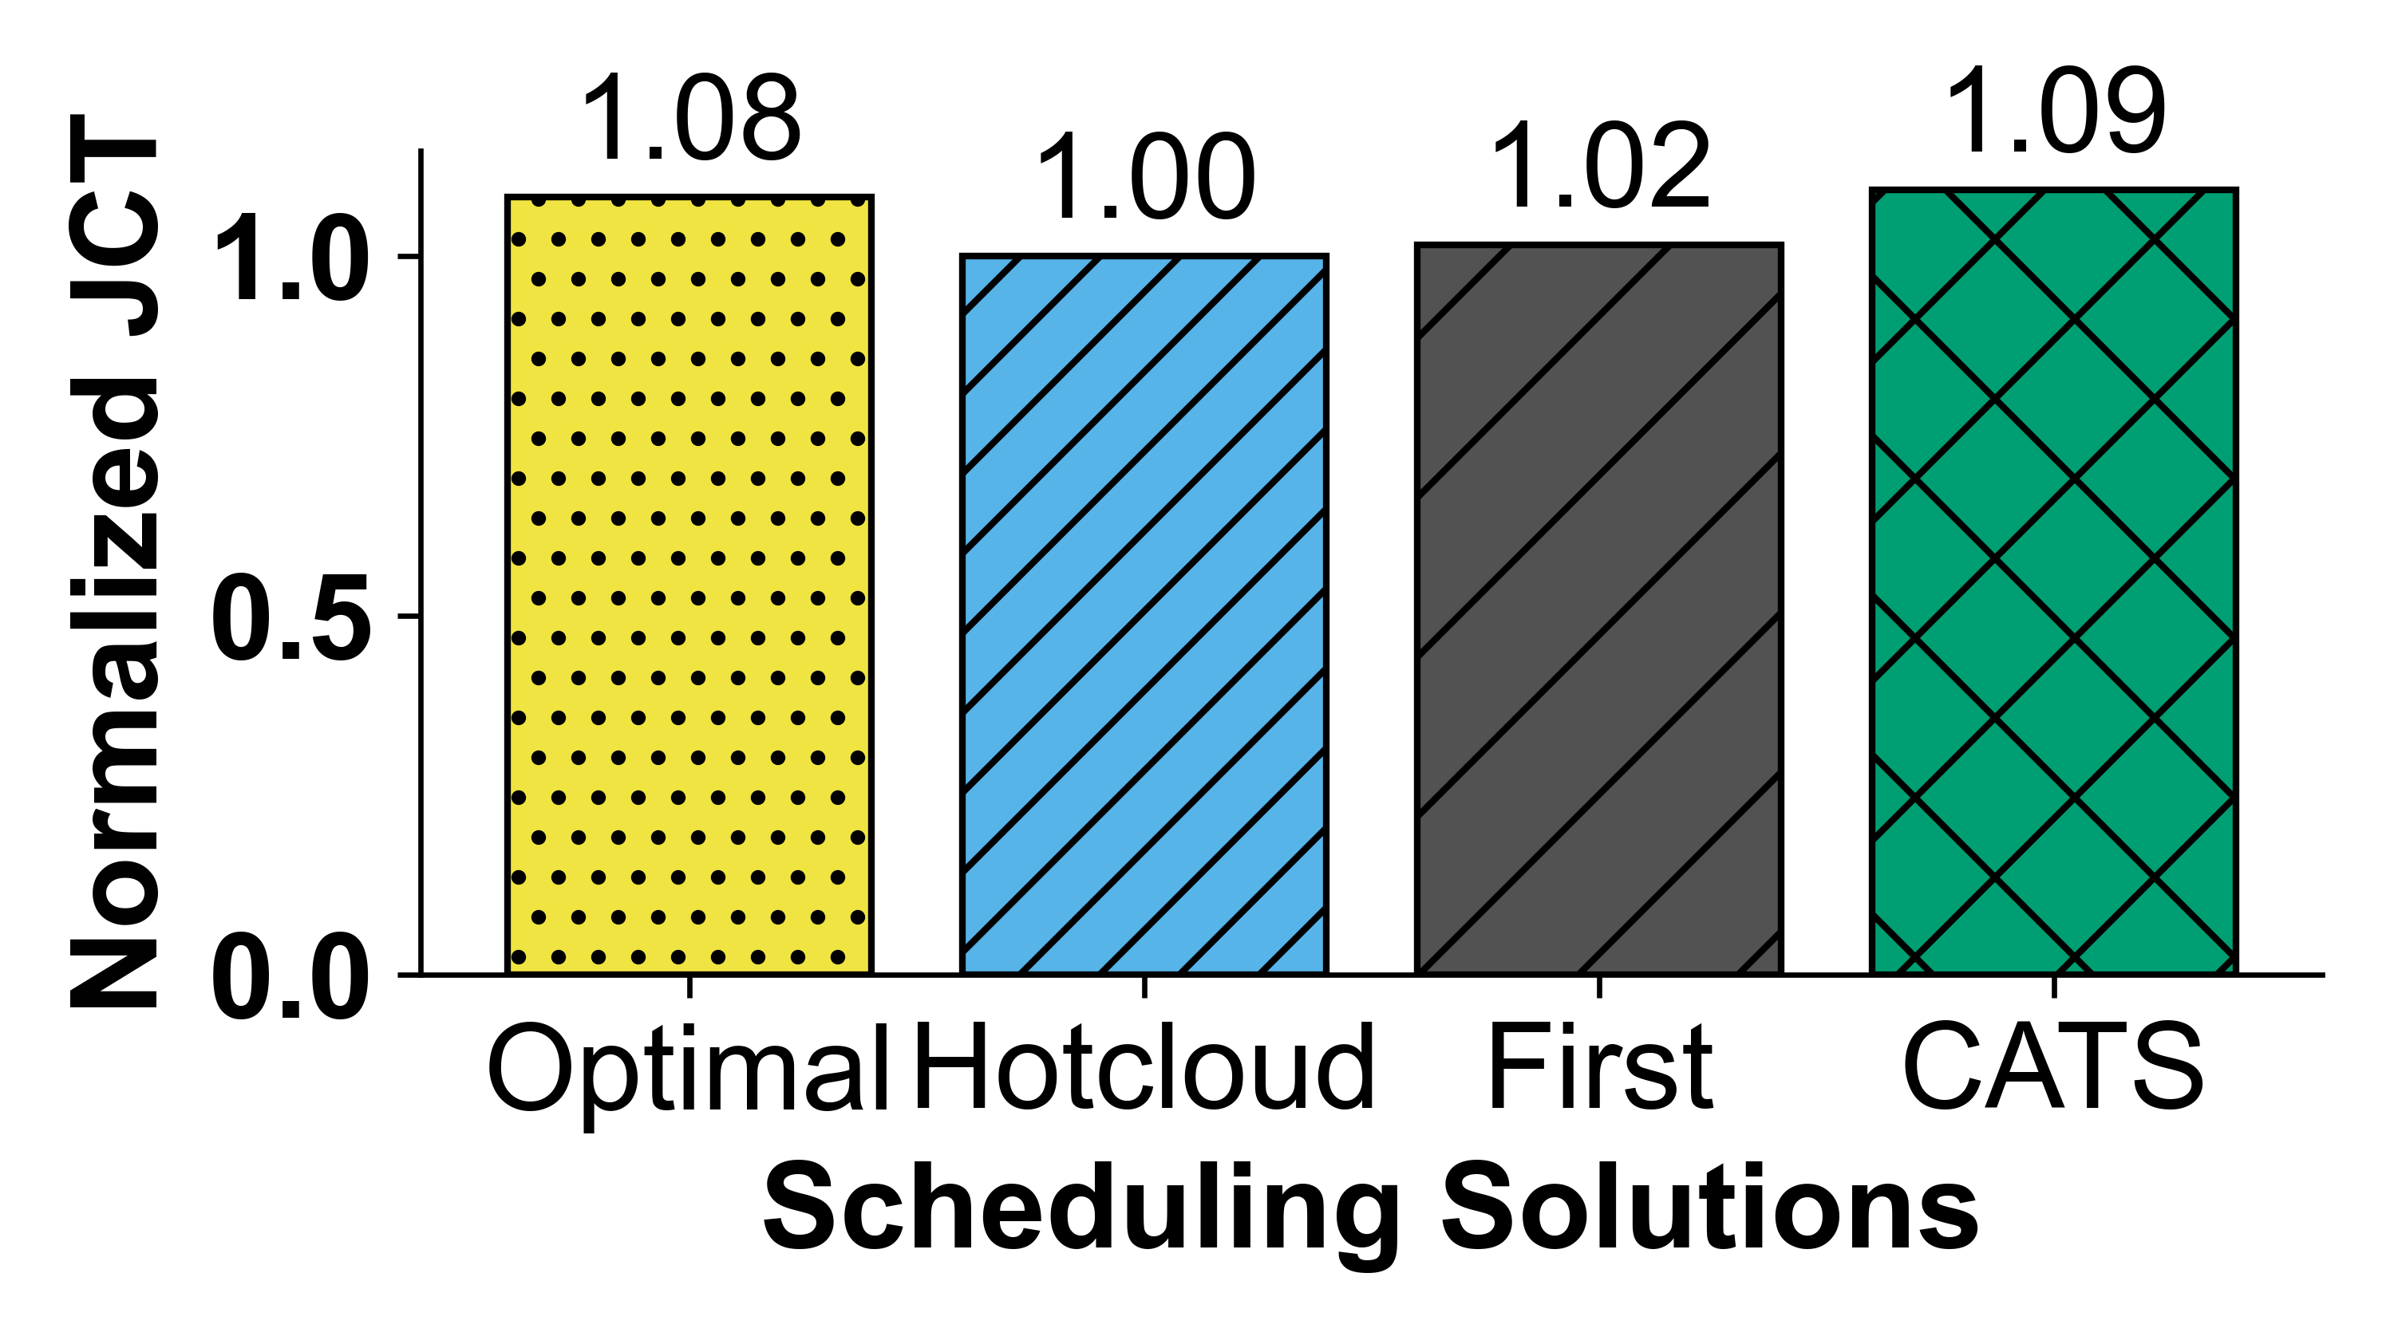
Hardware Evaluation
We evaluate CATS using 14 ML tasks sampled from the PAI trace.
The experiment consists of two stages to emulate bursty task arrivals: 8 tasks in Stage 1 and 6 tasks in Stage 2.
Optimal: Offline oracle (theoretical lower bound on power consumption)

Slide 11
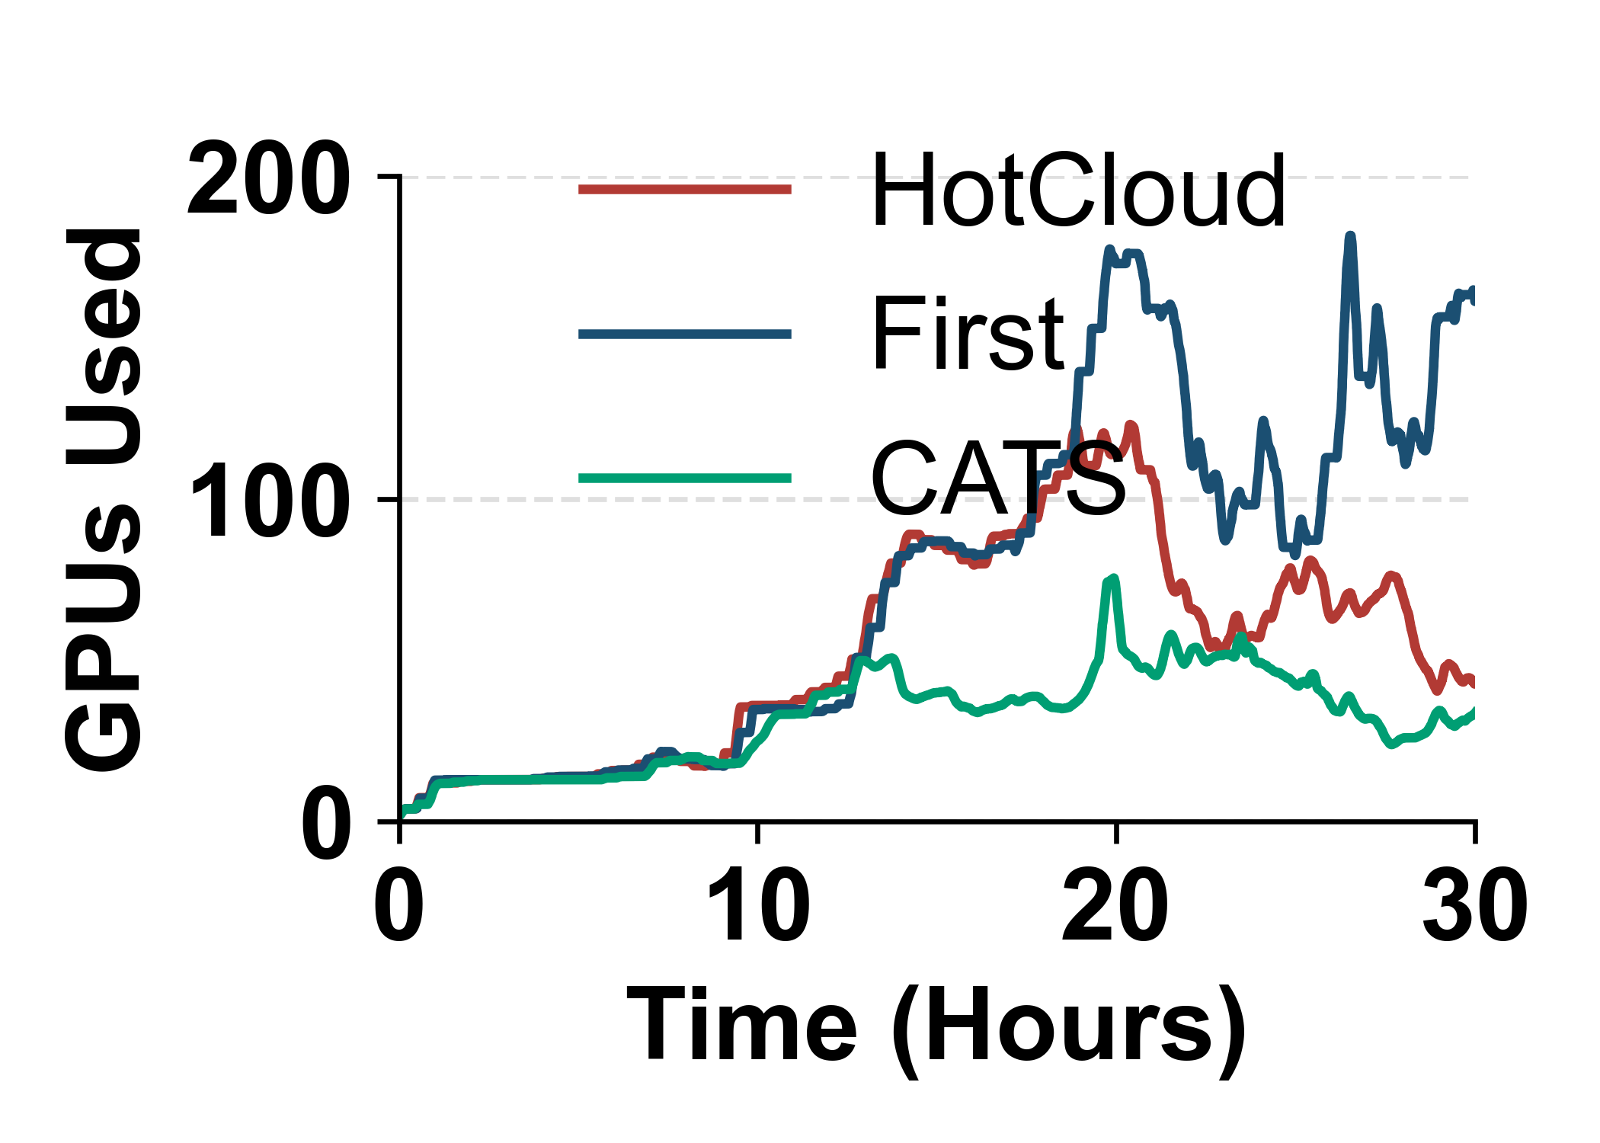
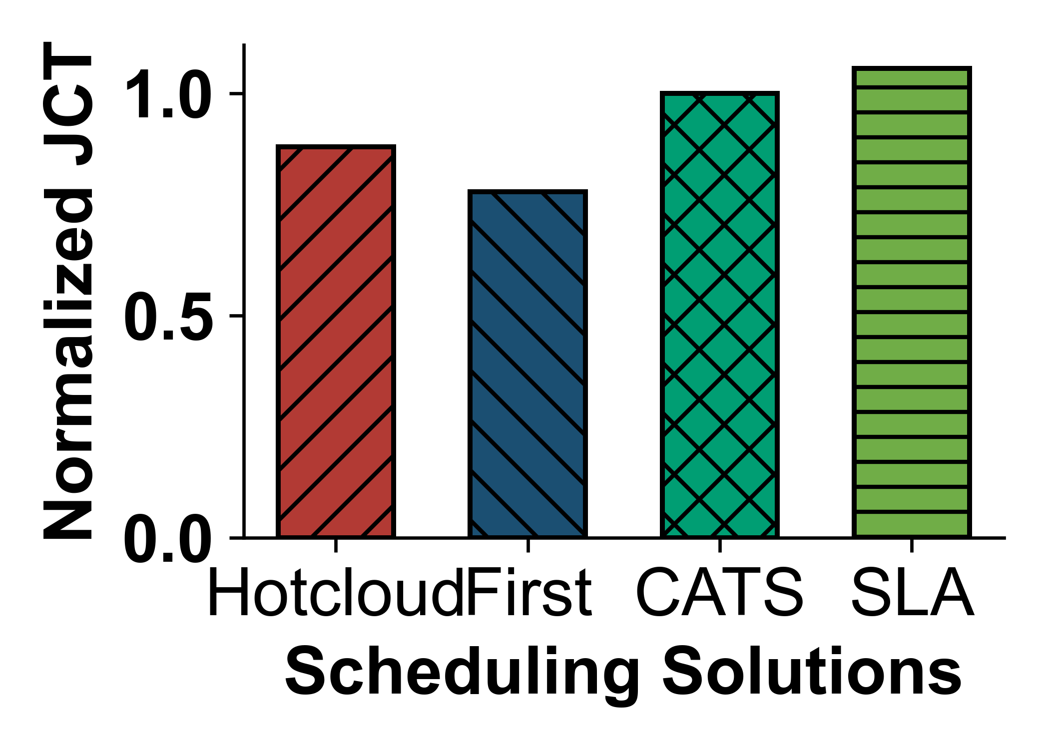
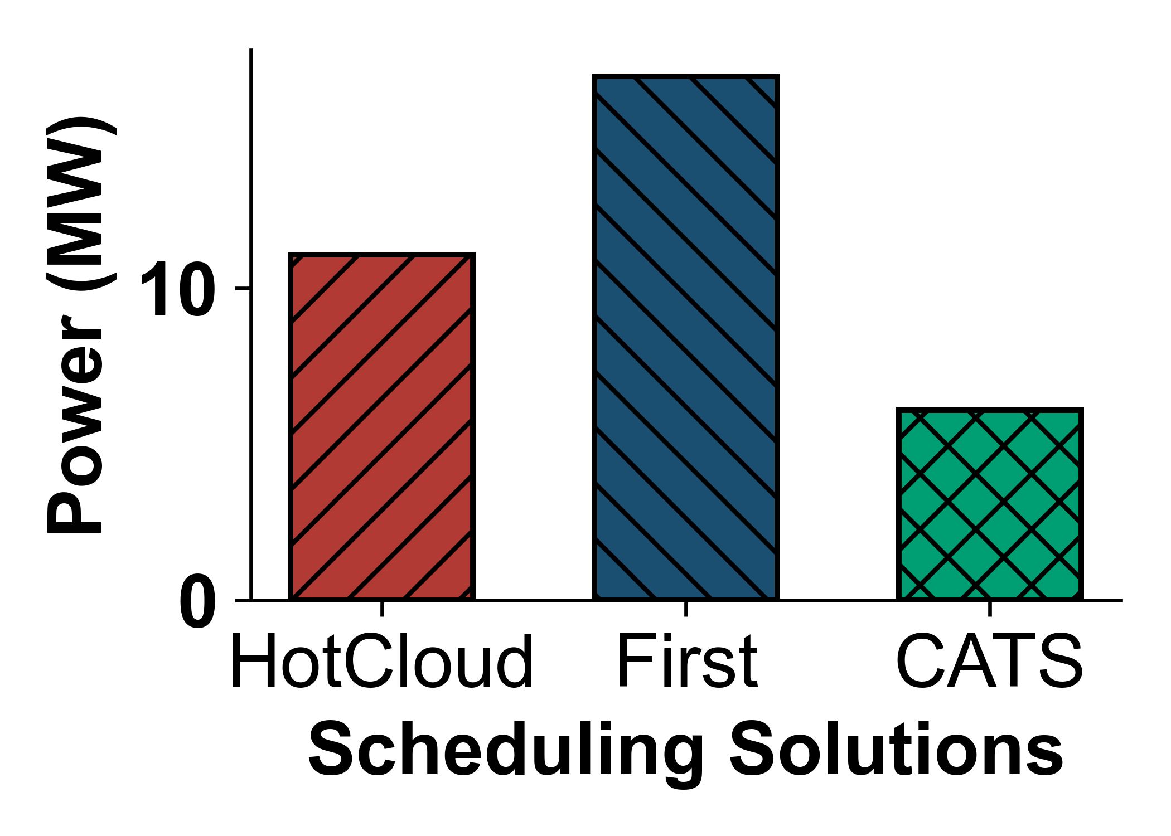
Simulation Evaluation
All GPUs and servers are initially asleep and are activated only when needed.
Idle GPUs and servers are periodically put back to sleep for all methods.
CATS uses the fewest GPUs on average.
CATS keeps the normalized JCT within the SLA threshold.
CATS also uses the fewest servers.
CATS has 63.59% lower power consumption than First.
Additional experiments
Simulation experiments on the Philly trace.
Simulation evaluation of other cluster scheduling solutions.
Overhead of correlation analysis.

Slide 12
Conclusion
AI/ML growth is making GPU power consumption a critical challenge in modern data centers.
ML training tasks often have weak or negative utilization correlations, so they do not always peak at the same time.
We proposed CATS, a correlation-aware task scheduling framework that consolidates training tasks onto fewer GPUs.
CATS saves power by using fewer active GPUs and puts unused GPUs and servers to sleep.

Slide 13

Thanks for your attention!
Q&A
This work is supported, in part, by the U.S. NSF under award CNS-2336886.

Slide 14
Overhead analysis
Samples | 1k | 100k | 1000k
Time (ms) | 0.295 | 1.325 | 12.999
Even with 1 million samples, computing the correlation takes less than 13 ms.
Correlation analysis introduces negligible overhead.

Slide 15
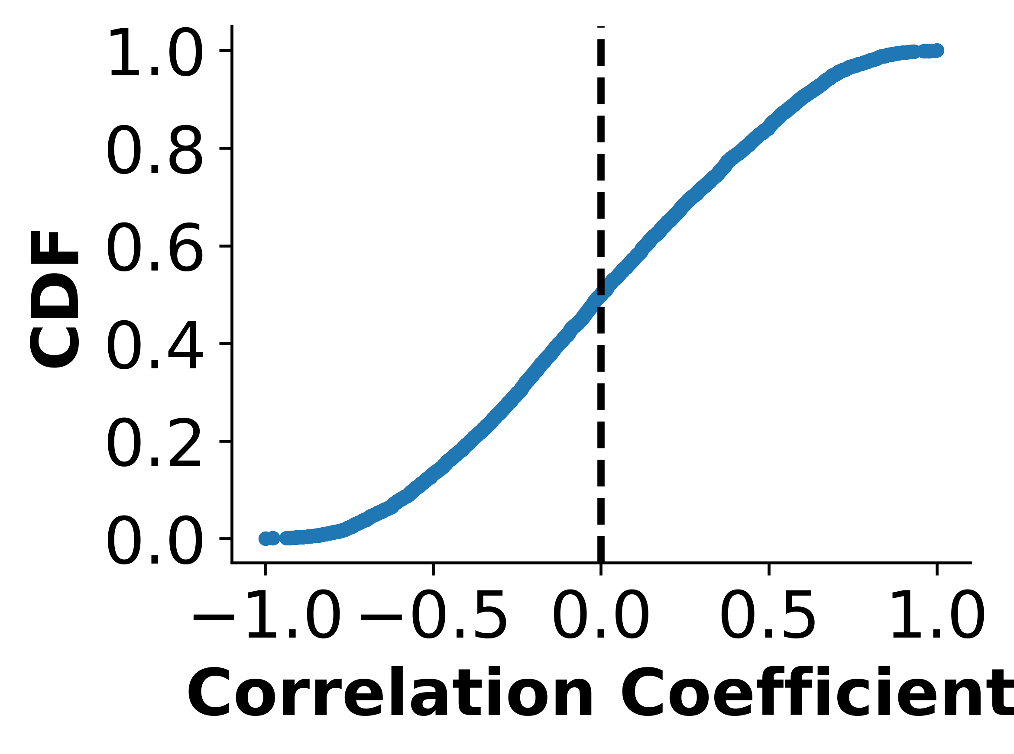
Correlation Analysis on ML traces
Observation 1: The GPU utilization of most training tasks is loosely correlated, so they usually do not peak at the same time.
Philly trace: Production ML training tasks from Microsoft’s GPU data center [ATC’19].
Cluster: Primarily Nvidia P100 GPUs executing ML training tasks.
Sampled tasks: 600 tasks selected from the middle of the trace.
46% of task pairs show negative correlation.
34% fall between 0 and 0.3 (weak positive correlation).

Slide 16
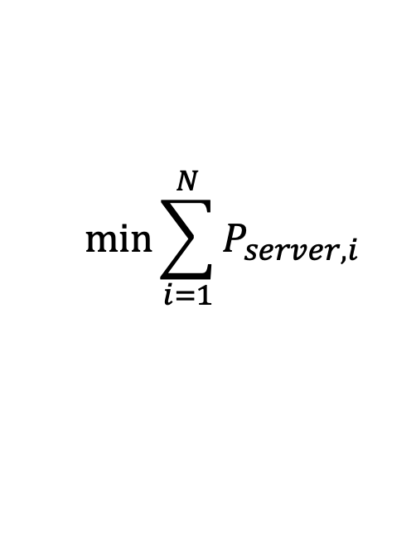
Optimization Problem
Objective: Consolidate complementary ML tasks onto fewer GPUs to reduce power consumption while maintaining acceptable job completion times.
Subject to
Every ML task is assigned to the required number of GPUs.
GPU memory capacity is not exceeded.
Unused GPUs and servers can be put to sleep.
GPU frequency adjustment satisfies the task SLA.
The optimization is NP-hard and quickly becomes impractical for online scheduling (Complete formulation in Section II).
$$min⁡\sum_{i=1}^{N}{P_{server, i}}$$

Slide 17
Consolidation Analysis on ML traces
Philly trace
Most jobs consume significantly less than 16 GB.
GPU memory consumption is fragmented across workloads.
Observation 2: GPU memory consumption is fragmented, providing an opportunity to
consolidate tasks.

Slide 18
Correlation Analysis of ML workloads
Vision : DenseNet, Inception, MobileNet, ResNet, GoogleNet, VGG
Transformer : Swin, GPT-2
Configuration: 80 epochs, with batch sizes of 10-60.
Observation: Most workload pairs exhibit weak or negative correlations, indicating that GPU utilization does not peak at the same time.

