Slide 1




FC-GPU: Feedback Control GPU Scheduling for Real-time Embedded Systems
Srinivasan Subramaniyan and Xiaorui Wang
Dept. of Electrical and Computer Engineering
The Ohio State University

Slide 2
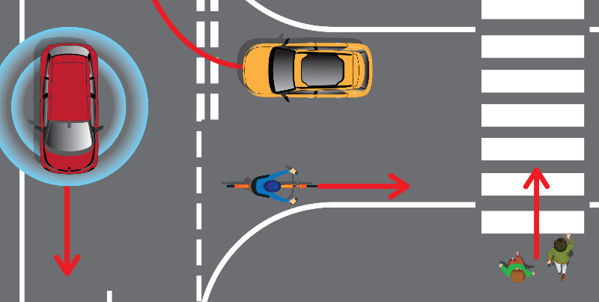


Introduction
GPUs in Real-Time Systems
Autonomous Vehicles: image recognition and path planning.
Drones: real-time object detection.
VR Glasses: real-time processing and rendering.
Existing GPU scheduling solutions:
GPU-TDMh [ICIP’17] : uses time division multiplexing to schedule hard real-time sporadic tasks on a single GPU.
SBEET [RTSS’21] and SBEET-mg [RTSS’22] : real-time frameworks that optimize the energy efficiency of embedded systems.
Padel [IEEE ESL’25]: offline, priority-based GPU scheduler.
Notes:
GPUs are becoming essential in real-time systems because they can process huge amounts of data in parallel. In real-time applications, every millisecond counts, so using GPUs helps meet strict timing requirements.
“In autonomous cars, GPUs are the backbone of image recognition — detecting road signs, pedestrians, and other vehicles. They also support path planning, allowing the vehicle to decide how to steer or brake safely in real-time.
drones, GPUs enable fast object detection. This is crucial for collision avoidance and for tracking moving targets,
So the real challenge is balancing GPU resource allocation with strict timing guarantees.

Slide 3
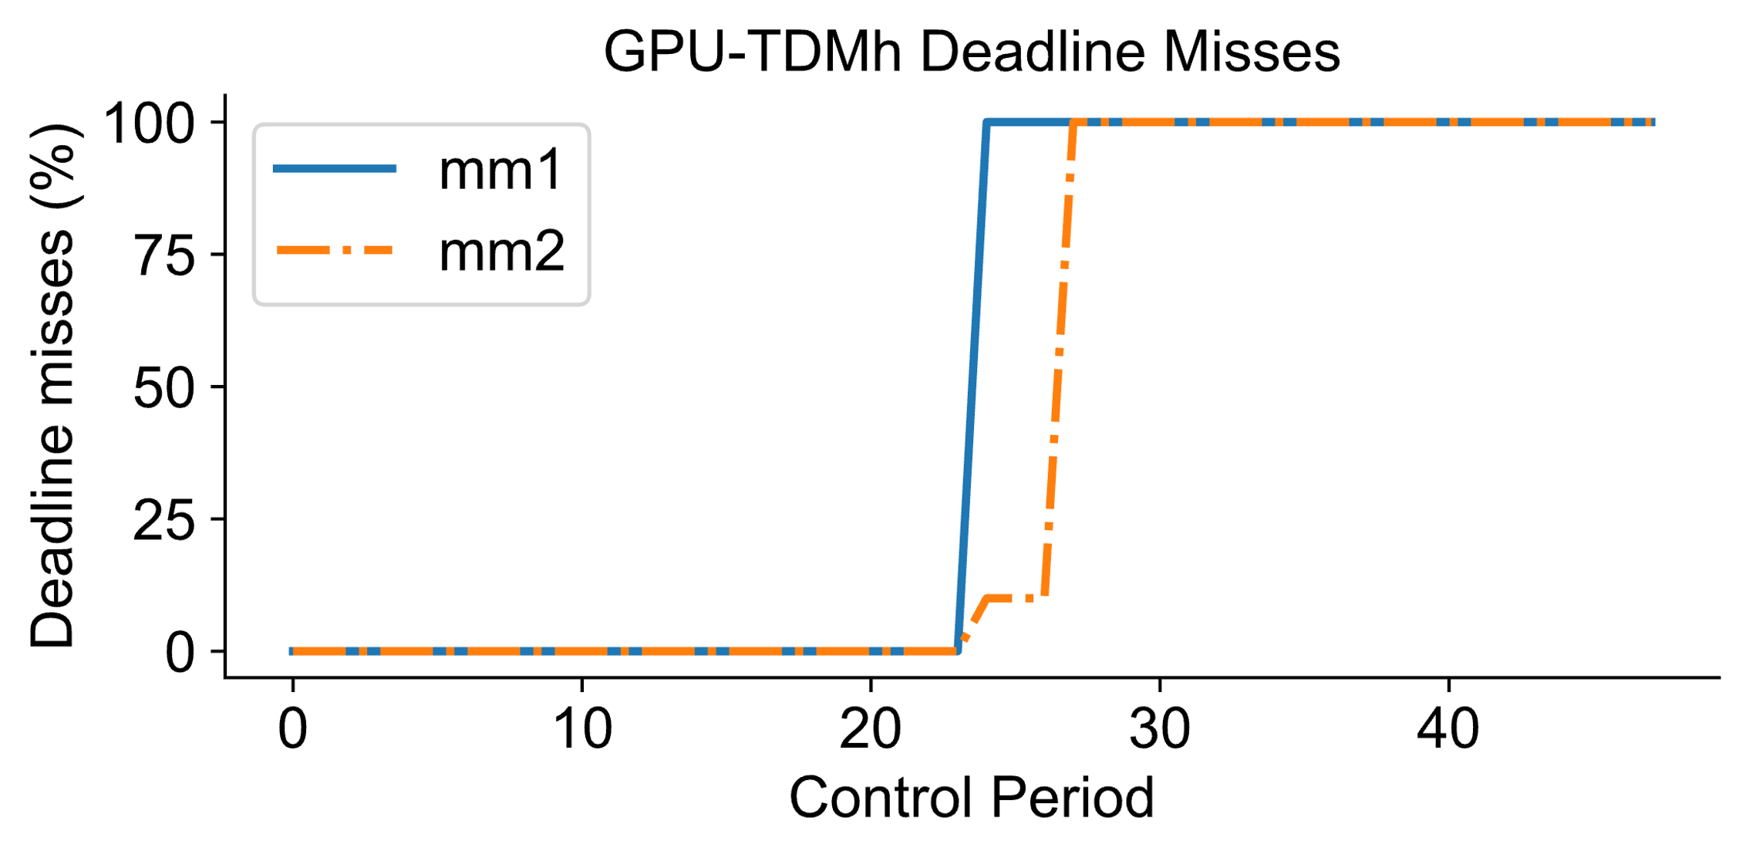
Limitations
Existing GPU scheduling solutions operate in an open-loop manner:
Up to control period 20: 0% deadline misses.
At control period 20 : input load increases.
Open-loop scheduler: cannot adapt, continues with fixed configuration.
Limitations of open-loop scheduling:
Overestimation: Resource waste.
Underestimation: Deadline misses.

Slide 4
Feedback Control
Control the input so the system follows the desired value.
Feedback control scheduling: control CPU utilization [RTAS’03].
Real-time applications, such as autonomous driving [ICDCS’20].
Optimize system utilities such as energy efficiency [RTCSA’09].
Existing FCS solutions are only applicable to CPUs
RMS utilization bounds cannot be applied to GPUs.
FCS solutions also controls the task deadline miss ratio to a set point.
FC-GPU: the first feedback control GPU scheduling framework for soft real-time embedded systems.

Slide 5


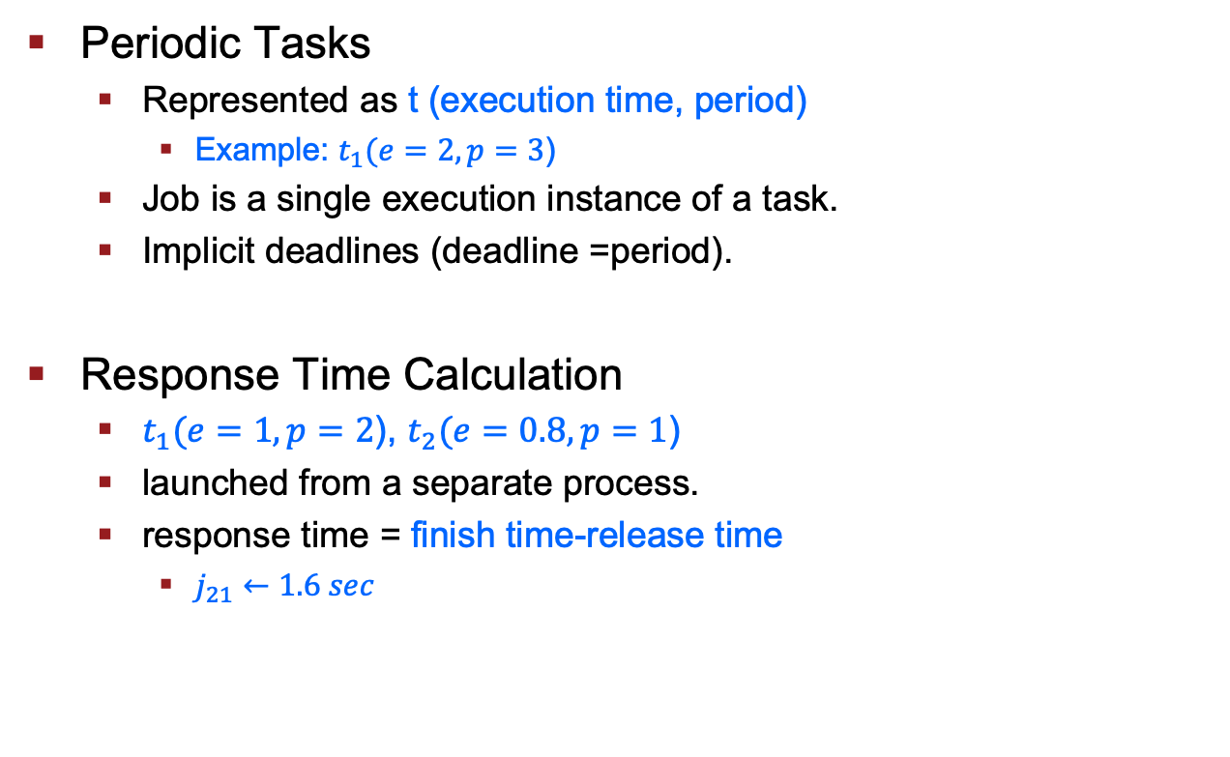










Task Model
Periodic Tasks
Represented as t (execution time, period)
Example: $t_{1}(e=2,p=3$)
Job is a single execution instance of a task.
Implicit deadlines (deadline =period).
Response Time Calculation
$t_{1}(e=1,p=2$), $t_{2}(e=0.8,p=1$)
launched from a separate process.
response time = finish time-release time
$j_{21}←1.6 sec$
$$t_{1}$$
$$j_{11}$$
$$j_{12}$$
0
1
2
3
4
5
6
$$t_{1}$$
$$j_{11}$$
$$j_{12}$$
$$t_{2}$$
$$j_{21}$$
$$j_{22}$$
$$gpu$$
0
1
2
3
4
$$j_{21}$$
$$finishes its execution$$

Slide 6



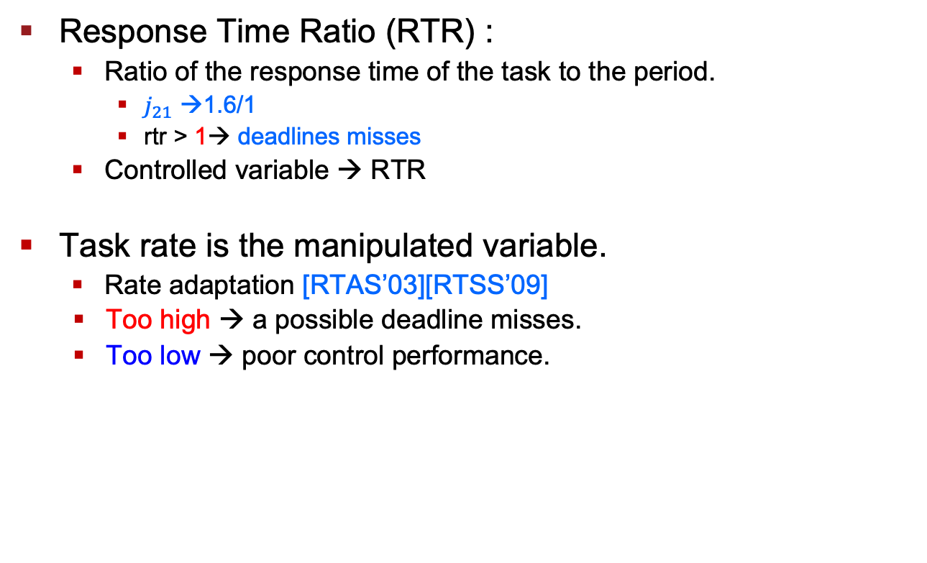








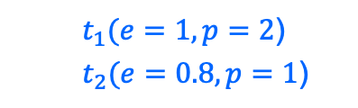






RTR Control
Response Time Ratio (RTR) :
Ratio of the response time of the task to the period.
$j_{21}$ →1.6/1
rtr > 1→ deadlines misses
Controlled variable → RTR
Task rate is the manipulated variable.
Rate adaptation [RTAS’03][RTSS’09]
Too high → a possible deadline misses.
Too low → poor control performance.
$t_{1}(e=1,p=2$)
$t_{2}(e=0.8,p=1$)
$$t_{1}$$
$$j_{11}$$
$$j_{12}$$
$$t_{2}$$
$$j_{22}$$
Deadline misses
$$j_{21}$$
$$gpu$$
0
1
2
3
4
$$j_{21}$$
$$finishes its execution$$
$t_{2}(e=0.8,p=1$)
$$j_{21}$$
$$j_{22}$$
$$j_{23}$$
After rate adaptation
$t_{2}(e=0.8,p=1.6$)
$$j_{21}$$
$$j_{22}$$
$$j_{23}$$
0
1
2
3
4
Notes:
controlled variable, which is the system outcome we want to regulate,
manipulated variable, which is the input we can adjust to influence that outcome

Slide 7
FC-GPU : Overview
Task Rate
Actuator
New task rates for next control period
Task 1 Process
RTR MIMO Controller
Task 2 Process
Task N Process
…
CPU
Response Time Monitor
…
Concurrent Scheduler
Concurrent Scheduler
Concurrent Scheduler
GPU
Time
On GPU schedule
Time Sliced Scheduler
1 | 2 | … | N | 1 | 2 | … | N

Slide 8
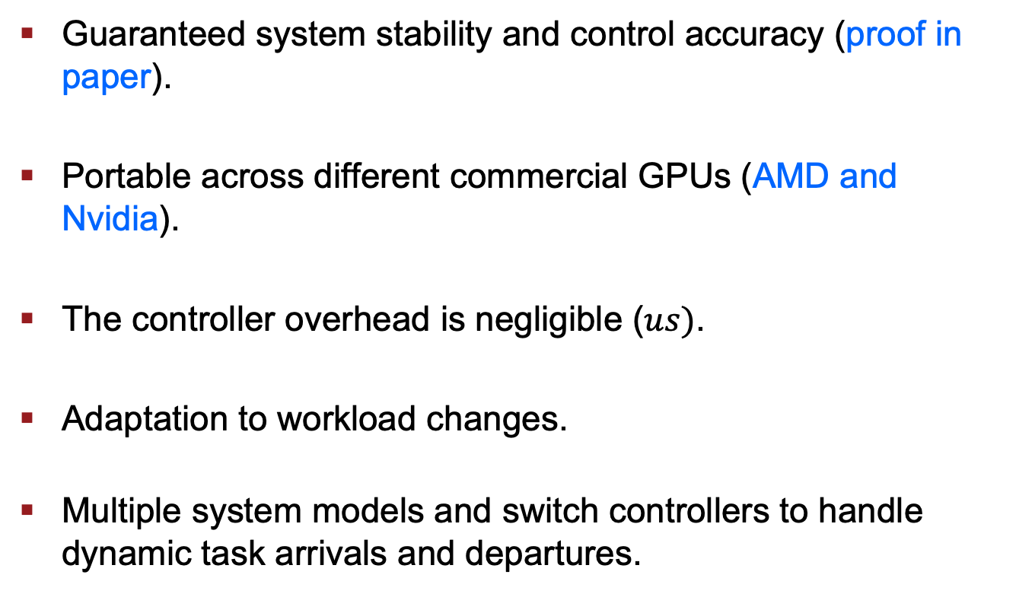
Advantages of FC-GPU
Guaranteed system stability and control accuracy (proof in paper).
Portable across different commercial GPUs (AMD and Nvidia).
The controller overhead is negligible ($us)$.
Adaptation to workload changes.
Multiple system models and switch controllers to handle dynamic task arrivals and departures.

Slide 9
Experimental Setup
Nvidia: RTX 3090 GPU and CUDA Toolkit 12.0
AMD: MI-100 GPU and ROCm 5.3.0
Workloads
Rodina Benchmark: (srad, hotspot,floyd, stencil)
Nvidia Sample: (stereodisparity,dxtc)
Synthetic: matrix multiplication
Baselines
Open-loop → GPU-TDMh
Closed-loop → Ad-hoc

Slide 10
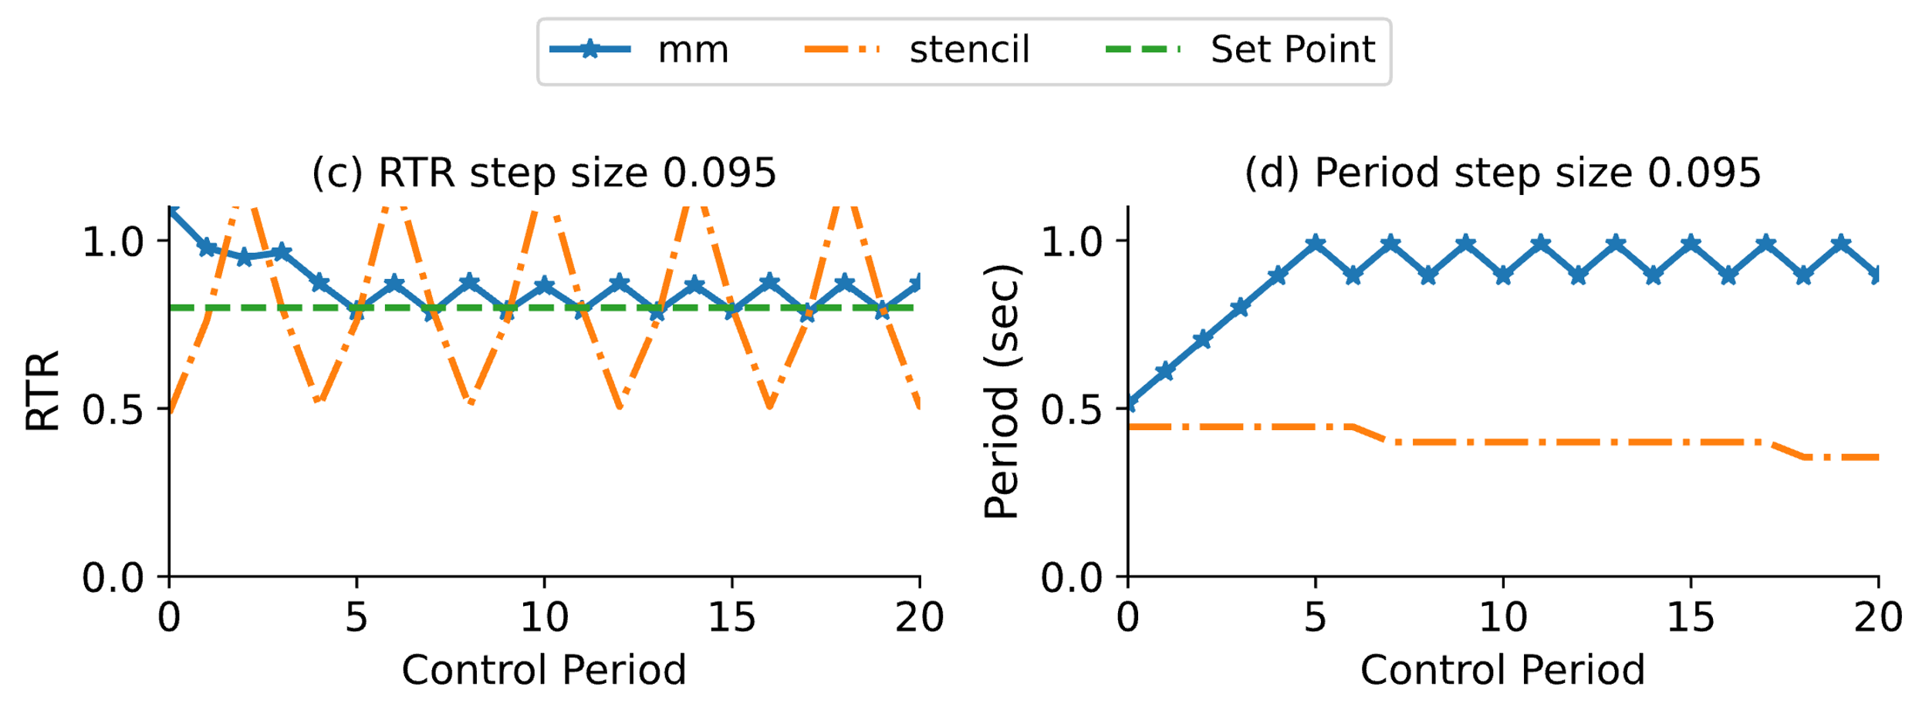
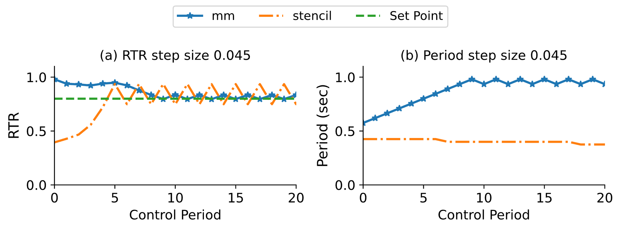

FC-GPU vs Ad-hoc
Heuristic-based adaptation
If RTR < Set Point → Increase task rate by fixed step size.
If RTR > Set Point → Decrease task rate by the same step size.
Tuned step size for minimal oscillations ($Δ= 0.045$)
Performance violations if hardware or application behavior deviates.
The response time of one task is affected by the task rate of the other task.

Slide 11
Online Workload Adaptation
Experiment:
Task (execution time, period):
mm (25, 80), stereodisparity (25.97, 100), stencil (51, 100), and dxtc (55.3, 15).
At control period 40, we increase the input size for mm.
FC-GPU mitigates these violations in subsequent control periods.
After stabilization, the deadline-miss ratio remains under 2%.
More experimental results are in the paper
Overhead measurements.
Dynamic arrival of new tasks.
Control accuracy under different setpoints
Nvidia and AMD GPUs.

Slide 12
Conclusion
Existing GPU real-time scheduling solutions are mostly open-loop and rely on WCET.
Traditional FCS are designed for CPU-based real-time tasks.
We present FC-GPU, the first feedback control GPU scheduling framework for soft real-time embedded systems.
Lower deadline miss ratio.

Slide 13
Q&A
Thanks a lot for the attention!
Questions?
This work is supported, in part, by the U.S. NSF under award CNS-2336886.

Slide 14
Context Switches
When a GPU switches from one task to another, it initiates a context switch.
GPU time-slicing operates differently from CPU time-slicing
Saving large register files and cache flushing.
GPUs often use partial state-saving techniques.
GPUs handle data transfer operations by loading data from the main memory into GPU memory.
Splits data transfers into smaller segments.
Preemption occurs at the boundaries of these segments.

Slide 15










Response Time Modeling
Response Time = Execution time + contention time
Execution time ($e_{1}$) → Exclusive access to GPU resources.
Contention time ($c_{1}$)→ Tasks compete for the same resources.
$q_{1\left(k\right)}=e_{1}+c_{1}\left(k\right)$
$q_{1}\left(k\right)=e_{1}+\left(θ_{2}+e_{2}\right)×r_{2}\left(k−1\right)$
$q_{1}\left(k\right)=e_{1}+\sum_{i=2}^{n}{{(e}_{i}+θ_{i}) ⋅r_{i}\left(k−1\right) }$
$$t_{1}(e_{1}=1.0,p_{1}=2)$$
$$t_{1}$$
$$j_{11}$$
$$j_{12}$$
$$j_{13}$$
$$t_{2}(e_{2}=1.5,p_{2}=3)$$
$$t_{2}$$
$$j_{21}$$
$$j_{22}$$
0
1
2
3
4
5
6

