Slide 1



DySM: Dynamic Scaling of GPU Streaming Multiprocessor in Spatially Shared Real-Time Embedded GPU Systems
Srinivasan Subramaniyan and Xiaorui Wang
Dept. of Electrical and Computer Engineering
The Ohio State University

Slide 2

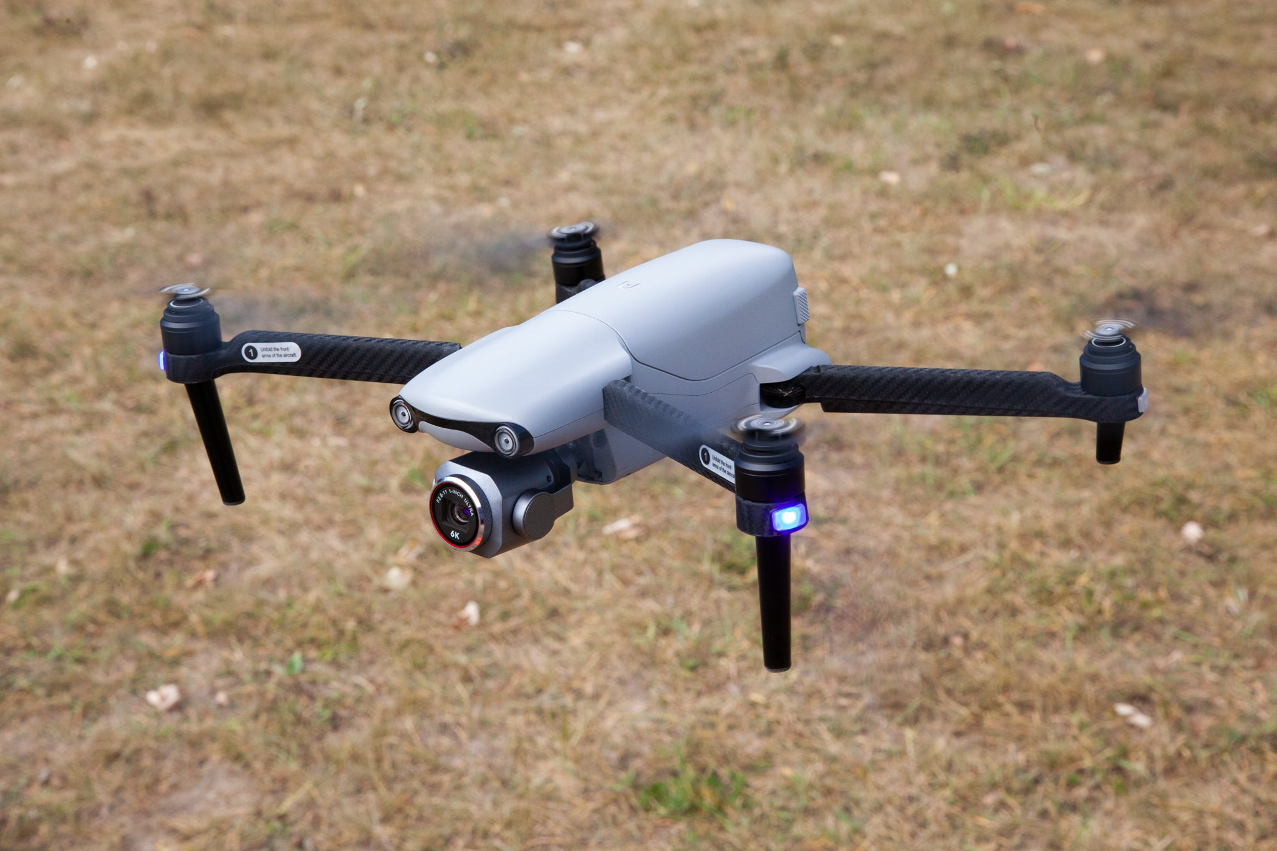

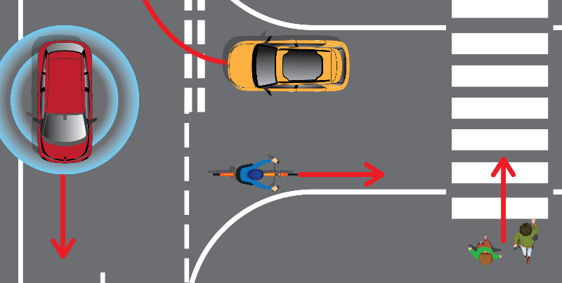


Introduction
GPUs in Real-Time Systems
Autonomous vehicles: image recognition and path planning.
Drones: real-time object detection.
VR glasses: real-time processing and rendering.
Notes:
GPUs are becoming essential in real-time systems because they can process huge amounts of data in parallel. In real-time applications, every millisecond counts, so using GPUs helps meet strict timing requirements.
“In autonomous cars, GPUs are the backbone of image recognition — detecting road signs, pedestrians, and other vehicles. They also support path planning, allowing the vehicle to decide how to steer or brake safely in real-time.
drones, GPUs enable fast object detection. This is crucial for collision avoidance and for tracking moving targets,
So the real challenge is balancing GPU resource allocation with strict timing guarantees.

Slide 3
GPU Scheduling
Sequential Scheduling
Tasks run sequentially.
Large idle gaps → low utilization.
Time-sliced Scheduling [EMSOFT’25]
Tasks run concurrently via time slicing.
Improves fairness, but adds context switching overhead
Spatial Sharing [HPCA’12,DAC’14]
GPU is partitioned among tasks.
Can minimize interference.
Sequential
T1
T2
T3
Time-slicing
Spatial Sharing
T3
T2
T1

Slide 4
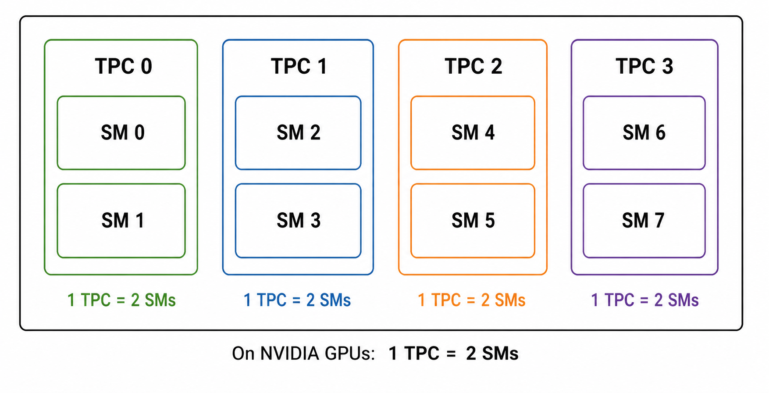
Spatial Sharing Mechanisms
Ensures Isolation
Persistent Threads [TPDS’23]
Software-controlled work sharing.
Requires kernel modification
TPC Masking [RTSS’23]
Hardware-enforced partitioning.
No kernel modification
Controlling TPCs indirectly controls SM allocation.

Slide 5
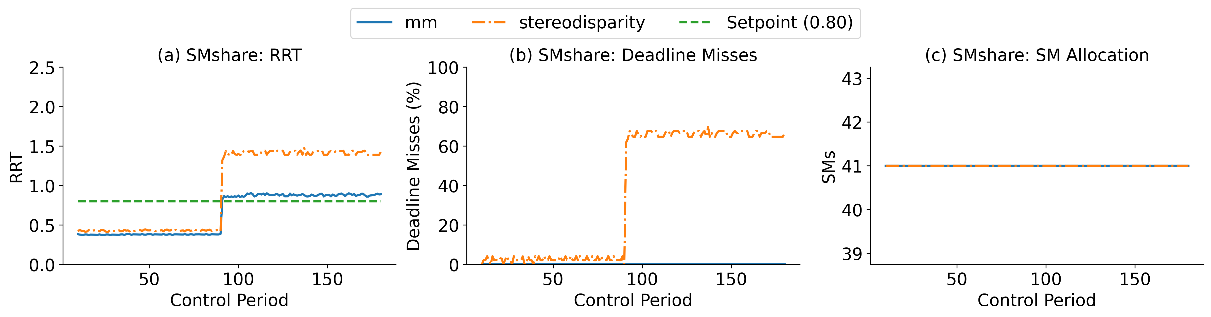
Limitation of Existing Solutions
Limitations
WCET underestimation → deadline misses.
WCET overestimation → wasted resources.
Cannot adapt to workload changes.
Challenge: How many SMs should each task receive at runtime when workloads change?
Existing schedulers use static SM allocation:
Offline WCET estimation.
Fixed SM allocation
Cannot adapt at runtime
Example: SMshare [HPCA’12] → equal SMs to all tasks.
Two periodic GPU tasks (execution time, period)
mm (29ms, 45ms) and stereodisparity (2.4ms, 21ms).
Increase the input for stereodisparity at control period 80.

Slide 6
Feedback Control
Control the input so the system follows the desired value.
Feedback control scheduling: control CPU utilization [RTAS’03].
Real-time applications, such as autonomous driving [ICDCS’20].
DySM: the first closed-loop, adaptive GPU scheduling algorithm for spatially shared GPUs in soft real-time systems.
DySM performs Relative Response Time (RRT) control.
Ratio of the response time of the task to the period.
Controlled Variable: Relative Response Time (RRT).
Manipulated Variable: number of allocated SMs/TPC.
RRT > Set Point: deadline misses.
RRT < Set Point: resource wastage.
Goal: maintain RRT close to the desired set point.

Slide 7
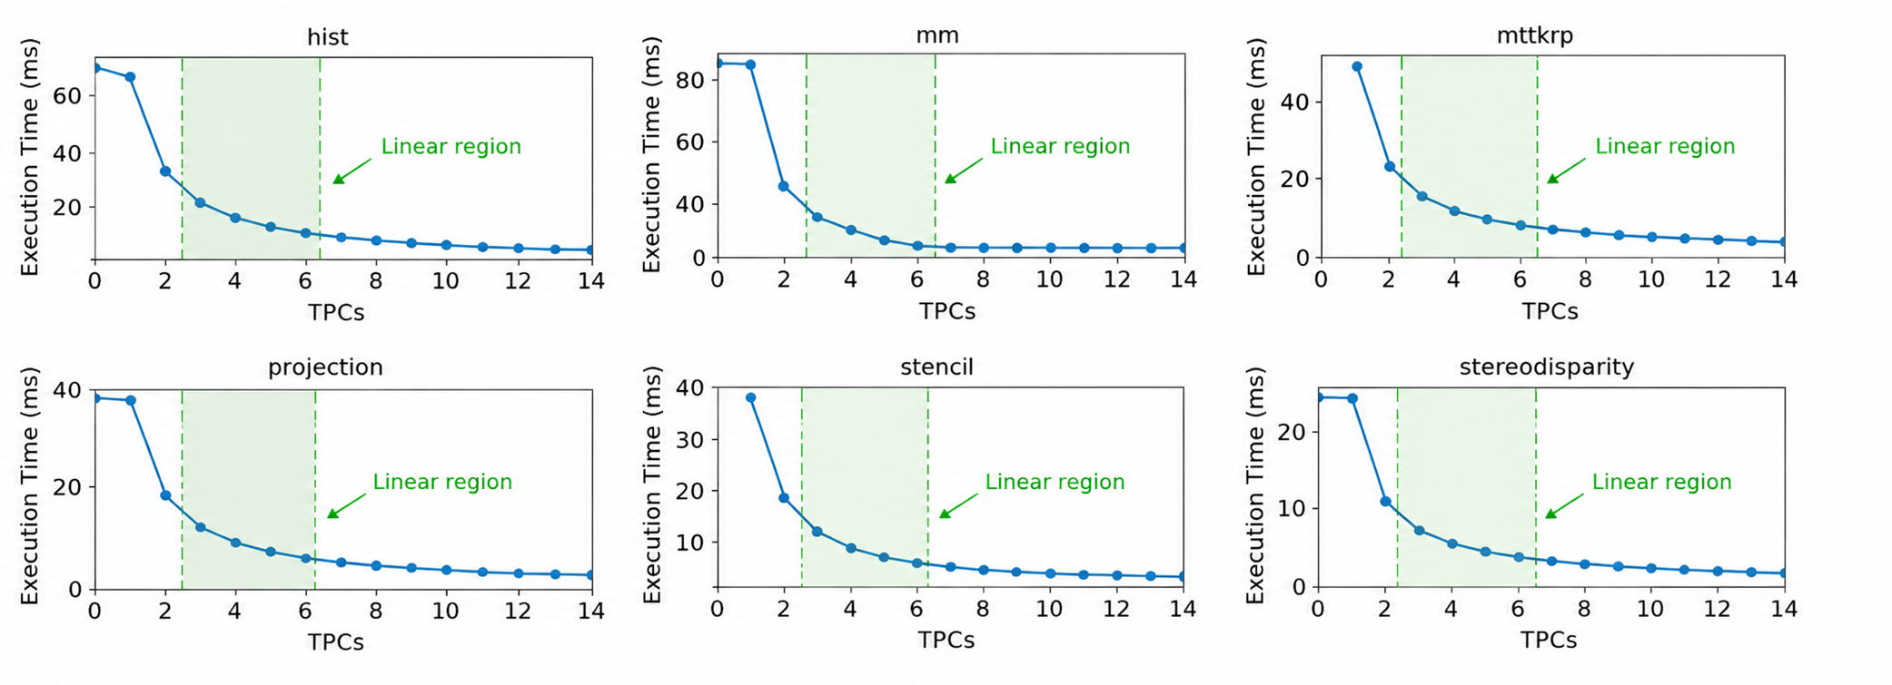
System Modeling
Profile task execution time for tasks under different SM allocations.
DySM operates within the approximately linear region for accurate modeling and control.

Slide 8
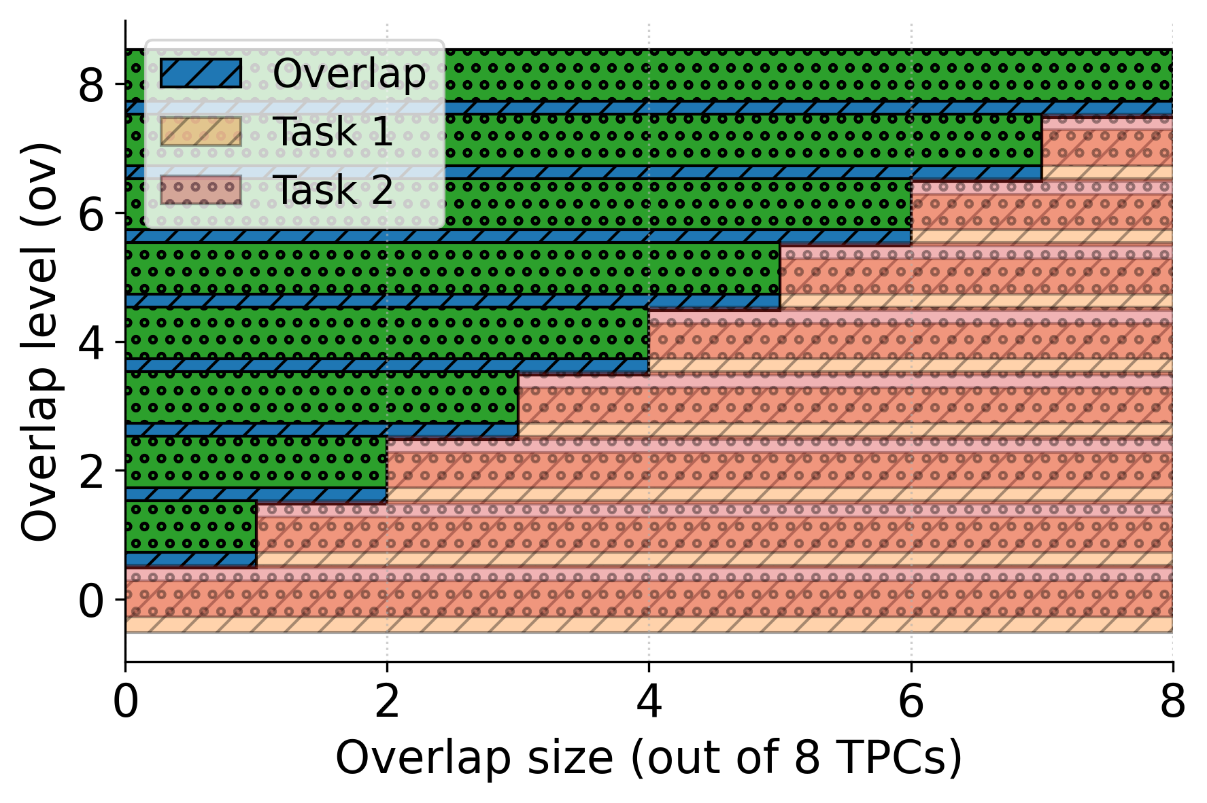
Impact of Overlapping TPC Allocations
Experiment:
Two periodic tensor-computation tasks are released every 30 ms on separate CUDA streams.
Task 1 fixed to TPCs 0–7.
Task 2 gradually shifted from TPCs 8–15 to 0–7.
Increase TPC overlap from 0 to 8 shared TPCs

Slide 9
DySM Overview
TPCs for the next control period
SM 0
SM 1
Actuator
Warp scheduler
Warp scheduler
CUDA Cores
TPC 0
CUDA Cores
MIMO Controller
Task 1
…
Task N
Response Time Monitor
TPC 0
TPC 2
TPC N-1
…
Stream 0
Stream N
TPC 1
TPC 3
TPC N
Hardware Scheduler
Channels
TPC : Thread Processing Cluster
Task rates
TPCs
Feedback loop

Slide 10
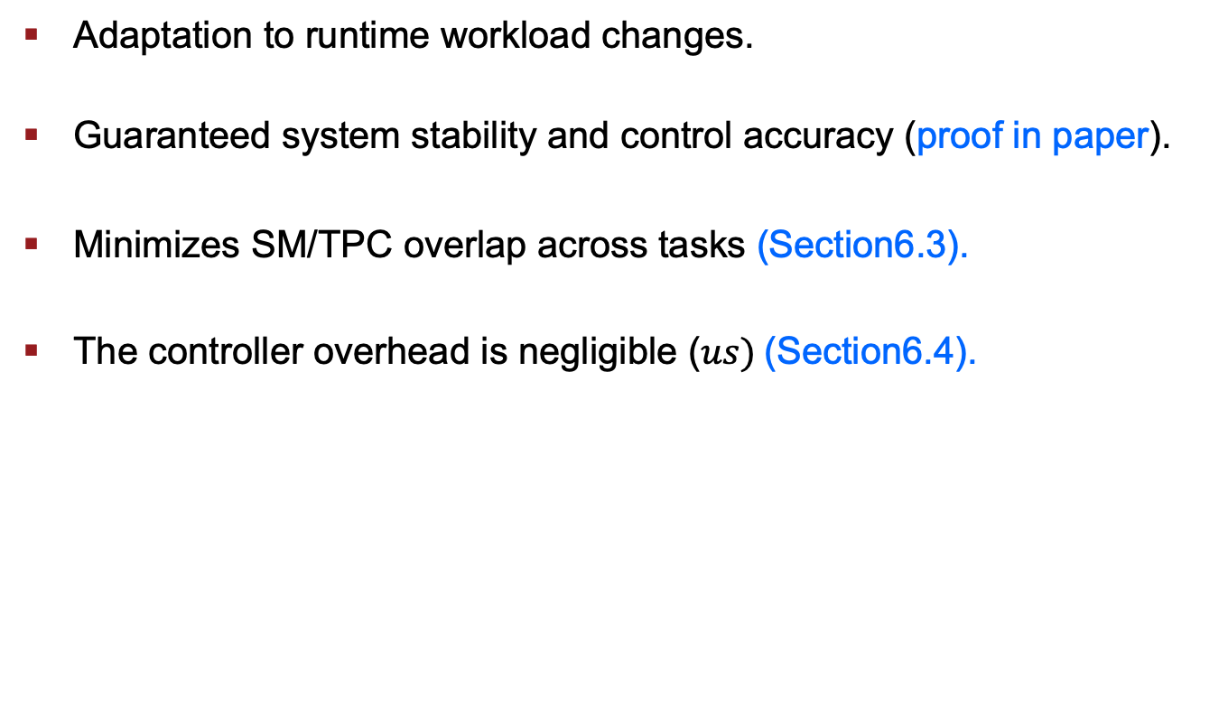
Advantages of DySM
Adaptation to runtime workload changes.
Guaranteed system stability and control accuracy (proof in paper).
Minimizes SM/TPC overlap across tasks $\text{(}\text{Section}\text{6.}\text{3}\text{).}$
The controller overhead is negligible ($us) \text{(}\text{Section}\text{6.4).}$

Slide 11
Experimental Setup
Nvidia: RTX 3090 GPU and CUDA Toolkit 12.0.
Dynamic SM Scaling: Controller outputs are converted to TPC allocations via libsmctrl [RTSS’23] using TPC masking.
Delta-sigma modulation approximates fractional SM allocations using nearby integer SM values. (e.g., a target of 5 SMs can be realized by alternating between 4 and 6 SM allocations).
Workloads
Rodinia Benchmark: (projection, histogram, stencil).
Nvidia Sample: (stereodisparity, matrix multiplication).
Metrics: Relative Response Time (RRT) and Deadline Miss Ratio.

Slide 12
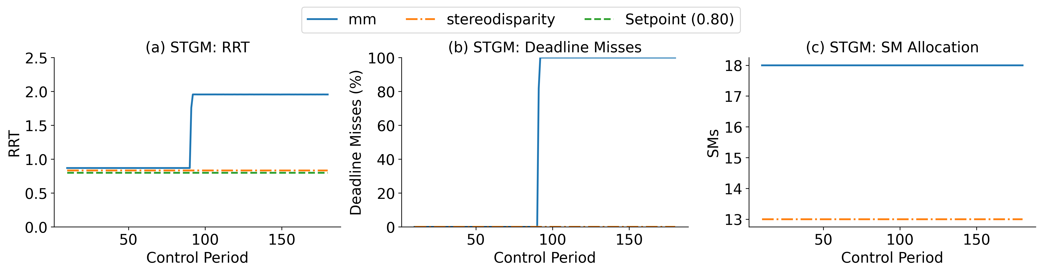
Runtime Workload Variations - STGM
STGM [RTCSA’19]
Open-loop scheduler with offline SM allocation.
SM allocation based on response-time analysis.
18 SMs →mm
13 SMs →stereodisparity.
Increase the input size of mm at control period 80.
Deadline misses occur when the workload increases.
Fails under dynamic workload changes due to lack of runtime adaptation.

Slide 13
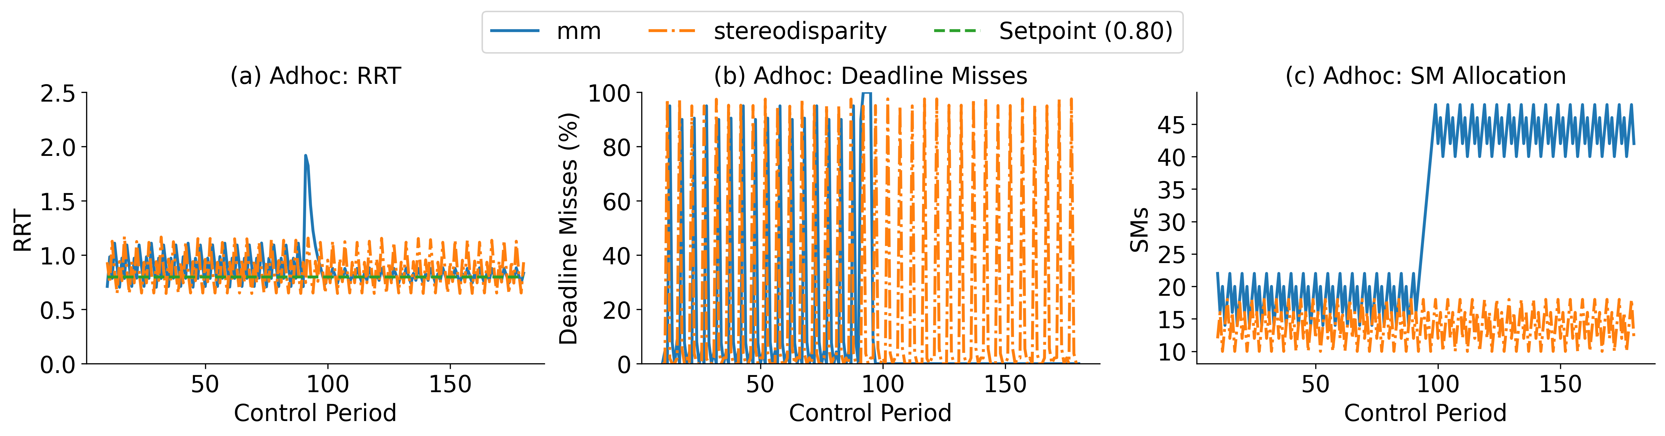
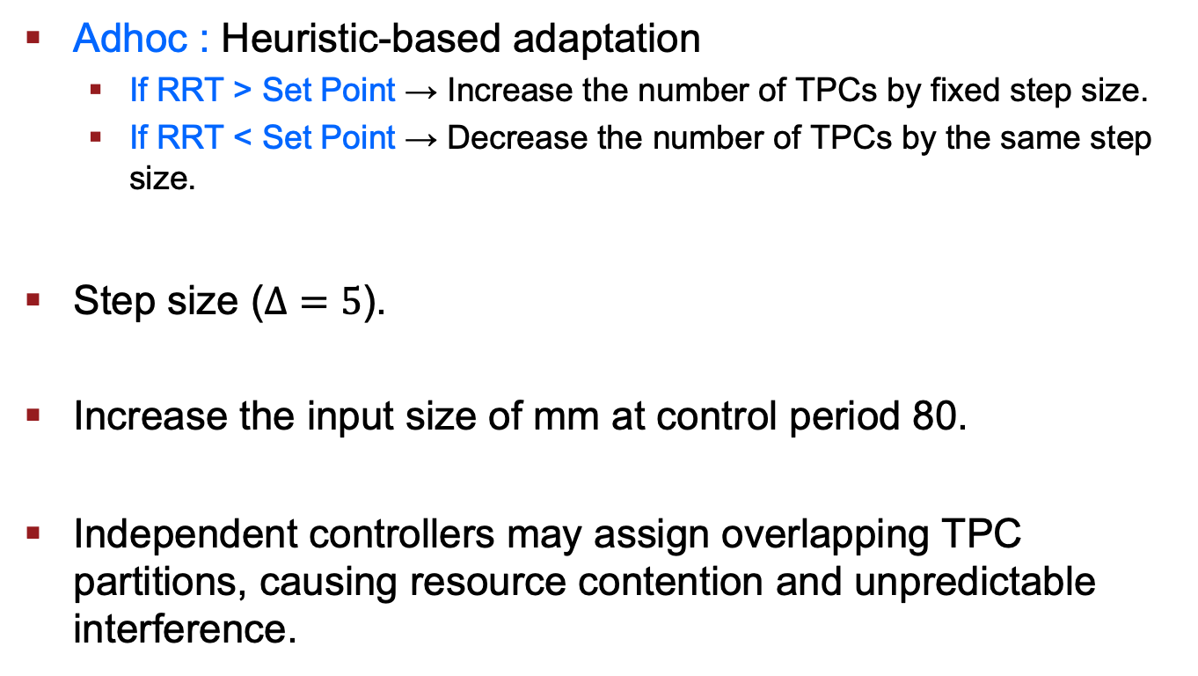
Runtime Workload Variations - Adhoc
Adhoc : Heuristic-based adaptation
If RRT > Set Point → Increase the number of TPCs by fixed step size.
If RRT < Set Point → Decrease the number of TPCs by the same step size.
Step size ($Δ=5$).
Increase the input size of mm at control period 80.
Independent controllers may assign overlapping TPC partitions, causing resource contention and unpredictable interference.

Slide 14
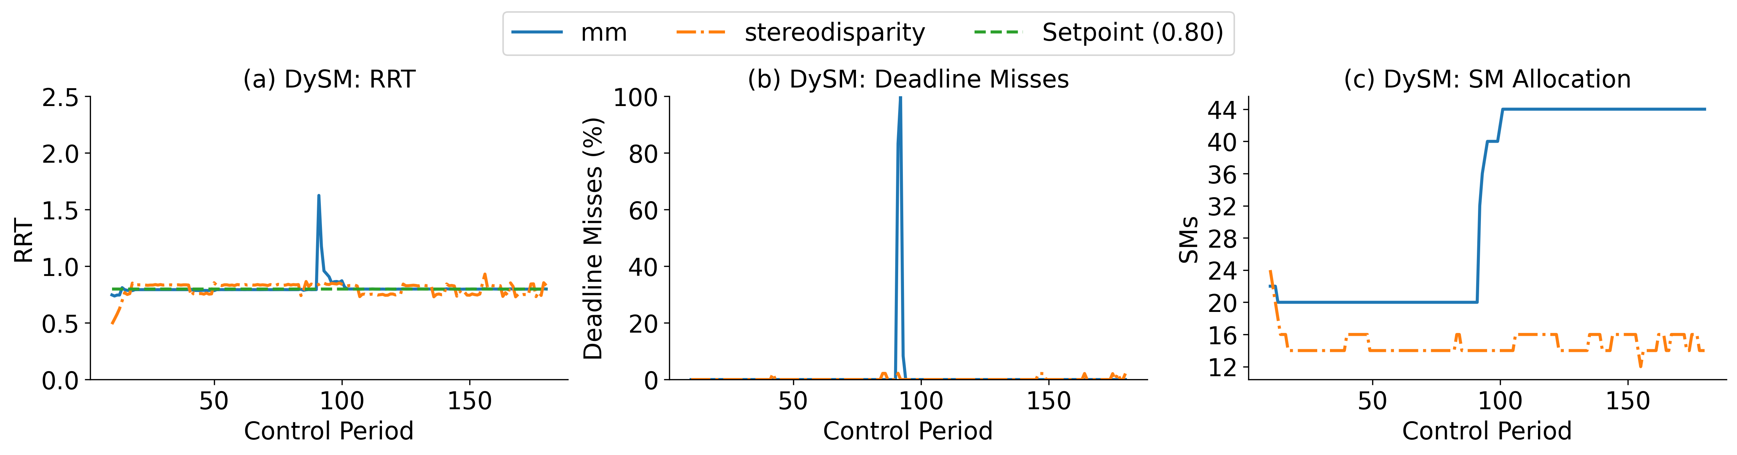
Runtime Workload Variations - DySM
More experimental results are in the paper
Overhead measurements.
Control accuracy under different setpoints.
DySM: Closed-loop scheduling solution with coordinated SM allocation.
Maintains RRT close to the desired set point under workload changes.
After stabilization, the deadline-miss ratio remains under 1%.

Slide 15
Conclusion
Existing GPU real-time scheduling solutions are primarily open-loop and rely on offline WCET estimation.
DySM is a feedback-control-based GPU scheduling framework for spatially shared real-time embedded systems.
Dynamically scales SM allocations based on measured task response times.
Coordinates GPU resources using a resource-aware MIMO controller.
Reduces deadline misses while adapting to runtime workload variations.

Slide 16

Q&A
Thanks for your attention!
Q&A
This work is supported, in part, by the U.S. NSF under award CNS-2344505.

Slide 17
Overhead Analysis
Verify that runtime SM/TPC mask updates introduce negligible overhead.
Alternate the active SM allocation between 60 SMs and 20 SMs across successive kernel launches.
Measure:
CPU-side mask update latency.
Kernel latency after the mask update.
Number of SMs actually used by the kernel.
Observation:
TPC mask updates incur negligible runtime overhead.
Allocation changes take effect at the next kernel launch.
No significant increase in task response time.

Slide 18
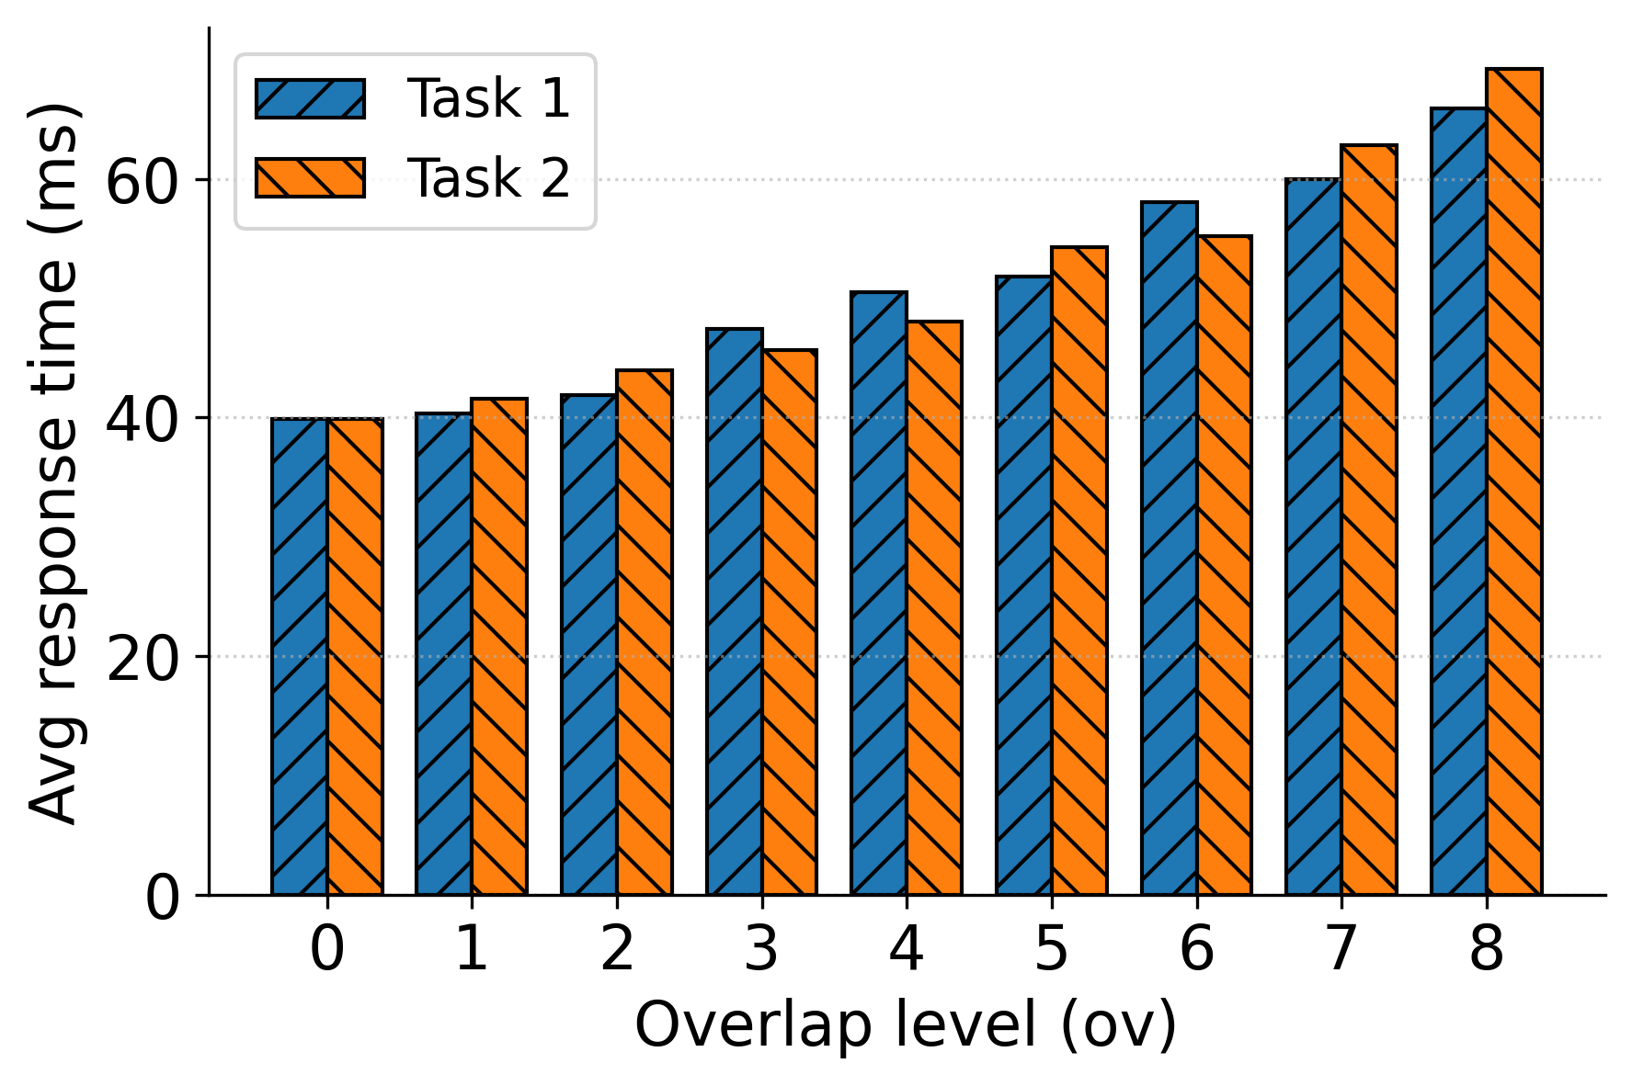
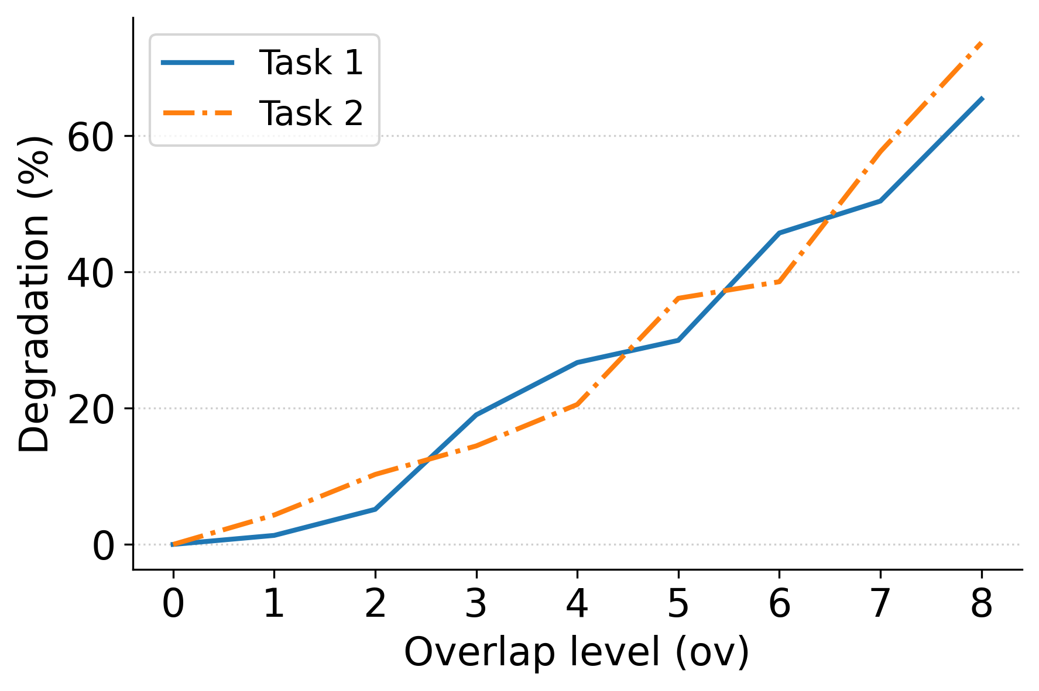
Impact of Overlapping TPC Allocations
Key Observations:
Response time increases as TPC overlap grows.
Maximum overlap results in up to 74% performance degradation.
Overlapping TPCs introduce compute contention and queueing delays.

