Slide 1

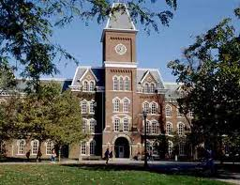
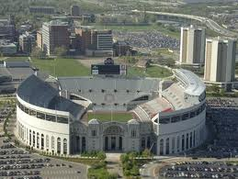
Power Capping of GPU Servers for Machine Learning Inference Optimization
Yuan Ma, Srinivasan Subramaniyan, Xiaorui Wang
Dept. of Electrical and Computer Engineering
The Ohio State University

Slide 2
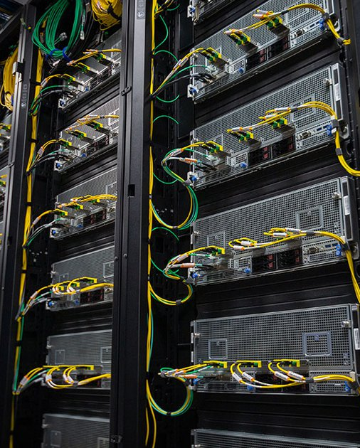
The Impact of AI on Datacenter
200 Nvidia V100 GPUs was deployed in an AI datacenter cluster.
AI, especially LLM, makes data center are more hungry for Advanced GPUs.
We purchase 60 H100 GPUs.
200*250<200*250+60*700
How can those GPU be safely hosted in this power infrastructure?
Two choice:
Build another data center to accommodate those GPUs
Power oversubscription
Notes:
To start with this presentation, let’s think about one scenario that would happen in the real industry.
Imagine that we have an AI datacenter cluster that has around 200 Nvidia V100 GPUs. Now, As the development of Aritificial Intelligence, especially the hot topic of large language model. Both of industry and academia are hungry for datacenter computing power for both of training and inference jobs. As a result, we would like to upgrade the data center and buy a bunch of more advanced GPUs.
So we buy 60 H100 GPUs.
We realize that there is a problem with the power infrastructure. Lets do a simple math, for your information, the TDP ~~~~
The previous power infrastructure is designed for satisfying the theoretical maximum power draw of those 200 v100 GPUs. When we move those newly purchased h100 in, the theoretical maximum power draw of all servers would exceed the actual power infrastructure capacity.
We got a serious question: How can those GPU be safely hosted in this power infrastructure?
Well, actually, I can give you two choices here.
One choice is to build another datacenter to accommodate, but this would consume a huge amount of money for the upgrades of the power infrastructure.
I can give you guys another choice, which is power oversubscription.

Slide 3
Why Power Capping
Power Oversubscription
Host more servers than power infra capacity.
Power Capping
Cap peak power consumption to prevent power overload.
Adopted by many companies:
Meta[ASPLOS’24], unlocks 12.85 MW of capacity by power oversubscription with ML heuristics.
Microsoft[ATC’21], reduces infrastructure cost by up to $155M per site with power capping.
Google[ASPLOS’20], increases 25%+ power capacity via priority-aware capping
and etc…
Notes:
So power oversubscription is just to deploy more servers in the same infrastructure. Because it is observed that data center power consumption is typically far less than the theoretical maximum power draw of deployed equipment. This technique can create new data center capacity without additional construction.
However, power oversubscription must be used together with power capping, which monitors the power consumption in real time and caps their peak power draw to prevent power overload to enable safe power oversubscription.
These pair of technique has been adopted by many companies, for example,

Slide 4
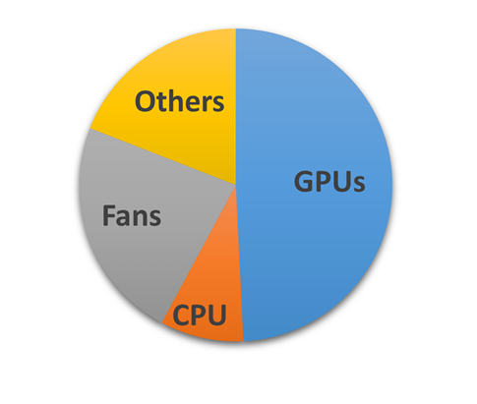
Power Capping Technique
Traditional power capping focuses on CPU DVFS
Dynamic Voltage and Frequency Scaling
AI is the game changer:
GPU is much more powerful than CPU
Inference Server: Multi-GPU and one host CPU.[Alibaba ATC’23]
Existing methods: either on CPU or GPU, or isolate CPU and GPU
CPU and GPU are coordinate with each other:
CapGPU is the first framework coordinating CPU and each GPU for better inference performance.
Power Consumption of
an 8×A100-80GB server.
ASPLOS’24
Notes:
Lets look into the power capping techniques,
Traditional power capping techniques focuses on the CPU DVFS.
The full name of DVFS is Dynamic Voltage and Frequency Scaling, which is controlling the CPU socket power consumption by adjusting the voltage and frequency of CPU.
However, AI the game changer. As the development of deep learning, especially the large language model in recent years, machine learning inference and training workload makes GPU servers dominates the datacenter power usage.
You can see the pie chart on the right, which is a power consumption analysis of a GPU server with 8 A100 GPUs from a paper published by Microsoft in Asplos 2024. This chart shows that the majority of server consumption is from GPUs, and only a very small portion of entire server’s power consumption is from CPU. As a results, if we just do CPU DVFS to Inference servers, the impact is very small.
This type of GPU server is very commonly used for machine learning inference, with one host CPU and multiple GPUs. While the inference jobs is assigned on each GPU, CPU is also involved in certain necessary tasks for machine learning inference, including data preprocessing.
There are some existing power capping methods for inference servers, however, their research either only care about frequency scaling and changing batch size on one GPU, or on both CPU and GPU but isolate one from another and control them seperately.
However, CPU and GPU are actually coordinate with each other for ML inference jobs. For example, CPU could do the preprocessing and feed the data to GPU. So that GPU wouldn’t have to wait CPU for further operations. However, to the best of our knowledge, our proposed framework, CapGPU, is the first coordinate CPU and each GPU for better inference performance.

Slide 5
Objectives
Precise power control to the Power Limit
Satisfy each GPU’s inference Service-Level Objective
Achieve the best possible ML inference Throughput
🔥
⚡️🎯
Setpoint
🐢
Notes:
Lets look at the figure here, the straight line in the middle of it represents the power setpoint.
For both of CPU task and GPU task,
If the power is under the setpoint, the performance will be slow, which is because frequency will be decreased as power goes down.
If the power is above the setpoint, the power oversubscription will be unsafe.
So the most desirable situation for power capping is the power just reach and remains at the predefined setpoint target.
Based on this idea, the goal of this paper could be summarized as three main points.
Firstly, Precise power control to the Power Limit.
As in the real industry scenario, power capping must ensure that it could cap the peak power consumption to prevent power overload. In another word, the real time power consumption of a server, must be lower than or equal to a predefined power setpoint. It is also notable that the setpoint is also possible to change subject to real world need.
However, as we said before, the higher power consumption, the better performance a server could achieve. So we would like to let the real time power consumption to be as close to the setpoint as possible, so we can get a better machine learning performance.
Secondly, we have to satisfy each GPU’s inference Service-Level Objective
Inference tasks in modern data centers often have strict Service-level Objective. Usually when we are talking about SLO, it refers to latency in our scenario, which requires that their latency remain below a specified value, like how long we can receive our answer from a prompt to ChatGPT.
In some situations, the SLO would change.
If a power capping design just try to control the power without looking after the SLO requirement, probably the power limit won’t be exceeded, but a lot of task’s SLO will be violated.
That is the reason why we have a specific design for SLO in this project.
Thirdly, We definitely would like to achieve the best possible ML inference throughput for best possible performance.

Slide 6
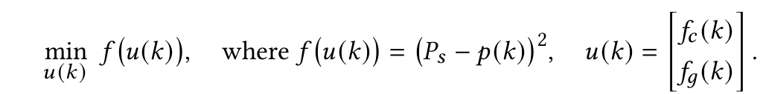
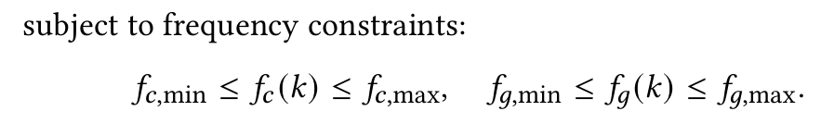

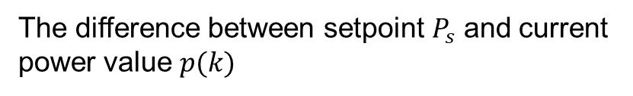
Problem Formulation
Control Objective:
The difference between setpoint $P_{s}$ and current power value $p(k)$
$$u\left(k\right)=\left[\begin{aligned}f_{g,1}\left(k\right), \\ … \\ f_{g,n}\left(k\right),\end{aligned}\right]$$
Notes:
Now let’s formalize the control problem that CapGPU is trying to solve.
Our control objective is simple: we want to minimize the difference between a target power setpoint, denoted as Ps, and the actual measured power, p(k), at time step k.
We express this as an optimization problem:
We want to minimize a cost function f(u(k)), where f is the square of Ps−p(k)，which penalizes any deviation from the setpoint.
The control input u(k) is a vector consisting of CPU and GPU frequencies:
This optimization is subject to frequency constraints for both CPU and GPU:
In another words, our goal is to tune CPU and GPU frequencies such that the system’s total power stays as close as possible to a desired budget — while satisfying some hardware limits.

Slide 7
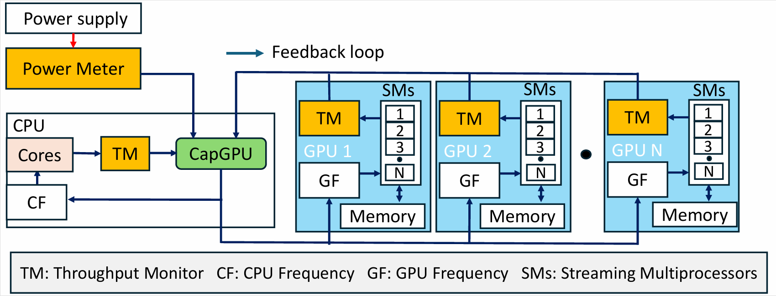
Proposed Solution
CapGPU is a MIMO feedback control framework.
Measure
Real-Time Power
Inference
workload
Data
Preprocessing
Controller
Notes:
Our proposed solution CapGPU is a Multi Input Multi Output feedback control framework. I will introduce how the feed back control loop work in our designed system.
Firstly, we have a power meter which can measure the average power consumption of entire server of previous control period. This total power consumption serves as the controlled variable in the loop. This power value will also be passed to the controller through a feedback path.
On the CPU side, we divide the CPU cores into 2 parts, we allocate one core for CapGPU controller, and other cores running the data preprocessing workload. For cores running data preprocessing workload, they will receive the CPU frequency given by the controller and output their real-time throughput as a feedback to controller.
On the GPU side, We would assign each one GPU on the server with one inference workload. Each GPU is equipped with:
A Throughput Monitor that measures inference performance.
A GPU Frequency (GF) control knob, which CapGPU adjusts individually for each GPU.
The core element of the entire system is the CapGPU controller, which receive all throughput message from cpu and gpu as well as the measured power data, while outputting new frequency value of GPU and CPU for the next step. We choose a model predictive controller for this feedback control, which will be discussed in details in the following slides.
The feedback closed loop control continuously observes power and throughput performance of both GPU and CPU. dynamically adjusts both CPU and GPU frequencies to meet the power budget while maximizing overall throughput.

Slide 8
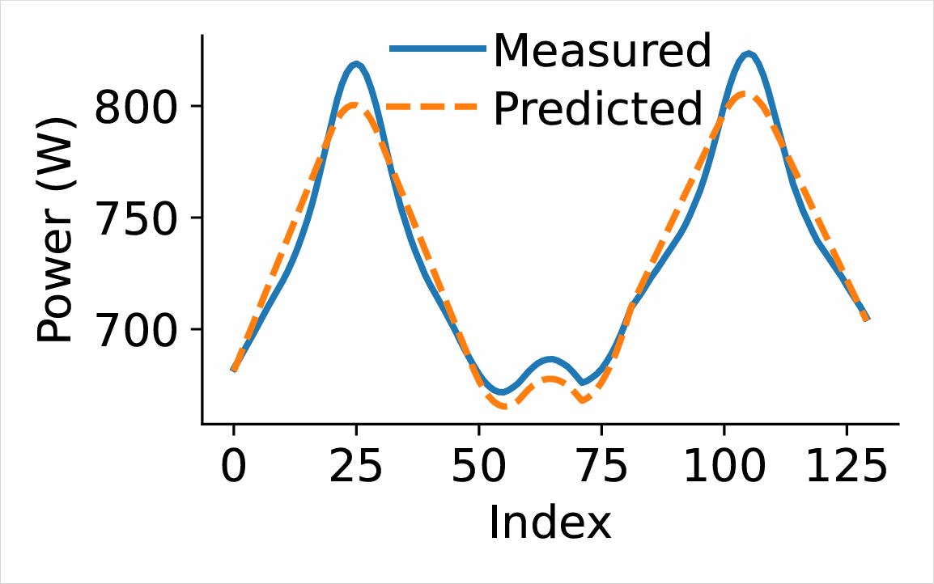
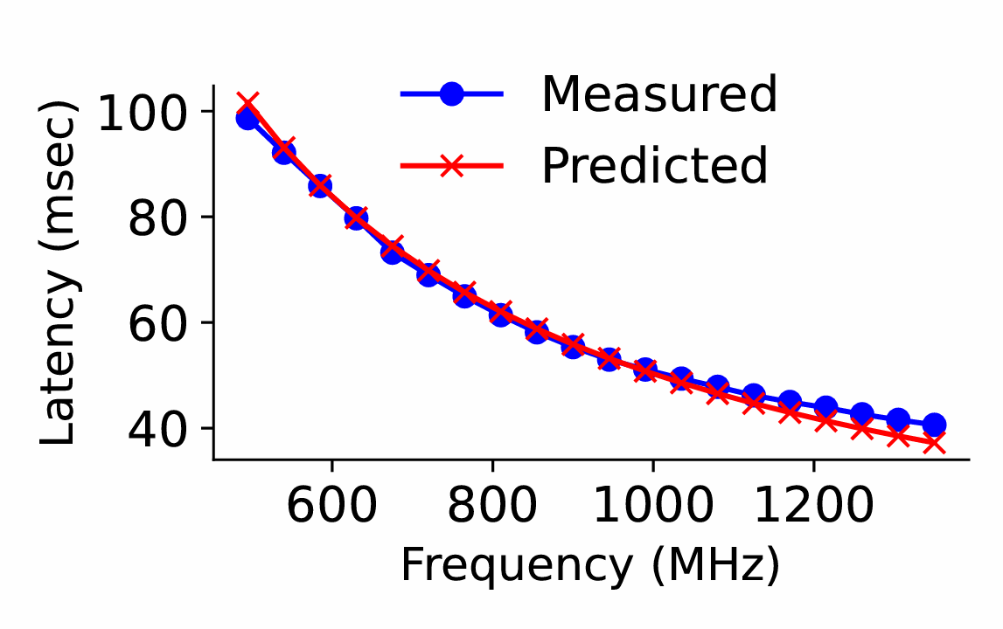
System Model
CPU and GPU frequency scaling are actuation knobs:
Well-defined interface: nvidia-smi, AMD ROCm, cpupower
Two system model:
Power model: helps controller reach setpoint.
Latency model: helps controller satisfyies constraints.
Notes:
We choose CPU and GPU frequency scaling as actuation knobs because there are plenty of well-defined interfaces for frequency scaling on GPU and CPUs. For example, nvidia has nvidia-smi or NVML, AMD has rocm, and Intel has cpupower.
Based on these two actuation knobs, we generate two system model with the help of system identification.
The first one is power model. As we introduced before, the power of server is highly related with CPU and GPU frequency. The power model could be modeled with a quadratic model. However, for the simplicity, for each of them, we deployed a linear model to model the relationship. Here we can see from the left hand side, our predicted power, which is the orange dashed line in the figure, closely matches the measured power, indicating a good fit. This model will be pushed to contyroller to predict the server power of the next step.
Another one is Latency model. This model is highly associated with SLO control. The idea is, if we could control the latency lower than the SLO, which means that the frequency should be higher than a certain value, the SLO of this workload will be satisfied. Our model also closely matches the measured values.

Slide 9
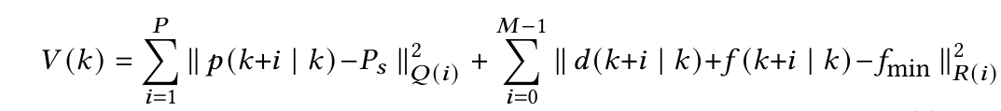

Model Predictive Controller
Why Model Predictive Controller?
MPC can solve problem with constraints and dynamic allocation easily.
Frequency Changes for each GPU and CPU
Ps
Power Model
SLO
Constraints
$$\left[\begin{aligned}d_{cpu}\left(k+1\right) \\ d_{gpu1}\left(k+1\right) \\ … \\ d_{gpuN}\left(k+1\right)\end{aligned}\right]$$
Power Budget
optimization solver
p(k)
Minimize difference
between power and setpoint
Manage the
control step
Cost Function
Current Power
Notes:
In this slides, I will introduce the model predictive controller in details.
So why we choose the model predictive controller? It is because the MPC could solve problem with constrainst and dynamic allocation easily.
At each control step, the MPC receives two inputs, the predefined power budget ps and measured power pk.
The optimization solver uses:
A power model to predict how frequency changes will affect future power.
SLO constraints, which ensure that the service level objectives are satisfied.
And A cost function, which penalizes deviation from the power budget
The first term of cost function is trying to minimize the difference beween power ans setpoint.
The second term is used to manage the control step, in case the total power has too much fluctuations.
Finally at the end of each control step, the controller will outputs Frequency Changes for each GPU and CPU.

Slide 10
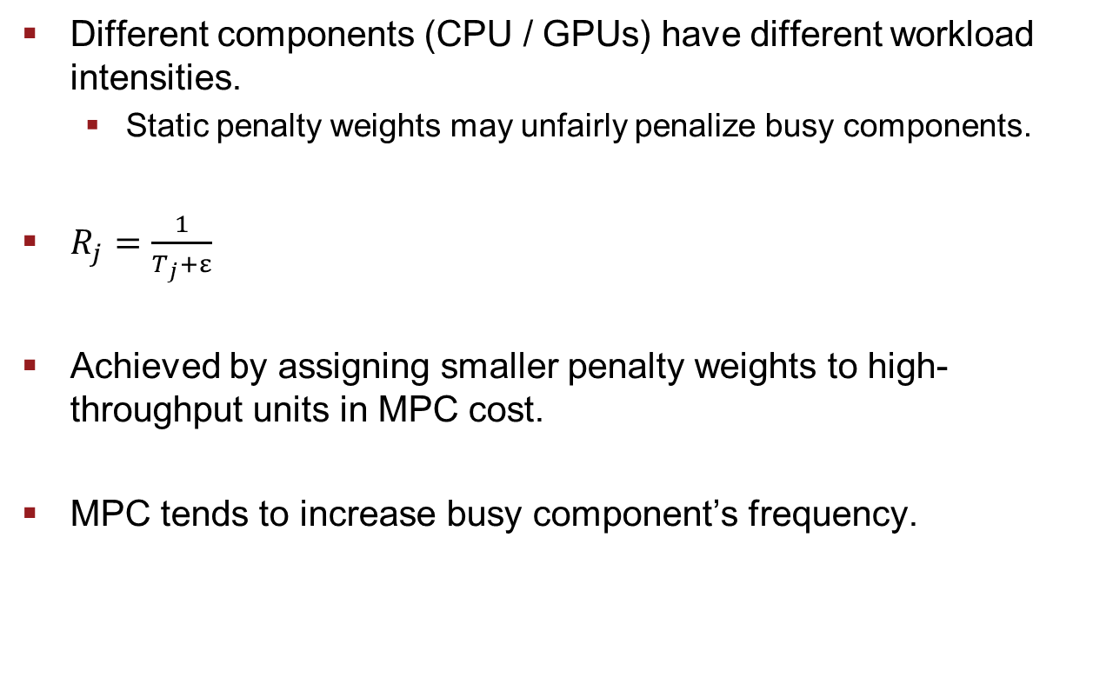
Weight Assignment
Different components (CPU / GPUs) have different workload intensities.
Static penalty weights may unfairly penalize busy components.
$R_{j}=\frac{1}{T_{j}+ε}$
Achieved by assigning smaller penalty weights to high-throughput units in MPC cost.
MPC tends to increase busy component’s frequency.
Notes:
We also utilize a weight assignment mechanism to allocate power among CPU and GPUs.
Since differenct components have different workload intensities. Static penalty weights may unfairly penalize busy componenets.
As we talked in the framework slide, we receive both of CPU and GPU throughput and utilize here for the dynamic penalties, while T denotes the throughput.
So this weight assignment machanism is achieved by assigning smaller penlty weights to high throughput units in MPC cost.
So MPC tends to increase the frequency of busier components.

Slide 11
Experimental Setup
Testbed:
A server hosts three Nvidia V100 GPUs and Intel Xeon Gold 5215.
Frequency Modulators:
CPU DVFS: cpupower
GPU frequency scaling: nvidia-smi
Approximate a fractional level with discrete freq levels?
Delta-sigma: For 2.25 GHz, do 2, 2, 2, and 3 on a subinterval.
Workload:
GPU inference: Swin Transformer, ResNet50, and VGG16 .
CPU: a data analysis workload based on Alibaba PAI dataset.
Notes:
We have done our experiment on a test bed with 3 V100 GPUs and one Intel processor.
For the frequency modulators,
We choose the CPU power for CPU DVFS, nvidia-smi for GPU frequency scaling.
As both of CPU and GPU, the available frequency levels in the sytem are dicrete. We utilize a technique called Delta-sigma to approximate a fractional level.
For example, to reach 2.25GHz, we do 2,2,2, and 3 on a subinterval.
We assigned each GPU on the server with one machine learning inference workload, with swin transformer, resnet 50, and vgg 16.
It is also notable that swin transformer is a transformer based deep learning workload. We would like to show that our framework can also work well with transformers.
For CPU, we choose a data analysis workload based on the ALibbaPai dataset to mimic the data preprocessing workload in the real industry

Slide 12
Baselines
Fixed-step: a controller that only changes frequency of GPU and CPU with fixed value.(TPDS’22)
GPU-Only: a proportional controller to control power by adjusting GPU frequency.(ICDCS’22)
CPU-Only: a proportional controller to control power by adjusting CPU frequency. (HPCA’08)
CPU+GPU: control the CPU and GPU power independently by 2 separate loops.(IGSC’18)
Notes:
In the experiments, we use 4 state of the art baselines for comparison with our CapGPU framework.
The first baseline is fixed-step, which is also the most commonly used techinique by industry. a controller that only changes frequency of GPU and CPU with fixed value.
The second one is GPU-Only. Instead of a coordinate allocation between each GPU and CPU, they will only use a proportional controller to control power by adjusting GPU frequency. It is notable that since only a proportional controller is used,
This controller cannot allocate different power consumption for each hardware based on real-time throughput and would be possible violate SLO.
The third one is CPU-Only, which is similar to GPU only but this technique only adjusting the CPU frequency, representing the traditional power capping techniques.
The last one is CPU + GPU. Although this technique control the CPU and GPU

Slide 13
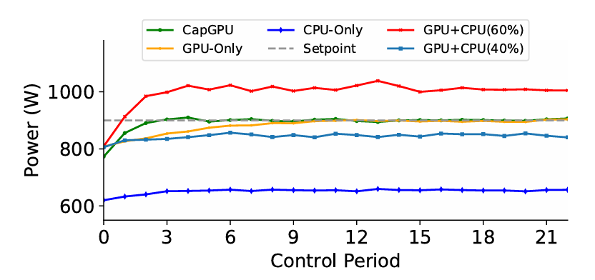
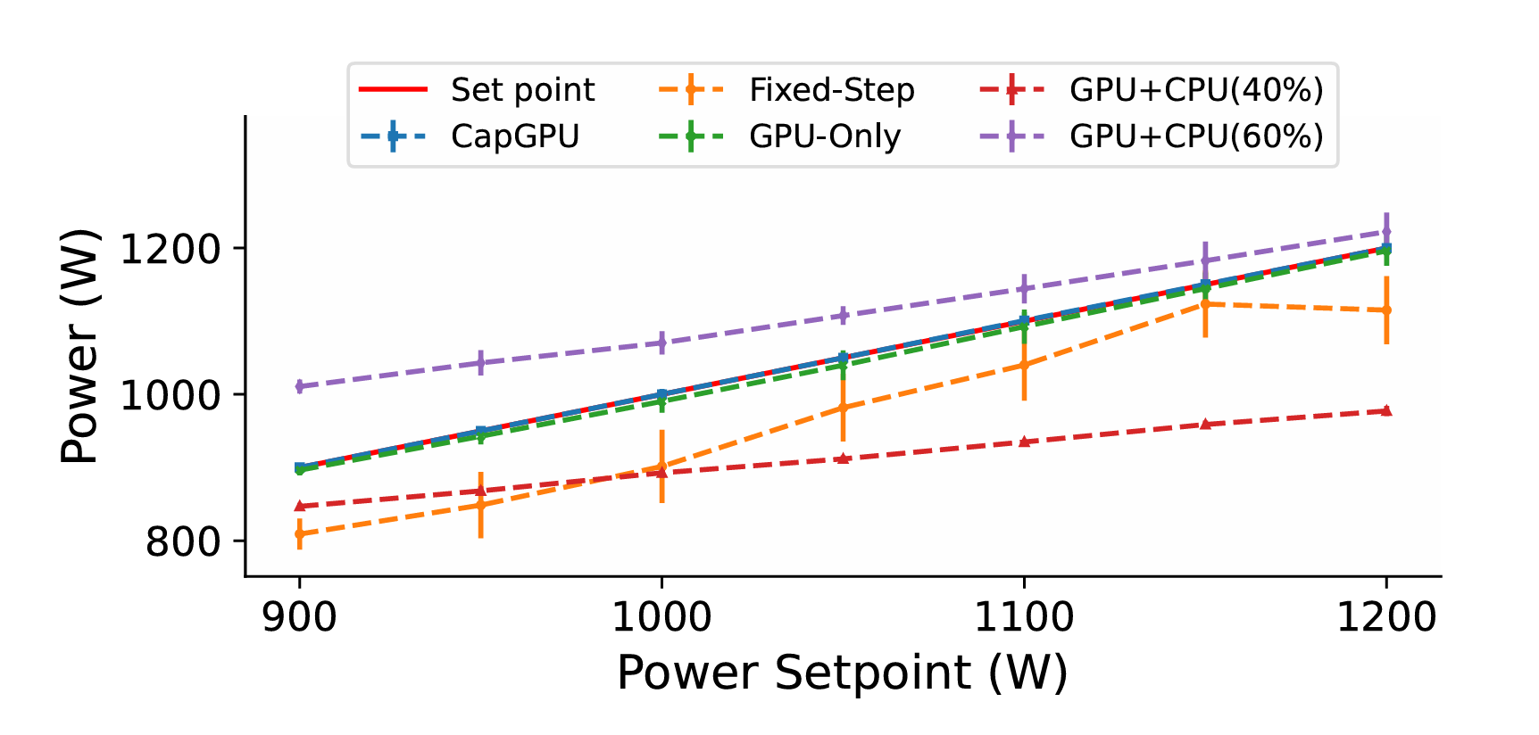
Comparison with Baselines
CapGPU has the most precise power control.
Notes:
The first evaluation we did the comparison with baselines,
While some baseline cannot even converge to the setpoints. Like CPU-Only cannot converge to setpoint is because the impact of cpu dvfs is comparably small when it is comparing with GPU. And GPU+CPU cannot converge to setpoint sometimes is because it is hard to find the suitable power allocation when cpu and gpu are doing two isolation loops. CapGPU has the most precise control as well as taking the minimum time to converge.
The right hand side can show that capGPU is able to converge to any power setpoint in the available range.
(不需要再念最后一行

Slide 14
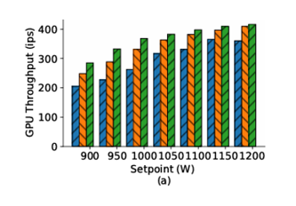
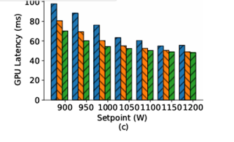
Comparison for Different Setpoints
In this experiments, we compare the performance of all the solutions.
CapGPU delivers the highest GPU inference throughput and the lowest latency.
More results are shown in the paper.
Notes:
In this evaluation, we compare the performance of all the solutions for different setpoints.
You may want to ask why we just show 3 methods in this figure, which is because the last experiments shows that not all methods are able to converge to setpoint, so we just remove those methods for this evaluation.
The left handside is GPU throughput and right hand side is latency. CapGPU is the green column.
It is clearly that CapGPU delivers the highest GPU inference throughput and the lowest latency, which means that CapGPU shows the best performance among State of the art techniques.
More results are shown in the paper, please check our paper for more results!

Slide 15
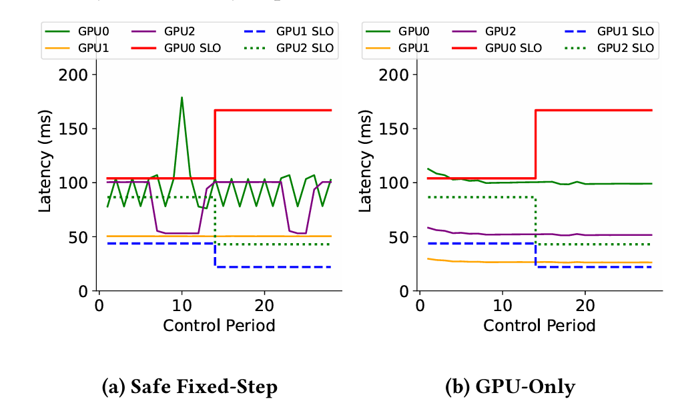
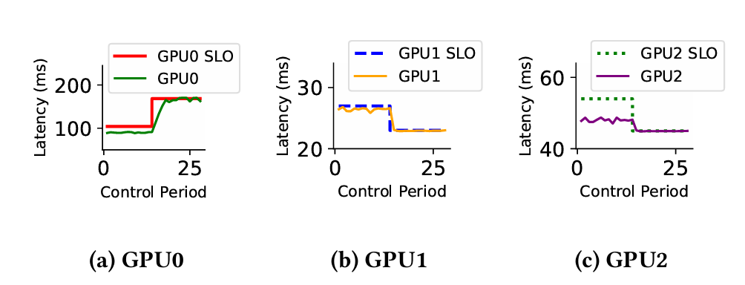
Time Varying SLO
Service Level Objective (SLO)
CapGPU is able to adapt changing SLOs of each inference task because of SLO constraints in MPC.
Notes:
The third evaluation is about varying SLO. Let me explain why we need this scenario here.
In many cloud-based ML inference services, SLO requirements often become stricter during periods of high demand.
For example on a art event on ChatGPT, thousands of users submitted prompts simultaneously, expecting quick image generation.
In such a situation, cloud service provider may ask for a stricter latency constraints to ensure quick response.
We push the changing slo in the middle of the run, in the left hand side, we show our baseline with no SLO specific design,
For example, lets look at the purple line, which is the latency curve of GPU2 while the SLO requirement for this GPU is shown in the green dashed line. we noticed that for both of fixed-step and GPU-only, actually the latency of them would not change with SLO requirement.
But in the right hand side. Is the results with CapGPU. We cansee the latency would change with the SLO requirement immediately because of the utilization of SLO constraints in MPC.
We also did an evaluation on time varying power setpoint in our paper, which also get a pretty good results comparing to baselines. You can check our paper if you are interested in that.

Slide 16
Conclusion
Power oversubscription
Power demand of modern inference server
Existing power capping cannot take coordinated control of GPU + CPU for inference servers.
CapGPU is the first MIMO power capping method coordinating both GPU and CPU on ML inference server.
More precise power control
Higher inference throughput
Better inference latency guarantees
Notes:
In conclusion, in this presentation, we went through Power oversubscription, And analysed the power demand of mordern inference server, which are the reasons why we have to do a power capping for inference GPU servers.
We also did a literature review for existing power techniques, and found that they cannot take the coordinated control of both GPU And CPU.
So we proposed the CapGPU, as the first MIMO power capping method coordinating both GPU and CPU on ML inference server.
With several evaluation on the test bed, we claimed that capGPU has more precise power control, higher inference throughput, and better inference latency guarantees comparing with 4 sota power capping techniques.

Slide 17
Acknowledgement
This work was supported in part by the U.S. National Science Foundation under Grants CNS-2336886 and CNS-2344505.

Slide 18
Thank you for listening!

Slide 19

Stability Analysis
The system is stable if the total power converges to the desired setpoint.
Ps is the desired setpoint.
p(k) is the total power.
Nominal Control Inputs
Actual System Model
Closed-Loop System
Pole Analysis
Notes:
We define stability as the server’s total power converging to the target setpoint over time — that is,
“The limit of p of k as k approaches infinity equals P sub s
To prove this, we follow a control-theoretic process:
Nominal control inputs are computed using the estimated system model, which relates CPU/GPU frequencies to total power.
But in reality, the actual system may behave slightly differently — so we model this deviation with a new parameter matrix A′A'A′.
We then substitute our nominal control inputs into this actual system to form the closed-loop system.
Finally, we perform pole analysis. If all poles lie within the unit circle in the complex plane, the system is guaranteed to converge — which it does under our design.
In short, CapGPU ensures that power control is not only adaptive, but also mathematically stable, even when hardware behavior shifts slightly

