Slide 1


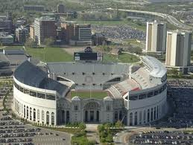
Latency-guaranteed Co-location of Inference and Training for Reducing Data Center Expenses
Guoyu Chen
Srinivasan Subramaniyan
Xiaorui Wang
Dept. of Electrical and Computer Engineering
The Ohio State University

Slide 2





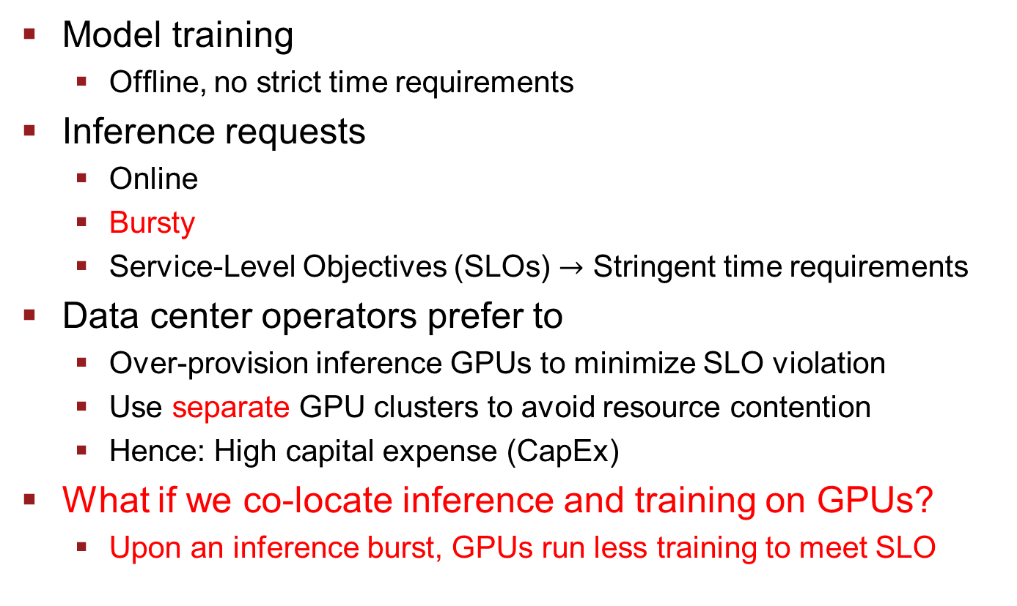
Cloud Services for ML
Model training
Offline, no strict time requirements
Inference requests
Online
Bursty
Service-Level Objectives (SLOs) $→$ Stringent time requirements
Data center operators prefer to
Over-provision inference GPUs to minimize SLO violation
Use separate GPU clusters to avoid resource contention
Hence: High capital expense (CapEx)
What if we co-locate inference and training on GPUs?
Upon an inference burst, GPUs run less training to meet SLO
Inference
Cluster
Training
Cluster
Number of
Inference requests
ChatGPT
Time

Slide 3
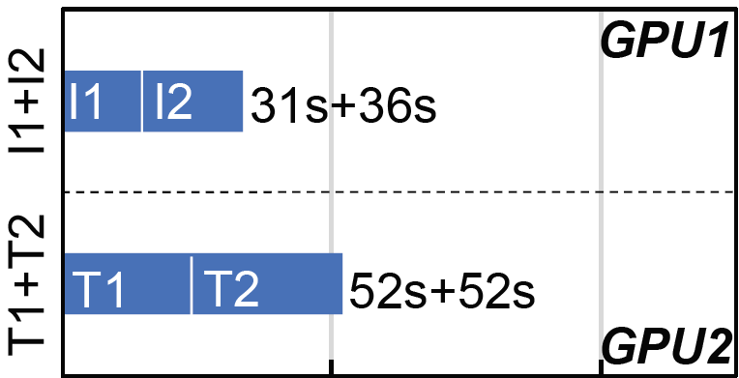
Baselines and Motivation
Example: 2 GPUs and 4 Jobs
No Co-location
Used in today’s data centers
Each GPU only runs one job at any given time
Wasting GPU resources
Using 2 GPUs
Long job duration
Job type | Inference |  | Training
Job name | I1 | I2 | T1 | T2
Needed GPU utilization (%) | 50 | 50 | 50 | 50
Duration when running alone (s) | 30 | 35 | 52 | 52
Inference latency SLO (s) | 56 | 61 | N/A | N/A
Notes:
Measurement is from Testbed

Slide 4
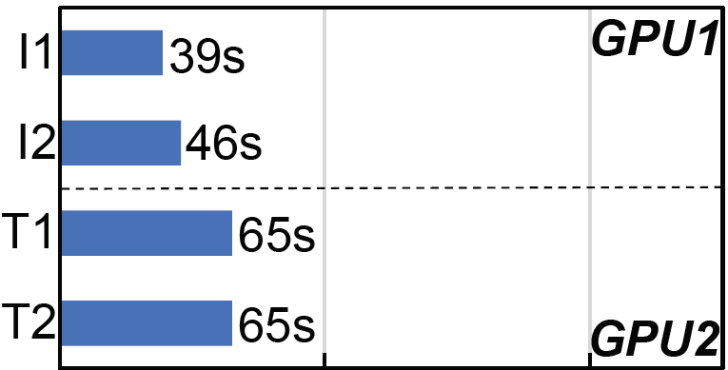
Baselines and Motivation
What if running parallel to reduce job duration?
Spatial sharing of GPU resources is enabled
Separate Co-location (GSLICE) [SoCC’20]
Training and inference jobs have dedicated GPUs
Each of the 4 jobs gets 50% GPU resources
Using 2 GPUs
Meeting SLOs (I1: 56s, I2: 61s)

Slide 5
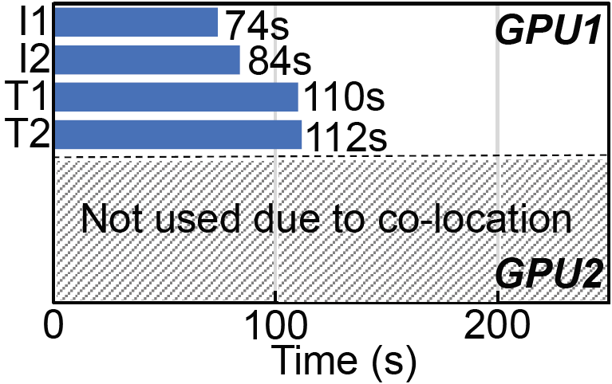
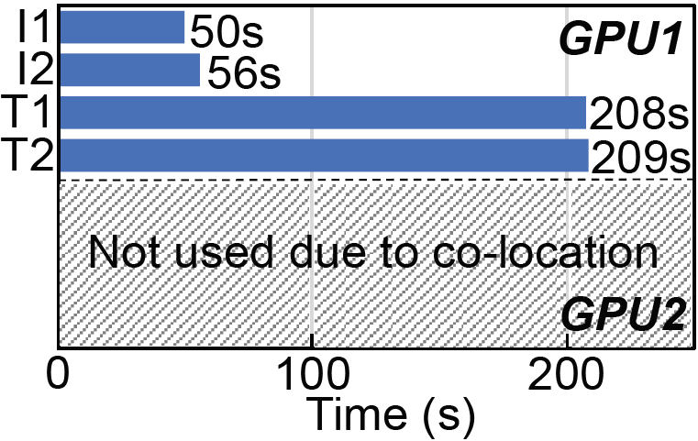
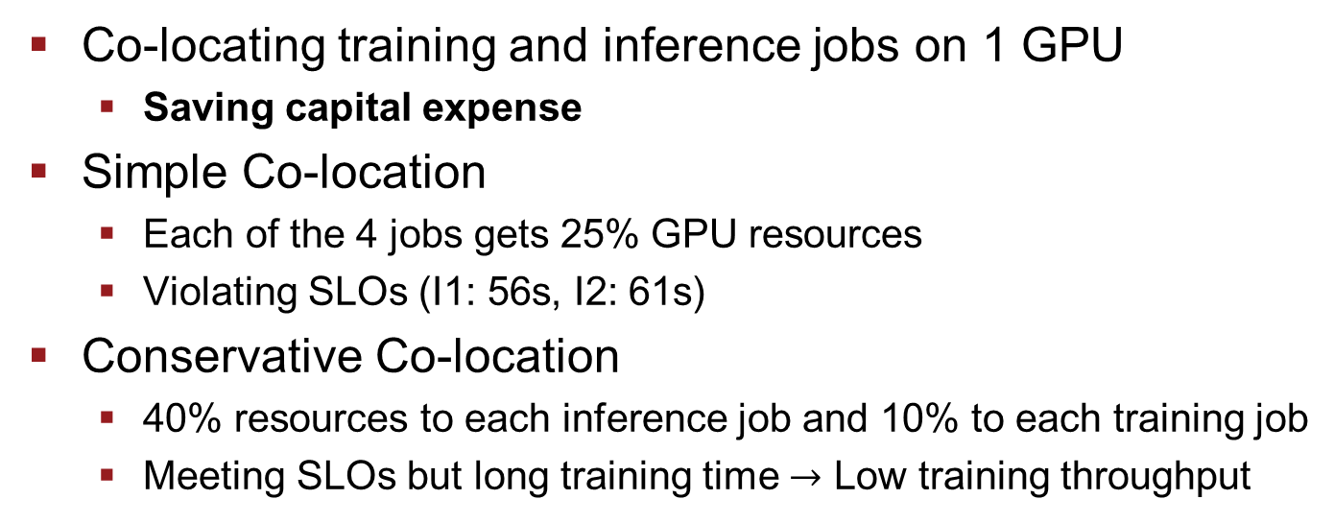
What if We Do Co-location?
Co-locating training and inference jobs on 1 GPU
Saving capital expense
Simple Co-location
Each of the 4 jobs gets 25% GPU resources
Violating SLOs (I1: 56s, I2: 61s)
Conservative Co-location
40% resources to each inference job and 10% to each training job
Meeting SLOs but long training time $→$ Low training throughput
Simple
Conservative
Notes:
How can we have both advantages?

Slide 6
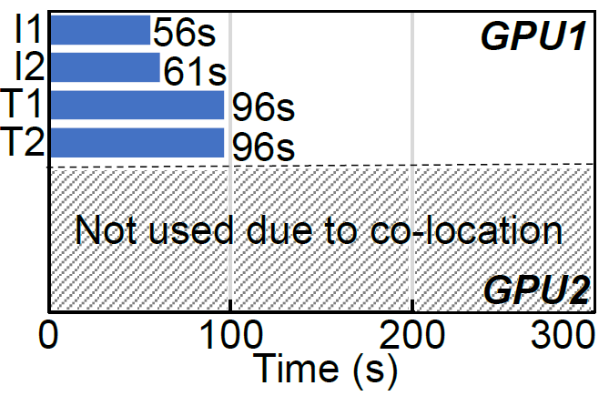
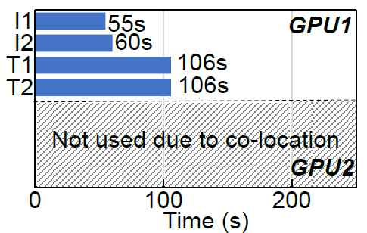
What if We Do Co-location?
SLO-aware co-location
Co-locates training and inference jobs on the same GPU
Dynamic GPU resource allocation under spatial sharing
Explicitly meeting SLOs → Higher training throughput
Training jobs use all resources after finishing inference jobs
Less training time
Ideal (w/o overheads), similar to our proposed solution
Ideal
Proposed

Slide 7
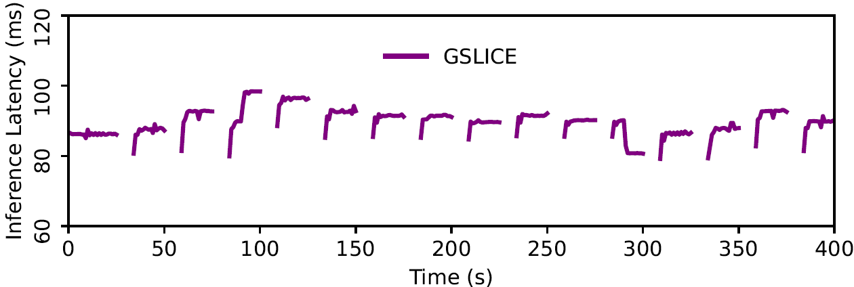
How to Allocate GPU Resources?
Multi-Process Service (MPS) on Nvidia GPUs
Provisions maximum percentage of active threads
Enables spatial sharing
Large overhead and needs restarting process
Periodic sleep of co-located training jobs
Releases GPU resources to co-located inference jobs
Lightweight and prompt adjustment
Implemented by sleep function with byte code
Use SIGSTOP and SIGCONT w/out byte code

Slide 8
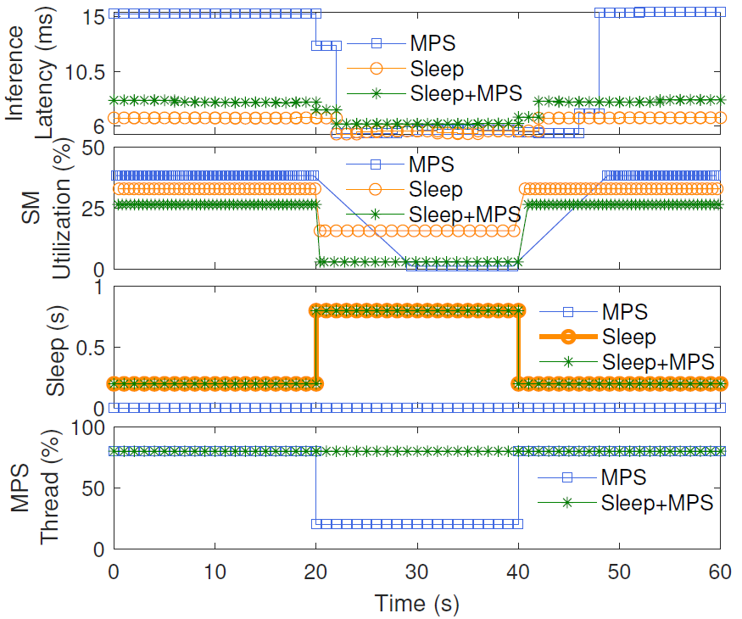
MPS vs. Sleep vs. MPS+Sleep
MPS: 7s large overhead
Sleep: Small latency adaption range
Sleep+MPS: Much smaller overhead and larger adaption range
Notes:
An example of co-locating 1 training job and 1 inference job

Slide 9
Proposed Solution: GPUColo
Training jobs
Two-tier control and co-location solution
Co-locates training and inference jobs
Based on control theory: proportional controllers
Inner loop adjusts sleep interval of training jobs
Outer loop optimizes MPS thread percentages of training jobs
Online inference requests
Inference Latency Control on Each Server
GPU Spatial
Sharing
GPU resource for inference
GPU resource for training
Job
Dispatcher
Training
iteration
Sleep
interval
Training
iteration
Bin packing
Time
Inner-loop Inference
Latency Controller
Server 1
GPU MPS
Actuator
Server 2
Inference Latency
Monitor
Server N
Outer-loop GPU
Resource Optimizer
Data Center
Notes:
Mention first-fit dispatching and packing
Inner loop: 4s
Outer loop: 100s

Slide 10
Advantages of GPUColo
Spatially co-locates training and inference jobs
Dynamic GPU resource adjustment for training and inference
Uses fewer GPUs so lower CapEx
Prompt latency control by using sleep
Small overheads
Fast convergence of latency to the SLO
Guaranteed system stability and control accuracy
Adaptation to workload changes
Fewer SLO violations
Higher training and inference throughput

Slide 11
Testbed and Simulation
Testbed
Two Nvidia RTX 3090 GPUs in two servers
PyTorch, TensorFlow and MXNet
Resnet50 for inference and Resnet101 for training
Dataset: images of the size 224x224
Simulation
Real-world ML trace from Alibaba 6500 GPU cluster [NSDI’22]
Implements clock, job dispatching, GPUs and controllers

Slide 12
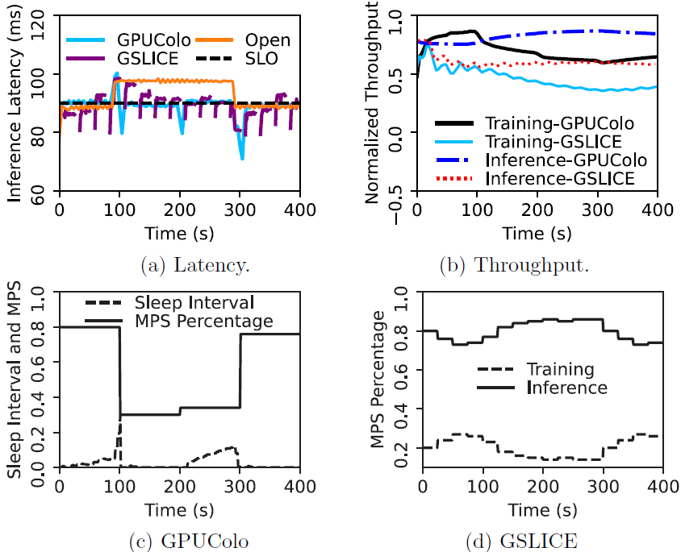
Results: GPUColo vs. GSLICE
State-of-the-art baseline: GSLICE [SOCC’20]
Separate co-location of training and inference jobs
Dynamic GPU resource allocation based on MPS only
Fragmented inference latency due to MPS restarting
GPUColo
Responds faster to meet the SLO with two-tier control
36.1% higher inference throughput and 51.5% higher training throughput due to smaller overheads
workload
increase

Slide 13
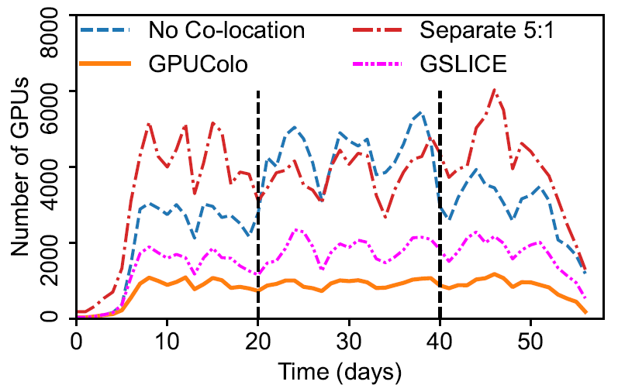
Results: Large-scale Simulation
Separate keeps inference GPUs 5 times training GPUs
Leading to a lot of unused inference GPUs [OSDI’20]
GPUColo uses less GPUs by co-location
74.9% less GPUs than No Co-location
50.2% less GPUs than GSLICE
Saving up to $22.9M capital expense ($10k for each A100 GPU)
3:1
6:1
3:1=Number of Inference:Training

Slide 14
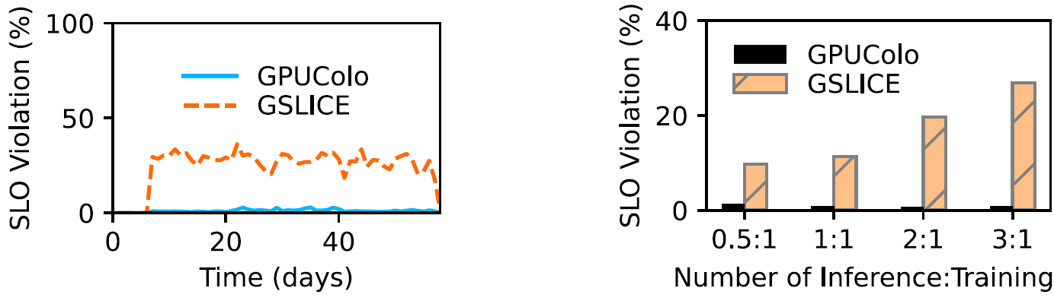

Results: SLO Violation in Simulation
GSLICE
Co-located inference jobs competes for GPU resources
28.4% SLO violation on average (Inference:Training=3:1)
More inference jobs $→$Higher SLO violation rates
GPUColo
Inference jobs can always get more resources to meet SLOs
1.1% SLO violation on average

Slide 15
Conclusion
ML cloud services are popular in data centers
Inference requests are bursty
Inference GPUs are over-provisioned to meet SLOs
Separate inference and training GPU clusters
Hence: High capital expense
GPUColo: Two-tier control and co-location solution
Spatially co-locates training and inference jobs
Dynamically allocates GPU resources to training and inference
Provides explicit SLO guarantees
Saves up to 74.9% GPUs for a lower capital expense

Slide 16

Thanks for your attention!
Q&A
This work is supported, in part, by the U.S. NSF under award CNS-2336886.

Slide 17
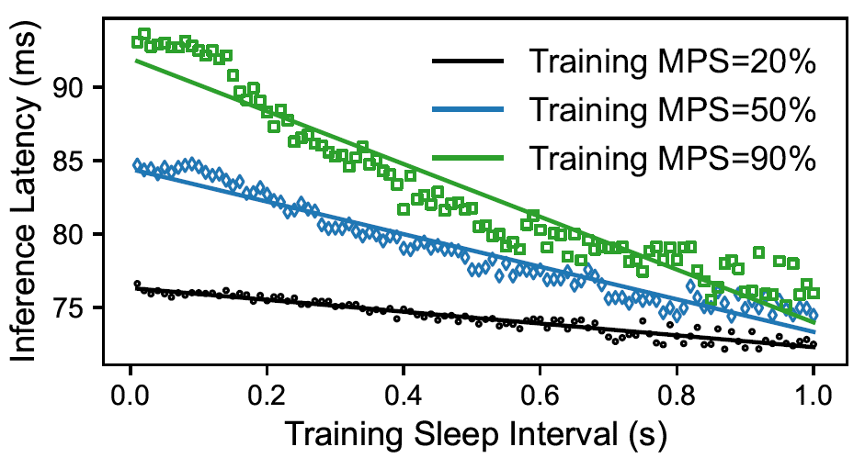
GPUColo Controller Design
Linear model between latency and training sleep interval
4s control period
Linear model between latency error and MPS percentage
100s control period
Proportional controller
System identification result:
Notes:
The workload of set 1 and set 2 has a batch size 100 and 105, respectively.

Slide 18
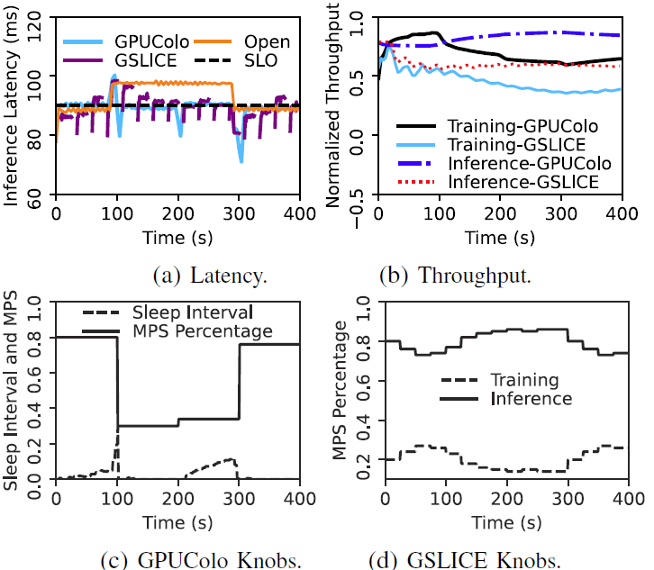
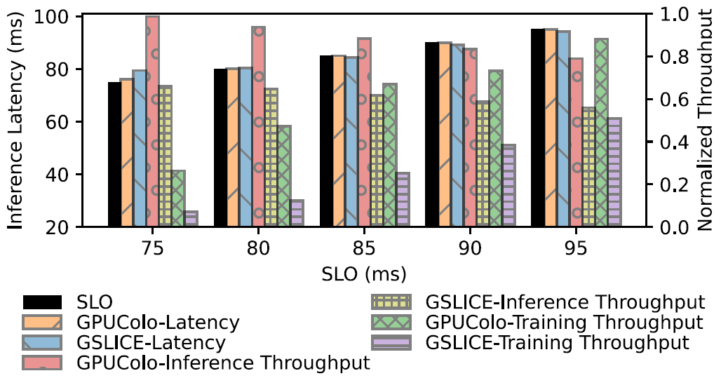
GPUColo vs. GSLICE Cont’d
GPUColo has better control accuracy than GSLICE
Up to 49.27% higher inference throughput at 75ms
Up to 2.8× higher training throughput at 80ms

Slide 19
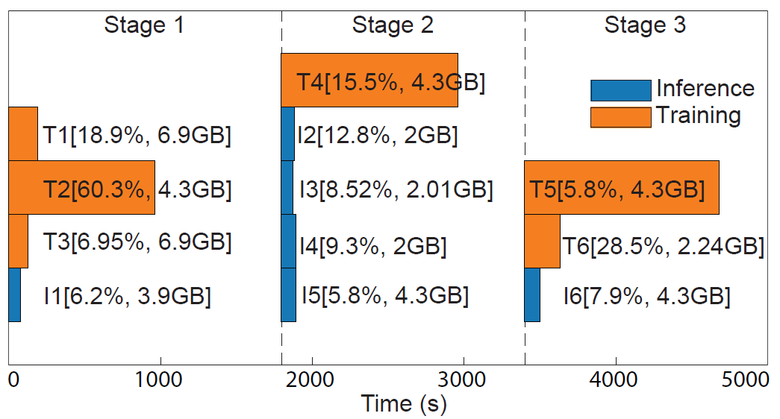
Evaluation of Real-world Trace Samples
6 inference jobs and 6 training jobs

Slide 20
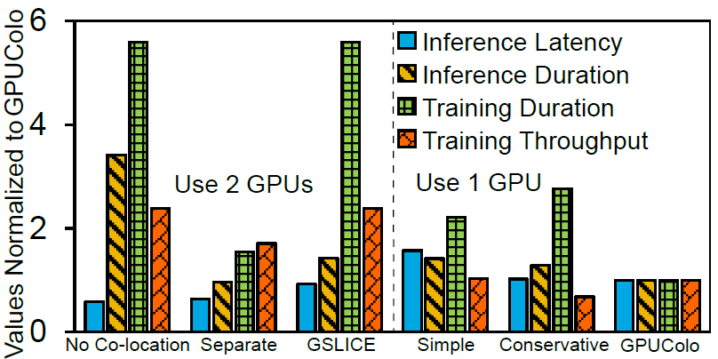
Evaluation of Real-world Trace Samples
No Co-location, Separate and GSLICE must use 2 GPUs
No Co-location has longer duration due to sequential running
GSLICE has longer duration due to MPS overheads
Simple violates SLOs due to equal GPU resource sharing
Conservative has lower training throughput
GPUColo uses 1 GPU and meets SLOs with two-tier control

Slide 21
GPUColo Controller Deployment
1: One controller for the entire data center
Centralized solution
Long communication delay
Control decision outdated due to long computation
2: One controller per inference job
Distributed strategy
Confliction between controllers
3: One controller per co-located GPU
Our choice
Scalable without having conflict

