Slide 1
Bluestock Mutual Fund Analytics Capstone Project
Prepared By:
Srinivasan S
Tools Used:
Python | Pandas | NumPy | SQLite | SQL | Power BI

Slide 2
Executive Summary
Built an end-to-end mutual fund analytics platform using Python, SQLite, SQL and Power BI.

Slide 3
Business Problem
Investors need better tools to compare funds, evaluate risk and understand performance.

Slide 4
Project Architecture
Raw Data → ETL → SQLite → Analytics → Dashboard → Insights

Slide 5
Dataset Overview
Fund Master, NAV History, AUM, SIP Inflows, Transactions, Holdings and Benchmarks.

Slide 6
ETL Pipeline
Extraction, Transformation and Loading into SQLite and processed datasets.

Slide 7
EDA Findings
Industry AUM growth, SIP trends, category inflows and fund house rankings.

Slide 8
Performance Analytics
CAGR, Sharpe Ratio, Alpha, Beta, Maximum Drawdown and Fund Score.

Slide 9
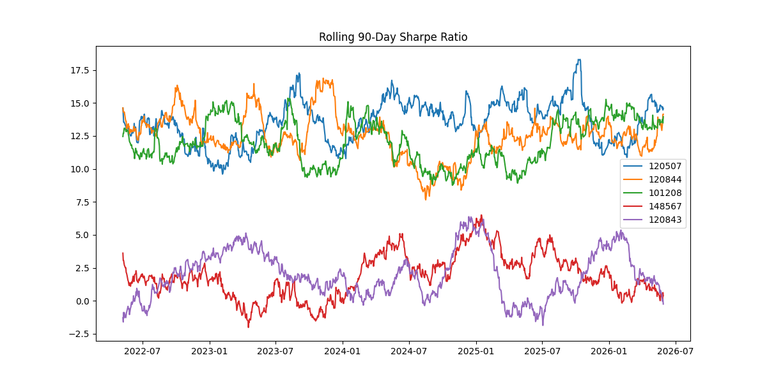
Advanced Analytics
VaR, CVaR, Rolling Sharpe Ratio, HHI, Cohort Analysis and SIP Continuity.
• Historical VaR (95%) calculated for 40 schemes
• CVaR used to measure tail risk exposure
• Rolling 90-Day Sharpe Ratio evaluated consistency
• HHI calculated for 34 portfolios
• Investor Cohort Analysis performed
• SIP Continuity Analysis identified at-risk investors
Notes:
• Historical VaR (95%) calculated for 40 schemes
• CVaR used to measure tail risk exposure
• Rolling 90-Day Sharpe Ratio evaluated consistency
• HHI calculated for 34 portfolios
• Investor Cohort Analysis performed
• SIP Continuity Analysis identified at-risk investors

Slide 10
Investor Analytics
Investor cohorts and SIP continuity analysis.

Slide 11
Key Insights
High Sharpe funds delivered better risk-adjusted returns; SIP participation is growing.

Slide 12
Recommendations
Focus on risk-adjusted returns, diversification and SIP retention.

Slide 13
Future Scope
Monte Carlo Simulation, Efficient Frontier and Streamlit deployment.

Slide 14
Project Outcomes
40 Mutual Fund Schemes Analyzed
SQLite Database Developed
4 Interactive Power BI Dashboards Created
VaR & CVaR Calculated
Rolling Sharpe Ratio Implemented
HHI Portfolio Analysis Completed
Fund Recommendation Engine Developed

Slide 15
Conclusion
Comprehensive mutual fund analytics solution successfully developed.

Slide 16
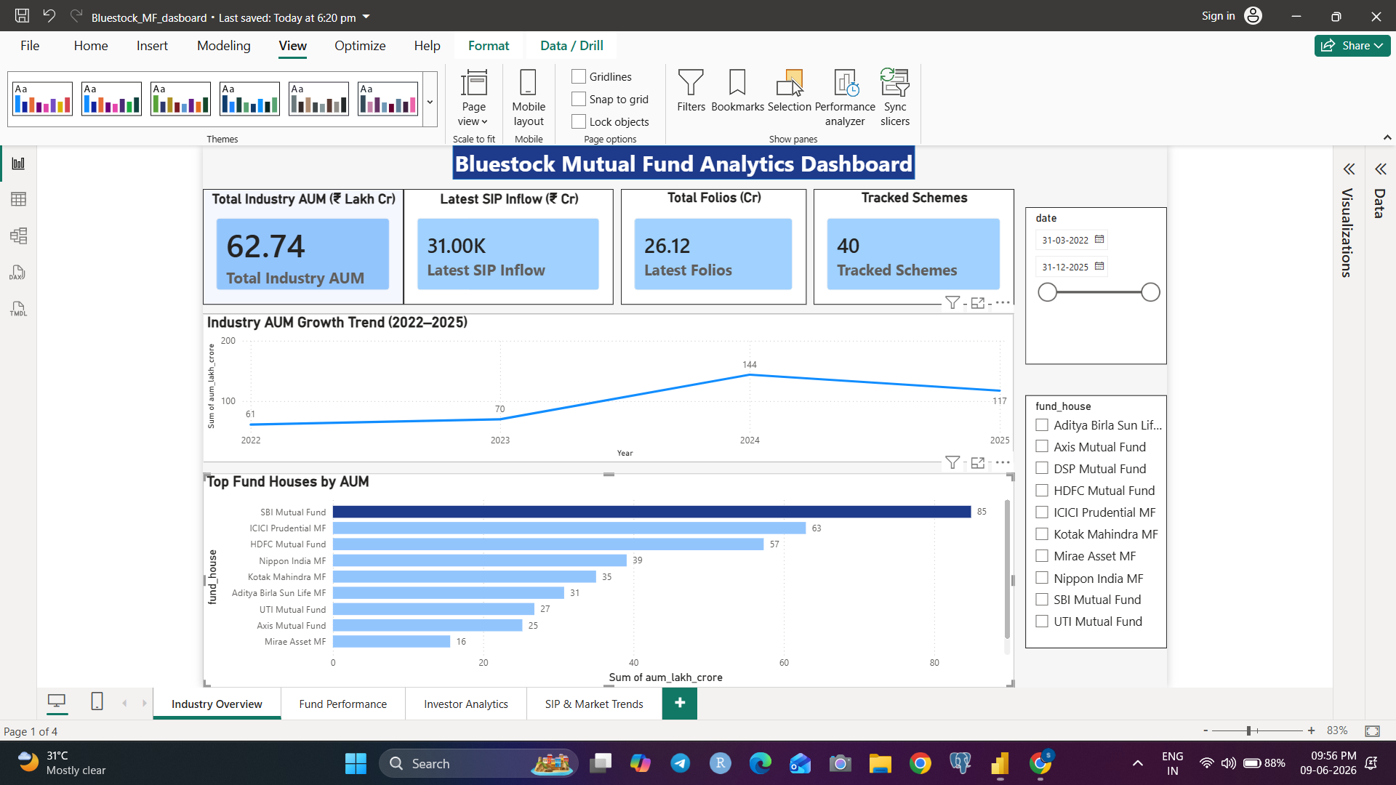
Dashboard - Industry Overview

Slide 17
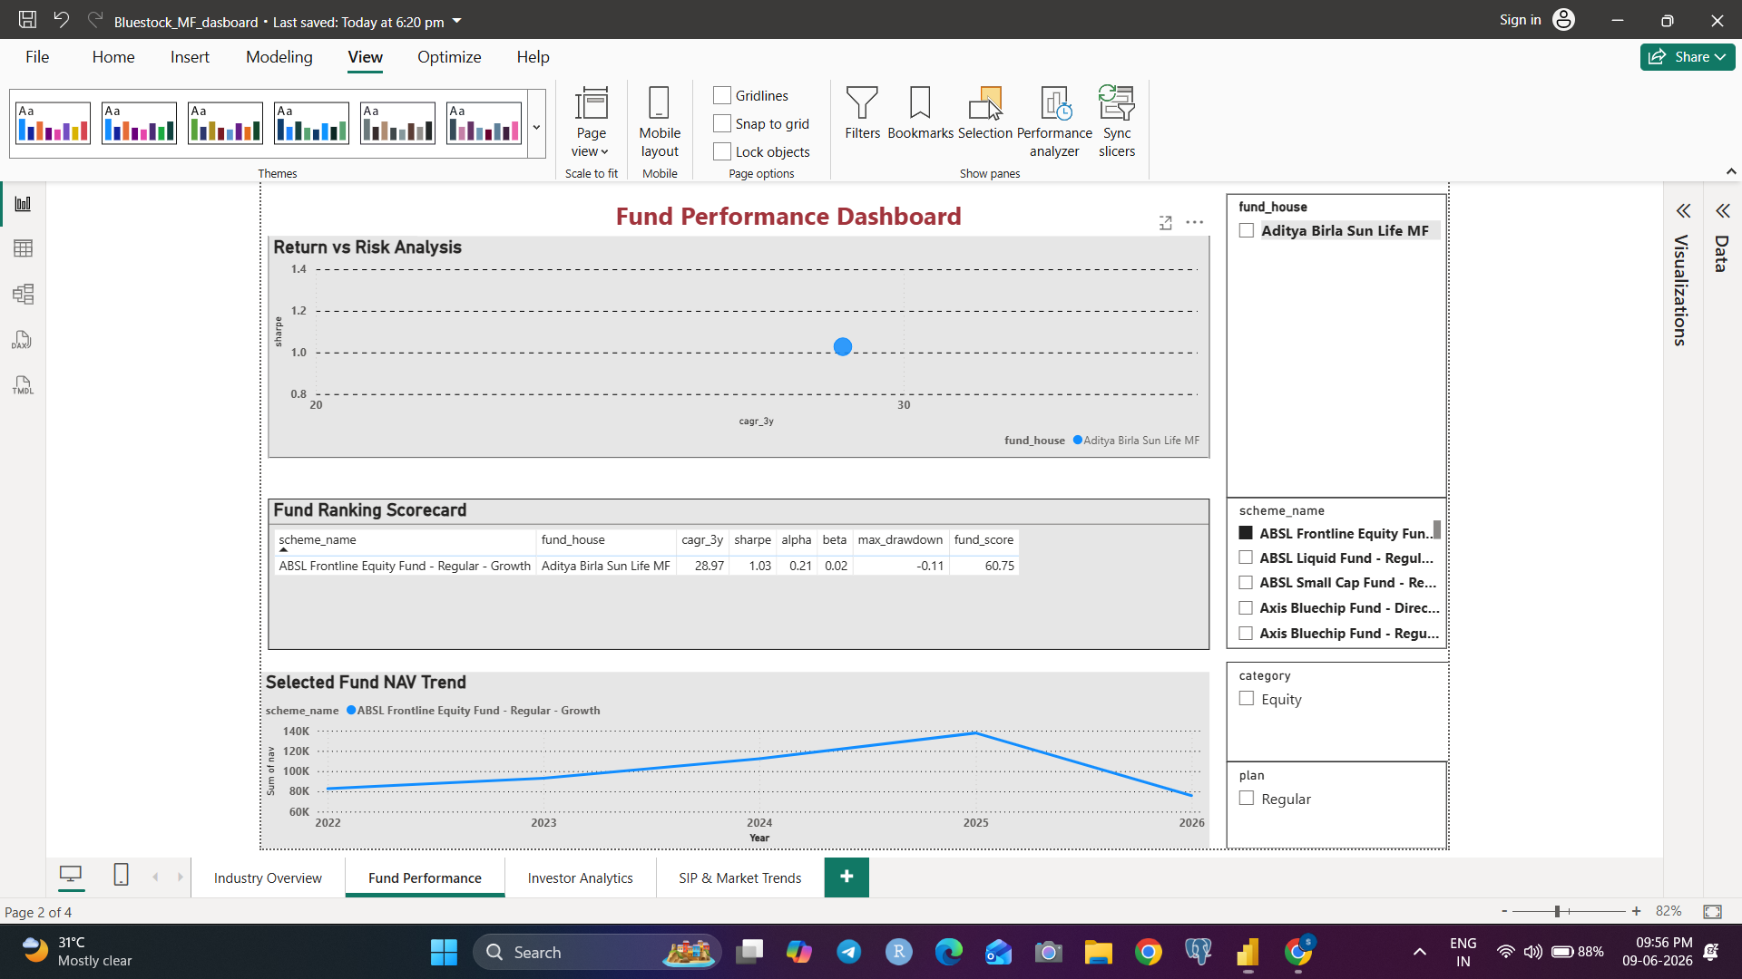
Dashboard - Fund Performance

Slide 18
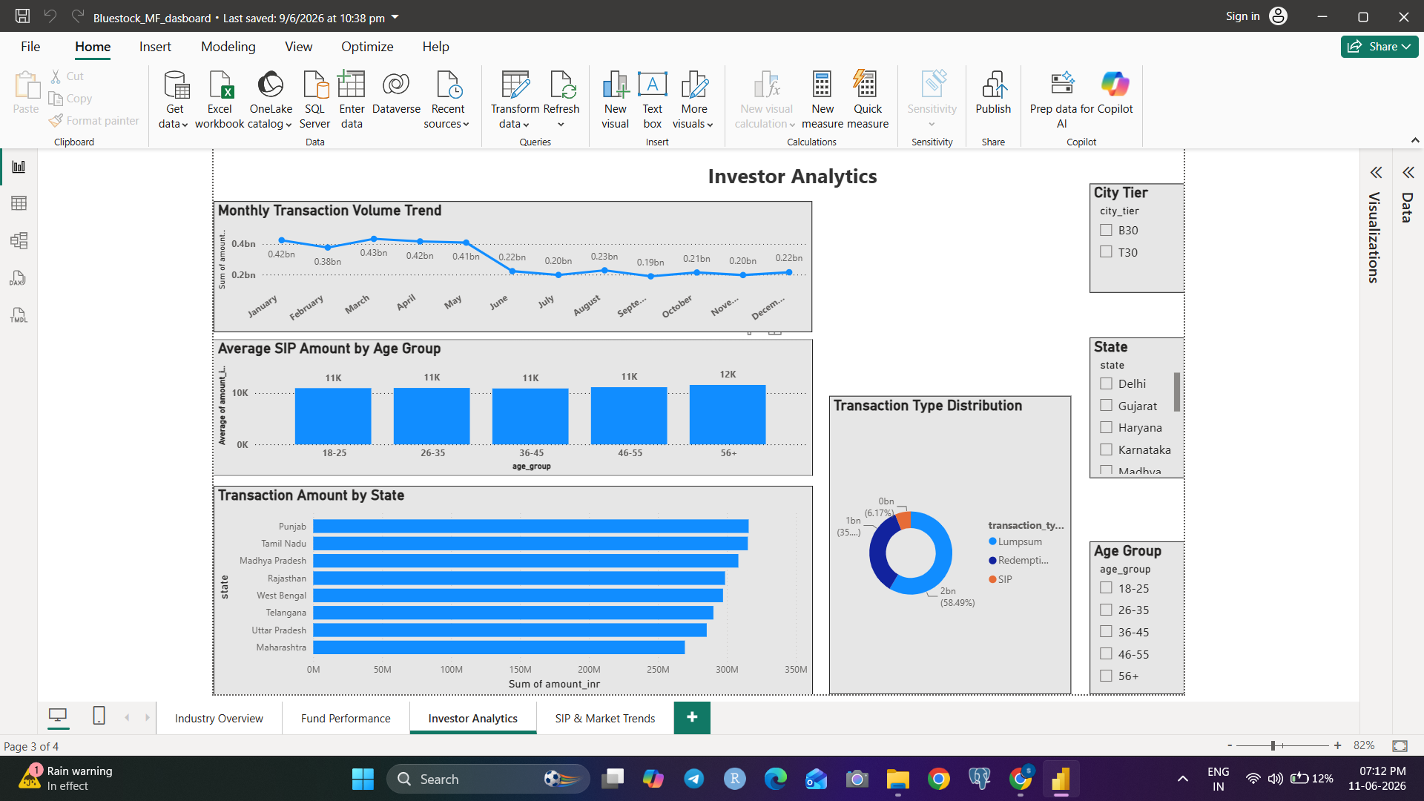
Dashboard - Investor Analytics

Slide 19
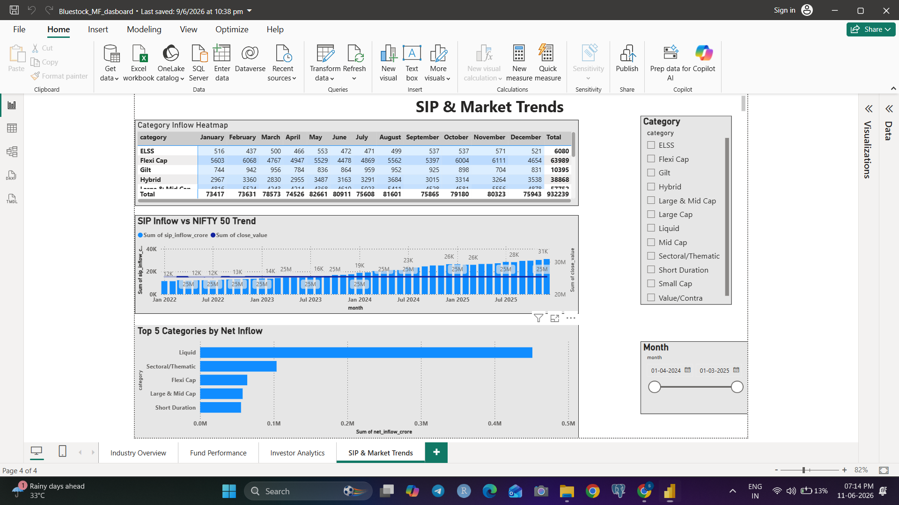
Dashboard - SIP & Market Trends

