Slide 1
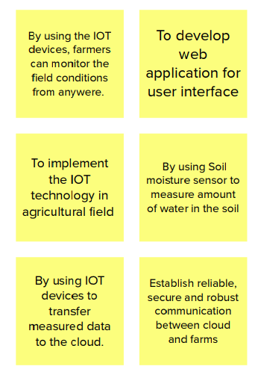
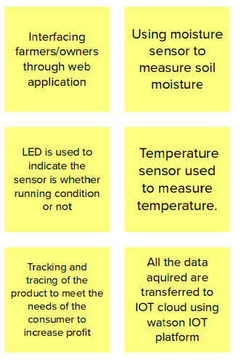
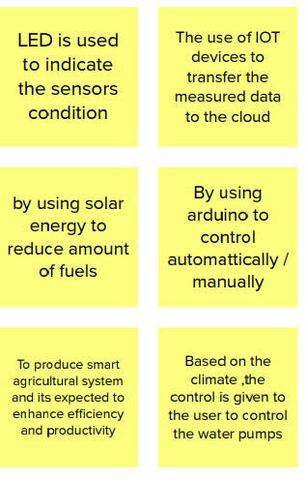
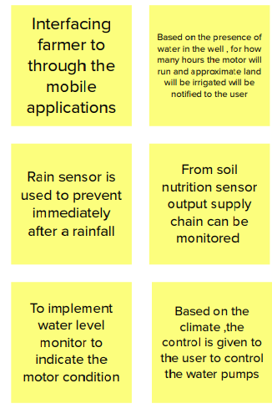
SmartFarmer - IoT Enabled Smart Farming Application
Srinivasa Prithvi KS
Surendar S
Pavan Mukesh
Rithika M

