Slide 1
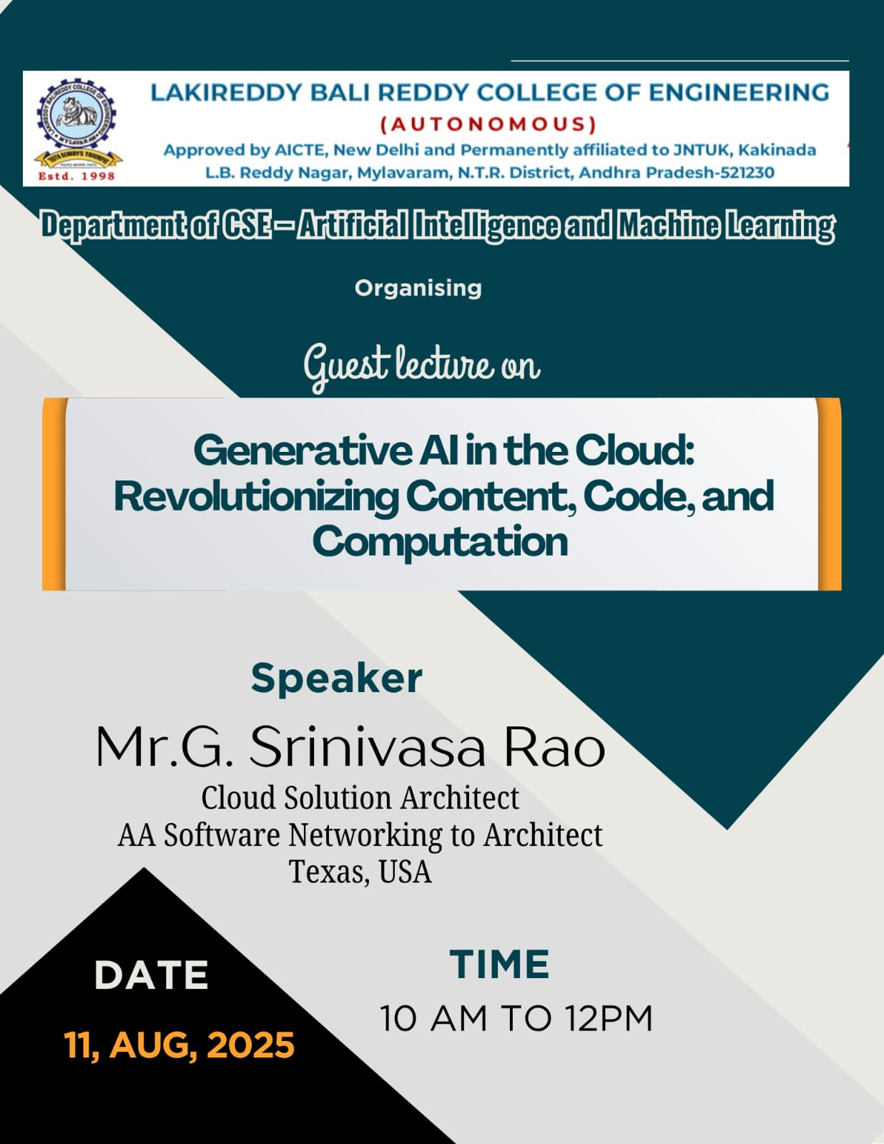

Slide 2
* 25 Years of IT Experience * 9 + Years as Solution Architect * 15 Years offshore * Indosoft International Hyderabad - Web Developer 1 Year * ITC Infotech UK, Bangalore India - Java Developer 4 Year * SLK Software, Bangalore, India - Sr. Java Developer 2 years * Cognizant Technologies India - Tech Lead 6 Years, Application Architect 3 Years * Cognizant Technologies USA - Solution Architect -Dallas USA - 6 Years * AA Software & Networking Inc, Dallas USA. - Cloud Engineer, Cloud Solution Architect
Above me
Certifications:
Java Certified Developer
Java Certified Architect
Cognizant Certified Solution Architect- India
AWS Certified Solution Architect
Srinivasa Rao Gurram M.Tech CS
Clients
Financial Clients:
PayPal, MoneyGram
Education:
College Board
Connected Vehicles:
Sirius XM Connected Vehicle Services Inc.
Food :
TECO Bell
Telecom:
Verizon, T-Mobile
HealthCare:
Farmers Insurance, UHG, Kaiser, Pleasanton, CA
Airline:
Delta Airlines, Atlanta
Expert in:
Cloud Migration
Serverless Architect using AWS Lambda Platform

Slide 3
From AWS Foundations to AI Practitioner & Next-Gen AI Paradigms
Cloud Foundations to AI Practitioner: Comprehensive Learning Journey

Slide 4
Agenda
1
Generative AI in the Cloud: Revolutionizing Content, Code, and Computation
2
Course Objectives
4
Certification Roadmap Overview
5
Core Domains (AWS Cloud Practitioner)
6
Real-World Concepts & Best Practices
7
AI Practitioner Domains & Weightings
8
Domain 1: AI/ML Foundations
9
Domain 2: Generative AI

Slide 5



About the Speaker
Meet Srinivasa Rao Gurram: Your Guide in AI and Cloud Technologies
Expertise in AI and Cloud Technologies
Srinivasa Rao Gurram is a recognized authority in the realms of artificial intelligence and cloud computing. His extensive portfolio includes a variety of projects that harness these advanced technologies, driving significant innovation and operational efficiency across multiple sectors.
Industry Experience
With more than ten years of experience in the technology sector, Srinivasa has partnered with top-tier organizations to deploy AI-driven solutions that not only optimize operational workflows but also enhance customer interaction and satisfaction.
Passionate Educator
Srinivasa is deeply committed to education, striving to empower aspiring tech professionals. His teaching philosophy revolves around interactive learning and the practical application of AI and cloud principles, ensuring students are well-prepared for real-world challenges.
Notes:
In this segment, we are thrilled to introduce our esteemed speaker, Srinivasa Rao Gurram. With a profound expertise in both artificial intelligence and cloud technologies, Srinivasa has been at the forefront of innovation in these fields. His extensive industry experience spans over a decade, during which he has successfully led projects that integrate AI solutions into various business models, significantly enhancing operational efficiency and customer satisfaction. Beyond his professional accomplishments, Srinivasa is a passionate educator, dedicated to nurturing the next generation of tech leaders. His teaching approach emphasizes practical applications and real-world relevance, ensuring that students not only grasp theoretical concepts but also understand their implications in the industry. We are excited to have him guide us through this comprehensive learning journey.

Slide 6



Generative AI in the Cloud: Revolutionizing Content, Code, and Computation
Cloud Foundations to AI Practitioner: Comprehensive Learning Journey
Innovative Integration of AI and Cloud
The convergence of AI technologies and cloud computing platforms is fundamentally reshaping various domains by enabling seamless scalability and flexibility in deploying AI solutions.
Empowerment Through Education
Targeted towards undergraduate and graduate students, this course serves to equip learners with essential knowledge that bridges theoretical understanding and practical skills in the AI and cloud computing space.
Expertise from Industry Leaders
Delivered by Srinivasa Rao Gurram, an esteemed guest lecturer, participants will benefit from insights that come from real-world applications and industry best practices in AI and cloud services.
Notes:
The evolution of technology has brought forth an exciting paradigm where generative AI is harmoniously embedded within cloud environments. This integration offers unprecedented opportunities for content creation, coding assistance, and computational efficiencies across diverse sectors. With this course designed specifically for undergraduate and graduate students, we aim to provide a comprehensive educational journey. By learning from recognized industry leaders like Srinivasa Rao Gurram, participants will gain valuable insights that not only reflect academic rigor but also respond to the dynamic needs of the industry.

Slide 7


Course Objectives
Building Foundational Expertise in Cloud and AI
AWS Cloud Foundation Mastery
Participants will cultivate a robust understanding of the AWS Cloud landscape, culminating in the AWS Certified Cloud Practitioner certification, which serves as a pivotal first step in cloud literacy.
AI Practitioner Certification Preparation
By delving into advanced AI concepts, learners will acquire necessary skills and knowledge to succeed in the AWS Certified AI Practitioner exam, enabling them to validate their expertise in AI and cloud.
Exploration of Generative AI Technologies
The curriculum incorporates a comprehensive investigation into the world of generative AI, including techniques like Vibe Coding and Agent-AI interactions, ensuring readiness for emerging careers in AI-driven roles.
Notes:
The objectives of this course are strategically constructed to build a substantial foundation for students in the realm of cloud computing and artificial intelligence. Our first goal is for participants to achieve AWS Cloud certification, which signifies a strong grasp of foundational cloud tenets. Following that, we will explore crucial AI principles and prepare learners for certification as AWS AI Practitioners. In addition, the course emphasizes the burgeoning field of generative AI by investigating cutting-edge methodologies and technologies, making our learners well-positioned to secure AI-focused roles.

Slide 8



Certification Roadmap Overview
A Structured Path to Cloud and AI Mastery
Phase 1: Establishing Cloud Fundamentals
The first phase entails laying down essential AWS Cloud Practitioner content necessary for understanding cloud services and infrastructure, along with critical examination preparedness.
Phase 2: Diving into AI Practitioner Domains
In this stage, participants will engage deeply with the domains covered in the AWS AI Practitioner exam, enhancing their readiness through practice-oriented learning.
Phase 3: Advanced AI Paradigms Exploration
The final phase focuses on navigating advanced AI paradigms including generative AI, agent protocols, and coding workflows, ensuring participants are equipped for the evolving landscape.
Notes:
Navigating through the landscape of cloud and AI certifications can be a daunting task; however, our structured roadmap provides a clear and efficient pathway. The journey begins with Phase 1, which focuses on core concepts of AWS Cloud necessary for foundational understanding. Phase 2 elevates the learners into the intricacies of AI, preparing them for the corresponding certification exam. Finally, Phase 3 propels them into advanced paradigms, including innovative applications of generative AI and related technologies, ensuring they are well-prepared for modern cloud roles.

Slide 9
Core Domains (AWS Cloud Practitioner)
Essential Components of AWS Knowledge
Valuating AWS Cloud Capabilities: Understanding the value proposition of AWS empowers practitioners to leverage its unique benefits, including elasticity, performance, and cost efficiency.
Shared Responsibility Model Insights: Familiarity with the shared responsibility model is crucial for managing security and compliance, delineating boundaries between customer and provider responsibilities.
Security Best Practices Framework: Implementing security best practices not only protects cloud assets but also instills customer confidence and meets regulatory mandates.
AWS Economics: Billing & Optimization: Mastering cost optimization strategies within AWS helps organizations manage expenses effectively while maximizing value from their cloud investments.
Comprehending AWS Global Infrastructure: Recognizing the layout of AWS’s global infrastructure aids stakeholders in deploying applications that are highly available and resilient across regions.
Notes:
To become proficient as an AWS Cloud Practitioner, it's imperative to navigate through the core domains that shape cloud competency. Recognizing the tangible benefits of AWS creates strategic advantages in leveraging its resources effectively. Understanding the shared responsibility model not only helps in clarifying security tasks but also ensures compliance with vital regulations. It's equally important to implement stringent security practices and focus on economic aspects such as cost control and optimization. Lastly, a thorough comprehension of the global infrastructure enables us to make informed decisions regarding deployment and availability.

Slide 10




Real-World Concepts & Best Practices
Translating Theory into Practice
AWS Well-Architected Framework
Familiarity with the Well-Architected Framework is essential for evaluating and improving cloud architecture through enhanced performance, security, reliability, and cost-effectiveness.
Cloud Adoption Framework Utilization
The Cloud Adoption Framework serves as a guideline for organizations to strategically transition to the cloud through providing best practices for implementation and governance.
Effective AWS Support Plans
Understanding various AWS Support Plans enables organizations to choose appropriate levels of support based on operational requirements and business priorities.
Management Tools for Governance
Utilizing management tools empowers cloud architects to monitor and control resources efficiently, ensuring compliance and optimal resource usage.
Notes:
The journey from theoretical understanding to real-world application hinges on comprehending industry best practices. Adopting the AWS Well-Architected Framework fundamentally refines cloud architecture by promoting crucial principles like security and cost management. Further, employing the Cloud Adoption Framework can streamline the migration process and enforce governance. An adept selection of AWS Support Plans ensures that organizations have the required backing, while various management tools facilitate effective oversight, measurement, and optimization of cloud resources.

Slide 11
AI Practitioner Domains & Weightings
Understanding Key Areas of AI Knowledge
Domain 1 (20%): AI & ML Fundamentals: An essential grasp of fundamental AI and ML concepts is foundational, guiding practitioners through the intricacies of model pipelines and their applications.
Domain 2 (24%): Generative AI Foundations: A deeper dive into generative AI, encompassing topics like tokenization and foundation models, represents a significant part of the certification framework.
Domain 3 (28%): Applications of ML Models: Understanding real-world applications of foundation models, including retrieval-augmented generation and embedding techniques, is critical for practical implementation.
Domain 4 (14%): Responsible AI Practices: A focus on responsible AI addresses crucial considerations related to fairness, bias, and ethical frameworks that guide AI implementations for social good.
Domain 5 (14%): Compliance and Security in AI: Knowledge of security, compliance, and governance procedures in AI solutions helps ensure that implemented systems adhere to regulatory standards.
Notes:
The structuring of AI knowledge into distinct domains allows for an organized approach to learning and certification. Domain 1 lays the groundwork in AI and ML fundamentals, facilitating understanding of pivotal concepts. The significance of generative AI, as covered in Domain 2, showcases innovations and advancements shaping today’s AI space. Domain 3 emphasizes practical applications of the technology, which has become increasingly important in various industries. Meanwhile, Domains 4 and 5 delve into the ethical dimensions and security concerns surrounding AI implementation, ensuring practitioners are equipped to use AI responsibly within frameworks of compliance.

Slide 12

Domain 1: AI/ML Foundations
Exploring the Basics of Artificial Intelligence and Machine Learning
Terminology Clarity
Establishing a clear understanding of terminology such as artificial intelligence, machine learning, deep learning, and natural language processing is fundamental for novices and experts alike.
Comprehensive ML Pipeline
Mastery of the ML pipeline stages, encompassing data preparation, training processes, evaluation metrics, deployment strategies, and ongoing monitoring practices, is essential.
AWS Tool Familiarization
Familiarity with AWS-specific tools like SageMaker and Data Wrangler empowers practitioners to utilize robust platforms for managing ML workflows effectively.
Notes:
In Domain 1, we delve into the foundational aspects of artificial intelligence and machine learning, where clarity in terminologies lays the bedrock for deeper learning. A well-structured understanding of the machine learning pipeline, from data preparation through to deployment and monitoring phases, is key for creating effective AI models. Additionally, leveraging AWS tools like SageMaker and Data Wrangler ensures that practitioners are armed with the technology necessary to streamline these processes and enhance their learnings.

Slide 13
Domain 2: Generative AI
Harnessing the Power of Generative Technologies
Fundamental Concepts Exploration
An essential examination of foundational generative AI concepts including tokens, embeddings, and transformer architectures guides the learner through complex AI structures.
Diverse Use Cases
Identifying numerous applications of generative AI across domains such as content creation, automated summarization, interactive chatbots, and dynamic code generation showcases its versatility.
AWS Generative AI Services
Acquainting learners with AWS offerings such as SageMaker JumpStart and Amazon Bedrock empowers them to leverage cloud-based tools for their generative AI tasks.
Evaluating Pros and Cons of Generative AI
Understanding limitations such as hallucinations and latency alongside benefits helps in making informed decisions regarding the adoption of generative AI solutions in businesses.
Notes:
In this final domain, we focus on the transformative power of generative AI technologies. It is imperative to first grasp foundational concepts, including key elements that constitute the structure of generative models, such as tokens and embeddings. From here, we can explore diverse use cases that highlight how generative AI is revolutionizing fields like content generation, automated interactions, and even coding workflows. By utilizing AWS's tailored services for generative AI, learners can effectively implement these capabilities. Lastly, a careful evaluation of both the advantages and limitations of generative AI will equip practitioners with the insight necessary to navigate this innovative landscape strategically.

