Slide 1

Oakora: A Scalable Microservices-Based Online Furniture Marketplace
Project Title
SOA Project Review-1
Team Members Name: A.Srinivas Roll Number 2420030349
Name:S.Roshan Roll Number 2420030528 Name:M.Pranay Roll Number 2420030562
 | Under the Guidance of Dr.K.Venkateswari CSE Professor, Department of Computer Science and Engineering, KLH CSE Bowrampet Campus

Slide 2
Outline of Project Work
Focus
Introduction
Literature Survey
Challenges
Research Objectives
Conclusion & Future Work
References
Publications Details

Slide 3
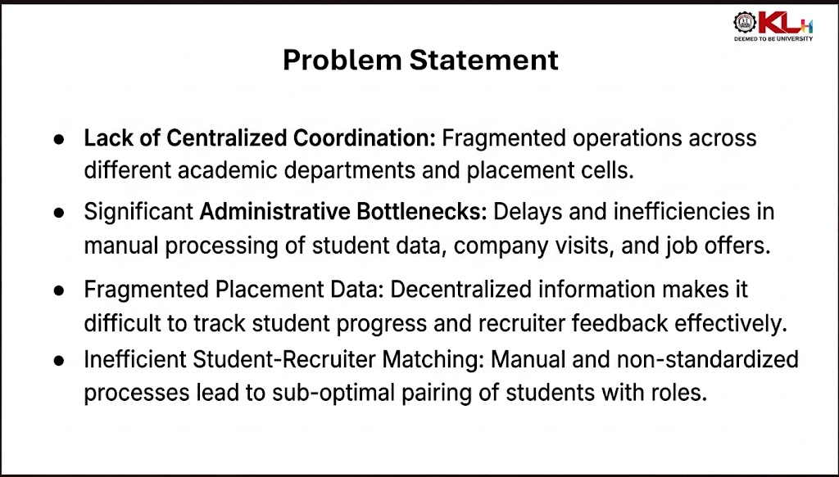
Problem Statement

Slide 4
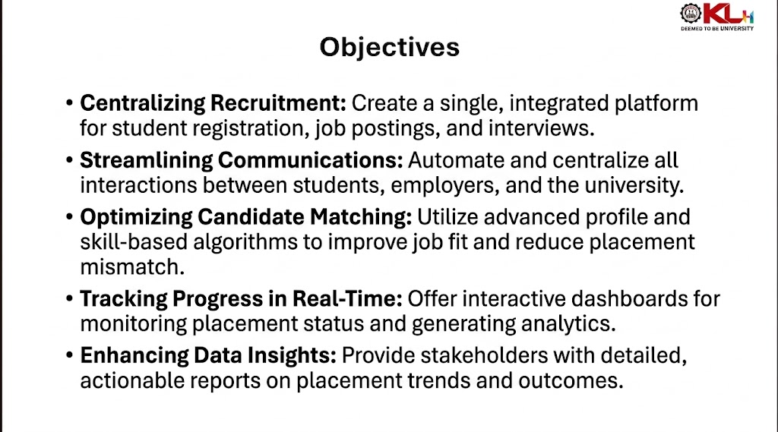
Objectives

Slide 5
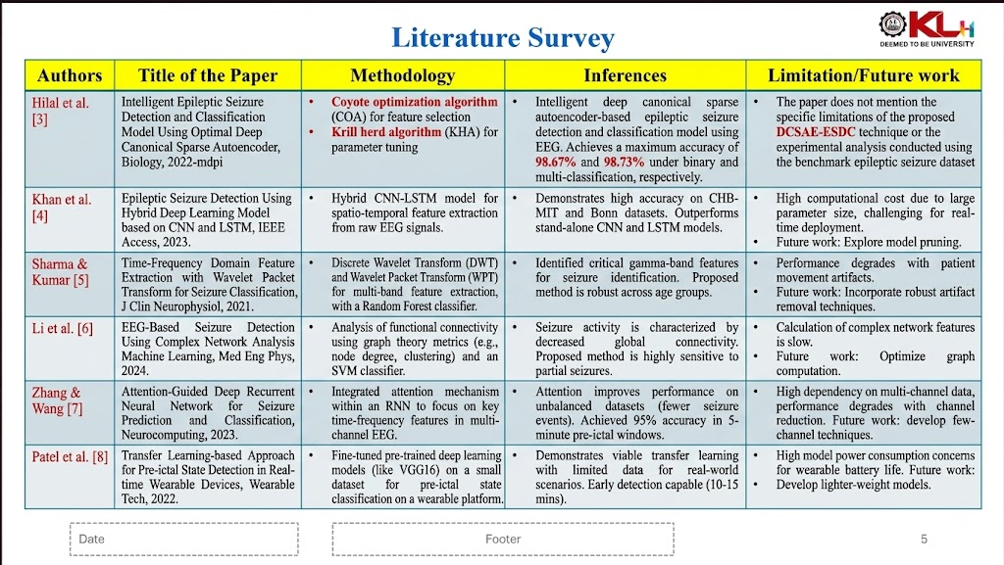
Literature Survey
Authors | Title of the Paper | Methodology | Inferences | Limitation/Future work
Hilal et. al. [3] | Intelligent Epileptic Seizure Detection and Classification Model Using Optimal Deep Canonical Sparse Autoencoder, Biology, 2022-mdpi | Coyote optimization algorithm (COA) for feature selection Krill herd algorithm (KHA) for parameter tuning | intelligent deep canonical sparse autoencoder-based epileptic seizure detection and classification model using EEG signals. It achieves a maximum accuracy of 98.67% and 98.73% under binary and multi-classification, respectively. | The paper does not mention the specific limitations of the proposed DCSAE-ESDC technique or the experimental analysis conducted using the benchmark epileptic seizure dataset

Slide 6
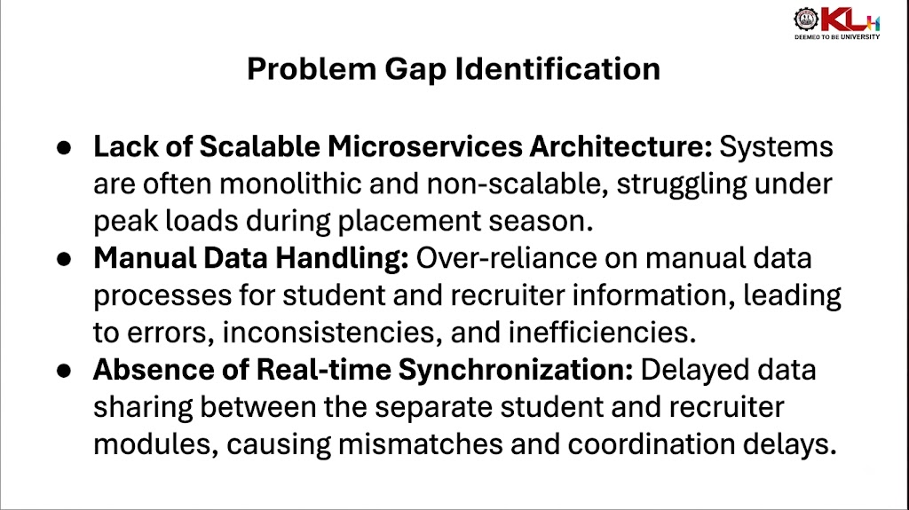
Problem Gap Identification

Slide 7
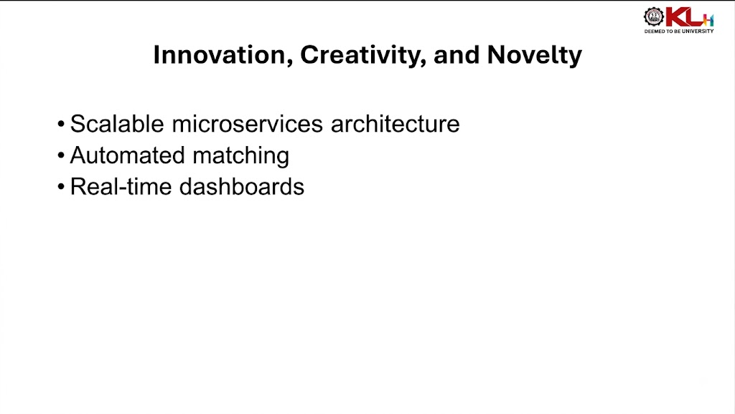
Innovation, Creativity, and Novelty

Slide 8
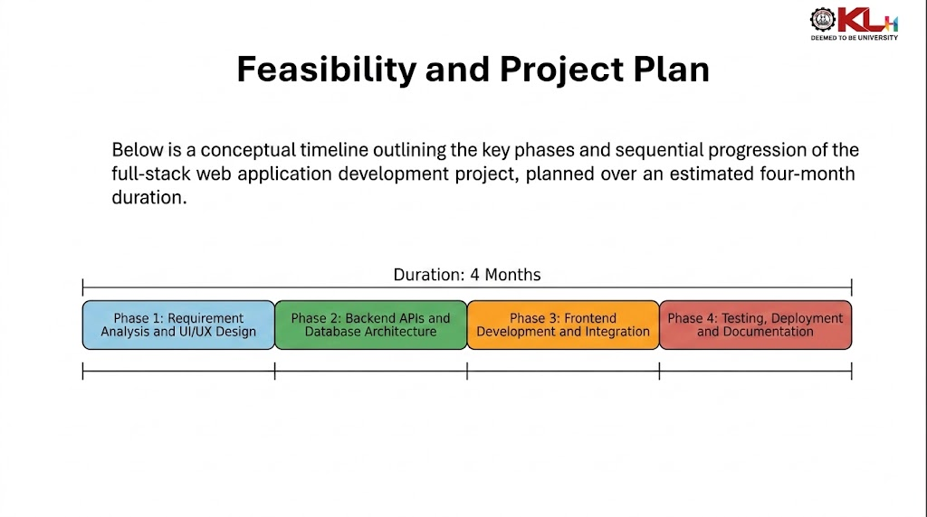
Feasibility and Project Plan
TIMELINE CHART FOR EACH PHASE OF YOUR PROJECT SHOULD BE THERE AFTER EXPLANATION

