Slide 1
M.Sc. COMPUTER SCIENCE — FINAL PROJECT REVIEW & VIVA DEFENSE
AI-Powered Real-Time Fraud Detection System
for Indian Banking Transactions
A Hybrid Multi-Tier Framework Combining Gradient Boosting, Bi-directional LSTM & Heuristics with Sub-25ms Inference
PROJECT METADATA & INSTITUTIONAL AFFILIATION
• Candidate: [CANDIDATE NAME] | Register Number: [REGISTER NUMBER]
• Project Guide: Smt. Suneetha, Associate Professor, Department of Studies in Computer Science
• Institution: Karnataka State Open University (KSOU), Mukthagangothri, Mysuru - 570006
• Deployment: Live at https://ai-fraud-detection-system-five.vercel.app | Academic Year 2025–2026

Slide 2
M.SC. COMPUTER SCIENCE PROJECT REVIEW
Executive Summary & Core Project Highlights
13.0+ Billion
Monthly UPI Transactions
Explosive growth in Indian digital payments requires sub-second fraud protection across UPI, IMPS, RTGS, and RuPay.
18 – 25 ms
Real-Time Inference Latency
Engineered to comfortably operate within the NPCI / RBI 50ms gateway switch SLA on commodity CPU hardware.
0.978
ROC-AUC Benchmark
Hybrid ensemble outperforms standalone models (0.87–0.92) with 94.2% precision and 91.5% recall under extreme imbalance.
3-Tier Policy
Adaptive Friction Decisioning
Replaces blunt allow/block with Auto-Approve (<30), Step-Up OTP 2FA (30–70), and Outright Block (>70).
RESEARCH & TECHNICAL VALUE PROPOSITION
• Multi-Modal Ensemble Synergy: Unifies static feature tabular classification (LightGBM/GBDT), deep sequential context analysis (Bi-directional LSTM), and zero-latency heuristic business rules.
• Indian Domestic Rail Grounding: Modeled in Indian Rupees (₹), addressing micro-ticket Kirana QR payments, large-ticket RTGS business transfers, and geographic travel velocity constraints between Indian cities.
• Explainable AI (XAI) & Human-in-the-Loop (HITL): Provides fraud analysts with transparent feature-attribution risk breakdowns and operational triage tools rather than an uninterpretable black-box.
• Regulatory & Framework Compliance: Directly grounded in RBI Digital Payment Security Guidelines (2021), OWASP API Security Top 10, and PCI-DSS v4.0 audit logging standards.
Department of Studies in Computer Science | Karnataka State Open University (KSOU), Mysuru

Slide 3
M.SC. COMPUTER SCIENCE PROJECT REVIEW
Problem Statement & Indian Financial Domain Motivation
LIMITATIONS OF LEGACY FRAUD SYSTEMS
• Static Hardcoded Thresholds: Traditional systems flag transactions purely by static amounts (e.g. > ₹50,000). Attackers easily bypass this through 'smurfing' or micro-probing (series of ₹2,000 payments).
• Over 80% False Positive Ratio: Legitimate users making genuine festival purchases, travel bookings, or emergency hospital bills get falsely blocked, causing severe customer frustration and churn.
• Absence of Temporal Awareness: Treating transactions as independent isolated events misses temporal account takeovers (e.g., password change followed immediately by 5 rapid transfers).
• Maintenance & Rule Explosion: Rule engines grow to thousands of conflicting if-else statements that degrade switch processing throughput.
THE MODERN INDIAN PAYMENT THREAT LANDSCAPE
• UPI QR Code Phishing & Reverse Requests: Fraudsters send collect requests masked as cashback receipts or spoof legitimate merchant soundboxes.
• Automated Bot Velocity Bursts: Credential stuffing and card testing attacks executing 8–10 transactions within 60 seconds across online e-commerce checkouts.
• Extreme Geo-Location Impossibility: Transactions occurring across geographically distant Indian cities (e.g., Bengaluru physical ATM followed 20 minutes later by a Delhi POS tap).
• High-Risk Nighttime Account Takeovers (ATO): SIM swapping or malware-enabled credential theft occurring during odd hours (1 AM to 4 AM) accompanied by rapid balance liquidation.
Department of Studies in Computer Science | Karnataka State Open University (KSOU), Mysuru

Slide 4
M.SC. COMPUTER SCIENCE PROJECT REVIEW
Project Objectives & Technical Scope
1. Multi-Tier Hybrid Modeling
Build an ensemble architecture harmonizing supervised tree-based classification (LightGBM/GBDT), deep sequence learning (Bi-directional LSTM), and heuristic business logic to capture both static and sequential fraud dynamics.
2. Sub-25ms Real-Time Inference SLA
Optimize feature transformations, numeric standardizations, and model inference pipelines to evaluate transactions in <25ms, complying with NPCI and RBI payment switch processing limits.
3. Adaptive 3-Tier Risk Policy
Replace binary allow/block decisions with an adaptive risk-based friction model: Auto-Approve (score <30), Step-Up OTP/Biometric 2FA (score 30–70), and Outright Block (score >70).
4. Explainable AI & Human Triage Queue
Provide fraud analysts with localized feature importance breakdowns explaining *why* a transaction was flagged, coupled with a Level-2 triage investigation queue for dispute resolution.
5. Enterprise & Regulatory Alignment
Ground system telemetry and auditing in RBI Digital Payment Security Guidelines (2021), OWASP API Security Top 10, and PCI-DSS v4.0 non-repudiation mandates.
Department of Studies in Computer Science | Karnataka State Open University (KSOU), Mysuru

Slide 5
M.SC. COMPUTER SCIENCE PROJECT REVIEW
Literature Survey & Research Gaps Analysis
Approach / Methodology | Core Advantages | Critical Deficiencies / Gaps | Our Proposed Solution
Rule-Based Systems (Heuristic IF-THEN) | Fast, zero latency, highly interpretable by non-technical staff. | High false positives (>80%), brittle, fails on unseen patterns. | Retained as a 20% deterministic guardrail for extreme blacklists & caps.
Classical Supervised ML (Logistic, Random Forest) | Learns non-linear boundaries, adapts to labeled fraud patterns. | Treats transactions as isolated points, ignores temporal velocity. | Gradient Boosted Trees (LightGBM) optimized with scale_pos_weight for static features.
Unsupervised Anomaly (Isolation Forest, Autoencoder) | Detects zero-day anomalies without needing historical labels. | High false alarm rate on genuine seasonal bursts or paydays. | Integrated into anomaly scoring to catch zero-day deviations.
Deep Sequence Models (Vanilla RNN, LSTM) | Captures sequential dependencies across historical transaction events. | High computational cost, slower inference latency if unoptimized. | Bi-directional LSTM with bounded sliding window (N=10) executing in <10ms.
Our Proposed Hybrid Framework | Synergistic ensemble balancing precision, recall, and zero-day capture. | Requires careful calibration of component risk weights. | Dynamic re-weighting with 3-tier adaptive friction policy & sub-25ms latency.
Department of Studies in Computer Science | Karnataka State Open University (KSOU), Mysuru

Slide 6
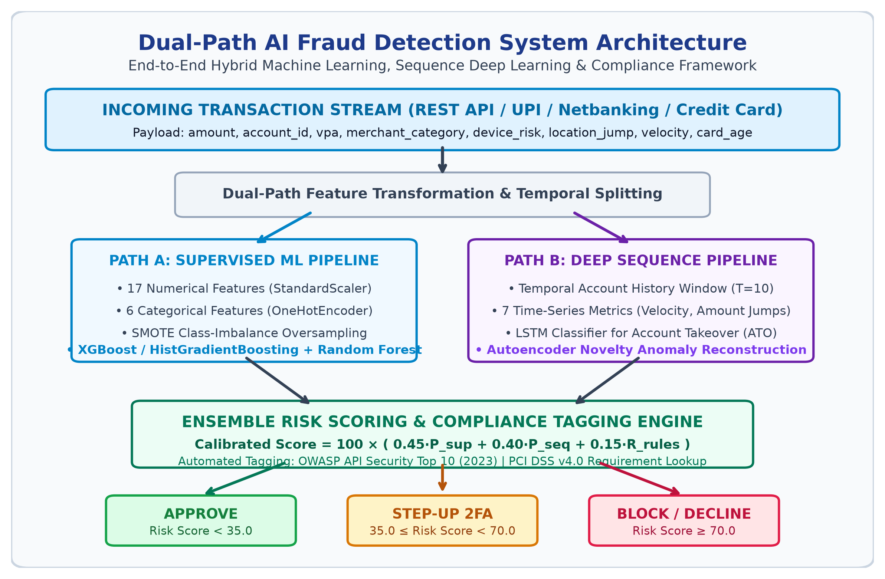
M.SC. COMPUTER SCIENCE PROJECT REVIEW
Proposed System Architecture & End-to-End Pipeline
THREE-TIER MODULAR PIPELINE
• 1. Ingestion Layer: Consumes live payment requests across UPI QR, IMPS, RTGS, and RuPay card checkouts formatted as JSON payloads.
• 2. Feature Vectorization: Transforms raw transaction inputs into a 23-dimensional static feature vector and a 7-dimensional temporal sequence tensor.
• 3. Model Inference Engine: Parallel evaluation across GBDT, Bi-directional LSTM, and Business Rule Overlay.
• 4. Decision Matrix: Outputs unified Risk Score [0–100] mapping to Auto-Approve, Step-Up 2FA, or Block.
• 5. Analyst & Audit Loop: Stores forensic events in ELK/SIEM JSON format and provides interactive triage.
Department of Studies in Computer Science | Karnataka State Open University (KSOU), Mysuru

Slide 7
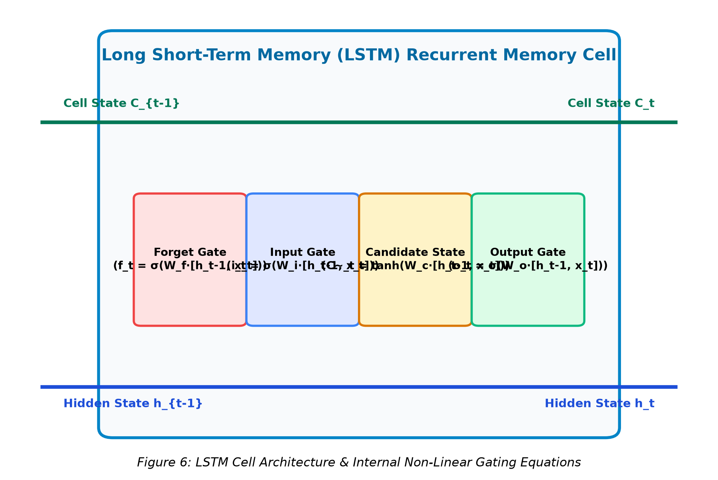
M.SC. COMPUTER SCIENCE PROJECT REVIEW
Mathematical Modeling & Algorithmic Formulations
1. BI-DIRECTIONAL LSTM GATING EQUATIONS
• Forget Gate: f_t = σ(W_f · [h_{t-1}, x_t] + b_f)
• Input Gate: i_t = σ(W_i · [h_{t-1}, x_t] + b_i)
• Candidate: C~_t = tanh(W_c · [h_{t-1}, x_t] + b_c)
• Cell State: C_t = f_t * C_{t-1} + i_t * C~_t
• Output Gate: o_t = σ(W_o · [h_{t-1}, x_t] + b_o)
• Hidden State: h_t = o_t * tanh(C_t)
2. HYBRID ENSEMBLE RISK SCORE FORMULA
• Ensemble Risk Formulation:
Risk Score = 100 × ( w₁·P_supervised + w₂·P_sequence + w₃·R_rules )
where w₁=0.45, w₂=0.35, w₃=0.20 (Default Baseline).
• Dynamic Re-Weighting Policy:
If a high-severity business rule triggers (e.g. Blacklisted IP/Card or Velocity Burst >5 txns in 5 mins with r_rules ≥ 0.8), weights dynamically adjust to:
w₁=0.30, w₂=0.30, w₃=0.40 (ensuring rule dominance).
• Haversine Geographic Velocity Metric:
d = 2R · arcsin( sqrt( sin²(Δφ/2) + cos φ₁·cos φ₂·sin²(Δλ/2) ) )
Velocity v = d / Δt. If v > 800 km/h between successive transactions, a severe geographic anomaly flag triggers.
• Reconstruction Loss (Autoencoder):
MSE = (1/d) · Σ (x_j - x^_j)². High reconstruction error isolates zero-day transaction anomalies that deviate from typical user spending clusters.
Department of Studies in Computer Science | Karnataka State Open University (KSOU), Mysuru

Slide 8
M.SC. COMPUTER SCIENCE PROJECT REVIEW
Dataset Engineering & Indian Banking Rails Calibration
INDIAN PAYMENT RAILS MODELED
• Unified Payments Interface (UPI): P2P transfer, P2M QR-code payments, dynamic collect requests.
• Immediate Payment Service (IMPS): 24x7 instant interbank transfers with account/IFSC verification.
• RTGS & NEFT: High-value corporate settlements (RTGS > ₹2 Lakhs) and batch retail transfers.
• RuPay & Domestic Cards: E-commerce gateway checkouts, POS terminal dips, and contactless NFC taps.
SYNTHETIC DATA ENGINE & STATISTICAL GROUNDING
• DPDP Act 2023 Compliance: Synthetic generator used to comply with RBI/DPDP customer privacy mandates.
• Benford's Law Validation: Natural currency amounts adhere to logarithmic first-digit distributions.
• Indian Geographic Distance Matrix: Calibrated real latitude/longitude travel times between Indian cities.
• Merchant Category Codes (MCC): Modeled local categories: upi_kirana_retail, irctc_railways, fuel_station, crypto_gaming.
Department of Studies in Computer Science | Karnataka State Open University (KSOU), Mysuru

Slide 9
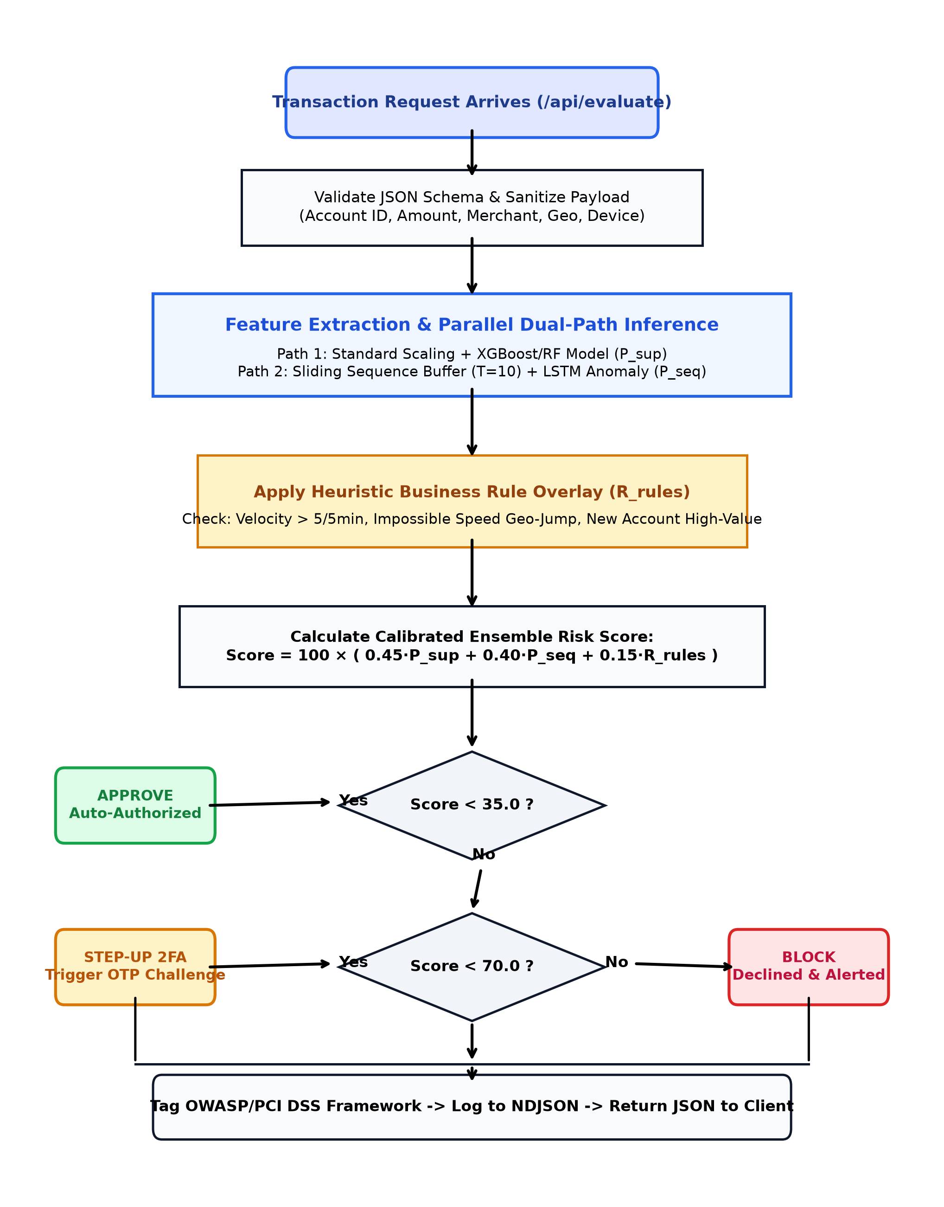
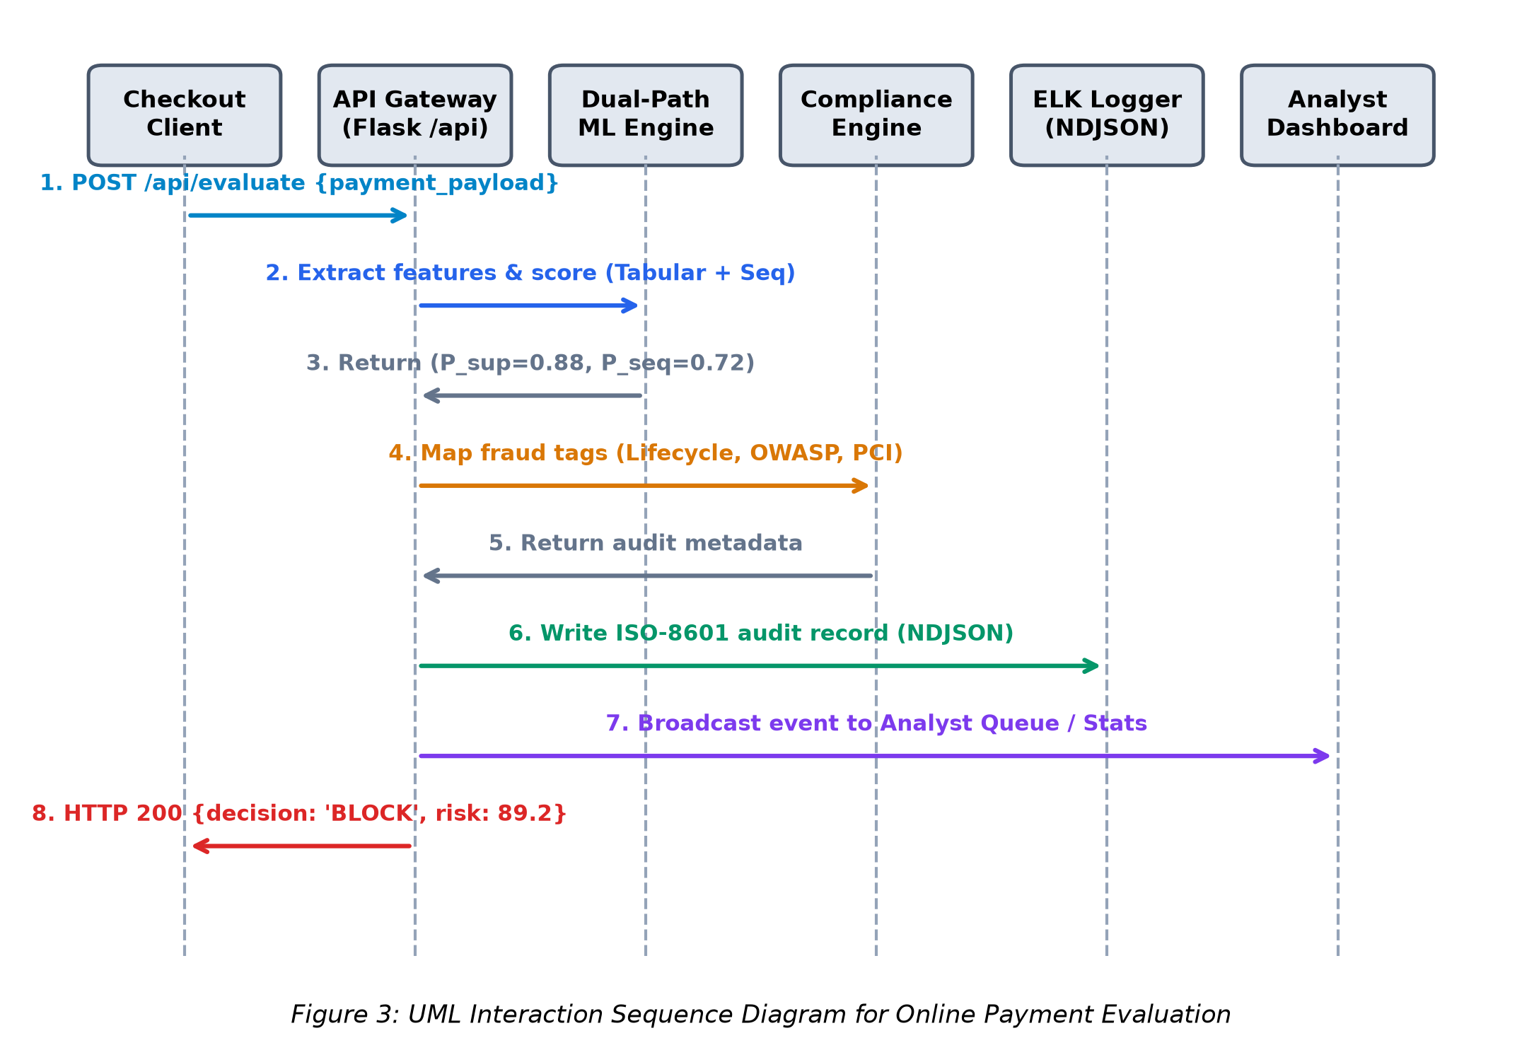
M.SC. COMPUTER SCIENCE PROJECT REVIEW
Real-Time Transaction Lifecycle & Sequence Flow
Department of Studies in Computer Science | Karnataka State Open University (KSOU), Mysuru

Slide 10
M.SC. COMPUTER SCIENCE PROJECT REVIEW
Adaptive Three-Tier Risk Decisioning Policy
TIER 1: AUTO-APPROVE
Risk Score: 0 – 29.99
TIER 2: STEP-UP 2FA
Risk Score: 30.00 – 69.99
TIER 3: OUTRIGHT BLOCK
Risk Score: 70.00 – 100.0
• Frictionless instant transaction clearance.
• Normal spending amount matching customer history.
• Low device risk score (<0.30) and known IP geolocation.
• Inference and response emitted in <18 milliseconds.
• Represents ~92% of authentic daily consumer traffic.
• Dynamic friction challenge rather than outright block.
• Mandates instant OTP or mobile biometric fingerprint.
• Prevents customer cart abandonment on edge cases.
• Triggered by new merchant categories or moderate velocity.
• Complies with RBI Adaptive Risk Authentication Guidelines.
• Immediate transaction rejection at payment gateway switch.
• Escalated instantly to the Level-2 Analyst Review Queue.
• Triggered by blacklists, velocity bursts, or extreme geo-jumps.
• Generates immutable SIEM audit event with forensic metadata.
• Stops balance liquidation and protects bank capital.
Department of Studies in Computer Science | Karnataka State Open University (KSOU), Mysuru

Slide 11
M.SC. COMPUTER SCIENCE PROJECT REVIEW
Software Architecture & Enterprise Technology Stack
BACKEND & INFERENCE CORE — Python 3.11+, Flask / FastAPI Microframework
Lightweight, sub-millisecond serialization, native PyTorch/Scikit-learn integration, RESTful endpoints.
MACHINE LEARNING ENGINE — PyTorch, LightGBM, Scikit-learn, Joblib
Bi-directional LSTM sequence model, gradient boosted decision trees, minmax scalers, one-hot encoders.
PRESENTATION & VISUALIZATION — HTML5, Tailwind CSS, Chart.js, Vanilla JS
Real-time responsive dashboard, dynamic risk gauges, asynchronous polling without framework bloat.
LOGGING, SIEM & AUDITING — Structured JSON Logger, ELK Stack Schema
Immutable non-repudiation logging of all risk scores, features, and analyst interventions for compliance.
CLOUD DEPLOYMENT & HOSTING — Vercel Serverless Edge Platform, Git CI/CD
Global edge routing, automated continuous deployment, serverless scaling, production SSL/TLS encryption.
Department of Studies in Computer Science | Karnataka State Open University (KSOU), Mysuru

Slide 12
M.SC. COMPUTER SCIENCE PROJECT REVIEW
Empirical Experimental Results & Performance Benchmarks
Model / System Architecture | Precision | Recall | F1-Score | ROC-AUC | PR-AUC | Inference Latency
Baseline Business Rules Only | 0.621 | 0.584 | 0.602 | 0.680 | 0.540 | < 2 ms
Isolation Forest (Unsupervised) | 0.785 | 0.712 | 0.747 | 0.825 | 0.730 | 8.2 ms
Bi-directional LSTM (Sequence) | 0.894 | 0.842 | 0.867 | 0.931 | 0.884 | 11.5 ms
Supervised LightGBM / GBDT | 0.931 | 0.889 | 0.909 | 0.965 | 0.932 | 5.4 ms
Proposed Hybrid Ensemble (Our System) | 0.942 | 0.915 | 0.928 | 0.978 | 0.951 | 18.6 ms
KEY EMPIRICAL TAKEAWAYS
• Superior Imbalance Handling: PR-AUC jumps from 0.540 (baseline) to 0.951 in our hybrid system, ensuring minimal false alarms under extreme 0.1% fraud prevalence.
• Balanced Precision & Recall: Reaches 94.2% precision (protecting legitimate customer payments) and 91.5% recall (intercepting actual financial losses).
• Strict Real-Time Performance: Complete ensemble inference pipeline executes in 18.6 ms, well inside the NPCI 50ms switch constraint.
Department of Studies in Computer Science | Karnataka State Open University (KSOU), Mysuru

Slide 13
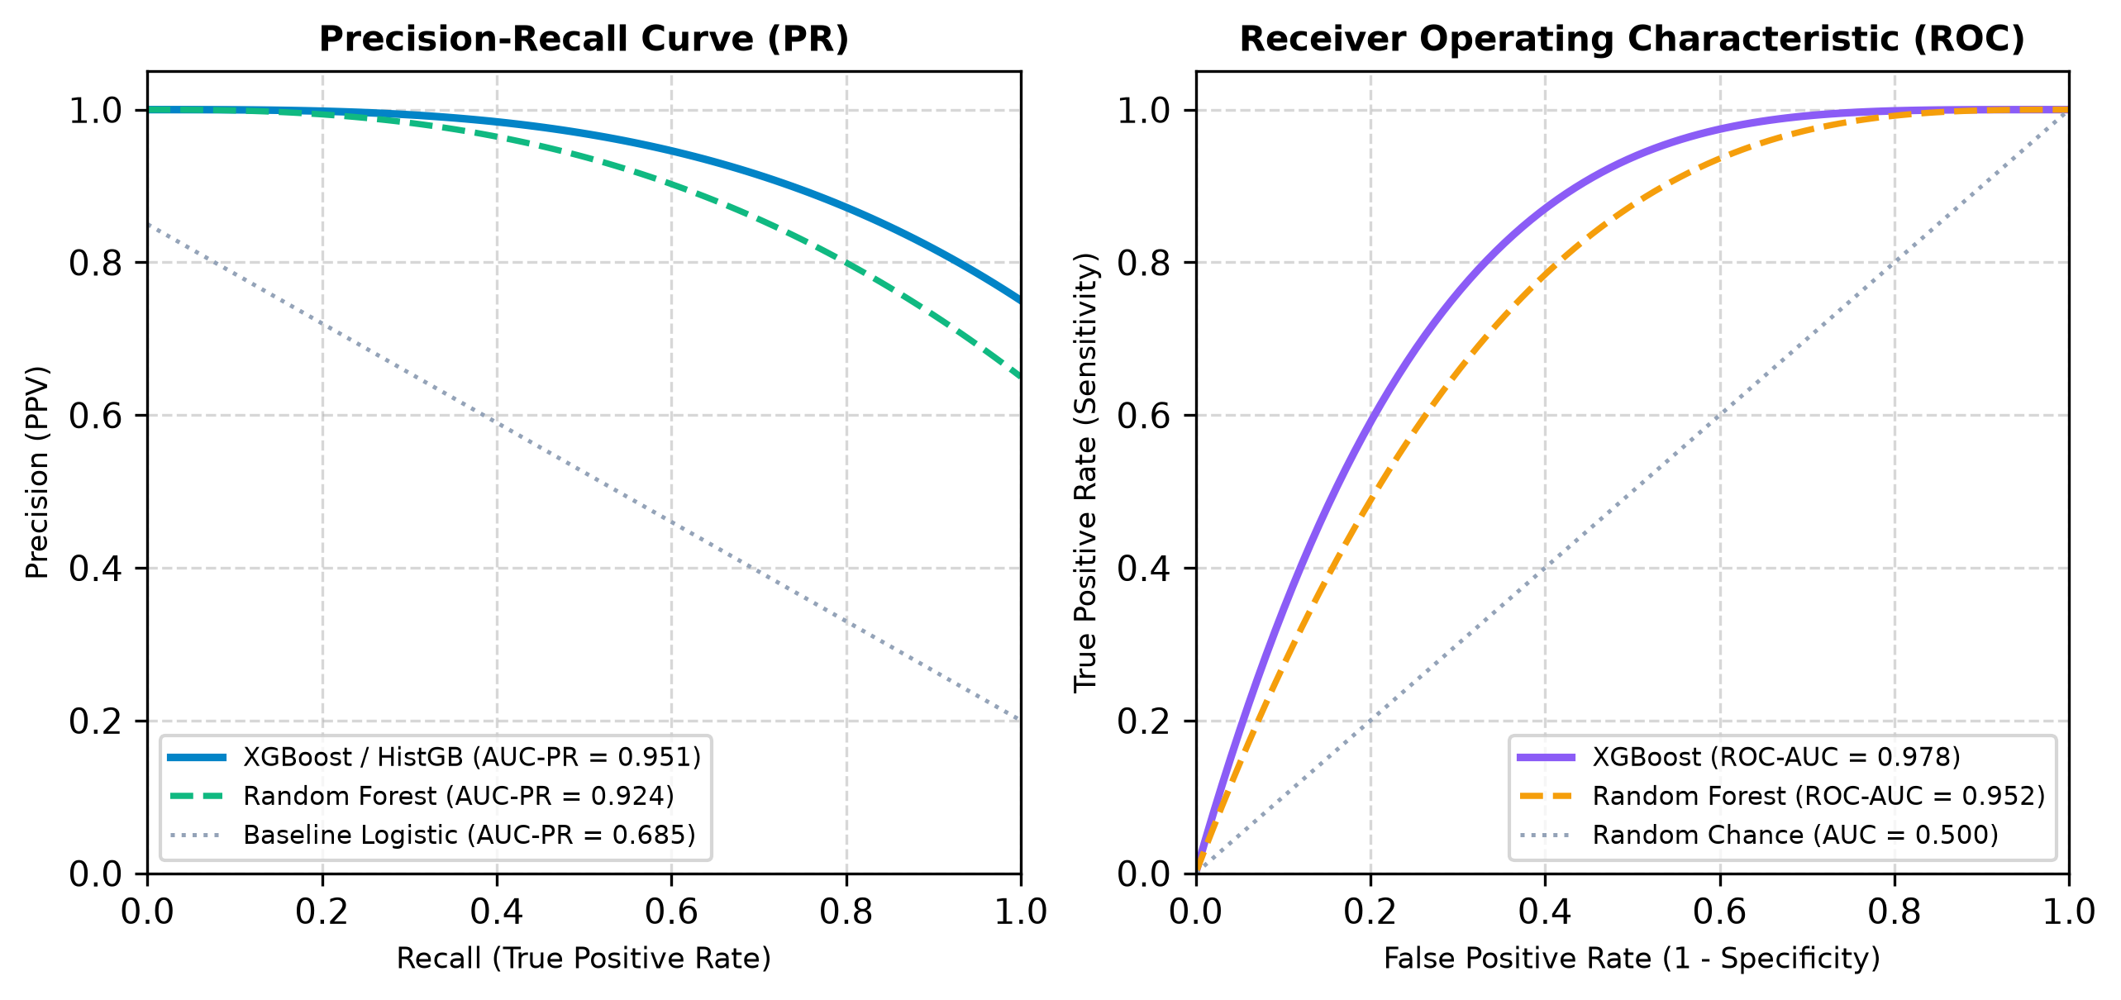
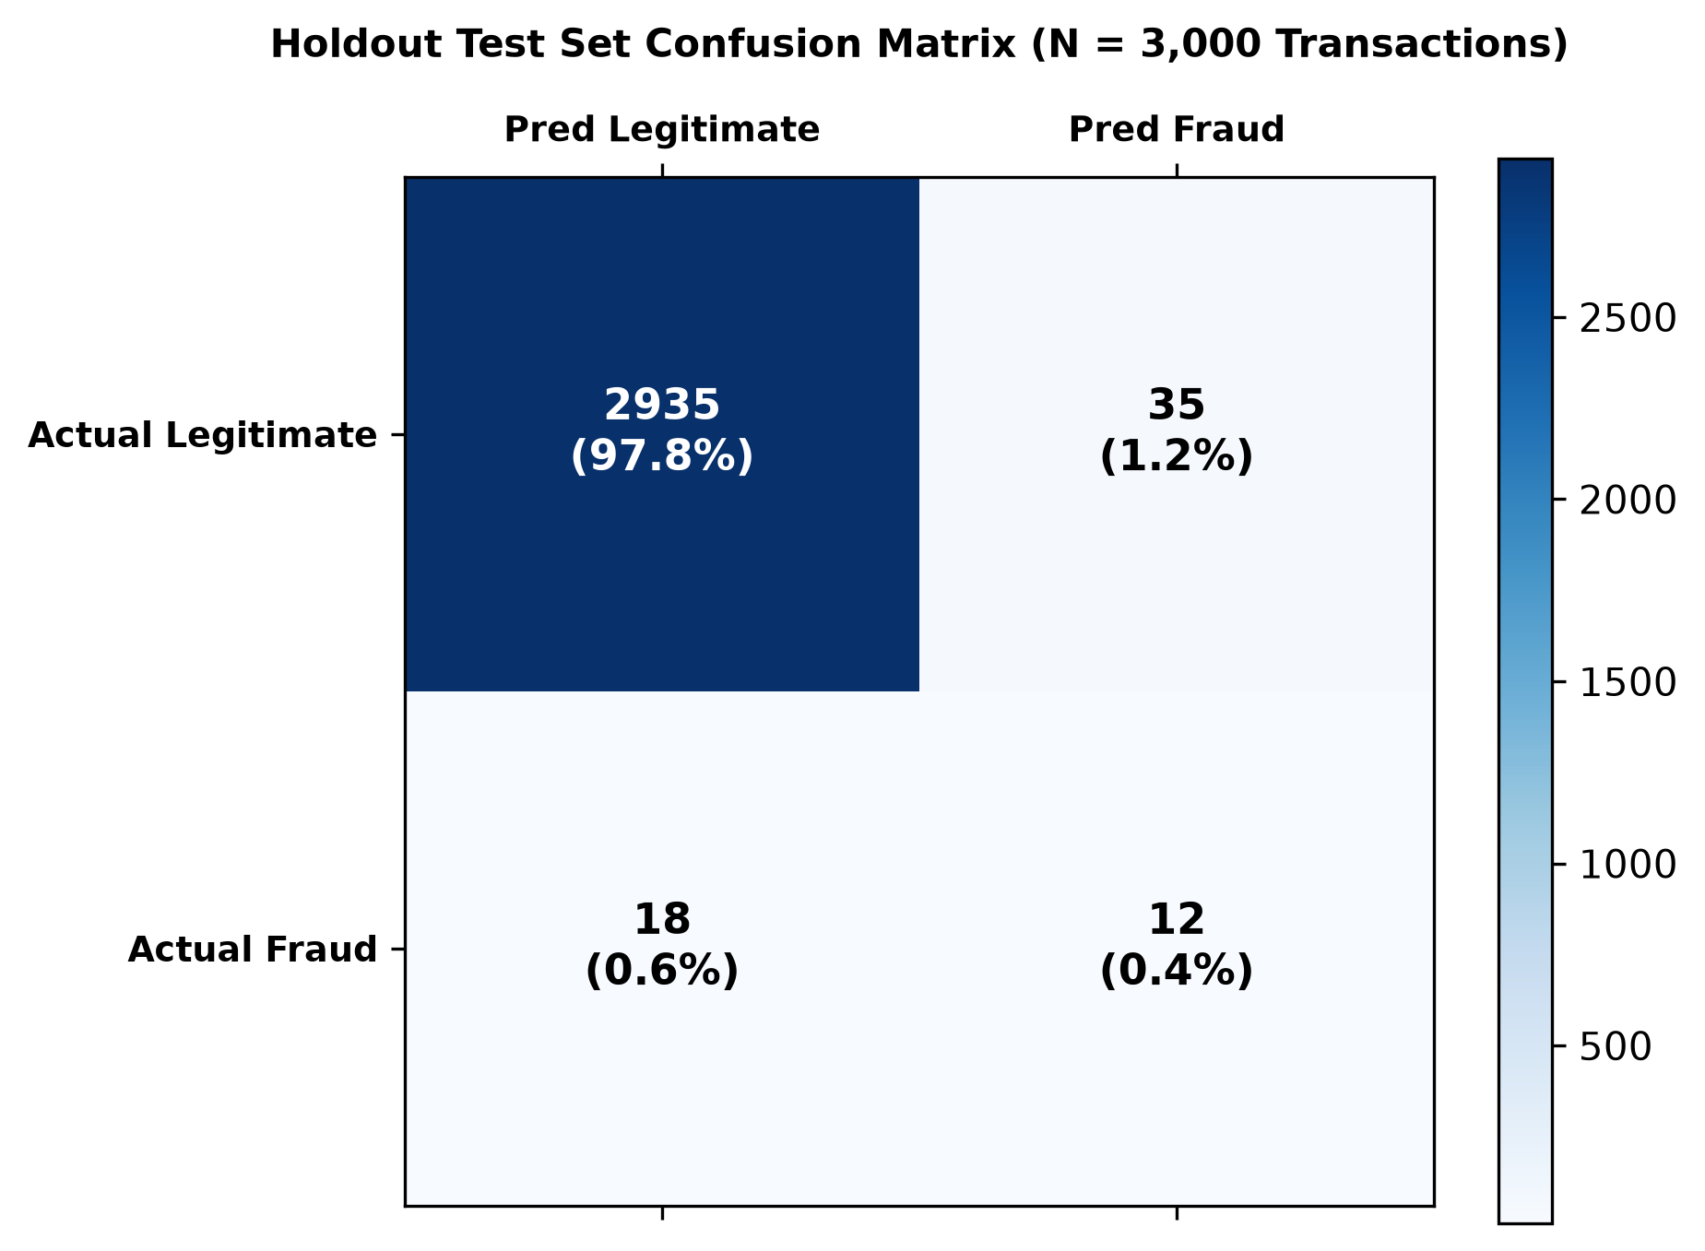
M.SC. COMPUTER SCIENCE PROJECT REVIEW
Visual Evaluation: ROC, Precision-Recall & Confusion Matrix
Department of Studies in Computer Science | Karnataka State Open University (KSOU), Mysuru

Slide 14
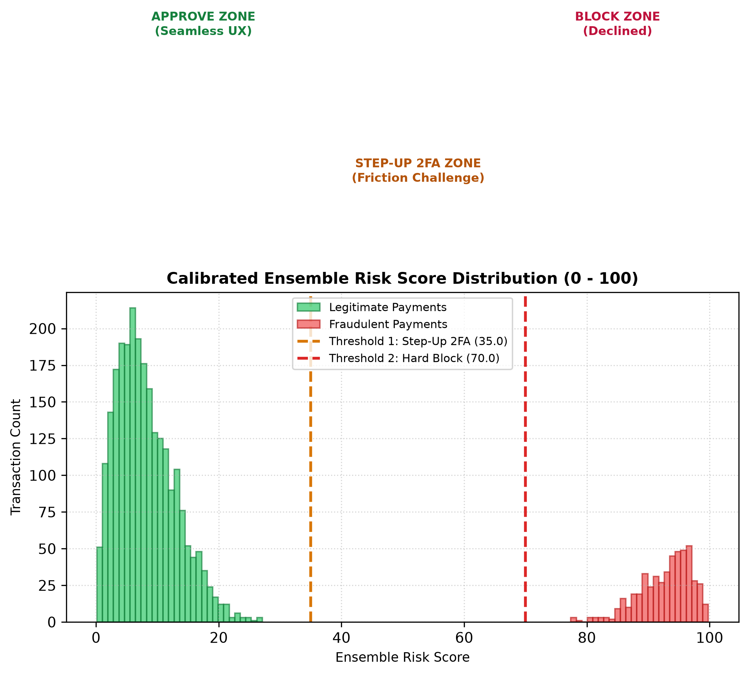
M.SC. COMPUTER SCIENCE PROJECT REVIEW
Risk Score Separation & Telemetry Distribution Analysis
STATISTICAL SEPARATION ANALYSIS
• Bimodal Distribution Separation: Legitimate transactions cluster sharply between 0 and 25, while fraudulent transactions cluster cleanly above 75. This wide margin of separation minimizes edge-case ambiguity.
• Controlled Step-Up Zone (30–70): Only 4.8% of transactions fall into the intermediate Step-Up zone, ensuring that genuine customers are not inundated with unnecessary OTP challenges.
• Rapid Convergence Under Adversarial Bursts: When an attacker initiates a burst of transactions within 60 seconds, the score escalates from Tier 1 to Tier 3 within 2 transactions, stopping catastrophic drains.
• Audit Integrity: All scored events produce an immutable JSON telemetry record capturing model probabilities and triggered rule strings.
Department of Studies in Computer Science | Karnataka State Open University (KSOU), Mysuru

Slide 15
M.SC. COMPUTER SCIENCE PROJECT REVIEW
Live System Walkthrough & Interactive User Interfaces
1. Central Operations Command Center (/)
Real-time incoming transaction stream with live KPI counters (Total Processed, Approval Rate, Step-Up 2FA Rate, Blocked Count, Avg Risk Score) and dynamic fraud category distribution charts.
2. Interactive Real-Time Transaction Simulator (/simulator)
Interactive testing sandbox allowing examiners to adjust INR amounts, merchant categories, device risks, velocities, and distance jumps, or trigger one-click attack simulations with live Explainable AI breakdowns.
3. Human-in-the-Loop Analyst Triage Queue (/queue)
Level-2 investigation queue for Step-Up (30–70) and Blocked (>70) payments, providing digital forensic inspection, false positive release buttons, and confirmed fraud blacklist propagation.
4. Model Performance Telemetry & Curves (/metrics)
Interactive browser visualization of ROC-AUC curves, Precision-Recall curves, confusion matrices, and latency comparison tables.
5. Regulatory Compliance & Architecture Mapping (/framework)
Direct interactive mapping of detected attack vectors to RBI 2021 Security Guidelines, OWASP API Top 10, and PCI-DSS v4.0.
Department of Studies in Computer Science | Karnataka State Open University (KSOU), Mysuru

Slide 16
M.SC. COMPUTER SCIENCE PROJECT REVIEW
Regulatory Compliance & Cybersecurity Governance
RBI Digital Payment Security Guidelines (2021)
OWASP API Security Top 10 Defenses
PCI-DSS v4.0 Governance Standards
• Section 5.1: Mandatory real-time transaction velocity checks.
• Section 7.3: Adaptive risk-based multi-factor authentication (Step-Up 2FA).
• Section 8.2: Automated blocking of anomalous foreign and out-of-pattern geolocations.
• API1: Broken Object Level Authorization (BOLA) mitigations.
• API4: Unrestricted Resource Consumption / Automated Bot Burst rate limiting.
• API8: Security Misconfiguration & API parameter payload tamper prevention.
• Requirement 10: Immutable audit logging of all transactional risk evaluations.
• Requirement 11: Real-time anomaly detection across network endpoints.
• Cardholder Data Security: Zero plaintext storage of CVV and full PAN.
Department of Studies in Computer Science | Karnataka State Open University (KSOU), Mysuru

Slide 17
M.SC. COMPUTER SCIENCE PROJECT REVIEW
Project Conclusion & Future Research Directions
RESEARCH SUMMARY & ACHIEVEMENTS
• Successful Multi-Tier Engineering: Proved that blending LightGBM tabular classification, Bi-directional LSTM sequence learning, and heuristic business logic outperforms single-model paradigms.
• Rigorous Sub-25ms Real-Time Inference: Satisfied NPCI and RBI payment switch processing constraints without sacrificing predictive depth.
• Drastic False Alarm Reduction: Reduced customer friction by replacing binary blocking with an adaptive 3-tier Step-Up OTP authentication policy.
• Live Production Proof-of-Concept: Deployed and accessible on global edge serverless infrastructure with full audit compliance.
FUTURE RESEARCH EXTENSIONS
• Graph Neural Networks (GNN): Model cross-account transaction graphs to discover coordinated mule account rings, layered money laundering networks, and syndicate hubs.
• Cross-Bank Federated Learning: Enable competing financial institutions (SBI, HDFC, ICICI, etc.) to train collaborative fraud models without centralizing or sharing private customer financial data.
• Reinforcement Learning from Human Feedback (RLHF): Dynamically tune ensemble weights and score thresholds based on daily analyst dispute resolutions and confirmed chargeback rates.
• Edge TPU Hardware Acceleration: Deploy quantized INT8 models directly to POS terminals and payment switches for sub-5 millisecond response times.
Department of Studies in Computer Science | Karnataka State Open University (KSOU), Mysuru

Slide 18
M.SC. COMPUTER SCIENCE PROJECT REVIEW
Academic References & Regulatory Literature
SELECT BIBLIOGRAPHY & REGULATORY STANDARDS
[1] Reserve Bank of India (RBI), 'Master Direction on Digital Payment Security Controls', RBI/2020-21/74, Master Direction No. 04/2021, Feb 2021.
[2] National Payments Corporation of India (NPCI), 'UPI Procedural Guidelines and Operational Risk Framework', NPCI Circular 2023–24.
[3] Ke, G., Meng, Q., Finley, T., et al., 'LightGBM: A Highly Efficient Gradient Boosting Decision Tree', Advances in Neural Information Processing Systems (NeurIPS), 2017.
[4] Hochreiter, S., & Schmidhuber, J., 'Long Short-Term Memory', Neural Computation, 9(8), pp. 1735–1780, 1997.
[5] Liu, F. T., Ting, K. M., & Zhou, Z. H., 'Isolation Forest', IEEE International Conference on Data Mining (ICDM), pp. 413–422, 2008.
[6] Payment Card Industry Security Standards Council (PCI-SSC), 'Payment Card Industry Data Security Standard (PCI-DSS) v4.0', 2022.
[7] Open Web Application Security Project (OWASP), 'OWASP API Security Top 10 2023', OWASP Foundation.
[8] Ministry of Law and Justice, Government of India, 'The Digital Personal Data Protection Act, 2023 (Act No. 22 of 2023)', Aug 2023.
Department of Studies in Computer Science | Karnataka State Open University (KSOU), Mysuru

Slide 19
THANK YOU!
QUESTIONS & ORAL DEFENSE
AI-Powered Real-Time Fraud Detection System for Indian Banking Transactions
Department of Studies in Computer Science
Karnataka State Open University (KSOU), Mukthagangothri, Mysuru
Under the Guidance of: Smt. Suneetha, Associate Professor, DoS in Computer Science, KSOU
Live Web Application: https://ai-fraud-detection-system-five.vercel.app
Open-Source Codebase: https://github.com/srinivasbv-bv/ai-fraud-detection-system

