Slide 1
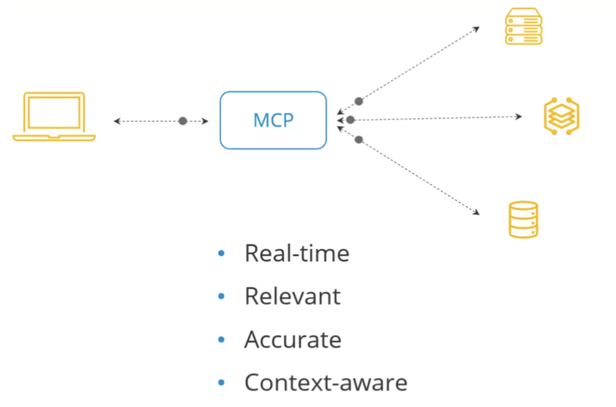

Slide 2
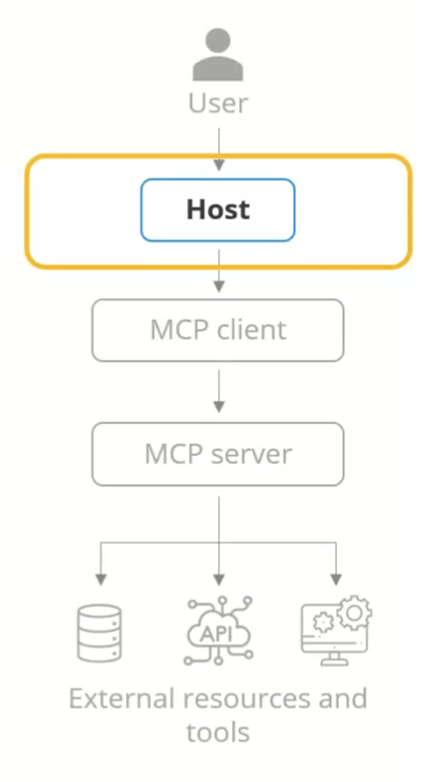
The host
The central orchestrator in MCP is usually an AI-powered app like a chatbot, IDE, or productivity tool that embeds a language model.
Responsibilities:
• Lifecycle Management: Handles creation, initialization, and coordination of multiple tool calls.
• Authorization and Security: Manages user permissions, consent, and enforces security boundaries.
• Context Aggregation: Gathers contextual data from all clients to deliver richer input to the AI model.
• Integration Coordination: Connects the LLM with MCP tools to retrieve external data like stock prices or weather.

Slide 3
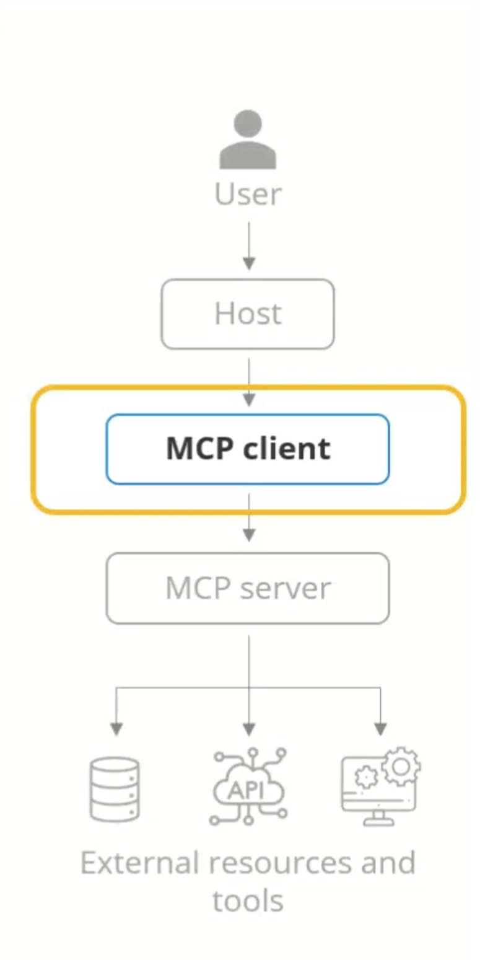
MCP clients
Act as intermediaries between the host and MCP servers, maintaining dedicated connections to ensure clear boundaries and strong security.
Responsibilities
• Dedicated Connections: Each client connects to a single server, ensuring isolated, secure one-to-one communication.
• Message Routing: Manages two-way communication like routing all requests, responses, and notifications.
• Capability Management: Keeps track of the tools, resources, and templates their server supports.
• Protocol Negotiation: Clients and servers negotiate supported features during setup to ensure they’re compatible.
• Subscription Management: Subscribes to server resources and receives updates when changes occur.

Slide 4
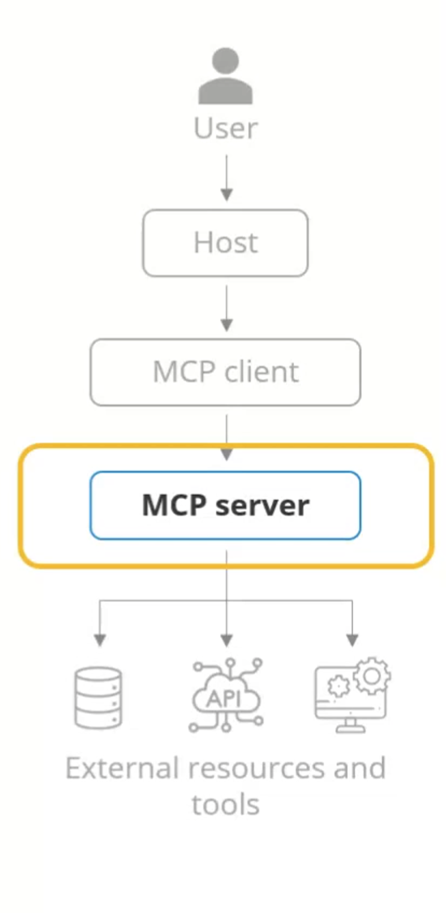
MCP servers
Lightweight programs that expose tools, services, or data sources to clients—enabling the host to interact with external systems.
Responsibilities
• Exposing Capabilities: Makes tools, data sources, and templates available to clients using MCP primitives.
• Focused Functionality: Each server provides a specific function or data access point supporting modular design.
• Security and Isolation: Only receives relevant context, ensuring strict data boundaries and isolation from other servers.
• Communication Methods: Runs locally (via Stdio) or remotely (via HTTP/SSE for real-time updates).

Slide 5
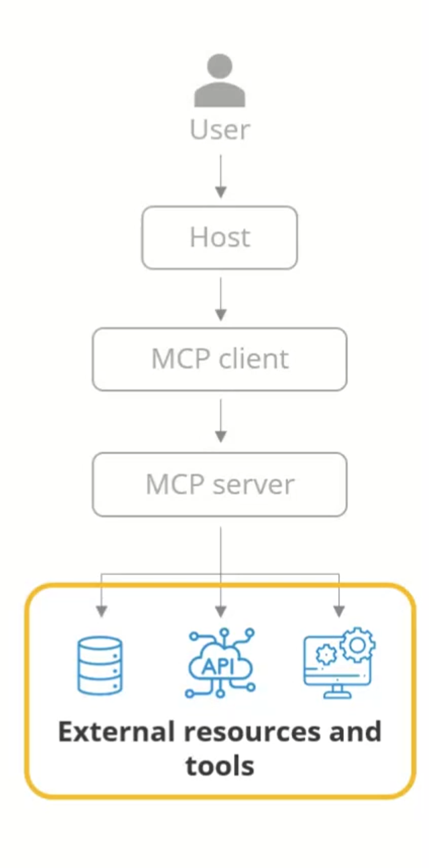
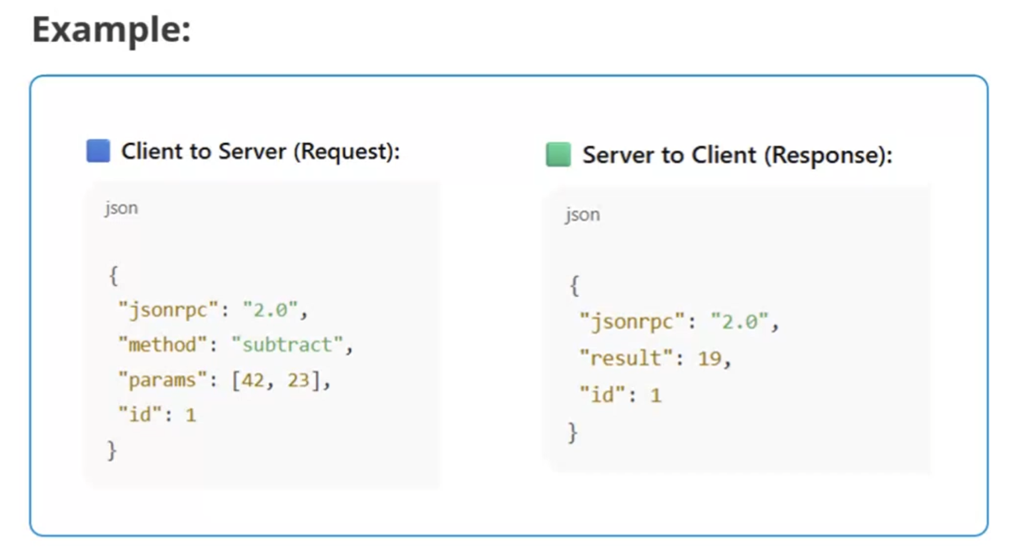
Data sources and services
The actual APIs, databases, or tools that store information accessed by MCP servers to deliver real-time, relevant data to the AI.
The MCP architecture is built on a robust, standardized communication protocol, typically using JSON-RPC 2.0 for message passing.

Slide 6
Data sources and services
The actual APIs, databases, or tools that store information accessed by MCP servers to deliver real-time, relevant data to the AI.
The interaction
Request Initiation: The client sends a request to its MCP server, asking for data or a specific action.
Server Processing: The server handles the request by accessing the necessary tool or data source.
Response Delivery: The server returns the result to the client, which forwards it to the host and the AI model.
Contextual Handling: The host aggregates and manages all context, ensuring the AI receives complete, coherent input.

Slide 7
Key principles of MCP architecture
Standardization
A universal protocol that replaces custom integrations, enabling seamless interoperability across tools and models.
Security and Isolation
Enforces strict context limits to protect sensitive data and honor user consent.
Modularity and Composability
Servers provide focused functions and can be combined within a host for flexible, scalable setups.
Capability Negotiation
Clients and servers agree on supported features during setup, ensuring compatibility and forward extensibility.
Ease of Implementation
Lightweight design thereby reducing development effort for both clients and servers.

