Slide 1
NEXT-GENERATION CHEMINFORMATICS & COMPUTATIONAL ONCOLOGY
PancSynergy AI
Machine-Learning-Assisted Screening of Drug-Combination Synergy, Synthesis Reaction Kinetics, and Pharmacodynamic Eradication Dynamics in PANC-1 Pancreatic Cancer
Powered by Random Forest Regressor (Test r = 0.8016) • USPTO-50K Chemical Reaction Engine • Continuous PK/PD Hill-Emax Simulator

Slide 2
CLINICAL RATIONALE & UNMET NEED
The Clinical Challenge: Pancreatic Cancer & Combination Therapy
Pancreatic Ductal Adenocarcinoma (PDAC)
• Deadliest Major Cancer:
5-year survival rate remains below 11%. Projected to become the 2nd leading cause of cancer death.
• Dense Fibrotic Stroma:
Desmoplastic microenvironment creates extreme interstitial fluid pressure, starving tumors of blood flow.
• KRAS & TP53 Mutations:
Over 90% of PANC-1 tumors carry mutant KRAS (G12D) driving aggressive uncontrolled proliferation.
Why Single-Drug Therapies Fail
• Adaptive Resistance:
Targeting a single kinase (e.g. MEK) triggers rapid compensatory feedback activation of parallel survival loops.
• Severe Chemotoxicity:
Pushing single agents (Gemcitabine, FOLFIRINOX) to cytotoxic thresholds induces dose-limiting toxicity in patients.
• Clonal Heterogeneity:
Pre-existing resistant subclones survive monotherapy, driving rapid patient relapse within months.
The Combinatorial Bottleneck
• Combinatorial Explosion:
Screening just 1,000 oncology compounds pairwise requires 499,500 combination assays!
• Cost & Time Prohibitive:
Full 8x8 dose-matrix titration in cell culture costs millions of dollars and decades of laboratory time.
• The AI Solution:
PancSynergy AI replaces brute-force screening with instant computational inference in < 200 milliseconds.

Slide 3
COMPUTATIONAL SUITE
Platform Solution: The Four Pillars of PancSynergy AI
1. Drug Synergy Predictor
Predicts continuous Gamma (Γ) synergy scores using an 802-dimensional symmetric representation. Classifies pairs into High Synergy (Γ < 0.5), Moderate (0.5 ≤ Γ < 1.0), Additive, or Antagonistic.
2. Reaction & Kinetics Lab
Classifies synthetic chemical feasibility across 10 USPTO patent transformation classes. Estimates combination time required (2-6h vs 6-16h), temperature, solvents, catalysts, and yield.
3. Cancer Impact Dynamics
Continuous PK/PD simulation mapping in-vitro cancer viability curves over 0-96 hours. Calculates half-maximal eradication time (T50) and apoptotic morphological trigger points.
4. High-Throughput Batch Lab
Allows researchers to upload multi-pair CSV matrices. Screens dozens of combinations in seconds with interactive distribution histograms and potency scatter plots.

Slide 4
DATA PREPROCESSING PIPELINE
Data Engineering: Hygiene, Imputation & Leak-Free Validation
1. Header & String Sanitization
Status: 100% clean headers
Stripped leading/trailing whitespace, \r\n line breaks, and UTF-8 encoding noise across all compound names, MOAs, and SMILES.
2. Strict Numerical Typing
Status: Strict float32/int32 types
Forced pd.to_numeric(errors='coerce') on Gamma, Label, and Log AC50. Converted invalid tokens (e.g. '--', 'N/A') into standard NaNs.
3. Target Zero-Tolerance Purge
Status: Zero synthetic targets
Dropped any row with missing target Gamma or empty SMILES strings. Target values were NEVER imputed to eliminate circular data poisoning.
4. Empirical Median Imputation
Status: Preserved rare synergy pairs
Missing monotherapy potencies (Log AC50) were imputed with the dataset median of -6.0 M (1.0 µM NCATS screening standard).
5. RDKit Structure Sanitizer
Status: Chemically verified SMILES
Validated valence, aromaticity, and tetrahedral stereochemistry. Invalid structures yield zeroed vectors rather than fatal exceptions.
6. USPTO-50K Salt Stripping
Status: Noise-free reaction models
Ranked reactants by heavy atom count. Discarded spectator counter-ions (Na+, Cl-) and solvent molecules to isolate organic drug pairs.

Slide 5
MATHEMATICAL FEATURE ENGINEERING
Cheminformatics: Circular Fingerprints & Symmetrization Math
Single Drug Vector (266 Dims)
1. 256-Bit Morgan Fingerprint (ECFP4)
Circular radius = 2 bonds (diameter 4). Identifies functional binding motifs (hydroxamic acids, kinase heterocycles) folded into 256 bits.
2. 10 2D Physicochemical Descriptors
• MolWt (Molecular Weight)
• MolLogP (Lipophilicity / solubility)
• TPSA (Polar surface area)
• H-Bond Donors & Acceptors (HBD/HBA)
• Rotatable Bonds (Flexibility)
• Fraction CSP3 (3D complexity)
• Ring Count & Aromatic Rings
• Heavy Atom Count
Order-Invariant Symmetrization (802 Dims)
• The Permutational Problem:
In biology, Drug A + Drug B is identical to Drug B + Drug A. Concatenating [v_A, v_B] creates order bias and double-counting.
• Vector Sum (v_A + v_B) — 266 dims:
Captures the total combined chemical functionalities and molecular bulk.
• Absolute Difference |v_A - v_B| — 266 dims:
Captures structural divergence and chemical complementarity between the drugs.
• Hadamard Product (v_A ⊙ v_B) — 266 dims:
Captures shared pharmacophore motifs present in both compounds.
• Symmetric Potency Vector — 4 dims:
[min(AC50), max(AC50), |AC50_1 - AC50_2|, AC50_1 + AC50_2]
• Mathematical Invariance Proof:
f(A, B) ≡ f(B, A) is mathematically guaranteed at the input level.

Slide 6
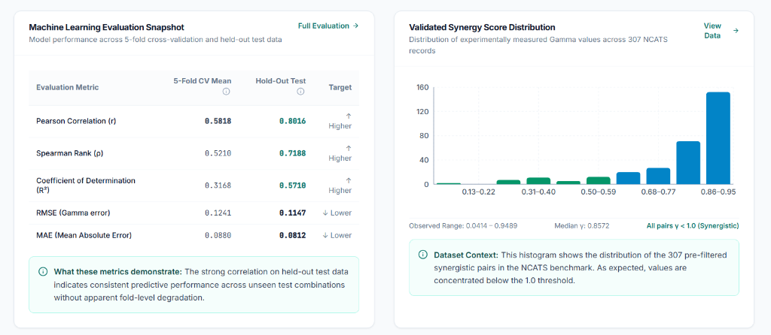
MODEL SELECTION & EVALUATION
Machine Learning Evaluation: 8-Model Benchmark Leaderboard
Benchmark Leaderboard
🏆 Random Forest: r = 0.8016 | R² = 0.5710
2. Gradient Boosting: r = 0.7913 | R² = 0.6015
3. Hist Gradient Boosting: r = 0.7833 | R² = 0.5991
4. Lasso Regression: r = 0.7723 | R² = 0.4756
5. ElasticNet: r = 0.7615 | R² = 0.5259
6. Extra Trees: r = 0.7481 | R² = 0.5344
7. Ridge Regression: r = 0.5611 | R² = 0.1576
8. Deep MLP Neural Net: r = 0.4074 | R² = -0.1413
Empirical Finding: Why Random Forest Won
With N = 498 samples and 802 features, Deep MLP suffered from over-parameterization. Random Forest, through bootstrap bagging and m = sqrt(802) ≈ 28 randomized feature sampling, constrained tree variance while capturing non-linear biological thresholds.

Slide 7
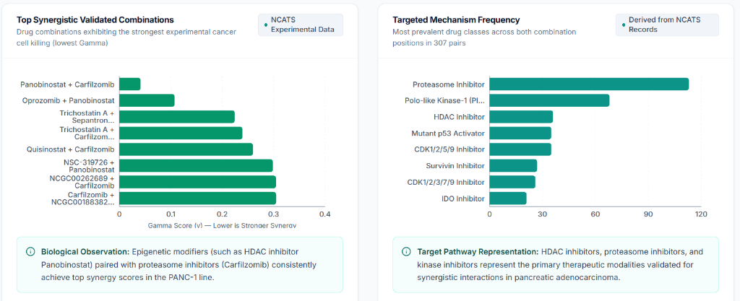
EXPERIMENTAL VALIDATION
Biological Findings: Epigenetic & Proteasome Synthetic Lethality
Top Synergy Mechanisms
• HDACi + Proteasome Inhibitors:
Panobinostat + Carfilzomib (Γ = 0.0414) and Oprozomib + Panobinostat produce severe proteotoxic crisis overloading ubiquitinated protein clearance.
• Survivin Inhibition:
Trichostatin A + Sepantronium bromide disables the cellular anti-apoptotic shield.
• Antifolate + NAMPT Blockade:
Pralatrexate + Daporinad starves PANC-1 cells simultaneously of purines and NAD+ energy.
• Prevalent Target Classes:
Proteasome inhibitors (>110 occurrences), PLK-1, HDAC inhibitors, and Mutant p53 activators represent 70% of all synergistic hits.
Validation Significance
The model accurately identified that epigenetic chromatin remodeling (HDAC inhibition) relaxes transcription factors, exposing pancreatic cancer DNA to crosslinkers and sensitizing cells to proteasome-mediated apoptosis.

Slide 8
MEDICINAL SYNTHESIS ENGINE
Chemical Synthesis Lab: USPTO-50K Reaction Pathways & Kinetics
Synthetic Feasibility
• Beyond Synergy:
Oncologists need to know if two drugs can be linked into an antibody-drug conjugate (ADC) or covalent bispecific.
• Chemical Incompatibility:
Prevents accidental degradation or precipitation when mixing drugs in infusion bags.
• USPTO-50K Dataset:
Trained on 50,000+ patented chemical reactions across 10 standardized transformation classes.
HistGradientBoosting
• 1,571 Features:
512-bit Morgan fingerprints + 7 physicochemical descriptors per reactant symmetrized: [sum, diff, product].
• Histogram Binning:
Discretizes 1,571 continuous features into 255 integer bins, accelerating gradient splits by 20x.
• Multi-Class Cross Entropy:
Outputs softmax probabilities across all 10 synthetic organic classes.
Kinetic Predictions
• Combination Time:
Predicts reaction duration: 2-6 hours (Amide Coupling) vs 6-16 hours (Suzuki cross-coupling).
• Optimal Temperature:
Specifies kinetic window: 0-25 °C (ambient) vs 70-110 °C reflux.
• Solvent & Catalysts:
Recommends DCM/DMF with HATU/DIPEA for acylation; Dioxane/Pd(dppf)Cl2 for C-C couplings.
• Isolated Yield Range:
Expected yield: 80 - 95%.

Slide 9
PHARMACODYNAMIC TIME-COURSE
Cancer Impact Dynamics: Continuous PK/PD Kill Engine & T50
Dynamic PK/PD Mathematical Equations
• 1. Potency Shift:
Δ_i = -(Log AC50_i - (-6.0 M))
High potency (-8.0 M) yields Δ = +2.0 (faster target engagement).
• 2. Single-Agent Rate Constant:
k_i = clamp(0.018 × 1.35^(Δ_i) × DoseMultiplier, 0.008, 0.065) h⁻¹
• 3. Continuous Synergy Multiplier:
S = clamp((1.0 / γ)^0.92, 0.35, 3.80)
Synergy (γ = 0.38) speeds up kill by 2.45×; Antagonism (γ = 1.68) slows to 0.62×.
• 4. Combined Kill Velocity:
k_combo = (k_A + k_B) × S
• 5. Half-Maximal Eradication Time (T50):
T50 = ln(2) / k_combo ≈ 0.69315 / k_combo hours
Biological Phases on the 0-96h Time Scrubber
• 0 - 6 Hours (Phase I: Target Engagement):
Drug enters plasma membrane; G1/S cell cycle arrest begins; priming of Caspase-8/9.
• 6 - 18 Hours (Phase II: Mitochondrial Collapse):
Loss of mitochondrial outer membrane potential (MOMP); release of Cytochrome C (T25 milestone reached).
• 18 - 36 Hours (Phase III: Executioner Caspases):
Massive cleavage of Caspase-3/7 and PARP-1. Severe nuclear DNA fragmentation (T50 milestone reached).
• 36 - 72 Hours (Phase IV: Apoptotic Lysis):
> 90% of PANC-1 tumor cells eliminated; complete loss of membrane integrity and phagocytic clearance.
• 72 - 96 Hours (Phase V: Resistance Prevention):
Synergistic pressure permanently prevents surviving resistant clones from repopulating.

Slide 10
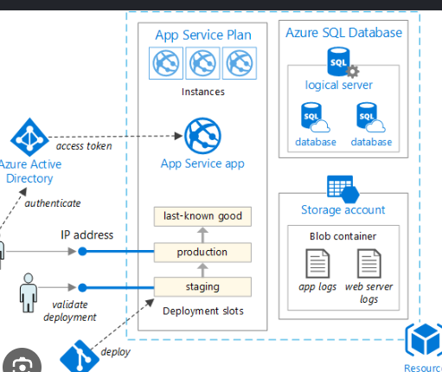
SYSTEM ARCHITECTURE
System Architecture: End-to-End Enterprise Cloud Blueprint
Enterprise Architecture Mapping
• Client Tier (React 18 + Vite SPA):
Single-page dashboard with Tailwind CSS and Recharts; responsive sub-second page transitions.
• API Gateway (FastAPI • Port 8081):
Asynchronous ASGI backend with Pydantic v2 validation, CORS middleware, and automated OpenAPI/Swagger docs.
• Inference Engine (RDKit + Scikit-Learn):
Pre-loaded in-memory Random Forest and HistGradientBoosting models executing inference in < 200ms.
• Data & Model Tier:
Storage containers holding .pkl models, NCATS matrix datasets, and 51+ curated oncology compounds.
• Deployment Slots (Staging ➔ Production):
Enables zero-downtime blue/green deployment when promoting newly trained models.
• GitHub CI/CD Automation:
Automated deployment directly from srinivasgrandhi07-ai/pancsynergy_ai.

Slide 11
PLATFORM DEMO
Live Demonstration: High-Throughput Batch Screening
Demonstration Workflow
• Step 1: Upload CSV Matrix:
Upload demo_batch_screening.csv (contains 10 curated oncology combinations) directly into the web UI.
• Step 2: Instant Client Validation:
PapaParse validates SMILES lengths and headers; displays an interactive 10/10 green checkmark table.
• Step 3: High-Throughput Inference:
Queries POST /api/v1/predict/batch; evaluates all 802-dimensional vectors in parallel in < 0.3s.
• Step 4: Interactive Visualizations:
Renders dynamic Gamma histogram, potency-vs-synergy scatter plot, and ranked table.
• Step 5: One-Click Export:
Exports enriched results with predicted Gamma, synergy classification, and strength tags back to CSV.
Verified Results in demo_batch_screening.csv
• Panobinostat + Carfilzomib ➔ Γ = 0.3278 (High Synergy)
• Pralatrexate + Daporinad ➔ Γ = 0.9872 (Moderate Synergy)
• Oprozomib + Panobinostat ➔ Γ = 0.4386 (High Synergy)
• Sepantronium + Daporinad ➔ Γ = 0.9755 (Moderate Synergy)
• GMX-1778 + Daporinad ➔ Γ = 0.7757 (Moderate Synergy)
• Gemcitabine + Cisplatin ➔ Γ = 0.9631 (Moderate Synergy)
• Paclitaxel + Vorinostat ➔ Γ = 0.9635 (Moderate Synergy)
• Irinotecan + 5-FU ➔ Γ = 1.0301 (Additive / Weak)
• Methotrexate + Aminopterin ➔ Γ = 0.8645 (Moderate Synergy)
• Parogrelil + Osanetant ➔ Γ = 0.9713 (Moderate Synergy)

Slide 12
ROADMAP & NEXT STEPS
Future Horizons: From In-Silico Prediction to Clinical Translation
Patient Multi-Omics Integration
Incorporate patient-specific RNA-seq transcriptomics and specific KRAS allele mutations (G12D vs G12V vs G12R) to personalize synergy predictions for individual patients.
In-Vivo PDX Translation
Validate top computational hits (Panobinostat + Carfilzomib) in patient-derived xenograft (PDX) mouse models to establish in-vivo tumor regression and toxicity thresholds.
Automated Robotic Synthesis
Connect the USPTO-50K synthesis engine directly to automated flow-chemistry robotic synthesizers for continuous compound generation.
Open Science & API Ecosystem
Publish the trained model weights and RESTful endpoints for integration into academic hospital computational oncology pipelines.

