Slide 1
Architectural Support for Cloud Computing Project Presentation
By
Aida Ghazi Zadeh
And
Srinivas Havanur
Presented on: 04 December 2015

Slide 2
Simulation of a datacenter
Implemented on the cars in a parking lot of a medium-sized airport
Using C++ language
Have used different classes:
spot_location : (spot number, car number, cluster number, region number, etc …)
cars : (car number, spot number, job number, arrival time, departure time, etc …)
jobs : (job number, car number, job duration, VM size, etc …)
Notes:
Spot location : This class includes all information about the parking spots and also it keeps track of whether parking spot is occupied or not.
The spot class has the information about which car is allocated to which spot and it also stores the information about the cluster number and region number so if we want to get any information like arrival time or departure time of the car in a specific spot then we can use the spot number and car number in those classes.
Also if I want to get the information of a job assigned to a particular car then we can use the job number and car number of the objects.

Slide 3
Assumptions
Simulating for total of 5000 incoming cars
Simulation runs for 24 hours
Parking lot has 4 different Region centers
Each region center is connected to 4 group centers
Each group center has 4 clusters
Each cluster has 40 parking spots
Disk bandwidth is assumed to be 200MB/sec (hennessy-patterson)
Notes:
Simulating for total of 5000 incoming cars. It means that it is not restricted to 5000. We chose this number but we can change this and we tested it for 5000 incoming cars.
Simulation runs for 24 hours which is equivalent to 1440 minutes.
Parking lot has 4 different Region centers. Overall 2560 parking spots
Disk bandwidth is assumed to be 200MB/sec This information is collected from hennessy-patterson text book as mentioned in the requirement.

Slide 4
Assumptions (Arrival and Departure Time)
When we start the simulation the parking lot is full
Departure time is randomly generated
Arrival time is 0
For new cars:
The arrival and departure time of flight details are read from files
Arrival time of car = 1 hour before flight departure
Departure time of car = 1 hour after flight arrival
Notes:
6. The departure time of a car for car 1-2560 is calculated with the help of a function which randomly generates the departure time.
The departure time and arrival time of a car for car 2561-5000 is calculated with the help of the input file.
The arrival and departure time of flight details are read from files and we calculate the arrival and departure time of cars from these flight details.
Arrival time is 0: why? When the simulation starts we are only worried about the departure time of the car and we are not worried about the arrival time of the car that’s why we assigned 0

Slide 5
Assumptions (Job and Data Size)
We assumed :
VM size of each job is in the range 1000-3000MB
It takes 6 seconds to complete 1MB of job (Processing time)
Amount of data each job produces is 4 times the Virtual Machine size

Slide 6
Assumptions (Job Duration)
Job Duration= VM Processing Time + Data Storage Time+
Data Replication Time to Same Cluster +
Data Replication Time To Same Region;
Job duration time, calculated using the wireless and wired bandwidth
Notes:
//we assume that 1 MB takes 1/10 minute to finish and we added data storage time. In simple words, 6seconds to complete 1MB

Slide 7
Assumptions (Migration and Replication)
Car is said to be turned away if:
There are no parking spots available when the car arrives
Minimum of 3 replicas are stored
Data replication of a job starts when we hit the middle of job
Maximum migration time is 10 minutes
Notes:
Data replication of a job starts when we hit the middle of job, meaning when the half of the job is done.
Minimum of 3 replicas are stored
First one on the local disk of a car
Second one on a car belonging to same cluster
Third one on a car belonging to a different cluster of the same region

Slide 8
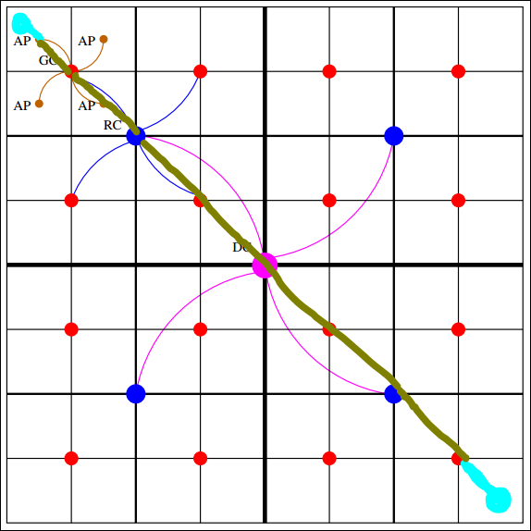
Assumptions (Migration and Replication)

Slide 9
It’s time for a demo

