Slide 1

HR - ANALYTICS
Group -2 : Team Members
Mrs. B.Mounika
Ms.Mamatha Sunchu
Mr. Parikshit Singh Bais
Mr Nagesh A Pahurkar
Ms.Shraddha Prakash Shivgan
Mr. Badiyaa Srivardhan
Project Name - P551
Mentor: Neha Sanjiv Tadam

Slide 2

INDEX
Introduction
Data Overview
Objectives: KPI
Analysis (Dashboard)
Recommendation and Insights
Conclusion

Slide 3
INTRODUCTION
HR analytics involves the collection and analysis of HR-related data, including employee data, performance metrics, and other relevant data points like attrition, hourly rate, work life balance.
By using advanced analytical tools and techniques, HR analytics provides valuable insights into HR processes and trends, enabling organizations to make more informed decisions about their employees and improve overall performance.

Slide 4
DATA OVERVIEW:
DATA CLEANING :
Two of the columns in the employee dataset are labelled: "Standard Hours" and "Employee Count". In "Standard Hours", we found that all the records have a value of 80.
In "Employee Count", we found that all the records have a value of 1. It is the number of employees working in the company, where each employee, whether full-time or part-time, is counted as 1. As these columns all have the same values, we decided to drop them.

Slide 5
Employee count in the Organization
50,000
24,895
25,105

Slide 6
Total Employees
50,000
24,895
25,105

Slide 7
Active Employees
24,895
50,000
25,105

Slide 8
Ex-Employees
25,105
50,000
24,895

Slide 9
OBJECTIVES
The aim of this project is to analyze employee retention and attrition rates with the organization and provide insights to the HR team for developing effective retention strategies.
Through data analysis and visualizations, we will identify factors that contribute to :
Employee turnover and attrition.
Evaluate the effectiveness of existing retention strategies.
To verify the satisfaction level of employee in the organization.
Provide recommendations to improve employee retention.

Slide 10
PROBLEM STATEMENT
Average attrition rate for all Departments
Average hourly rate of Male Research Scientist
Attrition rate Vs Monthly Income stats
Average working years for each Department
Job role Vs Work life balance
Attrition rate Vs Years Since last promotion

Slide 11
KPI 1: Average Attrition rate for all Departments
This KPI is to find out the
relationship between each
department and its attrition rate and here attrition rate is highest for Research & Development Department whereas lowest is for Hardware Department.

Slide 12
KPI 2: Attrition Rate Vs Monthly Income Stats
Employees with a job level Hardware (highest paid) and Employees with a job level of 1 are Support (lowest paid)
As the job level increases, the number of employees that want to attire decrease job level of r has the highest number of employees that want to attire.

Slide 13
KPI 3:Average Working Years for each Department
From this chart we can observe that the average working years in all departments is 20.5 years.
The number of employees who have worked for a shorter period of time are the ones who want to attire
As the age increases, the total number of working years increases.
Hardware
R&D
Software
HR
Sales
Support

Slide 14
KPI 4: Attrition Rate Vs Years Since Last Promotion
In this KPI we can see highest attrition is from 0-5 years since last promotion. While the employees who have not got promoted for more than 20 years they shows more fluctuation the Attrition Rate vs since last year promotion against job role.

Slide 15
KPI 5: Job Role Vs Work Life Balance for Total Employees
From the analysis we can conclude that,
For Research directors and the developers the work life balance is poor.
For human resources the work life balance is good.
Remaining job roles have moderate work life balance.
Healthcare Representative
Developer

Slide 16
KPI 6: Average Hourly rate of Male Research Scientist
This KPI is to find out the average hourly rate of male research scientists which is 114.45 and for females it is 115.16

Slide 17
Extra kpi : Attrition rate Vs Stock option Level
Except HR department, there seems to be a trend where employees with attrition are those having lower stock levels compared to those without attrition. Employees might be attiring because they have lower stock option level than other employees of same role.

Slide 18
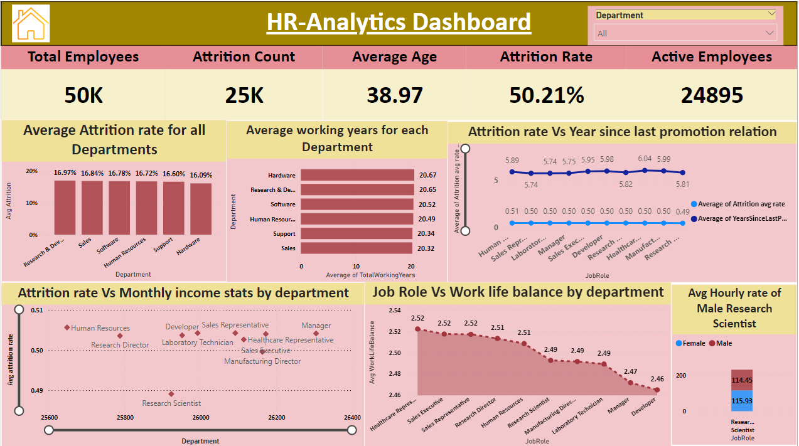

Slide 19
Project INSIGHTS
Research & Development Department has “Highest attrition rate 51.21%” and Hardware Department has a “Lowest attrition with rate 49.44%”.
Hardware Department has Highest Monthly Income 26,208.Thus Hardware department has the lowest attrition rate and Support Department has Lowest Monthly Income 25,907.
Mangers and Research directors have the highest total working years and Sales Representative have the lowest total working years.
We know that Mangers and Research directors have the highest avg monthly income and have oldest avg age, Therefore, it is highly possible that they are attiring due to retirement. Other job roles are attiring after shorter working years & we predict that it is to look for better job opportunities.
Except HR department, there seems to be a trend where employees with attrition are those having lower stock levels compared to those without attrition. Employees might be attiring because they have lower stock option level than other employees of same role.
Developers having lowest Work Life Balance and Healthcare Representative having Highest Work Life Balance.
Highest Attrition is from 0-5.8 years since last promotion. While the employees who have not got promoted for more than 20 years they shows more fluctuation.

Slide 20
RECOMMENDATION
Instead of exit interviews, conduct stay interviews with employees to gather feedback about the job.
Ensure that employees receive fair pay in same job level , same job role with almost equal monthly income and compensation for their work and to find out what motivates an employee to continue to work in an organization.
Increase allowance for employees to work overtime, and make sure that those working overtime are being paid more than those who are not.
Ensure employees have manageable workloads by regularly monitoring and adjusting workloads to maintain better work-life balance.
Offer stock option to more employees especially new recruits as an incentive.

Slide 21
CONCLUSION
Putting it all to together, most employees with attrition have low job role, low monthly income, low working years at company and low stock option level.
It’s high time for the company to follow employee retention strategies , to recognise the employees with high performance rating and get promoted & provide certain percent salary hike for other employees.
“Research indicates that workers have three prime needs: Interesting work, recognition for doing a good job, and being let in on things that are going on in the company.” – Zig Ziglar.
Employees who are engaged are more likely to stay with their organization, reducing overall turnover and the costs associated with it. They feel a stronger bond to their organization’s mission and purpose, making them more effective brand ambassadors. They build stronger relationships with customers, helping their company increase sales and profitability. “

Slide 22
Thank you

