Slide 1

Mapping Polarized Opinions: Topic Modeling of Controversial Reddit Comments

Slide 2
Problem definition
Online discussions about the Israel-Hamas conflict on Reddit often reflect polarized opinions, especially in controversial comments. This project aims to analyze these comments using BERTTopic to identify dominant themes and categorize them into Pro-Israel, Pro-Hamas, Anti-Israel, and Anti-Hamas perspectives.
Additionally, it seeks to predict the topic of new controversial comments, providing a probability score for each category, enabling deeper insights into the nature of contentious online discourse.

Slide 3
Data DESCRIPTION
Source: Reddit (IsamasRed dataset), collected between August and November 2023.
Data Volume: ~400,000 conversations and over 8 million comments.
Subreddits: Includes 25 conflict-centric subreddits (e.g., r/IsraelPalestine, r/IsraelHamasWar) and 75 conflict-inclusive subreddits (e.g., r/worldnews, r/news).
Attributes: Comment text and metadata (upvotes, downvotes, timestamps, subreddits, and controversiality indicators).

Slide 4
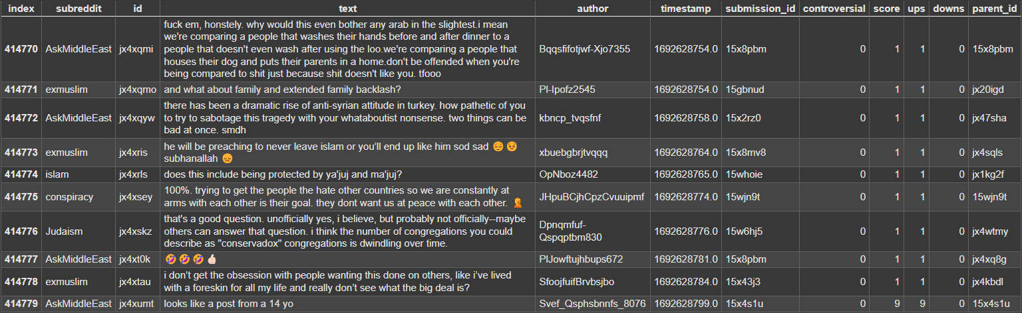

Slide 5
DATA PREPROCESSING
Data Splitting:
The dataset, containing millions of comments per month, was divided into smaller chunks for efficient processing.
Each chunk was processed individually to ensure memory-efficient handling.
Filtering Controversial Comments:
From each data chunk, only comments marked as "controversial" were retained for analysis.
Timestamp Conversion:
The comment timestamps, stored in UNIX timestamp format, were converted to a readable date format for easier interpretation and analysis.

Slide 6
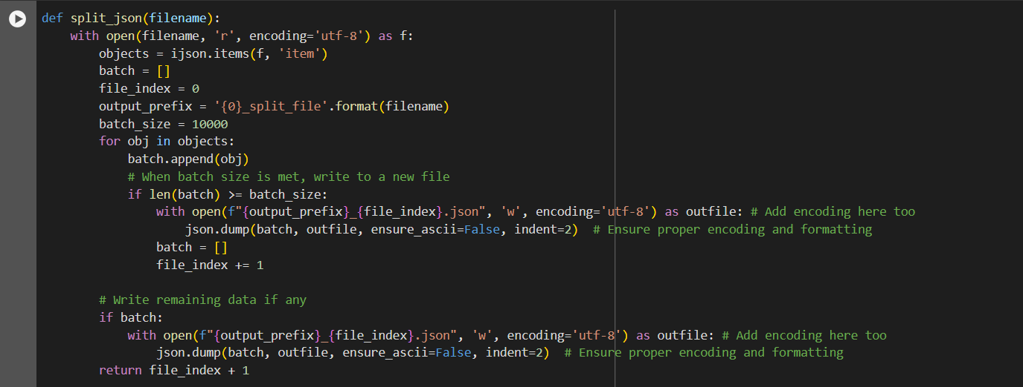
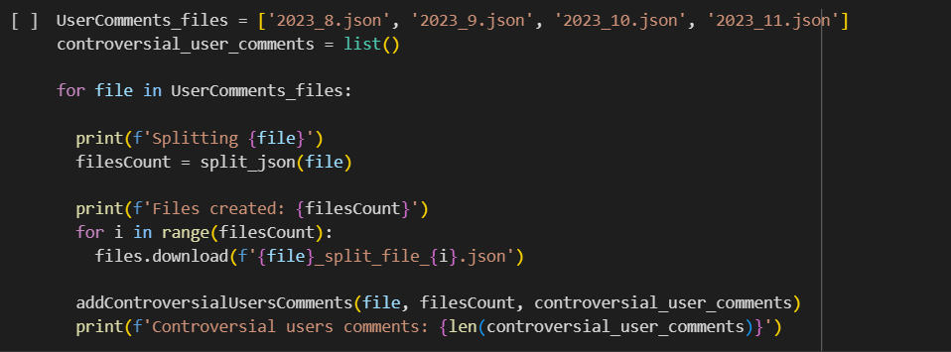
DATA PREPROCESSING

Slide 7
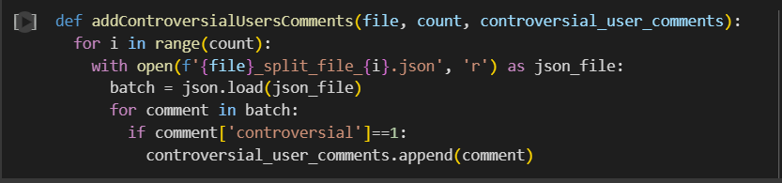
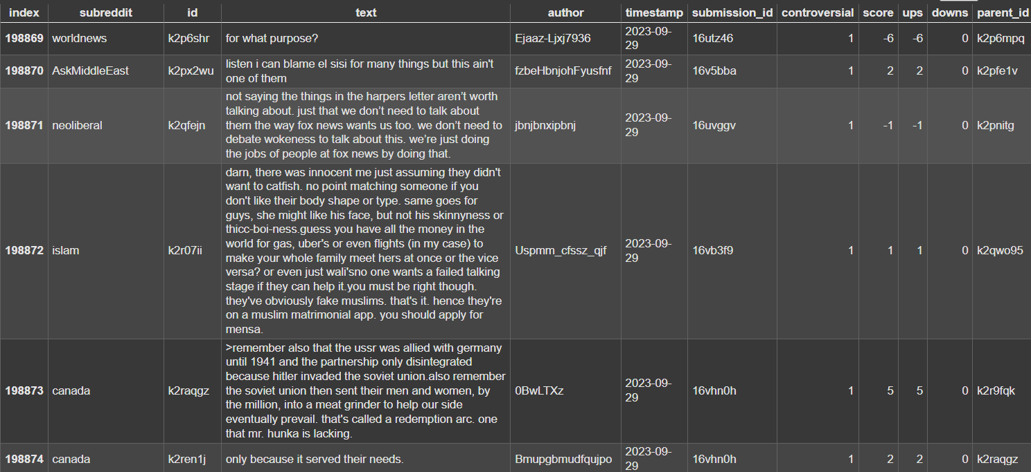
DATA PREPROCESSING

Slide 8
Data exploration
Total controversial comments: 1,98,879.
Day-Wise Distribution: Significant spike in comments observed during the last week of October, likely tied to key events in the Israel-Hamas conflict.
Month-Wise Distribution:
August and September: Fewer comments with consistent activity.
October: Sharp increase, especially in the last week, making it the most active month.
November: Activity gradually declines but remains higher than August and September.

Slide 9
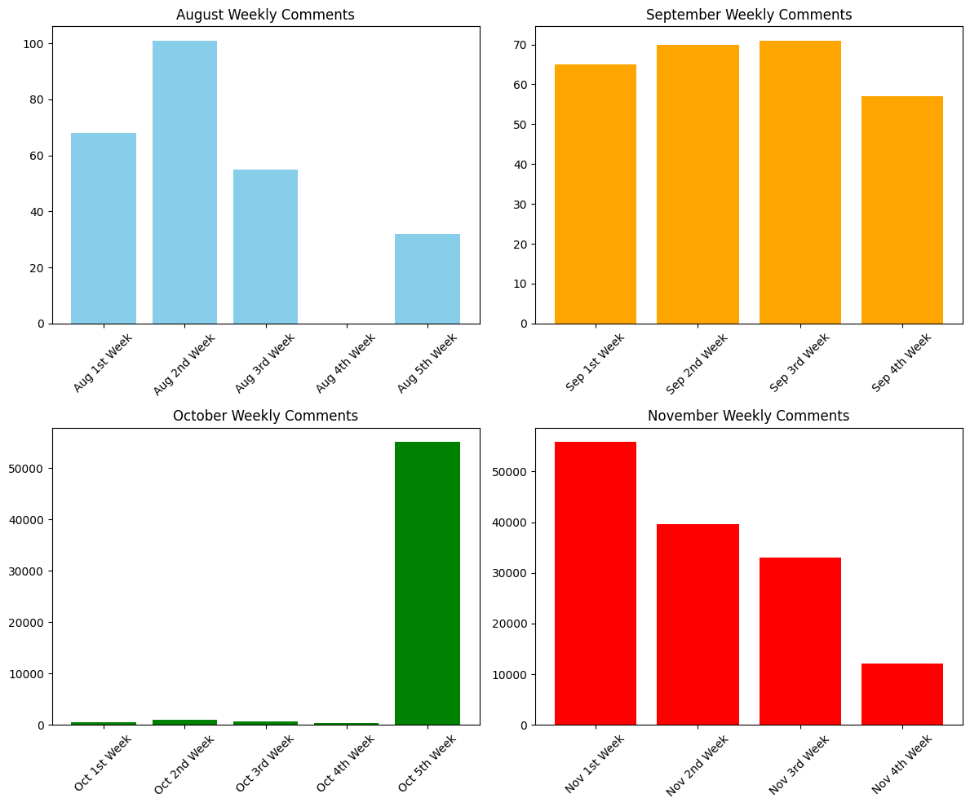

Slide 10
Topic modelling
Embedding Extraction: Text embeddings are generated using a pre-trained model to capture semantic meaning.
Dimensionality Reduction and Clustering: UMAP reduces embedding dimensions, and HDBSCAN clusters similar embeddings into topics.
Topic Representation: CountVectorizer and Class-Based TF-IDF extract the most relevant words for each topic.
Fine-Tuning: Enhance topic clarity using representation models like KeyBERTInspired.

Slide 11
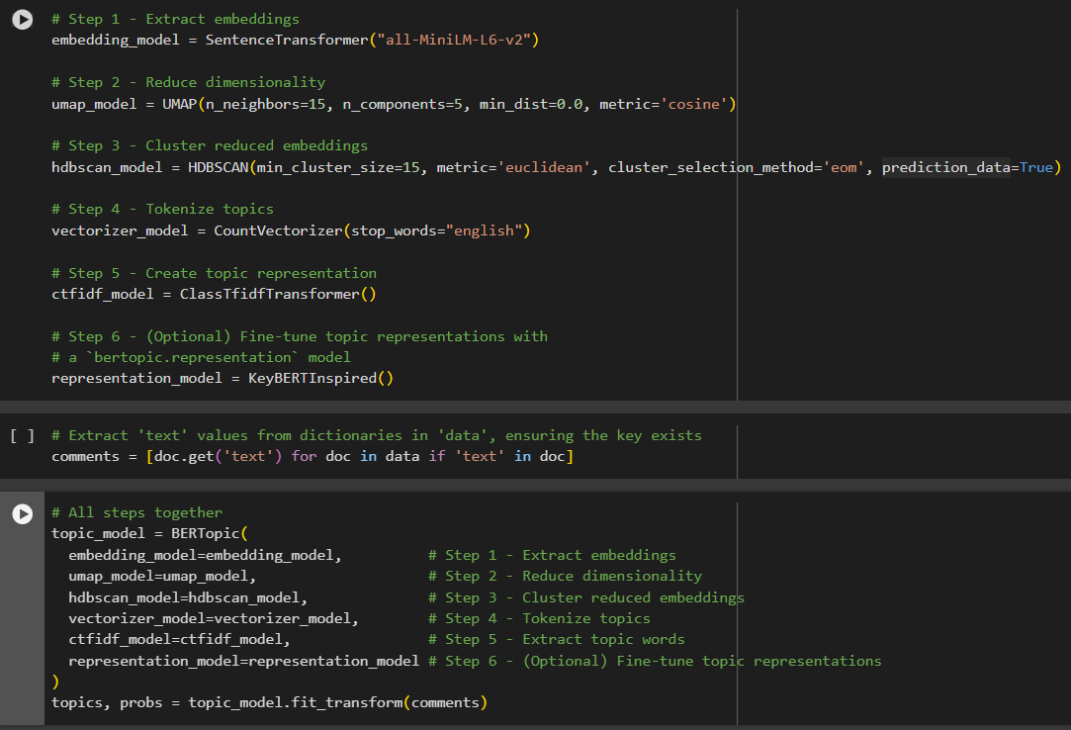
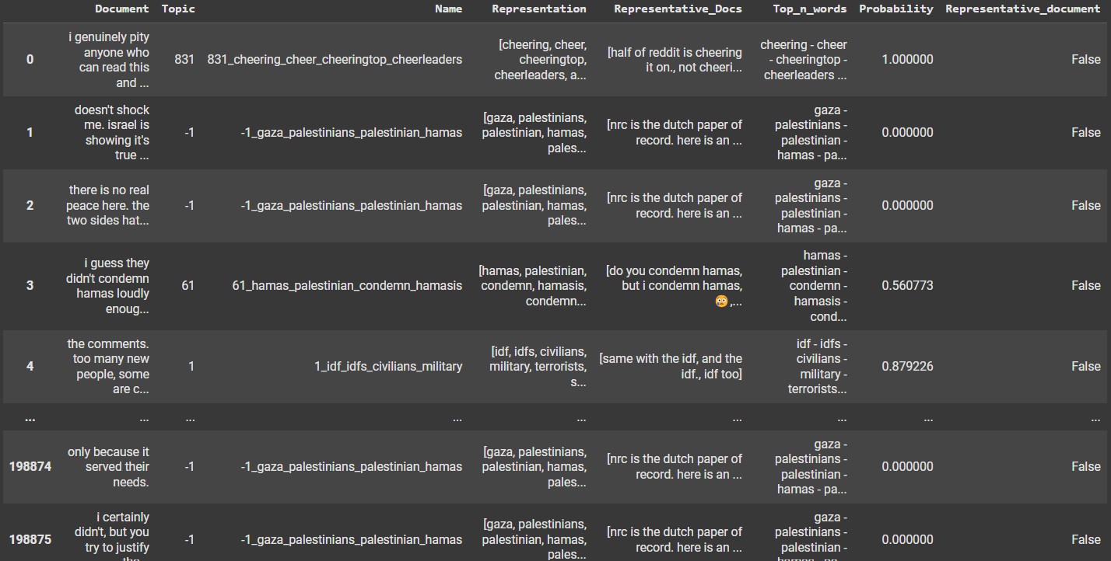

Slide 12
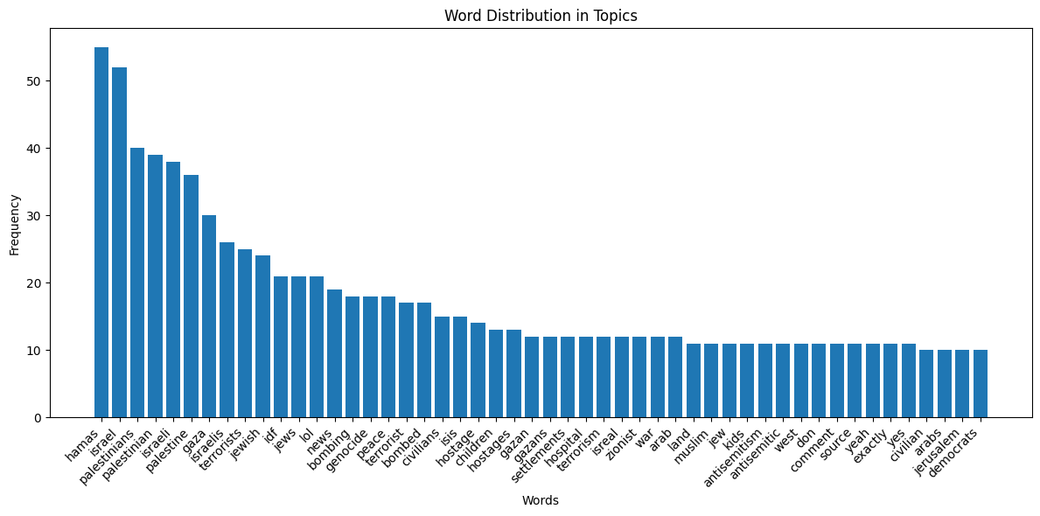
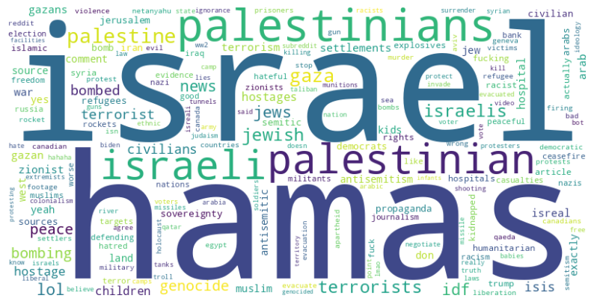
Top N-Topics

Slide 13
TOPICS PARTITIONING
Precomputed Keyword Embeddings: BERT embeddings are generated for Israel and Hamas keywords derived from a research study. These embeddings are used to compare similarity with new text.
Category Prediction: Determines whether the text belongs to Israel, Hamas, or Neutral by calculating cosine similarity between the text embedding and the precomputed keyword embeddings.
Sentiment Analysis: Uses a DistilBERT sentiment analyzer to classify the text as Pro (Positive) or Anti (Negative) with a confidence score.
Output: Returns the predicted category, similarity score, sentiment, and sentiment confidence for the analyzed text.

Slide 14
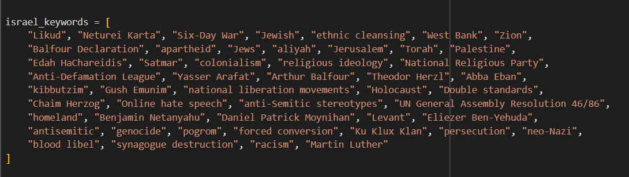
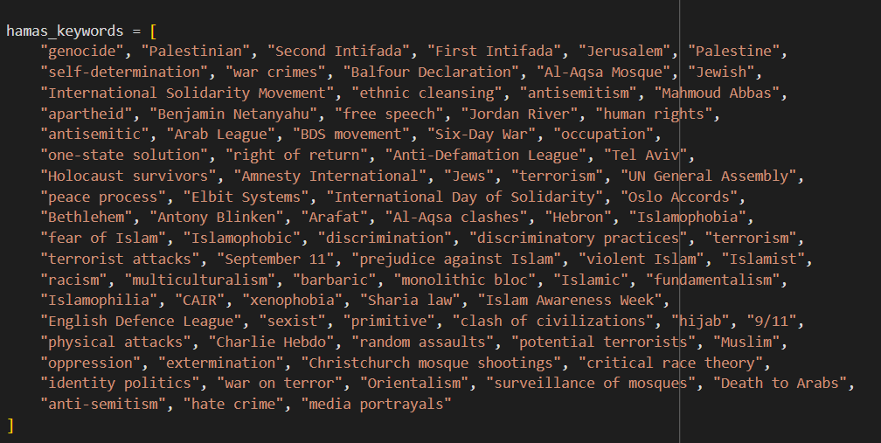
Israel-hamas keywords

Slide 15
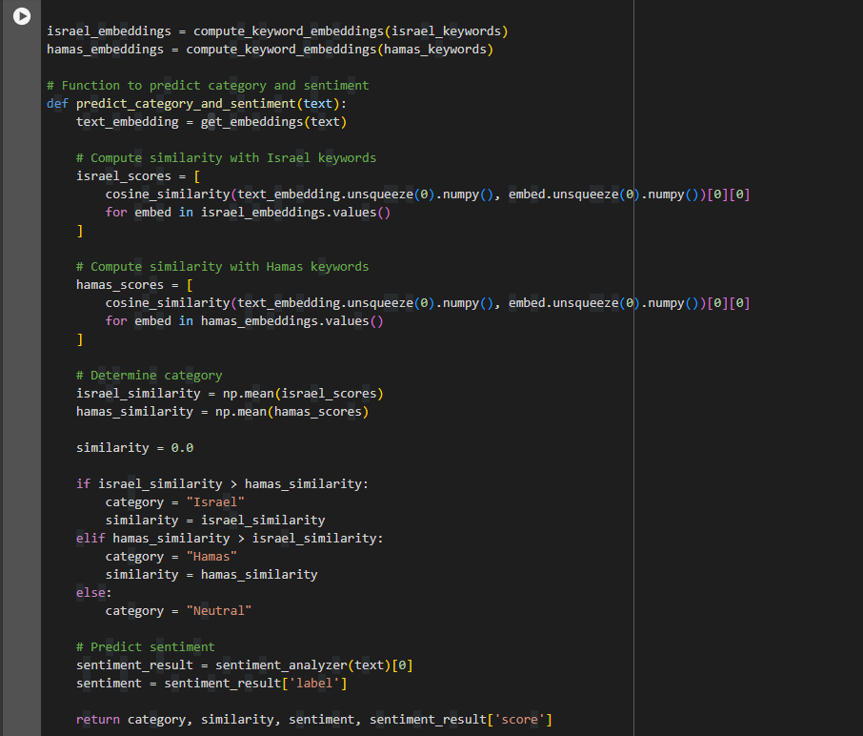

Slide 16
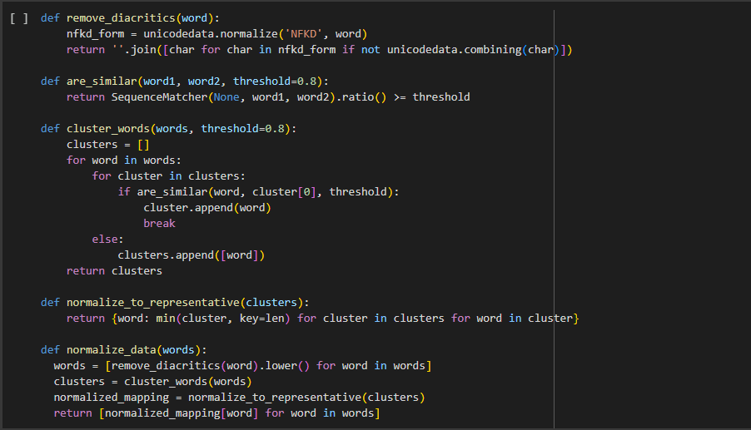
Normalization
Remove Diacritics: Uses unicodedata to remove special characters and accents from words, making them uniform.
Cluster Words: Groups words into clusters of similar terms based on a similarity threshold (default: 0.8) using SequenceMatcher.
Normalize Words: Maps each word in a cluster to a representative word (shortest word in the cluster) for consistency.
Aggregate Data: Groups normalized words and calculates the mean of Categorical Score (Value1) and Sentiment Score (Value2) for each category, updating the dataset with the aggregated results.

Slide 17
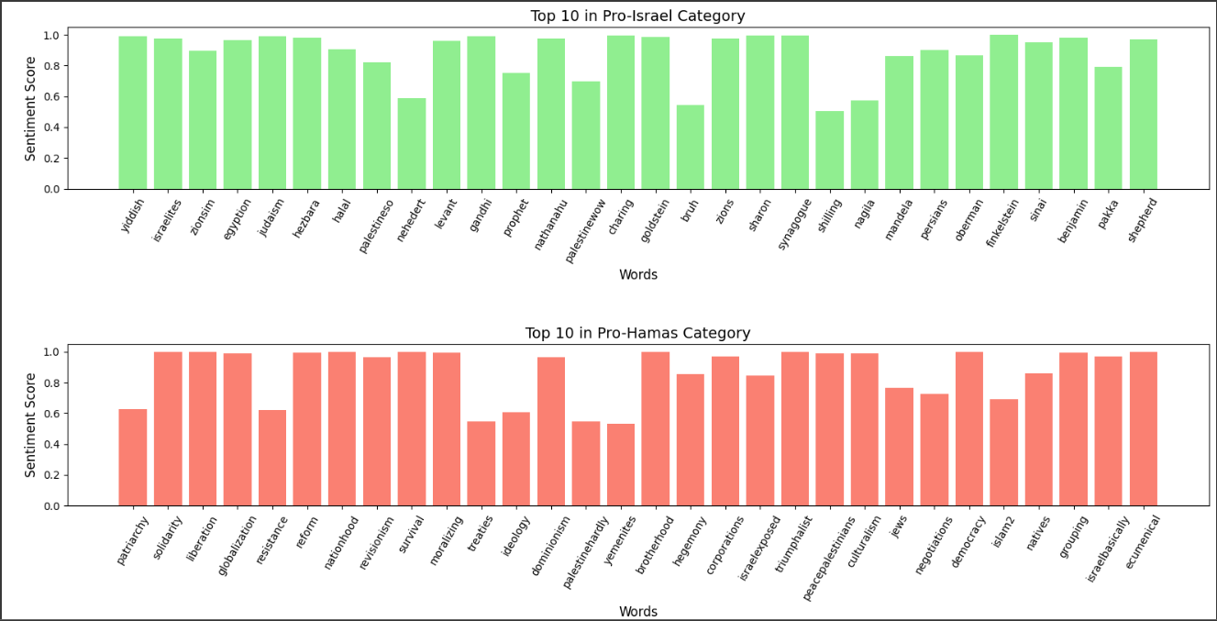
RESULTS

Slide 18
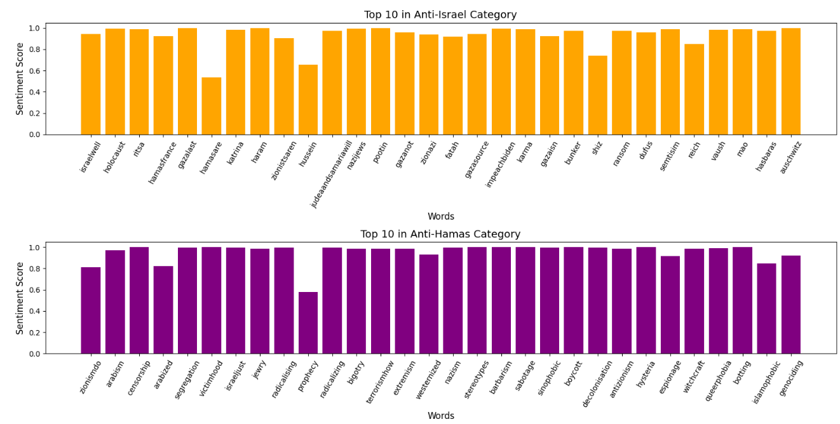

Slide 19
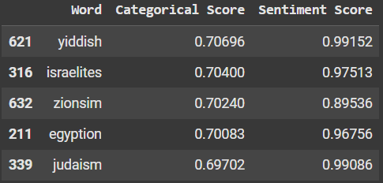
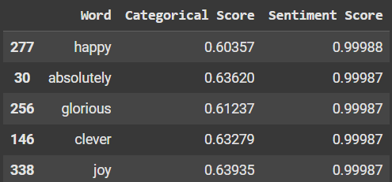
PRO-ISRAEL
CATEGORICAL SCORE
SENTIMENT SCORE

Slide 20
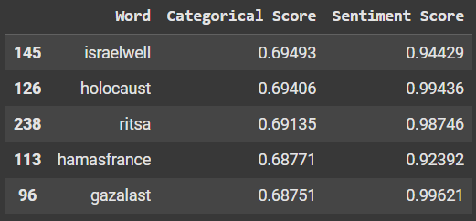
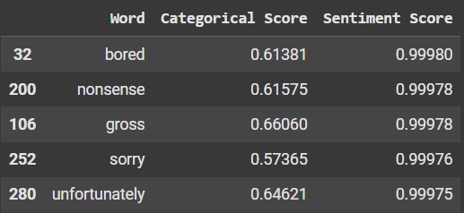
ANTI-ISRAEL
CATEGORICAL SCORE
SENTIMENT SCORE

Slide 21
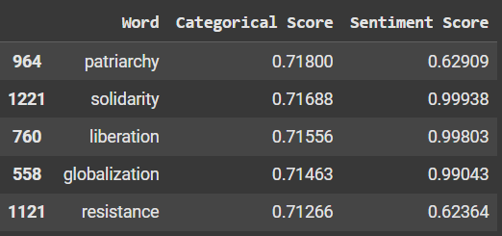
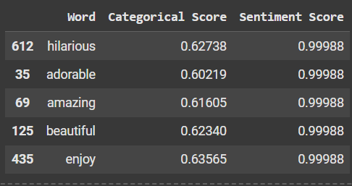
PRO-HAMAS
CATEGORICAL SCORE
SENTIMENT SCORE

Slide 22
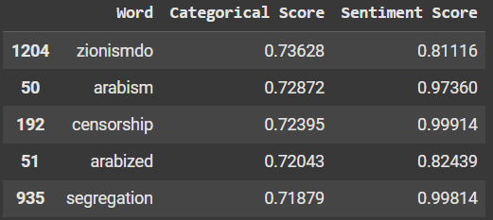
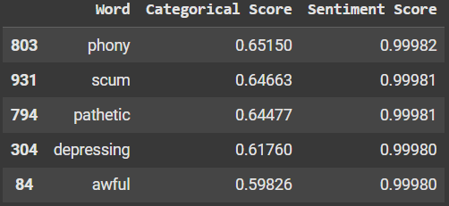
ANTI-HAMAS
CATEGORICAL SCORE
SENTIMENT SCORE

Slide 23
CONCLUSION
Aggregation of categorical and sentiment scores provided clearer insights into the dominant themes within each category.
The results highlighted key representative keywords for Pro-Israel, Pro-Hamas, Anti-Israel, Anti-Hamas, and Neutral categories, offering a structured view of public discourse.
These findings pave the way for detailed analysis of sentiment trends and thematic shifts, enabling a deeper understanding of polarized discussions around the Israel-Hamas conflict.
The refined dataset offers a strong foundation for future work, such as predictive modeling or time-series trend analysis.

Slide 24
Thank you

