Slide 1
ZEROCKS
BY 160117733054
160117733055

Slide 2
1.Introduction
Many students in our college stand in a queue to get a xerox or a print out before the day of the exam.
Students who need to prepare for the exam have to wait for a long time to get their study material printed.
Project ‘Zerocks’ automates the process of taking a printout in a xerox shop.
This project intends to save time to both the user and the one who owns the xerox shop.

Slide 3
2.User Interface
Using a graphical user interface is easier than the command line interface since all the work can be done with the click of a button.
The application ZEROCKS uses graphical user interface which is a built
using JAVA.
The swing package in JAVAX and awt package in JAVA help create various graphical interfaces like frames ,buttons ,text fields etc.

Slide 4
3.Account Management
Since there are a lot of students in the college, a user account in the project becomes a must to instantly identify a student and provide the services of the application.
The account management involves two categories :
1:Student or user account
2:Guest account.
All the usernames and passwords for the these accounts will be stored in a file in the systems memory.

Slide 5
4.Login and Sign Up
When a user tries to login to his account , his username and password are checked from the file and if they are incorrect he will be asked to enter the username and password again.
When the user tries to signup a new account the file containing usernames and passwords will be opened in write mode and all the info about the user will be stored in it.
In the same way when the person tries to login the file will be opened in read mode.

Slide 6
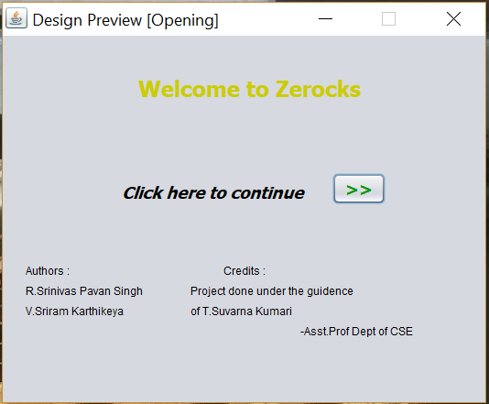
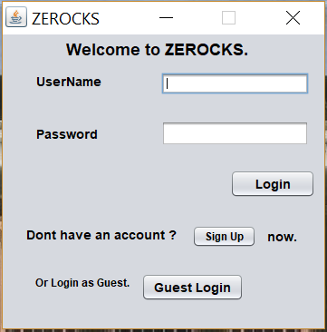
Screen Shots
Opening Frame
Login Frame

Slide 7
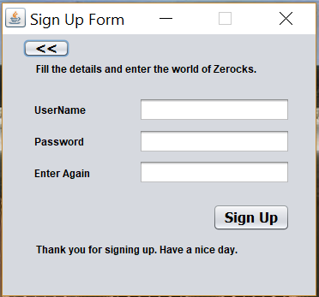
Screen Shots
SignUp module

Slide 8
5.Main process
After the user logins into his account or uses a guest account he will be asked to chose the file that he wants the printout of.
When the user selects document the application asks the user for information about how many copies he wants and also shows the approximate amount of money he needs to pay.
The document now is directly sent to the xerox shop through LAN or through email which then will be printed by the time the user reaches the shop.

Slide 9
6.Notifications
When all the copies are printed the user gets a notification from the xerox shop that the process has been completed.
The notification process works by taking time in consideration.
When the shop keeper starts the printing process the application estimates the amount of time needed to print those copies.
This time is set like an alarm to send the notification to the user.

Slide 10
7.Guest Account
The guest account provides an instant access into the application and enables the user to send his documents with out login.
As anyone can open the guest account, it doesn’t notify about the printing process and also doesn’t show the amount of money that need to be paid.
The user then has to manually find out how money he has to pay.

Slide 11
START
FROM SIGN UP
TRUE
LOGIN?
FALSE
OPEN FILE IN READ MODE
SIGNUP OR GUEST
DISPLAY
SIGNUP?
ENTER USERNAME AND PASSWORD
TRUE
FALSE
OPEN FILE IN READ
MODE
DISPLAY

Slide 12
DISPLAY
GUEST?
USERNAME==CORRECT?
ENTER USERNAME
ENTER PASSWORD
TRUE
MAIN PROCESS
PASSWORD==CORRECT?
TRUE
USERNAME=
EXISTING?
FALSE
LOGGED IN
DISPLAY
OPEN FILE IN APPEND MODE
MAIN PROCESS
JUMP TO LOGIN
SIGNED UP

Slide 13
CONCLUSION
The project ZEROCKS has the following objectives :
Reducing the wait at the shop for the copies.
Improving the communication between the user and the service provider.
Providing notifications which increase productivity.
To bring a good experience to the user using the app.

Slide 14
Thank you

