Slide 1



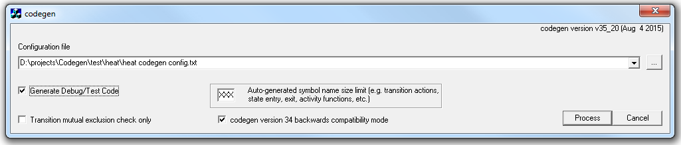



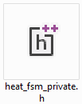
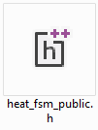
Codegen inputs & outputs

Slide 2
…_fsm_functs.c
Added calls to debug hook functions.
Enabled by conditional compilation.
…
/* Entry action function definitions */
void heat_fsm_powerup_entry(void)
{
#ifdef FSM_DEBUG
FSM_DebugHook_heat_fsm_powerup_entry();
#endif /* FSM_DEBUG */
fsm_timer1_enable(HEAT_FSM_POWER_UP_WAIT, &heat_fsm_config);
ind2_fsm_disable();
ind2_fsm_post_purge_disable();
blower_fsm_heat_call_disable();
blower_fsm_heat_disable();
heat_fsm_heat_mode = LOW;
heat_fsm_low_limit_trip_cntr = 0;
heat_fsm_high_limit_trip_cntr = 0;
heat_fsm_force_to_high = FALSE;
heat_fsm_limit_force_to_high = FALSE;
heat_fsm_force_to_high_next = FALSE;
}
void heat_fsm_standby_entry(void)
{
#ifdef FSM_DEBUG
FSM_DebugHook_heat_fsm_standby_entry();
#endif /* FSM_DEBUG */
heat_fsm_clear_error_codes();
ind2_fsm_disable();
…

Slide 3
…_fsm_debug.txt
Generated stubs for debug hook functions.
May be pasted into unit test driver code.
Can be modified as desired.
…
/*
* FSB Debug Hook Function for heat_fsm_powerup_entry().
*/
int FSM_DebugHook_heat_fsm_powerup_entry(void)
{
// fprintf(stdout, "heat_fsm_powerup_entry()\n");
// fflush(stdout);
return 0;
}
/*
* FSB Debug Hook Function for heat_fsm_standby_entry().
*/
int FSM_DebugHook_heat_fsm_standby_entry(void)
{
// fprintf(stdout, "heat_fsm_standby_entry()\n");
// fflush(stdout);
return 0;
}
/*
* FSB Debug Hook Function for heat_fsm_blower_off_delay_entry().
*/
int FSM_DebugHook_heat_fsm_blower_off_delay_entry(void)
{
// fprintf(stdout, "heat_fsm_blower_off_delay_entry()\n");
// fflush(stdout);
return 0;
}
…

