Slide 1
DOCKERS:PRE-SEQUAL
General query across globe regarding Dockers

Slide 2
What Isn't Docker?
Before we talk about what Docker is, I will talk about what it isn't. What is the negation of Docker? What are its limits? What can't Docker do?
Docker is NOT a Linux Container technology (like LXC)
Docker is NOT limited to just LXC anymore (can theoretically manage VMs in the future)
Docker is NOT a Configuration Manager replacement (like Chef, Puppet, SaltStack, etc)
Docker is NOT a PaaS
Docker is NOT good at linking across separate servers or VMs (yet, see ambassadors)
Docker is NOT good at isolating Linux Containers from each other (shared kernel)

Slide 3
What Is Docker?
So then what is Docker good at?
Docker is great at building and sharing disk images with others through the Docker Index
Docker is a manager for infrastructure (today's bindings are for Linux Containers, but future bindings including KVM, Hyper-V, Xen, etc.)
Docker is a great image distribution model for server templates built with Configuration * Managers (like Chef, Puppet, SaltStack, etc)
Docker uses btrfs (a copy-on-write filesystem) to keep track of filesystem diff's which can be committed and collaborated on with other users (like git)
Docker has a central repository of disk images (public and private) that allow you to easily run different operating systems (Ubuntu, Centos, Fedora, even Gentoo)

Slide 4
When To Use Docker?
Docker is a basic tool, like git or java, that you should start incorporating into your daily development and ops practices.
Use Docker as version control system for your entire app's operating system
Use Docker when you want to distribute/collaborate on your app's operating system with a team
Use Docker to run your code on your laptop in the same environment as you have on your server (try the building tool)
Use Docker whenever your app needs to go through multiple phases of development (dev/test/qa/prod, try Drone or Shippable, both do Docker CI/CD)
Use Docker with your Chef Cookbooks and Puppet Manifests (remember, Docker doesn't do configuration management)

Slide 5
What Alternatives Are There to Docker?
The Amazon AMI Marketplace is the closest thing to the Docker Index that you will find. With AMIs, you can only run them on Amazon. With Docker, you can run the images on any Linux server that runs Docker.
The Warden project is a LXC manager written for Cloud Foundry without any of the social features of Docker like sharing images with other people on the Docker Index.
Heroku :is a cloud Platform-as-a-Service (PaaS)

Slide 6
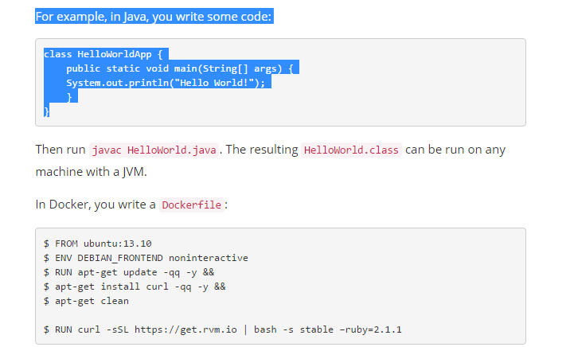
How Docker Is Like Java
ava's promise: Write Once. Run Anywhere.
Docker has the same promise. Except instead of code, you can configure your servers exactly the way you want them (pick the OS, tune the config files, install binaries, etc.) and you can be certain that your server template will run exactly the same on any host that runs a Docker server.

Slide 7
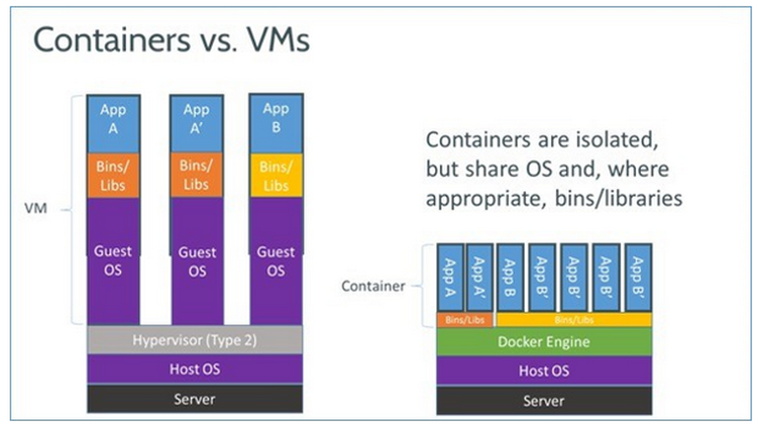
Dockers vs VM

