Slide 1
IBM AICTE PROJECT
AI AGENT FOR DIGITAL FINANCIAL LITERACY
Presented By:
Student name :SRINIVAS S
College Name: BMS INSTITUTE OF TECHNOLOGY
Department : EEE

Slide 2
OUTLINE
Problem Statement
Technology used
Wow factor
End users
Result
Conclusion
Git-hub Link
Future scope
IBM Certifications

Slide 3
PROBLEM STATEMENT
Many individuals, especially from rural or less digitally aware communities, face challenges in understanding digital financial tools such as UPI, online banking, loan procedures, or scam prevention. Lack of awareness leads to financial mismanagement, fraud risks, and exclusion from government schemes.
Proposed Solution:
An AI-powered Financial Literacy Agent using Natural Language Processing (NLP) and Retrieval-Augmented Generation (RAG) to educate users on essential financial topics. The assistant provides clear guidance on digital transactions, budgeting, loans, and scam prevention — all with multilingual support and reliable responses sourced from government portals and financial institutions.

Slide 4
TECHNOLOGY USED
IBM cloud lite services
IBM Watsonx.ai Studio
IBM Granite Foundation Model (LLM)
Natural Language Processing (NLP)
Vector Index (Watsonx.ai)
Retrieval Augmented Generation (RAG)

Slide 5
IBM CLOUD SERVICES USED
IBM Cloud Watsonx AI Studio
IBM Cloud Watsonx AI runtime
IBM Cloud Agent Lab
IBM Granite foundation model
IBM Cloud Object Storage
IBM Cloud IAM (Identity and Access Management)

Slide 6
WOW FACTORS
This AI agent aims to empower users with accurate, accessible, and personalized financial knowledge.
It will reduce misinformation, help users make better money decisions, and increase trust in
digital financial systems.
The solution is especially impactful for underserved communities and first-time digital users.
Unique features:
Retrieval-based answers from trusted sources like RBI and NPCI
Natural Language Processing (NLP) for understanding diverse user queries
Document-based responses using a Vector Index (RAG implementation)
Safe handling of off-topic or unrelated questions
Designed for multilingual interaction to reach regional users
Covers essential topics like UPI, online scams, loans, budgeting, and savings

Slide 7
END USERS
General Public
First-time Digital Users
Elderly Citizens
Students and Young Adults
NGOs and Government Outreach Programs
Self-Help Groups / Women’s Collectives
Educators / Institutions
Microfinance Beneficiaries

Slide 8
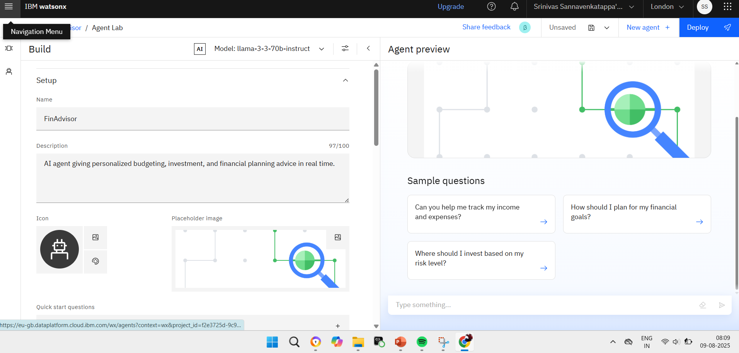
RESULTS : SETTING UP

Slide 9
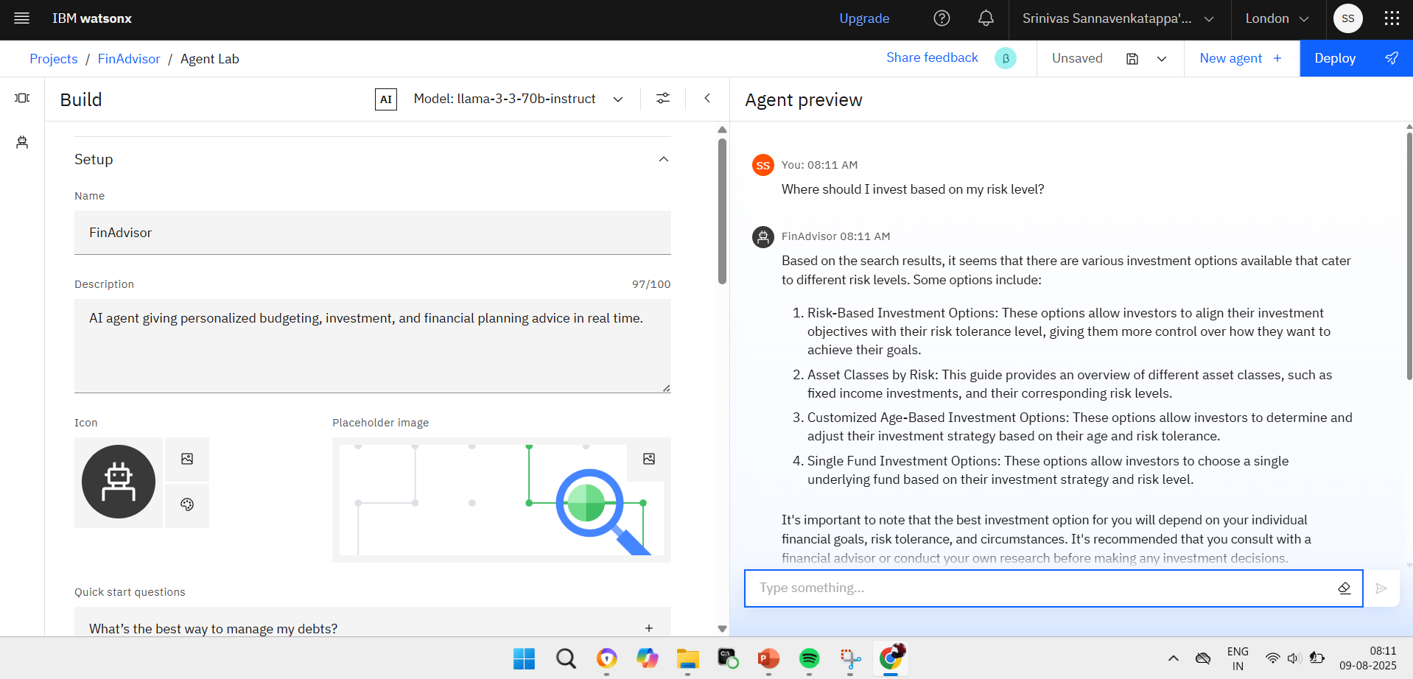
RESULTS : AGENT PREVIEW

Slide 10
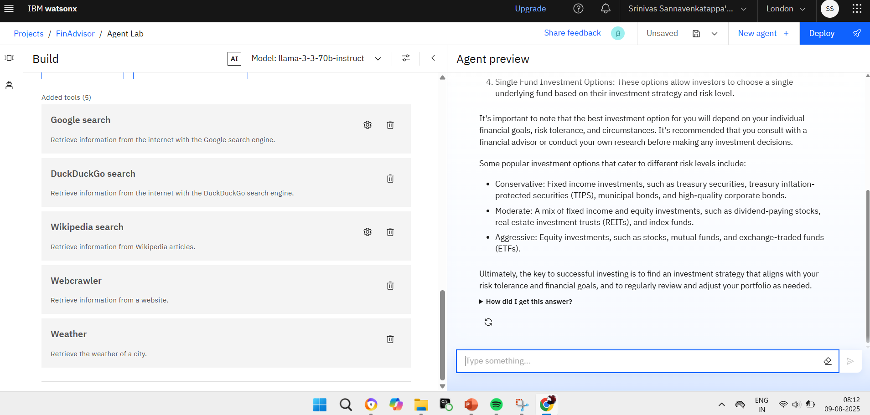
RESULTS : TOOLS USED (ALSO USED VECTOR DATABASE INDEX)

Slide 11
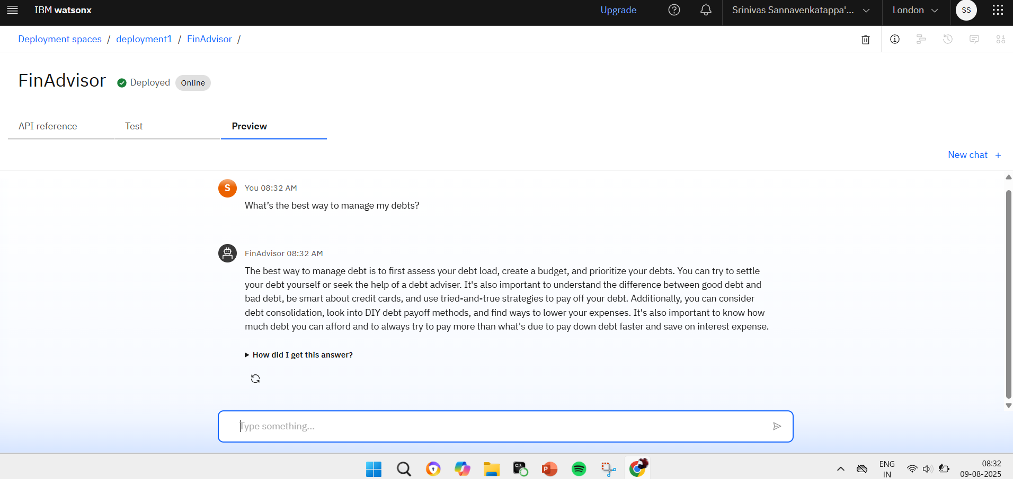
Deployed AI Agent
RESULTS

Slide 12
CONCLUSION
The Digital Financial Literacy AI Agent leverages the power of IBM Watsonx.ai and Retrieval-Augmented Generation (RAG) to deliver accessible, accurate, and context- aware financial guidance.
By addressing real-world concerns like UPI safety, loan awareness, and scam
prevention, the assistant empowers users to make informed financial decisions.
With multilingual support and document-backed answers, it ensures inclusivity, trust, and reliability.
This solution has the potential to bridge the digital divide and promote financial well-
being across diverse communities.

Slide 13
GITHUB LINK
https://github.com/srinivass07/Edunet-IBM-Skill-build-Internship

Slide 14
FUTURE SCOPE
Multilingual Research Support
Voice-Activated Research Assistant
Real-Time Collaboration Features
Research Gap and Novel Topic Identification
Integration with Publishing Platforms
AI-Assisted Paper Drafting

Slide 15
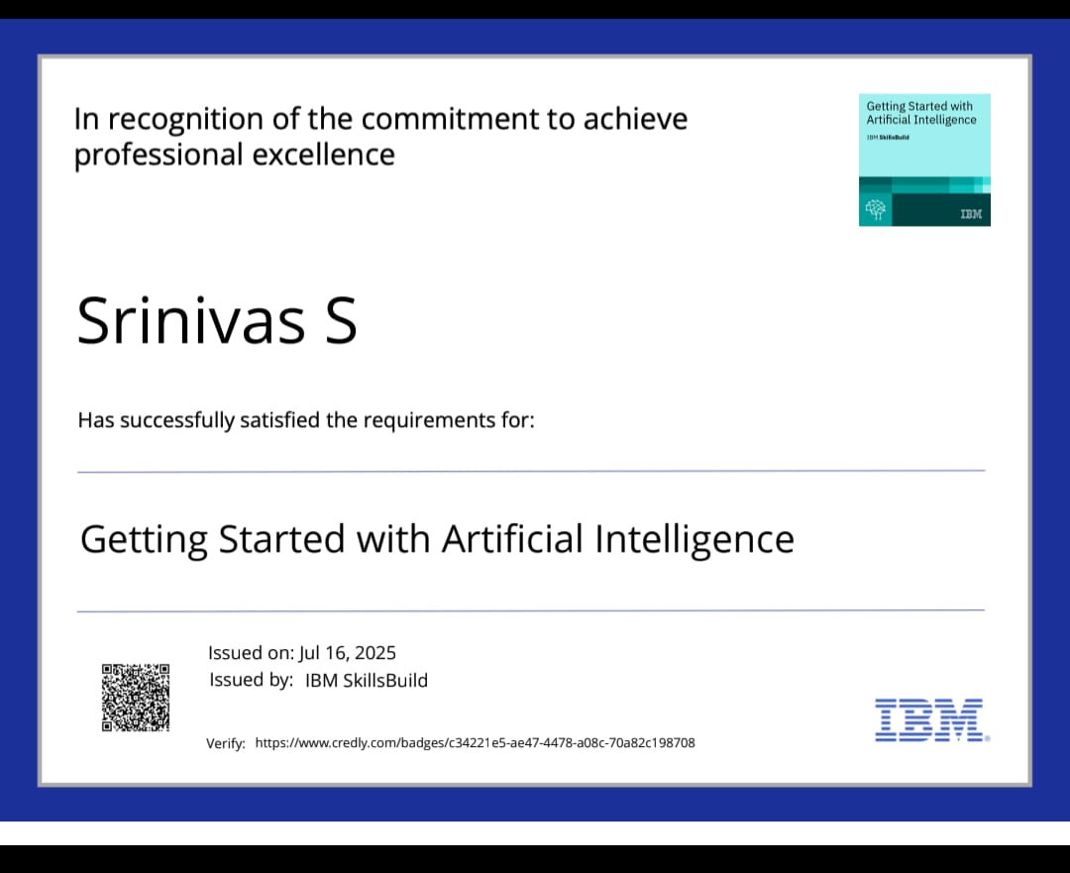

course certificate 1

Slide 16
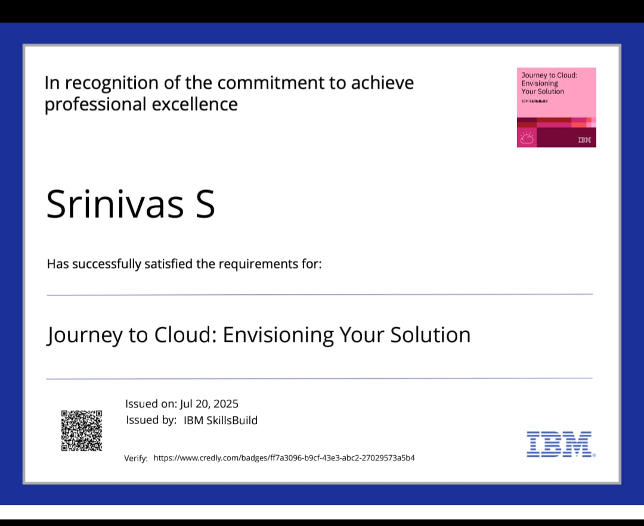
course certificate 2

Slide 17
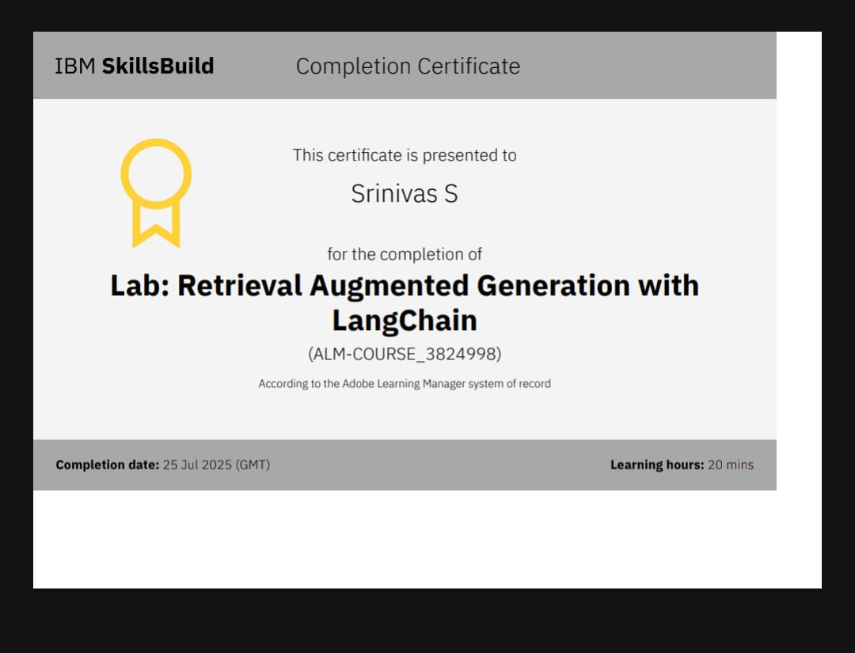
Lab course certificate 3

Slide 18
THANK YOU

