Slide 1
AML / FRAUD ANALYTICS CASE STUDY
Strengthening AML Transaction Monitoring
From Control Gaps to Explainable, Risk-Based Detection
A business-led case study that identifies a monitoring weakness, quantifies the risk, redesigns the control and turns analytics into an investigation workflow.
LEGACY CONTROL
CONTROL GAP
POC REDESIGN
0.5%
1,646 / 1,654
100%*
→
→
fraud recall
confirmed fraud cases missed
fraud recall in test
*Held-out synthetic test data; feasibility evidence, not a production performance claim.
Business Analysis • AML/KYC • Python • SQL • Power BI
Prepared by Srinivas Suresh
Notes:
Open by framing this as a business control improvement, not a dashboard demo. The headline is that a documented control behaved differently than expected, and the analysis translates that gap into a measurable future-state process.

Slide 2
01 | EXECUTIVE SUMMARY
A control weakness was measurable — and fixable
The decision is whether to validate the redesigned approach on real historical data and move into a governed pilot.
0.5%
100%*
6
Legacy fraud recall
POC fraud recall
False alarms
Only 8 of 1,654 confirmed fraud cases surfaced.
All 1,654 confirmed fraud cases surfaced in the held-out test.
Six non-fraud alerts across 51,286 test transactions.
ROOT CAUSE
Documented monitoring intent did not match the implemented rule logic.
RESPONSE
Use transparent rules for obvious patterns and analytics for harder residual risk.
MANAGEMENT ASK
Approve real-data validation → Compliance threshold workshop → shadow-mode pilot.
AML Fraud & Transaction Monitoring — Executive Case Study
2
Notes:
Lead with the decision. Pause on the three numbers, then explain that the recommendation is validation and shadow mode — not immediate production replacement.

Slide 3
02 | CONTROL GAP
The legacy rule was effectively blind to most confirmed fraud
Held-out test population: 51,286 transactions containing 1,654 confirmed fraud cases.
1,654
8
1,646
Confirmed fraud
Detected
Missed
Known fraud cases in the test population.
Cases caught by the existing monitoring rule.
Confirmed fraud cases that never entered the alert queue.
SO WHAT?
This was not a small tuning issue. If a transaction is never flagged, investigators cannot review it — creating silent control failure.
Plain-English analogy: a smoke detector that sounds for 8 of 1,654 fires needs the detector logic reviewed before the response team is blamed.
AML Fraud & Transaction Monitoring — Executive Case Study
3
Notes:
Let the numbers land. Emphasize that the weakness occurs before investigation: if the rule does not fire, analysts never receive the case.

Slide 4
03 | ROOT-CAUSE ANALYSIS
What stakeholders believed the control did was not what it actually did
The key BA finding was a traceability failure between business intent, technical implementation and test evidence.
DOCUMENTED INTENT
IMPLEMENTED LOGIC
“Flag transfers over $200,000.”
Amount > $200K AND sender balance shows no change
≠
66.6% of confirmed fraud cases were above $200K, so stakeholders could reasonably expect broad coverage.
The extra condition was highly restrictive. The rule fired only 16 times in the full dataset.
BA TAKEAWAY
Business rule → technical logic → test evidence → production KPI must remain traceable and reviewable.
AML Fraud & Transaction Monitoring — Executive Case Study
4
Notes:
This is the core business-analysis slide. Explain the difference between documented intent and implemented logic, then connect it to requirements traceability and testing.

Slide 5
04 | BUSINESS IMPACT
Why this matters beyond a model metric
A weak detection control affects assurance, regulatory defensibility, analyst workload and management decisions.
COMPLIANCE
OPERATIONS
Suspicious activity can remain unreviewed, weakening escalation and SAR/STR decisioning.
Alert queues can look manageable simply because risky transactions never entered them.
ASSURANCE
FEEDBACK
Leadership may believe a control exists while actual coverage is materially narrower.
Without recall/precision monitoring, rule tuning becomes opinion-led instead of evidence-led.
MANAGEMENT LENS
The goal is not “more alerts.” It is the right alerts, with evidence, at a workload the investigation team can absorb.
AML Fraud & Transaction Monitoring — Executive Case Study
5
Notes:
Translate the technical defect into executive concerns: compliance exposure, operational blind spots, false assurance and a weak feedback loop.

Slide 6
05 | BUSINESS REQUIREMENTS
Define outcomes before choosing tools
The redesign is governed by six testable requirements that Compliance, Operations and Analytics can all understand.
01
DETECT
02
EXPLAIN
03
PRIORITIZE
Surface suspicious activity missed by the legacy rule.
Show why each alert or risk classification was created.
Rank higher-risk cases ahead of lower-risk noise.
04
CONTEXTUALIZE
05
GOVERN
06
MEASURE
Expose transaction, account, balance and time signals.
Make thresholds and rule changes auditable.
Track recall, precision, false alarms and alert volume.
SUCCESS
Better detection + explainable reasoning + manageable analyst workload.
AML Fraud & Transaction Monitoring — Executive Case Study
6
Notes:
Show that the project was guided by business requirements rather than by a desire to build a model or dashboard.

Slide 7
06 | FUTURE-STATE OPERATING MODEL
Close the loop from prevention to continuous improvement
The target state makes detection quality, analyst workload and threshold decisions visible and governable.
PREVENT
DETECT
PRIORITIZE
INVESTIGATE
RESPOND
IMPROVE
1
2
3
4
5
6
KYC/CDD risk segmentation
Rules + analytics
Ranked alert queue
Case-level explanations
Escalate / document
Feedback + threshold tuning
TARGET OUTCOME
A controlled monitoring lifecycle — not a one-off model or dashboard.
AML Fraud & Transaction Monitoring — Executive Case Study
7
Notes:
For senior stakeholders, this is the operating-model slide. The target is a closed control lifecycle with visible ownership and measurable performance.

Slide 8
07 | RISK-BASED DETECTION DESIGN
Use simple logic where it works — analytics where it adds value
The architecture avoids unnecessary complexity and preserves explainability for investigators.
TIER 1
TIER 2
OUTPUT
Transparent rule
Residual-risk scoring
One ranked queue
Flag obvious deterministic patterns such as the sender account being drained to exactly zero.
For cases Tier 1 misses, combine amount, balance mismatch, transaction type, empty destination and structuring signals.
Tier 1 OR Tier 2 creates one prioritized alert list with the factors that explain why the case needs review.
Simple • auditable • explainable
Multi-signal • prioritized
Actionable • investigator-ready
DESIGN PRINCIPLE
Complexity must earn its place: keep obvious patterns simple; reserve analytics for residual cases rules cannot reliably separate.
AML Fraud & Transaction Monitoring — Executive Case Study
8
Notes:
Explain why analytics is selective. Obvious deterministic patterns remain transparent rules; analytics is reserved for harder residual cases.

Slide 9
08 | PROOF-OF-CONCEPT RESULTS
The redesign closed the observed gap without creating a large alert burden
Same held-out test period used for all comparisons: 51,286 transactions and 1,654 confirmed fraud cases.
100%
99.6%
6
Fraud recall
Alert precision
False alarms
1,654 / 1,654 confirmed fraud cases surfaced.
Very few generated alerts were non-fraud.
Six non-fraud alerts across the full test population.
BUSINESS INTERPRETATION
In this test window, detection improved materially without creating a large investigation burden.
RESPONSIBLE CAVEAT
Synthetic data + one held-out period. Treat this as feasibility evidence, not expected production performance.
AML Fraud & Transaction Monitoring — Executive Case Study
9
Notes:
Be confident but do not overclaim. The POC demonstrates feasibility on synthetic held-out data; it does not establish production performance.

Slide 10
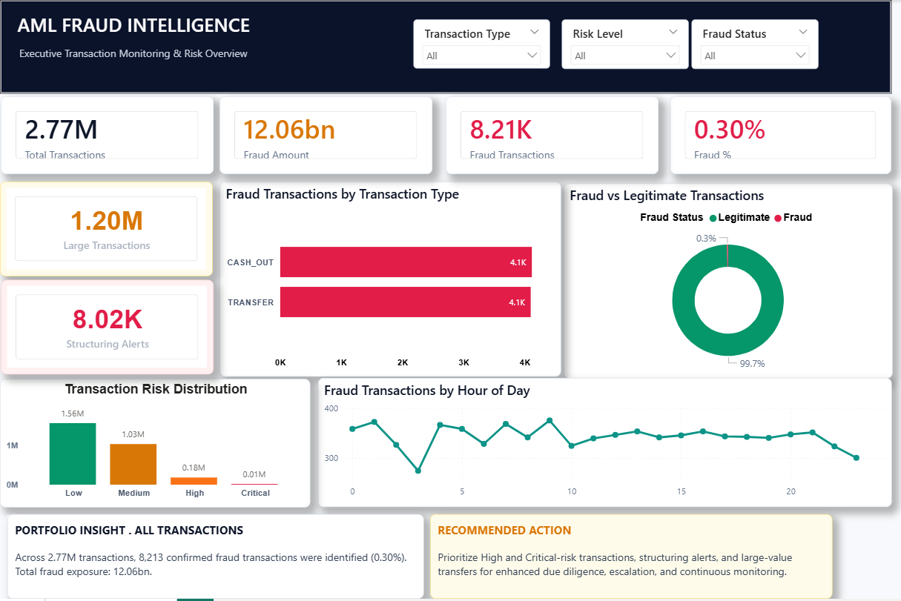
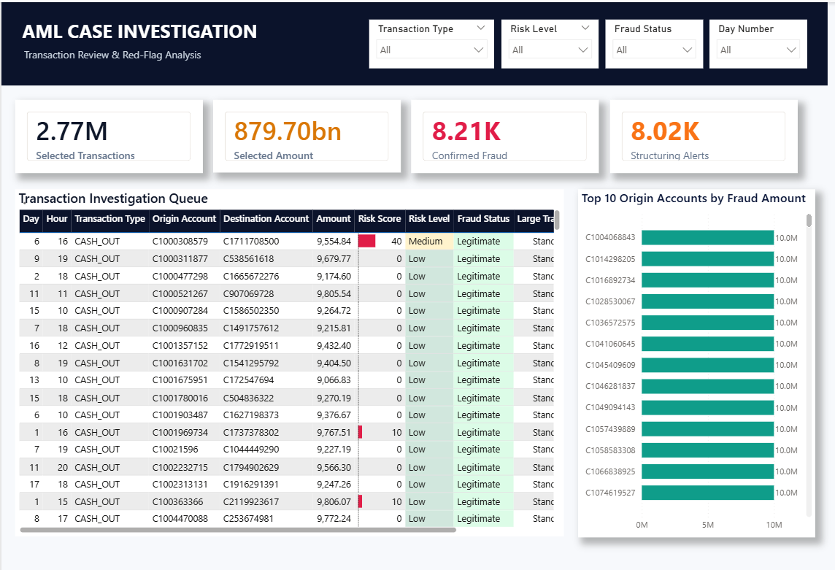
09 | POWER BI DECISION LAYER
Turn monitoring output into management and investigation action
The dashboard serves two audiences: leadership needs control visibility; investigators need prioritized case context.
EXECUTIVE OVERVIEW
INVESTIGATION DETAIL
Exposure, confirmed fraud, risk concentration, trends and recommended actions.
Prioritized transaction queue, risk score, red flags, amounts and account drill-down.
Queue caveat: this screenshot is sorted by transaction amount; in live use, re-sort by risk score so higher-risk cases surface first.
Important: dashboard totals reflect the full 2.77M synthetic monitoring population; POC recall/precision uses the separate 51,286-transaction held-out test.
AML Fraud & Transaction Monitoring — Executive Case Study
10
Notes:
Use the dashboard as evidence of operationalization. Executive Overview supports management decisions; Investigation Detail supports case review. Call out that the screenshot queue is sorted by amount and would be re-sorted by risk score in live use.

Slide 11
10 | FRAUD CONTROL PLAYBOOK
Reduce risk across the lifecycle — not only at the alert stage
No model or dashboard can “stop fraud” alone. Effective control combines prevention, detection, investigation and feedback.
PREVENT
DETECT
INVESTIGATE
RESPOND & IMPROVE
Know the customer
Spot abnormal behavior
Prioritize and explain
Close the loop
KYC/CDD quality, risk segmentation, authentication and beneficiary controls.
Balance anomalies, high-value movement, structuring/velocity and multiple risk signals.
Ranked queue, account context, red-flag reasons and consistent documentation.
Escalate/restrict where appropriate, consider SAR/STR obligations, tune controls using outcomes.
GOVERNANCE
Assign every control an owner, purpose, KPI, evidence source and review cadence.
AML Fraud & Transaction Monitoring — Executive Case Study
11
Notes:
This answers the question “how can the business control fraud?” Emphasize that no model stops fraud alone; prevention, detection, investigation and feedback work together.

Slide 12
11 | MANAGEMENT DECISION & ROADMAP
Validate first, then pilot safely
The POC should not replace a production control directly. The path forward is controlled validation and evidence-based adoption.
01
REAL-DATA VALIDATION
Re-run against historical alerts with known dispositions.
02
RISK APPETITE
Compliance agrees acceptable precision/recall trade-off and threshold policy.
03
SHADOW MODE
Generate new alerts alongside existing controls without production replacement.
04
OPERATIONALIZE
Add ownership, QA, explanations, change controls and ongoing KPI monitoring.
DECISION CONTROL
Thresholds owned by Compliance • tested by Analytics • monitored by Operations.
AML Fraud & Transaction Monitoring — Executive Case Study
12
Notes:
Present this as the decision path: validate on real data, agree risk appetite, run in shadow mode, then operationalize with governance.

Slide 13
EXECUTIVE CONCLUSION
The opportunity is not “more alerts.” It is better-controlled detection.
The case study identifies a monitoring gap, explains the root cause, defines measurable requirements and demonstrates a safer path to a stronger fraud-control process.
RECOMMENDED NEXT STEP
Validate real historical data → agree thresholds with Compliance → run in shadow mode → measure → decide on production adoption.
Srinivas Suresh
Notes:
End on the thesis: the goal is not more alerts; it is better-controlled detection. Ask for the next step, not approval for production deployment.

Slide 14
APPENDIX
Supporting Analysis & Governance Detail
Use these slides when stakeholders want to inspect the evidence behind the executive story.
Notes:
Appendix divider. Use only if stakeholders want supporting evidence.

Slide 15
APPENDIX A | EXPLAINABLE RISK INDICATORS
Translate raw transaction data into investigator-friendly signals
These features support prioritization and explain why a transaction deserves review.
Account emptied
Destination empty
Large amount
Sender balance goes to zero after transfer.
Receiver had zero balance before funds arrived.
High-value movement increases review severity.
Structuring
Balance mismatch
Risk score & level
Multiple smaller movements may indicate threshold avoidance.
Reported balances do not reconcile with movement.
Signals combine into Low / Medium / High / Critical priority.
WHY IT MATTERS
Investigators need reasons behind a score — not only a score.
AML Fraud & Transaction Monitoring — Executive Case Study
14
Notes:
Explain the engineered risk indicators in business language. The purpose is explainability and prioritization, not feature engineering for its own sake.

Slide 16
APPENDIX B | CASE WALKTHROUGH
A missed $10M transfer shows why a second detection layer matters
The transaction was not caught by the legacy rule or the simple drain-to-zero rule.
WHY IT DESERVES REVIEW
TRANSACTION FACTS
99.99% model risk score
Type
TRANSFER
Amount
$10,000,000
•
Exceptionally large transaction amount
Sender balance
$10.78M → $0.78M
•
Sender balance does not reconcile cleanly
Receiver balance
$0 → $0
•
Receiver balance does not increase despite supposed receipt
Legacy rule
Not flagged
INTERPRETATION
No single signal proves fraud; several unusual signals together justify investigation.
AML Fraud & Transaction Monitoring — Executive Case Study
15
Notes:
Walk through facts first, then risk reasons. Reinforce that multiple unusual signals justify investigation; no single signal proves fraud.

Slide 17
APPENDIX C | SUCCESS METRICS
Measure control quality and operating capacity together
A strong monitoring control must be effective, explainable and operationally manageable.
Fraud recall
Of known fraud, how much did we catch?
Alert precision
Of alerts raised, how many were actually fraud?
False-positive rate
How much analyst effort is spent on non-fraud?
Alert volume
Can the investigation team absorb the workload?
Investigation TAT
How quickly are alerts resolved?
Control drift
Is performance degrading as behavior changes?
KPI PRINCIPLE
Optimize for risk reduction and operational capacity — not accuracy alone.
AML Fraud & Transaction Monitoring — Executive Case Study
16
Notes:
Tie each metric to a management question and operating capacity. Avoid optimizing for accuracy alone.

Slide 18
APPENDIX D | LIMITATIONS & GOVERNANCE
What the project proves — and what still needs validation
The recommendation is deliberately stronger because the evidence boundary is explicit.
SYNTHETIC DATA
ONE TEST WINDOW
THRESHOLD CHOICE
The drain-to-zero pattern is unusually clean because it is embedded in the dataset. Real fraud behavior is messier.
Performance has not been validated across multiple periods, real customers or evolving fraud typologies.
The precision/recall balance reflects business risk appetite; Compliance should own the final threshold decision.
DECISION IMPLICATION
Proceed to real-data validation and shadow mode — not direct production replacement.
AML Fraud & Transaction Monitoring — Executive Case Study
17
Notes:
Do not hide the limitations. They are the reason the recommendation is real-data validation and shadow mode rather than direct replacement.

