Slide 1
COM302: Computer Networks

Slide 2
Course Content
Network – Requirements – Network architecture – Implementing network software – Performance
Direct link networks – Encoding – Framing – Error detection – Reliable transmission – Ethernet – Token rings – Wireless
Packet switching – Forwarding – Bridges – Cell switching – Internetworking – Datagram forwarding – ARP – DHCP – Routing – Multicast
Protocols – UDP – TCP – Remote procedure call – Congestion control – Congestion avoidance – QoS
Presentation formatting – Data compression – Cryptographic algorithms – Security mechanisms – Firewalls – Name service and other applications
Network Management
Practical aspect of Networking

Slide 3
Course
Be regular to classes and Labs
Course Timings
Day | Theory | Practical
Mon
Tue | 11.00 Hrs
Wed | 11.00 Hrs
Thu | 09.00 Hrs
Fri |  | 09.00 Hrs to 12.00 Hrs COM302P

Slide 4
Reference Books
Larry L Peterson & B. S Davie, Computer Networks A systems Approach, 4Th Edn, Morgan Kauffman Publishers.
William Stallings, Data and Computer Communications, Pearson Education Publishers
Tenenbaum A. S, Computer Networks, 4Th Edn, Prentice Hall.
Keshav, An Engineering Approach to Computer Networks, Addison Wesley.

Slide 5
Computer Networks
Heterogeneous systems need to talk to each other:
Media to connect
Wired – twisted pair, coaxial cable, fibre
Wireless – radio
Topology of the Network
Protocols and Software

Slide 6
Network Requirements
Connectivity
Cost-Effective Resource Sharing
Support for Common Services

Slide 7
Network Requirement
Connectivity

Slide 8
Connectivity
A network must provide connectivity among a set of computers
Sometimes it is enough to build a limited network that connects only a few select machines
For the reasons of privacy and security
Many corporate networks
Networks are designed to grow (scale) in a way that allows them the potential to connect all the computers in the world
Internet

Slide 9
Connectivity – Links, Nodes
At the lowest level
A network can consist of two or more computers directly connected by some physical medium
A coaxial cable or an optical fiber
We call such a physical medium a link
Node: is a specialized piece of hardware rather than a computer
We often refer computer as a node

Slide 10
Connectivity – Direct Links
Point-to-point: physical links are sometimes limited to a pair of nodes
Multiple Access: more than two nodes may share a single physical link

Slide 11
Limitations of Direct Link
If computer networks were limited to situations in which all nodes are directly connected to each other over a common physical medium
Then networks would either be very limited in the number of computers they could connect
Or the number of wires coming out of the back of each node would quickly become both unmanageable and very expensive
Fortunately, connectivity between two nodes does not necessarily imply a direct physical connection between them
Indirect connection may be achieved among a set of cooperating nodes

Slide 12
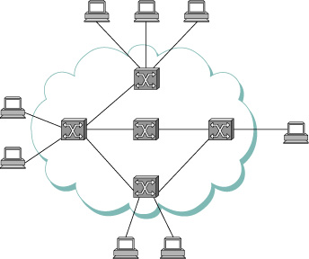
Connectivity – Indirectly connected links
Figure shows a set of nodes, each of which is attached to one or more point-to-point links
Those nodes that are attached to at least two links run software that forwards data received on one link out of another
If organized in a systematic way, these forwarding nodes form a switched network

Slide 13
Switched Networks
Two most common types are:
Circuit switched
Employed by the Telephone Systems
Packet switched
Computer networks
Packet Switched Network
The nodes in such a network send discrete blocks of data to each other
These blocks of data corresponding to some piece application data such as a file, a piece of email, or an image
We call each block of data either a packet or a message

Slide 14
Packet Switched Networks
Typically use a strategy called store-and-forward
Each node in a store-and-forward network first receives a complete packet over some link
Stores the packet in its internal memory, and then forwards the complete packet to the next node
In contrast, a circuit switched network first establishes a dedicated circuit across a sequence of links
and then allows the source node to send a stream of bits across this circuit to a destination node
The major reason for using packet switching rather than circuit switching in a computer network is efficiency

Slide 15
Connectivity
Cloud is one of the important icons of computer networking
Commonly called switches, and their primary function is to store and forward packets
In general we use a cloud to denote any type of network, whether it is a
Single point-to-point link
Multiple-access link
Or a switched network

Slide 16
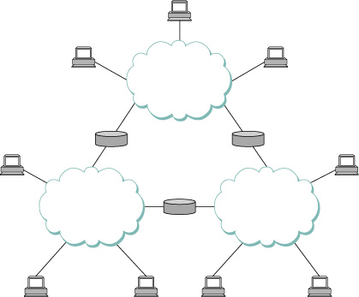
Interconnection of Networks
A set of independent networks(clouds) are interconnected to form an internetwork, or internet

Slide 17
Interconnection of Networks
A set of computers can be indirectly connected
A node that is connected to two or more networks is commonly called a router or gateway
It plays same role as a switch
It forwards messages from one network to another
Internet itself can be viewed as another kind of networks
An internet built from an interconnection of internets
Thus one can recursively build arbitrary large networks by interconnecting clouds to form larger cloud

Slide 18
Connectivity - Address
A set of hosts are directly or indirectly connected to each other does not mean that we have succeeded in providing host-to-host connectivity
The final requirement is that each node must be able to state which of the other nodes on the network it wants to communicate with
This is done by assigning an address to each node
An address is a byte string that identifies a node
The network can use a node’s address to distinguish it from the other nodes connected to the network

Slide 19
Connectivity – routing
When a source node wants the network to deliver a message to a certain destination node
It specifies the address of the destination node
If the sending and receiving nodes are not directly connected
Then the switches and routers of the network use this address to decide how to forward the message toward the destination
The process of determining systematically how to forward messages toward the destination node based on its address is called routing

Slide 20
Unicast, Broadcast and Multicast
Unicast:
The source node wants to send a message to a single destination node
Broadcast:
The source node might want to broadcast a message to all the nodes on the network
Multicast:
A source node might want to send a message to some other subset of the other nodes
But not all of them

Slide 21
Network Requirement
Cost-Effective Resource Sharing

Slide 22
How hosts share a Network
Any one pair of hosts can exchange the messages across a sequence of links and nodes
Will network support more than one pair of communication between the hosts
Multiplexing:
A system resource is shared among multiple users
Analogy to a timesharing computer system
Data being sent by multiple users can be multiplexed over the physical links that make up a network

Slide 23
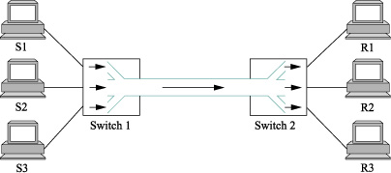
Multiplexing
Three hosts on the left side of the network (senders S1 – S3) are sending data to the three hosts on the right (receivers R1 – R3) by sharing switched networks that contains only one physical link

Slide 24
Multiplexing
Three flows of data – corresponding to the three pairs of hosts – are multiplexed onto a single physical link by switch1
The demultiplexed back into separate flows by switch 2
Multiplexing Methods
Synchronous time division multiplexing (STDM)
Frequency division multiplexing (FDM)

Slide 25
STDM
Idea is to divide time into equal-sized quanta and, in a round-robin fashion, give each flow a chance to send its data over the physical link
In other words, during
Time quantum 1, data from S1 to R1 is transmitted
Time quantum 2, data from S2 to R2 is transmitted
In time quantum 3, data from S3 to R3 is transmitted
In the next time quantum, the first flow (S1 to R1) gets go again,
and the process repeats

Slide 26
FDM
The idea is to transmit each flow over the physical link at different frequency
Much the same way that the signals for different TV stations are transmitted at a different frequency on a physical cable TV link

Slide 27
Limitations of STDM and FDM
If one of the flows (host pairs) does not have any data to send,
Its share of the physical link
That is, its time quantum or its frequency – remain idle
Even if one of the other flows has data to transmit
For computer communication, the amount of time that a link is idle can be very large
Example: consider the time you spend reading a web page (leave the link idle) compared to the time you spend fetching the page

Slide 28
Limitations of STDM and FDM
The maximum number of flows is fixed and known ahead of time
It is not practical to resize the quantum or to add additional quanta in the case of STDM
or to add new frequencies in the case of FDM

Slide 29
Statistical Multiplexing
It is like STDM in that the physical link is shared over time
First data from one flow is transmitted over the physical link, then data from another flow is transmitted, and so on.
Data is transmitted from each flow on demand rather than during a predetermined time slot
If only one flow has data to send, it gets to transmit that data without waiting for its quantum to come around
Thus without having to watch the quanta assigned to the other flows go by unused
It is avoidance of idle time that gives packet switching its efficiency

Slide 30
Limitations of Statistical Multiplexing
No mechanism to ensure that all the flows eventually get their turn to transmit over the physical link
Once flow begins sending a data, we need some way to limit the transmission, so that the other flows can have a turn
An upper bound on the size of the block of data that each flow is permitted to transmit at a given time
This limited size block of data is typically referred to as a packet

Slide 31
Packets
Packet switched network limits the maximum size of packets
A host may not be able to send a complete message in one packet
The source may need to fragment the message into several packets, with the receiver reassembling the packets back into the original message

Slide 32
Single Shared Link
Each flow sends a sequence of packets over the physical link, with a decision made on a packet-by-packet basis as to which flow’s packet to send next
If only one flow has data to send, then it can send a sequence of packets back-to-back
If more than one of the flows have data to send, then their packets are interleaved on the link

Slide 33
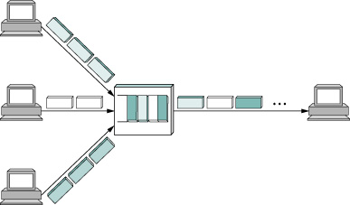
Multiple flows on a Shared Link
A Switch multiplexing Packets from Multiple Sources onto one Shared Link

Slide 34
Packet Switching Decision
Each switch in a packet switched network makes this decision independently, on a packet-by-packet basis
One of the issues that faces a network designer is how to make decision in a fair manner
A switch could be designed to service packets
On a first-in-first-out (FIFO) basis
Round-robin manner

Slide 35
QoS
Switching might be done to ensure that certain flows receive a particular share of the link’s bandwidth,
Or that they never have their packets delayed in the switch for more than a certain length of time
A network that attempts to allocate bandwidth to particular flows is sometimes said to support quality of service (QoS)

Slide 36
Congestion
In the above example the switch has to multiplex three incoming packet streams onto one outgoing link
It is possible that the switch will receive packets faster than the shared link
In this case this case, the switch is forced to buffer these packets in its memory
Switch receive packets faster than it can send them for an extended period of time
Switch will eventually run out of buffer space, and some packets will have to be dropped
This state of switch operation is called as congested

Slide 37
Requirements
Support for Common Services

Slide 38
Applications Programs on Networks
In simple the computer network is delivering packets among a collection of computers
A network as providing the means for a set of application processes that are distributed over those computers to communicate
The application programs running on the hosts connected to the network must be able to communicate in a meaningful way

Slide 39
Applications Programs on Networks
When two applications need to communicate with each other
There are a lot of complicated things that need to happen beyond simply sending a message from one host to another
One option would be for application designers to build all that complicated functionality into each application program
Many applications need common services, it is much more logical to implement those common services once
Such that application designer build the application using those services

Slide 40
Network Common Services
Network provides logical channels over which application-level processes can communicate with each other
Each channel provides the set of services required by that application
A cloud is abstractly represent connectivity among a set of computers
A channel connects one process to another
A channel is like a pipe connecting two applications
Sending application can put data in one end and expect that data to be delivered by the network to the application at the other end of the pipe

Slide 41
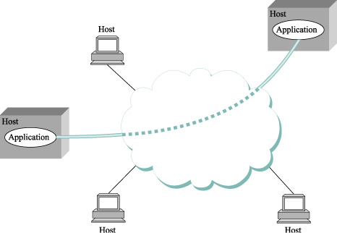
Channel
Processes communicating over an abstract channel

Slide 42
Identifying Common Communication Patterns
Involves
Understanding the common needs of a representative collection of applications
Extracting their common communication requirements
Incorporating the functionality that meets these requirements in the network
One of the earliest applications supported on any network is a file access program
FTP
NFS

Slide 43
Identifying Common Communication Patterns
FTP/ NFS
Whole files are transferred across the network or only single blocks of the file are read/written at a given time
The communication component of remote file access is characterized by a pair of processes
One that requests that a file be read or written
Client
A second process that honors this request
Server

Slide 44
Read and Write – Server & Client
Reading a file involves
The client sending a small request message to a server
The server responding with a large message that contains the data in the file
Writing works in opposite way
The client sends a large message containing the data to be written to the server
The server responds with a small message confirming that the write to disk has taken place

Slide 45
Video Applications
Two types of applications
Videoconferencing
Video on demand
Channels are
Request/reply channels
Message stream channels
Request/reply channel would be used by the file transfer and digital library applications

Slide 46
Request/reply Channel
It would guarantee that every message sent by one side is received by the other side
only one copy of each message is delivered
The request/reply channel might also protect the privacy and integrity of the data that flows over it
Unauthorized parties cannot read or modify the data being exchanged between the client and server processes

Slide 47
Message Stream Channels
Used by both the vide-on-demand and videoconferencing applications
It is parameterized to support both one-way and two-way traffic and to support different delay properties
The message stream channel might not need to guarantee that all messages are delivered
A video application can operate adequately even if some video frame is not received
The message stream channel might need to support multicast
So that multiple parties can participate in the teleconference or view the video

Slide 48
Channels/pipes
A network designer to strive for the smallest number of abstract channel types that can serve the largest number of applications
There is danger in trying to get away with too few channel abstractions
With change in application the network designers will probably be inventing new types of channels and adding options to existing channels
for as long as application programmers are inventing new applications

Slide 49
Bit Pipe
It is easiest to view host-to-host connectivity of the underlying network as simply providing a bit pipe
With any high-level communication semantics provided at the end hosts
The advantage of this approach is it keeps the switches in the middle of the network as simple as possible
They simply forward packets
But it requires the end hosts to take on much of the burden of supporting semantically rich process-to-process channels
The alternative is to push additional functionality onto the switches, thereby allowing the end hosts to be “dumb” devices

Slide 50
Reliability
Reliable message delivery is one of the most important functions that a network can provide
It is difficult determine how to provide this reliability
Without understanding how networks can fail
The computer networks do not exist in a perfect world
Physical Problems
Machine crash and later are rebooted
Fiber are cut
Electrical interference corrupts bits in the data being transmitted
Switches run out of buffer space
Software
The software that manages the hardware sometimes forwards packets into oblivion

Slide 51
Reliability – Bit Level Failure
The major requirement of a network is to recover from certain kind of failures
Three general cases of failures in the network is
Bit Errors
The packet transmitted over a physical link, bit errors may be introduced into the data
i.e., 1 is turned into a 0 or vice versa
Burst error – several consecutive bits are corrupted
Bit errors typically occurs because the outside forces
Such as lightening strikes, power surges and microwave ovens, interface with the transmission of data

Slide 52
Reliability
The good news is that bit errors are fairly rare
Affecting on average only one out of every 10⁶ to10⁷ bits on a typical copper base cable
One out of every 10¹² to 10¹⁴ bits on a typical optical fiber
There are techniques that detect these bit errors with high probability
It is sometimes possible to correct for such errors
If damage is so bad, than it is necessary to discard the entire packet
In such a case, the sender may be expected to retransmit the packet

Slide 53
Reliability – Packet Failure
Failure is at the packet, rather than the bit level
i.e., a complete packet is lost by network
One reason this can happen is that the packet contains an uncorrectable bit error and therefore has to be discarded
A switch that is forwarding it from one link to another – is so over loaded that it has no place to store the packet, and therefore is forced to drop it (congestion)

Slide 54
Reliability – Packet Failure
Software running on one of the nodes that handles the packet makes a mistake
It might incorrectly forward a packet out on the wrong link
So packet never finds its way to the ultimate destination
One of the main difficulties in dealing with lost packets is distinguished between a packet that is indeed lost and one that is merely late in arriving at the destination

Slide 55
Reliability – Node and Link Failure
Failure is at node and link level
A physical link is cut or the computer it is connected to crashes
This can be caused by software that crashes a power failure, or a reckless backhoe operator
Failure due to misconfiguration of a network device are also common
Any of these failures can eventually be corrected, they can have a dramatic effect on the network for an extended period of time

Slide 56
Reliability – Node and Link Failure
In a packet switched network, it is sometimes possible to route around a failure node or link

Slide 57
Network architecture

Slide 58
Network Architecture
A computer network must provide general, cost-effective, fair, and robust connectivity among a large number of computers
To deal with the network complexity, network designers have to develop a general blueprint – usually called network architectures
Network architectures guide the design and implementation of network
Two of the most widely referenced architectures –
The OSI architecture
The Internet architecture

Slide 59
Network Architecture
Layering and Protocols

Slide 60
Layering – Abstraction
When a system gets complex, the system designer introduces another level of abstraction
An abstraction is to define a unifying model that can capture some important aspect of the system
An abstraction for applications that hides the complexity of the network from application writers
Abstraction normally leads to layering in network systems

Slide 61
Layering
The general idea is to start with the services offered by the underlying hardware and
Add a sequence of layers, each providing a higher (more abstract) level of service.
The services provided at the high layers are implemented in terms of the services provided by the low layers

Slide 62
Layering – Example
A simple network as having two layers of abstraction sandwiched between the application program and underlying hardware
Application Programs
Process-to-process Channels
Host-to-host Connectivity
Hardware
Example of a layered network system

Slide 63
Layering – Example
The layer immediate above the hardware in this case might provide host-to-host connectivity
Abstracting away the fact that there may be an arbitrarily complex network topology between any two hosts
The next layer up builds on the available host-to-host communication service and provides support for process-to-process channels

Slide 64
Layering
Layering offers two features
it decomposes the problem of building a network into more manageable components
One can implement several layers, each of which solves one part of the problem
It provides a more modular design
If you want to add some new services, you may only need to modify the functionality at one layer
By reusing the functions provided at all the other layers

Slide 65
Layering – Multiple Abstraction
Multiple abstractions are provided at any given level of the system
Each provides a different services to the higher layers but building on the same low-level abstractions
Lets consider the two channels
A request/reply services
A message stream services
These two channels might be alternative offerings at some level of a multilevel networking system

Slide 66
Layering – Multiple Abstraction
Application Programs
Request/reply Channel
Message Stream Channel
Host-to-host Connectivity
Hardware
Layered System with alternative abstraction available at a given layer

Slide 67
Protocol
The abstract objects that make up the layers of a network system are called protocols
A protocol provides a communication service that higher-level objects use to exchange the messages
Example
Imagine a network that supports a request/reply protocol and a message stream protocol

Slide 68
Protocol – Interfaces
Each protocol defines two different interfaces
It defines a service interface to the other objects on the same computer that want to use its communication services
This service interface defines the operations that local objects can perform on the protocol
Examples
A request/reply protocol would support operations by which an application can send and receive messages
An implementation of HTTP protocol support an operation to fetch a page of hypertext from a remote server

Slide 69
Protocol – Interfaces
A protocol defines a peer interface to its counterpart (peer) on another machine
This interface defines the form and meaning of messages exchanged between protocol peers to implement the communication service
This would determine the way in which a request/reply protocol on one machine communicates with its peer on another machine
Example: In the case of HTTP
The protocol specification defines in detail how a “GET” command is formatted
What arguments can be used with command

Slide 70
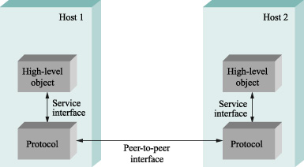
Protocol
A protocol defines a communication services that it exports locally (the service interface)
Along with a set of rules governing the messages that the protocol exchanges with its peer(s) to implement this service (the peer interface)

Slide 71
Protocol
Peer-to-peer communication is indirect
Except at the hardware level where peers directly communicate with each other over a link
Each protocol communicates with its peer by passing messages to some lower-level protocol
Which in turn delivers the message to its peers
In addition, there are potentially multiple protocols at any given level, each providing a different communication service
Therefore represent suite of protocols that make up a network system with a protocol graph

Slide 72
Protocol Graph
The nodes of the graph correspond to protocols, and the edges represent a depends on relation
Example
The request/reply protocol (RRP) and message stream protocol (MSP) implement two different types of process-to-process channels
Both depend on Host-to-host protocol (HHP), which provides a host-to-host connectivity service

Slide 73
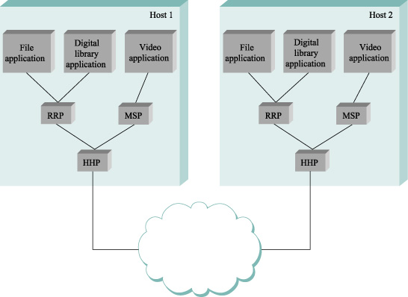
Protocol Graph – Example

Slide 74
Protocol Graph – Example
Host 1:
The file access program on host 1 wants to send a message to its peer on host 2 using communication services offered by protocol RRP
In this case, the file application asks RRP to send the message on its behalf
To communicate with its peer, RRP then invokes the services of HHP
which in turn transmits the message to its peer on the other machine
Host 2:
Once the message has arrived at protocol HHP on host 2
HHP passes the message up to RRP, which in turn delivers the message to the file application

Slide 75
Protocol – Interface Vs Module
Protocols is used in two different ways
Interfaces – the operations defined by the service interface and the form and meaning of messages exchanged between peers
Modules – that actually implements required interfaces
Protocol specification distinguish the given protocol is an interface type or module type

Slide 76
Protocol – Specifications
Generally expressed using combination of
prose, pseudocode, state transition diagrams, pictures of packet formats and other abstract notations
A given protocol can be implemented in different ways by different programmers
The challenge is to ensuring that two different implementations of the same specification can successfully exchange messages
Two or more protocol modules that do accurately implement a protocol specification are said to interoperate with each other

Slide 77
Protocols
We can imagine many different protocols and protocol graphs that satisfy the communication requirements of a collection of applications
Standardization:
International Standard Organization (ISO)
Internet Engineering Task Force (IETF)
Establish/defines policies for a particular protocol graph
Network Architecture: The set of rules governing, the form and content of a protocol graph

Slide 78
Network Architecture
Encapsulation

Slide 79
Example – A protocol Graph

Slide 80
Encapsulation
When one of the application programs sends a message to its peer by passing the message to protocol RRP
From RRP perspective, the message it is given by the application is an uninterpreted string of bytes
RRP does not care that these bytes represent an array of integers, an email message, a digital image, or whatever
It simply charged with sending them to its peer
However, RRP must communicate control information to its peer, instructing it how to handle the message when it is received

Slide 81
Encapsulation
RRP does this by attaching a header to the message
A header is a small data structure
From a few bytes to a few dozen bytes
Used among peers to communicate with each other
Headers are usually attached to the front of a message
In some cases, this peer-to-peer control information is sent at the end of the message
Called as a trailer
The exact format for the header attached by the RRP is defined by its protocol specification

Slide 82
Encapsulation
The rest of the message
The data being transmitted on behalf of the application is called the message’s body or payload
It means application’s data is encapsulated in the new message created by protocol RRP
This process of encapsulation is then repeated at each level of the protocol graph

Slide 83
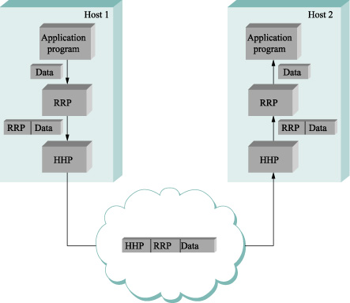
Encapsulation Example
High level messages are encapsulated inside of low-level message

Slide 84
Example
HHP encapsulate RRP’s message by attaching a header of its own
If we now assume that HHP sends the message to its peer over some network
Then when the message arrives at the destination host, it process it in the opposite order
HHP first interprets the HHP header at the front of the message (i.e., takes whatever action is appropriate given the contents of the header),
Passes the body of the message (but not the HHP header) up to the application program

Slide 85
Example
The message passed up from RRP to the application on host 2 is exactly the same message as the application passed down to RRP on host 1
The application does not see any of the headers that have been attached to it to implement the lower-level communication services
Node in the network (e.g., switches and router) may inspect the HHP header at the front of the message

Slide 86
Encapsulation
A low-level protocol does not interpret the message it is given by some high-level protocol
It does not know how to extract any meaning from the data contained in the message
Encryption
The low-level protocol applies some simple transformation to the data it is given, such as to compress or encrypt it
In this case, the protocol is transforming the entire body of the message, including both the original application’s data and all the headers attached to that data by higher-level protocols

Slide 87
Network Architecture
Multiplexing and Demultiplexing

Slide 88
Multiplexing and Demultiplexing
The fundamental idea of packet switching is to multiplex multiple flows of data over a single physical link
The same idea applies up and down the protocol graph, not to switching nodes

Slide 89
Example

Slide 90
Multiplexing and Demultiplexing
RRP implementing a logical communication channel, with message from two different applications multiplexed over this channel at the source host
And then demultiplexed back to the appropriate application at the destination host
Practically
A header that RRP attaches to its message contains an identifier that records the application to which the message belongs
This identifier is called as RRP’s demultiplexing key or demux key

Slide 91
Multiplexing and Demultiplexing
At the source host, RRP includes the appropriate demux key in its header
When the message is delivered to RRP on the destination host
It strips its header, examines the demux key and demultiplexes the message to the correct application
RRP is not unique in its support for multiplexing
Nearly every protocol implements this mechanism
Example:
HHP has its own demux key to determine which messages to pass up to RRP and which to pass up to MSP

Slide 92
Multiplexing and Demultiplexing
There is no uniform agreement among protocols
Even those within a single network architecture
On exactly what constitutes a demux key
Some protocols use 8-bit field (meaning they can support only 256 high-level protocols) and others use 16- or 32-bit fields
Some protocols have a single demultiplexing field in their header
The same demux key is used on both sides of the communication
Some protocols have a pair of demultiplexing fields in their header
Each sides uses a different key to identify the high-level protocol (or application program) to which the message is to be delivered

Slide 93
Network Architecture
OSI Architecture

Slide 94
OSI Architecture
The ISO formally define a common way to connect computers
OSI: Open System Architecture
OSI defines a partitioning of network functionality into seven layers
Where one or more protocols to implement the functionality assigned to a given layer
ISO and ITU publishes a series of protocol specifications based on the OSI architecture
This series sometimes called “Xdot” series
X.25, X.400, X.500 and so on

Slide 95
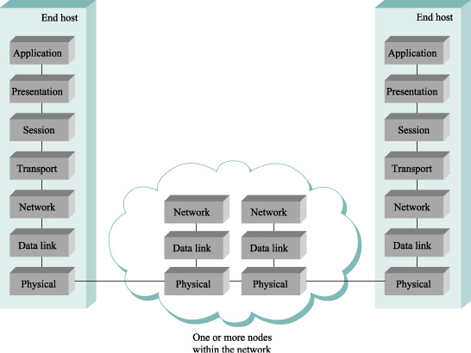
OSI Network Architecture

Slide 96
OSI Network Architecture
Physical layer handles the transmission of raw bits over communication link
Data link layer then collects a stream of bits into a large aggregate called a frame
Network adaptors, along with device drivers running in the node’s OS, typically implement the data link level
This means that frames, not raw bits, are actually delivered to hosts
The network layer handles routing among nodes within a packet-switched network
At this layer, the unit of data exchanged among nodes is typically called a packet rather than a frame

Slide 97
OSI Network Architecture
The lower three layers are implemented on all network nodes, including switches within the network and hosts connected along the exterior the network
Transport layer implements a process-to-process channel
Here, the unit of data exchanged is commonly called a message rather than a packet or a frame
The transport layer and higher layers typically run only on the end hosts and not on the intermediate switches or routers

Slide 98
OSI Architecture
Application Layer is the top (seventh) layer
Application layer protocols include things like the File Transfer Protocol (FTP)
Which defines a protocol by which file transfer application can interoperate
Presentation Layer is concerned with the format of exchanged between peers
Example:
Whether an integer is 16, 32, or 64 bits long and whether the most significant byte is transmitted first or last or how video stream is formatted

Slide 99
OSI Architecture
Session Layer provides name space that is used to tie together the potentially different transport streams that are part of a single application
Example: It might manage an audio stream and a video stream that are being combined in a teleconferencing application

Slide 100
Network Architecture
Internet Architecture

Slide 101
Internet Architecture
Is also called as TCP/IP architecture
Internet architecture evolved out of experiences with an earlier packet-switched network called the ARPANET
Both the Internet and the ARPANET were funded by the Advanced Research Project Agency (ARPA) – US Defense
The Internet and ARPANET were around before the OSI architecture

Slide 102
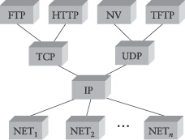
Internet Architecture
A four layer model
Internet Protocol Graph

Slide 103
Internet Architecture
Application
TCP
UDP
IP
NETWORK
An alternative view to the Internet architecture
The “network” layer shown here is sometimes referred to as the “subnetwork” or “link” layer

Slide 104
Internet Architecture
At the lowest level are a wide variety of network protocols, denoted NET₁ , NET₂ and so on
In practice these protocols are implemented by a combination of hardware (e.g., network adaptor) and software (e.g., a network device driver)
For example: Ethernet or Fiber Distributed Data Transfer (FDDI) protocols at this layer

Slide 105
Internet Architecture
The second layer consists of a single protocol – Internet Protocol(IP)
This protocol supports the multiple networking technologies into a single logical internetwork
The third layer contains two main protocols
The Transmission Control Protocol (TCP)
The User Datagram Protocol (UDP)
TCP and UDP provide alternative logical channels to application programs
TCP provides reliable byte-stream channel
UDP provides an unreliable datagram delivery channel
UDP and TCP protocols are also called as end-to-end protocols
We can refer this layer or protocol as Transfer protocol

Slide 106
Internet Architecture
Above the transport layer/protocol is Application protocols
Such as
FTP, TFTP (Trivial File Transport Protocol)
Telnet (remote login)
SMTP (Simple Mail Transfer Protocol, or electronic mail)
HTTP (Hyper Text Transfer Protocol)

Slide 107
Internet Architecture Features
Three features
The internet layering does not imply strict layering
The application is free to bypass the defined transport layers and to directly use IP or one of the underlying networks
Programmers are free to define new channel abstractions or applications that run on top of any of the existing protocols

Slide 108
Internet Architecture features
Protocol graph looks like a hourglass shape
Wide at the top, narrow in the middle, and wide at the bottom
This shape actually reflects the central philosophy of the architecture
i.e., IP serves as the focal point for the architecture
It defines a common method for exchanging packets among a wide collection networks
Above IP can be arbitrarily many transport protocols, each offering different channel abstraction to application programs
Below IP, the architecture allows for arbitrarily many different network technologies ranging from Ethernet to wireless to single point-to-point links

Slide 109
Internet Architecture features
A new protocol is officially (IETF) included in the architecture
There needs to be both a protocol specification and at least one (and preferably two) representative implementations of the specification
This IETF cultural assumption of the design community helps to ensure that the architecture’s protocols can be efficiently implemented

Slide 110
Reference
Larry L Peterson & B S Davie, Computer Networks: A Systems Approach, 4 Edn, Morgan Kauffman Publishers, 2007

