Slide 1
Implementing Network Software

Slide 2
Implementing Network Software
Network architectures and protocol specifications are essential things to define a good blue print
The number of computers connected to the Internet has roughly doubled every 12 to 18 months since 1981
Number of Internet users are increasing exponentially over the year
Great success of Internet contributed by
A good architecture
Major contribution is its functionality is provided by the software running in general purpose computers
The significance of this is that new functionality can be added readily with “just a small matter of programming”

Slide 3
Application Programming Interface (Sockets)
Since most network protocols are implemented in software (especially those high in the protocol stack)
All computers implement their network protocols as part of the operating system
The interface that OS provides to its networking subsystem
Is called as the network Application Programming Interface (API)
Each operating system is free to define its own network API
Over time certain of these APIs have become widely supported

Slide 4
Application Programming Interface (Sockets)
The socket interface originally provided by the Berkeley distribution of Unix
It is supported in virtually all popular operating systems
The advantage of industry-wide support for a single API is that applications can be easily ported from one OS to another
Developers can easily write applications for multiple OSs
The network application programs typically interact with many parts of the OS other than the network

Slide 5
Application Programming Interface (Sockets)
Two systems support the same network API does not mean that their file system, process, or graphic interfaces are the same
Each protocol provides a certain set of services
The API provides a syntax by which those services can be invoked in this particular OS
The socket is the point where a local application process attaches to the network
The interface defines operations for
creating a socket,
attaching the socket to network
Sending/receiving message through the socket, and closing the socket

Slide 6
Application Programming Interface (Sockets)
First step to create a socket
int socket(int domain, int type, int protocol)
The domain argument specifies the protocol family that is going to be used
PF_INET denotes the internet family
PF_UNIX denotes the Unix pipe facility
PF_PACKET denotes direct access to network interface(i.e., it bypasses the TCP/IP protocol stack)
The type argument indicates the semantic of the communication
SOCK_STREAM denotes a byte stream
SOCK_DGRAM is an alternative that denotes a message-oriented service, such as that provided by UDP

Slide 7
Application Programming Interface (Sockets)
On a server machine the application process performs a passive open
The server says that it is prepared to accept connections,
but it does not actually establish a connection
The serve does the connection by invoking the following three operations
int bind(int socket, struct sockaddr *address, int addr_len)
int listen(int socket, int backlog)
int accept(int socket, struct sockaddr *address, int *addr_len)
The bind operation: binds the newly created socket to the specified address

Slide 8
Application Programming Interface (Sockets)
The listen operation defines how many connections can be pending on the specified socket
Accept operation carries out the passive open
It is a blocking operation that does not return until a remote participant has established a connection
When it does complete, it returns a new socket that corresponds to this just established connection
The address argument contains the remote participant’s address

Slide 9
Application Programming Interface (Sockets)
On the client machine, the application process performs an active open;
It says who it wants to communicate
int connect(int socket, struct sockaddr *address, int addr_len)
This process does not return until TCP has successfully established a connection at which time the application is free to begin sending data
In practice, the client usually, specifies only the remote participant’s address and lets the system fill in the local information

Slide 10
Application Programming Interface (Sockets)
Server usually listens for messages on a well-known port, a client typically does not care which port it uses for itself
The OS simply selects an unused one
Once connection is established, the application processes invoke the following two operations to send and receive data
int send(int socket, char *message, int msg_len, int flags)
Sends the given message over the specified socket
int recv(int socket, char *buffer, int buf_len, int flags)
Receives a message from the specified socket into the given buffer
Both the operations take a set of flags that control certain details of the operation

Slide 11
End System: Computer on the ‘Net
Internet
Also known as a “host”…

Slide 12
Clients and Servers
Client program
Running on end host
Requests service
E.g., Web browser
Server program
Running on end host
Provides service
E.g., Web server
GET /index.html
“Site under construction”

Slide 13
Client-Server Communication
Client “sometimes on”
Initiates a request to the server when interested
E.g., Web browser on your laptop or cell phone
Doesn’t communicate directly with other clients
Needs to know server’s address
Server is “always on”
Services requests from many client hosts
E.g., Web server for the www.iiitdm.ac.in Web site
Doesn’t initiate contact with the clients
Needs fixed, known address

Slide 14
Peer-to-Peer Communication
No always-on server at the center of it all
Hosts can come and go, and change addresses
Hosts may have a different address each time
Example: peer-to-peer file sharing
Any host can request files, send files, query to find a file’s location, respond to queries, …
Scalability by harnessing millions of peers
Each peer acting as both a client and server

Slide 15
Client and Server Processes
Program vs. process
Program: collection of code
Process: a running program on a host
Communication between processes
Same end host: inter-process communication
Governed by the operating system on the end host
Different end hosts: exchanging messages
Governed by the network protocols
Client and server processes
Client process: process that initiates communication
Server process: process that waits to be contacted

Slide 16
Delivering the Data: Division of Labor
Network
Deliver data packet to the destination host
Based on the destination IP address
Operating system
Deliver data to the destination socket
Based on the destination port number (e.g., 80)
Application
Read data from and write data to the socket
Interpret the data (e.g., render a Web page)

Slide 17
Socket: End Point of Communication
Sending message from one process to another
Message must traverse the underlying network
Process sends and receives through a “socket”
In essence, the doorway leading in/out of the house
Socket as an Application Programming Interface
Supports the creation of network applications
User Process
User Process
socket
socket
Operating
System
Operating
System

Slide 18
Identifying the Receiving Process
Sending process must identify the receiver
The receiving end host machine
The specific socket in a process on that machine
Receiving host
Destination address that uniquely identifies the host
An IP address is a 32-bit quantity
Receiving socket
Host may be running many different processes
Destination port that uniquely identifies the socket
A port number is a 16-bit quantity

Slide 19
Using Ports to Identify Services
Server host 128.2.194.242
Service request for
128.2.194.242:80
(i.e., the Web server)
Client host
Web server
(port 80)
Client
OS
Echo server
(port 7)
Service request for
128.2.194.242:7
(i.e., the echo server)
Web server
(port 80)
Client
OS
Echo server
(port 7)

Slide 20
Knowing What Port Number To Use
Popular applications have well-known ports
E.g., port 80 for Web and port 25 for e-mail
See http://www.iana.org/assignments/port-numbers
Well-known vs. ephemeral ports
Server has a well-known port (e.g., port 80)
Between 0 and 1023 (requires root to use)
Client picks an unused ephemeral (i.e., temporary) port
Between 1024 and 65535
Uniquely identifying traffic between the hosts
Two IP addresses and two port numbers
Underlying transport protocol (e.g., TCP or UDP)

Slide 21
Port Numbers are Unique per Host
Port number uniquely identifies the socket
Cannot use same port number twice with same address
Otherwise, the OS can’t demultiplex packets correctly
Operating system enforces uniqueness
OS keeps track of which port numbers are in use
Doesn’t let the second program use the port number
Example: two Web servers running on a machine
They cannot both use port “80”, the standard port #
So, the second one might use a non-standard port #
E.g., http://www.iiitdm.ac.in:8080

Slide 22
UNIX Socket API
Socket interface
Originally provided in Berkeley UNIX
Later adopted by all popular operating systems
Simplifies porting applications to different OSes
In UNIX, everything is like a file
All input is like reading a file
All output is like writing a file
File is represented by an integer file descriptor
API implemented as system calls
E.g., connect, read, write, close, …

Slide 23
Typical Client Program
Prepare to communicate
Create a socket
Determine server address and port number
Initiate the connection to the server
Exchange data with the server
Write data to the socket
Read data from the socket
Do stuff with the data (e.g., render a Web page)
Close the socket

Slide 24
Servers Differ From Clients
Passive open
Prepare to accept connections
… but don’t actually establish
… until hearing from a client
Hearing from multiple clients
Allowing a backlog of waiting clients
... in case several try to communicate at once
Create a socket for each client
Upon accepting a new client
… create a new socket for the communication

Slide 25
Typical Server Program
Prepare to communicate
Create a socket
Associate local address and port with the socket
Wait to hear from a client (passive open)
Indicate how many clients-in-waiting to permit
Accept an incoming connection from a client
Exchange data with the client over new socket
Receive data from the socket
Do stuff to handle the request (e.g., get a file)
Send data to the socket
Close the socket
Repeat with the next connection request

Slide 26
Putting it All Together
Server
socket()
bind()
Client
listen()
socket()
establish
connection
accept()
connect()
block
send request
write()
read()
process
request
send response
write()
read()

Slide 27
Client Creating a Socket: socket()
Creating a socket
int socket(int domain, int type, int protocol)
Returns a file descriptor (or handle) for the socket
Originally designed to support any protocol suite
Domain: protocol family
PF_INET for the Internet (IPv4)
Type: semantics of the communication
SOCK_STREAM: reliable byte stream (TCP)
SOCK_DGRAM: message-oriented service (UDP)
Protocol: specific protocol
UNSPEC: unspecified

Slide 28
Client: Learning Server Address/Port
Server typically known by name and service
E.g., “www.cnn.com” and “http”
Need to translate into IP address and port #
E.g., “64.236.16.20” and “80”
Translating the server’s name to an address
struct hostent *gethostbyname(char *name)
Argument: host name (e.g., “www.cnn.com”)
Returns a structure that includes the host address
Identifying the service’s port number
struct servent
*getservbyname(char *name, char *proto)
Arguments: service (e.g., “ftp”) and protocol (e.g., “tcp”)
Static config in/etc/services

Slide 29
Client: Connecting Socket to the Server
Client contacts the server to establish connection
Associate the socket with the server address/port
Acquire a local port number (assigned by the OS)
Request connection to server, who hopefully accepts
Establishing the connection
int connect (int sockfd,
struct sockaddr *server_address,
socketlen_t addrlen)
Arguments: socket descriptor, server address, and address size
Returns 0 on success, and -1 if an error occurs

Slide 30
Client: Sending Data
Sending data
ssize_t write (int sockfd, void *buf, size_t len)
Arguments: socket descriptor, pointer to buffer of data to send, and length of the buffer
Returns the number of bytes written, and -1 on error

Slide 31
Client: Receiving Data
Receiving data
ssize_t read (int sockfd, void *buf, size_t len)
Arguments: socket descriptor, pointer to buffer to place the data, size of the buffer
Returns the number of characters read (where 0 implies “end of file”), and -1 on error
Closing the socket
int close(int sockfd)

Slide 32
Server: Server Preparing its Socket
Server creates a socket and binds address/port
Server creates a socket, just like the client does
Server associates the socket with the port number (and hopefully no other process is already using it!)
Choose port “0” and let kernel assign ephemeral port
Create a socket
int socket (int domain, int type, int protocol)
Bind socket to the local address and port number
int bind (int sockfd,
struct sockaddr *my_addr,
socklen_t addrlen)
Arguments: sockfd, server address, address length
Returns 0 on success, and -1 if an error occurs

Slide 33
Server: Allowing Clients to Wait
Many client requests may arrive
Server cannot handle them all at the same time
Server could reject the requests, or let them wait
Define how many connections can be pending
int listen(int sockfd, int backlog)
Arguments: socket descriptor and acceptable backlog
Returns a 0 on success, and -1 on error
What if too many clients arrive?
Some requests don’t get through
The Internet makes no promises…
And the client can always try again

Slide 34
Server: Accepting Client Connection
Now all the server can do is wait…
Waits for connection request to arrive
Blocking until the request arrives
And then accepting the new request
Accept a new connection from a client
int accept(int sockfd,
struct sockaddr *addr, socketlen_t *addrlen)
Arguments: sockfd, structure that will provide client address and port, and length of the structure
Returns descriptor of socket for this new connection

Slide 35
Server: One Request at a Time?
Serializing requests is inefficient
Server can process just one request at a time
All other clients must wait until previous one is done
May need to time share the server machine
Alternate between servicing different requests
Do a little work on one request, then switch when you are waiting for some other resource (e.g., reading file from disk)
“Nonblocking I/O”
Or, use a different process/thread for each request
Allow OS to share the CPU(s) across processes
Or, some hybrid of these two approaches

Slide 36
Client and Server: Cleaning House
Once the connection is open
Both sides and read and write
Two unidirectional streams of data
In practice, client writes first, and server reads
… then server writes, and client reads, and so on
Closing down the connection
Either side can close the connection
… using the close() system call
What about the data still “in flight”
Data in flight still reaches the other end
So, server can close() before client finishes reading

Slide 37
One Annoying Thing: Byte Order
Hosts differ in how they store data
E.g., four-byte number (byte3, byte2, byte1, byte0)
Little endian (“little end comes first”): Intel x86’s
Low-order byte stored at the lowest memory location
Byte0, byte1, byte2, byte3
Big endian (“big end comes first”)
High-order byte stored at lowest memory location
Byte3, byte2, byte1, byte 0
Makes it more difficult to write portable code
Client may be big or little endian machine
Server may be big or little endian machine

Slide 38
Endian Example: Where is the Byte?
31 |  |  |  |  |  |  | 24
23 |  |  |  |  |  |  | 16
15 |  |  |  |  |  |  | 8
7 |  |  |  |  |  |  | 0
1 | 2
3 | 4
5 | 6
7 | 8
8 bits memory
16 bits Memory
32 bits Memory
1000
1001
1002
1003
 | 78
 | +1 | +0
1000
1002
1004
1006
 |  | 78
 | +3 | +2 | +1 | +0
1000
1004
1008
100C
 |  |  |  | 78
Little-Endian
1000
1001
1002
1003
 | 78
 | +0 | +1
1000
1002
1004
1006
 | 78
 | +0 | +1 | +2 | +3
1000
1004
1008
100C
 | 78
Big-Endian

Slide 39
IP is Big Endian
But, what byte order is used “on the wire”
That is, what do the network protocol use?
The Internet Protocols picked one convention
IP is big endian (aka “network byte order”)
Writing portable code require conversion
Use htons() and htonl() to convert to network byte order
Use ntohs() and ntohl() to convert to host order
Hides details of what kind of machine you’re on
Use the system calls when sending/receiving data structures longer than one byte

Slide 40
Using htonl and htons
int sockfd = // connected SOCK_STREAM
u_int32_t my_val = 1234;
u_int16_t my_xtra = 16;
u_short bufsize = sizeof (struct data_t);
char *buf = New char[bufsize];
bzero (buf, bufsize);
struct data_t *dat = (struct data_t *) buf;
dat->value = htonl (my_val);
dat->xtra = htons (my_xtra);
int rc = write (sockfd, buf, bufsize);

Slide 41
Implementing Network Software
Protocol Implementation Issues

Slide 42
Protocol Implementation Issues
A high level protocol interacts with a low-level protocol
Example: TCP needs an interface to send outgoing messages to IP
IP needs to be able to deliver incoming messages to TCP
Process Model
Most operating systems provide an abstraction called a process, or alternatively, a thread
Each process runs largely independently of other processes
The OS is responsible for making sure that resources
Such as address space and CPU cycles, are allocated to all the current processes

Slide 43
Process Model
The process abstraction makes it fairly straightforward to have a lot of things executing concurrently on one machine
Example: each user application might execute in its own process, and various things inside the OS might execute as other processes
When the OS stops one process from executing on the CPU and starts up another one, we call the change a context switch

Slide 44
Network Process Models
Two models
Process-per-protocol model
Each protocol is implemented by a separate process
As a message moves up or down the protocol stack
It is passed from one process/protocol to another
Example: process that implements protocol i processes the message, then passes it to protocol i-1 and so on
Host OS provides interprocess communication
To support one process/protocol passes a message to the next process/protocol

Slide 45
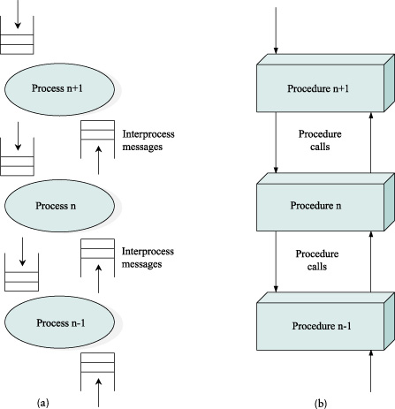
Network Process Models
Process-per-Protocol
Process-per-Message

Slide 46
Network Process Models
Process-per-message
Treats each protocol as a static piece of code and associates the processes with the message
When message arrives from the network, the OS dispatches a process that it makes responsible for the message as it moves up the protocol graph
At each level, the procedure that implements that protocol is invoked
Which eventually results in the procedure for the next protocol being invoked and so on
In both directions, the protocol graph is traversed in a sequence of procedure calls

Slide 47
Process-per-Model vs process-per-message
Process-per-Model
A context switch is required at each level of the protocol graph – typically time consuming
Requires a context switch at each level
process-per-message
The process-per-message model is generally more efficient
A procedure call is an order of magnitude more efficient than a context switch on most computers
A procedure call per level

Slide 48
Message Buffers
The application process provides the buffer that contains the outbound message
When calling send
Similarly it provides the buffer into which an incoming message is copied
when invoking the receive operation
This forces the topmost protocol to copy the message from the application’s buffer into a network buffer, and vice versa

Slide 49
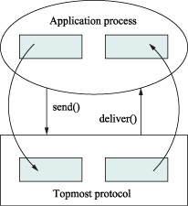
Message Buffers
Copying incoming/outgoing messages between application buffer and network buffer

Slide 50
Message Buffers –Drawback
Copying data from one buffer to another is one of the most expensive things a protocol implementation can do
Memory speed is slower when compared to processors
Most of networks defines an abstract data type for messages that is shared by all protocols in the protocol graph
This abstraction permits
Message to be passed up and down the protocol graph without copying
It also provides a copy free ways of manipulation of messages
Such as adding and stripping headers
Fragmenting large messages into a set of small messages
Reassembling a collection of small messages into a single large message

Slide 51
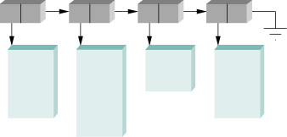
Message Buffers
The exact form of message abstraction differs from OS to OS
In generally involves a linked list of pointers to message buffers
Example message data Structure

Slide 52
Performance
The effectiveness of computations distributed over the network often depends directly on the efficiency with which the network delivers the computation’s data
Network performance is measured in two fundamental ways
Bandwidth (throughput)
Latency (delay)

Slide 53
Performance
Bandwidth and Latency

Slide 54
Bandwidth and Latency
Bandwidth: the number of bits that can be transmitted over the network in a certain period of time
Example: 10 millions bits per seconds
It is able to deliver 10 million bits every second
On 10 Mbps network, it takes 0.1 microsecond (μs) to transmit each bit
Latency: corresponding to how long it takes a message to travel from one end of a network to the other
Latency is measured strictly in terms of time

Slide 55
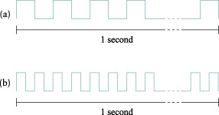
Bandwidth
Bits transmitted at a particular bandwidth can be regarded as having some width
Bits transmitted at 1mbps (each bit 1us wide)
Bits transmitted at 2mbps (each bit 0.5us wide)

Slide 56
Latency
Round-trip time (RTT): the time it takes to send a message from one end of a network to the other and back
Latency depends of three parameters
Propagation Delay
Transmit Delay: the amount of time it take to transmit a unit of data
Queue Delays: since packets switches generally need to store packets for some time before forwarding them on an outbound link
Latency = Propagation + Transmit + Queue
Propagation = Distance/SpeedOfLight
Transmit = Size/Bandwidth

Slide 57
Latency
Distance: Length of the wire over which the data will travel
SpeeOfLight: effective speed of light over that wire
Size: size of the packet
Bandwidth: bandwidth at which the packet is transmitted

Slide 58
Performance
Bandwidth and latency combine to define the performance characteristics of a given link or channel
Latency dominates bandwidth for some applications
A client that sends a 1-byte message to a server and receives a 1-byte message in return is latency bound
The application performs much differently on different channels
A transcontinental channel with a 100ms RTT
An across the room channel with a 1ms RTT
The channel is 1Mbps or 100Mbps is relatively insignificant
To transmit a byte on a above will take 8us and 0.08us time.

Slide 59
Performance
A digital library program that is being asked to fetch a 25MB image
The more bandwidth that is available, the faster it will be able to return the image to the user
The bandwidth of the channel dominates performance

Slide 60

Delay x Bandwidth Product
A channel a pair of processes as a hollow pipe
The latency corresponds to the length of the pipe
Bandwidth gives the diameter of the pipe
The delay x bandwidth product gives the volume of the pipe
For example a transcontinental channel with a one-way latency of 50ms and a bandwidth of 45 Mbps is able to hold
50 x 10⁻³ sec x 45 x 10⁶ bits/sec
2.25 x 10⁶ bits

Slide 61
Delay x Bandwidth Product
Link Type | Bandwidth (typical) | Distance (typical) | Round-trip Delay | Delay x BW
Dail – up | 56 Kbps | 10Km | 87 µs | 5bits
Wireless LAN | 54 Mbps | 50m | 0.33 µs | 18 bits
Satellite | 45 Mbps | 35,000 Km | 230 ms | 10Mb
Cross-country fiber | 10Gbps | 4,000 km | 40 ms | 400 Mb
The delay x bandwidth product is important to know then constructing high-performance networks
Because it corresponds to how many bits the sender must transmit before the first bit arrives at the receiver

Slide 62
Delay x Bandwidth Product
Relative importance of bandwidth and latency depends on application
For large file transfer, bandwidth is critical
For small messages (HTTP, NFS, etc.), latency is critical
Variance in latency (jitter) can also affect some applications (e.g., audio/video conferencing)

Slide 63
Delay x Bandwidth Product
How many bits the sender must transmit before the first bit arrives at the receiver if the sender keeps the pipe full
Takes another one-way latency to receive a response from the receiver
If the sender does not fill the pipe—send a whole delay × bandwidth product’s worth of data before it stops to wait for a signal—the sender will not fully utilize the network

Slide 64
Delay x Bandwidth Product
Infinite bandwidth
RTT dominates
Throughput = TransferSize / TransferTime
TransferTime = RTT +(1/Bandwidth) x TransferSize
Its all relative
1-MB file to 1-Gbps link looks like a 1-KB packet to 1-Mbps link

Slide 65
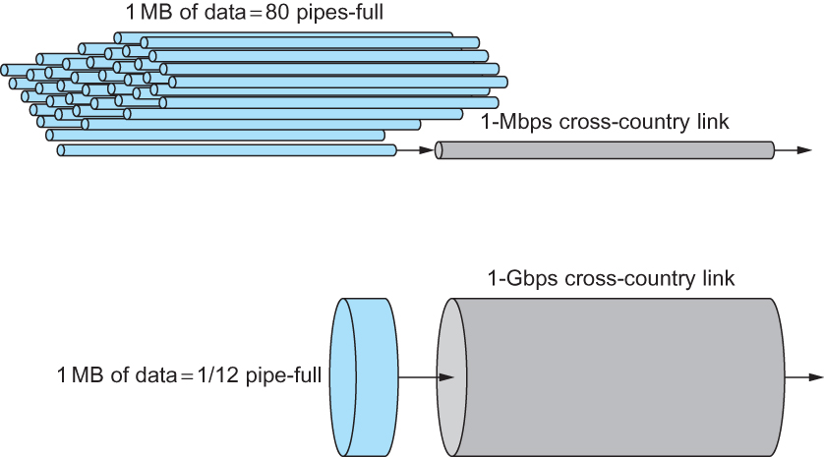
Relationship between Bandwidth and Latency
A 1-MB file would fill the 1-Mbps link 80 times,
but only fill the 1-Gbps link 1/12 of one time

Slide 66
Throughput of Network
Throughput = TransferSize/ TransferTime
TransferTime = RTT + (1/Bandwidth) x TransferSize

Slide 67
Summary
We have identified what we expect from a computer network
We have defined a layered architecture for computer network that will serve as a blueprint for our design
We have discussed the socket interface which will be used by applications for invoking the services of the network subsystem
We have discussed two performance metrics using which we can analyze the performance of computer networks

