Slide 1
Direct link networks

Slide 2
Outline
Hardware Building Blocks
Encoding
Framing
Error Detection
Reliable Transmission
Ethernet
Rings
Wireless

Slide 3
Objectives
Exploring different communication medium over which we can send data
Understanding the issue of encoding bits onto transmission medium so that they can be understood by the receiving end
Discussing the matter of delineating the sequence of bits transmitted over the link into complete messages that can be delivered to the end node
Discussing different technique to detect transmission errors and take the appropriate action

Slide 4
Objectives
Discussing the issue of making the links reliable in spite of transmission problems
Introducing Media Access Control Problem
Introducing Carrier Sense Multiple Access (CSMA) networks
Introducing Wireless Networks with different available technologies and protocol

Slide 5
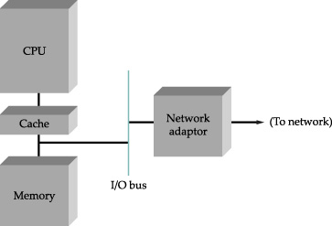
Nodes
Example of workstation architecture

Slide 6
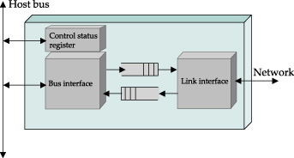
Nodes
CSR is readable and writable from CPU
Software on the host
Writes to the CSR to instruct it to transmit and/or receive data
Reads from the CSR to learn the current status of the adaptor
Block diagram of typical Network adaptor

Slide 7
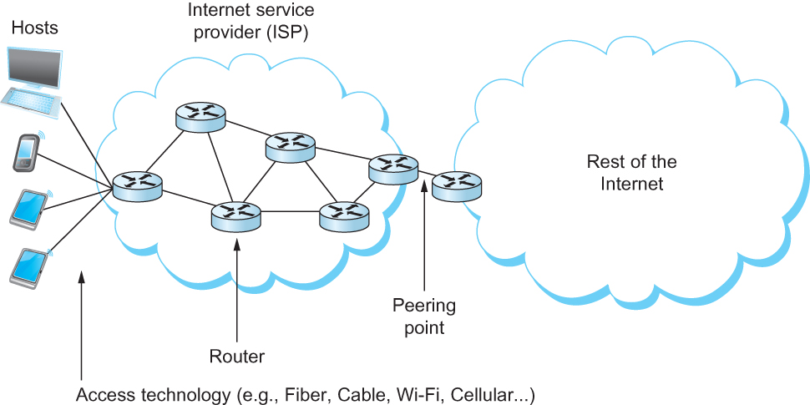
Perspectives on Connecting
An end-user’s view of the Internet

Slide 8
Link Capacity and Shannon-Hartley Theorem
Gives the upper bound to the capacity of a link in terms of bits per second (bps) as a function of signal-to-noise ratio of the link measured in decibels (dB).
C = Blog₂(1+S/N)
B is Bandwidth, frequency support range 300 to 3300 Hz.
Where B = 3300 – 300 = 3000Hz, S is the signal power, N the average noise.
The signal to noise ratio (S/N) is measured in decibels is related to dB = 10 x log₁₀(S/N). If there is 30dB of noise then S/N = 1000.
Now C = 3000 x log₂(1001) = 30kbps.

Slide 9
Links
All practical links rely on some sort of electromagnetic radiation propagating through a medium or, in some cases, through free space
One way to characterize links, then, is by the medium they use
Typically copper wire in some form (as in Digital Subscriber Line (DSL) and coaxial cable),
Optical fiber (as in both commercial fiber-to-the home services and many long-distance links in the Internet’s backbone), or
Air/free space (for wireless links)

Slide 10
Links
Another important link characteristic is the frequency
Measured in hertz, with which the electromagnetic waves oscillate
Distance between the adjacent pair of maxima or minima of a wave measured in meters is called wavelength
Speed of light divided by frequency gives the wavelength.
Frequency on a copper cable range from 300Hz to 3300Hz; Wavelength for 300Hz wave through copper is speed of light on a copper / frequency
(2/3) x 3 x 10⁸ /300 = 667 x 10³ meters.
Placing binary data on a signal is called encoding.
Modulation involves modifying the signals in terms of their frequency, amplitude, and phase.

Slide 11
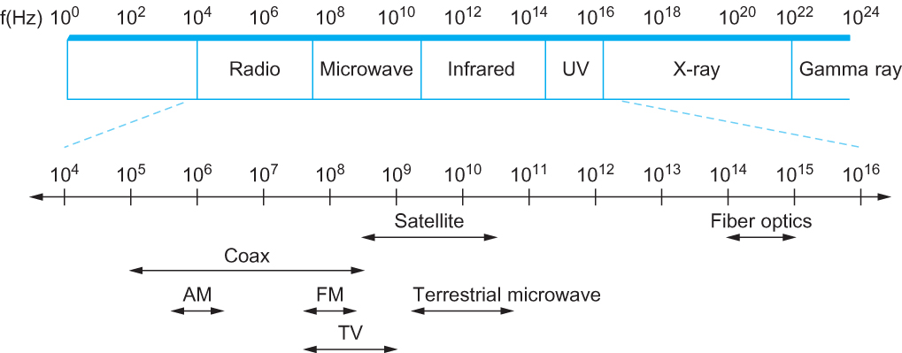
Links
Electromagnetic spectrum

Slide 12
Cables
Cable | Typical Bandwidth | Distance
Category 5 Twisted Pair | 10 – 100 Mbps | 100m
Thin – net coax | 10 – 100 Mbps | 200m
Thick – net coax | 10 – 100 Mbps | 500m
Multimode Fiber | 100Mbps | 2Km
Single – mode fiber | 0.1 – 10 Gbps | 40Km
Common types of cables and fibers available for Local Links

Slide 13
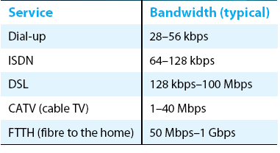
Links
Common services available to connect your home

Slide 14
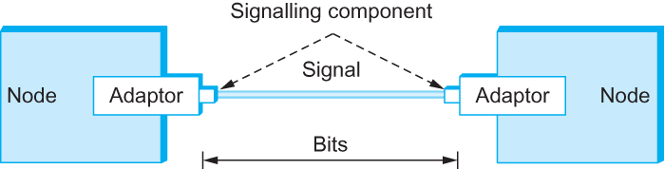
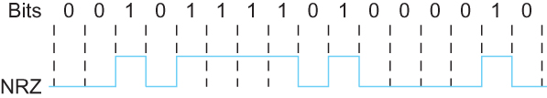
Encoding
Signals travel between signaling components; bits flow between adaptors
NRZ encoding of a bit stream

Slide 15
Encoding
Problem with NRZ (nonreturn to zero)
Baseline wander
The receiver keeps an average of the signals it has seen so far
Uses the average to distinguish between low and high signal
When a signal is significantly low than the average, it is 0, else it is 1
Too many consecutive 0’s and 1’s cause this average to change, making it difficult to detect

Slide 16
Encoding
Problem with NRZ
Clock recovery
Frequent transition from high to low or vice versa are necessary to enable clock recovery
Both the sending and decoding process is driven by a clock
Every clock cycle, the sender transmits a bit and the receiver recovers a bit
The sender and receiver have to be precisely synchronized

Slide 17
Encoding
NRZI
Non Return to Zero Inverted
Sender makes a transition from the current signal to encode 1 and stay at the current signal to encode 0
Solves for consecutive 1’s

Slide 18
Encoding – Manchester
Manchester encoding
Merging the clock with signal by transmitting Ex-OR of the NRZ encoded data and the clock
Clock is an internal signal that alternates from low to high, a low/high pair is considered as one clock cycle
In Manchester encoding
0: low→ high transition
1: high→ low transition

Slide 19
Encoding - Manchester
Problem with Manchester encoding
Doubles the rate at which the signal transitions are made on the link
Which means the receiver has half of the time to detect each pulse of the signal
The rate at which the signal changes is called the link’s baud rate
In Manchester the bit rate is half the baud rate

Slide 20
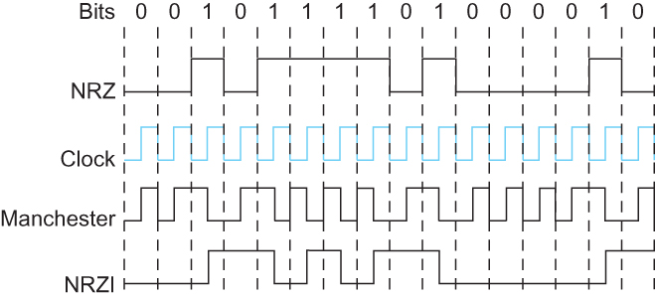
Encoding
Different encoding strategies

Slide 21
Encoding
4B/5B encoding
Insert extra bits into bit stream so as to break up the long sequence of 0’s and 1’s
Every 4-bits of actual data are encoded in a 5- bit code that is transmitted to the receiver
5-bit codes are selected in such a way that each one has no more than one leading 0(zero) and no more than two trailing 0’s.
No pair of 5-bit codes results in more than three consecutive 0’s

Slide 22
4B/5B Encoding
4 – bit Data Symbol | 5 – bit Code
0000 | 11110
0001 | 01001
0010 | 10100
0011 | 10101
0100 | 01010
0101 | 01011
0110 | 01110
0111 | 01111
1000 | 10010
1001 | 10011
1010 | 10110
1011 | 10111
1100 | 11010
1101 | 11011
1110 | 11100
1111 | 11101

Slide 23
Encoding
4B/5B encoding
16 left
11111 – when the line is idle
00000 – when the line is dead
00100 – to mean halt
13 left :
7 invalid (no more than One leading ‘0’, two tailing ‘0s’),
6 for various control symbols/signals

Slide 24
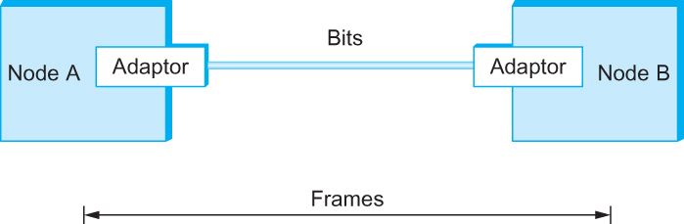
Framing
We are focusing on packet-switched networks, which means that blocks of data (called frames at this level), not bit streams, are exchanged between nodes.
It is the network adaptor that enables the nodes to exchange frames.
Bits flow between adaptors, frames between hosts

Slide 25
Framing
When node A wishes to transmit a frame to node B, it tells its adaptor to transmit a frame from the node’s memory. This results in a sequence of bits being sent over the link.
The adaptor on node B then collects together the sequence of bits arriving on the link and deposits the corresponding frame in B’s memory.
Recognizing exactly what set of bits constitute a frame—that is, determining where the frame begins and ends—is the central challenge faced by the adaptor

Slide 26
Framing
Byte-oriented Protocols (PPP)
To view each frame as a collection of bytes (characters) rather than bits
BISYNC (Binary Synchronous Communication) Protocol
Developed by IBM (late 1960)
DDCMP (Digital Data Communication Protocol)
Used in DECNet

Slide 27
Framing
BISYNC – sentinel approach
Frames transmitted beginning with leftmost field
Beginning of a frame is denoted by sending a special SYN (synchronize) character
Data portion of the frame is contained between special sentinel character STX (start of text) and ETX (end of text)
SOH : Start of Header
DLE : Data Link Escape
CRC: Cyclic Redundancy Check

Slide 28

Framing
Header: Link level reliable delivery algorithm
BISYNC Frame Format

Slide 29
Framing
Recent PPP which is commonly run over Internet links uses sentinel approach
Special start of text character denoted as Flag
0 1 1 1 1 1 1 0
Address, control: default numbers
Protocol for demux: IP / IPX
Payload: negotiated (1500 bytes)
Checksum: for error detection

Slide 30

Framing
PPP Frame Format

Slide 31

Framing
Byte-counting approach
DDCMP (Digital Data Communication Message Protocol)
count : how many bytes are contained in the frame body
If count is corrupted
Framing error
DDCMP Frame Format

Slide 32

Framing
Bit-oriented Protocol
HDLC : High Level Data Link Control
Beginning and Ending Sequences
0 1 1 1 1 1 1 0
HDLC Frame Format

Slide 33
Framing
HDLC Protocol
On the sending side, any time five consecutive 1’s have been transmitted from the body of the message (i.e. excluding when the sender is trying to send the distinguished 01111110 sequence)
The sender inserts 0 before transmitting the next bit

Slide 34
Framing
HDLC Protocol
On the receiving side
5 consecutive 1’s
Next bit 0 : Stuffed, so discard it
1 : Either End of the frame marker
Or Error has been introduced in the bitstream
Look at the next bit
If 0 ( 01111110 ) → End of the frame marker
If 1 ( 01111111 ) → Error, discard the whole frame
The receiver needs to wait for next
01111110 before it can start
receiving again

Slide 35
Clock-Based Framing (SONET)
Synchronous Optical Network (SONET) Standard is used for long distance transmission of data over optical network.
It supports multiplexing of several low speed links into one high speed links
An STS – 1 frame is used in this method
Overhead
Payload
9 rows
90 columns

Slide 36
Clock-Based Framing (SONET)
It is arranged as nine rows of 90 bytes each, and the first 3 bytes of each row are overhead, with the rest being available for data
The first 2 bytes of the frame contain a special bit pattern, and it is these bytes that enable the receiver to determine where the frame starts
The receiver looks for the special bit pattern consistently, once in every 810 bytes, since each frame is 9 x 90 = 810 bytes long

Slide 37
Clock-Based Framing (SONET)
The STS – N frame can be thought of as consisting of N STS – 1 frames, where the bytes from these frames are interleaved;
That is, a byte from the first frame is transmitted, then a byte from the second frame is transmitted, and so on
Payload from these STS – 1 frames can be linked together to form a large STS – N payload, such a link is denoted STS – Nc. One of the bit in overhead is used for this purpose

Slide 38
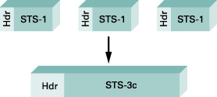
Clock-Based Framing (SONET)
Three STS – 1 frame multiplexed onto one STS – 3c frame

Slide 39
Error Detection
Bit errors are introduced into frames
Because of electrical interference and thermal noises
Detecting Error
Correction Error
Two approaches when the recipient detects an error
Notify the sender that the message was corrupted, so the sender can send again.
If the error is rare, then the retransmitted message will be error-free
Using some error detection and correction algorithm, the receiver reconstructs the message

Slide 40
Error Detection
Common technique for detecting transmission error
CRC (Cyclic Redundancy Check)
Used in HDLC, DDCMP, CSMA/CD, Token Ring
Other approaches
Two Dimensional Parity (BISYNC)
Checksum (IP)

Slide 41
Error Detection
Basic Idea of Error Detection
To add redundant information to a frame that can be used to determine if errors have been introduced
Imagine (Extreme Case)
Transmitting two complete copies of data
Identical → No error
Differ → Error
Poor Scheme ???
n bit message, n bit redundant information
Error can go undetected
In general, we can provide strong error detection technique
k redundant bits, n bits message, k << n
In Ethernet, a frame carrying up to 12,000 bits of data requires only 32-bit CRC

Slide 42
Error Detection
Extra bits are redundant
They add no new information to the message
Derived from the original message using some algorithm
Both the sender and receiver know the algorithm
Sender Receiver
Receiver computes r using m
If they match, no error
m
r
m
r

Slide 43
Two Dimensional Parity
Two-dimensional parity is exactly what the name suggests
It is based on “simple” (one-dimensional) parity, which usually involves adding one extra bit to a 7-bit code to balance the number of 1s in the byte. For example,
Odd parity sets the eighth bit to 1 if needed to give an odd number of 1s in the byte, and
Even parity sets the eighth bit to 1 if needed to give an even number of 1s in the byte

Slide 44
Two-dimensional parity
Two-dimensional parity does a similar calculation for each bit position across each of the bytes contained in the frame
This results in an extra parity byte for the entire frame, in addition to a parity bit for each byte
Two-dimensional parity catches all 1-, 2-, and 3-bit errors and most 4-bit errors

Slide 45
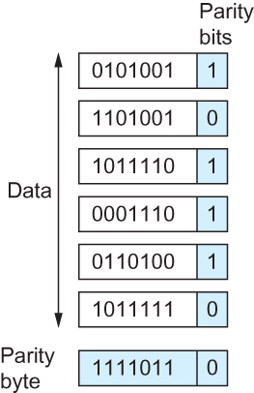
Two-dimensional parity
Two Dimensional Parity

Slide 46
Internet Checksum Algorithm
Not used at the link level
Add up all the words that are transmitted and then transmit the result of that sum
The result is called the checksum
The receiver performs the same calculation on the received data and compares the result with the received checksum
If any transmitted data, including the checksum itself, is corrupted, then the results will not match, so the receiver knows that an error occurred

Slide 47
Internet Checksum Algorithm
Consider the data being check-summed as a sequence of 16-bit integers.
Add them together using 16-bit ones complement arithmetic (explained next slide) and then take the ones complement of the result.
That 16-bit number is the checksum

Slide 48
Internet Checksum Algorithm
In ones complement arithmetic, a negative integer −x is represented as the complement of x;
Each bit of x is inverted.
When adding numbers in ones complement arithmetic, a carryout from the most significant bit needs to be added to the result.

Slide 49
Internet Checksum Algorithm
Consider, for example, the addition of −5 and −3 in ones complement arithmetic on 4-bit integers
+5 is 0101, so −5 is 1010; +3 is 0011, so −3 is 1100
If we add 1010 and 1100 ignoring the carry, we get 0110
In ones complement arithmetic, the fact that this operation caused a carry from the most significant bit causes us to increment the result, giving 0111, which is the ones complement representation of −8 (obtained by inverting the bits in 1000), as we would expect

Slide 50
Evaluation of checksums
Data overhead - 16 or 32 bits
Computational overhead - simple additions
Undetected errors - some periodic reversal of bits (e.g., reversing one bit in each of four data items)

Slide 51
Example failure of checksums
Data Item (Binary) | Checksum Value | Data Item (Binary) | Checksum Value
0 0 0 1 | 1 | 0 0 1 1 | 3
0 0 1 0 | 2 | 0 0 0 0 | 0
0 0 1 1 | 3 | 0 0 0 1 | 1
0 0 0 1 | 1 | 0 0 1 1 | 3
Totals | 7 | Totals | 7

Slide 52
Cyclic redundancy checks (CRCs)
Detects more errors than checksums and only requires simple hardware
Can be analyzed mathematically but is best presented in terms of the hardware design

Slide 53
Cyclic Redundancy Check (CRC)
Reduce the number of extra bits and maximize protection
Given a bit string 110001 we can associate a polynomial on a single variable x for it.
1.x⁵+1.x⁴+0.x³+0.x²+0.x¹+1.x⁰ = x⁵+x⁴+1 and the degree is 5.
A k-bit frame has a maximum degree of k-1
Let M(x) be a message polynomial and C(x) be a generator polynomial.

Slide 54
Cyclic Redundancy Check (CRC)
Let M(x)/C(x) leave a remainder of 0.
When M(x) is sent and M’(x) is received we have M’(x) = M(x)+E(x)
The receiver computes M’(x)/C(x) and if the remainder is nonzero, then an error has occurred.
The only thing the sender and the receiver should know is C(x).

Slide 55
Cyclic Redundancy Check (CRC)
Polynomial Arithmetic Modulo 2
Any polynomial B(x) can be divided by a divisor polynomial C(x) if B(x) is of higher degree than C(x).
Any polynomial B(x) can be divided once by a divisor polynomial C(x) if B(x) is of the same degree as C(x).
The remainder obtained when B(x) is divided by C(x) is obtained by subtracting C(x) from B(x).
To subtract C(x) from B(x), we simply perform the exclusive-OR (XOR) operation on each pair of matching coefficients.

Slide 56
Cyclic Redundancy Check (CRC)
Let M(x) be a frame with m bits and let the generator polynomial have less than m bits say equal to r.
Let r be the degree of C(x). Append r zero bits to the low-order end of the frame, so it now contains m+r bits and corresponds to the polynomial x^{r}M(x).

Slide 57
Cyclic Redundancy Check (CRC)
Divide the bit string corresponding to x^{r}M(x) by the bit string corresponding to C(x) using modulo 2 division.
Subtract the remainder (which is always r or fewer bits) from the string corresponding to x^{r}M(x) using modulo 2 subtraction (addition and subtraction are the same in modulo 2).
The result is the check summed frame to be transmitted. Call it polynomial M’(x).

Slide 58
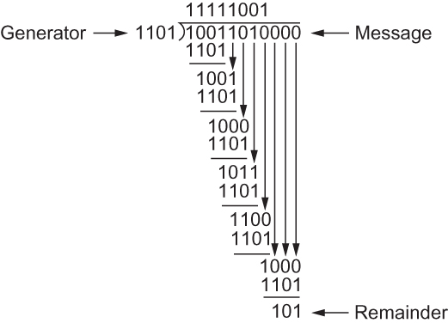
Cyclic Redundancy Check (CRC)
CRC Calculation using Polynomial Long Division

Slide 59
Cyclic Redundancy Check (CRC)
Properties of Generator Polynomial
Let P(x) represent what the sender sent and P(x) + E(x) is the received string. A 1 in E(x) represents that in the corresponding position in P(x) the message the bit is flipped.
We know that P(x)/C(x) leaves a remainder of 0, but if E(x)/C(x) leaves a remainder of 0, then either E(x) = 0 or C(x) is factor of E(x).
When C(x) is a factor of E(x) we have problem; errors go unnoticed.
If there is a single bit error then E(x) = x^{i}, where i determines the bit in error. If C(x) contains two or more terms it will never divide E(x), so all single bit errors will be detected.

Slide 60
Cyclic Redundancy Check (CRC)
Properties of Generator Polynomial
In general, it is possible to prove that the following types of errors can be detected by a C(x) with the stated properties
All single-bit errors, as long as the x^{k} and x⁰ terms have nonzero coefficients.
All double-bit errors, as long as C(x) has a factor with at least three terms.
Any odd number of errors, as long as C(x) contains the factor (x+1).
Any “burst” error (i.e., sequence of consecutive error bits) for which the length of the burst is less than k bits. (Most burst errors of larger than k bits can also be detected.)

Slide 61
Cyclic Redundancy Check (CRC)
Six generator polynomials that have become international standards are:
CRC-8 = x⁸+x²+x+1
CRC-10 = x¹⁰+x⁹+x⁵+x⁴+x+1
CRC-12 = x¹²+x¹¹+x³+x²+x+1
CRC-16 = x¹⁶+x¹⁵+x²+1
CRC-CCITT = x¹⁶+x¹²+x⁵+1
CRC-32 = x³²+x²⁶+x²³+x²²+x¹⁶+x¹²+x¹¹+x¹⁰+x⁸+x⁷+x⁵+x⁴+x²+x+1

Slide 62
Reliable Transmission

Slide 63
Reliable Transmission
CRC is used to detect errors.
Some error codes are strong enough to correct errors.
The overhead is typically too high.
Corrupt frames must be discarded.
A link-level protocol that wants to deliver frames reliably must recover from these discarded frames.
This is accomplished using a combination of two fundamental mechanisms
Acknowledgements and Timeouts

Slide 64
Reliable Transmission
An acknowledgement (ACK for short) is a small control frame that a protocol sends back to its peer saying that it has received the earlier frame.
A control frame is a frame with header only (no data).
The receipt of an acknowledgement indicates to the sender of the original frame that its frame was successfully delivered.

Slide 65
Reliable Transmission
If the sender does not receive an acknowledgment after a reasonable amount of time, then it retransmits the original frame.
The action of waiting a reasonable amount of time is called a timeout.
The general strategy of using acknowledgements and timeouts to implement reliable delivery is sometimes called Automatic Repeat reQuest (ARQ).

Slide 66
Stop and Wait Protocol
Idea of stop-and-wait protocol is straightforward
After transmitting one frame, the sender waits for an acknowledgement before transmitting the next frame.
If the acknowledgement does not arrive after a certain period of time, the sender times out and retransmits the original frame

Slide 67
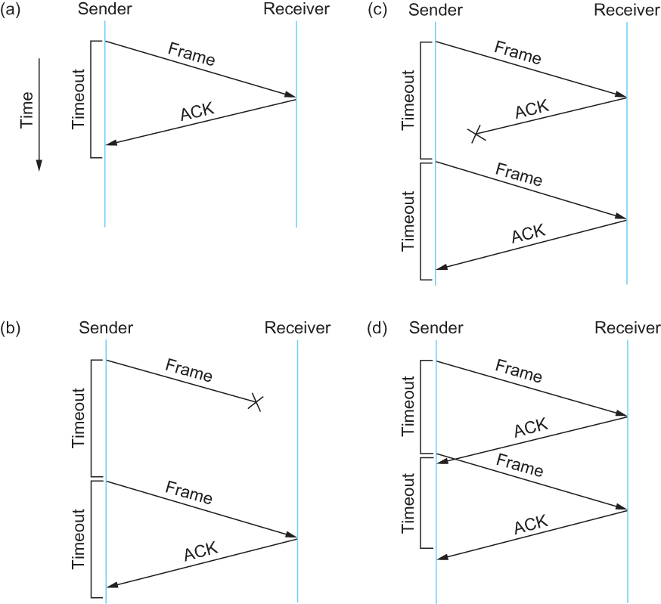
Stop and Wait Protocol
Timeline showing four different scenarios for the stop-and-wait algorithm.
(a) The ACK is received before the timer expires; (b) the original frame is lost; (c) the
ACK is lost; (d) the timeout fires too soon

Slide 68
Stop and Wait Protocol
If the acknowledgment is lost or delayed in arriving
The sender times out and retransmits the original frame, but the receiver will think that it is the next frame since it has correctly received and acknowledged the first frame
As a result, duplicate copies of frames will be delivered
How to solve this
Use 1 bit sequence number (0 or 1)
When the sender retransmits frame 0, the receiver can determine that it is seeing a second copy of frame 0 rather than the first copy of frame 1 and therefore can ignore it (the receiver still acknowledges it, in case the first acknowledgement was lost)

Slide 69
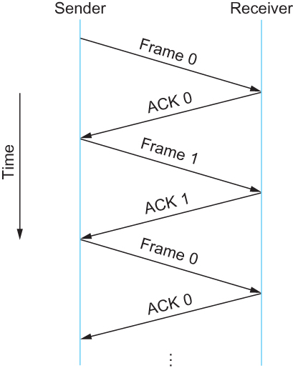
Stop and Wait Protocol
Timeline for stop-and-wait with 1-bit sequence number

Slide 70
Stop and Wait Protocol
The sender has only one outstanding frame on the link at a time
This may be far below the link’s capacity
Consider a 1.5 Mbps link with a 45 ms RTT
The link has a delay × bandwidth product of 67.5 Kb or approximately 8 KB
Since the sender can send only one frame per RTT and assuming a frame size of 1 KB
Maximum Sending rate
Bits per frame ÷ Time per frame = 1024 × 8 ÷ 0.045 = 182 Kbps
Or about one-eighth of the link’s capacity
To use the link fully, then sender should transmit up to eight frames before having to wait for an acknowledgement

Slide 71
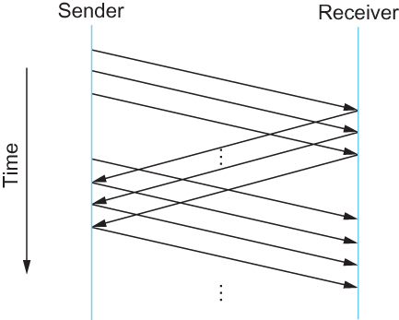
Sliding Window Protocol
Timeline for Sliding Window Protocol

Slide 72
Sliding Window Protocol
Sender assigns a sequence number denoted as SeqNum to each frame.
Assume it can grow infinitely large
Sender maintains three variables
Sending Window Size (SWS)
Upper bound on the number of outstanding (unacknowledged) frames that the sender can transmit
Last Acknowledgement Received (LAR)
Sequence number of the last acknowledgement received
Last Frame Sent (LFS)
Sequence number of the last frame sent

Slide 73
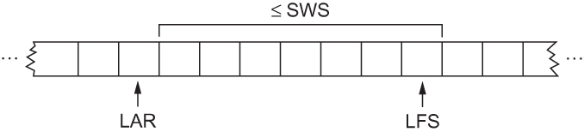
Sliding Window Protocol
Sender also maintains the following invariant
LFS – LAR ≤ SWS
Sliding Window on Sender

Slide 74
Sliding Window Protocol
When an acknowledgement arrives
the sender moves LAR to right, thereby allowing the sender to transmit another frame
Also the sender associates a timer with each frame it transmits
It retransmits the frame if the timer expires before the ACK is received
Note that the sender has to be willing to buffer up to SWS frames

Slide 75
Sliding Window Protocol
Receiver maintains three variables
Receiving Window Size (RWS)
Upper bound on the number of out-of-order frames that the receiver is willing to accept
Largest Acceptable Frame (LAF)
Sequence number of the largest acceptable frame
Last Frame Received (LFR)
Sequence number of the last frame received

Slide 76
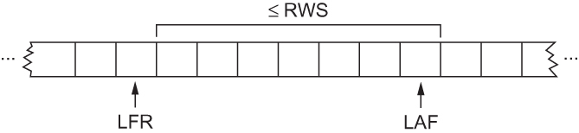
Sliding Window Protocol
Receiver also maintains the following invariant
LAF – LFR ≤ RWS
Sliding Window on Receiver

Slide 77
Sliding Window Protocol
When a frame with sequence number SeqNum arrives, what does the receiver do?
If SeqNum ≤ LFR or SeqNum > LAF
Discard it (the frame is outside the receiver window)
If LFR < SeqNum ≤ LAF
Accept it
Now the receiver needs to decide whether or not to send an ACK

Slide 78
Sliding Window Protocol
Let SeqNumToAck
Denote the largest sequence number not yet acknowledged, such that all frames with sequence number less than or equal to SeqNumToAck have been received
The receiver acknowledges the receipt of SeqNumToAck even if high-numbered packets have been received
This acknowledgement is said to be cumulative.
The receiver then sets
LFR = SeqNumToAck and adjusts
LAF = LFR + RWS

Slide 79
Sliding Window Protocol
For example, suppose LFR = 5 and RWS = 4
(i.e. the last ACK that the receiver sent was for seq. no. 5)
LAF = 9
If frames 7 and 8 arrive, they will be buffered because they are within the receiver window
But no ACK will be sent since frame 6 is yet to arrive
Frames 7 and 8 are out of order
Frame 6 arrives (it is late because it was lost first time and had to be retransmitted)
Now Receiver Acknowledges Frame 8
and bumps LFR to 8
and LAF to 12

Slide 80
Issues with Sliding Window Protocol
When timeout occurs, the amount of data in transit decreases
Since the sender is unable to advance its window
When the packet loss occurs, this scheme is no longer keeping the pipe full
The longer it takes to notice that a packet loss has occurred, the more severe the problem becomes
How to improve this
Negative Acknowledgement (NAK)
Additional Acknowledgement
Selective Acknowledgement

Slide 81
Issues with Sliding Window Protocol
Negative Acknowledgement (NAK)
Receiver sends NAK for frame 6 when frame 7 arrive (in the previous example)
However this is unnecessary since sender’s timeout mechanism will be sufficient to catch the situation
Additional Acknowledgement
Receiver sends additional ACK for frame 5 when frame 7 arrives
Sender uses duplicate ACK as a clue for frame loss
Selective Acknowledgement
Receiver will acknowledge exactly those frames it has received, rather than the highest number frames
Receiver will acknowledge frames 7 and 8
Sender knows frame 6 is lost
Sender can keep the pipe full (additional complexity)

Slide 82
Issues with Sliding Window Protocol
How to select the window size
SWS is easy to compute
Delay × Bandwidth
RWS can be anything
Two common setting
RWS = 1
No buffer at the receiver for frames that arrive out of order
RWS = SWS
The receiver can buffer frames that the sender transmits
It does not make any sense to keep RWS > SWS

Slide 83
Issues with Sliding Window Protocol
Finite Sequence Number
Frame sequence number is specified in the header field
Finite size
3 bit: eight possible sequence number: 0, 1, 2, 3, 4, 5, 6, 7
It is necessary to wrap around

Slide 84
Issues with Sliding Window Protocol
How to distinguish between different incarnations of the same sequence number?
Number of possible sequence number must be larger than the number of outstanding frames allowed
Stop and Wait: One outstanding frame
2 distinct sequence number (0 and 1)
Let MaxSeqNum be the number of available sequence numbers
SWS + 1 ≤ MaxSeqNum
Is this sufficient?

Slide 85
Issues with Sliding Window Protocol
SWS + 1 ≤ MaxSeqNum
Is this sufficient?
Depends on RWS
If RWS = 1, then sufficient
If RWS = SWS, then not good enough
For example, we have eight sequence numbers
0, 1, 2, 3, 4, 5, 6, 7
RWS = SWS = 7
Sender sends 0, 1, …, 6
Receiver receives 0, 1, … ,6
Receiver acknowledges 0, 1, …, 6
ACK (0, 1, …, 6) are lost
Sender retransmits 0, 1, …, 6
Receiver is expecting 7, 0, …., 5

Slide 86
Issues with Sliding Window Protocol
To avoid this,
If RWS = SWS
SWS < (MaxSeqNum + 1)/2

Slide 87
Issues with Sliding Window Protocol
Serves three different roles
Reliable
Preserve the order
Each frame has a sequence number
The receiver makes sure that it does not pass a frame up to the next higher-level protocol until it has already passed up all frames with a smaller sequence number
Frame control
Receiver is able to throttle the sender
Keeps the sender from overrunning the receiver
From transmitting more data than the receiver is able to process

Slide 88
Ethernet

Slide 89
Ethernet
Most successful local area networking technology of last 20 years.
Developed in the mid-1970s by researchers at the Xerox Palo Alto Research Centers (PARC).
Uses CSMA/CD technology
Carrier Sense Multiple Access with Collision Detection.
A set of nodes send and receive frames over a shared link.
Carrier sense means that all nodes can distinguish between an idle and a busy link.
Collision detection means that a node listens as it transmits and can therefore detect when a frame it is transmitting has collided with a frame transmitted by another node.

Slide 90
Ethernet (802.3)
Uses ALOHA (packet radio network) as the root protocol
Developed at the University of Hawaii to support communication across the Hawaiian Islands.
For ALOHA the medium was atmosphere, for Ethernet the medium is a coax cable.
DEC and Intel joined Xerox to define a 10-Mbps Ethernet standard in 1978.
This standard formed the basis for IEEE standard 802.3
More recently 802.3 has been extended to include a 100-Mbps version called Fast Ethernet and a 1000-Mbps version called Gigabit Ethernet.

Slide 91
Ethernet – Physical Properties
An Ethernet segment is implemented on a coaxial cable of up to 500 m.
This cable is similar to the type used for cable TV except that it typically has an impedance of 50 ohms instead of cable TV’s 75 ohms.
Hosts connect to an Ethernet segment by tapping into it.
A transceiver (a small device directly attached to the tap) detects when the line is idle and drives signal when the host is transmitting.
The transceiver also receives incoming signal.
The transceiver is connected to an Ethernet adaptor which is plugged into the host.
The protocol is implemented on the adaptor.

Slide 92
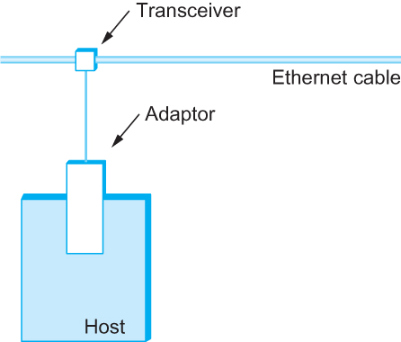
Ethernet – Physical Properties
Ethernet transceiver and adaptor

Slide 93
Ethernet – Physical Properties
Multiple Ethernet segments can be joined together by repeaters.
A repeater is a device that forwards digital signals.
No more than four repeaters may be positioned between any pair of hosts.
An Ethernet has a total reach of only 2500 m.

Slide 94
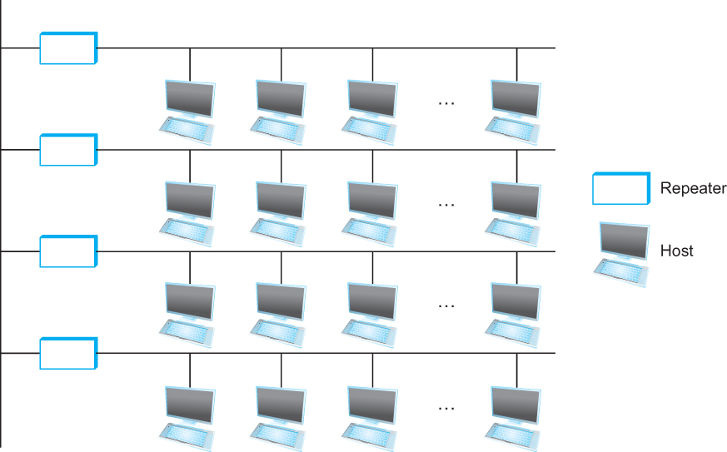
Ethernet Repeater – Physical Properties
Ethernet repeater

Slide 95
Ethernet – Physical Properties
Any signal placed on the Ethernet by a host is broadcast over the entire network
Signal is propagated in both directions.
Repeaters forward the signal on all outgoing segments.
Terminators attached to the end of each segment absorb the signal.
Ethernet uses Manchester encoding scheme.

Slide 96
Ethernet – Physical Properties
New Technologies in Ethernet
Instead of using coax cable, an Ethernet can be constructed from a thinner cable known as 10Base2 (the original was 10Base5)
10 means the network operates at 10 Mbps
Base means the cable is used in a baseband system
2 means that a given segment can be no longer than 200 m

Slide 97
Ethernet – Physical Properties
New Technologies in Ethernet
Another cable technology is 10BaseT
T stands for twisted pair
Limited to 100 m in length
With 10BaseT, the common configuration is to have several point to point segments coming out of a multiway repeater, called Hub

Slide 98
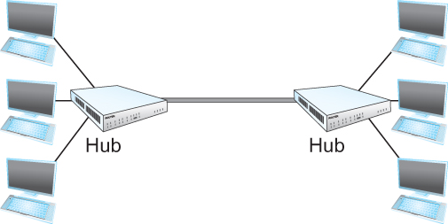
Ethernet Hub
Ethernet Hub

Slide 99
Access Protocol for Ethernet
The algorithm is commonly called Ethernet’s Media Access Control (MAC).
It is implemented in Hardware on the network adaptor.
Frame format
Preamble (64bit): allows the receiver to synchronize with the signal (sequence of alternating 0s and 1s).
Host and Destination Address (48bit each).
Packet type (16bit): acts as demux key to identify the higher level protocol.
Data (up to 1500 bytes)
Minimally a frame must contain at least 46 bytes of data.
Frame must be long enough to detect collision.
CRC (32bit)

Slide 100

Ethernet Frame
Ethernet Frame Format

Slide 101
Ethernet Address
Each host on an Ethernet (in fact, every Ethernet host in the world) has a unique Ethernet Address.
The address belongs to the adaptor, not the host.
It is usually burnt into ROM.
Ethernet addresses are typically printed in a human readable format
As a sequence of six numbers separated by colons.
Each number corresponds to 1 byte of the 6 byte address and is given by a pair of hexadecimal digits, one for each of the 4-bit nibbles in the byte
Leading 0s are dropped.
For example, 8:0:2b:e4:b1:2 is
00001000 00000000 00101011 11100100 10110001 00000010

Slide 102
Ethernet Addresses
To ensure that every adaptor gets a unique address, each manufacturer of Ethernet devices is allocated a different prefix that must be pretended to the address on every adaptor they build
AMD has been assigned the 24bit prefix 8:0:20

Slide 103
Ethernet Addresses
Each frame transmitted on an Ethernet is received by every adaptor connected to that Ethernet.
Each adaptor recognizes those frames addressed to its address and passes only those frames on to the host.
In addition, to unicast address, an Ethernet address consisting of all 1s is treated as a broadcast address.
All adaptors pass frames addressed to the broadcast address up to the host.
Similarly, an address that has the first bit set to 1 but is not the broadcast address is called a multicast address.
A given host can program its adaptor to accept some set of multicast addresses.

Slide 104
Ethernet Addresses
To summarize, an Ethernet adaptor receives all frames and accepts
Frames addressed to its own address
Frames addressed to the broadcast address
Frames addressed to a multicast addressed if it has been instructed

Slide 105
Ethernet Transmitter Algorithm
When the adaptor has a frame to send and the line is idle, it transmits the frame immediately.
The upper bound of 1500 bytes in the message means that the adaptor can occupy the line for a fixed length of time.
When the adaptor has a frame to send and the line is busy, it waits for the line to go idle and then transmits immediately.
The Ethernet is said to be 1-persistent protocol because an adaptor with a frame to send transmits with probability 1 whenever a busy line goes idle.

Slide 106
Ethernet Transmitter Algorithm
Since there is no centralized control it is possible for two (or more) adaptors to begin transmitting at the same time,
Either because both found the line to be idle,
Or, both had been waiting for a busy line to become idle.
When this happens, the two (or more) frames are said to be collide on the network.

Slide 107
Ethernet Transmitter Algorithm
Since Ethernet supports collision detection, each sender is able to determine that a collision is in progress.
At the moment an adaptor detects that its frame is colliding with another, it first makes sure to transmit a 32-bit jamming sequence and then stops transmission.
Thus, a transmitter will minimally send 96 bits in the case of collision
64-bit preamble + 32-bit jamming sequence

Slide 108
Ethernet Transmitter Algorithm
One way that an adaptor will send only 96 bit (called a runt frame) is if the two hosts are close to each other.
Had they been farther apart,
They would have had to transmit longer, and thus send more bits, before detecting the collision.

Slide 109
Ethernet Transmitter Algorithm
The worst case scenario happens when the two hosts are at opposite ends of the Ethernet.
To know for sure that the frame its just sent did not collide with another frame, the transmitter may need to send as many as 512 bits.
Every Ethernet frame must be at least 512 bits (64 bytes) long.
14 bytes of header + 46 bytes of data + 4 bytes of CRC

Slide 110
Ethernet Transmitter Algorithm
Why 512 bits?
Why is its length limited to 2500 m?
The farther apart two nodes are, the longer it takes for a frame sent by one to reach the other, and the network is vulnerable to collision during this time

Slide 111
Ethernet Transmitter Algorithm
Node A begins transmitting a frame at time t
d denotes the one link latency
The first bit of A’s frame arrives at B at time t + d
Suppose an instant before host A’s frame arrives, host B begins to transmit its own frame
B’s frame will immediately collide with A’s frame and this collision will be detected by host B
Host B will send the 32-bit jamming sequence
Host A will not know that the collision occurred until B’s frame reaches it, which will happen at t + 2 * d
Host A must continue to transmit until this time in order to detect the collision
Host A must transmit for 2 * d to be sure that it detects all possible collisions

Slide 112
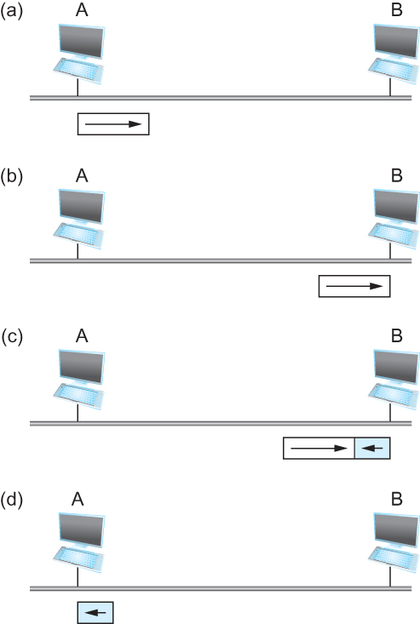
Ethernet Transmitter Algorithm
Worst-case scenario:
(a) Host A sends a frame at time t;
(b) Host A’s frame arrives at B at time t + d;
(c) Host B begins transmitting at time t + d and collides with A’s frame;
(d) B’s runt (32-bit) frame arrives at A at time t + 2d.

Slide 113
Ethernet Transmitter Algorithm
Consider that a maximally configured Ethernet is 2500 m long, and there may be up to four repeaters between any two hosts, the round trip delay has been determined to be 51.2 μs
Which on 10 Mbps Ethernet corresponds to 512 bits
The other way to look at this situation,
We need to limit the Ethernet’s maximum latency to a fairly small value (51.2 μs) for the access algorithm to work
Hence the maximum length for the Ethernet is on the order of 2500 m.

Slide 114
Ethernet Transmitter Algorithm
Once an adaptor has detected a collision, and stopped its transmission, it waits a certain amount of time and tries again.
Each time the adaptor tries to transmit but fails, it doubles the amount of time it waits before trying again.
This strategy of doubling the delay interval between each retransmission attempt is known as Exponential Backoff.

Slide 115
Ethernet Transmitter Algorithm
The adaptor first delays either 0 or 51.2 μs, selected at random.
If this effort fails, it then waits 0, 51.2, 102.4, 153.6 μs (selected randomly) before trying again;
This is k * 51.2 for k = 0, 1, 2, 3
After the third collision, it waits k * 51.2 for k = 0…2³ – 1 (again selected at random).
In general, the algorithm randomly selects a k between 0 and 2^{n} – 1 and waits for k * 51.2 μs, where n is the number of collisions experienced so far.

Slide 116
Experience with Ethernet
Ethernets work best under lightly loaded conditions.
Under heavy loads, too much of the network’s capacity is wasted by collisions.
Most Ethernets are used in a conservative way.
Have fewer than 200 hosts connected to them which is far fewer than the maximum of 1024.
Most Ethernets are far shorter than 2500m with a round-trip delay of closer to 5 μs than 51.2 μs.
Ethernets are easy to administer and maintain.
There are no switches that can fail and no routing and configuration tables that have to be kept up-to-date.
It is easy to add a new host to the network.
It is inexpensive.
Cable is cheap, and only other cost is the network adaptor on each host.

Slide 117
Rings (802.5, FDDI, RPR)

Slide 118
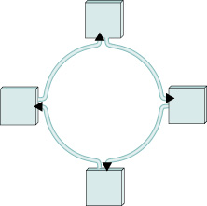
Ring Networks
Like Ethernets, are shared media networks
Token Ring Networks
PRONET: 10Mbps and 80 Mbps rings
IBM: 4Mbps token ring
16Mbps IEEE 802.5/token ring
100Mbps Fiber Distributed Data Interface (FDDI)
A ring networks consists of a set of nodes connected in a ring

Slide 119
Ring Networks
Basic Idea
frames flow in one direction: upstream to downstream
special bit pattern (token) rotates around ring
must capture token before transmitting
release token after done transmitting
immediate release
delayed release
remove your frame when it comes back around
stations get round-robin service

Slide 120
IEEE 802.5 Token Ring
Consists of a set of nodes connected in a ring.
Data flows in a particular direction only.
Data received from upstream neighbour forwarded to downstream neighbour.
Token – access to the shared ring
a special sequence of bits
circulates around the ring.

Slide 121
IEEE 802.5 Token Ring
Each node receives and forwards token.
Frame makes its way back to sender
frame removed by sender
sender reinsert token.
As token circulates around ring, each station gets a chance to transmit
Service round - robin fashion

Slide 122
Token Ring Issues
Any link or node failure
Network rendered useless
Solution –
electromechanical relay
Station active relay is open and station included
Station is inactive
no power
relay closed
bypass station

Slide 123
Token Ring Issues
HOST
HOST
Previous
Host
To Next
Host
Previous
Host
To Next
Host
Relay Open – Station Included
Relay Closed – Bypass Station

Slide 124
Multistation Access Unit (MSAU)
Several relays in a box
Add new station
Plug into MSAU
HOST1
HOST2
HOST3
From Previous
MSAU
HOST4
To Next MSAU

Slide 125
Token Ring (Characteristics)
Data rate: 4 Mbps or 16 Mbps
encoding: differential manchester
802.5 upto 250 station

Slide 126
Token Ring Access Control
Network adapter: receiver, and transmitter, and one or more bits of data storage between them.
When no stations have anything to transmit token circulates
Ring has enough storage capacity to hold an entire token.
1 bit / station

Slide 127
Token Ring Frame Format
Frame control data / token
PPPMRRR
No Limit
Priority Monitor Reservation
Request for next token with requested priority

Slide 128
IEEE 802.5
Token Size: 24 bits
Minimum number of stations is 24
Overcome this by including a monitor which adds the extra bits of delay
Token operation
Token circulates
Station seizes a token

Slide 129
IEEE 802.5
Modifies a bit in the second byte of token
Station that has token transmits data
Station drains token out of the ring
Station sends data
Each packet has destination address
All stations downhill check destination address
Destination copies packet
Packet finds its way back to sending station

Slide 130
IEEE 802.5
Sending station removes packet from ring
Station reinserts token into the ring
Size of packet stored in the ring
Larger/smaller than ring
Add/remove bits

Slide 131
IEEE 802.5
Issues
Size of data that given node is allowed to transmit
Token holding time (THT) = ∞ ?
Utilisation is 100%
Unfair to stations to other than the station holding the token
THT affects ring performance

Slide 132
Token Holding Time
Token Rotation Time (TRT):
TRT ≤ Active nodes * THT + Ring Latency
Ring Latency – token circulation time

Slide 133
Reliable Transmission
The 802.5 protocol provides a form of reliable delivery using 2 bits in the packet trailer
The A and C bits
Initially A and C zero.
Receiver sets A bit after seeing that it is the intended recipient
Receiver sets C bit after copying frame
If both A and C are not set – retransmit

Slide 134
Priorities in IEEE 802.5
Supports different levels of priority
3 bits
each station waiting to send, sets priority for packet packet’s priority as high current token
then token can be seized
Intending to send station – sets the priority on currently passing data frame

Slide 135
Priorities in IEEE 802.5
releasing station sets priority of token to n.
Lower priority packets circulate for long in ring
Token Release
Early release
After transmitting packet
Delayed release
After removing packet when it returns to the sender

Slide 136
Token Ring Maintenance
Designated monitor
any station can become a monitor
defined procedures for becoming a monitor
healthy monitor announces that it is a monitor at periodic interval
if a station does not see that packet for some time – then it sends a “claim token”
if claim token comes back to station then it is monitor
if another wants to claim see other stations claim first some arbitration rule.

Slide 137
Token Ring Maintenance
Role of monitor
insert additional delay in ring
ensure always that there is a token somewhere in the ring
regenerate a vanished token
no token seen for TRT => regenerate

Slide 138
Token Ring Maintenance
Orphaned / corrupted packets – drain them if orphaned
(A and C bits set – parent dies)
A bit set C bit not set – parent dies
bit is initially set to 1 by monitor
monitor notices back when packet passes by monitor a second time

Slide 139
Token Ring Maintenance
Detection of dead stations
some problem un detected
suspecting station sends a beacon frame –
how far beacon goes decide which stations must be bypassed

Slide 140
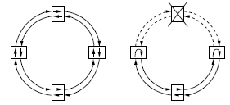
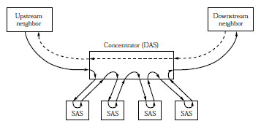
Physical Properties of FDDI
Dual Ring Configuration
Single and Dual Attachment Stations

Slide 141
Physical Properties of FDDI
Each station imposes a delay (e.g., 50ns)
Maximum of 500 stations
Upper limit of 100km (200km of fiber)
Uses 4B/5B encoding
Can be implemented over copper (CDDI)

Slide 142
Wireless (802.11)

Slide 143
Wireless Links
Wireless links transmit electromagnetic signals
Radio, microwave, infrared
Wireless links all share the same “wire” (so to speak)
The challenge is to share it efficiently without unduly interfering with each other
Most of this sharing is accomplished by dividing the “wire” along the dimensions of frequency and space
Exclusive use of a particular frequency in a particular geographic area may be allocated to an individual entity such as a corporation

Slide 144
Wireless Links
These allocations are determined by government agencies such as FCC (Federal Communications Commission) in USA
Specific bands (frequency) ranges are allocated to certain uses.
Some bands are reserved for government use
Other bands are reserved for uses such as AM radio, FM radio, televisions, satellite communications, and cell phones
Specific frequencies within these bands are then allocated to individual organizations for use within certain geographical areas.
Finally, there are several frequency bands set aside for “license exempt” usage
Bands in which a license is not needed

Slide 145
Wireless Links
Devices that use license-exempt frequencies are still subject to certain restrictions
The first is a limit on transmission power
This limits the range of signal, making it less likely to interfere with another signal
For example, a cordless phone might have a range of about 100 feet.

Slide 146
Wireless Links
The second restriction requires the use of Spread Spectrum technique
Idea is to spread the signal over a wider frequency band
So as to minimize the impact of interference from other devices
Originally designed for military use
Frequency hopping
Transmitting signal over a random sequence of frequencies
First transmitting at one frequency, then a second, then a third…
The sequence of frequencies is not truly random, instead computed algorithmically by a pseudorandom number generator
The receiver uses the same algorithm as the sender, initializes it with the same seed, and is
Able to hop frequencies in sync with the transmitter to correctly receive the frame

Slide 147
Wireless Links
A second spread spectrum technique called Direct sequence
Represents each bit in the frame by multiple bits in the transmitted signal.
For each bit the sender wants to transmit
It actually sends the exclusive OR of that bit and n random bits
The sequence of random bits is generated by a pseudorandom number generator known to both the sender and the receiver.
The transmitted values, known as an n-bit chipping code, spread the signal across a frequency band that is n times wider

Slide 148
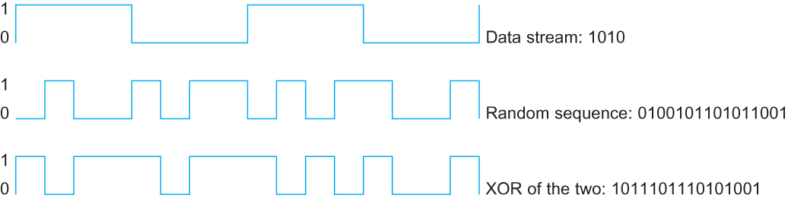
Wireless Links
Example 4-bit chipping sequence

Slide 149
Wireless Links
Wireless technologies differ in a variety of dimensions
How much bandwidth they provide
Distance – How far apart the communication nodes can be
Four prominent wireless technologies
Bluetooth
Wi-Fi (more formally known as 802.11)
WiMAX (802.16)
3G cellular wireless

Slide 150
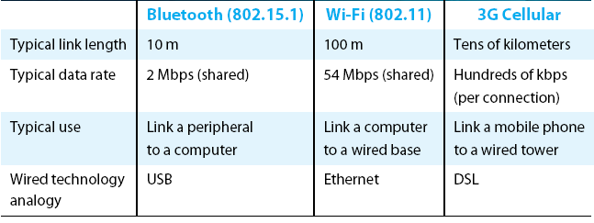
Wireless Links
Overview of leading wireless technologies

Slide 151
Wireless Links
Mostly widely used wireless links today are usually asymmetric
Two end-points are usually different kinds of nodes
One end-point usually has no mobility, but has wired connection to the Internet (known as base station)
The node at the other end of the link is often mobile

Slide 152
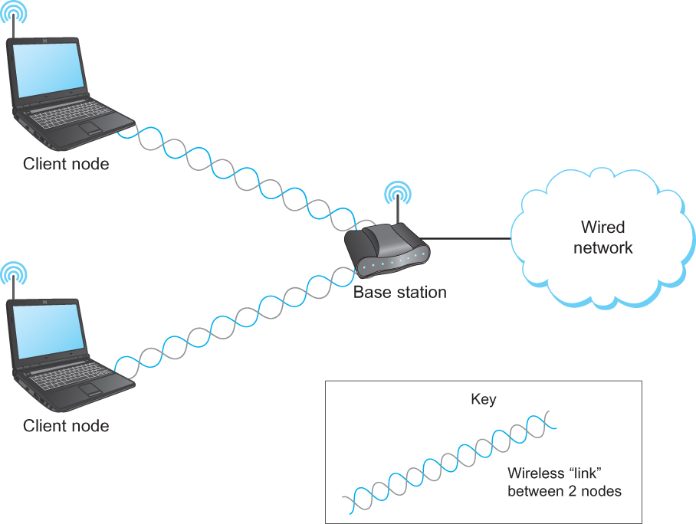
Wireless Links
A wireless network using a base station

Slide 153
Wireless Links
Wireless communication supports point-to-multipoint communication
Communication between non-base (client) nodes is routed via the base station
Three levels of mobility for clients
No mobility: the receiver must be in a fix location to receive a directional transmission from the base station (initial version of WiMAX)
Mobility is within the range of a base (Bluetooth)
Mobility between bases (Cell phones and Wi-Fi)

Slide 154
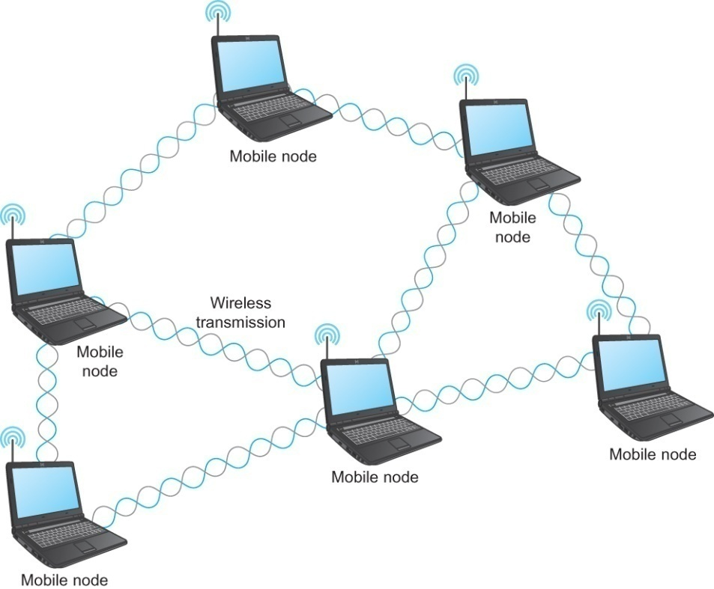
Wireless Links
Mesh or Ad-hoc network
Nodes are peers
Messages may be forwarded via a chain of peer nodes
A wireless ad-hoc or mesh network

Slide 155
IEEE 802.11
Also known as Wi-Fi
Like its Ethernet and token ring siblings, 802.11 is designed for use in a limited geographical area (homes, office buildings, campuses)
Primary challenge is to mediate access to a shared communication medium – in this case, signals propagating through space
802.11 supports additional features
power management and
security mechanisms

Slide 156
IEEE 802.11
Original 802.11 standard defined two radio-based physical layer standard
One using the frequency hopping
Over 79 1-MHz-wide frequency bandwidths
Second using direct sequence
Using 11-bit chipping sequence
Both standards run in the 2.4-GHz and provide up to 2 Mbps
Then physical layer standard 802.11b was added
Using a variant of direct sequence 802.11b provides up to 11 Mbps
Uses license-exempt 2.4-GHz band
Then came 802.11a which delivers up to 54 Mbps using OFDM
802.11a runs on license-exempt 5-GHz band
Most recent standard is 802.11g which is backward compatible with 802.11b
Uses 2.4 GHz band, OFDM and delivers up to 54 Mbps
Latest – 802.11n uses 2.4GHz, MIMO (a signal processing and smart antenna technique for transmitting multiple data streams through multiple antennas) , 300 Mbps

Slide 157
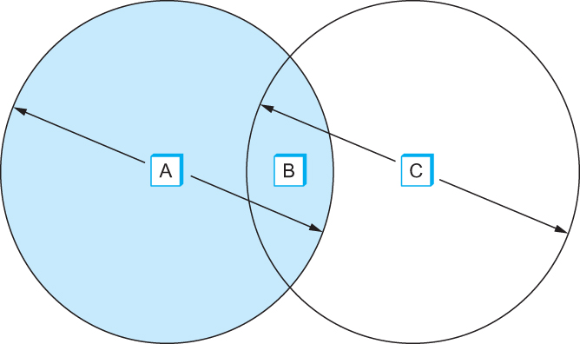
IEEE 802.11 – Collision Avoidance
Consider the situation in the following figure where each of four nodes is able to send and receive signals that reach just the nodes to its immediate left and right
For example, B can exchange frames with A and C, but it cannot reach D
C can reach B and D but not A
Example of a wireless network

Slide 158
IEEE 802.11 – Collision Avoidance
Suppose both A and C want to communicate with B and so they each send it a frame.
A and C are unaware of each other since their signals do not carry that far
These two frames collide with each other at B
But unlike an Ethernet, neither A nor C is aware of this collision
A and C are said to hidden nodes with respect to each other

Slide 159
IEEE 802.11 – Collision Avoidance
The “Hidden Node” Problem. Although A and C are hidden from each
other, their signals can collide at B. (B’s reach is not shown.)

Slide 160
IEEE 802.11 – Collision Avoidance
Another problem called exposed node problem occurs
Suppose B is sending to A. Node C is aware of this communication because it hears B’s transmission.
It would be a mistake for C to conclude that it cannot transmit to anyone just because it can hear B’s transmission.
Suppose C wants to transmit to node D.
This is not a problem since C’s transmission to D will not interfere with A’s ability to receive from B.

Slide 161
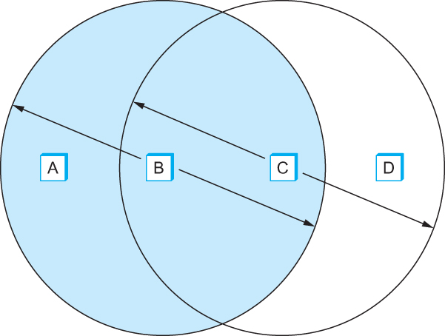
IEEE 802.11 – Collision Avoidance
Exposed Node Problem. Although B and C are exposed to each other’s
signals, there is no interference if B transmits to A while C transmits to D. (A and D’s
reaches are not shown.)

Slide 162
IEEE 802.11 – Collision Avoidance
802.11 addresses these two problems with an algorithm called Multiple Access with Collision Avoidance (MACA).
Key Idea
Sender and receiver exchange control frames with each other before the sender actually transmits any data.
This exchange informs all nearby nodes that a transmission is about to begin
Sender transmits a Request to Send (RTS) frame to the receiver.
The RTS frame includes a field that indicates how long the sender wants to hold the medium
- Length of the data frame to be transmitted
Receiver replies with a Clear to Send (CTS) frame
This frame echoes this length field back to the sender

Slide 163
IEEE 802.11 – Collision Avoidance
Any node that sees the CTS frame knows that
it is close to the receiver, therefore
cannot transmit for the period of time it takes to send a frame of the specified length
Any node that sees the RTS frame but not the CTS frame
is not close enough to the receiver to interfere with it, and
so is free to transmit

Slide 164
IEEE 802.11 – Collision Avoidance
Using ACK in MACA
Proposed in MACAW: MACA for Wireless LANs
Receiver sends an ACK to the sender after successfully receiving a frame
All nodes must wait for this ACK before trying to transmit
If two or more nodes detect an idle link and try to transmit an RTS frame at the same time
Their RTS frame will collide with each other
802.11 does not support collision detection
So the senders realize the collision has happened when they do not receive the CTS frame after a period of time
In this case, they each wait a random amount of time before trying again.
The amount of time a given node delays is defined by the same exponential backoff algorithm used on the Ethernet.

Slide 165
IEEE 802.11 – Distribution System
802.11 is suitable for an ad-hoc configuration of nodes that may or may not be able to communicate with all other nodes.
Nodes are free to move around
The set of directly reachable nodes may change over time
To deal with this mobility and partial connectivity,
802.11 defines additional structures on a set of nodes
Instead of all nodes being created equal,
some nodes are allowed to roam
some are connected to a wired network infrastructure
- they are called Access Points (AP) and they are connected to each other by a so-called distribution system

Slide 166
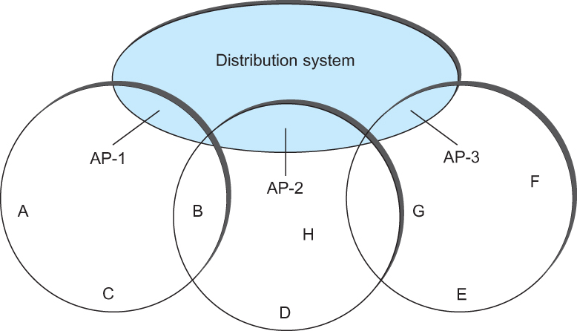
IEEE 802.11 – Distribution System
Following figure illustrates a distribution system that connects three access points, each of which services the nodes in the same region
Each of these regions is analogous to a cell in a cellular phone system with the APs playing the same role as a base station
The distribution network runs at layer 2 of the ISO architecture
Access points connected to a distribution network

Slide 167
IEEE 802.11 – Distribution System
Although two nodes can communicate directly with each other if they are within reach of each other, the idea behind this configuration is
Each nodes associates itself with one access point
For node A to communicate with node E, A first sends a frame to its AP-1 which forwards the frame across the distribution system to AP-3, which finally transmits the frame to E
Access points connected to a distribution network

Slide 168
IEEE 802.11 – Distribution System
How do the nodes select their access points
How does it work when nodes move from one cell to another
The technique for selecting an AP is called scanning
The node sends a Probe frame
All APs within reach reply with a Probe Response frame
The node selects one of the access points and sends that AP an Association Request frame
The AP replies with an Association Response frame
A node engages this protocol whenever
it joins the network, as well as
when it becomes unhappy with its current AP
This might happen, for example, because the signal from its current AP has weakened due to the node moving away from it
Whenever a node acquires a new AP, the new AP notifies the old AP of the change via the distribution system

Slide 169
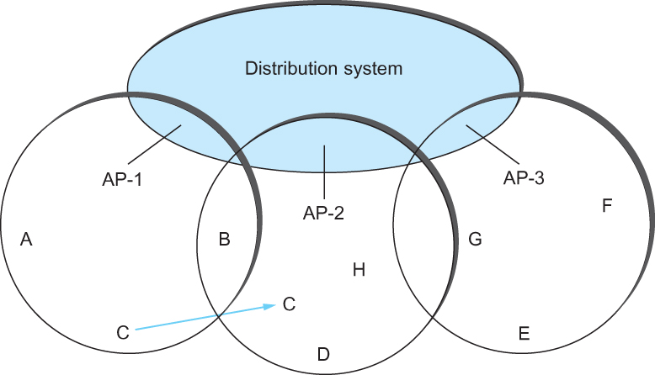
IEEE 802.11 – Distribution System
Consider the situation shown in the following figure when node C moves from the cell serviced by AP-1 to the cell serviced by AP-2.
As it moves, it sends Probe frames, which eventually result in Probe Responses from AP-2.
At some point, C prefers AP-2 over AP-1 , and so it associates itself with that access point.
This is called active scanning since the node is actively searching for an access point
Node Mobility

Slide 170
IEEE 802.11 – Distribution System
APs also periodically send a Beacon frame that advertises the capabilities of the access point; these include the transmission rate supported by the AP
This is called passive scanning
A node can change to this AP based on the Beacon frame simply by sending it an Association Request frame back to the access point.
Node Mobility

Slide 171
IEEE 802.11 – Frame Format
Source and Destinations addresses: each 48 bits
Data: up to 2312 bytes
CRC: 32 bit
Control field: 16 bits
Contains three subfields (of interest)
6 bit Type field: indicates whether the frame is an RTS or CTS frame or being used by the scanning algorithm
A pair of 1 bit fields : called ToDS and FromDS
Frame Format

Slide 172
IEEE 802.11 – Frame Format
Frame contains four addresses
How these addresses are interpreted depends on the settings of the ToDS and FromDS bits in the frame’s Control field
This is to account for the possibility that the frame had to be forwarded across the distribution system which would mean that,
the original sender is not necessarily the same as the most recent transmitting node
Same is true for the destination address
Simplest case
When one node is sending directly to another, both the DS bits are 0, Addr1 identifies the target node, and Addr2 identifies the source node

Slide 173
IEEE 802.11 – Frame Format
Most complex case
Both DS bits are set to 1
Indicates that the message went from a wireless node onto the distribution system, and then from the distribution system to another wireless node
With both bits set,
Addr1 identifies the ultimate destination,
Addr2 identifies the immediate sender (the one that forwarded the frame from the distribution system to the ultimate destination)
Addr3 identifies the intermediate destination (the one that accepted the frame from a wireless node and forwarded across the distribution system)
Addr4 identifies the original source
Addr1: E, Addr2: AP-3, Addr3: AP-1, Addr4: A

Slide 174
Bluetooth
Used for very short range communication between mobile phones, PDAs, notebook computers and other personal or peripheral devices
Operates in the license-exempt band at 2.45 GHz
Has a range of only 10 m
Communication devices typically belong to one individual or group
Sometimes categorized as Personal Area Network (PAN)
Version 2.0 provides speeds up to 2.1 Mbps
Power consumption is low

Slide 175
Bluetooth
Bluetooth is specified by an industry consortium called the Bluetooth Special Interest Group
It specifies an entire suite of protocols, going beyond the link layer to define application protocols, which it calls profiles, for a range of applications
There is a profile for synchronizing a PDA with personal computer
Another profile gives a mobile computer access to a wired LAN
The basic Bluetooth network configuration is called a piconet
Consists of a master device and up to seven slave devices
Any communication is between the master and a slave
The slaves do not communicate directly with each other
A slave can be parked: set to an inactive, low-power state

Slide 176
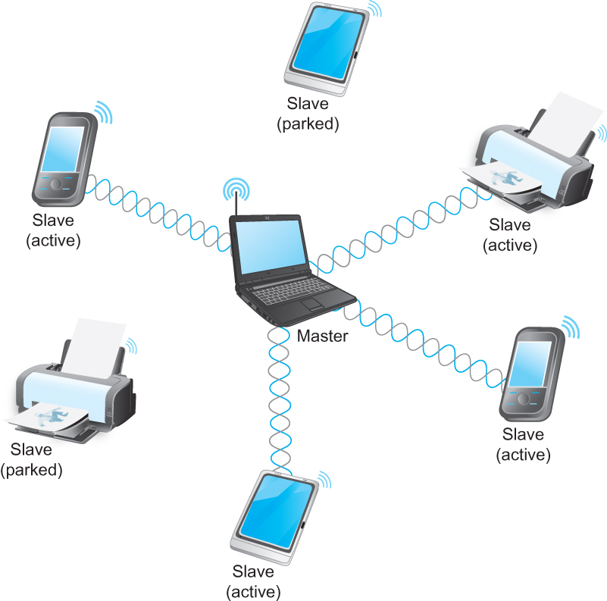
Bluetooth
A Bluetooth Piconet

Slide 177
ZigBee
ZigBee is a new technology that competes with Bluetooth
Devised by the ZigBee alliance and standardized as IEEE 802.15.4
It is designed for situations where the bandwidth requirements are low and power consumption must be very low to give very long battery life
It is also intended to be simpler and cheaper than Bluetooth, making it financially feasible to incorporate in cheaper devices such as a wall switch that wirelessly communicates with a ceiling-mounted fan

Slide 178
Summary
Introduced the many and varied type of links that are used to connect users to existing networks, and to construct large networks from scratch.
Looked at the five key issues that must be addressed so that two or more nodes connected by some medium can exchange messages with each other
Encoding
Framing
Error Detecting
Reliability
Multiple Access Links
Ethernet
Wireless 802.11, Bluetooth

Slide 179
Reference
Chapter – 2: Computer Networks A Systems Approach by Larry L. Peterson and Bruce S. Davie, 4Th Edition, Morgan Kaufmann Publications.

