Slide 1
Packet switching

Slide 2
Oultine
Switching and Forwarding
Bridges and LAN Switches
Cell Switches (ATM)

Slide 3
Switching and Forwarding

Slide 4
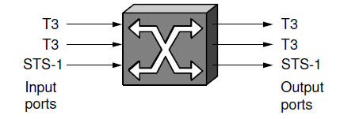
Switch
A mechanism that allows us to interconnect links to form a large network
A multi-input, multi-output device which transfer packets from an input to one or more outputs

Slide 5
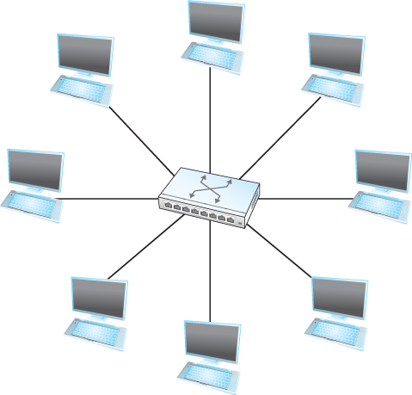
Switching and Forwarding
Adds the star topology to the point-to-point link, bus(Ethernet), and ring (802.5 and FDDI) topologies

Slide 6
Properties of Star Topology
A switch has a fixed number of inputs and outputs
which limits the number of hosts that can be connected to a single switch
Large networks can be build by interconnecting a number of switches
We can connect switches to each other and to hosts using point-to-point links
which typically means that we can build network of large geographic scope
Adding a new host to the network by connecting it to a switch does not necessarily mean that the hosts already connected will get worse performance from the network

Slide 7
Switching and Forwarding
It is impossible for two hosts on the same Ethernet to transmit continuously at 10Mbps because they share the same transmission medium
Every host on a switched network has its own link to the switch
So it may be entirely possible for many hosts to transmit at the full link speed (Bandwidth) provided that the switch is designed with enough aggregate capacity

Slide 8
Switching and Forwarding
A switch is connected to a set of links and for each of these links, runs the appropriate data link protocol to communicate with that node
A switch’s primary job is to receive incoming packets on one of its links and to transmit them on some other link
This function is referred as switching and forwarding
According to OSI architecture this is the main function of the network layer

Slide 9
Switching and Forwarding
How does the switch decide which output port to place each packet on?
It looks at the header of the packet for an identifier that it uses to make the decision
Two common approaches
Datagram or Connectionless approach
Virtual circuit or Connection-oriented approach
A third approach source routing is less common

Slide 10
Switching and Forwarding
Assumptions
Each host has a globally unique address
There is some way to identify the input and output ports of each switch
We can use numbers
We can use names

Slide 11
Switching and Forwarding
Datagrams
Key Idea
Every packet contains enough information to enable any switch to decide how to get it to destination
Every packet contains the complete destination address

Slide 12
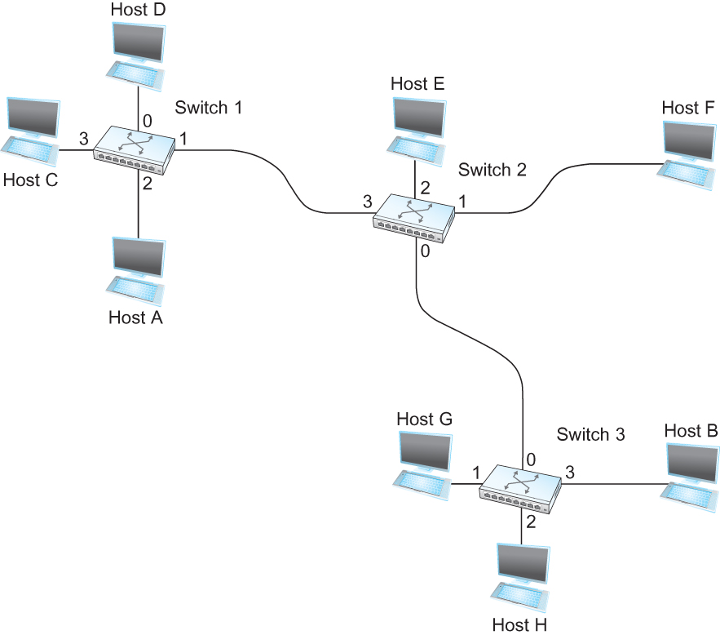
Switching and Forwarding
An example network
To decide how to forward a packet, a switch consults a forwarding table (sometimes called a routing table)

Slide 13
Switching and Forwarding
Destination Port
-------------------------------------
A 3
B 0
C 3
D 3
E 2
F 1
G 0
H 0
Forwarding Table for Switch 2

Slide 14
Characteristics of Connectionless (datagram) Network
A host can send a packet anywhere at any time, since any packet that turns up at the switch can be immediately forwarded (assuming a correctly populated forwarding table)
When a host send a packet, it has no way of knowing if the network is capable of delivering it or if the destination host even up and running
Each packet is forwarded independently of previous packets that might have been sent to the same destination
Thus two successive packets from host A to host B may follow completely different paths
A switch or link failure might not have any serious effect on communication if it is possible to find an alternate route around the failure and update the forwarding table accordingly.

Slide 15
Switching and Forwarding
Virtual Circuit Switching
Widely used technique for packet switching
Uses the concept of Virtual circuit (VC)
Also called a connection oriented model
First set up a virtual connection from the source host to the destination host and then send the data

Slide 16
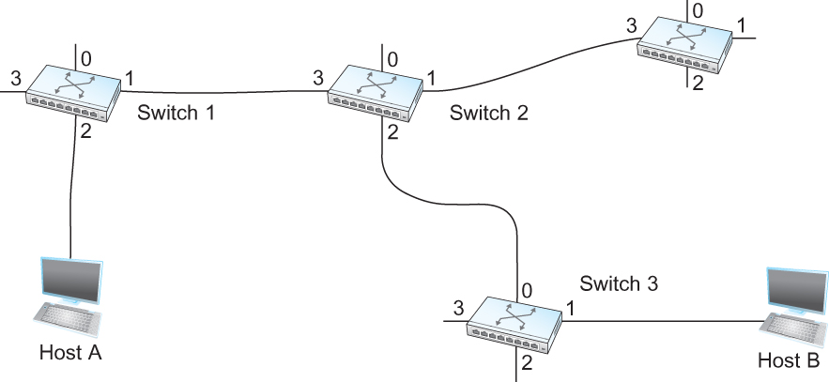
Switching and Forwarding
Host A wants to send packets to host B

Slide 17
Switching and Forwarding
Two- stage process
Connection setup
Data Transfer
Connection Setup
Establish “connection state” in each of the switches between the source and destination hosts
The connection state for a single connection consists of an entry in the “VC table” in each switch through which the connection passes

Slide 18
Switching and Forwarding
One entry in the VC table on a single switch contains
A virtual circuit identifier (VCI) that uniquely identifies the connection at this switch and that will be carried inside the header of the packets that belong to this connection
An incoming interface on which packets for this VC arrive at the switch
An outgoing interface in which packets for this VC leave this switch
A potentially different VCI that will be used for outgoing packets

Slide 19
Switching and Forwarding
The semantics for one such entry is
If a packet arrives on the designated incoming interface and that packet contains the designated VCI value in its header, then the packet should be sent out the specified outgoing interface with the specified outgoing VCI value first having been placed in its header

Slide 20
Switching and Forwarding
Note:
The combination of the VCI of the packets as they are received at the switch and the interface on which they are received uniquely identifies the virtual connection
There may be many virtual connections established in the switch at one time
Incoming and outgoing VCI values are not generally the same
VCI is not a globally significant identifier for the connection; rather it has significance only on a given link
Whenever a new connection is created, we need to assign a new VCI for that connection on each link that the connection will traverse
We also need to ensure that the chosen VCI on a given link is not currently in use on that link by some existing connection

Slide 21
Switching and Forwarding
Two broad classes of approach to establish connection state
Network Administrator will configure the state
The virtual circuit is permanent (PVC)
The network administrator can delete this
Can be thought of as a long-lived or administratively configured VC
A host can send message into the network to cause the state to be established
This is referred as signalling and the resulting virtual circuit is said to be switched (SVC)
A host may set up and delete such a VC dynamically without the involvement of a network administrator

Slide 22
Switching and Forwarding
Let’s assume that a network administrator wants to manually create a new virtual connection from host A to host B
First the administrator identifies a path through the network from A to B
11
5
7
4

Slide 23
Switching and Forwarding
The administrator then picks a VCI value that is currently unused on each link for the connection
For our example:
Suppose the VCI value 5 is chosen for the link from host A to switch 1
11 is chosen for the link from switch 1 to switch 2
So the switch 1 will have an entry in the VC table
Incoming Interface | Incoming VC | Outgoing Interface | Outgoing VC
2 | 5 | 1 | 11

Slide 24
Switching and Forwarding
Similarly, suppose
VCI of 7 is chosen to identify this connection on the link from switch 2 to switch 3
VCI of 4 is chosen for the link from switch 3 to host B
Switches 2 and 3 are configured with the following VC tables
Incoming Interface | Incoming VC | Outgoing Interface | Outgoing VC
3 | 11 | 2 | 7
Incoming Interface | Incoming VC | Outgoing Interface | Outgoing VC
0 | 7 | 1 | 4

Slide 25
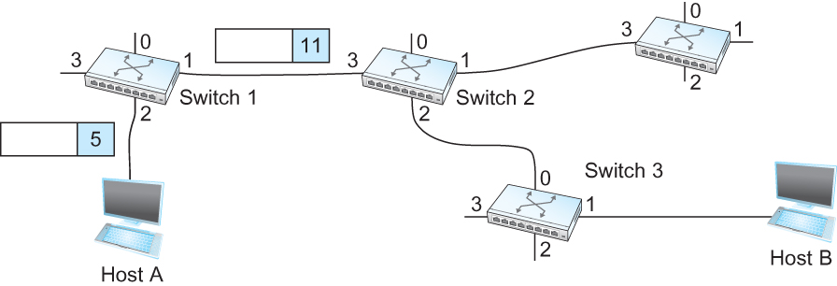
Switching and Forwarding
For any packet that A wants to send to B, A puts the VCI value 5 in the header of the packet and sends it to switch 1
Switch 1 receives any such packet on interface 2, and it uses the combination of the interface and the VCI in the packet header to find the appropriate VC table entry.
The table entry on switch 1 tells the switch to forward the packet out of interface 1 and to put the VCI value 11 in the header

Slide 26
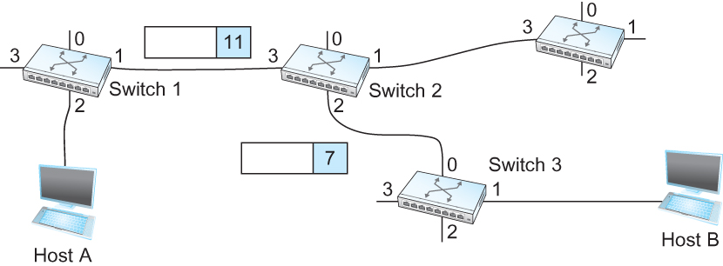
Switching and Forwarding
Packet will arrive at switch 2 on interface 3 bearing VCI 11
Switch 2 looks up interface 3 and VCI 11 in its VC table and sends the packet on to switch 3 after updating the VCI value appropriately
This process continues until it arrives at host B with the VCI value of 4 in the packet
To host B, this identifies the packet as having come from host A

Slide 27
Switching and Forwarding
In real networks of reasonable size, the burden of configuring VC tables correctly in a large number of switches would quickly become excessive
Thus, some sort of signalling is almost always used, even when setting up “permanent” VCs
In case of PVCs, signalling is initiated by the network administrator
Switched Virtual Circuits (SVCs) are usually set up using signalling by one of the hosts

Slide 28
Switching and Forwarding
How does the signalling work
To start the signalling process, host A sends a setup message into the network (i.e. to switch 1)
The setup message contains (among other things) the complete destination address of B.
The setup message needs to get all the way to B to create the necessary connection state in every switch along the way
It is like sending a datagram to B where every switch knows which output to send the setup message so that it eventually reaches B
Assume that every switch knows the topology to figure out how to do that
When switch 1 receives the connection request, in addition to sending it on to switch 2, it creates a new entry in its VC table for this new connection
The entry is exactly the same shown in the previous table
Switch 1 picks the value 5 for this connection

Slide 29
Switching and Forwarding
How does the signalling work (contd.)
When switch 2 receives the setup message, it performs the similar process and it picks the value 11 as the incoming VCI
Similarly switch 3 picks 7 as the value for its incoming VCI
Each switch can pick any number it likes, as long as that number is not currently in use for some other connection on that port of that switch
Finally the setup message arrives at host B.
Assuming that B is healthy and willing to accept a connection from host A, it allocates an incoming VCI value, in this case 4.
This VCI value can be used by B to identify all packets coming from A

Slide 30
Switching and Forwarding
Now to complete the connection, everyone needs to be told what their downstream neighbor is using as the VCI for this connection
Host B sends an acknowledgement of the connection setup to switch 3 and includes in that message the VCI value that it chose (4)
Switch 3 completes the VC table entry for this connection and sends the acknowledgement on to switch 2 specifying the VCI of 7
Switch 2 completes the VC table entry for this connection and sends acknowledgement on to switch 1 specifying the VCI of 11
Finally switch 1 passes the acknowledgement on to host A telling it to use the VCI value of 5 for this connection

Slide 31
Switching and Forwarding
When host A no longer wants to send data to host B, it tears down the connection by sending a teardown message to switch 1
The switch 1 removes the relevant entry from its table and forwards the message on to the other switches in the path which similarly delete the appropriate table entries
At this point, if host A were to send a packet with a VCI of 5 to switch 1, it would be dropped as if the connection had never existed

Slide 32
Switching and Forwarding
Characteristics of VC
Since host A has to wait for the connection request to reach the far side of the network and return before it can send its first data packet, there is at least one RTT of delay before data is sent
While the connection request contains the full address for host B (which might be quite large, being a global identifier on the network), each data packet contains only a small identifier, which is only unique on one link.
Thus the per-packet overhead caused by the header is reduced relative to the datagram model
If a switch or a link in a connection fails, the connection is broken and a new one will need to be established.
Also the old one needs to be torn down to free up table storage space in the switches
The issue of how a switch decides which link to forward the connection request on has similarities with the function of a routing algorithm

Slide 33
Switching and Forwarding
Good Properties of VC
By the time the host gets the go-ahead to send data, it knows quite a lot about the network-
For example, that there is really a route to the receiver and that the receiver is willing to receive data
It is also possible to allocate resources to the virtual circuit at the time it is established

Slide 34
Switching and Forwarding
For example, an X.25 network – a packet-switched network that uses the connection-oriented model – employs the following three-part strategy
Buffers are allocated to each virtual circuit when the circuit is initialized
The sliding window protocol is run between each pair of nodes along the virtual circuit, and this protocol is augmented with the flow control to keep the sending node from overrunning the buffers allocated at the receiving node
The circuit is rejected by a given node if not enough buffers are available at that node when the connection request message is processed

Slide 35
Switching and Forwarding
Comparison with the Datagram Model
Datagram network has no connection establishment phase and each switch processes each packet independently
Each arriving packet competes with all other packets for buffer space
If there are no buffers, the incoming packet must be dropped
In VC, we could imagine providing each circuit with a different quality of service (QoS)
The network gives the user some kind of performance related guarantee
Switches set aside the resources they need to meet this guarantee
For example, a percentage of each outgoing link’s bandwidth
Delay tolerance on each switch
Most popular examples of VC technologies are Frame Relay and ATM
One of the applications of Frame Relay is the construction of VPN

Slide 36
ATM
ATM (Asynchronous Transfer Mode)
Connection-oriented packet-switched network
Packets are called cells
5 byte header + 48 byte payload
Fixed length packets are easier to switch in hardware
Simpler to design
Enables parallelism

Slide 37
ATM
User – Network Interface (UNI)
Host-to-switch format
GFC: Generic Flow Control
VPI: Virtual Path Identifier
VCI: Virtual Circuit Identifier
Type: management, congestion control
CLP: Cell Loss Priority
HEC: Header Error Check (CRC-8)
Network – Network Interface (NNI)
Switch-to-switch format
GFC becomes part of VPI field
ATM Cell Format

Slide 38
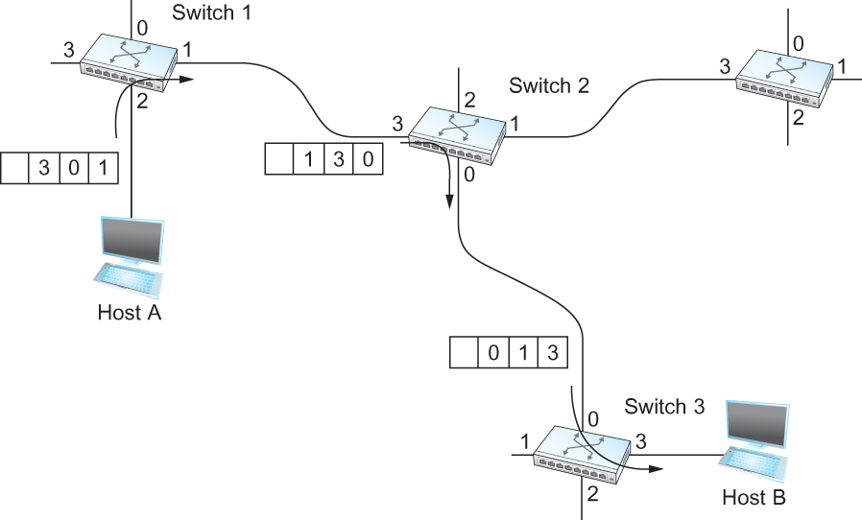
Source Routing
All the information about network topology that is required to switch a packet across the network is provided by the source host

Slide 39
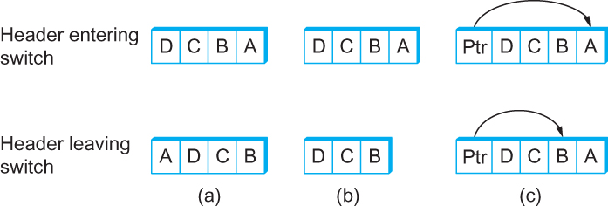
Source Routing
Other approaches in source routing
Three ways to handle headers for source routing
a) Rotation
b) Stripping
c) Pointer
The labels are read right to left

Slide 40
Bridges and LAN Switches

Slide 41
Bridges and LAN Switches
Class of switches that is used to forward packets between shared-media LANs such as Ethernets
Known as LAN switches
Referred to as Bridges
Suppose you have a pair of Ethernets that you want to interconnect
One approach is put a repeater in between them
It might exceed the physical limitation of the Ethernet
No more than four repeaters between any pair of hosts
No more than a total of 2500m in length is allowed

Slide 42
Bridges and LAN Switches
An alternative would be to put a node between the two Ethernets and have the node forward frames from one Ethernet to the other
This node is called a bridge
A collection of LANs connected by one or more bridges is usually said to form an extended LAN

Slide 43
Bridges and LAN Switches
Simplest Strategy for Bridges
Accept LAN frames on their inputs and forward them out to all other outputs
Used by early bridges
Learning Bridges
Observe that there is no need to forward all the frames that a bridge receive

Slide 44
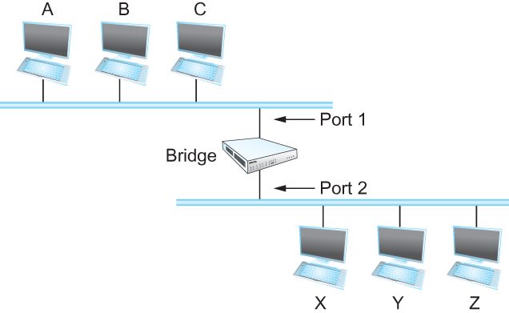
Bridges and LAN Switches
Consider the following figure
When a frame from host A that is addressed to host B arrives on port 1 there is no need for the bridge to forward the frame out over port 2
How does a bridge come to learn on which port the various hosts reside?

Slide 45
Bridges and LAN Switches
Solution
Download a table into the bridge
Who does the download
Human
Too much work for maintenance
Host | Port
A | 1
B | 1
C | 1
X | 2
Y | 2
Z | 2

Slide 46
Bridges and LAN Switches
Can the bridge learn this information by itself?
Yes
How
Each bridge inspects the source address in all the frames it receives
Record the information at the bridge and build the table
Entries are added over time
A timeout is associated with each entry
The bridge discards the entry after a specified period of time
To protect against the situation in which a host is moved from one network to another

Slide 47
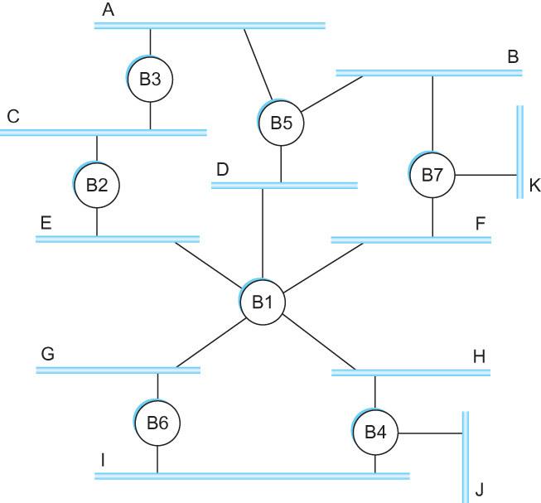
Bridges and LAN Switches
If the bridge receives a frame that is addressed to host not currently in the table
Forward the frame out on all other ports
Strategy works fine if the extended LAN does not have a loop in it
Why?
Frames potentially loop through the extended LAN forever
Bridges B1, B4 and B6 form a loop

Slide 48
Bridges and LAN Switches
How does an extended LAN come to have a loop in it?
Network is managed by more than one administrator
For example, it spans multiple departments in an organization
It is possible that no single person knows the entire configuration of the network
A bridge that closes a loop might be added without any one knowing
Loops are built into the network to provide redundancy in case of failures
Solution
Distributed Spanning Tree Algorithm

Slide 49
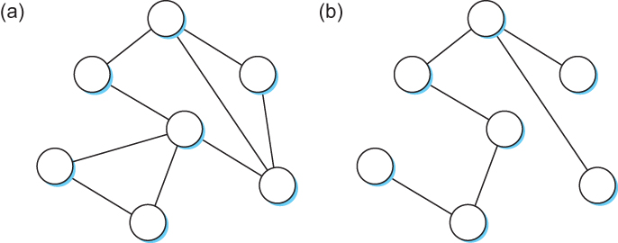
Spanning Tree Algorithm
Think of the extended LAN as being represented by a graph that possibly has loops (cycles)
A spanning tree is a sub-graph of this graph that covers all the vertices but contains no cycles
Spanning tree keeps all the vertices of the original graph but throws out some of the edges
Example of (a) a cyclic graph; (b) a corresponding spanning tree.

Slide 50
Spanning Tree Algorithm
Developed by Radia Perlman at Digital
a protocol used by a set of bridges to agree upon a spanning tree for a particular extended LAN
IEEE 802.1 specification for LAN bridges is based on this algorithm
Each bridge decides the ports over which it is and is not willing to forward frames
In a sense, it is by removing ports from the topology that the extended LAN is reduced to an acyclic tree
It is even possible that an entire bridge will not participate in forwarding frames

Slide 51
Spanning Tree Algorithm
Algorithm is dynamic
The bridges are always prepared to reconfigure themselves into a new spanning tree if some bridges fail
Main idea
Each bridge selects the ports over which they will forward the frames

Slide 52
Spanning Tree Algorithm
Algorithm selects ports as follows:
Each bridge has a unique identifier
B1, B2, B3,…and so on.
Elect the bridge with the smallest id as the root of the spanning tree
The root bridge always forwards frames out over all of its ports
Each bridge computes the shortest path to the root and notes which of its ports is on this path
This port is selected as the bridge’s preferred path to the root
Finally, all the bridges connected to a given LAN elect a single designated bridge that will be responsible for forwarding frames toward the root bridge

Slide 53
Spanning Tree Algorithm
Each LAN’s designated bridge is the one that is closest to the root
If two or more bridges are equally close to the root,
Then select bridge with the smallest id
Each bridge is connected to more than one LAN
So it participates in the election of a designated bridge for each LAN it is connected to.
Each bridge decides if it is the designated bridge relative to each of its ports
The bridge forwards frames over those ports for which it is the designated bridge

Slide 54
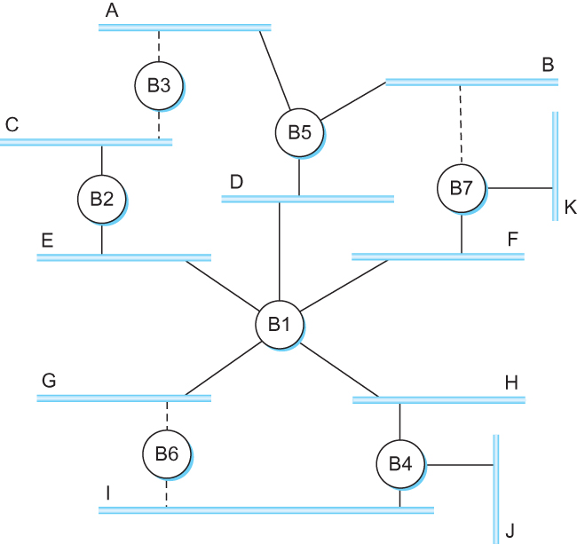
Spanning Tree Algorithm
B1 is the root bridge
B3 and B5 are connected to LAN A, but B5 is the designated bridge
B5 and B7 are connected to LAN B, but B5 is the designated bridge

Slide 55
Spanning Tree Algorithm
Initially each bridge thinks it is the root, so it sends a configuration message on each of its ports identifying itself as the root and giving a distance to the root of 0
Upon receiving a configuration message over a particular port, the bridge checks to see if the new message is better than the current best configuration message recorded for that port
The new configuration is better than the currently recorded information if
It identifies a root with a smaller id or
It identifies a root with an equal id but with a shorter distance or
The root id and distance are equal, but the sending bridge has a smaller id

Slide 56
Spanning Tree Algorithm
If the new message is better than the currently recorded one,
The bridge discards the old information and saves the new information
It first adds 1 to the distance-to-root field
When a bridge receives a configuration message indicating that it is not the root bridge (that is, a message from a bridge with smaller id)
The bridge stops generating configuration messages on its own
Only forwards configuration messages from other bridges after 1 adding to the distance field

Slide 57
Spanning Tree Algorithm
When a bridge receives a configuration message that indicates it is not the designated bridge for that port
=> a message from a bridge that is closer to the root or equally far from the root but with a smaller id
The bridge stops sending configuration messages over that port
When the system stabilizes,
Only the root bridge is still generating configuration messages.
Other bridges are forwarding these messages only over ports for which they are the designated bridge

Slide 58
Spanning Tree Algorithm
Consider the situation when the power had just been restored to the building housing the following network
All bridges would start off by claiming to be the root

Slide 59
Spanning Tree Algorithm
Denote a configuration message from node X in which it claims to be distance d from the root node Y as (Y, d, X)
Consider the activity at node B3

Slide 60
Spanning Tree Algorithm
B3 receives (B2, 0, B2)
Since 2 < 3, B3 accepts B2 as root
B3 adds 1 to the distance advertised by B2 and sends (B2, 1, B3) to B5
Meanwhile B2 accepts B1 as root because it has the lower id and it sends (B1, 1, B2) toward B3
B5 accepts B1 as root and sends (B1, 1, B5) to B3
B3 accepts B1 as root and it notes that both B2 and B5 are closer to the root than it is.
Thus B3 stops forwarding messages on both its interfaces
This leaves B3 with both ports not selected

Slide 61
Spanning Tree Algorithm
Even after the system has stabilized, the root bridge continues to send configuration messages periodically
Other bridges continue to forward these messages
When a bridge fails, the downstream bridges will not receive the configuration messages
After waiting a specified period of time, they will once again claim to be the root and the algorithm starts again
Note
Although the algorithm is able to reconfigure the spanning tree whenever a bridge fails, it is not able to forward frames over alternative paths for the sake of routing around a congested bridge

Slide 62
Broadcast and Multicast
Forwarding all broadcast/multicast frames
Current practice
Learn when no group members downstream
Accomplished by having each member of group G and send a frame to bridge multicast address with G in source field

Slide 63
Limitation of Bridges
Do not scale
Spanning tree algorithm does not scale
Broadcast does not scale
Do not accommodate heterogeneity

Slide 64
Cell Switching (ATM)

Slide 65
Cell Switching (ATM)
1980s and early 1990s; embraced by telephone industry
Used in both WAN and LAN setting
Specified by ATM forum
Connection-oriented (virtual circuit switching), packet-switched network
Signalling (Connection setup) protocol: Q.2931
Packets are called cells: 5-byte header + 48-byte payload
Commonly transmitted over SONET
Other physical layers possible

Slide 66
Variable Vs Fixed-Length Packets
No optimal length => variable-length packet
If small: high header-to-data overhead
If large: low utilization for small messages
Fixed-Length Easier to Switch in Hardware
Simpler to implement
Enables parallelism (since length is known and fixed)

Slide 67
Big Vs Small Packets
Small Improves Queue behavior
finer-grained preemption point for scheduling link
maximum packet = 4KB
Link speed = 100Mbps
transmission time = 4096 x 8/100 = 327.68us
High priority packet may sit in the queue 327.68us
In contrast, 53 x 8/100 = 4.24us for ATM
near cut-through behavior
two 4KB packets arrive at same time
link idle for 327.68us while both arrive
Because the switch must wait to receive the whole first packet before starting transmitting it
at end of 327.68us, still have 8KB to transmit
in contrast, can transmit first cell after 4.24us
at end of 327.68us, just over 4KB left in queue

Slide 68
Big Vs Small Packets
Small Reduces Latency (for voice)
voice digitally encoded at 64KBps (8-bit samples at 8KHz)
need full cell’s worth of samples before sending cell
example: 1000-byte cells implies 125ms per cell (too long)
smaller latency implies no need for echo cancellers (since a very small latency feels like “0 latency”)
ATM Compromise: 48 bytes
US: would like it to be 64 bytes (has echo canceller, thus can afford large packets to reduce header-to-payload ratio)
Europe: advocates 32 bytes (no echo canceller, thus need small packet)
Compromise: 48 = (32+64)/2

Slide 69

Cell Format
User-Network Interface (UNI): host-to-switch format
GFC: Generic Flow Control (still being defined)
VPI: Virtual Path Identifier
VCI: Virtual Circuit Identifier
Type: management, congestion control, AAL5 (later)
CLP: Cell Loss Priority
HEC: Header Error Check (CRC-8)
Network-Network Interface (NNI): switch-to-switch format
GFC becomes part of VPI field

Slide 70
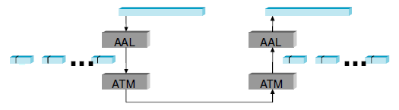
Segmentation and Reassembly
Accomplished by ATM Adaptation Layer (AAL)
Two sub layers:
Higher layer: Convergence Sub layer (CS)
responsible for packaging the higher layer PDU (protocol data unit) with additional information required for the adaptation necessary for specific service types (e.g., bit rate, connection-oriented or connectionless)
Lower layer: Segmentation and Reassembly (SAR)

Slide 71
Different Types of AALs
AAL 1 and 2 designed for applications that need guaranteed rate (e.g., voice, video)
AAL 3/4 designed for data packet
AAL 5 is an alternative standard for data packet

Slide 72

AAL 3/4
Convergence Sub layer Protocol Data Unit (CS-PDU)
CPI: common part indicator (version field); not used yet
Btag/Etag: beginning and ending tag (deal with cell corruption)
BAsize: hint on amount of buffer space to allocate
Length: size of whole PDU

Slide 73

SAR: Cell Format --- payload
Type
BOM: beginning of message
COM: continuation of message
EOM end of message
SEQ: sequence number
MID: multiplexing identifier
Length: number of bytes of payload (from CS-PDU) in this cell; in bytes

Slide 74
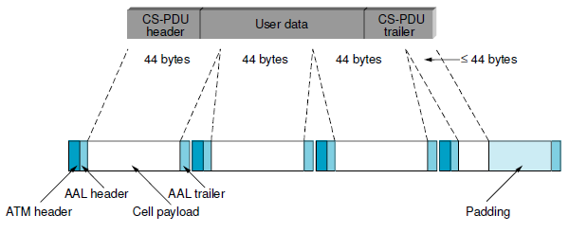
Encapsulation & segmentation for AAL3/4

Slide 75

AAL5
Simplifies the format of AAL ¾
CS-PDU Format
Pad, so trailer always falls at end of ATM cell
Len: size of PDU (data only); in bytes
CRC-32 (detects missing or misordered cells)
SAR: Cell Format --- payload
end-of-PDU bit in Type field of ATM header
Compared with AAL 3/4 , AAL 5 does not provide an additional level of multiplexing onto one virtual circuit (which was achieved via MID in AAL¾)

Slide 76
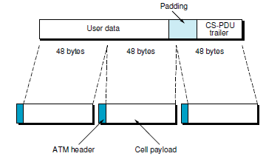
Encapsulation & segmentation for AAL 5

Slide 77
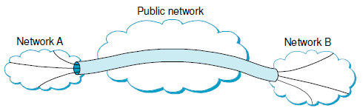
Virtual path
Two-level hierarchy of virtual connections
Virtual path (VP)
Virtual circuit (VC)
Switches in public network only maintains state about VPs, which is much fewer than the number of VCs
Thus, improves systems scalability

Slide 78
Cell Switching
Implementation and Performance

Slide 79
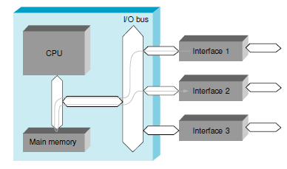
A workstation used as a packet switch
Flexible in trying out different routing/switching strategies
Experimental systems
(-) high switching overhead, and thus potentially low throughput

Slide 80
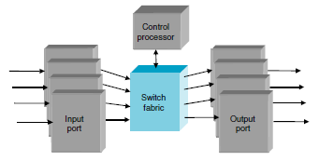
A 4×4 switch
Input ports: switching logic control (e.g., which output ports to forward packets); usually do not buffer packets
Switch fabric: forward packets from input ports to output ports; may have internal buffer space
Output ports: buffering

Slide 81
Switch Fabrics
Shared Bus
This type of switches used in conventional workstation
Bandwidth determines the throughput of the switch
Shared Memory
Packets are written into a memory location by an input port and then read from memory by the output ports
Memory bandwidth determines switch throughput
Crossbar:
Switch is a matrix of pathways that can be configured to connect any input port to any output port

Slide 82
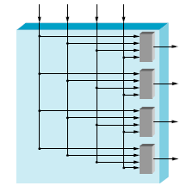
Crossbar Switch
A 4 x 4 Crossbar Switch

Slide 83
Switch Fabrics
Self-routing:
Rely on some information in the packet header to direct each packet to its correct output

Slide 84
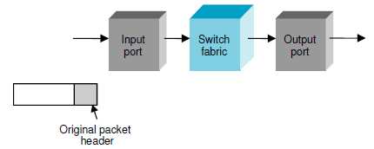
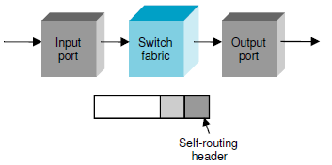
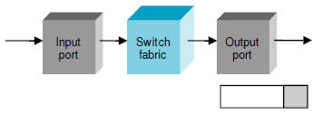
Switch fabrics (contd.)
Self-routing header is applied to a packet at input to enable the fabric to send the packet to the correct output, where it is removed
Packet arrives at the input port
Input port attaches self-routing header to direct packet to correct output
Self-routing header is removed at output port before packet leaves switch

Slide 85
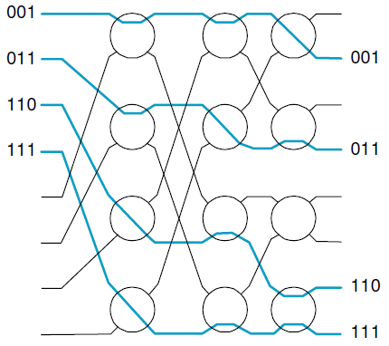
Switch fabrics (contd.)
Banyan Network: switch elements in 1st column looks at the most significant bit of output port number: 0 -> route packet to the top; 1 -> route to bottom …
Batcher-Banyan Switch design: Batcher network first sorts packets (for parallel tx.), then the packets are sent to Banyan network

Slide 86
Reference
Chapter – 3: Computer Networks A Systems Approach by Larry L. Peterson and Bruce S. Davie, 4Th Edition, Morgan Kaufmann Publications.

