Slide 1
internetworking

Slide 2
Outline
Simple Internetworking (IP)
Routing
Multicast

Slide 3
Simple Internetworking (IP)
What is an Internetwork

Slide 4
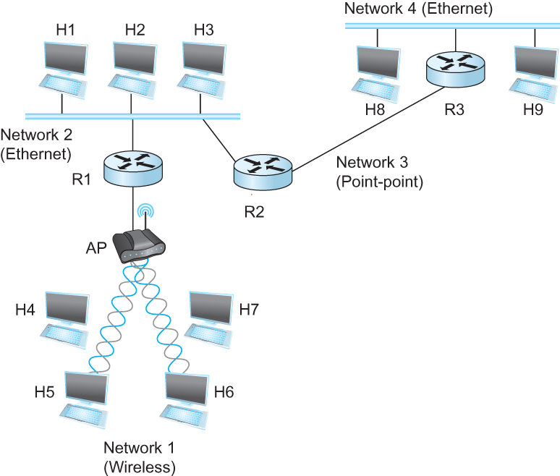
What is Internetworking
An arbitrary collection of networks interconnected to provide some sort of host – host packet delivery service
A simple internetwork where H represents hosts and R represents routers

Slide 5
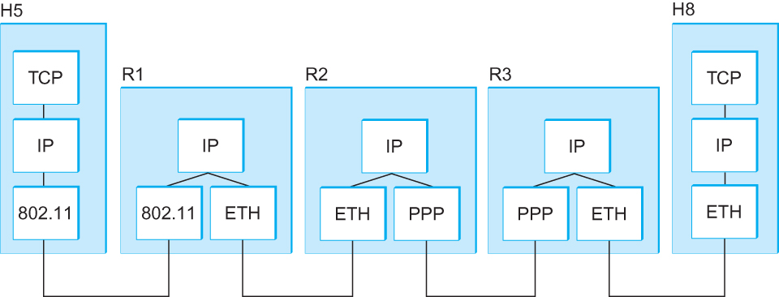
What is IP
IP stands for Internet Protocol
Key tool used today to build scalable, heterogeneous internetworks
It runs on all the nodes in a collection of networks and defines the infrastructure that allows these nodes and networks to function as a single logical internetwork
A simple internetwork showing the protocol layers

Slide 6
IP Service Model
Packet Delivery Model
Connectionless model for data delivery
Best-effort delivery (unreliable service)
Packets are lost
Packets are delivered out of order
Duplicate copies of a packet are delivered
Packets can be delayed for a long time
Global Addressing Scheme
Provides a way to identify all hosts in the network

Slide 7
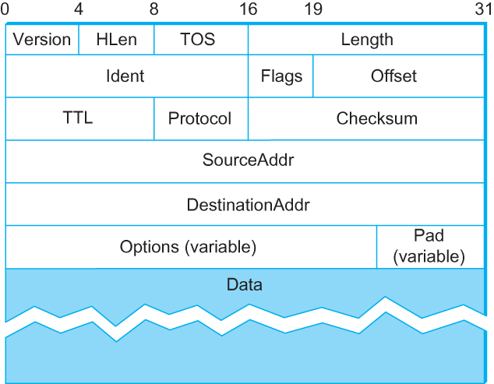
Packet Format (IPv4)
Version (4)
Hlen(4): number of 32-bit words in header
TOS(8): Type of service (not widely used)
Length(16): number of bytes in this datagram
Idnet(16): used by fragmentation
Flags/Offset(16): used by fragmentation
TTL(8): number of hops this datagram has traveled
Protocol(8): demux key (TCP=6, UDP=17)
Checksum(16): of the header only
DestAddr & SrcAddr (32)

Slide 8
IP Fragmentation and Reassembly
Each network has some MTU (Maximum Transmission Unit)
Ethernet (1500 bytes), FDDI (4500 bytes)
Strategy
Fragmentation occurs in a router when it receives a datagram that it wants to forward over a network which has (MTU < datagram)
Reassembly is done at the receiving host
All the fragments carry the same identifier in the Ident field
Fragments are self-contained datagrams
IP does not recover from missing fragments

Slide 9
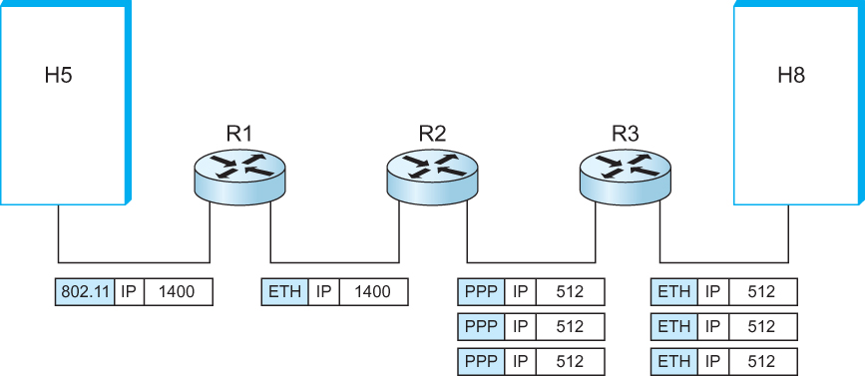
IP Fragmentation and Reassembly
IP datagrams traversing the sequence of physical networks

Slide 10
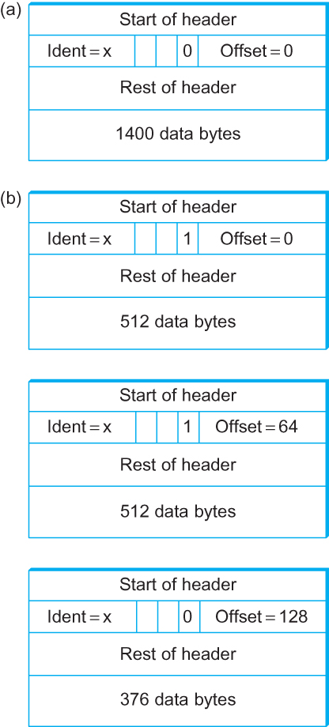
IP Fragmentation and Reassembly
Header fields used in IP fragmentation. (a) Unfragmented packet; (b) fragmented packets.

Slide 11
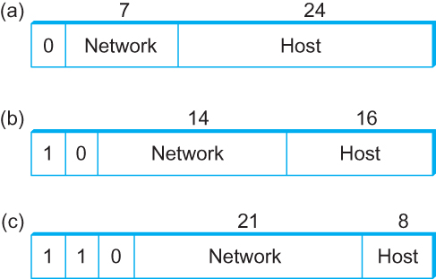
Global Addresses
Properties
Globally unique
Hierarchical: network + host
4 Billion IP address, half are A type, ¼ is B type, and 1/8 is the C type
Format
Dot notation
10.3.2.4
128.96.33.81
192.12.69.77

Slide 12
IP Datagram Forwarding
Strategy
Every datagram contains destination’s address
If directly connected to destination network, then forward to host
If not directly connected to destination network, then forward to some router
Forwarding table maps network number into next hop
Each host has a default router
Each router maintains a forwarding table
Example (router R2)
NetworkNum | NextHop
1 | R1
2 | Interface 1
3 | Interface 0
4 | R3

Slide 13
IP Datagram Forwarding - Algorithm
if (NetworkNum of destination = NetworkNum of one of my interfaces) then
deliver packet to destination over that interface
else
if (NetworkNum of destination is in my forwarding table) then
deliver packet to NextHop router
else
deliver packet to default router
For a host with only one interface and only a default router in its forwarding table, this simplifies to
if (NetworkNum of destination = my NetworkNum)then
deliver packet to destination directly
else
deliver packet to default router

Slide 14
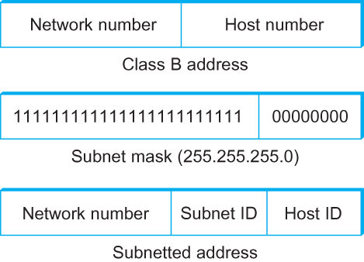
Subnetting
Add another level to address/routing hierarchy: subnet
Subnet masks define variable partition of host part of class A and B addresses
Subnets visible only within site

Slide 15
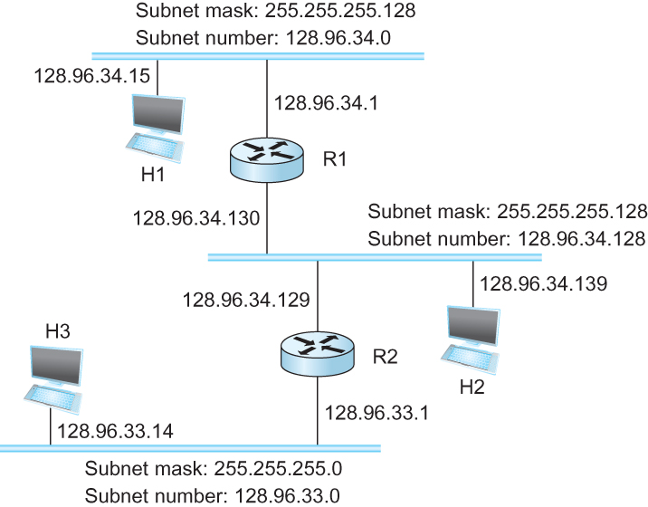
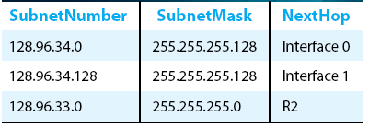
Subnetting
Forwarding Table at Router R1

Slide 16
Subnetting
Forwarding Algorithm
D = destination IP address
for each entry < SubnetNum, SubnetMask, NextHop>
D1 = SubnetMask & D
if D1 = SubnetNum
if NextHop is an interface
deliver datagram directly to destination
else
deliver datagram to NextHop (a router)

Slide 17
Subnetting
Would use a default router if nothing matches
Not necessary for all ones in subnet mask to be contiguous
Can put multiple subnets on one physical network
Subnets not visible from the rest of the internet

Slide 18
Classless Addressing
Classless Inter-Domain Routing
A technique that addresses two scaling concerns in the Internet
The growth of backbone routing table as more and more network numbers need to be stored in them
Potential exhaustion of the 32-bit address space
Address assignment efficiency
Arises because of the IP address structure with class A, B and C addresses
Forces us to hand out network address space in fixed-size chunks of three very different sizes
A network with two hosts needs a class C address
Address assignment efficiency = 2/255 = 0.78
A network with 256 hosts needs a class B address
Address assignment efficiency = 256/65535 = 0.39

Slide 19
Classless Addressing
Exhaustion of IP address space center on exhaustion of the class B network numbers
Solution
Say “NO” to any autonomous system(AS) that requests a class B address unless they can show a need for something close to 64K addresses
Instead give them an appropriate number of class C addresses
For any AS with at least 256 hosts, we can guarantee an address space utilization of at least 50%

Slide 20
Classless Addressing
Problem with this solution
Excessive storage requirement at the routers
If a single AS has, say 16 class C network numbers assigned to it
Every Internet backbone router needs 16 entries in its routing tables for that AS
This is true, even if the path to every one of these networks is the same
If we had assigned a class B address to the AS
The same routing information can be stored in one entry
Efficiency = 16 x (255/65,536) = 6.2%

Slide 21
Classless Addressing
CIDR tries to balance the desire to minimize the number of routes that a router needs to know against the need to hand out addresses efficiently
CIDR uses aggregate routes
Uses a single entry in the forwarding table to tell the router how to reach a lot of different networks
Breaks the rigid boundaries between address classes

Slide 22
Classless Addressing
Consider an AS with 16 class C network numbers.
Instead of handing out 16 addresses at random, hand out a block of contiguous class C addresses
Suppose we assign the class C network numbers from 192.4.16 through 192.4.31
Observe that top 20 bits of all the addresses in this range are the same (11000000 00000100 0001)
We have created a 20-bit network number (which is in between class B network number and class C number)
Requires to hand out blocks of class C addresses that share a common prefix

Slide 23
Classless Addressing
Requires to hand out blocks of class C addresses that share a common prefix
The convention is to place a /X after the prefix where X is the prefix length in bits
For example, the 20-bit prefix for all the networks 192.4.16 through 192.4.31 is represented as 192.4.16/20
By contrast, if we wanted to represent a single class C network number, which is 24 bits long, we would write it 192.4.16/24

Slide 24
Classless Addressing
How do the routing protocols handle this classless addresses
It must understand that the network number may be of any length
Represent network number with a single pair
<length, value>
All routers must understand CIDR addressing

Slide 25
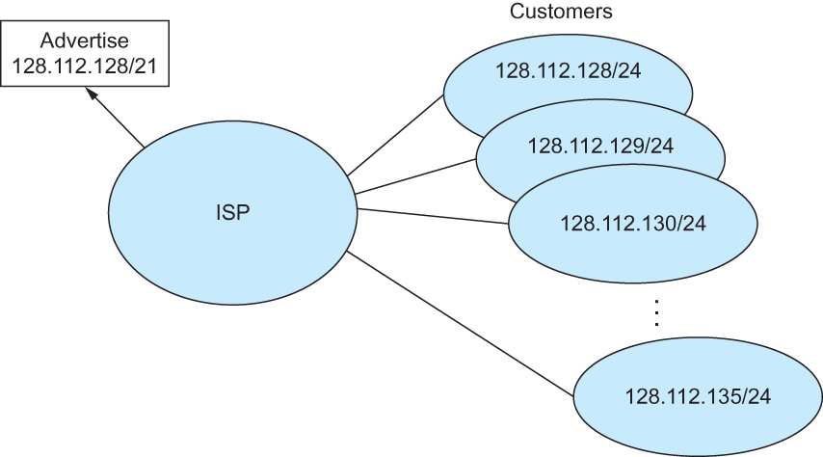
Classless Addressing
Route aggregation with CIDR

Slide 26
IP Forwarding Revisited
IP forwarding mechanism assumes that it can find the network number in a packet and then look up that number in the forwarding table
We need to change this assumption in case of CIDR
CIDR means that prefixes may be of any length, from 2 to 32 bits

Slide 27
IP Forwarding Revisited
It is also possible to have prefixes in the forwarding tables that overlap
Some addresses may match more than one prefix
For example, we might find both 171.69 (a 16 bit prefix) and 171.69.10 (a 24 bit prefix) in the forwarding table of a single router
A packet destined to 171.69.10.5 clearly matches both prefixes.
The rule is based on the principle of “longest match”
171.69.10 in this case
A packet destined to 171.69.20.5 would match 171.69 and not 171.69.10

Slide 28
Address Translation Protocol (ARP)
Map IP addresses into physical addresses
destination host
next hop router
Techniques
encode physical address in host part of IP address
table-based
ARP (Address Resolution Protocol)
table of IP to physical address bindings
broadcast request if IP address not in table
target machine responds with its physical address
table entries are discarded if not refreshed

Slide 29
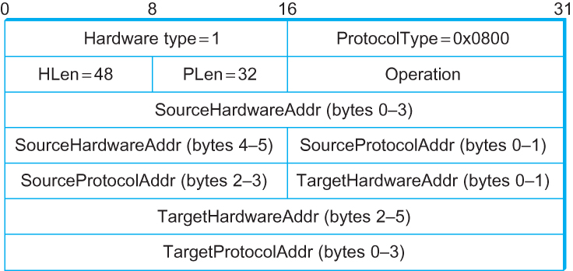
ARP Packet Format
HardwareType: type of physical network (e.g., Ethernet)
ProtocolType: type of higher layer protocol (e.g., IP)
HLEN & PLEN: length of physical and protocol addresses
Operation: request or response
Source/Target Physical/Protocol addresses

Slide 30
Host Configuration
Ethernet addresses are configured into network by manufacturer and they are unique
IP addresses must be unique on a given internetwork but also must reflect the structure of the internetwork
Most host Operating systems provide a way to manually configure the IP information for the host
Drawbacks of manual configuration
A lot of work to configure all the hosts in a large network
Configuration process is error-prune
Automated configuration processes is required

Slide 31
Dynamic Host Configuration Protocol (DHCP)
DHCP server is responsible for providing configuration information to hosts
There is at least one DHCP server for an administrative domain
DHCP server maintains a pool of available addresses

Slide 32
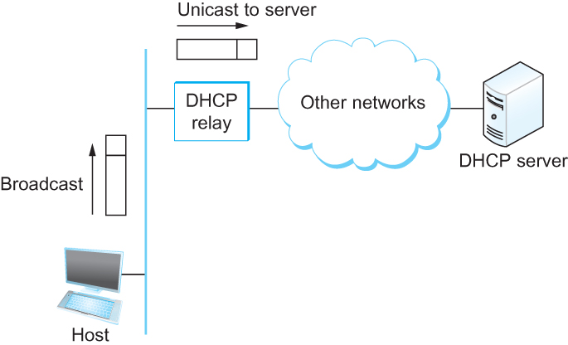
DHCP
Newly booted or attached host sends DHCPDISCOVER message to a special IP address (255.255.255.255)
DHCP relay agent unicasts the message to DHCP server and waits for the response

Slide 33
Internet Control Message Protocol (ICMP)
Defines a collection of error messages that are sent back to the source host whenever a router or host is unable to process an IP datagram successfully
Destination host unreachable due to link/node failure
Reassembly process failed
TTL had reached 0 (so datagram don’t cycle forever)
IP header checksum failed
ICMP – Redirect
From router to a source host
With a better route information

Slide 34
Routing
Forwarding Versus Routing
Forwarding
To select an output port based on destination address and routing table
Routing
Process by which routing table is built

Slide 35
Routing – Forwarding Table Vs Routing Table
Forwarding Table
Used when a packet is being forwarded and so must contain enough information to accomplish the forwarding function
A row in the forwarding table contains the mapping from a network number to an outgoing interface and some MAC information, such as Ethernet address of the next hop
Routing Table
Built by the routing algorithm as a precursor to build the forwarding table
Generally contains mapping from network numbers to next hops

Slide 36
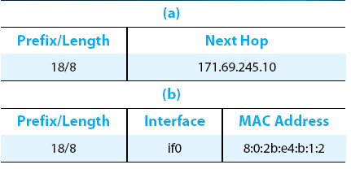
Routing
Example rows from (a) routing and (b) forwarding tables

Slide 37
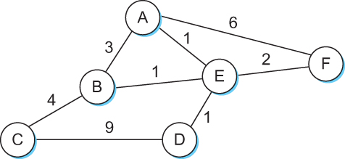
Routing
Network as a Graph
The basic problem of routing is to find the lowest-cost path between any two nodes
Where the cost of a path equals the sum of the costs of all the edges that make up the path

Slide 38
Routing
For a simple network, we can calculate all shortest paths and load them into some nonvolatile storage on each node
Such a static approach has several shortcomings
It does not deal with node or link failures
It does not consider the addition of new nodes or links
It implies that edge costs cannot change
Why is the solution?
Need a distributed and dynamic protocol
Two main classes of protocols
Distance Vector
Link State

Slide 39
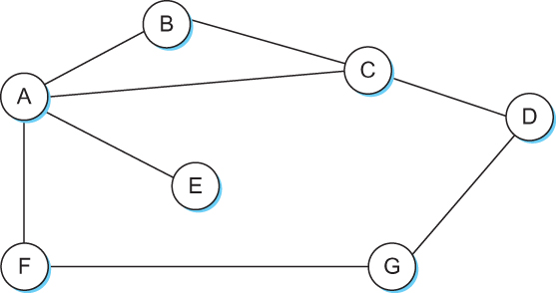
Distance Vector
Each node constructs a one dimensional array (a vector) containing the “distances” (costs) to all other nodes and distributes that vector to its immediate neighbors
Starting assumption is that each node knows the cost of the link to each of its directly connected neighbors

Slide 40
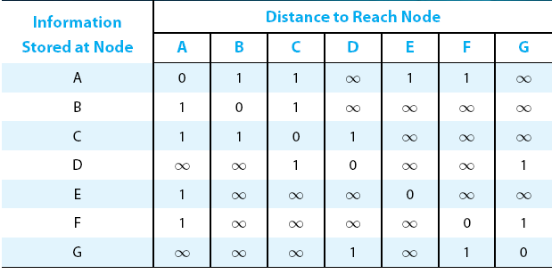
Distance Vector
Initial distances stored at each node (global view)

Slide 41
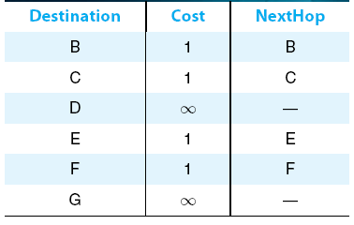
Distance Vector
Initial routing table at node A

Slide 42
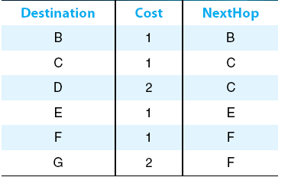
Distance Vector
Final routing table at node A

Slide 43
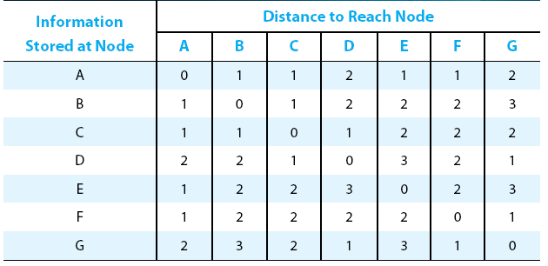
Distance Vector
Final distances stored at each node (global view)

Slide 44
Distance Vector
The distance vector routing algorithm is sometimes called as Bellman-Ford algorithm
Every T seconds each router sends its table to its neighbor each router then updates its table based on the new information
Problems include fast response to good new and slow response to bad news. Also too many messages to update

Slide 45
Distance Vector
When a node detects a link failure
F detects that link to G has failed
F sets distance to G to infinity and sends update to A
A sets distance to G to infinity since it uses F to reach G
A receives periodic update from C with 2-hop path to G
A sets distance to G to 3 and sends update to F
F decides it can reach G in 4 hops via A

Slide 46
Distance Vector
Slightly different circumstances can prevent the network from stabilizing
Suppose the link from A to E goes down
In the next round of updates, A advertises a distance of infinity to E, but B and C advertise a distance of 2 to E
Depending on the exact timing of events, the following might happen
Node B, upon hearing that E can be reached in 2 hops from C, concludes that it can reach E in 3 hops and advertises this to A
Node A concludes that it can reach E in 4 hops and advertises this to C
Node C concludes that it can reach E in 5 hops; and so on
This cycle stops only when the distances reach some number that is large enough to be considered infinite
Count – to – infinity problem

Slide 47
Count-to-infinity Problem
Use some relatively small number as an approximation of infinity
For example, the maximum number of hops to get across a certain network is never going to be more than 16
One technique to improve the time to stabilize routing is called split horizon
When a node sends a routing update to its neighbors, it does not send those routes it learned from each neighbor back to that neighbor
For example, if B has the route (E, 2, A) in its table, then it knows it must have learned this route from A, and so whenever B sends a routing update to A, it does not include the route (E, 2) in that update

Slide 48
Count – to – infinity Problem
In a stronger version of split horizon, called split horizon with poison reverse
B actually sends that back route to A, but it puts negative information in the route to ensure that A will not eventually use B to get to E
For example, B sends the route (E, ∞) to A

Slide 49
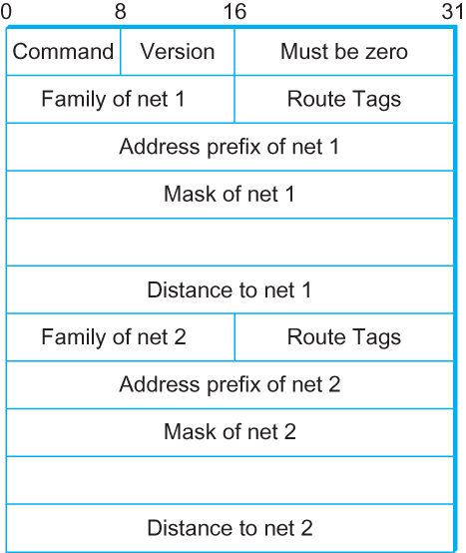
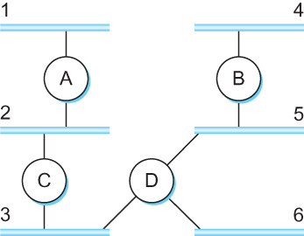
Routing Information Protocol (RIP)
Example Network running RIP
RIPv2 Packet Format

Slide 50
Link State Routing
Strategy: Send to all nodes (not just neighbors) information about directly connected links (not entire routing table)
Link State Packet (LSP)
Id of the node that created the LSP
Cost of link to each directly connected neighbor
Sequence number (SEQNO)
Time-to-live (TTL) for this packet
Reliable Flooding
Store most recent LSP from each node
Forward LSP to all nodes but one that send it
Generate new LSP periodically; increment SEQNO
Start SEQNO at 0 when reboot
Decrement TTL of each stored LSP; discard when TTL = 0

Slide 51
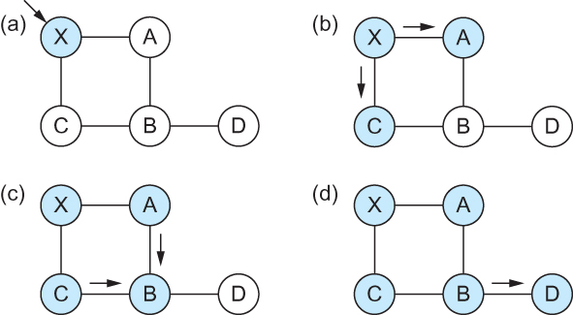
Link State
Reliable Flooding
Flooding of link-state packets. (a) LSP arrives at node X; (b) X floods LSP to A and C; (c) A and C flood LSP to B (but not X); (d) flooding is complete

Slide 52
Shortest Path Routing
Dijkstra’s Algorithm - Assume non-negative link weights
N: set of nodes in the graph
l((i, j): the non-negative cost associated with the edge between nodes i, j ∈N and l(i, j) = ∝ if no edge connects i and j
Let s ∈N be the starting node which executes the algorithm to find shortest paths to all other nodes in N
Two variables used by the algorithm
M: set of nodes incorporated so far by the algorithm
C(n) : the cost of the path from s to each node n
The algorithm
M = {s}
For each n in N – {s}
C(n) = l(s, n)
while ( N ≠ M)
M = M ∪ {w} such that C(w) is the minimum
for all w in (N-M)
For each n in (N-M)
C(n) = MIN (C(n), C(w) + l(w, n))

Slide 53
Shortest Path Routing
In practice, each switch computes its routing table directly from the LSP’s it has collected using a realization of Dijkstra’s algorithm called the forward search algorithm
Specifically each switch maintains two lists, known as Tentative and Confirmed
Each of these lists contains a set of entries of the form (Destination, Cost, NextHop)

Slide 54
Shortest Path Routing
The algorithm
Initialize the Confirmed list with an entry for myself; this entry has a cost of 0
For the node just added to the Confirmed list in the previous step, call it node Next, select its LSP
For each neighbor (Neighbor) of Next, calculate the cost (Cost) to reach this Neighbor as the sum of the cost from myself to Next and from Next to Neighbor
If Neighbor is currently on neither the Confirmed nor the Tentative list, then add (Neighbor, Cost, Nexthop) to the Tentative list, where Nexthop is the direction I go to reach Next
If Neighbor is currently on the Tentative list, and the Cost is less than the currently listed cost for the Neighbor, then replace the current entry with (Neighbor, Cost, Nexthop) where Nexthop is the direction I go to reach Next
If the Tentative list is empty, stop. Otherwise, pick the entry from the Tentative list with the lowest cost, move it to the Confirmed list, and return to Step 2.

Slide 55
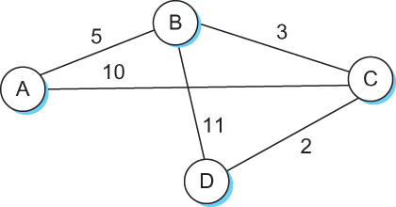
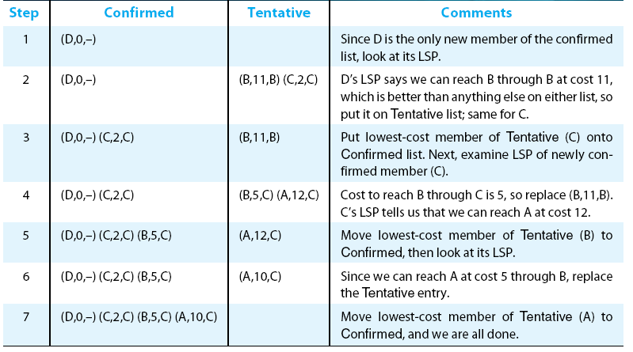
Shortest Path Routing

Slide 56
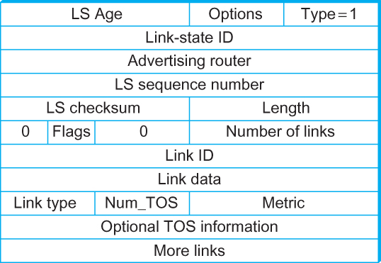
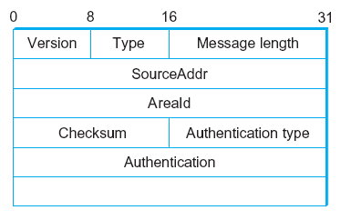
Open Shortest Path First (OSPF)
OSPF Header Format
OSPF Link State Advertisement

Slide 57
IPv6

Slide 58
Major Features
128 – bit addresses
Multicast
Real-time service
Authentication and security
Auto-configuration
End-to-end fragmentation
Enhanced routing functionality, including support for mobile hosts

Slide 59
IPv6 Addresses
Classless addressing/routing (similar to CIDR)
Notation: x:x:x:x: x:x:x:x (x = 16-bit hex number)
Contiguous 0s are compressed: 47CD::A456:0124
IPv6 compatible IPv4 address: 128.42.1.87
Address assignment
Provider-based
Geographic

Slide 60
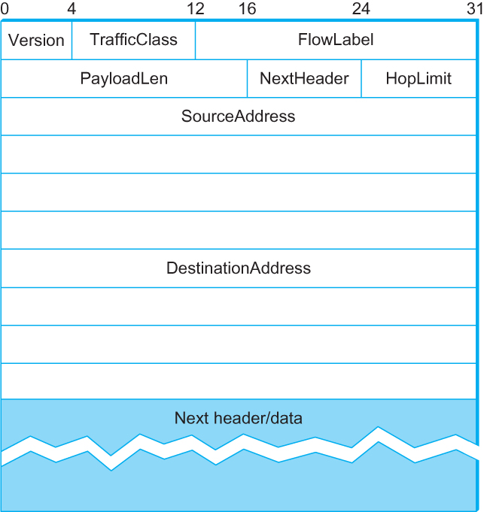
IPv6 Header
40-byte “base” header
Extension headers (fixed order, mostly fixed length)
Fragmentation
Source routing
Authentication and security
Other options

Slide 61
Internet Multicast

Slide 62
Multicast
One-to-many
Radio station broadcast
Transmitting news, stock-price
Software updates to multiple hosts
Many-to-many
Multimedia teleconferencing
Online multi-player games
Distributed simulations

Slide 63
Multicast
Without support for multicast
A source needs to send a separate packet with the identical data to each member of the group
This redundancy consumes more bandwidth
Redundant traffic is not evenly distributed, concentrated near the sending host
Source needs to keep track of the IP address of each member in the group
Group may be dynamic
To support many-to-many and one-to-many IP provides as IP-level multicast

Slide 64
Multicast
Basic IP multicast model is many-to-many based on multicast groups
Each group has its own IP multicast address
Hosts that the members of a group receive copies of any packets sent to that group’s multicast address
A host can be in multiple groups
A host can join and leave groups

Slide 65
Multicast
Using IP multicast to send the identical packet to each member of the group
A host sends a single copy of the packet addressed to the group’s multicast address
The sending host does not need to know the individual unicast IP address of each member
Sending host does not send multiple copies of the packet

Slide 66
Multicast
IP’s original many-to-many multicast has been supplemented with support for a form of one-to-many multicast
One-to-many multicast
Source specific multicast (SSM)
A receiving host specifies both a multicast group and a specific sending host
Many-to-many model
Any source multicast (ASM)

Slide 67
Multicast
A host signals its desire to join or leave a multicast group by communicating with its local router using a special protocol
In IPv4, the protocol is Internet Group Management Protocol (IGMP)
In IPv6, the protocol is Multicast Listener Discovery (MLD)
The router has the responsibility for making multicast behave correctly with regard to the host

Slide 68
Multicast Routing
A router’s unicast forwarding tables indicate for any IP address, which link to use to forward the unicast packet
To support multicast, a router must additionally have multicast forwarding tables that indicate, based on multicast address, which links to use to forward the multicast packet
Unicast forwarding tables collectively specify a set of paths
Multicast forwarding tables collectively specify a set of trees
Multicast distribution trees

Slide 69
Multicast Routing
To support source specific multicast, the multicast forwarding tables must indicate which links to use based on the combination of multicast address and the unicast IP address of the source
Multicast routing is the process by which multicast distribution trees are determined

Slide 70
Distance-Vector Multicast
Each router already knows that shortest path to source S goes through router N.
When receive multicast packet from S, forward on all outgoing links (except the one on which the packet arrived), iff packet arrived from N.
Eliminate duplicate broadcast packets by only letting
“parent” for LAN (relative to S) forward
shortest path to S (learn via distance vector)
smallest address to break ties

Slide 71
Distance Vector Multicast
Reverse Path Broadcast (RPB)
Goal: Prune networks that have no hosts in group G
Step 1: Determine of LAN is a leaf with no members in G
leaf if parent is only router on the LAN
determine if any hosts are members of G using IGMP
Step 2: Propagate “no members of G here” information
augment <Destination, Cost> update sent to neighbors with set of groups for which this network is interested in receiving multicast packets.
only happens when multicast address becomes active.

Slide 72
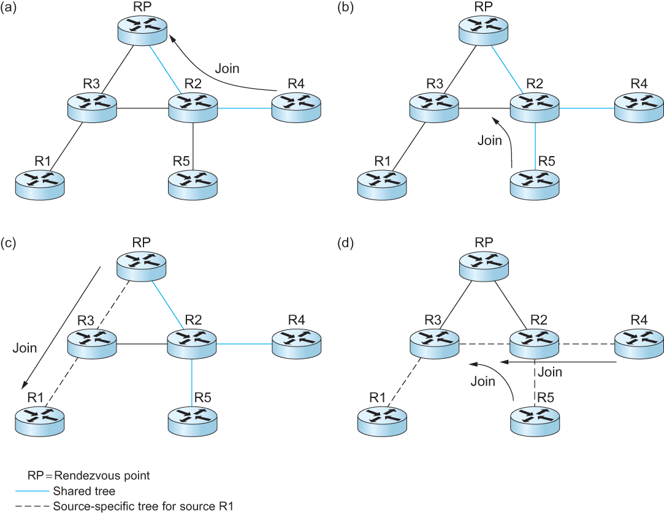
Protocol Independent Multicast (PIM)
Shared Tree
Source specific tree

Slide 73
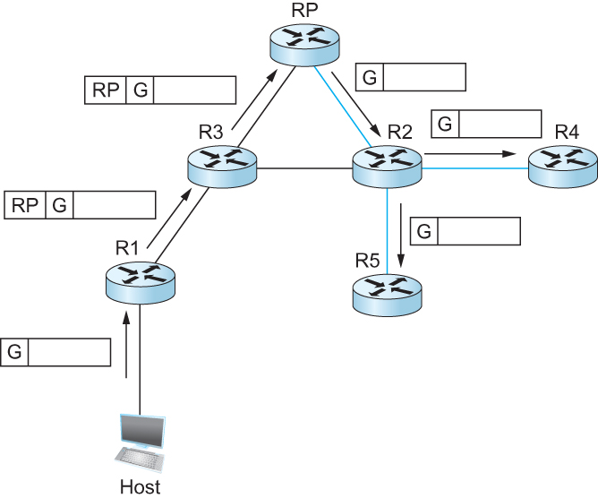
Protocol Independent Multicast (PIM)
Delivery of a packet along a shared tree. R1 tunnels the packet to the RP, which forwards it along the shared tree to R4 and R5.

Slide 74
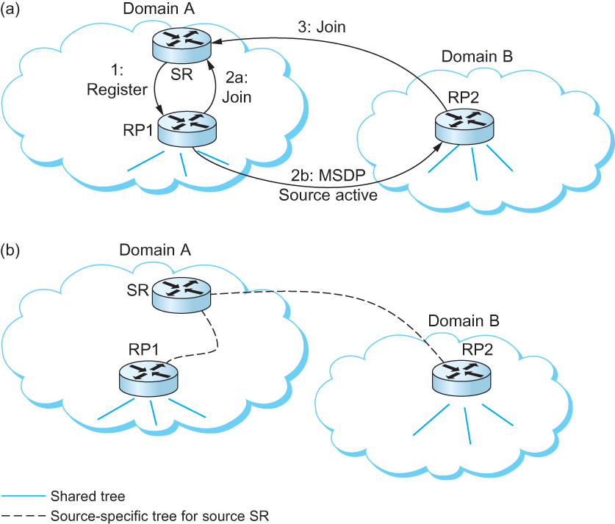
Inter – domain Multicast
Multicast Source Discovery Protocol (MSDP)

Slide 75
Routing for Mobile Hosts
Mobile IP
Home Agent
Router located on the home network of the mobile hosts
Home Address
The permanent IP address of the mobile host
Has a network number equal to that of the home network and thus of the home agent
Foreign Agent
Router located on a network to which the mobile node attaches itself when it is away from its home network

Slide 76
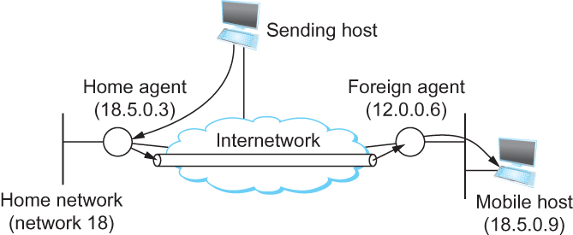
Routing for Mobile Hosts

Slide 77
Routing for Mobile Hosts
Problem of delivering a packet to the mobile node
How does the home agent intercept a packet that is destined for the mobile node?
Proxy ARP
How does the home agent then deliver the packet to the foreign agent?
IP tunnel
Care – of – address
How does the foreign agent deliver the packet to the mobile node?

Slide 78
Routing for Mobile Hosts
Route optimization in Mobile IP
The route from the sending node to mobile node can be significantly sub-optimal
One extreme example
The mobile node and the sending node are on the same network, but the home network for the mobile node is on the far side of the internet
Triangle Routing Problem

Slide 79
Routing for Mobile Hosts
Solution
Let the sending node know the care-of-address of the mobile node. The sending node can create its own tunnel to the foreign agent
Home agent sends binding update message
The sending node creates an entry in the binding cache
The binding cache may become out-of-date
The mobile node moved to a different network
Foreign agent sends a binding warning message

Slide 80
Reference
Chapter – 4: Computer Networks A Systems Approach by Larry L. Peterson and Bruce S. Davie, 4Th Edition, Morgan Kaufmann Publications.

