Slide 1
End–to–end protocols

Slide 2
Outline
Simple Demultiplexer (UDP)
Reliable Byte Stream (TCP)
Remote Procedure Call

Slide 3
End-to-end Protocols
Common properties that a transport protocol can be expected to provide
Guarantees message delivery
Delivers messages in the same order they were sent
Delivers at most one copy of each message
Supports arbitrarily large messages
Supports synchronization between the sender and the receiver
Allows the receiver to apply flow control to the sender
Supports multiple application processes on each host

Slide 4
End-to-end Protocols
Typical limitations of the network on which transport protocol will operate
Drop message
Reorder messages
Deliver duplicate copies of a given message
Limit messages to some finite size
Deliver messages after an arbitrarily long delay

Slide 5
End-to-end Protocols
Challenge for Transport Protocols
Develop algorithms that turn the less-then-desirable properties of the underlying network into the high level of service required by application programs

Slide 6
Simple Demultiplexer (UDP)
Extends host-to-host deliver service of the underlying network into a process-to-process communication service
Add a level of demultiplexing which allows multiple application processes on each host to share the network

Slide 7
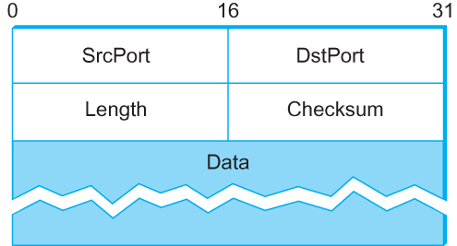
Simple Demultiplexer (UDP)
Format for UDP header (Note: length and checksum fields should be switched)

Slide 8
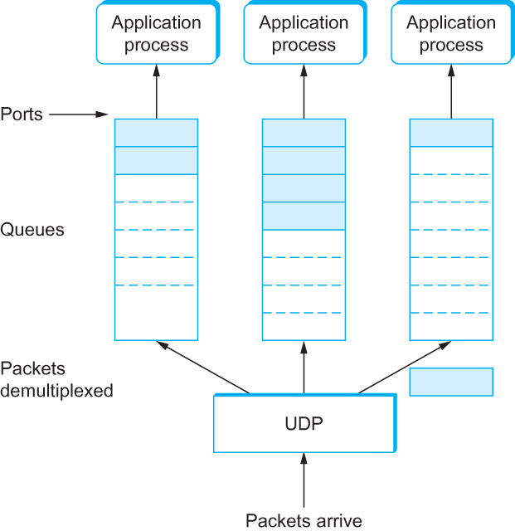
Simple Demultiplexer (UDP)
UDP Message Queue

Slide 9
Reliable Byte Stream (TCP)
In contrast to UDP, Transmission Control Protocol (TCP) offers the following services
Reliable
Connection oriented
Byte-stream service

Slide 10
Flow Control Vs Congestion Control
Flow control involves preventing senders from overrunning the capacity of the receivers
Congestion control involves preventing too much data from being injected into the network, thereby causing switches or links to become overloaded

Slide 11
End-to-end Issues
At the heart of the TCP is the sliding window algorithm
As the TCP runs over the Internet rather than a point-to-point link, the following issues need to be addressed by the sliding window algorithm
TCP supports logical connections between processes that are running on two different computers in the Internet
TCP connections are likely to have widely different RTT time
Packets may get reordered in the Internet

Slide 12
End-to-end Issues
TCP needs a mechanism using which each side of a connection will learn what resources the other side is able to apply to the connection
TCP needs a mechanism using which the sending side will learn the capacity of the network

Slide 13
TCP Segment
TCP is a byte-oriented protocol, which means that the sender writes bytes into a TCP connection and the receiver reads bytes out of the TCP connection
Although “byte stream” describes the service TCP offers to application processes, TCP does not, itself, transmit individual bytes over the Internet

Slide 14
TCP Segment
TCP on the source host buffers enough bytes from the sending process to fill a reasonably sized packet and then sends this packet to its peer on the destination host
TCP on the destination host then empties the contents of the packet into a receive buffer, and the receiving process reads from this buffer at its leisure
The packets exchanged between TCP peers are called segments.

Slide 15
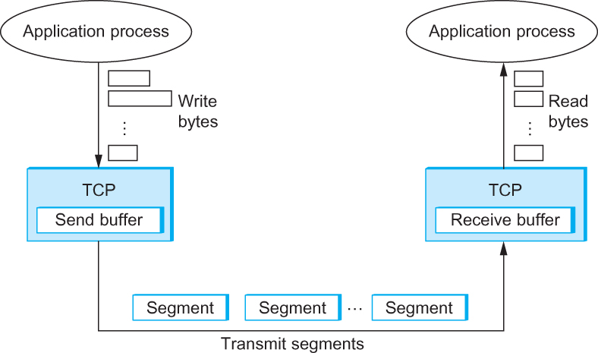
TCP Segment
How TCP manages a byte stream.

Slide 16
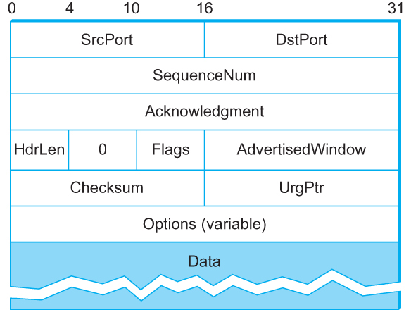
TCP Header
TCP Header Format

Slide 17
TCP Header
The SrcPort and DstPort fields identify the source and destination ports, respectively.
The Acknowledgment, SequenceNum, and AdvertisedWindow fields are all involved in TCP’s sliding window algorithm.
Because TCP is a byte-oriented protocol, each byte of data has a sequence number; the SequenceNum field contains the sequence number for the first byte of data carried in that segment.
The Acknowledgment and AdvertisedWindow fields carry information about the flow of data going in the other direction.

Slide 18
TCP Header
The 6-bit Flags field is used to relay control information between TCP peers.
The possible flags include SYN, FIN, RESET, PUSH, URG, and ACK.
The SYN and FIN flags are used when establishing and terminating a TCP connection, respectively.
The ACK flag is set any time the Acknowledgment field is valid, implying that the receiver should pay attention to it.

Slide 19
TCP Header
The URG flag signifies that this segment contains urgent data. When this flag is set, the UrgPtr field indicates where the nonurgent data contained in this segment begins.
The urgent data is contained at the front of the segment body, up to and including a value of UrgPtr bytes into the segment.
The PUSH flag signifies that the sender invoked the push operation, which indicates to the receiving side of TCP that it should notify the receiving process of this fact.
Finally, the RESET flag signifies that the receiver has become confused

Slide 20
TCP Header
Finally, the RESET flag signifies that the receiver has become confused, it received a segment it did not expect to receive—and so wants to abort the connection.
Finally, the Checksum field is used in exactly the same way as for UDP—it is computed over the TCP header, the TCP data, and the pseudoheader, which is made up of the source address, destination address, and length fields from the IP header.

Slide 21
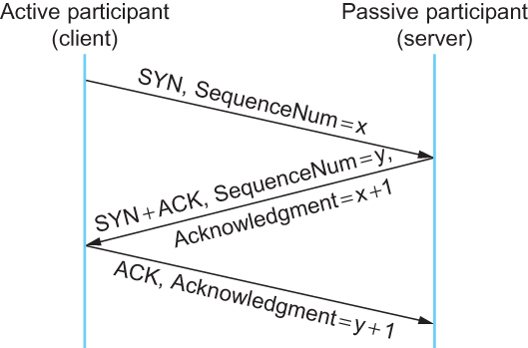
Connection Establishment/Termination in TCP
Timeline for three-way handshake algorithm

Slide 22
Sliding Window Revisited
TCP’s variant of the sliding window algorithm, which serves several purposes:
(1) It guarantees the reliable delivery of data
(2) It ensures that data is delivered in order, and
(3) It enforces flow control between the sender and the receiver

Slide 23
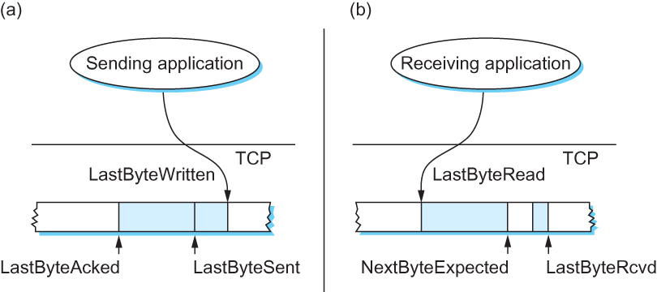
Sliding Window Revisited
Relationship between TCP send buffer (a) and receive buffer (b).

Slide 24
TCP Sliding Window
Sending Side
LastByteAcked ≤ LastByteSent
LastByteSent ≤ LastByteWritten
Receiving Side
LastByteRead < NextByteExpected
NextByteExpected ≤ LastByteRcvd + 1

Slide 25
TCP Flow Control
LastByteRcvd − LastByteRead ≤ MaxRcvBuffer
AdvertisedWindow = MaxRcvBuffer − ((NextByteExpected − 1) − LastByteRead)
LastByteSent − LastByteAcked ≤ AdvertisedWindow
EffectiveWindow = AdvertisedWindow − (LastByteSent − LastByteAcked)
LastByteWritten − LastByteAcked ≤ MaxSendBuffer
If the sending process tries to write y bytes to TCP, but
(LastByteWritten − LastByteAcked) + y > MaxSendBuffer
then TCP blocks the sending process and does not allow it to generate more data.

Slide 26
Protecting against Wraparound
SequenceNum: 32 bits longs
AdvertisedWindow: 16 bits long
TCP has satisfied the requirement of the sliding Window algorithm that is the sequence number Space be twice as big as the window size
2³² >> 2 x 2¹⁶

Slide 27
Protecting Against Wraparound
Relevance of the 32-bit sequence number space
The sequence number used on a given connection might wraparound
A byte with sequence number x could be sent at one time, and then at a later time a second byte with the same sequence number x could be sent
Packets cannot survive in the Internet for longer than the MSL (maximum segment lifetime)
MSL is set to 120sec
We need to make sure that the sequence number does not wrap around within a 120-second period of time
Depends on how fast data can be transmitted over the Internet

Slide 28
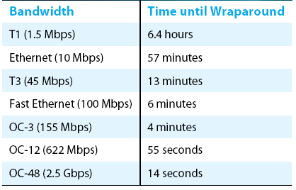
Protecting against Wraparound
Time until 32-bit sequence number space wraps around.

Slide 29
Keeping the Pipe Full
16-bit advertised window field must be big enough to allow the sender to keep the pipe full
Clearly the receiver is free not to open the window as large as the AdvertisedWindow field allows
If the receiver has enough buffer space
The window needs to be opened far enough to allow a full
Delay x bandwidth product’s worth of data
Assuming an RTT of 100 ms

Slide 30
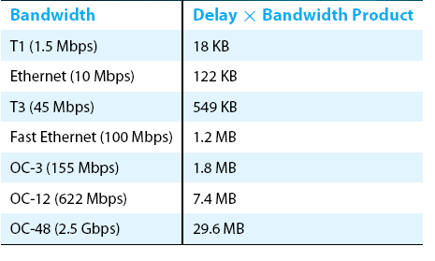
Keeping the Pipe Full
Required window size for 100-ms RTT

Slide 31
Triggering Transmission
How does TCP decide to transmit a segment?
TCP supports a byte stream abstraction
Application programs write bytes into streams
It is up to TCP to decide that it has enough bytes to send a segment

Slide 32
Triggering Transmission
What factors governs this decision
Ignore flow control: window is wide open, as would be the case when the connection starts
TCP has three mechanism to trigger the transmission of a segment
(1) TCP maintains a variable MSS and sends a segment as soon as it has collected MSS bytes from the sending process
MSS is usually set to the size of the largest segment TCP can send without causing local IP to fragment
MSS: MTU of directly connected network – (TCP header + and IP header)
(2) Sending process has explicitly asked TCP to send it
TCP supports push operation
(3) When a timer fires
Resulting segment contains as many bytes as are currently buffered for transmission

Slide 33
Silly Window Syndrome
If you think of a TCP stream as a conveyer belt with “full” containers (data segments) going in one direction and empty container (ACKs) going in the reverse direction, then MSS-sized segments correspond to large container and 1-byte segments correspond to very small containers
If the sender aggressively fills an empty container as soon as it arrives, then any small container introduced into the system remains in the system indefinitely
That is, it is immediately filled and emptied at each end, and never coalesced with adjacent containers to create large containers

Slide 34
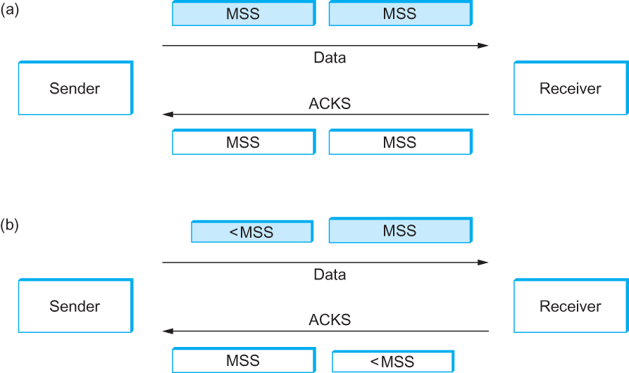
Silly Window Syndrome
Silly Window Syndrome

Slide 35
Nagle’s Algorithm
If there is data to send but the window is open less than MSS, then we may want to wait some amount of time before sending the available data
But how long?
If we wait too long, then we hurt interactive applications like Telnet
If we don’t wait long enough, then we risk sending a bunch of tiny packets and falling into the silly window syndrome
The solution is to introduce a timer and to transmit when the timer expires

Slide 36
Nagle’s Algorithm
We could use a clock-based timer, for example one that fires every 100ms
Nagle introduced an elegant self-clocking solution
Key Idea
As long as TCP has any data in flight, the sender will eventually receive an ACK
This ACK can be treated like a timer firing, triggering the transmission of more data

Slide 37
Nagle’s Algorithm
When the application produces data to send
If both the available data and the window ≥ MSS
Send a full segment
Else
If there is unACKed data in flight
Buffer the new data until an ACK arrives
Else
Send all the new data now

Slide 38
Adaptive Retransmission
Original Algorithm
Measure SampleRTT for each segment/ACK pair
Compute weighted average of RTT
EstRTT=αxEstRTT+(1–α)xSampleRTT
α between 0.8 and 0.9
Set timeout based on EstRTT
TimeOut = 2 x EstRTT

Slide 39
Original Algorithm
Problem
ACK does not really acknowledge a transmission
It actually acknowledges the receipt of data
When a segment is retransmitted and then an ACK arrives at the sender
It is impossible to decide if this ACK should be associated with the first or the second transmission for calculating RTTs

Slide 40
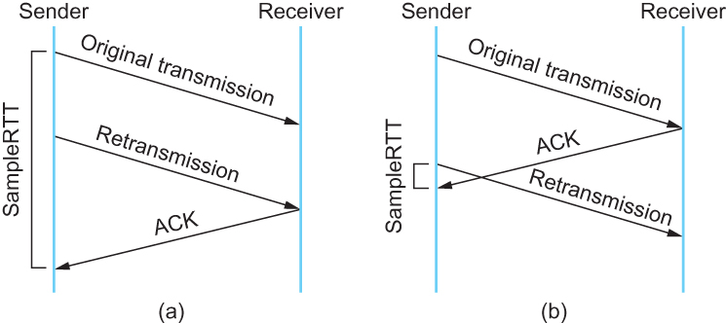
Karn/Partridge Algorithm
Associating the ACK with (a) original transmission versus (b) retransmission

Slide 41
Karn/Partridge Algorithm
Do not sample RTT when retransmitting
Double timeout after each retransmission

Slide 42
Karn/Partridge Algorithm
Karn-Partridge algorithm was an improvement over the original approach, but it does not eliminate congestion
We need to understand how timeout is related to congestion
If you timeout too soon, you may unnecessarily retransmit a segment which adds load to the network

Slide 43
Karn/Partridge Algorithm
Main problem with the original computation is that does not take variance of sample RTTs into consideration
If the variance among sample RTTs is small
Then the estimated RTT can be better trusted
There is no need to multiply this by 2 to compute the timeout

Slide 44
Karn/Partridge Algorithm
On the other hand, a large variance in the samples suggest that timeout value should not be tightly coupled to the Estimated RTT
Jacobson/Karels proposed a new scheme for TCP retransmission

Slide 45
Jacobson/Karels Algorithm
Difference = SampleRTT – EstimatedRTT
EstimatedRTT = EstimatedRTT + (x Difference)
Derivation = Derivation + (|Difference| - Deviation)
TimeOut = µ x EstimatedRTT + x Deviation
Where based on experience, µ is typically set to 1 and is set to 4. Thus, when the variance is small, TimeOut is close to EstimatedRTT; a large variance causes the deviation term to dominate the calculation

Slide 46
RPC

Slide 47
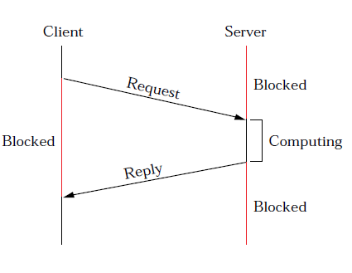
RPC

Slide 48
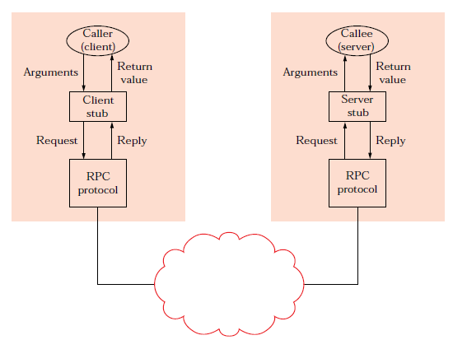
RPC

Slide 49
RPC Functions
RPC protocol consists of three basic functions
BLAST: fragments and reassembles large messages
CHAN: synchronizes request and reply messages
SELECT: dispatches request messages to the correct process

Slide 50
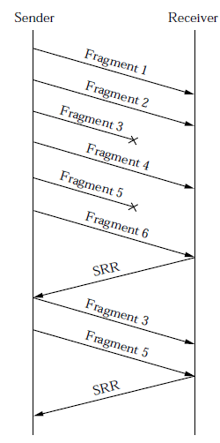
Bulk Transfer (BLAST)
Unlike AAL and IP in that it tries to recover from lost fragments; persistent, but does not guarantee delivery. Strategy is to use selective retransmission (partial acknowledgements)

Slide 51
Bulk Transfer (BLAST)
Sender:
After sending all fragments, set timer DONE
If receive SRR, send missing fragments and reset DONE
If timer DONE expires, free fragments
Receiver:
When first fragment arrives, set timer LAST_FRAG
When all fragments present, reassemble and pass up

Slide 52
Bulk Transfer (BLAST)
Four exceptional conditions
if last fragment arrives but message not complete
send SRR and set timer RETRY
if timer LAST_FRAG expires
send SRR and set timer RETRY
if timer RETRY expires for first or second time
send SRR and set timer RETRY
if timer RETRY expires for third time
give up and free partial message

Slide 53
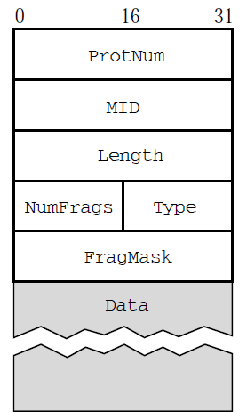
BLAST Header Format
MID must protect against wrap around
Type = DATA or SRR
NumFrags indicates number of fragments in message
FragMask distinguishes among fragments:
if Type=DATA, identifies this fragment
if Type=SRR, identifies missing fragments

Slide 54
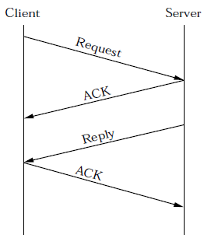
Request/Reply (CHAN)
Guarantees message delivery, and synchronizes client with server; i.e., blocks client until reply received. Supports at-most-once semantics
Simple case

Slide 55
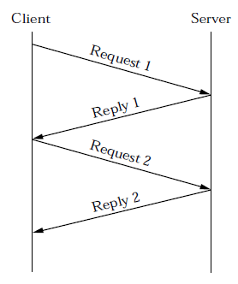
Request/Reply (CHAN)
Implicit Acknowledgements

Slide 56
CHAN – Complications
Lost message (request, reply, or ACK)
set RETRANSMIT timer
use message id (MID) field to distinguish
Slow (long running) server
client periodically sends “are you alive” probe, or
server periodically sends “I'm alive” notice
Want to support multiple outstanding calls
use channel id (CID) field to distinguish
Machines crash and reboot
use boot id (BID) field to distinguish

Slide 57
CHAN Header Format
typedef struct {
u_short Type; /* REQ, REP, ACK, PROBE */
u_short CID; /* unique channel id */
int MID; /* unique message id */
int BID; /* unique boot id */
int Length; /* length of message */
int ProtNum; /* high-level protocol */
} ChanHdr;

Slide 58
CHAN Session State
typedef struct {
u_char type; /* CLIENT or SERVER */
u_char status; /* BUSY or IDLE */
int retries; /* number of retries */
int timeout; /* timeout value */
XkReturn ret_val; /* return value */
Msg *request; /* request message */
Msg *reply; /* reply message */
Semaphore reply_sem; /* client semaphore */
int mid; /* message id */
int bid; /* boot id */
} ChanState;

Slide 59
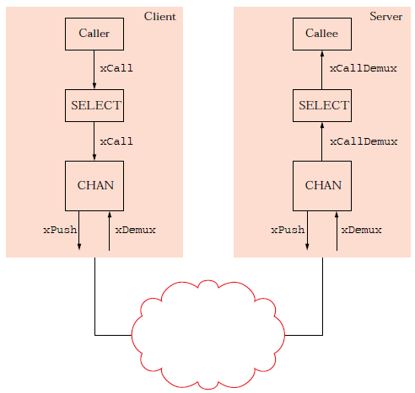
Dispatcher (SELECT)
Dispatches request messages to the appropriate procedure; fully synchronous counterpart to UDP
Address Space for Procedures
Flat: unique id for each possible procedure
Hierarchical: program + procedure within program

Slide 60
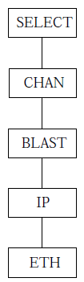
Putting it All Together
Simple RPC Stack

Slide 61
Reference
Chapter – 5: Computer Networks A Systems Approach by Larry L. Peterson and Bruce S. Davie, 4Th Edition, Morgan Kaufmann Publications.

