Slide 1
End-to-end data

Slide 2
Introduction
From the network’s perspective, application programs send messages to each other.
Each of these messages is just an uninterpreted string of bytes.
From the application’s perspective, however, these messages contain various kinds of data—arrays of integers, video frames, lines of text, digital images, and so on. In other words, these bytes have meaning.
We now consider the problem of how best to encode the different kinds of data that application programs want to exchange into byte strings

Slide 3
Outline
Presentation Formatting
Multimedia Data

Slide 4
Presentation Format
One of the most common transformations of network data is from the representation used by the application program into a form that is suitable for transmission over a network and vice versa.
This transformation is typically called presentation formatting.

Slide 5
Presentation Formatting
The sending program translates the data it wants to transmit from the representation it uses internally into a message that can be transmitted over the network;
i.e., the data is encoded in a message.
On the receiving side, the application translates this arriving message into a representation that it can then process;
i.e., the message is decoded.
Encoding is sometimes called argument marshalling, and decoding is sometimes called unmarshalling. This terminology comes from the RPC world

Slide 6
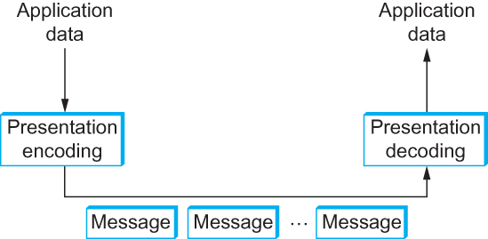
Presentation Formatting
Presentation formatting involves encoding and decoding application data

Slide 7
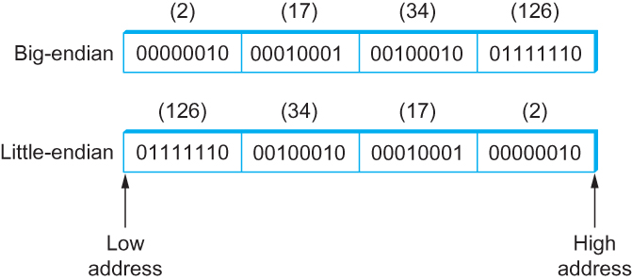
Presentation Formatting
Big-endian and little-endian byte order for the integer 34,677,374.

Slide 8
Taxonomy – Data Types
The first question is what data types the system is going to support.
In general, we can classify the types supported by an argument marshalling mechanism at three levels
At the lowest level, a marshalling system operates on some set of base types. Typically, the base types include integers, floating-point numbers, and characters. The system might also support ordinal types and booleans
At the next level are flat types—structures and arrays
At the highest level, the marshalling system might have to deal with complex types—those types that are built using pointers
In summary, depending on how complicated the type system is, the task of argument marshalling usually involves converting the base types, packing the structures, and linearizing the complex data structures, all to form a contiguous message that can be transmitted over the network

Slide 9
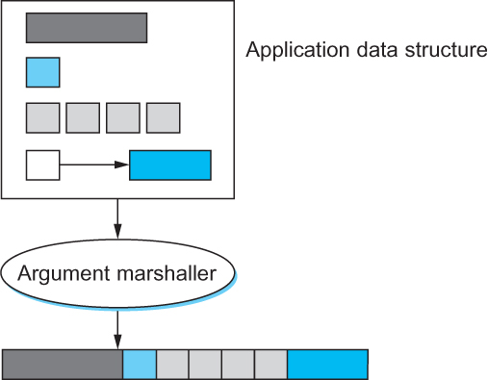
Presentation Formatting
Argument marshalling: converting, packing, and linearizing

Slide 10
Presentation Formatting
Conversion Strategy
Once the type system is established, the next issue is what conversion strategy the argument marshaller will use. There are two general options:
canonical intermediate form and receiver-makes-right

Slide 11
Conversion Strategy
The idea of canonical intermediate form is to settle on an external representation for each type;
The sending host translates from its internal representation to this external representation before sending data, and the receiver translates from this external representation into its local representation when receiving data
The alternative, which is sometimes called receiver-makes-right, has the sender transmit data in its own internal format;
The sender does not convert the base types, but usually has to pack and flatten more complex data structures.
The receiver is then responsible for translating the data from the sender’s format into its own local format

Slide 12
Tags – Presentation Formatting
The third issue in argument marshalling is how the receiver knows what kind of data is contained in the message it receives.
There are two common approaches: tagged and untagged data
A tag is any additional information included in a message—beyond the concrete representation of the base types—that helps the receiver decode the message
The alternative, of course, is not to use tags.
How does the receiver know how to decode the data in this case? It knows because it was programmed to know

Slide 13

Tags – Presentation Formatting
A 32-bit integer encoded in a tagged message

Slide 14
Stubs – Presentation Formatting
A stub is the piece of code that implements argument marshalling
Stubs are typically used to support RPC.
On the client side, the stub marshalls the procedure arguments into a message that can be transmitted by means of the RPC protocol
On the server side, the stub converts the message back into a set of variables that can be used as arguments to call the remote procedure
Stubs can either be interpreted or compiled

Slide 15
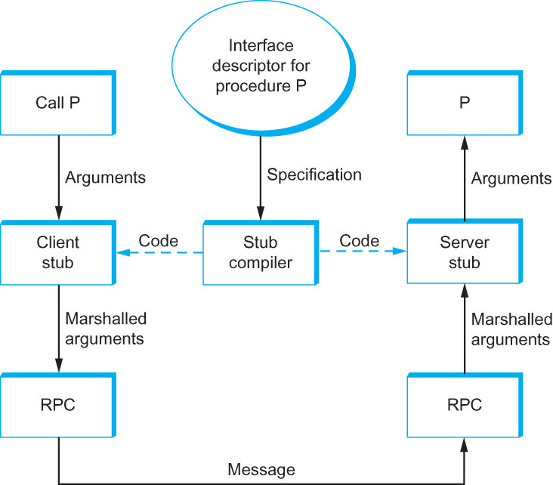
Stubs – Presentation Formatting
Stub compiler takes interface description as input and outputs client and server stubs.

Slide 16
Example – Presentation Formatting
XDR
External Data Representation (XDR) is the network format used with SunRPC.
In the taxonomy just introduced, XDR
Supports the entire C type system with the exception of function pointers
Defines a canonical intermediate form
Does not use tags (except to indicate array lengths)
Uses compiled stubs

Slide 17
Example – XDR
An XDR integer is a 32-bit data item that encodes a C integer
It is represented in two’s complement notation, with the most significant byte of the C integer in the first byte of the XDR integer, and the least significant byte of the C integer in the fourth byte of the XDR integer
That is, XDR uses big-endian format for integers
XDR supports both signed and unsigned integers, just as C does

Slide 18
Examples - XDR
XDR represents variable-length arrays by first specifying an unsigned integer (4 bytes) that gives the number of elements in the array, followed by that many elements of the appropriate type
XDR encodes the components of a structure in the order of their declaration in the structure
For both arrays and structures, the size of each element/ component is represented in a multiple of 4 bytes.
Smaller data types are padded out to 4 bytes with 0s
The exception to this “pad to 4 bytes” rule is made for characters, which are encoded one per byte

Slide 19
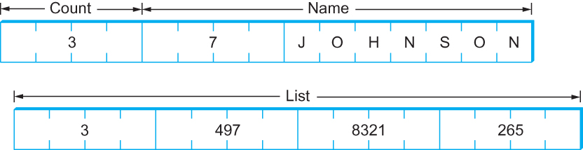
Example – XDR
Example encoding of a structure in XDR

Slide 20
Examples – ASN.1
Abstract Syntax Notation One (ASN.1) is an ISO standard that defines, among other things, a representation for data sent over a network
The representation-specific part of ASN.1 is called the Basic Encoding Rules (BER)
ASN.1 supports
Supports the C type system without function pointers,
Defines a canonical intermediate form, and
Uses tags
Its stubs can be either interpreted or compiled
One of the claims to fame of ASN.1 BER is that it is used by the Internet standard Simple Network Management Protocol (SNMP)

Slide 21
Examples – ASN.1
ASN.1 represents each data item with a triple of the form
The tag is typically an 8-bit field, although ASN.1 allows for the definition of multi-byte tags
The length field specifies how many bytes make up the value;
Compound data types, such as structures, can be constructed by nesting primitive types

Slide 22

Examples – ASN.1
Compound types created by means of nesting in ASN.1/BER
ASN.1/BER representation for a 4-byte integer

Slide 23
Examples – NDR
Network Data Representation (NDR) is the data-encoding standard used in the Distributed Computing Environment
Unlike XDR and ASN.1, NDR uses receiver-makes-right.
It does this by inserting an architecture tag at the front of each message; individual data items are untagged
NDR uses a compiler to generate stubs
This compiler takes a description of a program written in the Interface Definition Language (IDL) and generates the necessary stubs
IDL looks pretty much like C, and so essentially supports the C type system

Slide 24
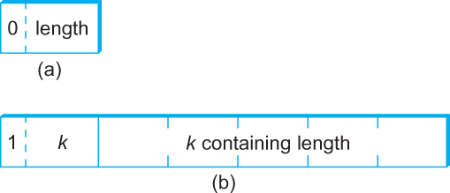
Examples – NDR
ASN.1/BER representation for length: (a) 1 byte; (b) multibyte
NDR’s architecture tag

Slide 25
Markup Languages – XML
Markup languages, of which HTML and XML are both examples, take the tagged data approach to the extreme
Data is represented as text, and text tags known as markup are intermingled with the data text to express information about the data
In the case of HTML, markup merely indicates how the text should be displayed; other markup languages like XML can express the type and structure of the data

Slide 26
Markup Languages – XML
XML syntax looks much like HTML
For example, an employee record in a hypothetical XML-based language might look like the XML document (next slide), which might be stored in a file named employee.xml
The first line indicates the version of XML being used, and the remaining lines represent four fields that make up the employee record, the last of which (hire date) contains three sub-fields

Slide 27
Markup Languages – XML
In other words, XML syntax provides for a nested structure of tag/value pairs, which is equivalent to a tree structure for the represented data (with employee as the root)
This is similar to XDR, ASN.1, and NDR’s ability to represent compound types, but in a format that can be both processed by programs and read by humans
More importantly, programs such as parsers can be used across different XML-based languages, because the definitions of those languages are themselves expressed as machine-readable data that can be input to the programs

Slide 28
Markup Languages – XML
<?xml version="1.0"?>
<employee>
<name>John Doe</name>
<title>Head Bottle Washer</title>
<id>123456789</id>
<hiredate>
<day>5</day>
<month>June</month>
<year>1986</year>
</hiredate>
</employee>

Slide 29
Markup Languages – XML
The definition of a specific XML-based language is given by a schema, which is a database term for a specification of how to interpret a collection of data
There are a number of schema languages defined for XML
We will focus here on the leading standard, known by the none-too-surprising name XML Schema
An individual schema defined using XML Schema is known as an XML Schema Document (XSD)

Slide 30
Markup Languages – XML
The XSD for the employee.xml example is shown in the next slide
it defines the language to which the example document conforms. It might be stored in a file named employee.xsd

Slide 31
Markup Languages – XML
<?xml version="1.0"?>
<schema xmlns="http://www.w3.org/2001/XMLSchema">
<element name="employee">
<complexType>
<sequence>
<element name="name" type="string"/>
<element name="title" type="string"/>
<element name="id" type="string"/>
<element name="hiredate">
<complexType>
<sequence>
<element name="day" type="integer"/>
<element name="month" type="string"/>
<element name="year" type="integer"/>
</sequence>
</complexType>
</element>
</sequence>
</complexType>
</element>
</schema>

Slide 32
Multimedia Data
Multimedia data, comprising audio, video, and still images, now makes up the majority of traffic on the Internet by many estimates
This is a relatively recent development—it may be hard to believe now, but there was no YouTube before 2005
The widespread transmission of multimedia across networks possible because of the advances in compression technology
Because multimedia data is consumed mostly by humans using their senses—vision and hearing—and processed by the human brain, there are unique challenges to compressing it

Slide 33
Multimedia Data
You want to try to keep the information that is most important to a human, while getting rid of anything that doesn’t improve the human’s perception of the visual or auditory experience
Hence, both computer science and the study of human perception come into play

Slide 34
Multimedia Data
To get a sense of how important compression has been to the spread of networked multimedia, consider the following example
A high-definition TV screen has something like 1080 × 1920 pixels, each of which has 24 bits of color information, so each frame is 1080 × 1920 × 24 = 50Mb and so if you want to send 24 frames per second, that would be over 1Gbps
That’s a lot more than most Internet users can get access to, by a good margin
By contrast, modern compression techniques can get a reasonably high quality HDTV signal down to the range of 10 Mbps, a two order of magnitude reduction, and well within the reach of many broadband users
Similar compression gains apply to lower quality video such as YouTube clips—web video could never have reached its current popularity without compression to make all those entertaining videos fit within the bandwidth of today’s networks

Slide 35
Lossless Compression Techniques – Multimedia Data
In many ways, compression is inseparable from data encoding
That is, in thinking about how to encode a piece of data in a set of bits, we might just as well think about how to encode the data in the smallest set of bits possible
For example, if you have a block of data that is made up of the 26 symbols A through Z, and if all of these symbols have an equal chance of occurring in the data block you are encoding, then encoding each symbol in 5 bits is the best you can do (since 2⁵ = 32 is the lowest power of 2 above 26)
If, however, the symbol R occurs 50% of the time, then it would be a good idea to use fewer bits to encode the R than any of the other symbols
In general, if you know the relative probability that each symbol will occur in the data, then you can assign a different number of bits to each possible symbol in a way that minimizes the number of bits it takes to encode a given block of data
This is the essential idea of Huffman codes, one of the important early developments in data compression

Slide 36
Lossless Compression Techniques – Multimedia Data
Run Length Encoding
Run length encoding (RLE) is a compression technique with a brute-force simplicity
The idea is to replace consecutive occurrences of a given symbol with only one copy of the symbol, plus a count of how many times that symbol occurs—hence the name “run length.”
For example, the string AAABBCDDDD would be encoded as 3A2B1C4D

Slide 37
Lossless Compression Techniques – Multimedia Data
Differential Pulse Code Modulation
Another simple lossless compression algorithm is Differential Pulse Code Modulation (DPCM)
The idea here is to first output a reference symbol and then, for each symbol in the data, to output the difference between that symbol and the reference symbol
For example, using symbol A as the reference symbol, the string AAABBCDDDD would be encoded as A0001123333 since A is the same as the reference symbol, B has a difference of 1 from the reference symbol, and so on

Slide 38
Lossless Compression Techniques – Multimedia Data
Dictionary based Methods
The final lossless compression method we consider is the dictionary-based approach, of which the Lempel-Ziv (LZ) compression algorithm is the best known
The Unix compress and gzip commands use variants of the LZ algorithm
The idea of a dictionary-based compression algorithm is to build a dictionary (table) of variable-length strings (think of them as common phrases) that you expect to find in the data, and then to replace each of these strings when it appears in the data with the corresponding index to the dictionary

Slide 39
Lossless Compression Techniques – Multimedia Data
Dictionary based Methods
For example, instead of working with individual characters in text data, you could treat each word as a string and output the index in the dictionary for that word
To further elaborate on this example, the word “compression” has the index 4978 in one particular dictionary; it is the 4978th word in /usr/share/dict/words
To compress a body of text, each time the string “compression” appears, it would be replaced by 4978

Slide 40
Image Representation and Compression
Given the increase in the use of digital imagery in recent years—this use was spawned by the invention of graphical displays, not high-speed networks—the need for standard representation formats and compression algorithms for digital imagery data has grown more and more critical
In response to this need, the ISO defined a digital image format known as JPEG, named after the Joint Photographic Experts Group that designed it. (The “Joint” in JPEG stands for a joint ISO/ITU effort.)

Slide 41
Image Representation and Compression
JPEG is the most widely used format for still images in use today
At the heart of the definition of the format is a compression algorithm, which we describe below
Many techniques used in JPEG also appear in MPEG, the set of standards for video compression and transmission created by the Moving Picture Experts Group

Slide 42
Image Representation and Compression
Digital images are made up of pixels (hence the megapixels quoted in digital camera advertisements)
Each pixel represents one location in the two-dimensional grid that makes up the image, and for color images, each pixel has some numerical value representing a color
There are lots of ways to represent colors, referred to as color spaces: RGB (red, green, blue)

Slide 43
Image Representation and Compression
You can think of color as being three dimensional quantity—you can make any color out of red, green and blue light in different amounts
In a three-dimensional space, there are lots of different, valid ways to describe a given point (consider Cartesian and polar co-ordinates, for example)
Similarly, there are various ways to describe a color using three quantities, and the most common alternative to RGB is YUV. The Y is luminance, roughly the overall brightness of the pixel, and U and V contain chrominance, or color information

Slide 44
Image Representation and Compression
Let’s look at the example of the Graphical Interchange Format (GIF)
GIF uses the RGB color space, and starts out with 8 bits to represent each of the three dimensions of color for a total of 24 bits
Rather than sending those 24 bits per pixel, however, GIF first reduces 24-bit color images to 8-bit color images
This is done by identifying the colors used in the picture, of which there will typically be considerably fewer than 2²⁴, and then picking the 256 colors that most closely approximate the colors used in the picture
There might be more than 256 colors, however, so the trick is to try not to distort the color too much by picking 256 colors such that no pixel has its color changed too much

Slide 45
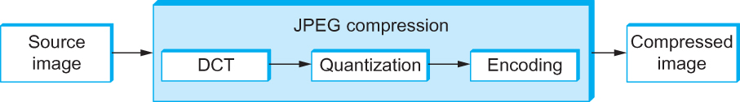
Image Representation and Compression
Block diagram of JPEG compression

Slide 46
JPEG Compression – DCT Phase
DCT is a transformation closely related to the fast Fourier transform (FFT).
It takes an 8 × 8 matrix of pixel values as input and outputs an 8 × 8 matrix of frequency coefficients
You can think of the input matrix as a 64-point signal that is defined in two spatial dimensions (x and y);
DCT breaks this signal into 64 spatial frequencies

Slide 47
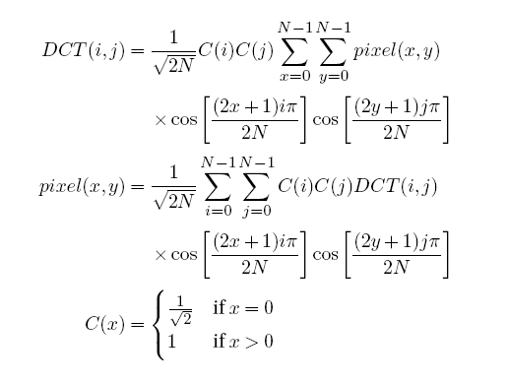
JPEG Compression – DCT Phase
DCT, along with its inverse, which is performed during decompression, is defined by the following formulas
where pixel(x, y) is the grayscale value of the pixel at position (x, y) in the 8×8 block being compressed; N = 8 in this case

Slide 48
JPEG Compression – Quantization Phase
The second phase of JPEG is where the compression becomes lossy
DCT does not itself lose information; it just transforms the image into a form that makes it easier to know what information to remove
Quantization is easy to understand—it’s simply a matter of dropping the insignificant bits of the frequency coefficients

Slide 49
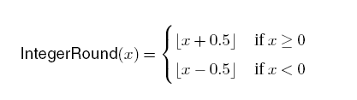
JPEG Compression – Quantization Phase
The basic quantization equation is
QuantizedValue(i, j) = IntegerRound(DCT(i, j)/Quantum(i, j))
Where
Decompression is then simply defined as
DCT(i, j) = QuantizedValue(i, j) × Quantum(i, j)

Slide 50
JPEG Compression – Encoding Phase
The final phase of JPEG encodes the quantized frequency coefficients in a compact form
This results in additional compression, but this compression is lossless
Starting with the DC coefficient in position (0,0), the coefficients are processed in the zigzag sequence
Along this zigzag, a form of run length encoding is used—RLE is applied to only the 0 coefficients, which is significant because many of the later coefficients are 0
The individual coefficient values are then encoded using a Huffman code

Slide 51
Video Compression (MPEG)
We now turn our attention to the MPEG format, named after the Moving Picture Experts Group that defined it
To a first approximation, a moving picture (i.e., video) is simply a succession of still images—also called frames or pictures—displayed at some video rate
Each of these frames can be compressed using the same DCT-based technique used in JPEG

Slide 52
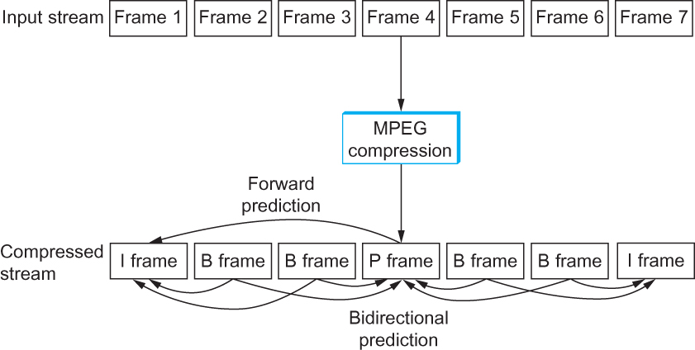
Video Compression (MPEG)
Sequence of I, P, and B frames generated by MPEG.

Slide 53
Video Compression (MPEG) – Frames Types
MPEG takes a sequence of video frames as input and compresses them into three types of frames, called
I frames (intrapicture),
P frames (predicted picture), and
B frames (bidirectional predicted picture)
Each frame of input is compressed into one of these three frame types.
I frames can be thought of as reference frames; they are self-contained, depending on neither earlier frames nor later frames

Slide 54
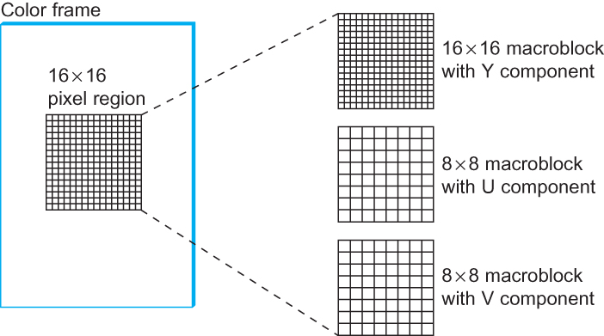
Video Compression (MPEG)
Each frame as a collection of macroblocks

Slide 55
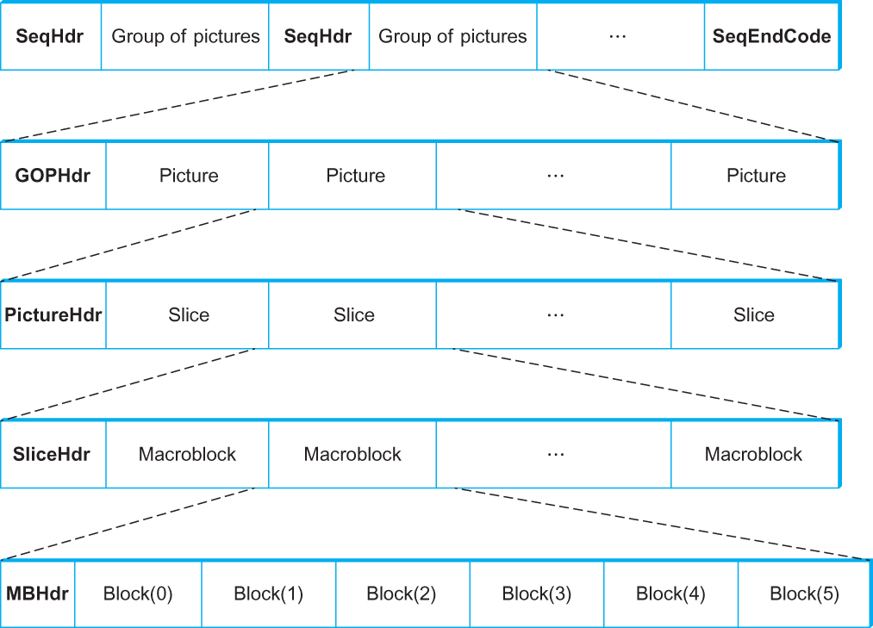
Video Compression (MPEG)
Format of an MPEG-compressed video stream

Slide 56
Summary
We have discussed how to represent data in the network
We have discussed different compression techniques for handling multimedia data in the network

Slide 57
Reference
Chapter – 7: Computer Networks A Systems Approach by Larry L. Peterson and Bruce S. Davie, 4Th Edition, Morgan Kaufmann Publications.

