Slide 1
Network security

Slide 2
Introduction
Computer networks are typically a shared resource used by many applications representing different interests.
The Internet is particularly widely shared, being used by competing businesses, mutually antagonistic governments, and opportunistic criminals.
Unless security measures are taken, a network conversation or a distributed application may be compromised by an adversary

Slide 3
Introduction
Consider some threats to secure use of, for example, the World Wide Web
Suppose you are a customer using a credit card to order an item from a website
An obvious threat is that an adversary would eavesdrop on your network communication, reading your messages to obtain your credit card information
It is possible and practical, however, to encrypt messages so as to prevent an adversary from understanding the message contents. A protocol that does so is said to provide confidentiality
Taking the concept a step farther, concealing the quantity or destination of communication is called traffic confidentiality

Slide 4
Introduction
Even with confidentiality there still remain threats for the website customer
An adversary who can’t read the contents of your encrypted message might still be able to change a few bits in it, resulting in a valid order for, say, a completely different item or perhaps 1000 units of the item
There are techniques to detect, if not prevent, such tampering
A protocol that detects such message tampering provides data integrity
The adversary could alternatively transmit an extra copy of your message in a replay attack

Slide 5
Introduction
To the website, it would appear as though you had simply ordered another of the same item you ordered the first time
A protocol that detects replays provides originality
Originality would not, however, preclude the adversary intercepting your order, waiting a while, then transmitting it—in effect, delaying your order
The adversary could thereby arrange for the item to arrive on your doorstep while you are away on vacation, when it can be easily snatched. A protocol that detects such delaying tactics is said to provide timeliness
Data integrity, originality, and timeliness are considered aspects of the more general property of integrity

Slide 6
Introduction
Another threat to the customer is unknowingly being directed to a false website
This can result from a DNS attack, in which false information is entered in a Domain Name Server or the name service cache of the customer’s computer
This leads to translating a correct URL into an incorrect IP address—the address of a false website
A protocol that ensures that you really are talking to whom you think you’re talking is said to provide authentication
Authentication entails integrity since it is meaningless to say that a message came from a certain participant if it is no longer the same message

Slide 7
Introduction
The owner of the website can be attacked as well. Some websites have been defaced; the files that make up the website content have been remotely accessed and modified without authorization
That is an issue of access control: enforcing the rules regarding who is allowed to do what. Websites have also been subject to Denial of Service (DoS) attacks, during which would-be customers are unable to access the website because it is being overwhelmed by bogus requests
Ensuring a degree of access is called availability

Slide 8
Introduction
In addition to these issues, the Internet has notably been used as a means for deploying malicious code that exploits vulnerabilities in end-systems
Worms, pieces of self-replicating code that spread over networks, have been known for several decades and continue to cause problems, as do their relatives, viruses, which are spread by the transmission of “infected” files
Infected machines can then be arranged into botnets which can be used to inflict further harm, such as launching DoS attacks

Slide 9
Outline
Cryptographic Building Blocks
Key Pre Distribution
Authentication Protocols
Example Systems
Firewalls

Slide 10
Cryptographic Building Blocks
We introduce the concepts of cryptography-based security step by step
The first step is the cryptographic algorithms—ciphers and cryptographic hashes
Cryptographic algorithms are parameterized by keys

Slide 11
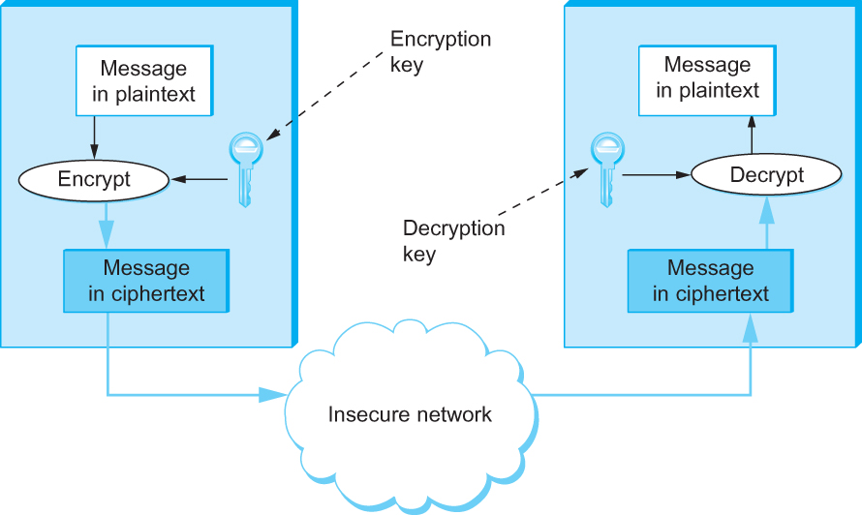
Cryptographic Building Blocks
Symmetric-key encryption and decryption

Slide 12
Principles of Ciphers
Encryption transforms a message in such a way that it becomes unintelligible to any party that does not have the secret of how to reverse the transformation
The sender applies an encryption function to the original plaintext message, resulting in a ciphertext message that is sent over the network
The receiver applies a secret decryption function–the inverse of the encryption function–to recover the original plaintext

Slide 13
Principles of Ciphers
The ciphertext transmitted across the network is unintelligible to any eavesdropper, assuming she doesn’t know the decryption function
The transformation represented by an encryption function and its corresponding decryption function is called a cipher
The basic requirement for an encryption algorithm is that it turn plaintext into ciphertext in such a way that only the intended recipient—the holder of the decryption key—can recover the plaintext

Slide 14
Principles of Ciphers
It is important to realize that when a potential attacker receives a piece of ciphertext, he may have more information at his disposal than just the ciphertext itself
Known plaintext attack
Ciphetext only attack
Chosen plaintext attack

Slide 15
Principles of Ciphers
Most ciphers are block ciphers: they are defined to take as input a plaintext block of a certain fixed size, typically 64 to 128 bits
Using a block cipher to encrypt each block independently—known as electronic codebook (ECB) mode encryption—has the weakness that a given plaintext block value will always result in the same ciphertext block
Hence recurring block values in the plaintext are recognizable as such in the ciphertext, making it much easier for a cryptanalyst to break the cipher

Slide 16
Principles of Ciphers
Block ciphers are always augmented to make the ciphertext for a block vary depending on context.
Ways in which a block cipher may be augmented are called modes of operation

Slide 17
Block Ciphers
A common mode of operation is cipher block chaining (CBC), in which each plaintext block is XORed with the previous block’s ciphertext before being encrypted
The result is that each block’s ciphertext depends in part on the preceding blocks, i.e. on its context. Since the first plaintext block has no preceding block, it is XORed with a random number
That random number, called an initialization vector (IV), is included with the series of ciphertext blocks so that the first ciphertext block can be decrypted

Slide 18
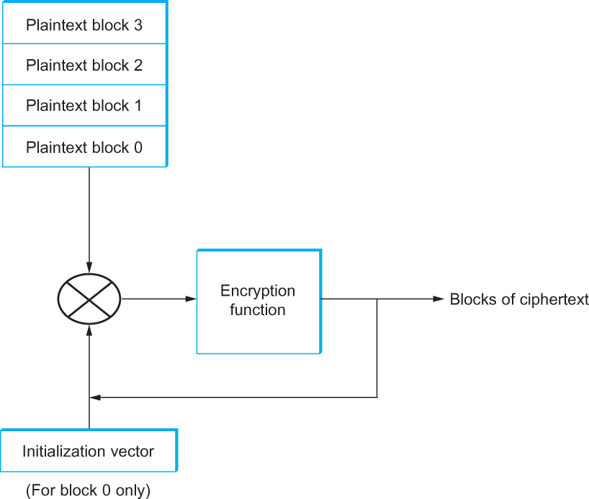
Block Ciphers
Cipher block chaining (CBC).

Slide 19
Symmetric Key Ciphers
In a symmetric-key cipher, both participants in a communication share the same key.
In other words, if a message is encrypted using a particular key, the same key is required for decrypting the message

Slide 20
Symmetric Key Ciphers
The U.S. National Institute of Standards and Technology (NIST) has issued standards for a series of symmetric-key ciphers
Data Encryption Standard (DES) was the first, and it has stood the test of time in that no cryptanalytic attack better than brute force search has been discovered
Brute force search, however, has gotten faster. DES’s keys (56 independent bits) are now too small given current processor speeds

Slide 21
Symmetric Key Ciphers
NIST also standardized the cipher Triple DES (3DES), which leverages the cryptanalysis resistance of DES while in effect increasing the key size
A 3DES key has 168 (= 3256) independent bits, and is used as three DES keys;
Let’s call them DES-key1, DES-key2, and DES-key3
3DES-encryption of a block is performed by first DES-encrypting the block using DES-key1, then DES-encrypting the result using DES-key2, and finally DES-encrypting that result using DES-key3
Decryption involves decrypting using DES-key3, then encrypting using DES-key2, then decrypting using DES-key1

Slide 22
Symmetric Key Ciphers
3DES is being superseded by the Advanced Encryption Standard (AES) standard issued by NIST in 2001
The cipher selected to become that standard (with a few minor modifications) was originally named Rijndael (pronounced roughly like “Rhine dahl”) based on the names of its inventors, Daemen and Rijmen
AES supports key lengths of 128, 192, or 256 bits, and the block length is 128 bits

Slide 23
Public Key Ciphers
An alternative to symmetric-key ciphers is asymmetric, or public-key, ciphers
Instead of a single key shared by two participants, a public-key cipher uses a pair of related keys, one for encryption and a different one for decryption
The pair of keys is “owned” by just one participant
The owner keeps the decryption key secret so that only the owner can decrypt messages; that key is called the private key

Slide 24
Public Key Ciphers
The owner makes the encryption key public, so that anyone can encrypt messages for the owner; that key is called the public key
Obviously, for such a scheme to work it must not be possible to deduce the private key from the public key
Consequently any participant can get the public key and send an encrypted message to the owner of the keys, and only the owner has the private key necessary to decrypt it

Slide 25
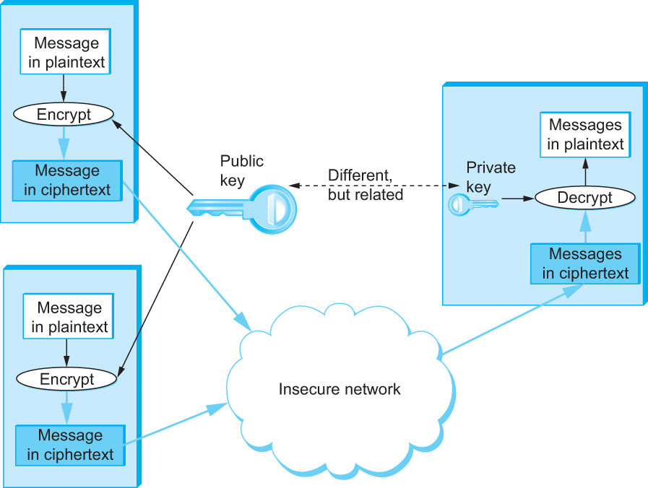
Public Key Ciphers
Public-key encryption

Slide 26
Public Key Ciphers
An important additional property of public-key ciphers is that the private “decryption” key can be used with the encryption algorithm to encrypt messages so that they can only be decrypted using the public “encryption” key
This property clearly wouldn’t be useful for confidentiality since anyone with the public key could decrypt such a message
This property is, however, useful for authentication since it tells the receiver of such a message that it could only have been created by the owner of the keys

Slide 27
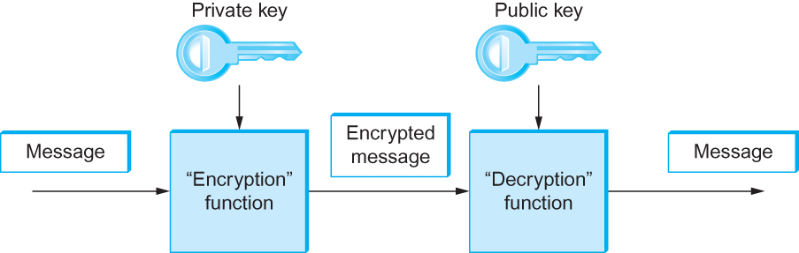
Public Key Ciphers
Authentication using public keys

Slide 28
Public Key Ciphers
The concept of public-key ciphers was first published in 1976 by Diffie and Hellman
The best-known public-key cipher is RSA, named after its inventors: Rivest, Shamir, and Adleman
RSA relies on the high computational cost of factoring large numbers
Another public-key cipher is ElGamal
Like RSA, it relies on a mathematical problem, the discrete logarithm problem, for which no efficient solution has been found, and requires keys of at least 1024 bits

Slide 29
Authenticator
An authenticator is a value, to be included in a transmitted message, that can be used to verify simultaneously the authenticity and the data integrity of a message
One kind of authenticator combines encryption and a cryptographic hash function
Cryptographic hash algorithms are treated as public knowledge, as with cipher algorithms
A cryptographic hash function (also known as a cryptographic checksum) is a function that outputs sufficient redundant information about a message to expose any tampering

Slide 30
Authenticator
Just as a checksum or CRC exposes bit errors introduced by noisy links, a cryptographic checksum is designed to expose deliberate corruption of messages by an adversary
The value it outputs is called a message digest and, like an ordinary checksum, is appended to the message
All the message digests produced by a given hash have the same number of bits regardless of the length of the original message
Since the space of possible input messages is larger than the space of possible message digests, there will be different input messages that produce the same message digest, like collisions in a hash table

Slide 31
Authenticator
There are several common cryptographic hash algorithms, including MD5 (for Message Digest 5) and Secure Hash Algorithm 1 (SHA-1).
MD5 outputs a 128-bit digest, and SHA-1 outputs a 160-bit digest
A digest encrypted with a public key algorithm but using the private key is called a digital signature because it provides nonrepudiation like a written signature

Slide 32
Authenticator
Another kind of authenticator is similar, but instead of encrypting a hash, it uses a hash-like function that takes a secret value (known to only the sender and the receiver) as a parameter
Such a function outputs an authenticator called a message authentication code (MAC)
The sender appends the MAC to her plaintext message
The receiver recomputes the MAC using the plaintext and the secret value, and compares that recomputed MAC to the received MAC

Slide 33
Authenticator
A common variation on MACs is to apply a cryptographic hash (such as MD5 or SHA-1) to the concatenation of the plaintext message and the secret value
The resulting digest is called a hashed message authentication code (HMAC) since it is essentially a MAC
The HMAC, but not the secret value, is appended to the plaintext message
Only a receiver who knows the secret value can compute the correct HMAC to compare with the received HMAC

Slide 34
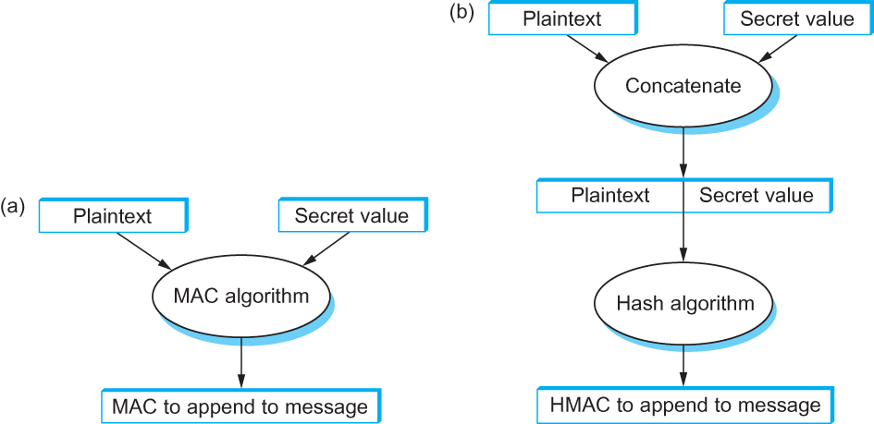
Authenticator
Computing a MAC versus computing an HMAC

Slide 35
Key Pre Distribution
To use ciphers and authenticators, the communicating participants need to know what keys to use
In the case of a symmetric-key cipher, how does a pair of participants obtain the key they share?
In the case of a public-key cipher, how do participants know what public key belongs to a certain participant?
The answer differs depending on whether the keys are short-lived session keys or longer-lived pre-distributed keys

Slide 36
Key Pre Distribution
A session key is a key used to secure a single, relatively short episode of communication: a session
Each distinct session between a pair of participants uses a new session key, which is always a symmetric-key key for speed
The participants determine what session key to use by means of a protocol—a session key establishment protocol
A session key establishment protocol needs its own security (so that, for example, an adversary cannot learn the new session key); that security is based on the longer-lived pre-distributed keys

Slide 37
Key Pre Distribution
There are several motivations for this division of labor between session keys and pre-distributed keys:
Limiting the amount of time a key is used results in less time for computationally intensive attacks, less ciphertext for cryptanalysis, and less information exposed should the key be broken
Pre-distribution of symmetric keys is problematic
Public key ciphers are generally superior for authentication and session key establishment but too slow to use encrypting entire messages for confidentiality

Slide 38
Pre-Distribution of Public Keys
The algorithms to generate a matched pair of public and private keys are publicly known, and software that does it is widely available
So if Alice wanted to use a public key cipher, she could generate her own pair of public and private keys, keep the private key hidden, and publicize the public key
But how can she publicize her public key— assert that it belongs to her—in such a way that other participants can be sure it really belongs to her?

Slide 39
Pre-Distribution of Public Keys
A complete scheme for certifying bindings between public keys and identities— what key belongs to who—is called a Public Key Infrastructure (PKI)
A PKI starts with the ability to verify identities and bind them to keys out of band. By “out of band,” we mean something outside the network and the computers that comprise it, such as in the following scenarios
If Alice and Bob are individuals who know each other, then they could get together in the same room and Alice could give her public key to Bob directly, perhaps on a business card

Slide 40
Pre-Distribution of Public Keys
If Bob is an organization, Alice the individual could present conventional identification, perhaps involving a photograph or fingerprints
If Alice and Bob are computers owned by the same company, then a system administrator could configure Bob with Alice’s public key
A digitally signed statement of a public key binding is called a public key certificate, or simply a certificate

Slide 41
Pre-Distribution of Public Keys
One of the major standards for certificates is known as X.509. This standard leaves a lot of details open, but specifies a basic structure. A certificate clearly must include
the identity of the entity being certified
the public key of the entity being certified
the identity of the signer
the digital signature
a digital signature algorithm identifier (which cryptographic hash and which cipher)

Slide 42
Pre-Distribution of Public Keys
Certification Authorities
A certification authority or certificate authority (CA) is an entity claimed (by someone) to be trustworthy for verifying identities and issuing public key certificates
There are commercial CAs, governmental CAs, and even free Cas
To use a CA, you must know its own key. You can learn that CA’s key, however, if you can obtain a chain of CA-signed certificates that starts with a CA whose key you already know
Then you can believe any certificate signed by that new CA

Slide 43
Pre-Distribution of Symmetric Keys
If Alice wants to use a secret-key cipher to communicate with Bob, she can’t just pick a key and send it to to him because, without already having a key, they can’t encrypt this key to keep it confidential and they can’t authenticate each other
As with public keys, some pre-distribution scheme is needed
Pre-distribution is harder for symmetric keys than for public keys for two obvious reasons
While only one public key per entity is sufficient for authentication and confidentiality, there must be a symmetric key for each pair of entities who wish to communicate. If there are N entities, that means N(N − 1)/2 keys
Unlike public keys, secret keys must be kept secret

Slide 44
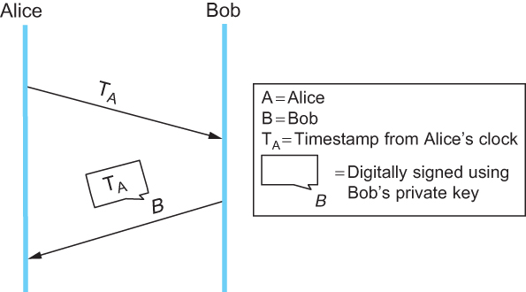
Pre-Distribution of Symmetric Keys
Authentication Protocols
A challenge-response protocol

Slide 45
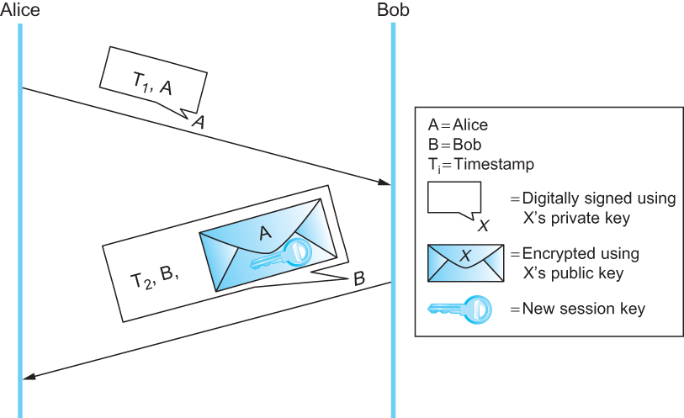
Pre-Distribution of Symmetric Keys
Public Key Authentication Protocols
A public-key authentication protocol that depends on synchronization

Slide 46
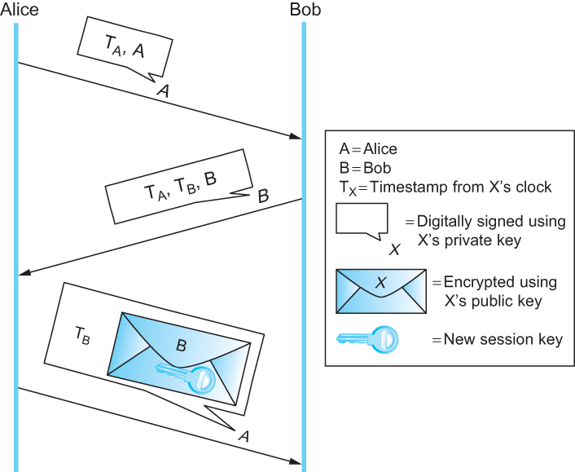
Pre-Distribution of Symmetric Keys
Public Key Authentication Protocols
A public-key authentication protocol that does not depend on synchronization.
Alice checks her own timestamp against her own clock, and likewise for Bob.

Slide 47
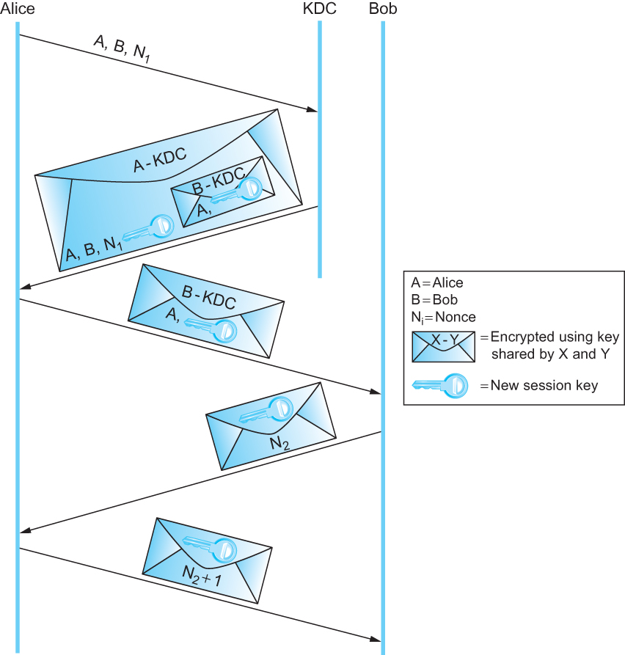
Pre-Distribution of Symmetric Keys
Symmetric Key Authentication Protocols
The Needham-Schroeder authentication protocol

Slide 48
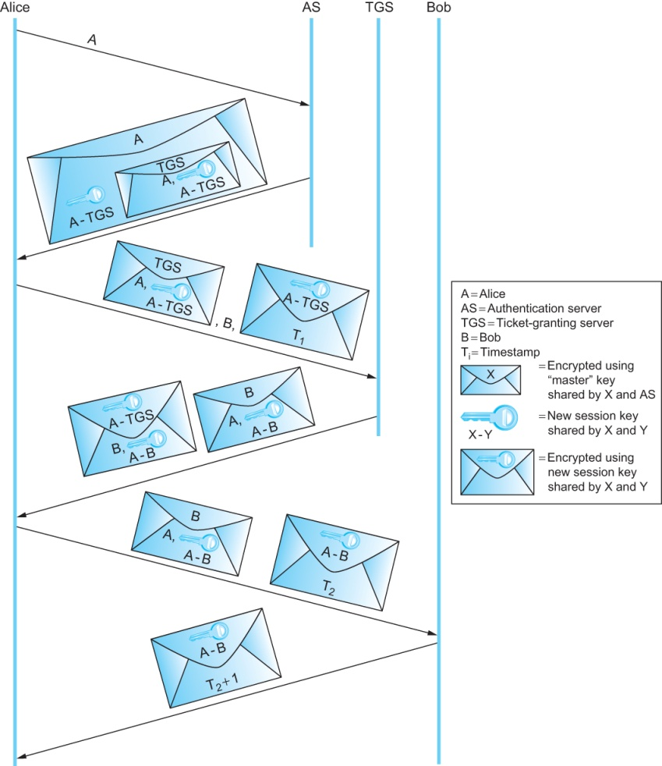
Pre-Distribution of Symmetric Keys
Symmetric Key Authentication Protocols
Kerberos Authentication

Slide 49
Pre-Distribution of Symmetric Keys
Diffie-Hellman Key Agreement
The Diffie-Hellman key agreement protocol establishes a session key without using any pre-distributed keys
The messages exchanged between Alice and Bob can be read by anyone able to eavesdrop, and yet the eavesdropper won’t know the session key that Alice and Bob end up with
On the other hand, Diffie-Hellman doesn’t authenticate the participants
Since it is rarely useful to communicate securely without being sure whom you’re communicating with, Diffie-Hellman is usually augmented in some way to provide authentication
One of the main uses of Diffie-Hellman is in the Internet Key Exchange (IKE) protocol, a central part of the IP Security (IPSEC) architecture

Slide 50
Pre-Distribution of Symmetric Keys
Diffie-Hellman Key Agreement
The Diffie-Hellman protocol has two parameters, p and g, both of which are public and may be used by all the users in a particular system
Parameter p must be a prime number. The integers mod p (short for modulo p) are 0 through p − 1, since x mod p is the remainder after x is divided by p, and form what mathematicians call a group under multiplication
Parameter g (usually called a generator) must be a primitive root of p: for every number n from 1 through p − 1 there must be some value k such that n = g^{k} mod p

Slide 51
Pre-Distribution of Symmetric Keys
Diffie-Hellman Key Agreement
For example, if p were the prime number 5 (a real system would use a much larger number), then we might choose 2 to be the generator g since:
1 = 2⁰ mod p
2 = 2¹ mod p
3 = 2³ mod p
4 = 2² mod p

Slide 52
Pre-Distribution of Symmetric Keys
Diffie-Hellman Key Agreement
Suppose Alice and Bob want to agree on a shared symmetric key. Alice and Bob, and everyone else, already know the values of p and g
Alice generates a random private value a and Bob generates a random private value b
Both a and b are drawn from the set of integers {1, ..., p−1}
Alice and Bob derive their corresponding public values—the values they will send to each other unencrypted—as follows
Alice’s public value is gª mod p
and Bob’s public value is g^{b} mod p
They then exchange their public values. Finally, Alice computes
g^{ab} mod p = (g^{b} mod p)ª mod p
and Bob computes
g^{ba} mod p = (gª mod p)^{b} mod p

Slide 53
Pre-Distribution of Symmetric Keys
Diffie-Hellman Key Agreement
Alice and Bob derive their corresponding public values—the values they will send to each other unencrypted—as follows
Alice’s public value is ga mod p
and Bob’s public value is gb mod p
They then exchange their public values. Finally, Alice computes
gab mod p = (gb mod p)a mod p
and Bob computes
gba mod p = (ga mod p)b mod p

Slide 54
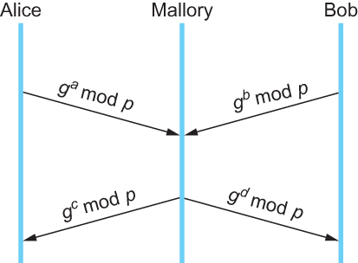
Pre-Distribution of Symmetric Keys
A man-in-the-middle attack

Slide 55
Example Systems: Pretty Good Privacy (PGP)
Pretty Good Privacy (PGP) is a widely used approach to providing security for electronic mail. It provides authentication, confidentiality, data integrity, and nonrepudiation
Originally devised by Phil Zimmerman, it has evolved into an IETF standard known as OpenPGP
PGP’s confidentiality and receiver authentication depend on the receiver of an email message having a public key that is known to the sender
To provide sender authentication and nonrepudiation, the sender must have a public key that is known by the receiver
These public keys are pre-distributed using certificates and a web-of-trust PKI
PGP supports RSA and DSS for public key certificates

Slide 56
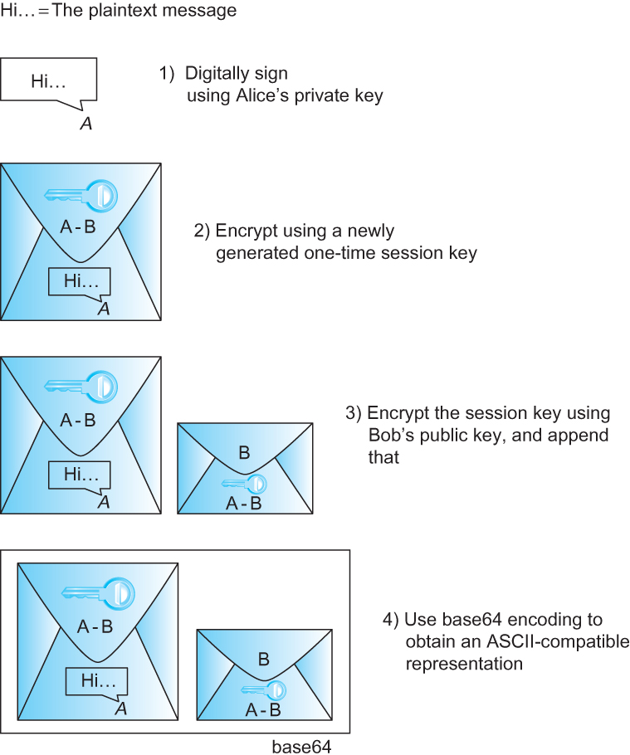
Example Systems: Pretty Good Privacy (PGP)
PGP’s steps to prepare a message for emailing from Alice to Bob

Slide 57
Example Systems: Secure Shell (SSH)
The Secure Shell (SSH) protocol is used to provide a remote login service, and is intended to replace the less-secure Telnet and rlogin programs used in the early days of the Internet
SSH is most often used to provide strong client/server authentication/ message integrity—where the SSH client runs on the user’s desktop machine and the SSH server runs on some remote machine that the user wants to log into—but it also supports confidentiality
Telnet and rlogin provide none of these capabilities
Note that “SSH” is often used to refer to both the SSH protocol and applications that use it; you need to figure out which from the context

Slide 58
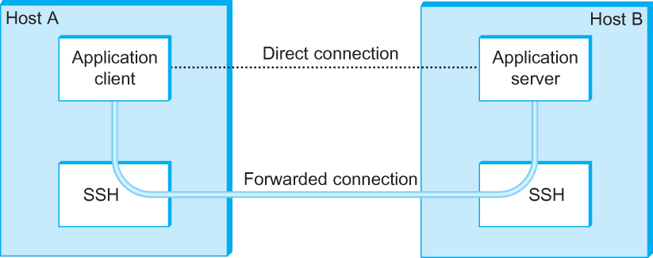
Example Systems: Secure Shell (SSH)
Using SSH port forwarding to secure other TCP-based applications

Slide 59
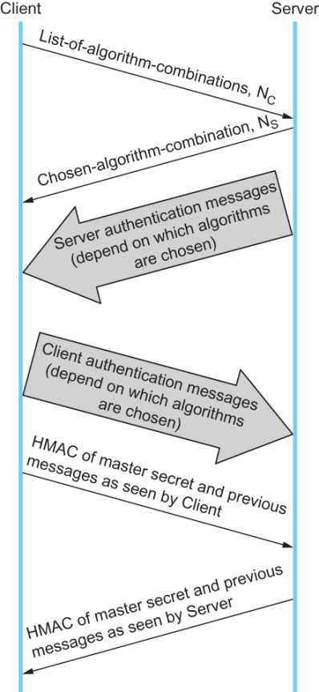
Example Systems: Transport Layer Security (TLS, SSL, HTTPS)
Handshake protocol to establish TLS session

Slide 60
Example Systems: IP Security (IPSec)
Support for IPsec, as the architecture is called, is optional in IPv4 but mandatory in IPv6
IPsec is really a framework (as opposed to a single protocol or system) for providing all the security services discussed throughout this chapter
IPsec provides three degrees of freedom
First, it is highly modular, allowing users (or more likely, system administrators) to select from a variety of cryptographic algorithms and specialized security protocols
Second, IPsec allows users to select from a large menu of security properties, including access control, integrity, authentication, originality, and confidentiality
Third, IPsec can be used to protect “narrow” streams (e.g., packets belonging to a particular TCP connection being sent between a pair of hosts) or “wide” streams (e.g., all packets flowing between a pair of routers)

Slide 61
Example Systems: IP Security (IPSec)
When viewed from a high level, IPsec consists of two parts
The first part is a pair of protocols that implement the available security services
They are the Authentication Header (AH), which provides access control, connectionless message integrity, authentication, and antireplay protection, and the Encapsulating Security Payload (ESP), which supports these same services, plus confidentiality
AH is rarely used so we focus on ESP here
The second part is support for key management, which fits under an umbrella protocol known as ISAKMP:
Internet Security Association and Key Management Protocol

Slide 62
Example Systems: IP Security (IPSec)
The abstraction that binds these two pieces together is the security association (SA)
An SA is a simplex (one-way) connection with one or more of the available security properties
Securing a bidirectional communication between a pair of hosts— corresponding to a TCP connection, for example—requires two SAs, one in each direction
Although IP is a connectionless protocol, security depends on connection state information such as keys and sequence numbers
When created, an SA is assigned an ID number called a security parameters index (SPI) by the receiving machine

Slide 63
Example Systems: IP Security (IPSec)
IPsec supports a tunnel mode as well as the more straightforward transport mode
Each SA operates in one or the other mode
In a transport mode SA, ESP’s payload data is simply a message for a higher layer such as UDP or TCP
In this mode, IPsec acts as an intermediate protocol layer, much like SSL/TLS does between TCP and a higher layer
When an ESP message is received, its payload is passed to the higher level protocol
In a tunnel mode SA, however, ESP’s payload data is itself an IP packet

Slide 64
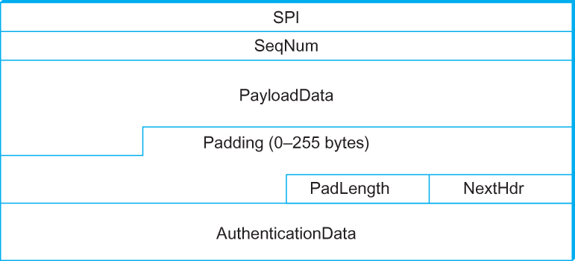
Example Systems: IP Security (IPSec)
IPsec’s ESP format

Slide 65
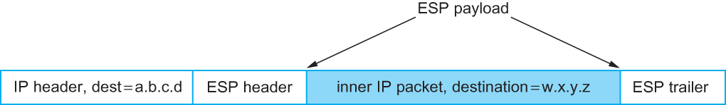
Example Systems: IP Security (IPSec)
An IP packet with a nested IP packet encapsulated using ESP in tunnel
mode. Note that the inner and outer packets have different addresses

Slide 66
Example Systems: Wireless Security (IEEE 802.11i)
The IEEE 802.11i standard provides authentication, message integrity, and confidentiality to 802.11 (Wi-Fi) at the link layer
WPA2 (Wi-Fi Protected Access 2) is often used as a synonym for 802.11i, although it is technically a trademark of The Wi-Fi Alliance that certifies product compliance with 802.11i
802.11i authentication supports two modes. In either mode, the end result of successful authentication is a shared Pairwise Master Key
Personal mode, also known as Pre-Shared Key (PSK) mode, provides weaker security but is more convenient and economical for situations like a home 802.11 network
The wireless device and the Access Point (AP) are preconfigured with a shared passphrase—essentially a very long password—from with the Pairwise Master Key is cryptographically derived

Slide 67
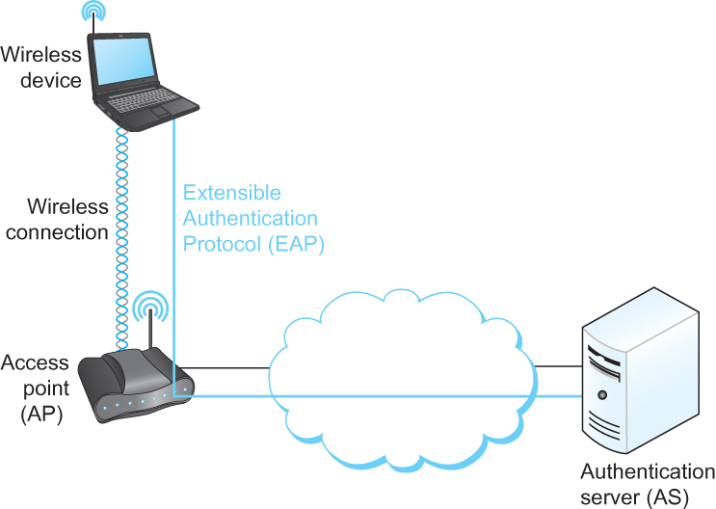
Example Systems: Wireless Security (IEEE 802.11i)
Use of an Authentication Server in 802.11i

Slide 68
Firewalls
A firewall is a system that typically sits at some point of connectivity between a site it protects and the rest of the network
It is usually implemented as an “appliance” or part of a router, although a “personal firewall” may be implemented on an end user machine
Firewall-based security depends on the firewall being the only connectivity to the site from outside; there should be no way to bypass the firewall via other gateways, wireless connections, or dial-up connections

Slide 69
Firewalls
In effect, a firewall divides a network into a more-trusted zone internal to the firewall, and a less-trusted zone external to the firewall
This is useful if you do not want external users to access a particular host or service within your site
Firewalls may be used to create multiple zones of trust, such as a hierarchy of increasingly trusted zones
A common arrangement involves three zones of trust: the internal network; the DMZ (“demilitarized zone”); and the rest of the Internet

Slide 70
Firewalls
Firewalls filter based on IP, TCP, and UDP information, among other things
They are configured with a table of addresses that characterize the packets they will, and will not, forward
By addresses, we mean more than just the destination’s IP address, although that is one possibility
Generally, each entry in the table is a 4-tuple: It gives the IP address and TCP (or UDP) port number for both the source and destination

Slide 71
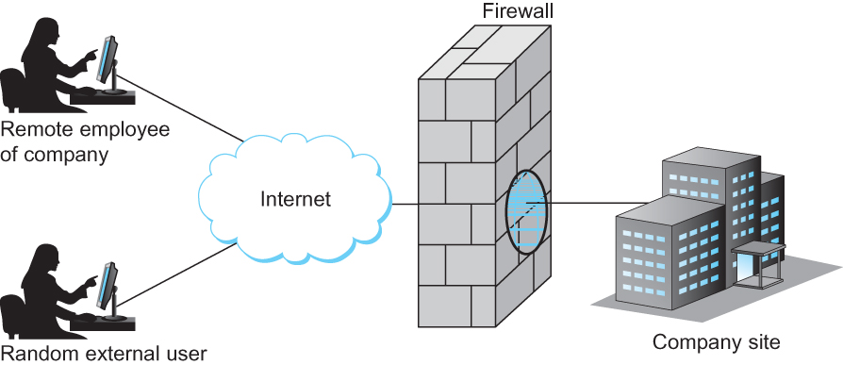
Firewalls
A firewall filters packets flowing between a site and the rest of the Internet

Slide 72
Summary
We have discussed privacy and security issues in the network
We have discussed different authentication protocols
We have discussed different key distribution protocols
We have discussed different cipher techniques
Classical and Public-Key
We have discussed some examples of secured systems
PGP, SSH, IPSec

Slide 73
Reference
Chapter – 8: Computer Networks A Systems Approach by Larry L. Peterson and Bruce S. Davie, 4Th Edition, Morgan Kaufmann Publications.

