Slide 1

STUDENT PLACEMENT DATABASE
-By M.N.V PAVANSAI(186922)

Slide 2
Table Of Contents:
INTRODUCTION TO SQL
INTRODUCTION TO PL/SQL
OBJECTIVE
ABSTRACT
SOFTWARE REQUIREMENTS
REQUIREMENTS
FULLFILLING REQUIREMENTS
TABLES USED
UML DIAGRAMS
ER DIAGRAM

Slide 3
Table Of Contents: (continued)
SOFTWARE ARCHITECTURE
SQL STATEMENT PROCESSING PHASES
SQL QUERIES PARSING
TOPICS USED FOR CODING
SOFTWARE ENGINEERING
SQL
PLSQL
TEST CASES
REAL TIME IMPLEMENTATION
ADVANTAGES
PEER TO PEER REVIEW
SUMMARY

Slide 4

OBJECTIVE
Designing the database, developing the queries and basic reports required for Student Placement Database

Slide 5

ABSTRACT
This database is used to keep track of the students who got selected during the campus placements. And this will be useful for the front end system, and it requires the backend query and the procedure.

Slide 6
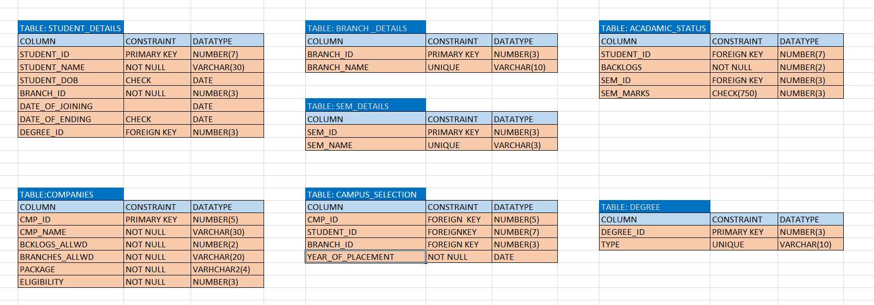
TABLES USED

Slide 7
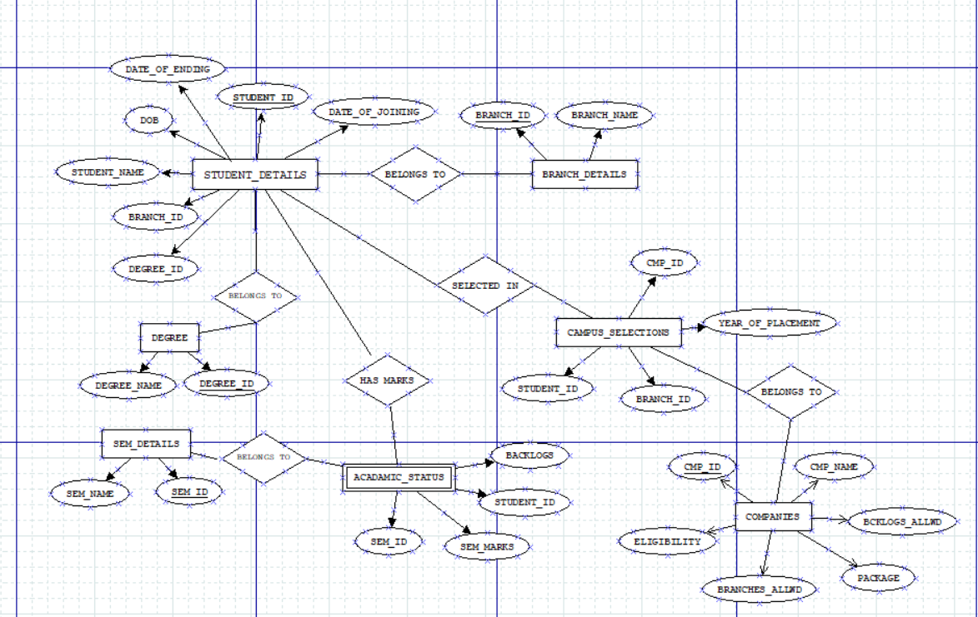
ER DIAGRAM

Slide 8

SOFTWARE ARCHITECURE

Slide 9
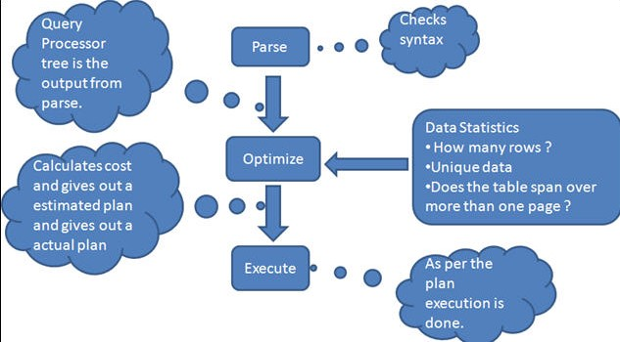

Slide 10

DEVELOPMENT PHASE

Slide 11
TOPICS USED FOR CODING
S. NO. | SUBJECT | TOPIC NAME
1 | SE |  | Data Model like Waterfall Model etc.,
2 | SQL |  | DDL, DML, DCL, TCL, DQL
3 | SQL |  | Joins & Sub Queries
4 | SQL |  | External Tables
5 | PLSQL |  | Procedures & Functions
6 | PLSQL |  | Triggers
7 | PLSQL |  | Exception Handling
8 | PLSQL |  | Cursors

Slide 12
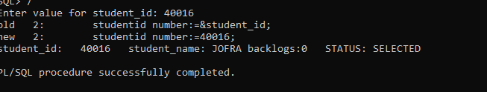
CODING
To perform any functionalities or make applications run we use coding.
The process of designing, writing, testing, debugging / troubleshooting, and maintaining the source code of computer programs.

Slide 13

TESTING

Slide 14
HOW TESTING IS PERFORMED?
BY EXAMINING THE USERS REQUIREMENTS
BY REVIEWING THE ARTIFACTS LIKE DESIGN DOCUMENTS
BY EXAMINING THE FUNCTIONALITY
BY EXAMINING THE INTERNAL STRUCTURES AND DESIGN
BY EXECUTING CODE

Slide 15
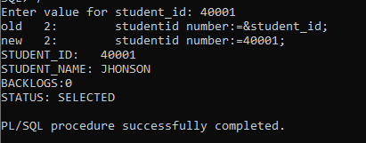
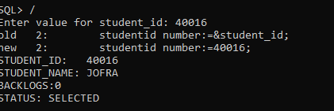
TEST CASES

Slide 16
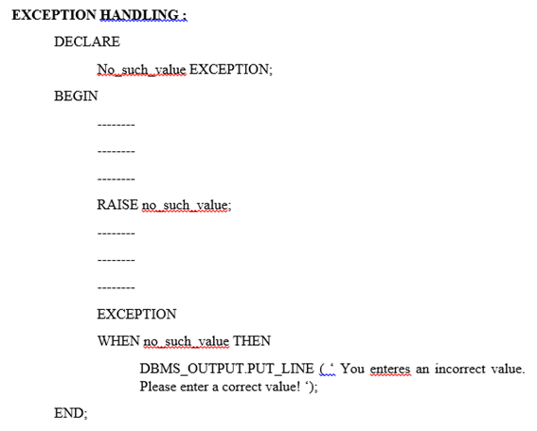
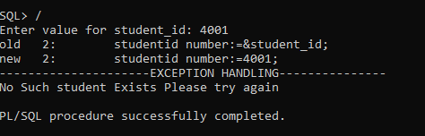
EXCEPTION HANDLING

Slide 17
REAL TIME IMPLEMENTATION
KEEPING THE DATA OF PLACEMENTS HAPPENED IN COLLEGE
EASY IMPLEMENTATION OF DATA USING PLSQL
ORAGNIZATIONS- EDUCATIONAL SYSTEMS
STORING OF STUDENT PERFORMANCES
EVALUATION SCHEME

Slide 18

REVIEW SHEET
DESCRIPTION | YES | NO
Is the code well-structured, consistent in style, and consistently formatted?
Are there any uncalled or unneeded modules or any unreachable code?
Is the code clearly and adequately documented with an easy-to-maintain commenting style?
Are all variables properly defined with meaningful, consistent, and clear names?
Are there any redundant or unused variables?
Are all loops, branches, and logic constructs complete, correct, and properly nested?
Are files / variables checked for existence before attempting to access them?

Slide 19
SUMMARY
A DATABASE SYSTEM FOR EXAMINATION AND EVALUATION SYSTEM IS BUILD WITH NECESSARY FUNCTIONALITIES.
VARIOUS FUNCTIONALITIES WHICH ARE BUILD USING THIS PROJECT IS :
CREATING TABLES
INSERTING DATA
DISPLAYS TEST MARKS OF AN EMPLOYEE WITH GIVEN SPECIFICATIONS
GIVES DETAILS OF BATCHES
PROCEDURES TO ACCEPT DETAILS AND DISPLAY REQUIRED FUNCTIONALITIES
CALCULATES ASSESMENT DETAILS
TRIGGERS TO CHECK THE REQUIREMENTS
CREATING DATA REPORTS

