Slide 1
Data Structures and Algorithms -3 (25CS2103E)
Matrix Chain Multiplication Optimization Using Dynamic Programming
Team Members
GOPIREDDY SUSMITHA-2520030201
U. VARSHITHA-2520030206
CHALLA SREEJA-2520030219
Under the Esteemed Guidance of
Ms. D. Swathi

Slide 2
Contents
Abstract
Introduction
Literature survey
Problem Statement and Objectives
Hardware and Software requirements
Results
Conclusion
Future Scope

Slide 3
Abstract
MatrixMind is a Java-based application that optimizes matrix chain multiplication using Dynamic Programming.
It determines the most efficient order of multiplying a sequence of matrices to minimize the total number of scalar multiplications.
The application uses Interval Dynamic Programming to calculate minimum costs and identify the optimal parenthesization.
It provides a graphical user interface developed using Java Swing, allowing users to enter matrix dimensions and visualize the results through DP cost tables, split tables, and algorithm analysis.
MatrixMind compares the optimized multiplication cost with a naïve left-to-right approach and displays the cost savings and percentage improvement.
The algorithm has a time complexity of O(n³) and a space complexity of O(n²), making the project an effective demonstration of Dynamic Programming and algorithm optimization.

Slide 4
Introduction
MatrixMind is a Java-based application developed to optimize matrix chain multiplication using Dynamic Programming.
Matrix multiplication can be performed in different orders, but each order may require a different number of scalar multiplications.
The main objective of this project is to identify the optimal multiplication order that minimizes computational cost.
The application uses Interval Dynamic Programming to evaluate different multiplication sequences and determine the minimum cost.
MatrixMind provides an interactive graphical interface using Java Swing, where users can enter matrix dimensions and view the results.
It displays the optimal parenthesization, minimum multiplication cost, naïve cost, cost savings, DP cost table, split table, and algorithm complexity.
The project demonstrates how Dynamic Programming improves computational efficiency by avoiding unnecessary calculations and selecting an optimal solution.

Slide 5
Literature Survey
Approach | Technique | Observation
Traditional approach | Fixed multiplication order | May perform unnecessary operations
Recursive approach | Recursion | Repeatedly solves subproblems
Dynamic Programming | Bottom-up DP | Avoids redundant calculations
Proposed system | Interval DP + comparison | Finds optimal order and compares cost
A practical tool that combines optimal parenthesization, cost analysis, and comparison with a naïve strategy provides a clearer demonstration of the benefits of Dynamic Programming.

Slide 6
Problem Statement
Matrix Chain Multiplication involves multiplying a sequence of matrices in a specific order.
Different multiplication orders can produce the same result but require different numbers of scalar multiplications.
Choosing an inefficient order increases computational cost and reduces efficiency.
Therefore, an efficient method is required to determine the optimal multiplication order with minimum cost.
MatrixMind addresses this problem by using Dynamic Programming to calculate the minimum multiplication cost and display the optimal parenthesization.

Slide 7
Objectives
To develop a Java-based application for Matrix Chain Multiplication optimization.
To implement the Dynamic Programming approach to find the minimum multiplication cost.
To determine the optimal parenthesization of a sequence of matrices.
To display the DP cost table and split table through a graphical user interface.
To compare the optimized cost with the naïve left-to-right multiplication cost.
To calculate the cost savings and percentage improvement.
To demonstrate the time complexity (O(n^3)) and space complexity (O(n^2)) of the algorithm.

Slide 8
Flow Chart
Input
Validate Dimensions
Naïve Cost
Dynamic Programming
Cost Table
Split Table
Minimum Cost
Optimal Parenthesization
Compare Results
Display

Slide 9
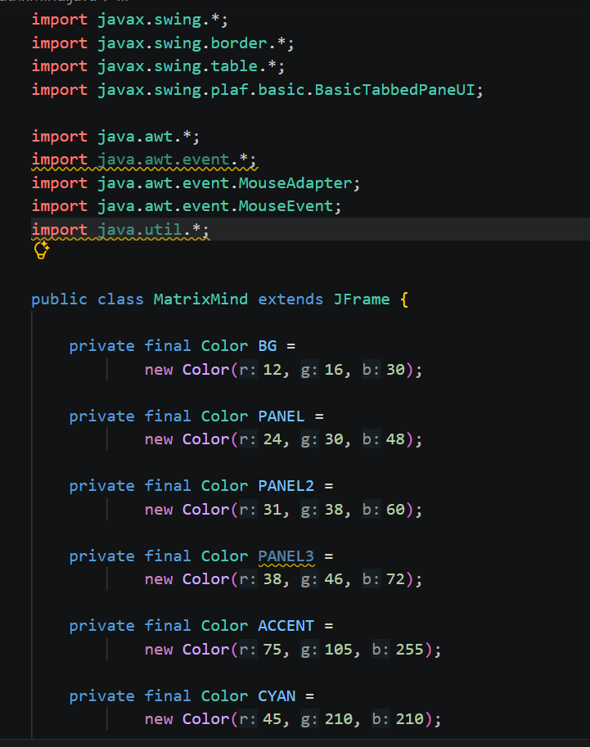
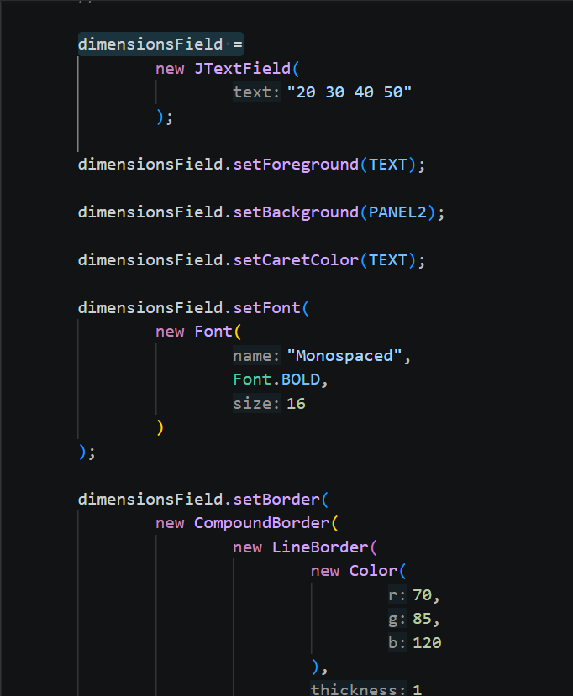
Code:

Slide 10
Results
MatrixMind successfully implements Matrix Chain Multiplication optimization using Dynamic Programming.
The application calculates the minimum number of scalar multiplications required for a given sequence of matrices.
It identifies the optimal parenthesization and displays the results through a Java Swing graphical user interface.
The application displays the DP cost table, split table, algorithm analysis, and complexity details.
It compares the optimized multiplication cost with the naïve left-to-right multiplication cost to show the cost savings.
Sample Test Results
Test Case 1: Dimensions: 10 30 5 60 20
Minimum multiplication cost: 8,500
Naïve multiplication cost: 16,500
Cost saved: 8,000
Percentage improvement: 48.48%
Optimal parenthesization: ((A1 × A2) × (A3 × A4))

Slide 11
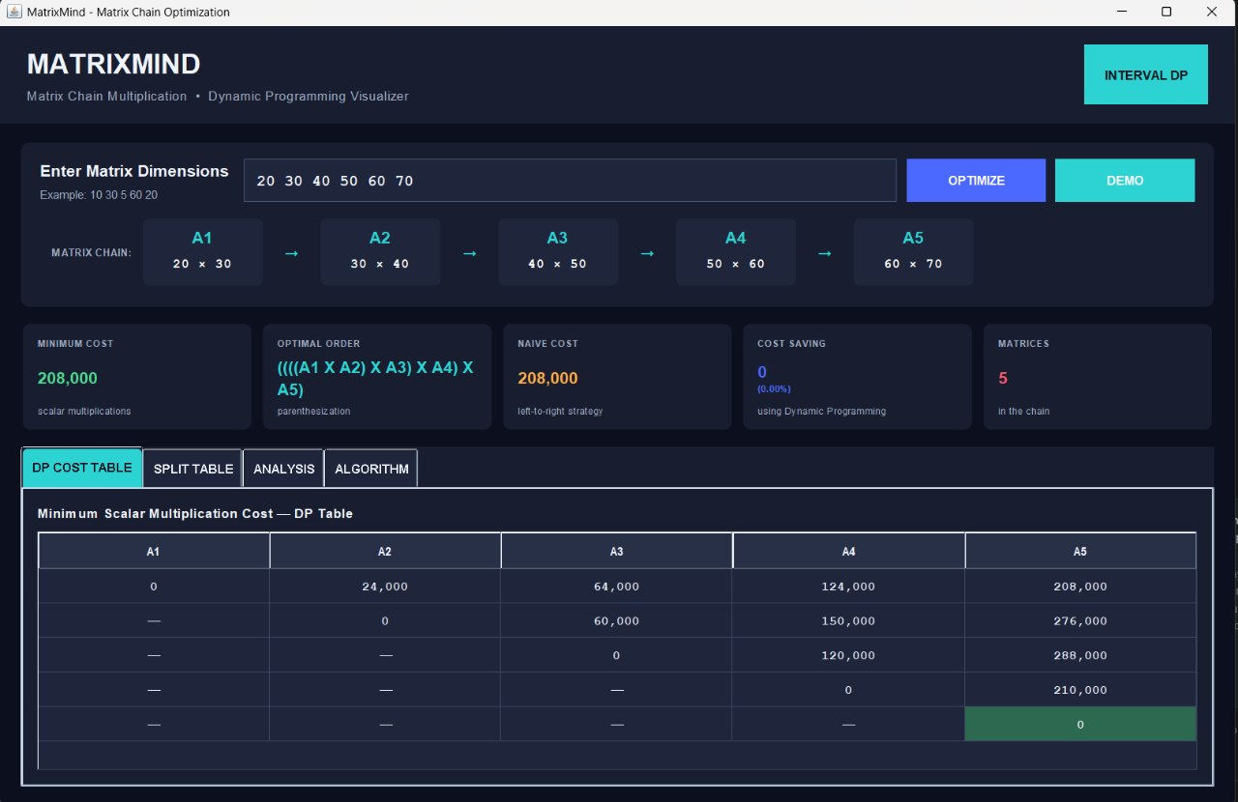
OUTPUT:

Slide 12
Technology Used
Hardware and Software requirements
1. Software Requirements
Operating System: Windows 10 / Windows 11
Programming Language: Java
GUI Development: Java Swing
Algorithm: Dynamic Programming (Matrix Chain Multiplication)
Development Environment: Visual Studio Code or any Java-compatible IDE
Java Development Kit (JDK): JDK 25
Compiler: Java Compiler (javac)
Execution Environment: Java Runtime Environment (JRE)
2. Hardware Requirements
Processor: Intel Core i3 or higher
RAM: Minimum 4 GB
Storage: Minimum 500 MB of free disk space
Display: Standard monitor or laptop display

Slide 13
Conclusion
MatrixMind successfully implements Matrix Chain Multiplication optimization using Dynamic Programming.
It identifies the optimal multiplication order and minimizes the number of scalar multiplications required.
The application provides a user-friendly Java Swing interface to display the optimal parenthesization, DP cost table, split table, and algorithm analysis.
It compares optimized and naïve multiplication costs to show the savings achieved.
The project demonstrates the practical application of Dynamic Programming in algorithm optimization, with a time complexity of O(n³) and space complexity of O(n²).

Slide 14
Future Scope
Support for Larger Inputs: Extend the application to handle longer matrix chains efficiently.
Graphical Visualization: Add step-by-step visualization of the Dynamic Programming process.
Performance Analysis: Compare Dynamic Programming with other approaches using different input sizes.
Enhanced User Interface: Improve the interface with interactive charts and clearer result visualization.
Export Results: Allow users to save or export the cost tables and optimization results.
Additional Algorithms: Extend the application to demonstrate other Dynamic Programming algorithms.

Slide 15
Thank you

