Slide 1

WINE QUALITY
PREDICTION
Using XGBoost & LightGBM
with Hyperparameter Tuning
Presented by:
U. Varshitha - 2520030206
Ch. Sreeja - 2520030219
Under the Guidance of : Ms. Rani

Slide 2
Problem Statement & Objective
Why predict wine quality from chemical measurements?
THE PROBLEM
OUR SOLUTION
Wine quality is associated with multiple chemical properties. Interpreting many measurements together can be difficult, and manual assessment may not scale easily.
Train machine-learning classifiers to learn patterns between physicochemical properties and recorded quality scores.
PROJECT OBJECTIVES
• Explore and visualize the WineQT dataset.
• Train and compare XGBoost and LightGBM models.
• Tune hyperparameters and evaluate on held-out test data.
• Deploy an interactive prediction and analysis website.
Prediction is an estimate from data patterns—not a guarantee of real-world wine quality.
02

Slide 3
Dataset Overview
WineQT.csv • dataset used in the project
1,143
13
11
6
wine samples
original columns
input features
quality classes
INPUT FEATURES
TARGET: quality
• Fixed acidity
• Total sulfur dioxide
The model predicts one of six scores: 3, 4, 5, 6, 7 or 8.
• Volatile acidity
• Density
• Citric acid
• pH
• Residual sugar
• Sulphates
ID column removed
• Chlorides
• Alcohol
Id identifies a row; it is not a chemical measurement used for prediction.
• Free sulfur dioxide
No missing values • No duplicate rows • Numerical features
03

Slide 4
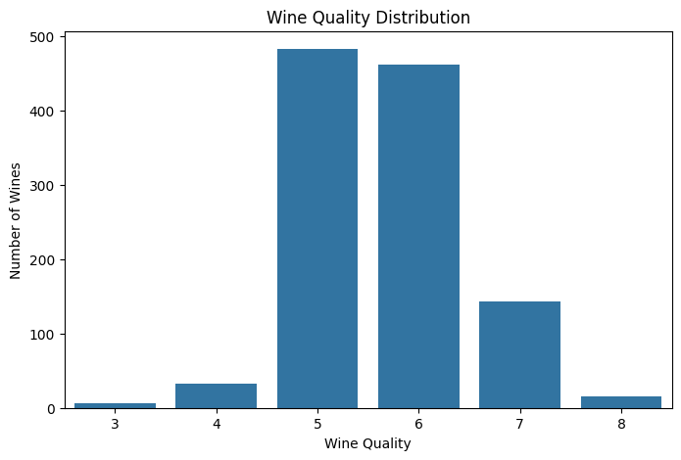
Exploratory Data Analysis (EDA)
Understand the dataset before model training
QUALITY SCORE DISTRIBUTION
Class imbalance
Most samples are quality 5 or 6; scores 7, 4, 3 and 8 are rare.
Correlation
Alcohol: about +0.48 with quality. Volatile acidity: about −0.41.
Data checks
0 missing values and 0 duplicate rows were found.
Correlation does not prove causation.
04

Slide 5
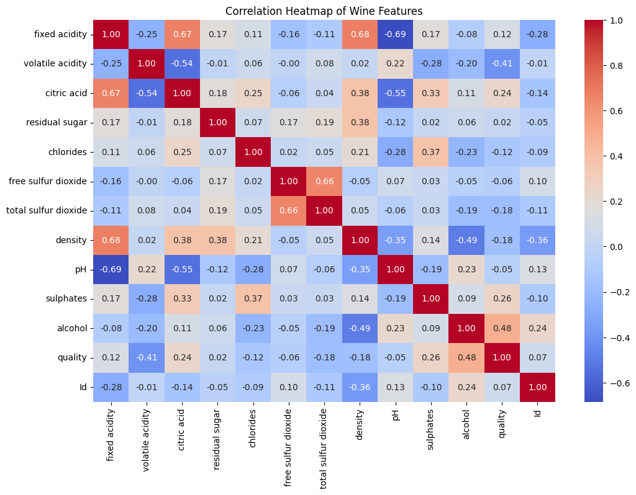
Correlation Heatmap
04

Slide 6
Data Preprocessing
Preparing the inputs and target for supervised learning
01
Remove Id
Drop the row identifier.
02
Separate X and y
X = 11 features; y = quality.
03
Stratified split
80% train / 20% test.
04
Encode labels
Scores 3–8 mapped to classes 0–5.
05
No scaling
Tree-based models generally do not require feature scaling.
Training set: 914 rows • Test set: 229 rows • random_state = 42
05

Slide 7
Algorithms Used
Two gradient-boosting frameworks were compared
XGBoost
LightGBM
• Extreme Gradient Boosting
• Ensemble of decision trees
• Builds trees sequentially to improve predictions
• Includes regularization options
• Light Gradient Boosting Machine
• Efficient gradient-boosting framework
• Uses decision-tree ensembles
• Commonly grows trees leaf-wise
Problem type: Supervised • Multiclass Classification
The model learns from labeled examples: chemical measurements are the inputs, and the recorded quality score is the target.
06

Slide 8
Hyperparameter Tuning
RandomizedSearchCV used to select promising settings
20 combinations
3-fold CV
Macro F1
n_iter = 20
cv = 3
scoring = f1_macro
SELECTED XGBOOST SETTINGS
Hyperparameter | Selected value
n_estimators | 100
max_depth | 5
learning_rate | 0.1
subsample | 0.8
colsample_bytree | 0.7
min_child_weight | 1
Why tune?
Settings affect model complexity and learning. Tuning compares combinations rather than relying on one guess.
Why macro F1?
It gives equal weight to each class’s F1-score, making rare classes more visible.
07

Slide 9
Model Comparison
Held-out test set • 229 samples • percentages
Model | Accuracy | Weighted F1 | Macro F1
XGBoost Baseline | 67.69% | 66.65% | 39.82%
XGBoost Weighted | 65.94% | 65.08% | 38.66%
XGBoost Tuned | 69.87% | 68.32% | 41.12%
LightGBM Baseline | 68.56% | 66.98% | 34.40%
LightGBM Tuned | 66.81% | 65.44% | 33.49%
Best test metrics
Interpret carefully
Tuned XGBoost: 69.87% accuracy and 41.12% macro F1.
LightGBM had slightly higher tuning CV macro F1, but tuned XGBoost did better on the reported held-out test metrics.
08

Slide 10
Final Model Evaluation
Tuned XGBoost • test-set results
69.87%
67.23%
69.87%
Accuracy
Weighted precision
Weighted recall
Overall correct predictions
Weighted by class support
Weighted by class support
68.32%
41.12%
Weighted F1
Macro F1
Precision–recall balance
Equal weight per class
Macro F1 is much lower than accuracy because performance is uneven across classes. The model missed the rare quality-3 and quality-4 examples in this test split.
09

Slide 11
Feature Importance
Top features according to the final XGBoost model
1. Alcohol
15.12% importance score
2. Volatile acidity
11.01% importance score
3. Sulphates
10.72% importance score
Feature importance is model-based; it does not prove a feature causes higher or lower quality.
10

Slide 12
Web Application & Workflow
Streamlit interface connected to the saved XGBoost model
User inputs
→
Streamlit app
→
XGBoost JSON
→
Prediction result
11 wine properties
Validate + arrange
Load saved model
Quality score + probabilities
THREE WEBSITE PAGES
Prediction
Data Exploration
Model Information
Sliders for inputs, predicted score, probability chart and input-range warning.
Dataset preview, descriptive statistics, quality distribution and correlations.
Comparison table, test metrics, hyperparameters, feature importance and confusion matrix.
Deployment: GitHub repository + Streamlit Community Cloud
11

Slide 13
Conclusion, Limitations & Future Work
What we learned and what can be improved
CONCLUSION
LIMITATIONS
Tuned XGBoost was selected from five experiments and achieved 69.87% test accuracy on the WineQT dataset.
Small, imbalanced dataset; poor results for rare quality classes; predictions are estimates, not professional assessments.
FUTURE IMPROVEMENTS
• Collect more representative samples for rare quality scores.
• Test additional imbalance-handling strategies and models.
• Evaluate on a separate external dataset and calibrate probabilities.
Thank you
12

Slide 14
Live Demo
Show the working application to your professor
LIVE WEBSITE
https://wine-quality-prediction-sxjqkaj96aobhbbxsmpf8r.streamlit.app/
DEMO CHECKLIST
• Open Prediction and change a few input sliders.
• Run prediction and explain the score and probability chart.
• Open Data Exploration and Model Information to show supporting analysis.
Repository: open the GitHub project and point out app.py, train_model.py, data/, and models/.
13

