Slide 1
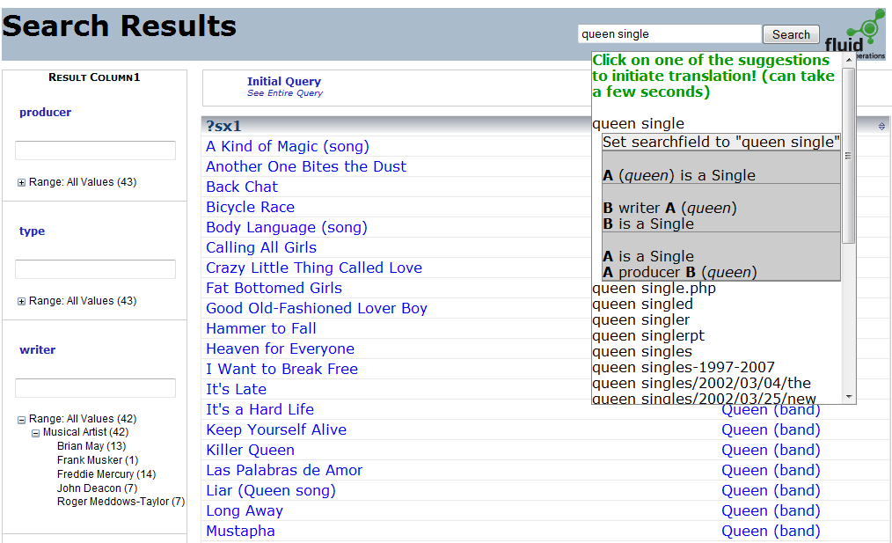
Keywords
Query Suggestions
Term
Suggestions
Results to a Relational Query
the band Queen (A),
some singles (B),
and B are connected with A
through the producer relation
Facets
Notes:
To give an impression where we are towards accomplishing this goal: demo first
Our current system:
Support the process of addressing complex information needs:
starts with keyword search: intepreting the query intent
and then browsing / exploration / refinement of results set via faceted search

