Slide 1
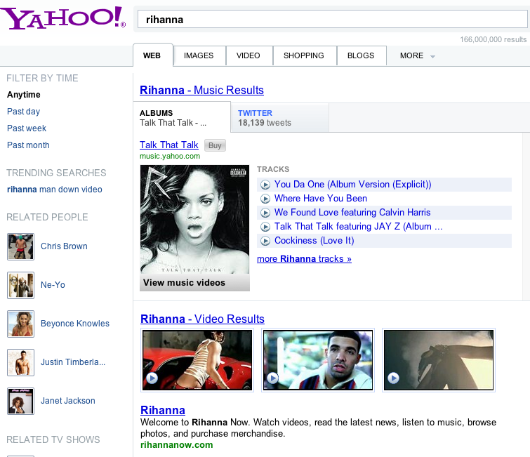
Keywords
Query Suggestions
Entity Description as Result
Related Entities
Web Page as Result

